Slide 1
Who talks when?
SLOT 00 · TDMA SCHEDULE PLANNER
Collision-free TDMA schedules with distance-2 graph colouring, and a bridge into EMANE
9 slots
4×4 grid, proven minimum
0
collisions, in my checker and in EMANE
200 / 200
random networks solved optimally
Aadya Jain · Vaan Megam Networks, Wireless Developer Internship
Notes:
Hi, I am Aadya. The assignment asks: if many radios share one frequency, who is allowed to talk in which time slot so that nobody collides, while keeping the frame as short as possible. I will show the brain (Part 1), the proof that its answer is optimal, and my approach for EMANE (Part 2).

Slide 2
Three rules decide who can share a slot
SLOT 01 · THE PROBLEM
Direct link
Hidden terminal
3+ hops apart
A
B
A
B
C
A
D
A and B hear each other. Same slot means a crash.
A and C can't hear each other, but both reach B. B hears noise.
Far enough that no receiver hears both.
Different slots
Different slots
Same slot is safe
Notes:
Radios within 500 m are linked. Rule 1: neighbours cannot share a slot. Rule 2, the hidden terminal: A and C cannot hear each other, so they do not know they collide, but B gets both signals at once and loses both. Rule 3: three or more hops apart, nobody hears both, so they can reuse the slot. That reuse is what makes the frame short.

Slide 3
Turn "2 hops" into an ordinary colouring problem
SLOT 02 · KEY IDEA
Radio graph G
Conflict graph G²
A
B
C
D
→
A
B
C
D
an edge = within 500 m
an edge = must NOT share a slot (red = added 2-hop pairs)
Distance-2 colouring of G = ordinary colouring of G². Build it once: for every radio B, join B's neighbours to each other, since any two of them would collide at B.
Notes:
This is the main idea. I build a second graph called G squared, or the conflict graph, where two radios are joined if they are 1 or 2 hops apart. Then the hard 2-hop rule becomes the normal rule: joined dots get different colours. And colour equals time slot. Building it is simple: for every radio B, connect all of B's neighbours to each other.

Slide 4
Five steps from coordinates to a checked schedule
SLOT 03 · PART 1 · THE BRAIN
1
2
3
4
5
Build graphs
3 heuristics
Improve
Prove
Verify
Radio graph (≤ 500 m) and conflict graph G²
Largest-First, Smallest-Last, DSATUR. Keep the best
Iterated greedy, 300 rounds. Never gets worse
Lower bound + exact search: is fewer possible?
Independent hop-distance check, then report
Input: the brief's JSON string, e.g. {"Node_01":[0,0], …}. Output: node → slot map, Slot × Node boolean matrix, optimality status, JSON for EMANE.
Notes:
Here is the whole pipeline. Step 1 builds the two graphs. Step 2 runs three greedy methods and keeps the best. Step 3 tries to squeeze it with iterated greedy. Step 4 computes the theoretical minimum and, if there is a gap, runs an exact search. Step 5 checks the final answer with separate code. Everything is about 1000 lines of Python including tests.

Slide 5
Same greedy rule, three smarter visiting orders
SLOT 04 · HEURISTICS
Greedy: visit radios one by one and give each the lowest slot its conflicts don't use. The order decides the quality.
Largest-First
Smallest-Last
DSATUR
Most conflicts first
Peel off the easiest radio, colour in reverse
Most boxed-in radio next
The hardest radios get placed while there is still choice.
Each radio sees few coloured conflicts. The best fit for distance-based graphs.
Handle the radio with the fewest options left, before it runs out.
Then: Iterated Greedy (Culberson) regroups radios by slot and recolours, and is proven never to get worse. Exact backtracking finds a smaller schedule or proves none exists (5 s limit, so it never hangs).
Notes:
Finding the true minimum is NP-hard, so I use heuristics. All three use the same greedy step and differ only in the order. Largest-First: busiest radios first. Smallest-Last: repeatedly remove the radio with the fewest conflicts, then colour in reverse. DSATUR: next is the radio whose neighbours already use the most slots. Then iterated greedy, which can never make it worse, and an exact search, which is affordable at 16 nodes.

Slide 6
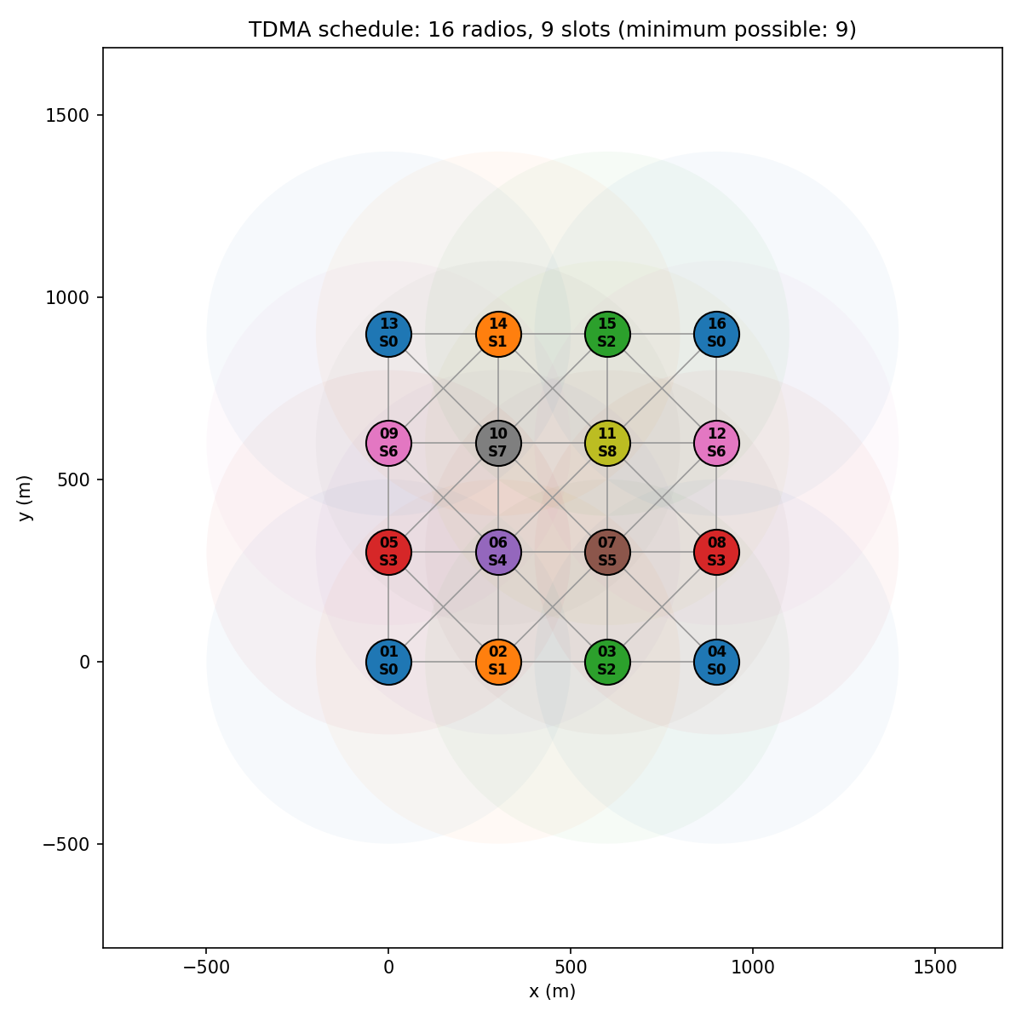
Not just a good answer: a proven minimum
SLOT 05 · PROOF
9 = 8 + 1
Node_06 has 8 neighbours. It and all of them must differ.
Degree bound: the busiest radio + its neighbours all need different slots
Clique bound: the biggest all-clashing group in G² needs one slot each
If schedule = bound, the report prints PROVEN OPTIMAL
Independent verifier re-measures real hop distances for every same-slot pair
Notes:
A heuristic alone cannot tell you how good its answer is, so I added a lower bound. On the grid, Node_06 has 8 neighbours, and those 8 are all 2 hops from each other through Node_06, so 9 radios all need different slots. My schedule uses 9, so it is proven optimal. The picture shows the four corners sharing slot 0, because they are 3 hops apart.

Slide 7
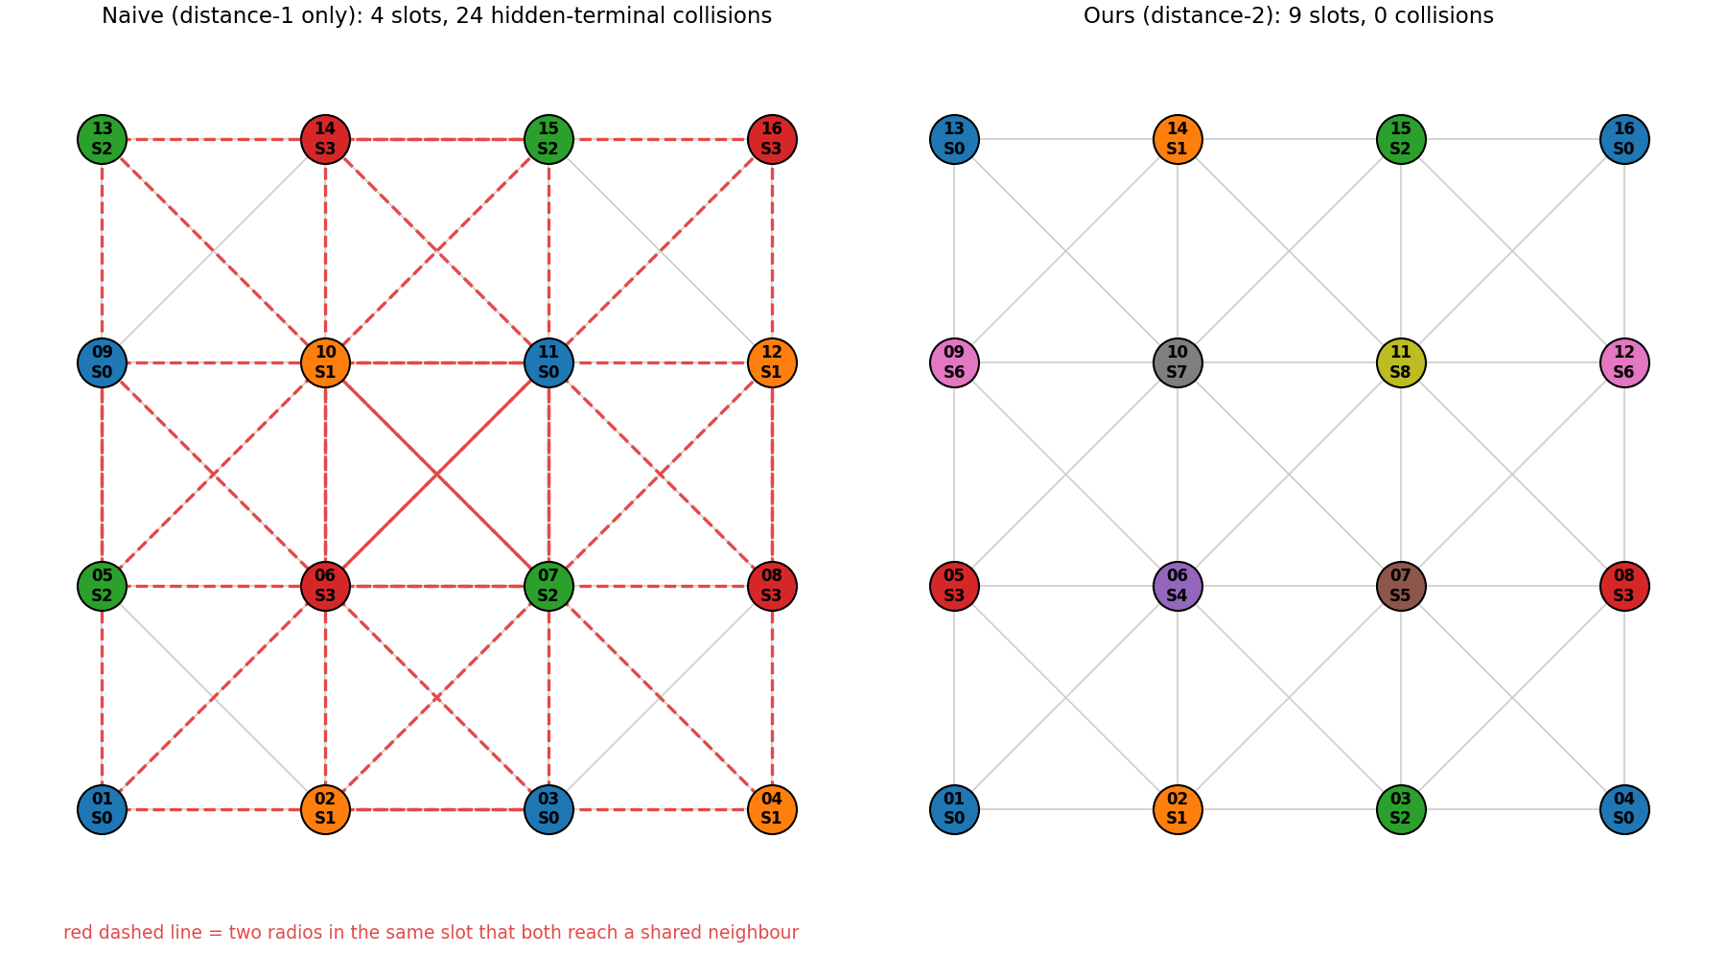
Fewer slots is not better if packets collide
SLOT 06 · WHY DISTANCE-2
4 slots
naive one-hop colouring: looks better…
24
hidden-terminal collisions
9 · 0
ours: slots · collisions
Side note: assuming the brief's 300 m grid, its 5-slot sample output has 21 hidden-terminal collisions, which my verifier caught.
Notes:
If you only keep direct neighbours apart, you get just 4 slots, but 24 pairs collide at a shared neighbour, shown in red. Ours needs 9 and has zero. Politely: if the brief's example is a 300 m grid, its sample output with 5 slots would have 21 collisions. I think it was only meant to show the format, but it was a nice test that my verifier catches real errors.

Slide 8
200 random networks, always at the minimum
SLOT 07 · STRESS TEST
Largest-First alone wastes a slot in up to 1 in 4 networks
Smallest-Last is the strongest single method: radio graphs are geometric, so there is always an easy radio to peel off
Combined pipeline: 100% proven optimal, 125 ms at 150 radios
Honest note: here the extra steps act mostly as a safety net and a proof
Notes:
To check it is not just lucky on 16 nodes, I ran 40 random layouts at each size up to 150 radios. Largest-First sometimes wastes a slot. Smallest-Last never did, which makes sense for distance-based graphs. The full pipeline hit the proven minimum in all 200 networks, in about a tenth of a second at 150 radios.

Slide 9
From schedule matrix to EMANE events
SLOT 08 · PART 2 · THE ENGINE
schedule.py
bridge.py
EMANE events
16 NEMs
→
→
→
Part 1 brain
JSON → EMANE files
schedule + pathloss
one namespace per radio
<emane-tdma-schedule>
<structure frames="1" slots="9" slotduration="1000" .../>
<multiframe frequency="2.4G" datarate="10M" ...>
<frame index="0">
<slot index="0" nodes="1,4,13,16"/> ← spatial reuse
<slot index="1" nodes="2,14"/>
...
TDMA model: tdmaeventschedulerradiomodel. Sends only in given slots, listens otherwise
1 ms slots, one shared 2.4 GHz channel, frame = our slot count
Pathloss events from the same 500 m rule, so "in range" matches Part 1 exactly
noisemode = all: overlapping signals interfere, so collisions really drop packets
Notes:
Part 2. The bridge reads Part 1's JSON and writes three things: the EMANE TDMA schedule XML, one platform file per radio, and a pathloss table from the same 500 m rule. Each radio runs as its own EMANE instance in its own Linux network namespace, all in one Docker container. Several node IDs in one slot is spatial reuse written in EMANE's own format.

Slide 10
EMANE follows the schedule: zero collisions
SLOT 09 · EMANE RESULTS
The test
5 ms slots: ours 0.0% loss
All 84 links clean. Naive: 61.4% loss, all collisions
Load our schedule, then every radio pings all its neighbours at the same time
Record per-link loss + each NEM's TxSlotStatusTable
Repeat with the naive 4-slot schedule (bridge.py --naive)
Each radio sent only in its own slot (checked in EMANE's slot tables)
1 ms slots: ours 0 collisions
Naive: 1,078 collision drops, 63.8% loss
Ours still lost 9.9% at 1 ms
Every drop was late arrival: 16 radios on 2 CPU cores
Proof that it is the laptop
Same test with 5 ms slots: loss went to zero
Notes:
I ran 16 emulated radios in EMANE. Every radio pinged all its neighbours at once, first with my schedule, then with the naive one. EMANE's slot tables show each radio only transmitted in its own slot. EMANE also counts every dropped packet with a reason. With 1 ms slots my schedule had zero collision drops, but still lost about 10 percent, and all of those were packets arriving after their slot ended, because 16 emulators share 2 CPU cores on my laptop. To prove that, I reran with 5 ms slots: my schedule delivered every packet on all 84 links, while the naive one still lost 61 percent, all to collisions.

Slide 11
How I know it works
SLOT 10 · TESTING
✓
Brief's cases
✓
Known answer
✓
Negative test
Direct link, hidden terminal (A→B←C), 3-hop reuse
4×4 grid gives exactly 9 slots, proven optimal
Verifier rejects a schedule with a hidden terminal
✓
Edge case
✓
Property test
✓
Bridge round trip
Isolated radios correctly share one slot
100 random layouts: every heuristic passes the verifier
Schedule → EMANE XML → parsed back is identical
Notes:
Every case from the brief has a test. There is a known-answer test, a test that the verifier catches a bad schedule, an edge case, a random property test over 100 layouts, and a round trip test for the EMANE bridge. The stress test also asserts zero collisions on all 200 networks.

Slide 12
Where I would take it with more time
SLOT 11 · WHAT'S NEXT
Moving radios
Traffic-aware slots
MANETs move. Recolour only the affected area and push a new schedule event.
Relays and gateways need more airtime. Use weighted colouring: k slots per radio.
Real propagation
Distributed planning
Build links from SNR, not a perfect 500 m circle, so both parts share the same physics.
Remove the single central brain with a distributed distance-2 colouring protocol.
Notes:
Limitations and next steps. My range model is a perfect circle, each radio gets one slot, the topology is static, and the planner is central. Each one has a natural next step, and these are exactly the problems a MANET product would face.

Slide 13
Thank you
SLOT 12 · END OF FRAME
Live demo
python3 schedule.py --file examples/grid_4x4.json --plot output/grid.png
python3 emane/bridge.py output/schedule.json
Aadya Jain · Questions welcome
Notes:
Thank you. I can now run the planner live on the grid or on any coordinates you give me, and show the generated EMANE schedule.

