Slide 1
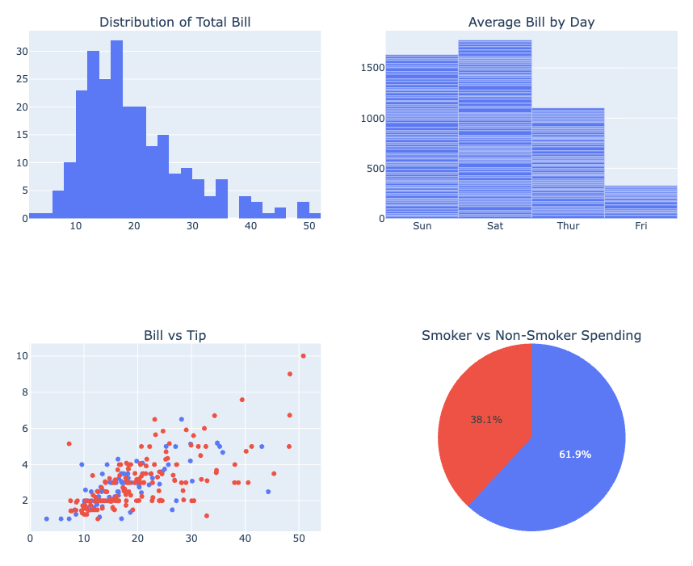
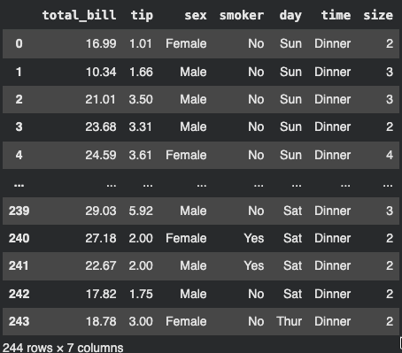

Data Analysis Workshop

Slide 2

Aadyaa Srivastava
I work at the intersection of data, cloud, and decision-making, turning complex data into actionable insights. Currently part of Google India’s Data Analytics team (Trust & Safety), where I build applications, dashboards and perform analysis of various types of data.
I’m also passionate about making tech simple and accessible, through content, workshops, and community learning.

Slide 3
Objectives
01
02
03
Data Journey & Toolkit
Understanding Data Visualization
What is data visualization?
Why do we need it?
Data vs insight (table vs chart)
Understanding Data analysis with real world examples
Understanding tools, Python, and its libraries and popularity.
Live Demo
Understand EDA, perform basic EDA (trends, comparisons)
Choosing the right chart for the right question and combining multiple charts
Converting insights into visuals using Plotly and Seaborn
Create an interactive dashboard: An introduction to Power BI

Slide 4
01
Understanding Data Visualization

Slide 5
Understanding the Problem
You’ve just joined an organization as a Data Analyst
You’re given restaurant data (bills, tips, customer details)
Your manager asks:
Which day generates the highest revenue?
What are the peak dining hours (Lunch vs Dinner)?
What factors influence higher tips?
What is the average response time for our orders?

Slide 6
02
Data Journey and Toolkit

Slide 7
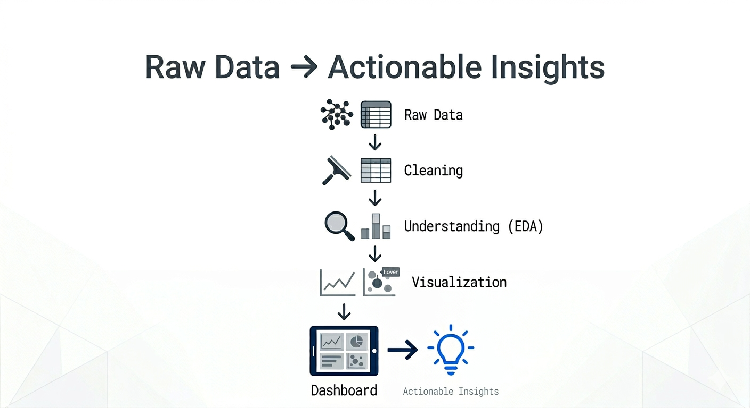
Journey
of
Data

Slide 8



Why are we using?
NumPy
Serves as the core programming language connecting data processing and visualization
Allows seamless integration of libraries for end-to-end data workflows
Works with arrays and numerical data at a low level
Enables fast mathematical operations that support data transformations before plotting
Works with data in rows and columns using DataFrames (tabular structure)
Used to filter, group, and reshape data into the exact format needed for visualization

Slide 9


Why are we using
what we are using?
Seaborn
Plotly
Uses structured data (DataFrames) to create statistical visualizations
Ideal for analyzing distributions, trends, and relationships between variables
Builds on processed data to create interactive, multi-dimensional visualizations
Allows users to explore data dynamically through hover, zoom, and filters

Slide 10
03
Live Demo

Slide 11

Live Demo Setup
We’ll be using Google Colab for today’s session
No setup required as everything runs in your browser
There is also a GitHub repo that has all the details
Get Started:
Open the Colab notebook (link below)
Follow along step by step
Resources:
GitHub Repository Link
Colab Notebook Link

Slide 12


Scan this QR to get the link for GitHub repo containing live demo code

Slide 13
From Analysis → Business Use

Slide 14
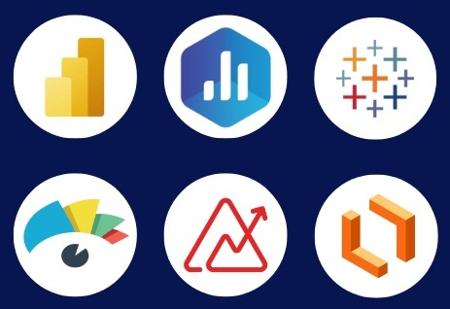
Introduction to PowerBI
What we learnt today using Python is how data analysis actually happens we cleaned the data, asked the right questions, and built visualizations to understand patterns. But in a real world setting, these insights need to be shared with teams who may not work with code. This is where tools like Microsoft Power BI , Tableau come in, helping convert analysis into interactive dashboards that are easy to explore, understand, and use for decision-making.

Slide 15
Thankyou

Slide 16

Connect with Me
LinkedIn https://www.linkedin.com/in/aadyaa-srivastava-a722a1184
X (Twitter): https://x.com/Aadyaasrivasta1
GitHub https://github.com/aadyaasrivastava18
Topmate https://topmate.io/aadyaasrivastava

