Slide 1
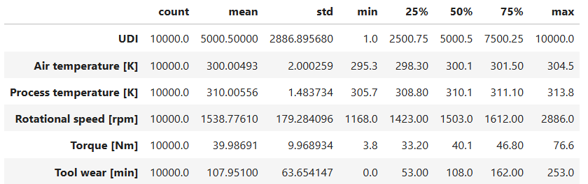
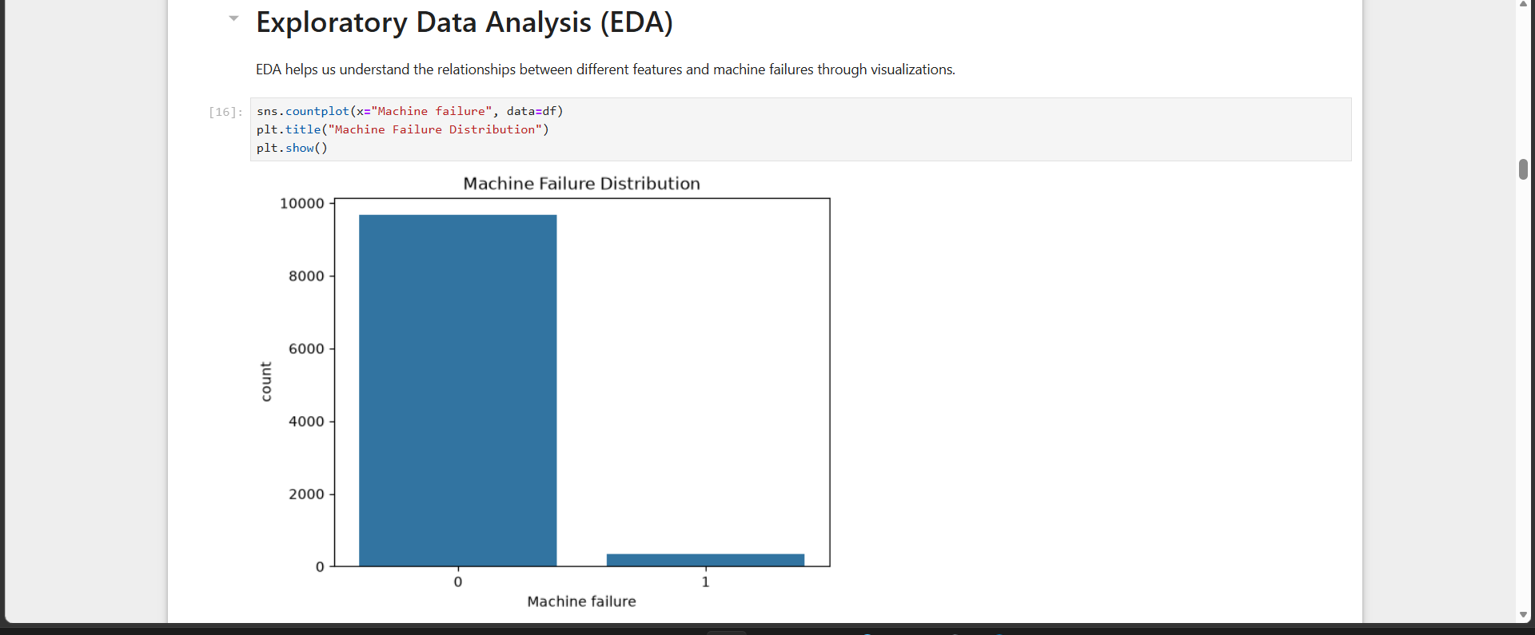
DATASET
Dataset Used – AI4I 2020 Predictive Maintenance Dataset
We use the AI4I 2020 Predictive Maintenance Dataset, a publicly available industrial dataset designed for predictive maintenance and machine failure detection. It contains 10,000 machine observations with realistic sensor readings, suitable for training ML models to identify failures before they occur.
1
Input Features
2
Target Variable
• Air Temperature (K)
• Process Temperature (K)
• Rotational Speed (RPM)
• Torque (Nm)
• Tool Wear (Minutes)
• Machine Type (Low, Medium, High)
• Machine Failure (Yes / No)
3
Failure Types
4
Why We Chose
This Dataset
• Tool Wear Failure (TWF)
• Heat Dissipation Failure (HDF)
• Power Failure (PWF)
• Overstrain Failure (OSF)
• Random Failure (RNF)
• Specifically designed for predictive maintenance
• Contains real industrial machine sensor data
• Includes multiple failure categories
• Ideal for building and evaluating ML models

Slide 2
WORKFLOW
End-to-End Project Pipeline
From raw sensor data to a live, self-healing recommendation — the pipeline is fully automated and repeatable.
1
2
3
4
5
6
Data
Collection
Data
Preprocessing
Exploratory
Analysis
Model Training
& Evaluation
Health Scoring &
Self-Healing
Dashboard
Deployment
Continuous feedback loop: operator confirmations on predicted failures flow back into the training data — improving model accuracy over time.

Slide 3
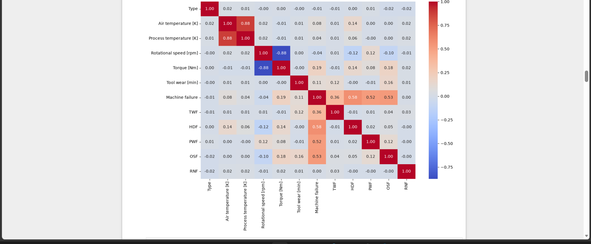
DATA PREPROCESSING
Preparing Data for Reliable Model Training
Clean, well-structured data is the foundation of every accurate prediction — five key steps get the raw dataset model-ready.
Correlation Matrix
1
Missing Value Treatment
Checked and handled null / inconsistent sensor readings to ensure a complete, reliable dataset.
2
Categorical Encoding
Converted the Type feature (Low / Medium / High) into numeric form for model compatibility.
3
Feature Selection
Used correlation analysis to identify and retain the most predictive sensor features.
4
Train-Test Split
Split data 80/20 into training and testing sets to fairly evaluate model performance.
5
Feature Scaling
Applied StandardScaler to normalize feature ranges for distance-sensitive models like SVM.

Slide 4
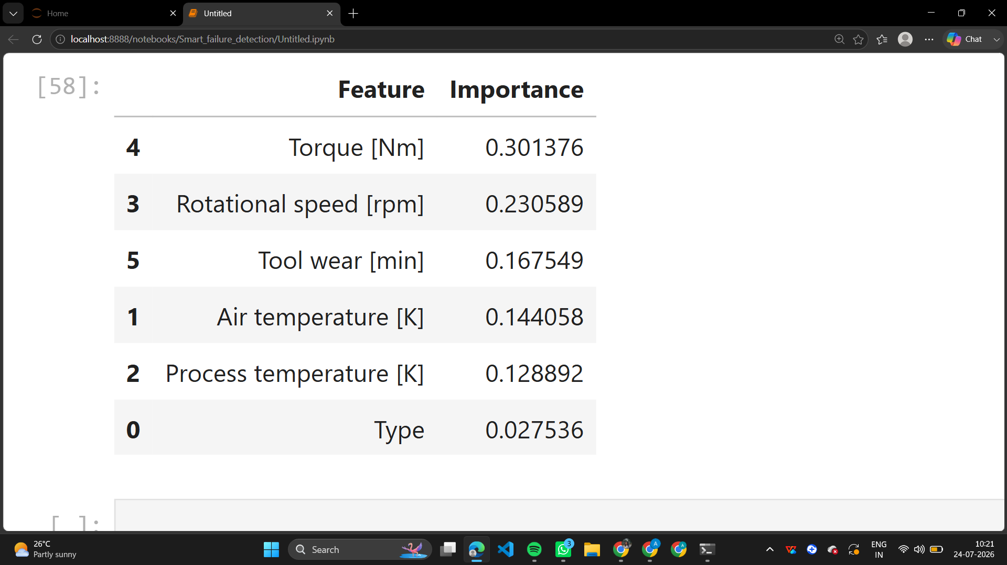
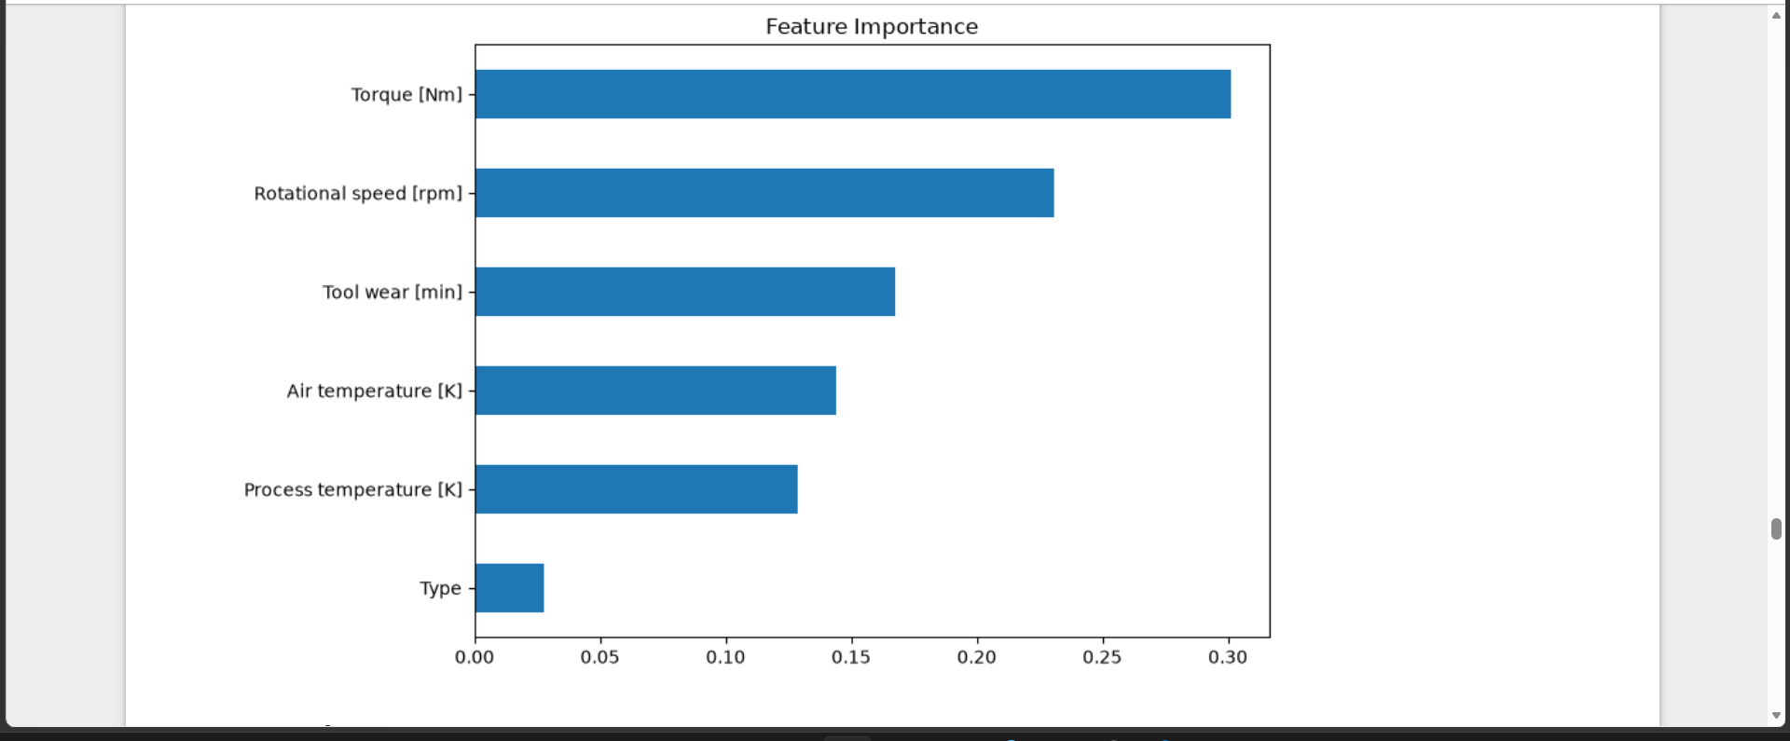
MACHINE LEARNING MODELS
Comparing Models to Find the Best Predictor
They were trained and evaluated on Accuracy, Precision, Recall, F1-Score, and Confusion Matrix.
Logistic Regression
97.30%
Accuracy
Decision Tree
97.85%
Accuracy
Random Forest
98.40%
✓ SELECTED
SVM
97.70%
Accuracy

Slide 5
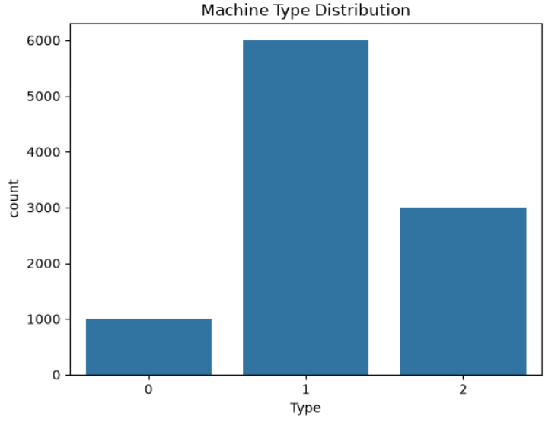
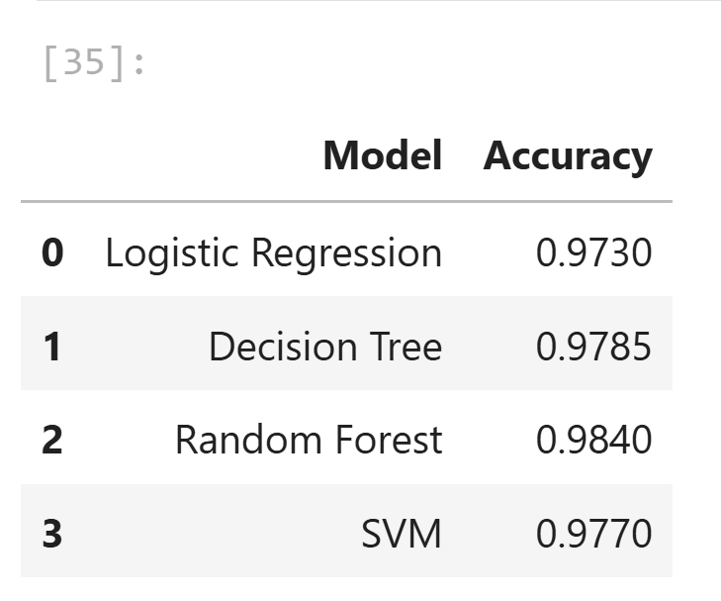
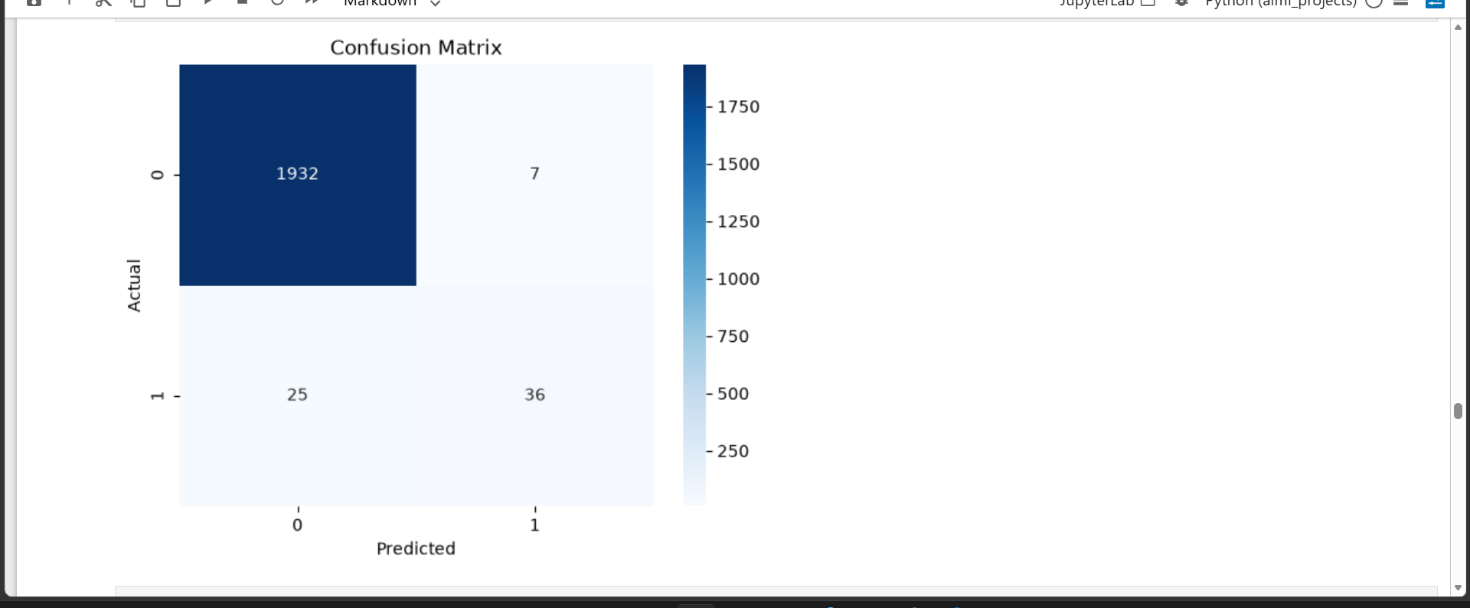
RESULTS
Random Forest Delivers the Strongest Performance
Model Accuracy Comparison
Confusion Matrix — Random Forest
KEY FINDINGS
Random Forest achieved the highest accuracy at 98.40% among all models tested.
Only 7 false alarms and 25 missed failures out of ~2,000 test cases.
Torque and Rotational Speed emerged as the strongest failure predictors.
Model maintains high recall on the rare failure class despite class imbalance.
Consistent performance across all five failure modes (TWF, HDF, PWF, OSF, RNF).
Selected as the production model for real-time health scoring.

Slide 6
SAMPLE PREDICTIONS
From Raw Sensor Data to Actionable Health Insights
Two live examples showing how the model turns sensor readings into a health score, failure probability, and a recommended action.
NORMAL OPERATION
CRITICAL — ATTENTION NEEDED
Machine #A-104 — Healthy
Machine #C-217 — High Risk
Machine Health Score
92%
Machine Health Score
27%
Failure Probability
4%
Failure Probability
86%
KEY SENSOR SIGNALS
KEY SENSOR SIGNALS
Torque 42 Nm · Rotational Speed 1,510 rpm · Tool Wear 38 min
Torque 61 Nm · Rotational Speed 2,340 rpm · Tool Wear 214 min
RECOMMENDED ACTION
RECOMMENDED ACTION
Continue standard monitoring schedule — no action needed at this time.
Self-healing action: reduce load, inspect tool insert, and schedule immediate maintenance.

Slide 7
PROJECT PROGRESS
85% Complete — On Track for Final Delivery
OVERALL PROGRESS
85%
✓ COMPLETED
◷ REMAINING
Data collection & preprocessing pipeline
Exploratory Data Analysis (EDA) & correlation study
Model training & evaluation (4 algorithms compared)
Random Forest selected as production model
Sample prediction & health scoring module
Streamlit dashboard development & UI polish
Self-healing recommendation engine refinement
Real-time IoT sensor integration testing
Final documentation & deployment

Slide 8
FUTURE SCOPE
Scaling Toward a Fully Autonomous Maintenance System
The current model is the foundation for a production-grade, always-on predictive maintenance platform.
1
Streamlit Dashboard
2
IoT Integration
An interactive web app for live machine health monitoring, accessible to plant operators and managers.
Stream real sensor data directly from edge devices and PLCs for true real-time predictions.
3
Cloud Deployment
4
Real-Time Monitoring & Alerts
Host the model on scalable cloud infrastructure (AWS / Azure) to support multiple plants.
Push live anomaly alerts to maintenance teams via SMS / email the moment risk is detected.

Slide 9

CONCLUSION
Toward Smarter, Self-Healing Manufacturing
This project demonstrates that AI can move beyond simple failure prediction by combining accurate classification, continuous health scoring, and prescriptive self-healing guidance into a single intelligent system for smart manufacturing.
1
2
3
Proven Predictive Power
Actionable Health Insights
Foundation for Industry 4.0
Random Forest achieved 98.4% accuracy , reliably classifying failures from real sensor data.
Health scores, failure probability, and self-healing recommendations go beyond a simple Yes/No prediction.
A scalable architecture, ready for IoT streaming and cloud deployment across multiple plants.

