Slide 1

MILESTONE 3
From Trained Model to a Live, Working Product
Building on the Random Forest model from Milestone 2, this milestone delivers a fully functional Streamlit web application — a SCADA-styled operator console for real-time diagnostics, fleet analytics, and prediction history, now live and deployed.
1
2
3
Interactive Dashboard
Live Deployment
End-to-End Traceability
A five-page SCADA-styled console built with Streamlit for real-time diagnostics and fleet monitoring.
Hosted on Streamlit Community Cloud and accessible to anyone as a public, always-on web app.
Every prediction is logged to an audit-ready history table, from raw input to health score.

Slide 2
FRONTEND
Inside the SCADA Monitors Dashboard
The frontend is a five-page Streamlit web app styled as an industrial SCADA operator console, giving live access to every part of the ML pipeline.
1
2
3
Home Overview
Predict Machine Failure
Analytics Dashboard
Fleet-wide KPIs, digital twin overview, and live OPC-UA stream status at a glance.
Interactive form for live sensor inputs, running real-time diagnostic inference on demand.
Fleet telemetry, root-cause pareto analysis, and correlation matrix with live filters.
4
5
6
Prediction History
About Project
SCADA Environment Panel
ISO 55000-style audit log of every diagnostic session, exportable as CSV.
Dataset, model, and team details for full transparency on how the system works.
Persistent sidebar showing engine, dataset, protocol, latency, and compliance status.
DESIGN LANGUAGE
Dark industrial theme • Live status badges • Card-based KPIs • MQTT / OPC-UA styled telemetry • Built entirely with Streamlit + Python

Slide 3
HOME DASHBOARD
Live KPIs on the SCADA Home Screen
The Home page greets operators with four real-time headline metrics pulled from the deployed Random Forest engine and the AI4I telemetry stream.
↓
↑
↑
↓
<12 ms
98.4%
10,000
-42.5%
Inference Latency
Model Accuracy
Monitored Telemetry
Downtime Reduction
Edge micro-service architecture keeps every diagnostic response near-instant.
ROC-AUC ensembled Random Forest engine powering every prediction.
AI4I industrial fleet records streamed live across 6 telemetry channels.
Estimated operational opex saved through early, data-driven intervention.

Slide 4
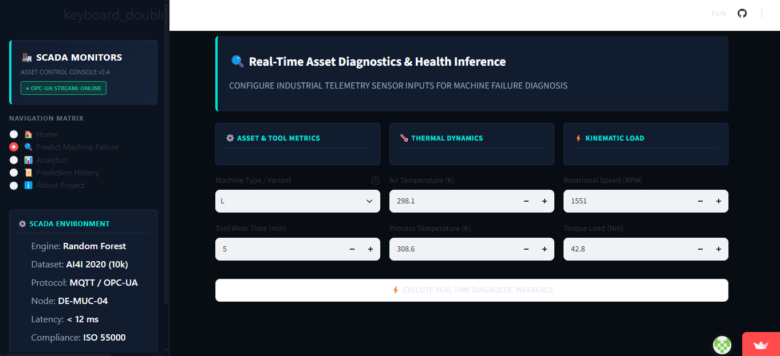
PREDICT PAGE
Real-Time Asset Diagnostics & Health Inference
The core prediction page lets an operator configure live industrial telemetry sensor inputs and run the Random Forest model on demand, grouped into three intuitive input categories.
1
Asset & Tool Metrics
2
Thermal Dynamics
• Machine Type / Variant (L, M, H)
• Tool Wear Time (minutes)
• Air Temperature (K) & Process Temperature (K)
3
Kinematic Load
4
How Inference
Runs
• Rotational Speed (RPM)
• Torque Load (Nm)
• Set all 6 inputs via steppers/dropdown
• Click “Execute Diagnostic Inference”
• Model scores the input instantly
• Auto-logged to Prediction History

Slide 5
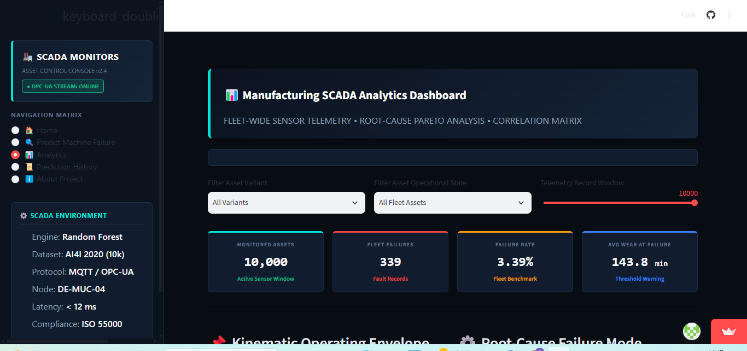
ANALYTICS PAGE
Manufacturing SCADA Analytics Dashboard
The Analytics page turns the full 10,000-record fleet into fleet-wide sensor telemetry, root-cause analysis, and a live correlation matrix — five capabilities in one screen.
SCADA Analytics View
1
Fleet KPI Cards
Monitored assets, fleet failures, failure rate, and average wear at failure, updated live.
2
Asset Variant Filter
Slice the fleet by machine variant to compare failure behavior across types.
3
Operational State Filter
Narrow the view to specific asset operational states across the fleet.
4
Telemetry Record Window
Adjustable slider controls how many of the 10,000 sensor records are analyzed.
5
Root-Cause Pareto
Kinematic operating envelope and root-cause failure mode charts, side by side.

Slide 6
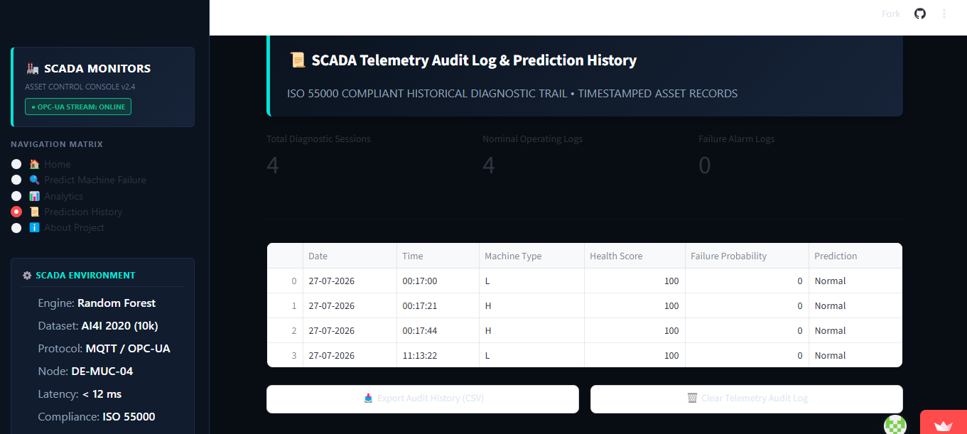
HISTORY PAGE
Every Prediction, Logged and Auditable
Prediction History & Audit Log
KEY FINDINGS
Every diagnostic session is timestamped and saved automatically — no manual logging.
Table records date, time, machine type, health score, failure probability, and verdict.
Styled as an ISO 55000-aligned historical diagnostic trail for compliance.
Session, nominal-log, and failure-alarm counters update live at the top of the page.
One-click “Export Audit History (CSV)” for offline review or reporting.
“Clear Telemetry Audit Log” gives operators a controlled reset when needed.

Slide 7
TECH STACK
Frontend Stack & Deployment
The dashboard layer is built and deployed with a lightweight, fully open-source Python stack — no separate frontend framework required.
APP & VISUALIZATION LAYER
HOSTING & PROJECT DELIVERY
Streamlit
Streamlit Community Cloud
Powers the entire multi-page app — navigation, forms, live inputs, and session state.
Hosts the app as a free, public, always-on web service with automatic redeploys.
Pandas & Plotly
GitHub
Handles telemetry data wrangling and renders the interactive charts on Home and Analytics.
Version control and CI trigger — every push to main redeploys the live app automatically.
Scikit-learn & Joblib
Custom CSS Theming
Loads the pre-trained Random Forest model for instant, in-app inference — no external API.
Hand-styled dark SCADA console theme layered on top of native Streamlit components.

Slide 8
MILESTONE 3 PROGRESS
96% Complete — Frontend Live, Final Polish Ahead
OVERALL PROGRESS
96%
✓ COMPLETED
◷ REMAINING
Full 5-page Streamlit dashboard built & deployed live
Real-time diagnostic inference page (Predict Machine Failure)
Analytics dashboard with fleet telemetry & correlation views
Prediction History audit log with CSV export
SCADA-styled dark theme UI polish across all pages
Load testing & performance optimization
Self-healing recommendation engine refinement
Real-time IoT sensor integration testing
Final documentation & project handover

Slide 9
Thank You
Presented By:
Aadya Patil
Balasri Korasikha
Bandaru Keerthi Pranathi
Chandini K
Vasavi Kolla

