Slide 1
FMCSA RESEARCH PROJECT | TENNESSEE
Where, how and why commercial vehicles crash in Tennessee
The TN CMV Crash Dashboard: what it does and what it shows
THE UNIVERSITY OF TENNESSEE, KNOXVILLE
Center for Transportation Research
Notes:
Introduce the dashboard: an interactive view of commercial motor vehicle crashes in Tennessee, built for the FMCSA-funded research project. Live at aadyash24.github.io/FMCSA.

Slide 2
THE BIG PICTURE
A decade of Tennessee truck and bus crashes, in one view
45,650
1,595
31,463
2015 to 2025
CMV crashes
people killed
people injured
years covered
Built on Tennessee TITAN police crash reports that involve a commercial motor vehicle (CMV).
A CMV is a vehicle over 10,000 lb gross weight rating, carrying more than eight people, or displaying a hazardous materials placard.
Every map and chart follows the same filters, so the whole dashboard tells one consistent story.
TN CMV Crash Dashboard | FMCSA research project | The University of Tennessee, Knoxville
2
Notes:
Headline numbers come straight from the crash extract. 2025 is a partial year (January to March), so recent trend lines drop at the right edge.

Slide 3
KEY FINDINGS SO FAR
What the data already tells us
Preliminary results from 45,650 CMV crashes, 2015 to 2025
3.1%
1,427 fatal crashes caused 1,595 deaths; serious injury crashes were 7.1%.
17.9%
Head-on crashes are rare but the deadliest collision type.
of CMV crashes were fatal
of head-on crashes were fatal
11,692
The most frequent collision type. Angle crashes cause the most injuries and deaths.
I-24
16.1 crashes per mile, ahead of I-65 (14.9) and I-40 (13.7). Not yet adjusted for traffic.
front-to-rear crashes
highest crash rate per mile
TN CMV Crash Dashboard | FMCSA research project | The University of Tennessee, Knoxville
3
Notes:
These are descriptive counts and rates, not causal findings. Corridor rates are raw crashes per mile, not per vehicle mile traveled. Contributing-factor results are held back until full driver records are loaded.

Slide 4
HOW IT WORKS
From raw crash records to an interactive site
1
2
3
4
TITAN crash data
Offline data prep
Static data files
Live dashboard
Collision, unit and person records for CMV crashes, 2015 to 2025
Python and R scripts clean the data, decode TITAN codes and place crashes on routes
Compact JSON files the browser loads directly, with no server needed
React and Leaflet site on GitHub Pages, filtering 45,650 crashes in the browser
One shared filter panel (year, county, severity, collision type, weather, route class and more) drives the map and every chart on every tab.
TN CMV Crash Dashboard | FMCSA research project | The University of Tennessee, Knoxville
4
Notes:
The site is fully static: Python and R prepare the data offline, the browser does all filtering. That keeps hosting free and the dashboard fast.

Slide 5
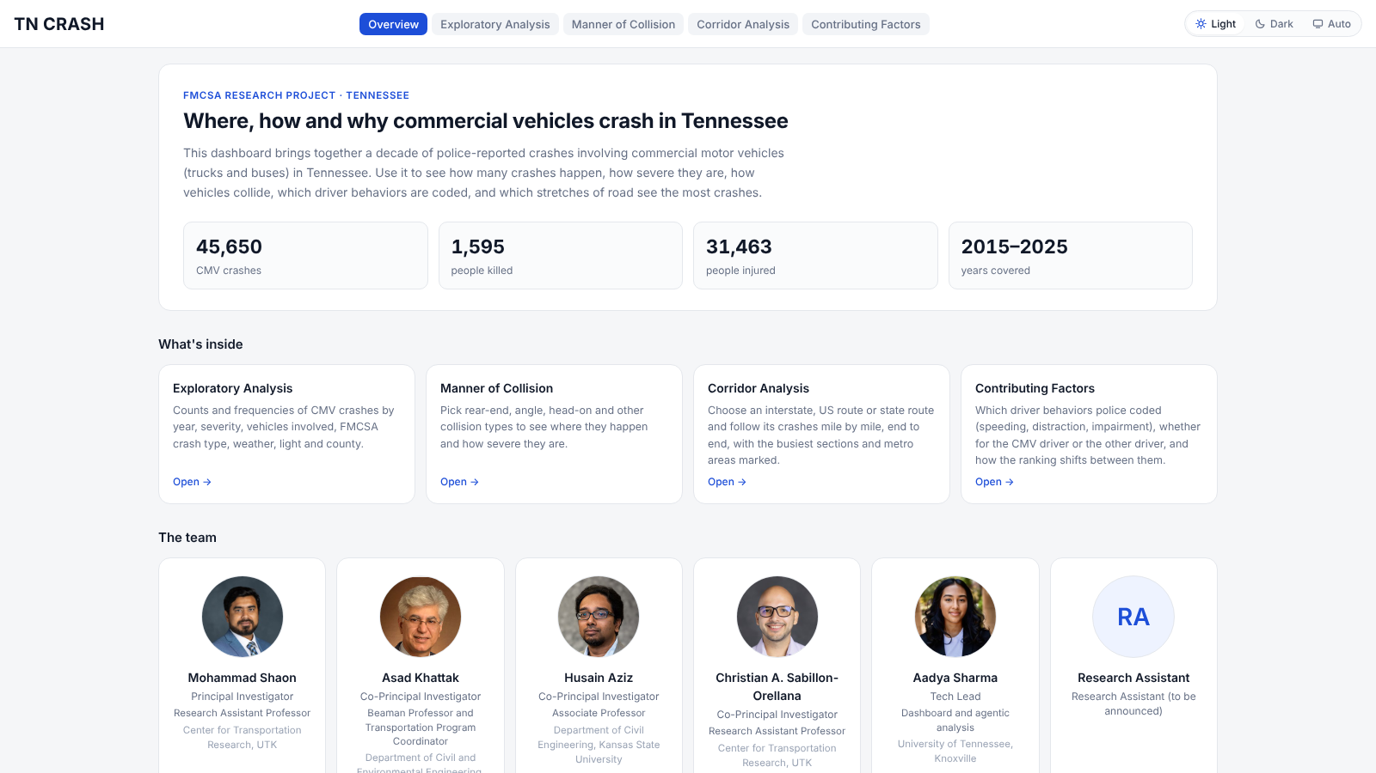
TAB 1 OF 5
Overview
What is this project and what does it cover?
Project summary and headline totals.
Cards that open each analysis tab.
The research team and contacts.
Data coverage by year: which crashes have vehicle and person records.
TN CMV Crash Dashboard | FMCSA research project | The University of Tennessee, Knoxville
5
Notes:
The landing page. The coverage chart is important context: person records exist for only a small share of crashes, mostly 2023 to 2025.

Slide 6
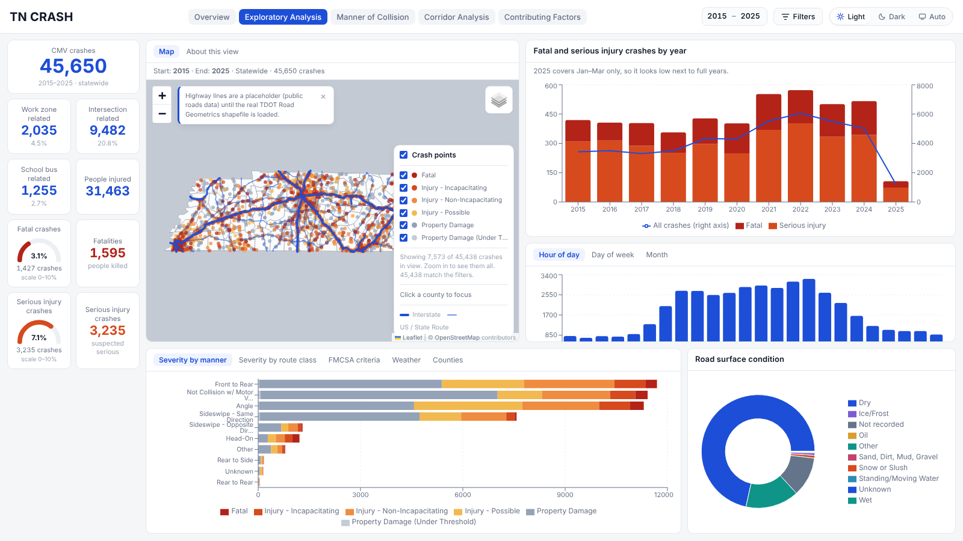
TAB 2 OF 5
Exploratory Analysis
How many crashes, how severe, and when?
Counts for work zone, intersection and school bus crashes.
Fatal and serious injury crashes by year.
Patterns by hour, day of week and month.
Severity by collision type, route class, FMCSA criteria, weather and county.
Click a county to focus every chart on it.
TN CMV Crash Dashboard | FMCSA research project | The University of Tennessee, Knoxville
6
Notes:
3.1% of CMV crashes were fatal (1,427 crashes, 1,595 deaths). Serious injury crashes were 7.1%. FMCSA reportable criteria are fatality, injury transported for treatment, or vehicle towed.

Slide 7
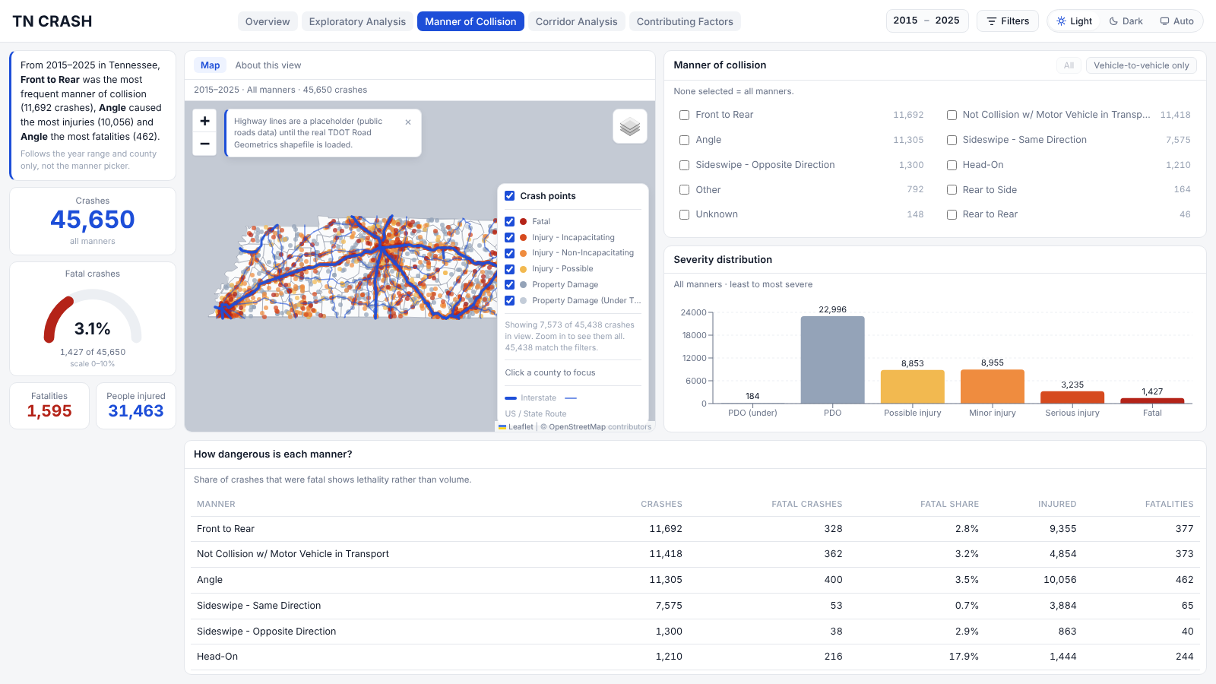
TAB 3 OF 5
Manner of Collision
How do vehicles collide, and which types are deadliest?
Pick one or more collision types, such as rear-end, angle or head-on.
See where each type happens and how severe it is.
Most frequent: front to rear (11,692 crashes). Most injuries and deaths: angle crashes.
Head-on crashes are rare but deadliest, at 17.9% fatal.
TN CMV Crash Dashboard | FMCSA research project | The University of Tennessee, Knoxville
7
Notes:
The bottom table separates volume from lethality: the fatal share shows which collision types are most dangerous, not just most common.

Slide 8
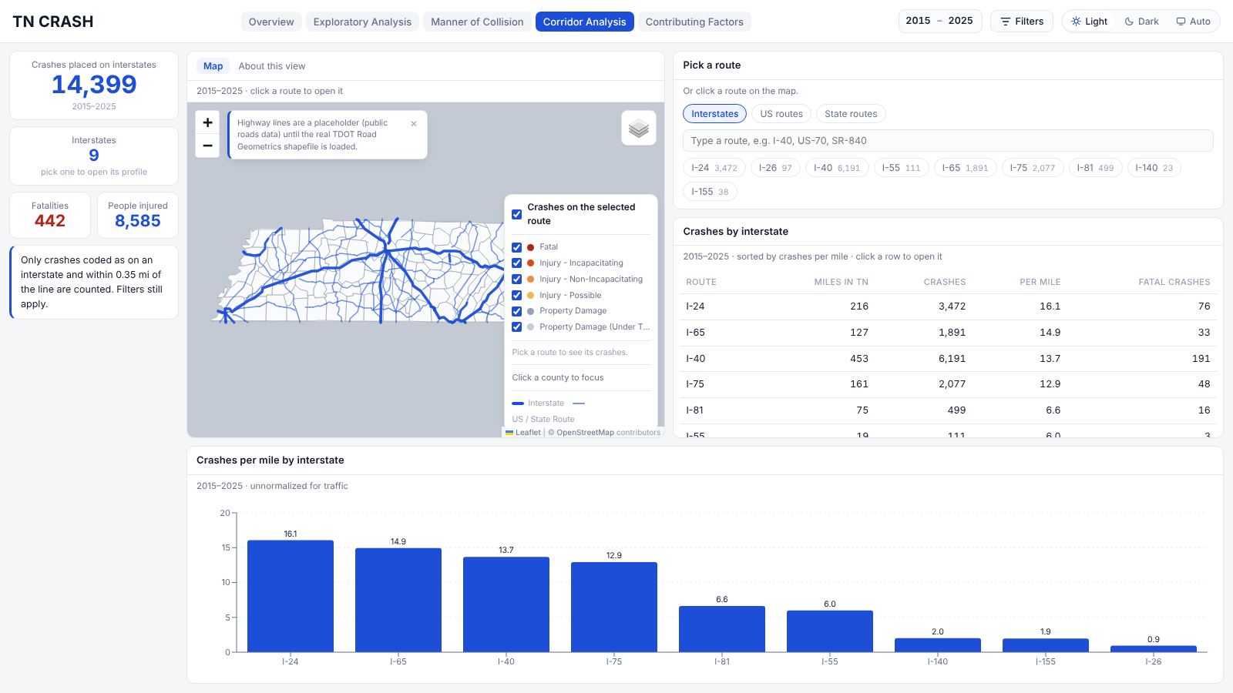
TAB 4 OF 5
Corridor Analysis
Which roads and stretches carry the most crashes?
Choose an interstate, US route or state route.
Follow its crashes mile by mile, with metro areas marked.
Rank routes by crashes per mile: I-24 (16.1), I-65 (14.9) and I-40 (13.7) lead.
Preliminary: counts are not yet adjusted for traffic volume.
TN CMV Crash Dashboard | FMCSA research project | The University of Tennessee, Knoxville
8
Notes:
Rates are raw crashes per mile, not per vehicle mile traveled. A traffic-normalized version needs AADT or VMT data. The highway lines are a public placeholder until the TDOT Road Geometrics shapefile is loaded.

Slide 9
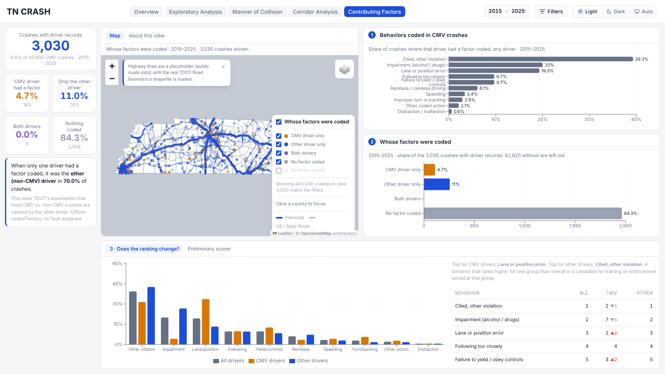
TAB 5 OF 5
Contributing Factors
Which driver behaviors are coded, and for whom?
Police list contributing factors per driver rather than assigning fault.
Which behaviors are coded most, and whose: CMV driver, other driver, both or none.
Does the ranking change between CMV and other drivers?
In progress: only 3,030 of 45,650 crashes have driver records so far.
TN CMV Crash Dashboard | FMCSA research project | The University of Tennessee, Knoxville
9
Notes:
This tab tests TDOT's assumption that most CMV versus non-CMV crashes are caused by the other driver. It is in progress until the full TITAN driver records are loaded, so treat current percentages as preliminary.

Slide 10
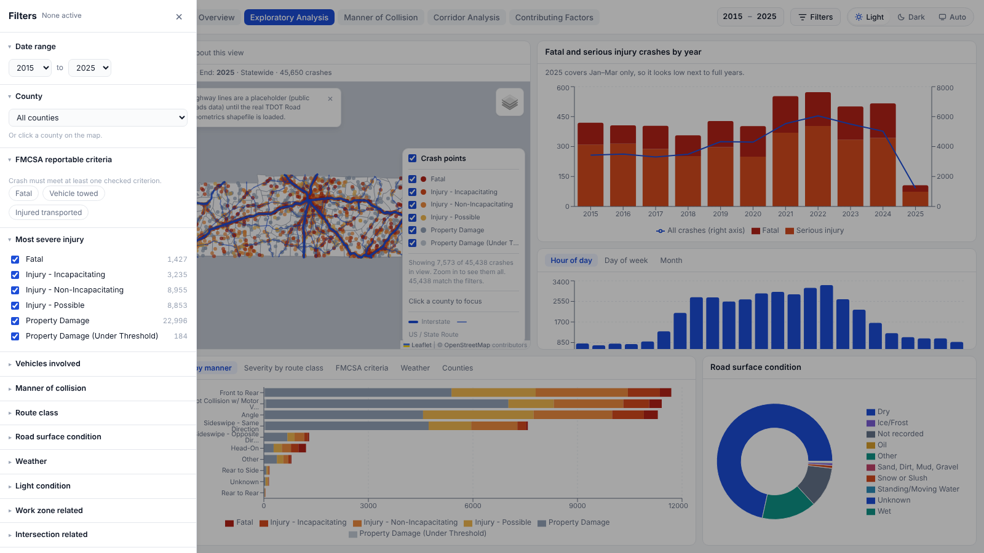
SHARED FILTERS
One set of filters drives every tab
Narrow the whole dashboard once and it stays narrowed
Date range and county.
FMCSA reportable criteria: fatal, vehicle towed, injured and transported.
Most severe injury and number of vehicles involved.
Collision type, route class, road surface, weather and light condition.
Work zone, intersection, school bus and law enforcement agency.
TN CMV Crash Dashboard | FMCSA research project | The University of Tennessee, Knoxville
10
Notes:
The year range also sits in the header on every tab. Links like ?tab=corridor open a specific tab directly.

Slide 11
STATUS AND ROADMAP
What is ready, what is in progress, and what is next
Ready
In progress
Planned
Overview, Exploratory Analysis and Manner of Collision
Corridor Analysis for interstates, US and state routes
Shared filters and the live site on GitHub Pages
Presentation mode hides unfinished tabs
Contributing Factors: needs full TITAN driver records
Real TDOT highway geometry in place of placeholder lines
Traffic-normalized crash rates
Mode 2: risk assessment on the roadways
Mode 3: predictive model of crash probability by road
TN CMV Crash Dashboard | FMCSA research project | The University of Tennessee, Knoxville
11
Notes:
The data coverage gap and placeholder highways are the two things to be upfront about with sponsors.

Slide 12





THE TEAM
Faculty and research team
Mohammad Shaon
Asad Khattak
Husain Aziz
Christian A. Sabillon-Orellana
Aadya Sharma
Principal Investigator
Co-Principal Investigator
Co-Principal Investigator
Co-Principal Investigator
Tech Lead
Center for Transportation Research, UTK
Civil and Environmental Engineering, UTK
Civil Engineering, Kansas State University
Center for Transportation Research, UTK
Dashboard and agentic analysis, UTK
mshaon06@utk.edu
akhattak@utk.edu
aziz.husain.nexus@gmail.com
csabillo@utk.edu
asharm41@vols.utk.edu
TN CMV Crash Dashboard | FMCSA research project | The University of Tennessee, Knoxville
12

Slide 13
Explore it live
aadyash24.github.io/FMCSA
Questions and feedback welcome
THE UNIVERSITY OF TENNESSEE, KNOXVILLE | Center for Transportation Research

