Slide 1
Student Repo
Review of the StudentRepo.zip code repository
Two main types of examples.
Generic Examples
Applied Examples
Notes:
The following presentation is a guided tour to familiarize yourself with what’s available in the Student Code Repo.
This code may be used in class, and while not explicitly required, it is best to site if you use it.
We are not going to go over the repo line by line, but merely point out what you should be looking at within the repo.
Self exploration is an important skill to develop

Slide 2
Generic Examples
Designed to show a specific concept of Java

Slide 3
SE 310 - Student Repo
The following directories exist.
10/02/2020 01:31 PM <DIR> abstractInputOutput
10/02/2020 01:31 PM <DIR> basicInheritance
10/02/2020 01:31 PM <DIR> CarCityVersion
10/02/2020 01:31 PM <DIR> inheritanceExamples
10/02/2020 01:31 PM <DIR> listsAndArrays
10/02/2020 01:31 PM <DIR> SimpleExamples_v10
10/02/2020 01:31 PM <DIR> SimpleExamples_v15
10/02/2020 01:31 PM <DIR> SimpleExamples_v15a
10/02/2020 01:31 PM <DIR> SimpleExamples_v20
10/02/2020 01:31 PM <DIR> staticExamples
10/02/2020 01:31 PM <DIR> transientSerialization
10/02/2020 01:31 PM <DIR> VehicleCityVersion
Notes:
The following directories exist.
We’ll look at them one at a time.

Slide 4
SE 310 - Student Repo
The following directories exist.
10/02/2020 01:31 PM <DIR> abstractInputOutput
10/02/2020 01:31 PM <DIR> basicInheritance
10/02/2020 01:31 PM <DIR> CarCityVersion
10/02/2020 01:31 PM <DIR> inheritanceExamples
10/02/2020 01:31 PM <DIR> listsAndArrays
10/02/2020 01:31 PM <DIR> SimpleExamples_v10
10/02/2020 01:31 PM <DIR> SimpleExamples_v15
10/02/2020 01:31 PM <DIR> SimpleExamples_v15a
10/02/2020 01:31 PM <DIR> SimpleExamples_v20
10/02/2020 01:31 PM <DIR> staticExamples
10/02/2020 01:31 PM <DIR> transientSerialization
10/02/2020 01:31 PM <DIR> VehicleCityVersion
Notes:
The first code to look at is abstracatInputOutput.

Slide 5
SE 310 - Student Repo
Abstracted Input and Output
Notes:
This project shows examples of input and output.
You can output to the:
Console
A file,
Or even audio.
You can input from the console as a string or an integer.
Furthermore, note, that you can change the instance of Out so the target of outputting changes, but the driver of the program doesn’t need to change beyond that.

Slide 6
SE 310 - Student Repo
Basic Inheritance – This is mislabeled should be Parameter Passing.
Notes:
Basic Inheritance is actually poorly titled. It really shows the various ways you can pass variables as parameters.
This illustrates concepts like pass by reference, by value and passing a copy of a reference.

Slide 7
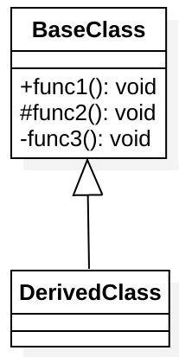
SE 310 - Student Repo
Inheritance Examples
Notes:
The inheritance Examples shows a very basic base class and an empty derived class.
You can play with this to see what methods of the base class are visible in the derived class.
Note that in the base class are methods that are public, protected and private.

Slide 8
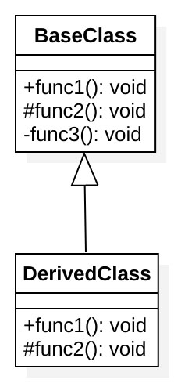
SE 310 - Student Repo
Inheritance Examples
Notes:
The project also has an example of inheritance with overriding some of the methods from the base class by creating new ones in the base class.

Slide 9
SE 310 - Student Repo
Lists and Arrays
Notes:
List and arrays is a single file program that demonstrate how to use an Array, Linked List, and an Array Lists.
The example includes adding and removing items as well as converting from one list form to another.

Slide 10
SE 310 - Student Repo
Static Examples
public class SquareRoot {
// Calculate a square root without using the Math.sqrt() function. This requires an
// integer input instead of a double value.
public static double squareRoot(int value){
double tmp;
double sqrt = value / 2;
do{
tmp = sqrt;
sqrt = (tmp + (value / tmp)) / 2;
} while((tmp - sqrt) != 0);
return sqrt;
}
public static void main(String[] args){
// Use the static function to get the sqrt
double sqrtOf4 = SquareRoot.squareRoot(4);
double sqrtOf100 = SquareRoot.squareRoot(100);
System.out.println("sqrtOf4: " + sqrtOf4);
System.out.println("sqrtOf100: " + sqrtOf100);
}
}
Notes:
The Static examples project has two programs.
Let’s look at SquareRoot first.
It uses static in the method declaration called squareRoot.
This allows the method to be called by referencing it from main with the classname and not having to instantiate an object.

Slide 11
SE 310 - Student Repo
Static Examples
public class Counter {
private static int count = 0;
public static void tick(){ ++count; }
public static int getCount(){ return count; }
public static void main(String[] args){
// Display the initial value for count
System.out.println("Initial count: " + Counter.getCount());
// Increment the counter
Counter.tick();
// Display the new value for the count
System.out.println("Count after tick: " + Counter.getCount());
// Tick the counter in a function and show that it updates the value here as well
tickInFunction();
System.out.println("Count after tickInFunction: " + Counter.getCount());
}
public static void tickInFunction(){
Counter.tick();
}
}
Notes:
The next example is counter which shows the use of a static variable, count.
Count is declared once and is a single instance for the entire program.
Static is also used in the definitions of tick and getCount as it was in the previous square root method.
This allows the two methods to be called by referencing them from a class not an object.

Slide 12
SE 310 - Student Repo
Transient Serialization Examples
public class Counter {
private static int count = 0;
public static void tick(){ ++count; }
public static int getCount(){ return count; }
public static void main(String[] args){
// Display the initial value for count
System.out.println("Initial count: " + Counter.getCount());
// Increment the counter
Counter.tick();
// Display the new value for the count
System.out.println("Count after tick: " + Counter.getCount());
// Tick the counter in a function and show that it updates the value here as well
tickInFunction();
System.out.println("Count after tickInFunction: " + Counter.getCount());
}
public static void tickInFunction(){
Counter.tick();
}
}
Notes:
This example highlights a number of features of Java.
There is a basic example of how to read a file line by line in readFileLinebyLine (TransientWhenSerializing).
We then have a function to serialize the class TransientWhenSerializing as well as deserialize it.
Pay attention to the use of the keyword transient, to prevent unwanted values to be serialized with the class.
ExampleMain demonstrates their use.

Slide 13
Applied Examples
Designed to show an ever-growing example which should give you an idea of the scope of what’s needed for homework #2.
Notes:
These applied examples were designed to show an ever-growing example which should give you an idea of the scope of what’s needed for homework #2.
We start with a basic example and add functionality to it, one step at a time.
In this powerpoint, we’ll show you just the UML, but you should be investigating the code as well.

Slide 14
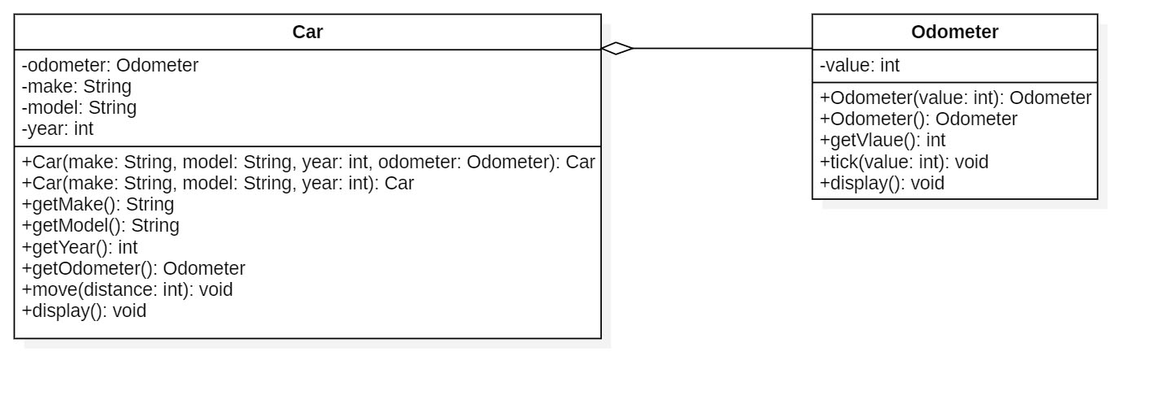
SE 310 - Student Repo
Simple Examples v10
Notes:
The first applied example shows the relationship between a car and an odometer, which is an has-a relationship.

Slide 15
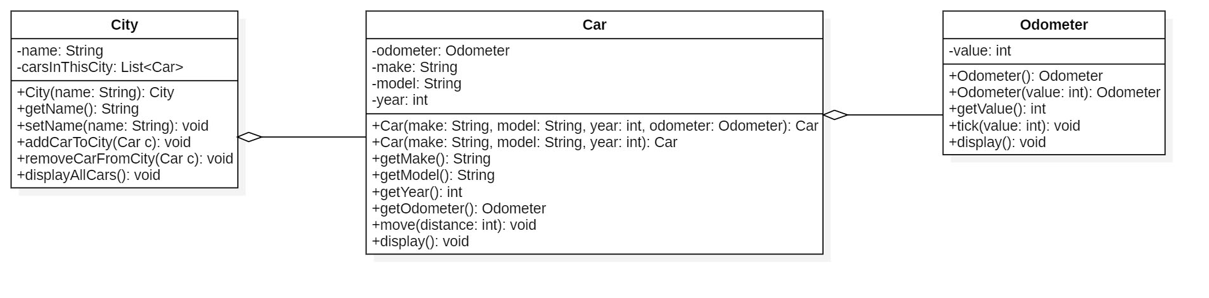
SE 310 - Student Repo
Simple Examples v15
Notes:
Next, we add a city to the example. Showing that a city has cars which has odometers.

Slide 16
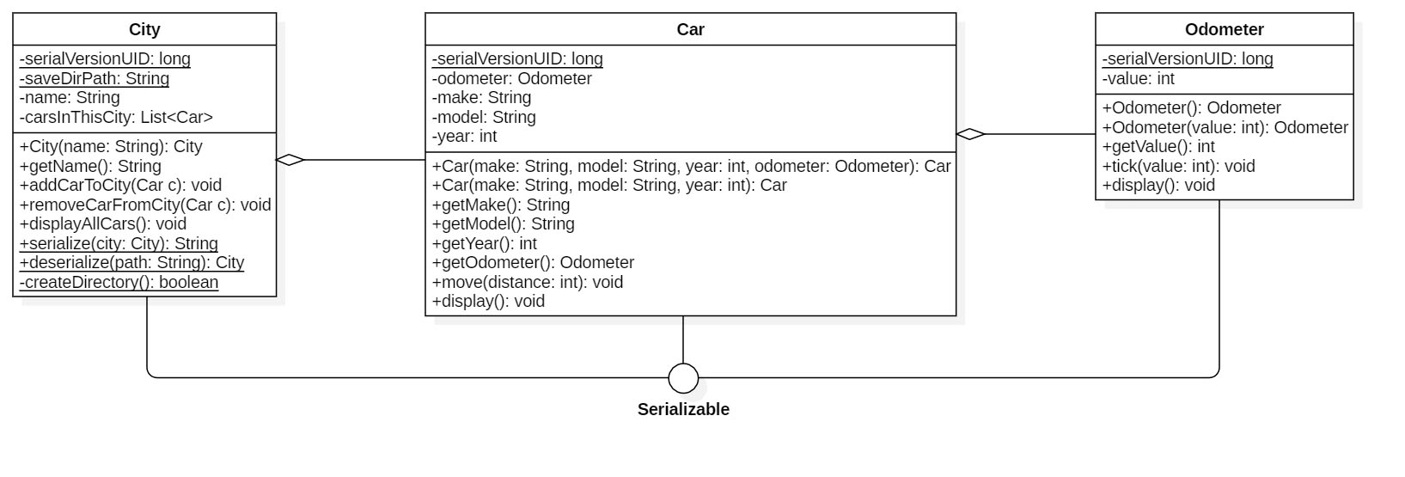
SE 310 - Student Repo
Simple Examples v20
Notes:
Continuing our example we show how these objects can be serialized.

Slide 17
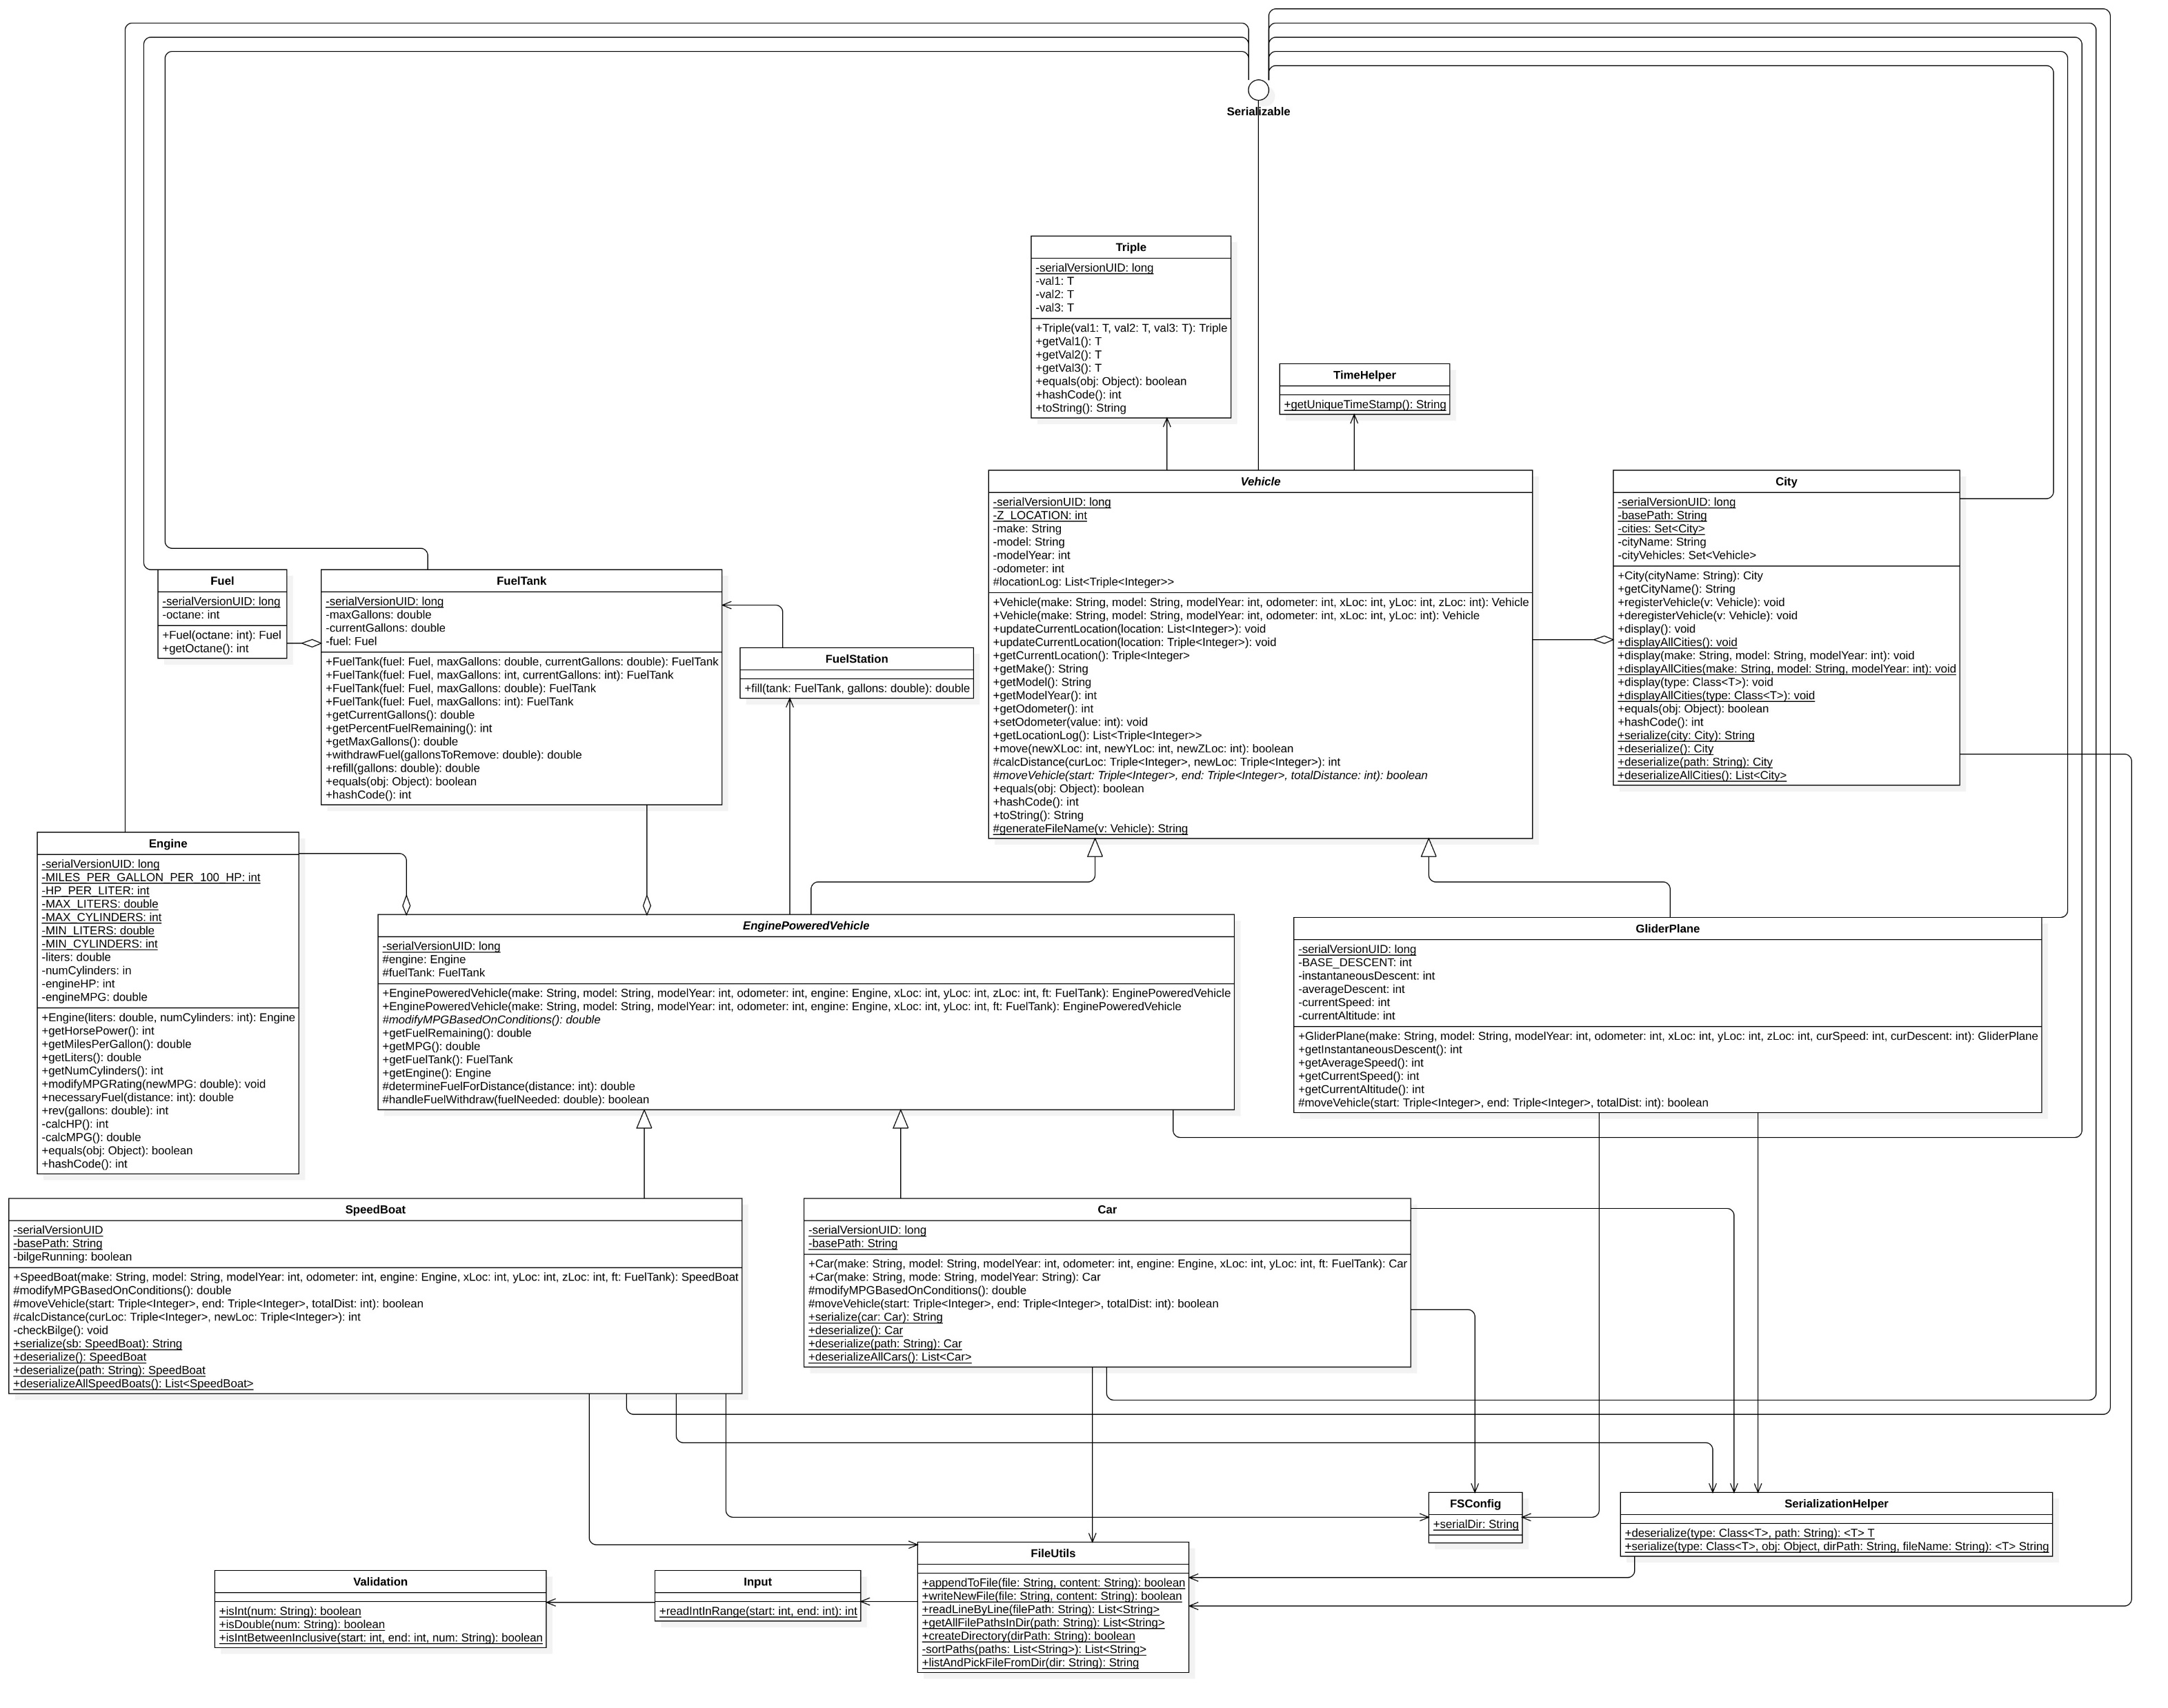
SE 310 - Student Repo
Car / Vehicle City Version
Notes:
The following is a much larger example adding vehicle other than cars and their components as well as utilities and plenty of details to give you even more examples. Car CityVersion does not have the non car vehicles.

