Slide 1
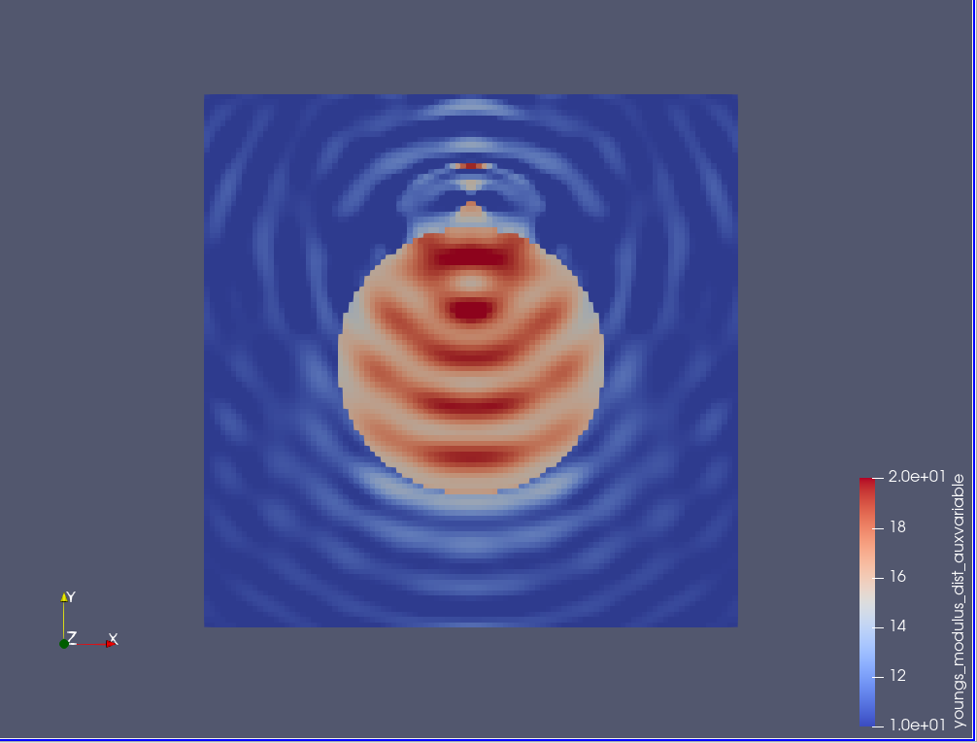
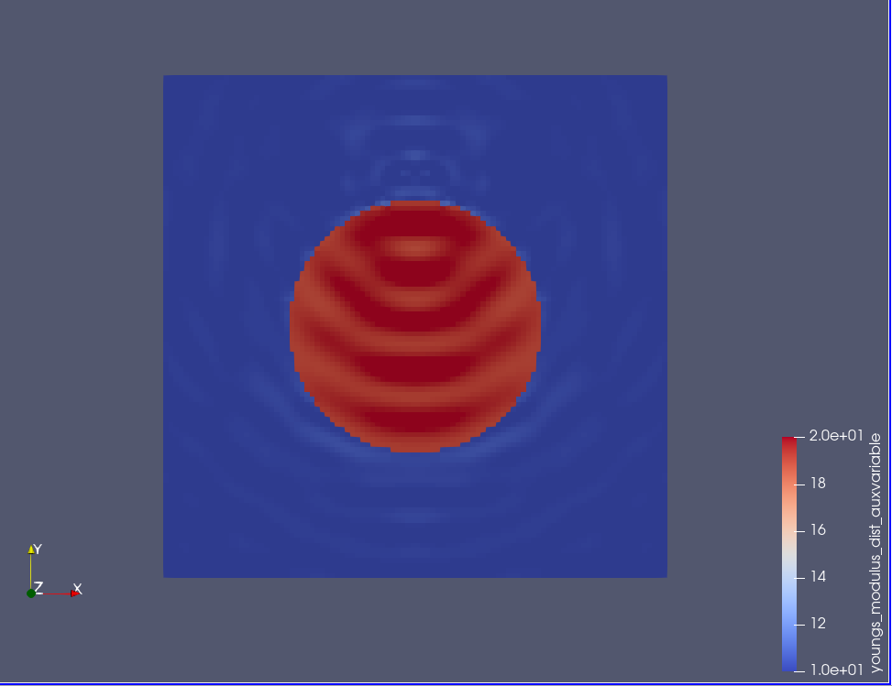
Input data
Compressible elastic wave equation
Ex.1-top
1 source @ (0.5,0.8)
Receivers: entire wavefield is considered.
1 freq @ (w=100 cycle)
E_matrix=10
E_inclusion=20
Initial_guess_inclusion=15
Diameter=0.5
Domain= 1x1
Mesh =100x100
Ex.1-bottom
Same input except Initial_guess_inclusion=19

Slide 2
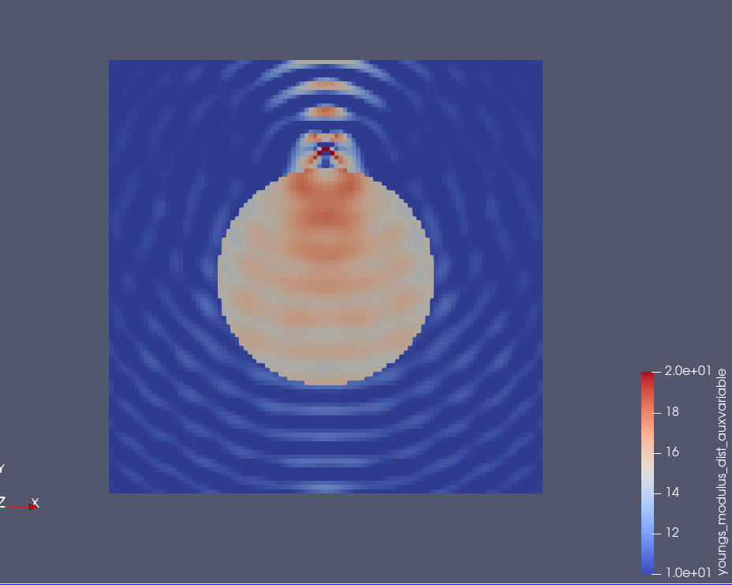
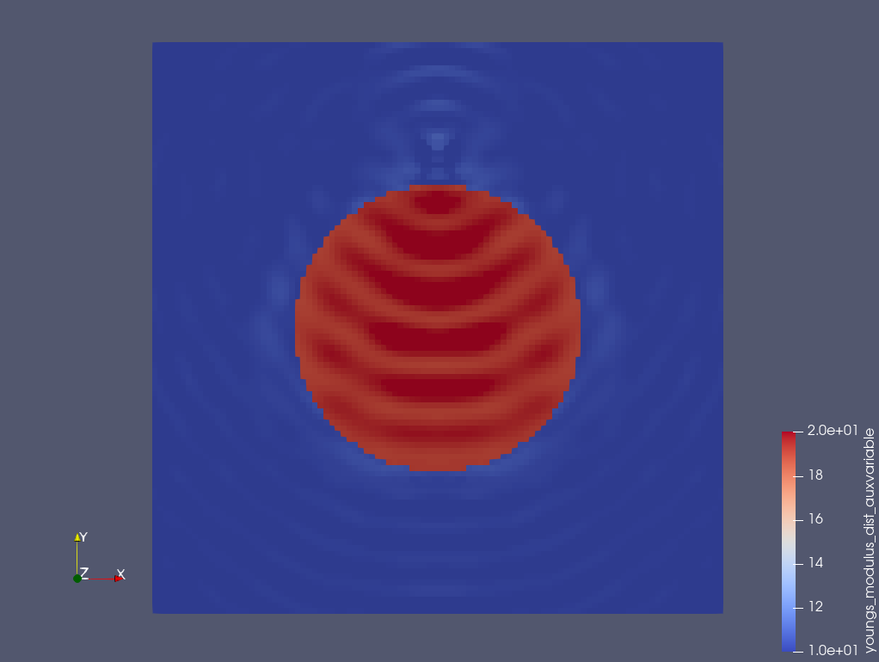
Parameters takes negative/very small values in the inversion process.
Input data
Incompressible elastic wave equation
Ex.1-top
1 source @ (0.5,0.8)
Receivers: entire wavefield is considered.
1 freq @ (w=100 cycle)
E_matrix=10
E_inclusion=20
Initial_guess_inclusion=15
Diameter=0.5
Domain= 1x1
Mesh =100x100
Ex.1-bottom
Same input except Initial_guess_inclusion=19

Slide 3
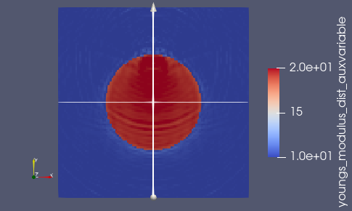
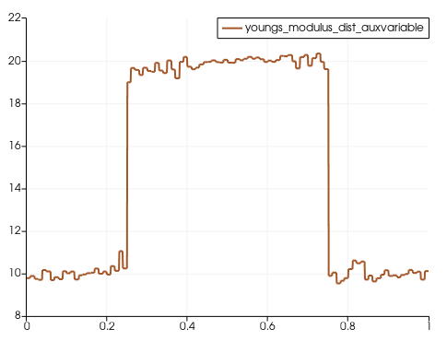
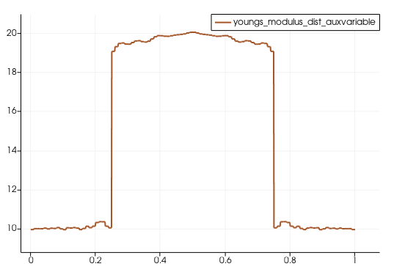
Input data
Incompressible elastic wave equation
1 source @ (0.5,0.8)
Receivers: entire wavefield is considered.
11 freq @ (w=100-300@20 cycle)
E_matrix=10
E_inclusion=20
Initial_guess_inclusion=19
Diameter=0.5
Domain= 1x1
Mesh =100x100
Section 1
Section 2
L2 norm – misfit function is used
Section 2
Section 1

Slide 4
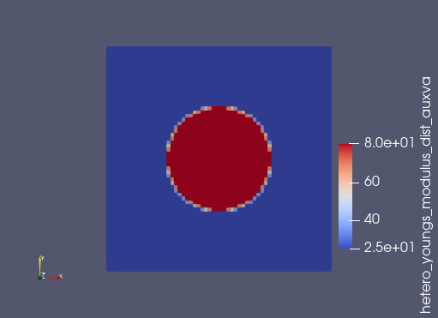
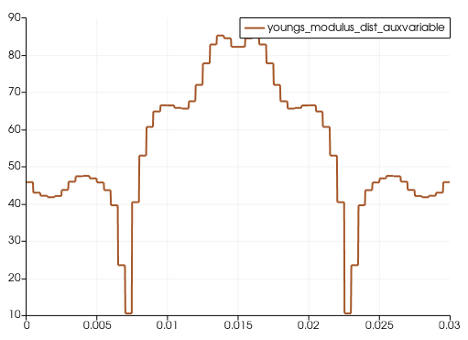
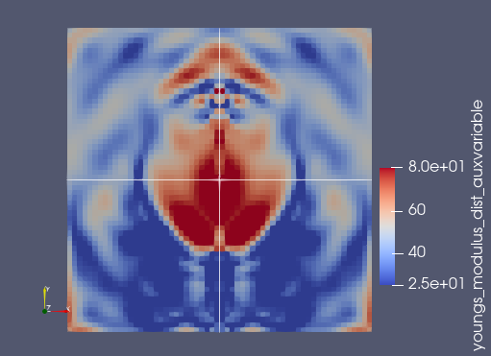
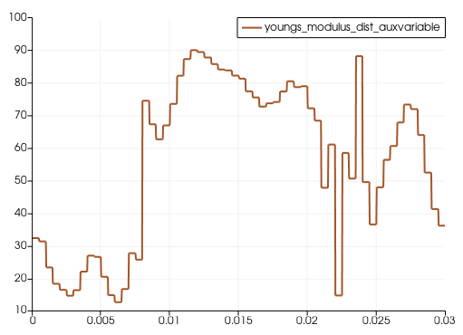
Input data
Incompressible elastic wave equation
1 source @ (0.015,0.024)
Receivers: 44 RCV@0.005.
51 freq @ (w=100-600@10 Hz)
E_matrix=25 kpa
E_inclusion=80 kpa
Initial_guess – was mistakenly set as homogenous=50 kpa
Diameter=0.014=14 mm
Domain= 0.03x0.03= 30 mmx30 mm
Mesh =60x60
Section 2
Section 1
Section 1
Cross-correlation function is used
Section 2

Slide 5
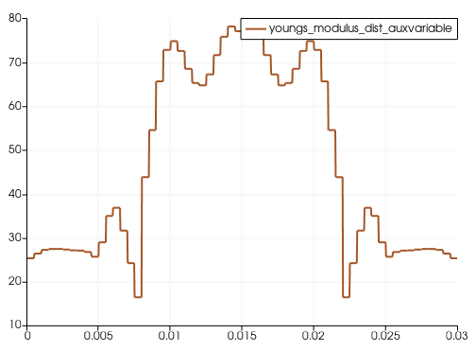
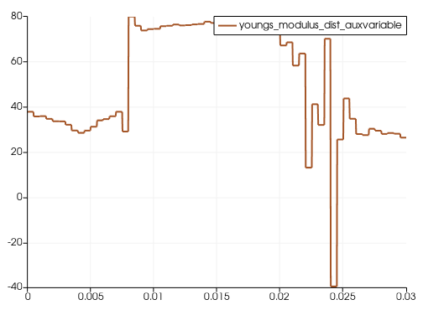
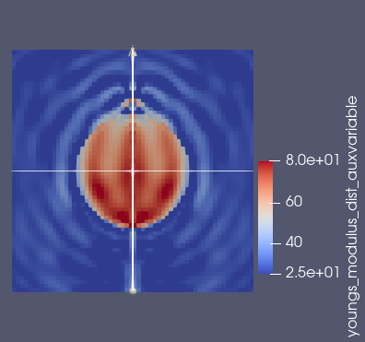
Input data
Incompressible elastic wave equation
1 source @ (0.015,0.024)
Receivers: 44 RCV@0.005.
51 freq @ (w=100-600@10 HZ)
E_matrix=25 kpa
E_inclusion=80 kpa
Initial_guess inclusion=50 kpa
Diameter=0.014=14 mm
Domain= 0.03x0.03= 30 mmx30 mm
Mesh =60x60
Section 2
Section 1
Cross-correlation function is used

Slide 6
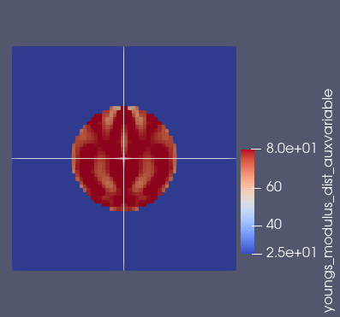
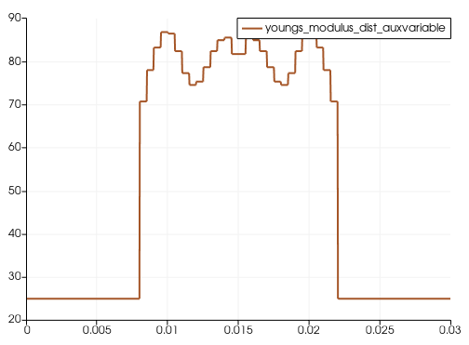
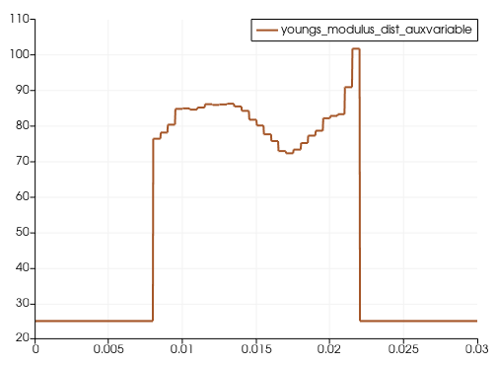
Input data
Incompressible elastic wave equation
1 source @ (0.015,0.024)
Receivers: 44 RCV@0.005.
11 freq @ (w=100-600@50 HZ)
E_matrix=25 kpa
E_inclusion=80 kpa
Initial_guess inclusion=50 kpa
Diameter=0.014=14 mm
Domain= 0.03x0.03= 30 mmx30 mm
Mesh =60x60
Section 2
Section 1
Section 1
Cross-correlation function is used
Section 2

Slide 7
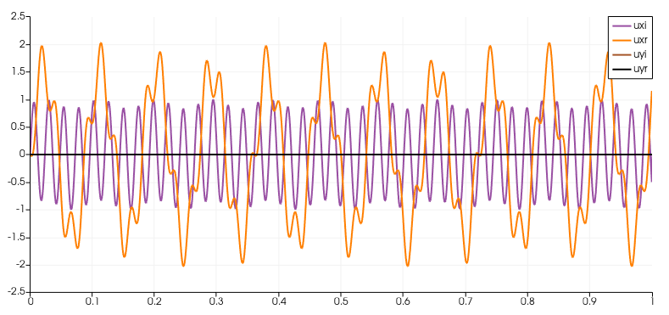
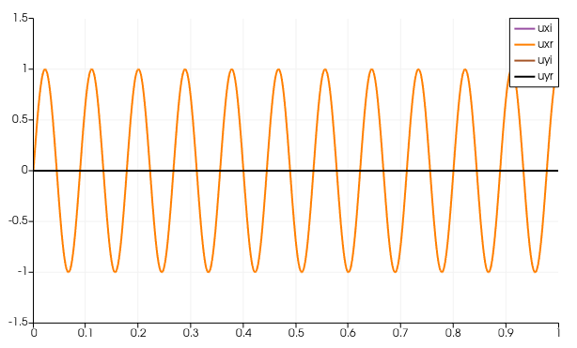
W=100 cycle,
Rho=1

Slide 8
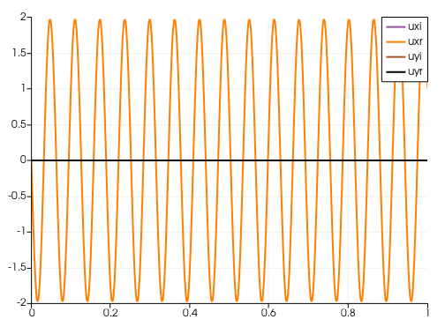
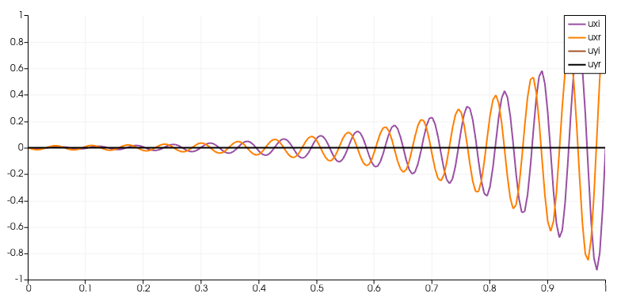

Slide 9
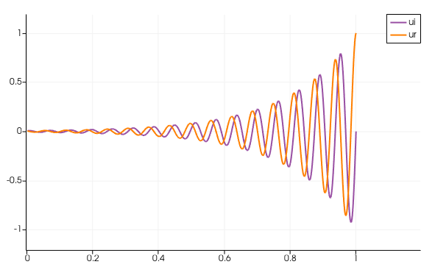

Slide 10
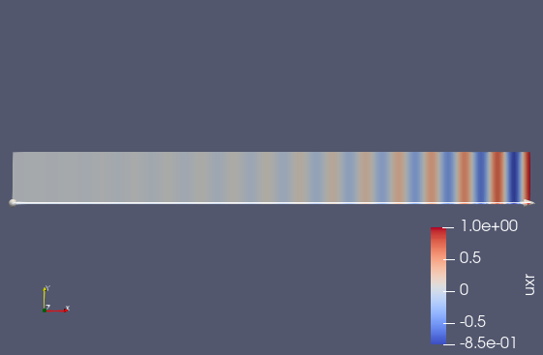
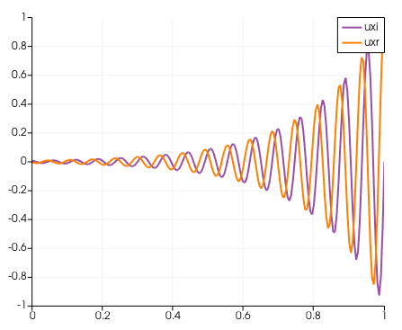

Slide 11
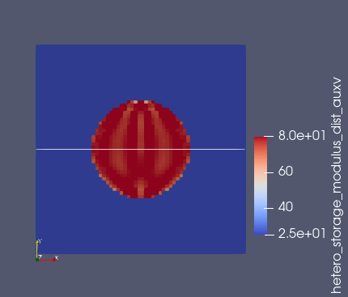
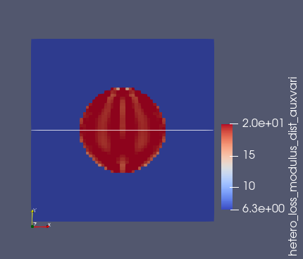
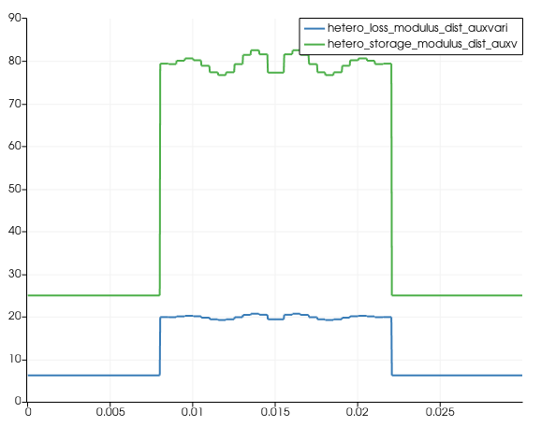
Incompressibe viscoelastic wave equation inversion
Input data
1 source @ (0.015,0.024)
Receivers: 44 RCV@0.005.
11 freq @ (w=100-600@50 HZ)
E_matrix=25 (1+i*w/w_bar) kpa
E_inclusion=80 (1+i*w/w_bar) kpa , w_bar=15000
Initial_guess inclusion=50 (1+i*w/w_bar) kpa
Diameter=0.014=14 mm
Domain= 0.03x0.03= 30 mmx30 mm
Mesh =60x60
Only one component of the wavefield is considered (Ux)
Reconstructed storage modulus
Reconstructed loss modulus @600HZ
Horizontal section cut - Elastic and viscoelastic modulus at @ 600 HZ
Convergence behavior-CC functional

