Slide 1

Graph Algorithms
CMPT 307 · Week 9

Slide 2
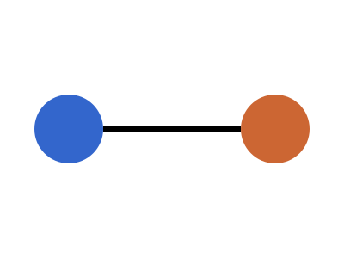
Minimum Spanning Trees
Kruskal's algorithm sorts edges by weight
  Uses union–find
Prim's algorithm grows one tree
Borůvka merges components
Notes:
Mention that Kruskal & Prim are both greedy.

Slide 3
Running times
Algorithm | Time
Kruskal | O(E log E)
Prim | O(E log V)

