Slide 1
CMPS 299A
Prepared by: Ahmad Adada, Ali Faour, Hadi Dabouk, Mohammad Fadlallah, and Nour Sfeir

Slide 2
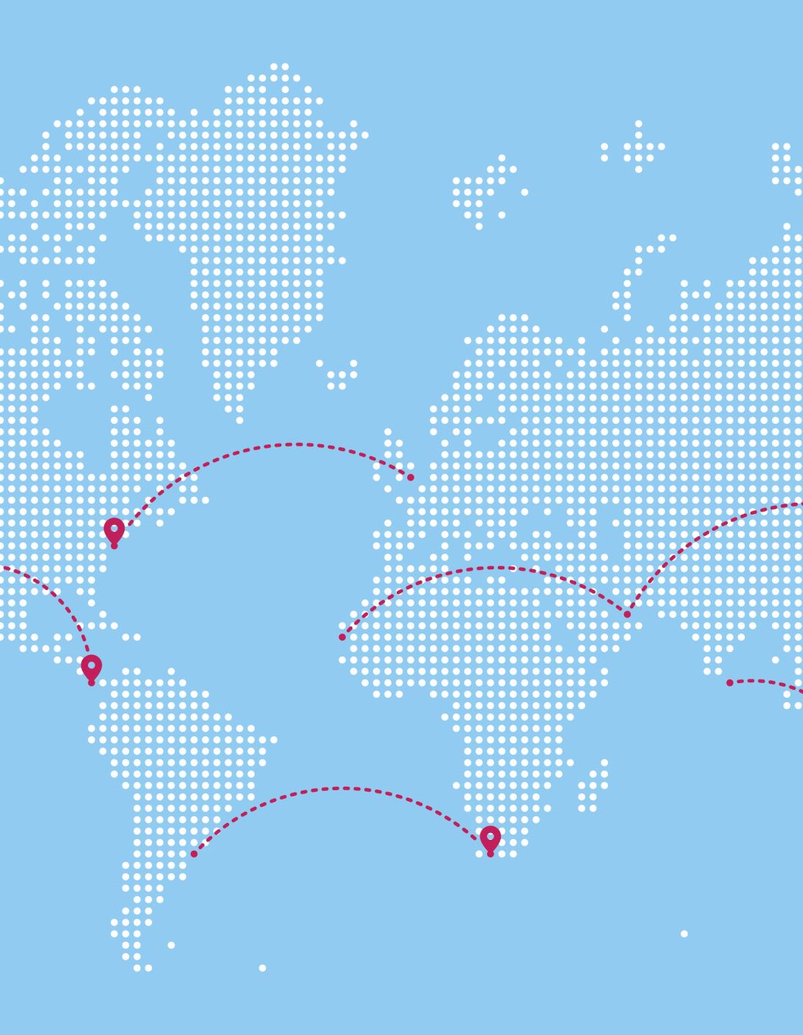
What is Ushahidi
Ushahidi is an open-source software application which utilizes user-generated reports to collate and map data.
It uses the concept of crowdsourcing serving as an initial model for what has been coined as "activist mapping" – the combination of social activism, citizen journalism and geographic information.

Slide 3
Ushaguzi
Uchaguzi is a platform by Ushahidi that started as an initiative to monitor the 2013 Kenyan General Election, in an effort to make the voting process more transparent, peaceful, and fair. The project gave citizens the ability to report on any suspicious or violent activity with the confidence that their voice would be heard, and their report taken seriously.
In 2022, facing another general election, Ushahidi collaborated with 19 civil society partners to create a customized version of the platform that enabled election situation room activities to be coordinated and monitored through technology.
The citizens were able to report on election events: Security Issues, Voting Issues, etc... through channels like WhatsApp, SMS, USSD, and social media.

Slide 4
Information Flow (1)
Extracting and monitoring citizen reports conveying any useful and relevant information for the election via different social media streams. For example: Twitter, Facebook, TikTok, and blogs.
Gathering reports sent directly from SMS, WhatsApp, USSD, etc...
Translation of posts from local languages to English
Reviewing all posts for location information of the incident/issue and mapping the posts to the locations (geolocation)
Converting these posts from SMS and Social media into the structure of existing surveys; for example, voting issues, security issues, and opinions.

Slide 5
Information Flow (2)
6- Verification: Uchaguzi evaluated the information received through a rigorous verification process to determine its credibility.
7- After verification, the reports were published into the platform.
8- Information sent from the platform to collaborating organizations and individuals who could use it to intervene positively and monitor the response to gauge its effectiveness.
9- Analysis and Research: Analyzing data within the platform and providing situation room reports in the form of narratives, data analysis, and visualizations. These were disseminated on social media and published on the platform to keep the public regularly informed.

Slide 6
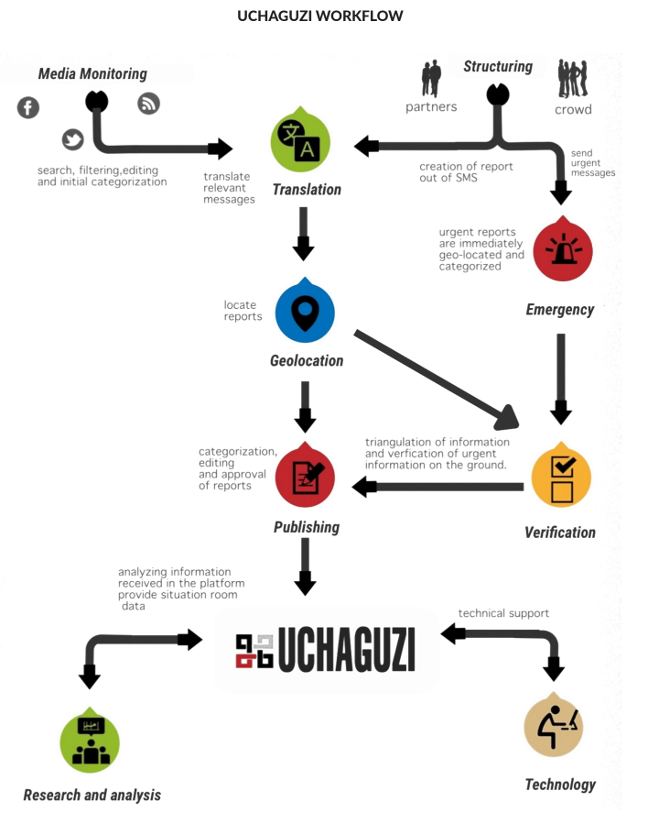

Slide 7
Impact
Uchaguzi 2022 proved to be an incredibly valuable tool during the election period, enabling citizens to have their voices heard and their reports escalated so they could receive the necessary assistance to exercise their right to vote. Through Uchaguzi, 93,236 reports were collected, and 12,387 of these were published.
A particularly impactful report was submitted by a person with a disability who was unable to access the polling booth at their designated voting station. Thanks to the swift escalation of this report by Uchaguzi, the National Council of Persons with Disabilities was able to take immediate action

Slide 8
Index On Censorship EU Project
Index on Censorship, (London, United Kingdom) and Osservatorio Balcani e Caucaso (Rovereto, Italy), have launched, mediafreedom.ushahidi.com, a website that will enable the reporting and mapping of media freedom violations across the 28 EU countries plus candidate countries.
The platform will collect and map out crowd-sourced information from media professionals and citizen journalists across Europe over the course of a year.
By mapping these reports online, the entire system will act as an advocacy, research and response tool, highlighting that violations on media freedom still occur in Europe

Slide 9
Modelling Data
The data received was then compiled and modeled into an index map of Europe where each country is given a free speech ranking from 1-10
Data:
Across Academic, Digital and Media/Press Freedom, the index modelled data compiled from a number of trusted sources including the World Press Freedom Index (compiled by Reporters Without Borders), the Varieties of Democracy research project (V-Dem), Committee to Protect Journalists, UNESCO’s Observatory of Killed Journalists, the Global Cybersecurity Index and Netblocks’ Cost of Shutdown Tool (COST). From these datasets, 178 relevant variables were identified and incorporated into the index.

Slide 10
Technique:
Using machine learning techniques, each country, for which there was available data for, were clustered based on their standing against all variables and then sorted into deciles from open (endoreses free speech) to closed.
As a result of this process, the Index Index is made of four rankings, one overall Index, as well as rankings for each individual freedom: academic, digital and media/press freedom

Slide 11
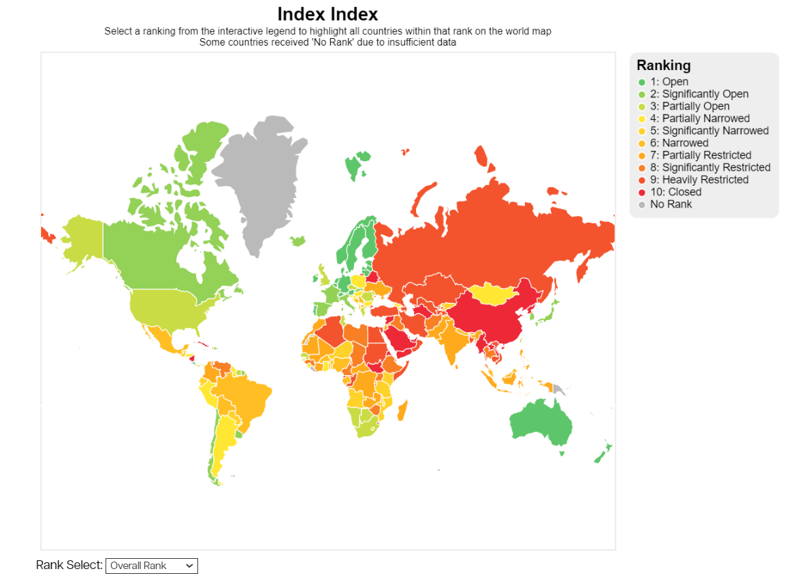

Slide 12
Outcome
The project launched in May 2014, and so far has mapped over 400 reports from 36 European countries.
Thanks to Ushahidi’s support, Index on Censorship was in the best possible position to contribute to the protection of media freedom and democracy in Europe.

Slide 13
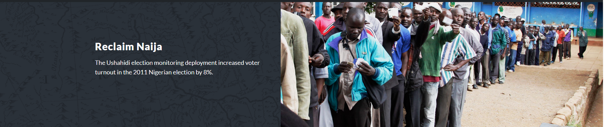
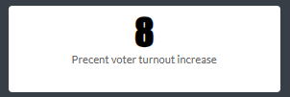
Reclaim Naija
This study explores how modern information and communication technologies (ICTs)can empower citizens to play an active role in ensuring fair and transparent elections, especially in contexts where official election monitoring might be inadequate.
“ At the more granular level, reports of administrative failures (.0006, p ≤ .1), overt electoral manipulation (.004, p ≤ .01), and physical intimidation of voters (.009, p ≤ .01) generated during the April 9th NASS elections are strongly and significantly correlated with increased voter turnout in the subsequent presidential election on April 16. For example, the mean number (N = 19) of reports of overt vote manipulation during the NASS election increases voter turnout in the presidential election by 8 percentage points (see Table 1 ).”

Slide 14
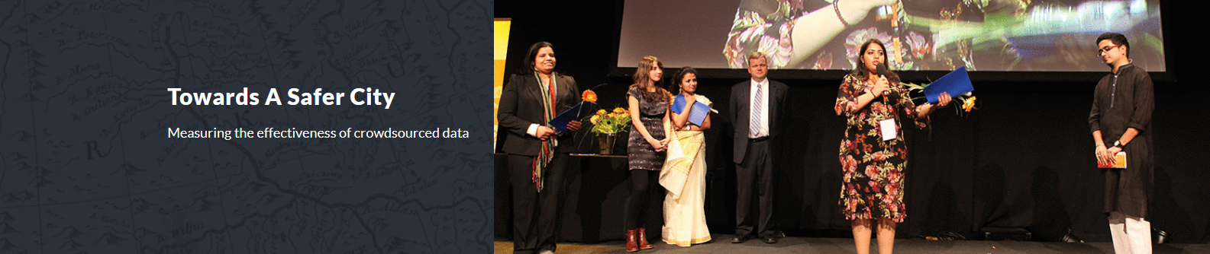

Aim and methodology:
This study compares the Harass map data with a quantitative analysis of the data collected based on 450 questionnaires (300 complete by women and 150 by men) distributed evenly between six administrative units of Greater Cairo and a qualitative analysis of the data collected based on 48 (30 female and 18 male) focus group discussions (FGDs) conducted. The FGD provided an open forum for participants to discuss sexual harassment, giving the researchers insight into how they perceive the phenomenon. Thematic analysis and qualitative case-oriented open coding were employed to study the data.
Findings:
-95.3% of women experienced harassment, mainly on streets and public transport, primarily in the afternoon, and 81.8% of them felt upset after it.
-Fuller and more comprehensive reports were received via the Map than in the interview, showing that sensitive topic are more comfortable being spoken about online.

Slide 15
Findings:
-Different types of harassment were reported more commonly depending on the approach employed with forms such as catcalls and ogling.
-Harassment was reported as occurring at broadly similar rates in the morning, afternoon and evening (although rarely at night) the Map data, while the vast majority of cases were reported as occurring in the afternoon or evening in the field data.
-The Map narratives exhibited a recurring four-part structure characterized by 1) a set-up of the scene, 2) details of the harassment itself, 3) the response of the harassed individual, and 4) the moral.
-Explicitly sexual language was found in the Map reports than in the interviews where euphemisms and vaguer language were generally favored.
Fuller and more comprehensive reports were received via the Map than in the interviews which may suggest that people are more willing to speak about the issue online than in person.
This may represent a major advantage of the Map over traditional methods.
The Map offers a space where individuals can speak relatively freely and anonymously, although the Map is not a perfect method for data collection as a great deal of information was lacking in the Map data set.
Our findings broadly support the hypothesis that the Map is an effective tool for data collection for sensitive issues despite its limitations.
"The Ushahidi map is an effective tool for data collection for sensitive issues, encouraging more participation and sometimes more truthful reports than other typical data collection means."

Slide 16
iWitness Pollution Map
Following the Deepwater Horizon disaster, the largest accidental marine oil spill in the petroleum industry's history, the Gulf Coast experienced severe environmental damage. The iWitness Pollution Map was created in response to this and ongoing pollution issues in the area. It collects and displays reports from citizens, NGOs, government agencies, and those responsible for the pollution.
Anne Rolfes, the founding director of the Louisiana Bucket Brigade, highlights the issue in the state where government agencies and industry are often unresponsive. She points out the lack of a comprehensive map to show the extent of devastation caused by such environmental disasters, emphasizing the importance of documenting these events as a form of justice.
LABB's Outreach Team Leader, Daniel Broy, expresses a desire to understand the full impact of these environmental incidents on public health. He notes the lack of information available and LABB's efforts to gather as much data as possible. Broy also discusses the LABB's initiative to encourage people to use their tools, like the Spill Map, to report ongoing environmental issues.
The iWitness platform, a deployment by the Louisiana Bucket Brigade, received over 3,000 reports related to the Gulf Oil spill. These reports were instrumental in arguing for greater environmental regulation in the state of Louisiana, showcasing the significant impact of community-sourced data in environmental advocacy and policy change.

Slide 17
I am Nirbaya
India is fourth most dangerous place in the world for women according to a TrustLaw Poll.
The I am Nirbhaya ("I am fearless") campaign uses Ushahidi's platform to allow any citizen to report incidences of sexual and gender-based violence in India, monitor and respond to the reported cases, and analyze data to find trends.
This deployment aims to increase the visibility of violence against women and accountability for institutions responsible, for ensuring the safety of all members of the society. It serves as a publicly available database of cases of violence against women aiming to empower those who have previously remained silent. It is a collective effort to map incidents, generate reports, and together build pressure on the police and government institutions that have turned a blind eye to women's safety in India.

