Slide 1
BRAINUSE!
A GAME IN REACT

Slide 2
Group Members:
Hafiz Muhammad Aafaq
Ismail Matteh
Muhammad Ibrahim Afsar Khan

Slide 3
Work Distribution:
There is no as such work distribution because we worked on it together.
The logics and idea of the game by Hafiz Muhammad Aafaq and Muhammad Ibrahim Afsar Khan
While the code implementation and debugging was Ismail’s part.

Slide 4
Tools Used
HTML
Javascript
CSS, CSS Modules
React
Web Tools which we have already learnt in the class

Slide 5
Introduction
A brain challenging game that checks if you can memorize the cards shown to you or not.
You can use as many tries as you like.
This game is implemented in React.js.

Slide 6
Code Implementation:
The code is implemented in React so we are going to discuss some important code snippets that are the building blocks of the project.
The coding part is divided in different folders like:
Html View
Js files
Scss files

Slide 7
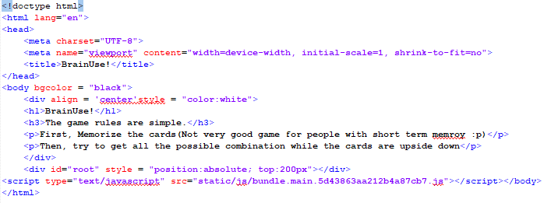
HTML VIEW:
This simple file just renders all the react and js code

Slide 8
JS FILES:
The Js files includes different files like:
main.js
image.js
cards.js
card.js
index.js

Slide 9
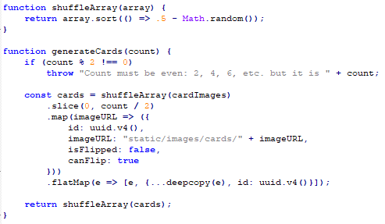
JS FILES:
We will be discussing the important code snippets here:
The card generation and
the array shuffling is given here.
The cards(which are actually the
Names of the images) are stored in
the array that are used here.

Slide 10
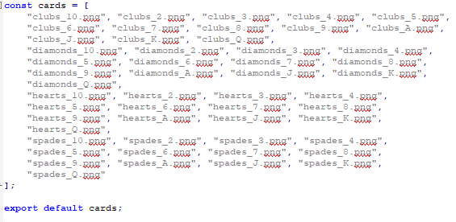
JS FILES:
The cards are stored in an array that is saved in a separate file named as cards.js

Slide 11
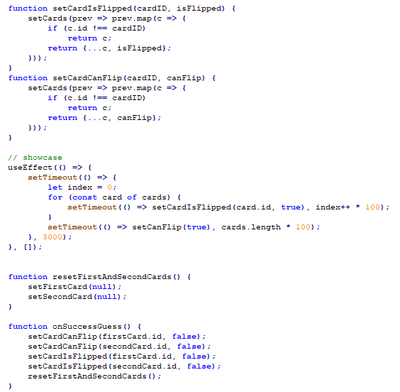
JS FILES:
Checking whether the card
is flipped or it can flip.
If the card don’t match,
Simply, flip the cards.
Correct guessing will make
the cards unflippable.

Slide 12
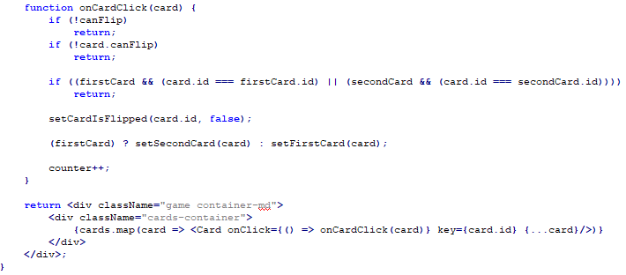
JS FILES:
Checking if the the cards are already flipped or not and also checking the first and second cards that are matched or not and then returning
all of the above
functionality in
a <div> tag.

Slide 13
SCSS Files:
Different SCSS files included are:
_fonts.scss
_variabls.scss
_global.scss
_grid.scss
main.scss
card.scss
game.scss
We are not discussing these files here!

Slide 14
Limitations

Slide 15
Our game is limited to a single player and not just that the UI is not that good

Slide 16
Challenges

Slide 17
Finding the project idea was a great challenge.

Slide 18
Future Works
We think that we can make more games and join them in a single folder with an interactive interface for the users
Users will be able to choose the game of their choice and then start a game
The folder that will be containing all the games should be a game launcher that can increase the game performance.

Slide 19
Conclusion
We learned alot about gaming in React.js and implemented a game that contained the rules of our own creation.
Although it was a game that was played in the past but we implemented it again using modern GUI so that the coming generation can see what the games of the past looked like.

Slide 20
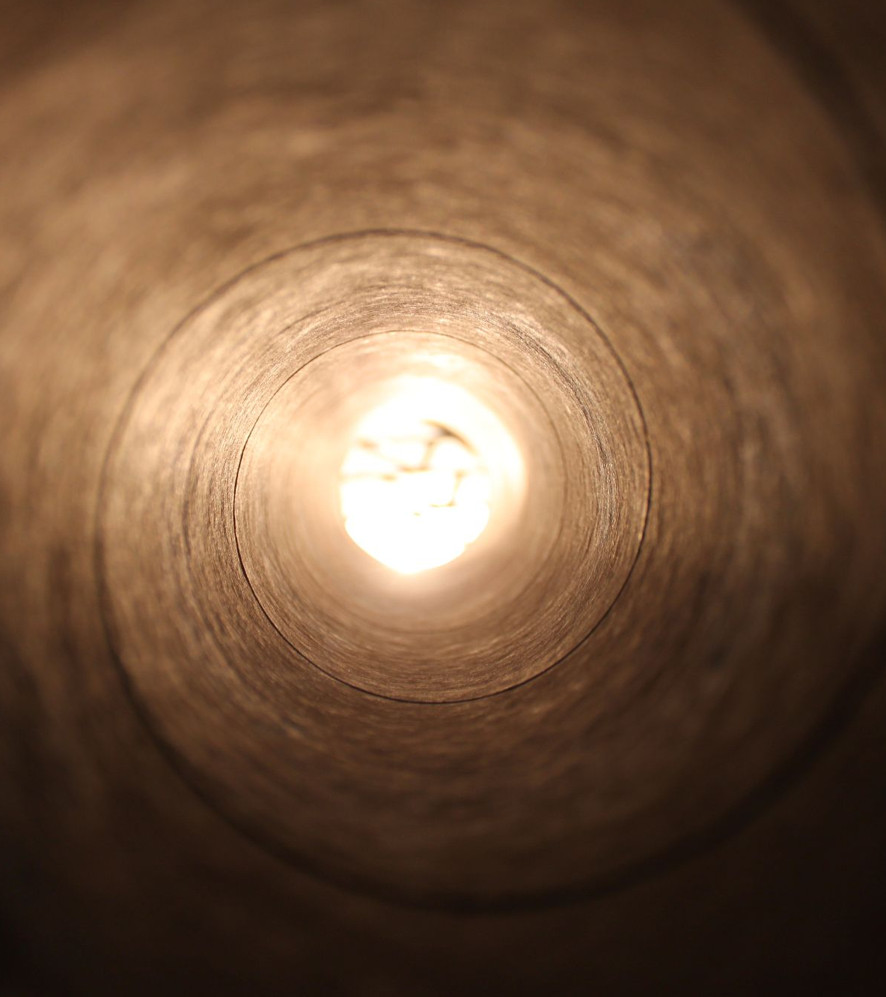

Queries?

Slide 21
Thank You!!

