Slide 1

DriverPass System Analysis
Aaron Fehir
Notes:
[No speaker notes required for this slide.]

Slide 2

System Requirements
Examples of Functional Requirements
The system shall validate user credentials when logging in
The system shall allow users to select between multiple package options
Examples of Nonfunctional Requirements
Capable of handling multiple customer accounts at once
Administrative access to system from web-based environments as well as the ability to access the system directly, without internet
Notes:
[In your speaker notes, include an explanation of the different requirements you determined for DriverPass’s system. What are the functional requirements you selected to describe? What are the nonfunctional requirements you selected to describe? Be sure to explain how these requirements meet DriverPass’s needs.]

Slide 3
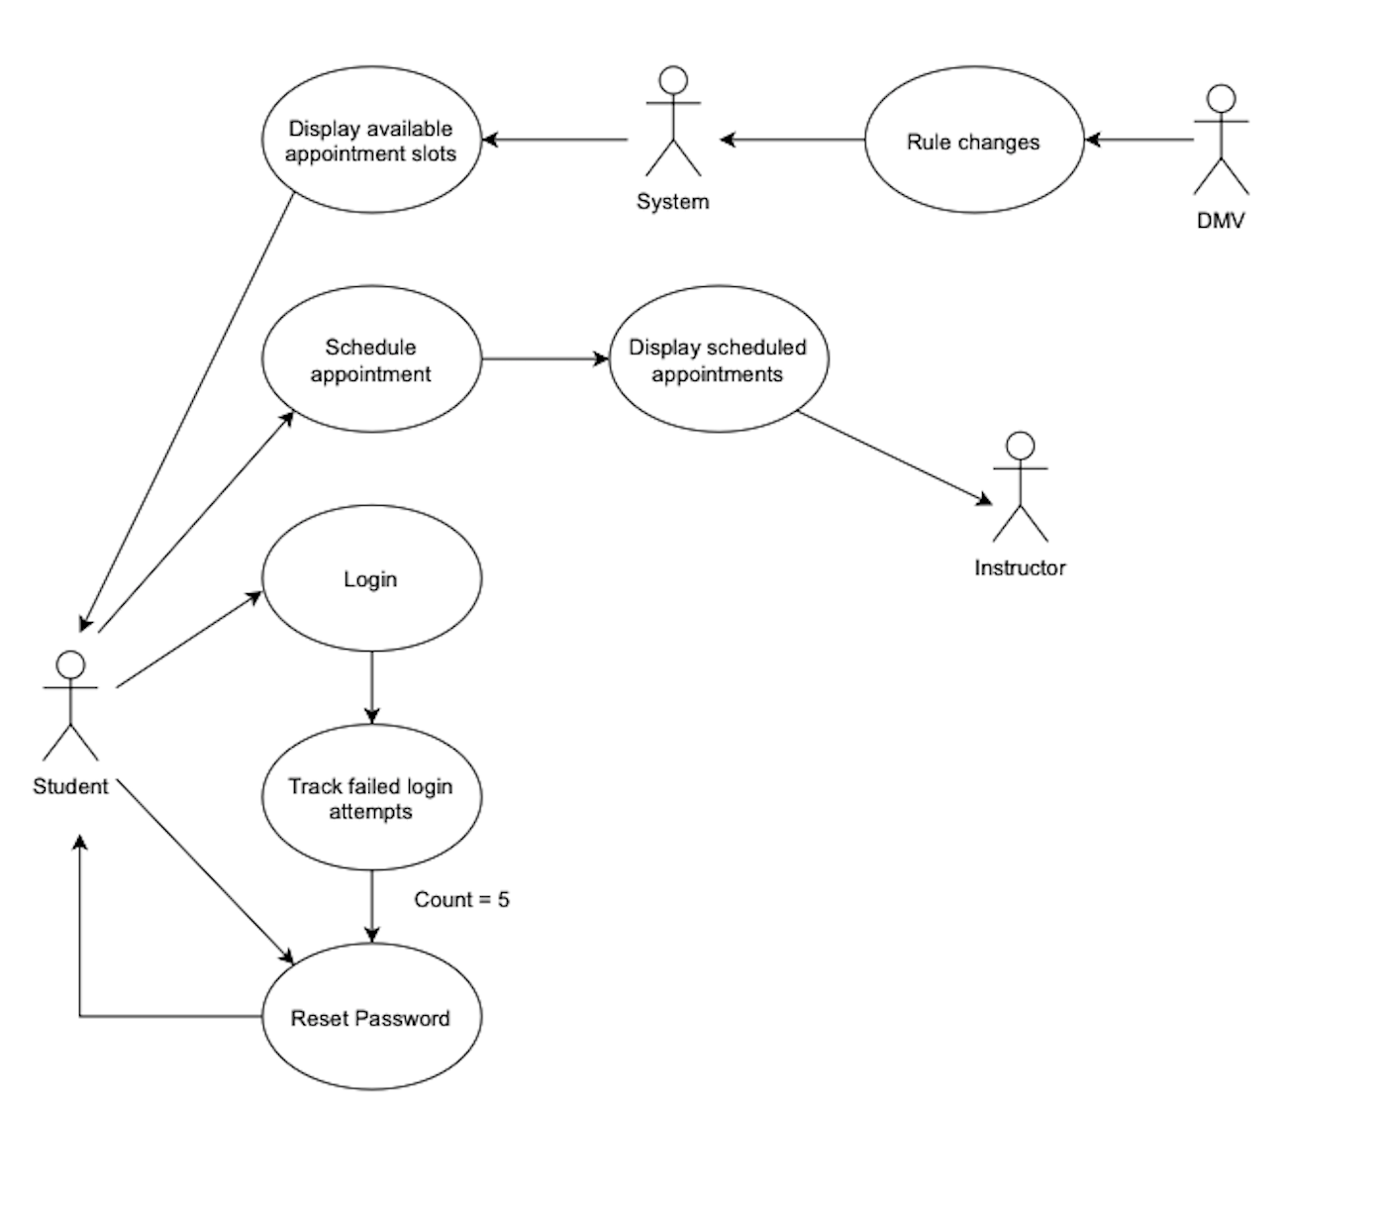
Use Case Diagram
Notes:
[Explain your diagram. Who are the different actors in the system? What are the different use cases? How did you account for DriverPass’s needs in your design? In your explanation, keep your audience in mind. Avoid the use of terms like “actors” and “use cases” in your explanation.]

Slide 4
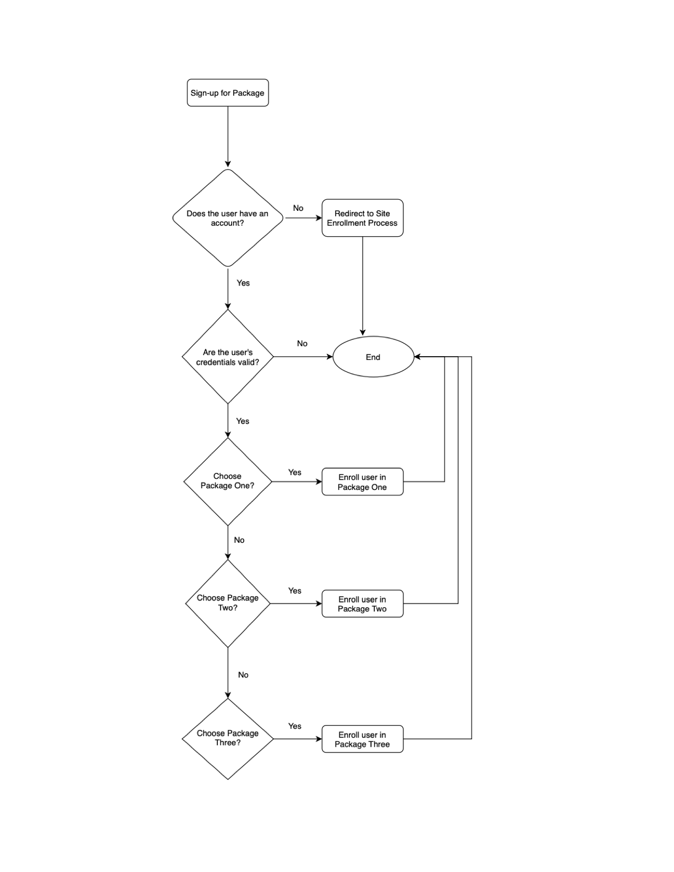
Activity Diagram
Notes:
[Explain your diagram. Which use case are you breaking down? What are the steps for this use case? How did you account for DriverPass’s needs in your design? In your explanation, keep your audience in mind. Avoid the use of technical terms such as “nodes,” “control flows,” and so on.]

Slide 5
Security
All users to the system are required to log into the system using a password
Passwords must meet minimum requirements of variety, complexity, and length
The system is closed to public network traffic by means of a firewall
If there is suspicious login activity the admin will be notified and will in turn notify the user that the account may have been compromised
Suspicious activity includes, but is not limited to, multiple failed attempts to login
Users will have five attempts to login before being notified to reset their password
Notes:
[How did you consider security in your design? In your explanation, keep your audience in mind by avoiding the use of technical terms.]

Slide 6
System Limitations
There is no way currently for users to read instructor bios and choose an instructor they will feel comfortable with
Maintaining student records and testing results all takes up space and costs money. It will be important for good practices to be implemented in order to avoid memory leaks and keep the system tidy
Notes:
[What are the limitations of your design? In your explanation, keep your audience in mind by avoiding the use of technical terms.]

