Slide 1

DATA110 • CAPSTONE PROJECT
Cyber Event Classification
Using Machine Learning Techniques
Afifa Sabha • Satvik Kumar
Data110 Capstone Project
Base Paper: Breiman, L. (2001). Random Forests. Machine Learning, 45(1), 5–32.
Notes:
Welcome. This capstone project applies a complete machine learning pipeline to classify cyber-attack types from a synthesized cybersecurity dataset, built on Breiman's Random Forest methodology. Presented by Afifa Sabha and Satvik Kumar.

Slide 2
Introduction
Cyberattacks are growing in scale, speed, and sophistication across every industry.
Manual triage of security incidents no longer scales with modern event volume.
Machine learning offers a path to automate classification of attack type from incident attributes.
This project builds and evaluates a complete ML pipeline for cyber-event classification, grounded in the ensemble learning theory of Breiman (2001).
Notes:
Cybersecurity incidents are increasing in volume, making manual classification infeasible. This project explores whether machine learning can automate the classification of attack types, using Random Forest theory as its foundation.

Slide 3

Problem Statement
Can a supervised machine learning model accurately predict the type of cyber-attack (attack_type) associated with a recorded security incident?
Formulated as an 8-class multiclass classification problem.
Classes: Phishing, DDoS, Zero-Day, Ransomware, Malware, SQL Injection, Brute Force, XSS.
Input: 15 recorded attributes per incident (attack characteristics, target system, organizational context, response metrics).
Notes:
The core problem: given recorded incident attributes, can we predict which of 8 attack types occurred? This is a multiclass classification task.

Slide 4

Objectives
1
Clean and explore the cybersecurity events dataset thoroughly
2
Engineer relevant temporal and derived features
3
Train & compare 4 classifiers: Logistic Regression, Decision Tree, Random Forest, ANN
4
Tune hyperparameters via GridSearchCV; validate via 5-fold cross-validation
5
Evaluate using Accuracy, Precision, Recall, F1, ROC-AUC
6
Select and justify the best model transparently
Notes:
Six objectives guide the project: from data cleaning through model selection, with an emphasis on rigorous, transparent evaluation.

Slide 5

Literature Review — Key Studies
Study | Focus | Key Finding
Breiman (2001) | Random Forest theory | Ensembles of trees reduce variance vs. single trees
Alharbi & Islam (2019) | RF + feature selection for IDS | Feature selection improves accuracy and speed
Sharafaldin et al. (2018) | CICIDS2017 benchmark dataset | Introduced a widely-used labeled IDS dataset
Engelen et al. (2021) | CICIDS2017 audit | Found labeling/leakage issues inflating accuracy
He et al. (2023) | Adversarial ML survey for IDS | High benchmark accuracy ≠ real-world robustness
Kapan & Sora Gunal (2023) | Classifier & feature evaluation | Feature selection matters more than algorithm choice
Full review covers 15 papers (2001–2026); see Thesis Report, Chapter 2.
Notes:
The literature review draws on 15 real, cited papers spanning Random Forest theory, IDS benchmark datasets, dataset auditing, and phishing/DDoS detection studies. A key theme: dataset quality is as important as model choice.

Slide 6

Research Gap & Novelty
Gap: most cybersecurity ML studies assume the dataset has genuine class-conditional signal; few explicitly audit and report when it doesn't.
Novelty: this project applies a rigorous, consistent 4-model comparison and treats dataset-quality auditing as a first-class deliverable, not an afterthought.
A cross-model convergence test (4 independent architectures agreeing on near-baseline performance) is used as diagnostic evidence — distinguishing a data problem from a model problem.
Notes:
Our literature review reveals a gap: most studies don't audit dataset quality before benchmarking models. This project's novelty is treating that audit as a core deliverable, using convergence across 4 different models as diagnostic evidence.

Slide 7



Dataset Overview
100,000
15
8
0
Records
Attributes
Attack Type Classes
Missing Values
Target: attack_type — Phishing, DDoS, Zero-Day, Ransomware, Malware, SQL Injection, Brute Force, XSS (balanced, ~12,500 each)
Predictors: target_system, outcome, security_tools_used, user_role, location, industry, mitigation_method, data_compromised_GB, attack_duration_min, attack_severity, response_time_min, timestamp
No missing values, no duplicate rows — structurally clean
Notes:
The dataset has 100,000 records, 15 attributes, 8 balanced attack-type classes, and no missing or duplicate data.

Slide 8

Methodology — Pipeline Flow
Data
Cleaning
→
EDA
→
Feature
Engineering
→
Train/Test
Split
→
Model
Training
→
Hyperparameter
Tuning
→
Evaluation
A consistent, reproducible pipeline applied identically to all four models for fair comparison.
Notes:
Our methodology follows a standard, reproducible seven-stage pipeline applied identically across all four models to ensure a fair comparison.

Slide 9

Data Cleaning
Step | Action | Result
Missing values | Checked across all 15 columns | None found
Duplicates | Full-row duplicate check | None found
Text formatting | Trimmed whitespace on categorical text | Standardized
Outliers (IQR) | Checked on 4 numeric columns | Rare; retained as plausible edge cases
Timestamp | Parsed to datetime; decomposed to hour/day/month | Ready for feature engineering
Notes:
Data cleaning found the dataset already structurally clean — no missing values or duplicates — but we still standardized text and checked for outliers as good practice.

Slide 10

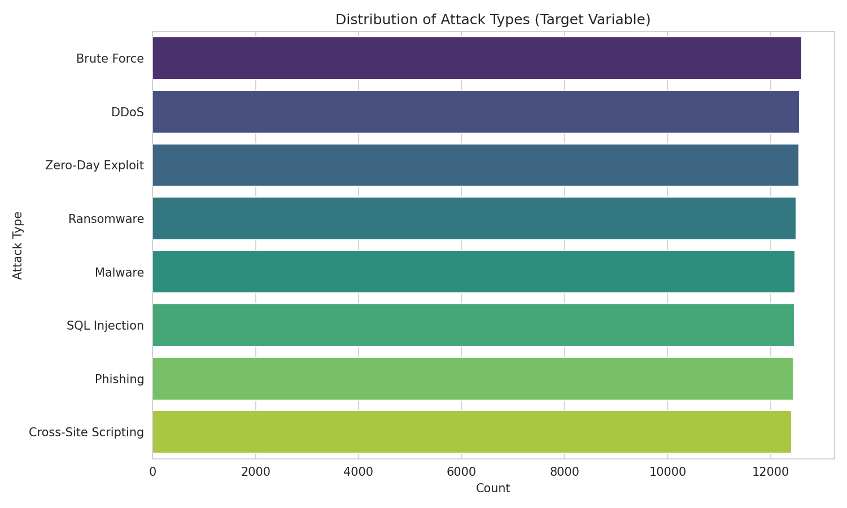
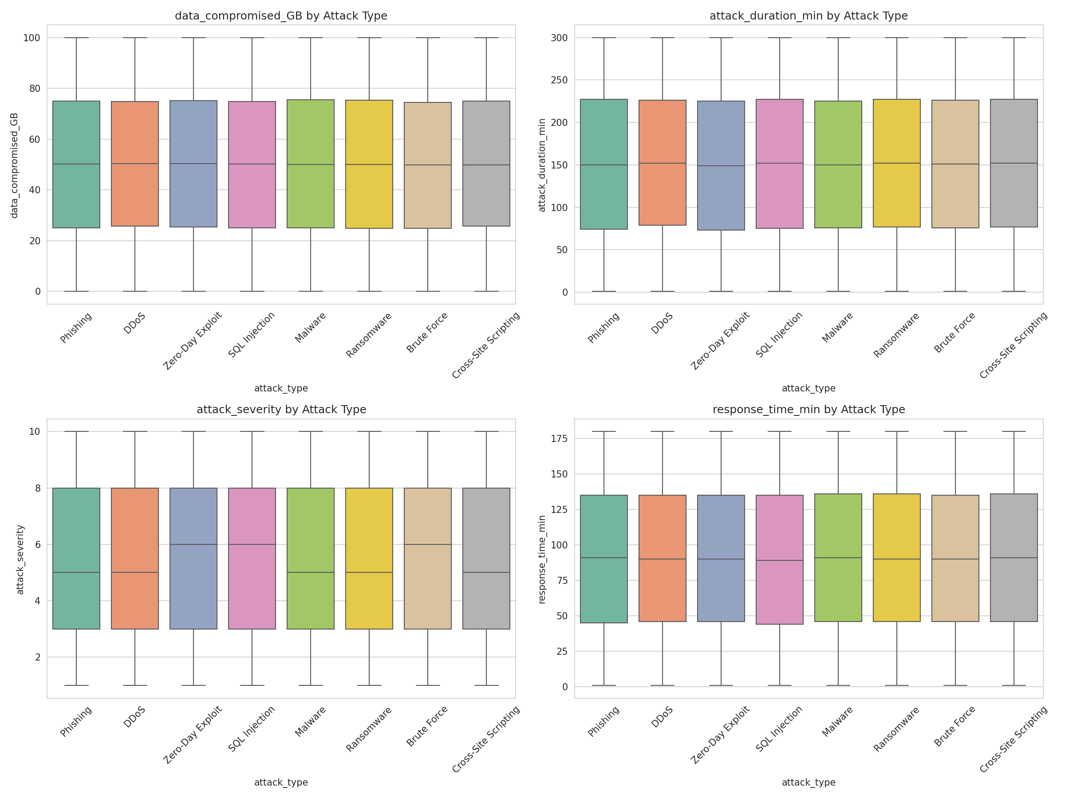
Exploratory Data Analysis
Target is balanced across 8 classes; numeric features show near-identical distributions across attack types — an early signal of low class-discriminative signal.
Notes:
Our EDA covered 8 visualizations. Two key ones shown here: the balanced target distribution, and boxplots showing numeric features barely differ across attack types — a strong early hint at the eventual model performance ceiling.

Slide 11

Feature Engineering
Technique | Applied To | Purpose
Identifier removal | attacker_ip, target_ip | Avoid memorization of near-unique values
Temporal extraction | timestamp | Expose hour / day-of-week / month patterns
Derived feature | hour | is_business_hours flag
Label Encoding | attack_type (target) | Numeric format required by classifiers
One-Hot Encoding | 7 nominal columns | Avoid false ordinal relationships
Standard Scaling | 4 numeric columns | Required for Logistic Regression & ANN
Notes:
Feature engineering included dropping identifiers, extracting time-based features, encoding categoricals, and scaling numerics — each step justified by the requirements of our downstream models.

Slide 12


Models Used & Justification
Logistic Regression
Decision Tree
Fast, interpretable linear baseline; sets a lower performance bound
Interpretable non-linear model; building block for Random Forest
Random Forest
Artificial Neural Network
Primary candidate (Breiman, 2001) — robust ensemble, feature importances
Tests whether higher-capacity non-linear modeling adds value
Notes:
Four models were selected to span the major model families used in the literature: linear, single-tree, ensemble-tree, and neural network — enabling a robust cross-architecture comparison.

Slide 13
Hyperparameter Tuning
Model | Grid Searched | Best Parameters | Best CV Accuracy
Random Forest | n_estimators ∈ {100,150} max_depth ∈ {10,20} | n_estimators=150 max_depth=20 | 0.1246
Decision Tree | max_depth ∈ {5,10,15,20} min_samples_split ∈ {2,5,10} | shallow depth min_samples_split=2 | 0.1245
Selection criterion: highest mean 3-fold cross-validation accuracy on the training set.
Grids kept compact given single-core compute — still explore meaningful ranges for both models.
Both models converge to similar CV accuracy regardless of configuration, itself informative.
Notes:
GridSearchCV selected the best Random Forest and Decision Tree configurations by 3-fold cross-validation accuracy. Notably, tuning barely moved performance — reinforcing that the ceiling is data-driven, not tuning-driven.

Slide 14

Model Comparison
Model | Accuracy | Precision | Recall | F1 Score | ROC-AUC
Random Forest | 0.1290 | 0.1294 | 0.1289 | 0.1285 | 0.5022
Decision Tree | 0.1246 | 0.1253 | 0.1249 | 0.1144 | 0.4986
Logistic Regression | 0.1241 | 0.1240 | 0.1241 | 0.1226 | 0.5007
ANN | 0.1229 | 0.1158 | 0.1232 | 0.0888 | 0.5038
Notes:
Random Forest achieves the highest accuracy and F1 score, marginally ahead of the other three models — all cluster tightly around the 12.5% random baseline for this 8-class problem.

Slide 15

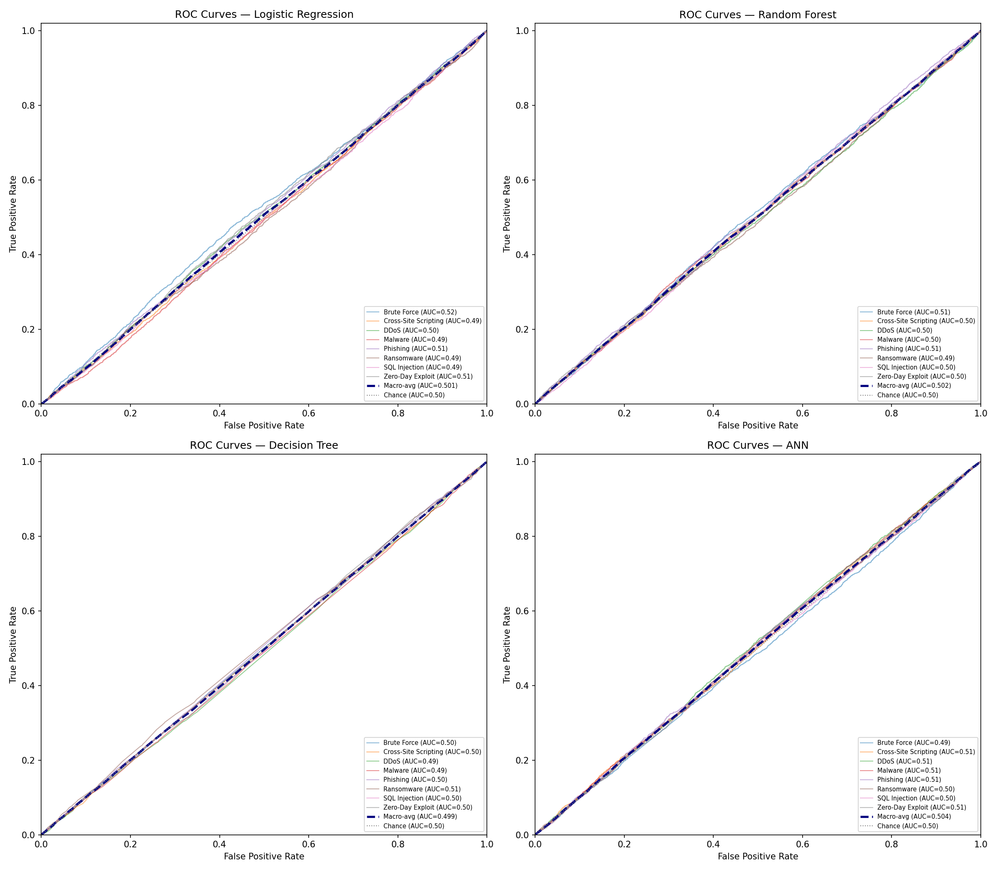
Results — ROC & Error Analysis
Macro-avg ROC-AUC clusters near 0.50 for all 4 models — chance-level ranking ability.
Best model (Random Forest) misclassifies 87.1% of test samples.
Per-class error rate: 84.6%–89.0% — a narrow 4.4-point spread across all 8 classes.
No dominant confusion pair — errors are broadly spread, not concentrated between similar attack types.
Notes:
Independent confirmation from ROC-AUC and error analysis: all models rank near chance level, and misclassification is spread evenly across classes rather than concentrated on similar attack-type pairs.

Slide 16

Practical Implications & Dataset Limitations
Every feature (numeric & categorical) is distributed almost uniformly with respect to attack_type — the dataset appears synthetically/randomly generated rather than reflecting real attack telemetry.
Four independent model architectures converge on the same near-baseline performance — strong evidence the limitation is data-driven, not model- or tuning-driven.
Practical takeaway: before deploying any classifier operationally, audit that logged features (e.g., packet-level or behavioral signals) actually carry discriminative signal — following the dataset-audit precedent of Engelen et al. (2021).
Notes:
The key limitation is the dataset itself, not the modeling approach. This has a real practical implication: security teams should audit feature quality before trusting an ML classifier in production.

Slide 17
Conclusion
Built and rigorously evaluated a complete ML pipeline for cyber-event classification across 4 model families.
Random Forest selected as the recommended model — highest accuracy/F1, and strongest robustness & interpretability per Breiman (2001).
Central contribution: transparent diagnosis that this dataset lacks meaningful class-conditional signal, demonstrated consistently across EDA, 4 models, cross-validation, ROC-AUC, and error analysis.
Honest reporting of near-baseline results reflects sound data science practice — not a pipeline failure.
Notes:
In conclusion, we built a rigorous ML pipeline and selected Random Forest as our recommended model. Our key contribution is the transparent, multi-method diagnosis that this dataset lacks predictive signal — a genuine and important finding.

Slide 18

Future Work
Apply this same pipeline to a real-world or realistically simulated dataset (e.g., CICIDS2017, UNSW-NB15).
Add SHAP-based interpretability to complement Random Forest feature importances.
Explore gradient boosting (XGBoost, LightGBM) and hybrid CNN-LSTM architectures.
Deploy the trained Random Forest model behind a lightweight inference API.
Adopt dataset-quality auditing as a standard first step before model development.
Notes:
Future work includes validating this pipeline on real-world datasets, adding SHAP interpretability, exploring gradient boosting and hybrid deep learning models, and deploying the model behind an API.

Slide 19

References (Selected)
Breiman, L. (2001). Random forests. Machine Learning, 45(1), 5–32.
Sharafaldin, I., Lashkari, A. H., & Ghorbani, A. A. (2018). Toward generating a new intrusion detection dataset and intrusion traffic characterization. ICISSP, 1, 108–116.
Engelen, G., Rimmer, V., & Joosen, W. (2021). Troubleshooting an intrusion detection dataset: The CICIDS2017 case study. IEEE S&P Workshops, 7–12.
He, K., Kim, D. D., & Asghar, M. R. (2023). Adversarial machine learning for network intrusion detection systems: A comprehensive survey. IEEE Communications Surveys & Tutorials, 25(1), 538–566.
Full 15-paper reference list in the accompanying Thesis Report (APA 7th Edition).
Notes:
Selected references shown here; the full 15-paper APA 7th edition reference list is in the thesis report.

Slide 20

Thank You
Questions & Discussion
Afifa Sabha • Satvik Kumar — Data110 Capstone Project
Notes:
Thank you. We're happy to take any questions.

