Slide 1
Employee Data Analysis using Excel
STUDENT NAME: T.Aafreen seema
REGISTER NO: 312207793
DEPARTMENT: Commerce
COLLEGE: The Quaide milleth college for men ,

Slide 2
PROJECT TITLE
Employee Performance Analysis using Excel

Slide 3


AGENDA
Problem Statement
Project Overview
End Users
Our Solution and Proposition
Dataset Description
Modelling Approach
Results and Discussion
Conclusion
3/21/2024 Annual Review

Slide 4

PROBLEM STATEMENT
"To effectively evaluate and enhance employee performance within our organization, we need to develop a comprehensive performance analysis tool using Excel. The tool should: 1. Aggregate Performance Data: 2. Analyze Performance Metrics 3. Generate Insights 4. Benchmark Performance 5. Facilitate Reporting By addressing these objectives, we aim to gain a clearer understanding of employee performance, recognize high performers, and identify opportunities for professional development.

Slide 5

PROJECT OVERVIEW:
To analyze employee performance in Excel, input data such as sales and attendance into a spreadsheet. Use functions to calculate averages and trends, create charts for visual insights, and apply pivot tables for detailed analysis. Set benchmarks and use conditional formatting to highlight performance levels. Summarize findings in a report to guide performance improvements.
.

Slide 6

WHO ARE THE END USERS?
The end users of employee performance analysis in Excel typically include managers, HR professionals, and team leaders. They use the analysis to assess individual and team performance, make informed decisions on promotions and training, and identify areas for improvement.

Slide 7

OUR SOLUTION AND ITS VALUE PROPOSITION
Our employee performance analysis solution offers a streamlined approach to assessing and improving workforce efficiency. By leveraging Excel for data organization, statistical analysis, and visualization, our solution provides clear insights into performance trends, identifies strengths and weaknesses, and supports data-driven decision-making. This leads to more effective management, targeted employee development, and enhanced overall productivity.

Slide 8
Dataset Description
The dataset includes columns for Employee ID, Name, Department, Position, Performance Metrics, Attendance, Review Scores, Goals/Targets, and Feedback. This data allows for detailed performance evaluation and trend analysis.

Slide 9

THE "WOW" IN OUR SOLUTION
The "wow" factor in our solution is its ability to transform complex performance data into clear, actionable insights through intuitive Excel dashboards and visualizations. This makes it easy for managers to quickly identify trends, make data-driven decisions, and drive employee development effectively.
3/21/2024 Annual Review
9

Slide 10
MODELLING
Modeling in the context of employee performance analysis involves creating statistical or data-driven models to predict and assess performance outcomes. This includes using techniques like regression analysis to understand factors influencing performance, and developing performance scoring systems or benchmarks. The goal is to identify patterns, forecast future performance, and guide decision-making for improvements.
10

Slide 11
RESULTS
The results of employee performance analysis typically include insights into individual and team performance trends, identification of high and low performers, and areas needing improvement. These results can lead to more informed decisions on promotions, training needs, and overall workforce management strategies.
11

Slide 12
conclusion
The conclusion of the employee performance analysis is that leveraging data-driven insights through tools like Excel enables better management decisions, targeted employee development, and improved overall productivity. The analysis highlights performance trends, strengths, and areas for growth, facilitating strategic planning and enhancement of workforce effectiveness.

Slide 13
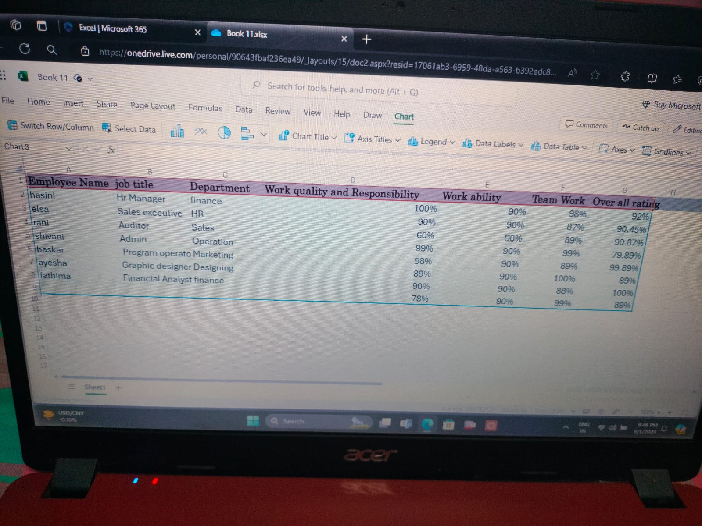

Slide 14
