Slide 1
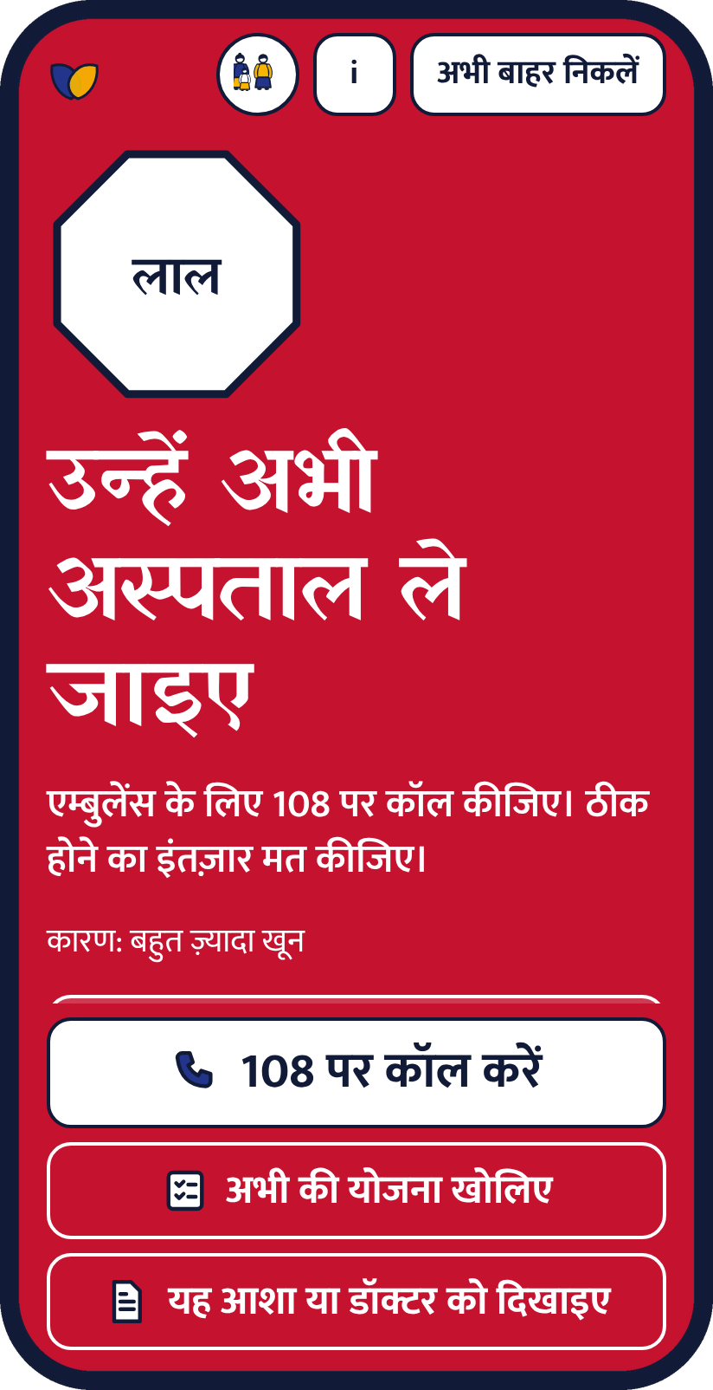
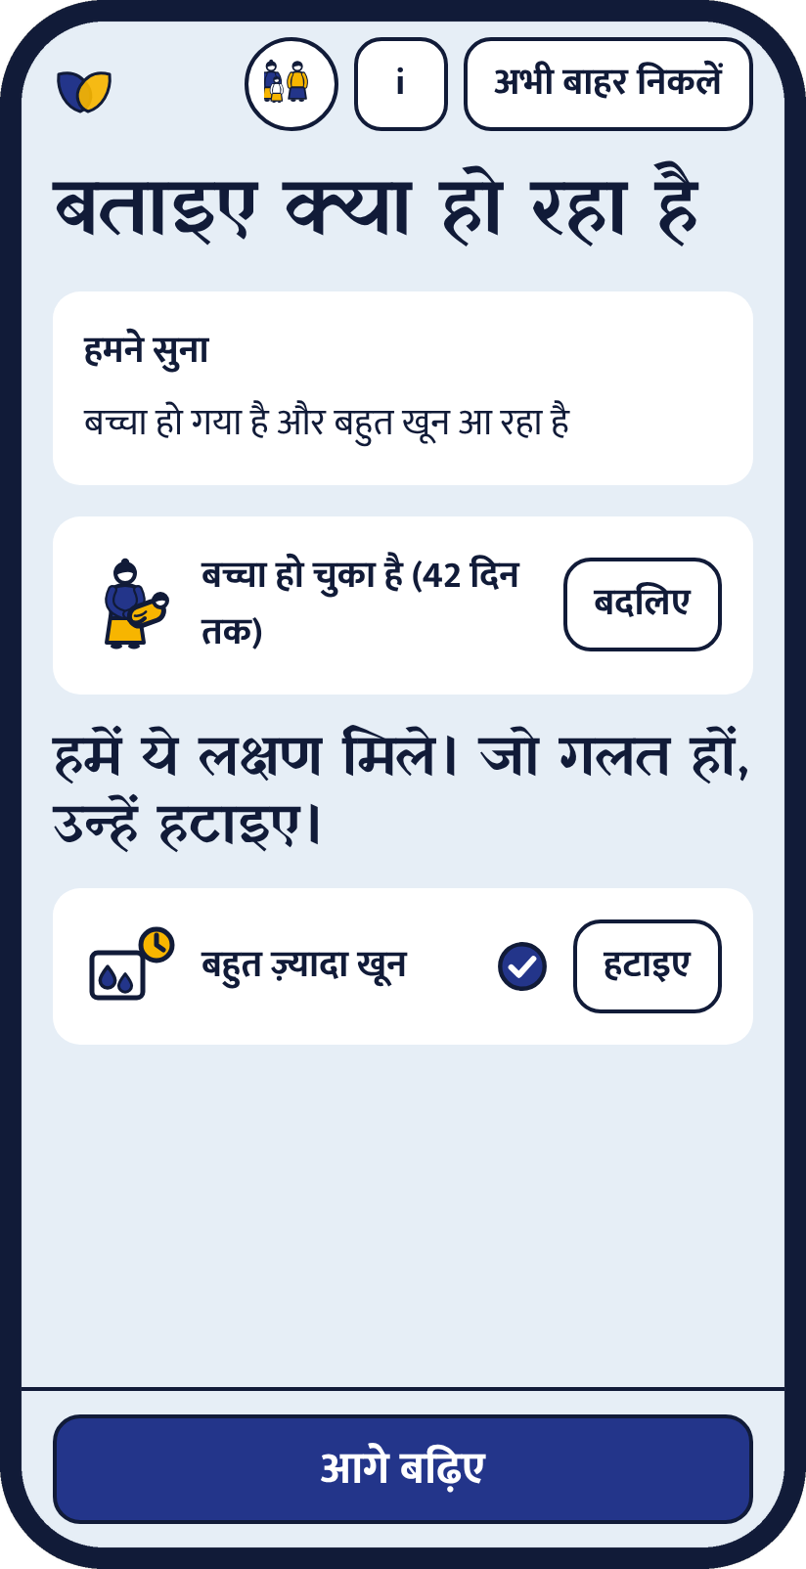
Maitri
A friend who tells the family what to do now
recHERsion 2026 | Problem Statement 1: Women's Healthcare
Team: [add team name]
Notes:
Maitri is an offline, Hindi-first danger-sign checker for pregnant and postpartum women. One line: other tools tell a woman what her symptoms might mean. Maitri tells her family what to do in the next ten minutes, and shows exactly why. Add the team name before presenting.

Slide 2
Contact is high. The decision is late.
25.2M
48.6%
1 in 3
births a year in India
of maternal deaths in one Indian hospital study involved a delay in deciding or seeking care
women still have fewer than four antenatal visits
Secondary source
Verified, single study
Secondary, derived
Sources and confidence labels are on the last slide.
Notes:
The gap is not contact: about 90.6% of births are institutional. The gap is recognising danger and deciding fast. The 48.6% figure is from one West Bengal hospital study, not national. We never present these as lives saved.

Slide 3


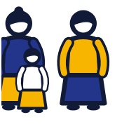
Built for the three people in the room
The woman
The ASHA or ANM
The family
On her own phone
Checks one woman after another
Decides if she goes now
About 36% of women do not own a phone (secondary source), so Maitri has family and ASHA modes.
Notes:
Three modes change the wording only ("Answer for yourself", "Ask the woman", "Answer for her"). The checks and rules are identical.

Slide 4
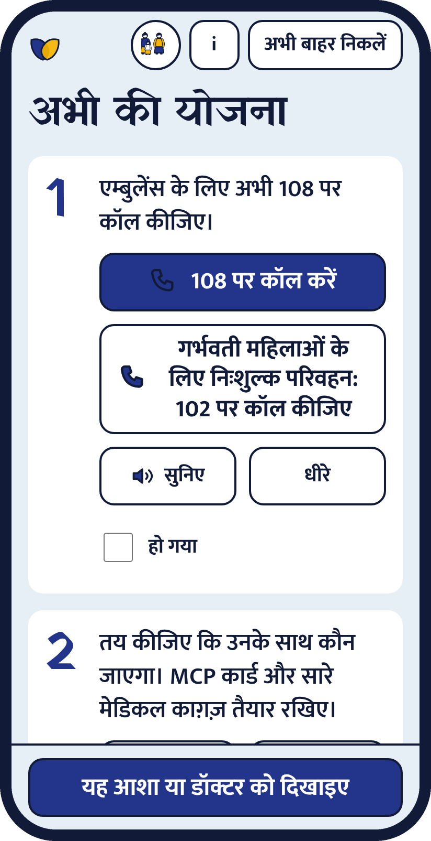
Say it. See why. Know what to do.
1
2
3
Say it or tap it
One RED sign ends the check
Call, plan, slip
Notes:
Walk the demo here: speak or tap. Signs are matched with fixed word lists, no AI. She can remove a wrong sign. One RED sign stops the questions and shows a large call button. Then the go-now plan and the slip. The voice screenshot uses a simulated recogniser; the real one needs a phone browser with speech recognition.

Slide 5
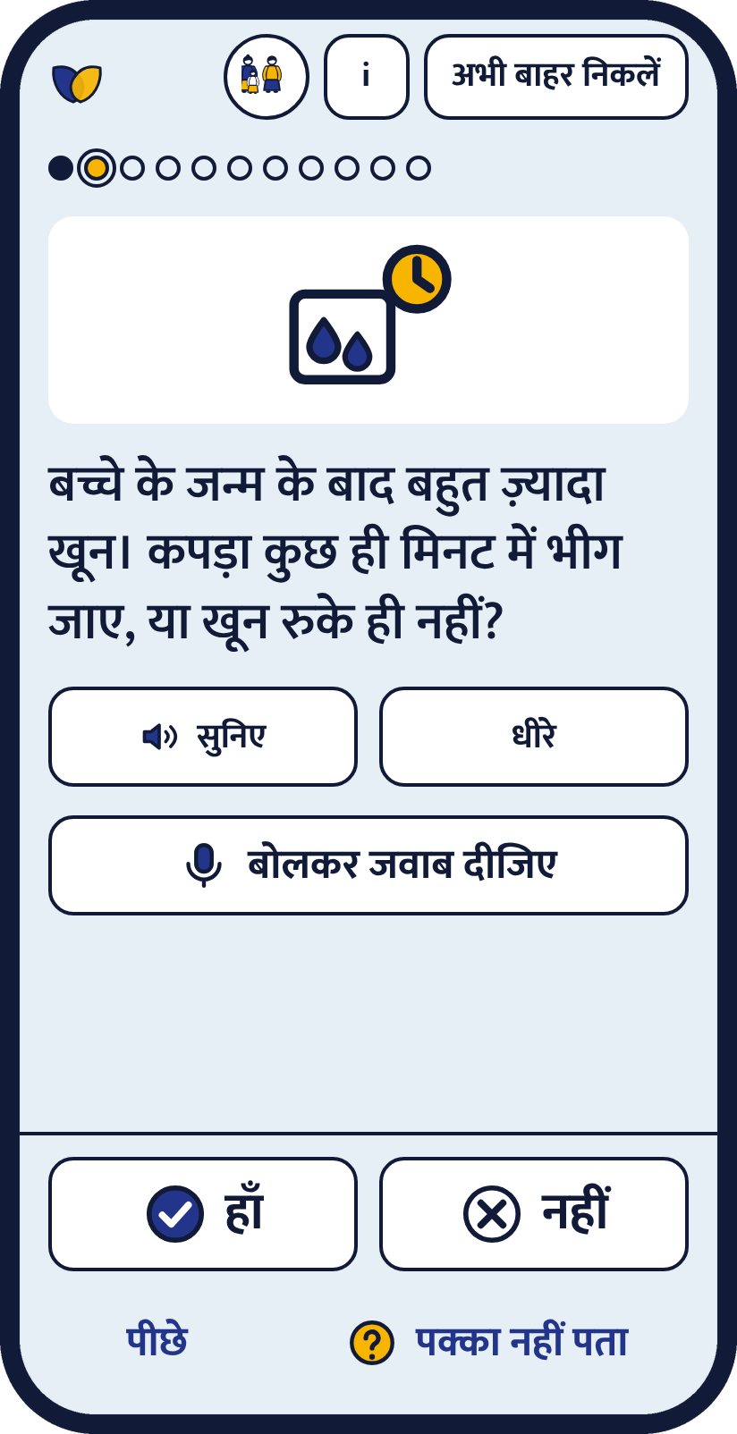








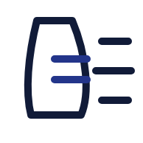



One question. One picture. One tap.
Tick. Cross. Not sure.
Notes:
Built for low literacy: every question has a picture, a Listen button and a Slow button, and tick, cross and question-mark symbols on the answers. Audio plays a clip if present, otherwise the phone's Hindi voice if it has one, otherwise the app says audio is not available. No audio clips are shipped yet.

Slide 6






What is in the prototype
Voice or tap
Works offline
Shows its rule
Hindi and English
After one visit
Every verdict names its sign
Maitri slip
Go-now plan
Private
Print or share a picture
Four steps and a call button
No account. Exit now.
Notes:
Also built: ASHA mode with an optional on-device list (off by default), and a rule review page where a clinician can mark rules reviewed and export an updated rules file.

Slide 7
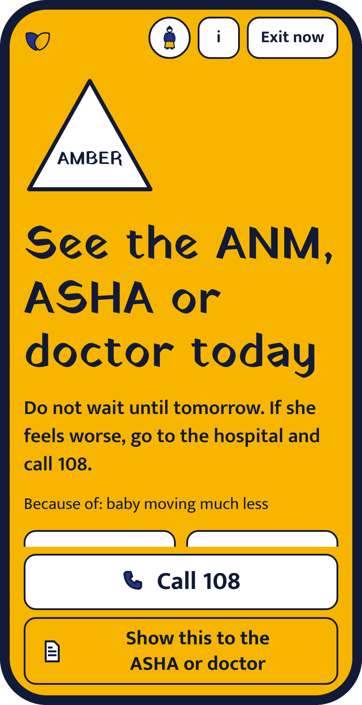
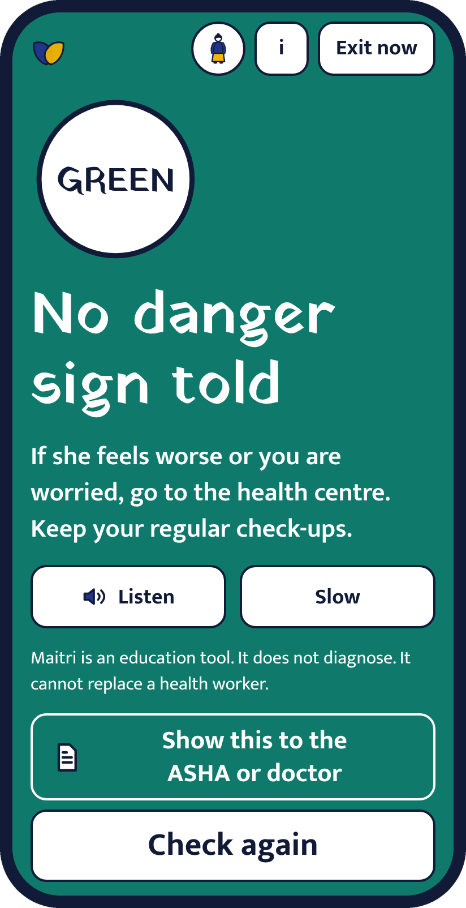
Word, shape and colour. It reads in greyscale.
RED
AMBER
GREEN
Go to the hospital now
See the ANM, ASHA or doctor today
No danger sign told
Notes:
The three levels are our own design, based on the MoHFW Mother and Child Protection card (which has one level: take to hospital immediately) and WHO guidance. The About page says so. The lowest result is "No danger sign told" plus a go-if-worse line. The app never says "fine" or "safe". "Not sure" escalates.

Slide 8
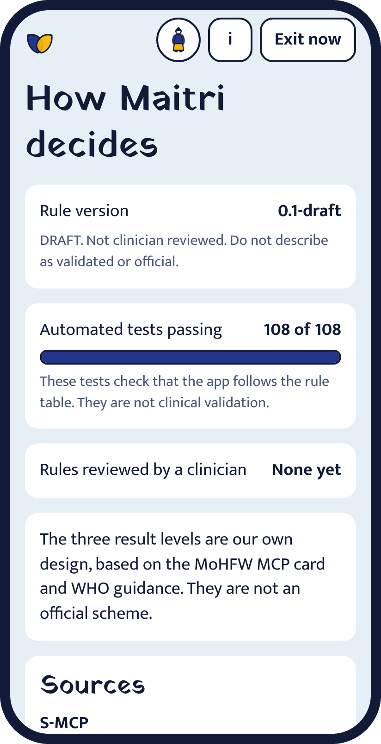
It shows its work
108/108
automated tests pass
46
rule cases, checked by a second implementation
1 file
holds every rule, with its source
None yet
clinician reviews. We say it out loud.
Tests check the code matches the rule table. They are not clinical validation.
Notes:
Judges can open the Trust page in the app: rule version, sources, test count, review status and every helpline with its confirmation status. Only Tele-MANAS 14416 is confirmed; the other numbers are shown as not yet confirmed.

Slide 9

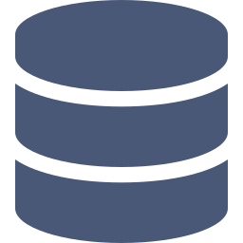
How it is built
On the phone. No account, no network needed.
Optional cloud
Rule engine
Voice word lists
Sign-in by phone code
Deterministic. 46 cases.
Speech to the same answers
Daily log, Postgres with row level security
Screens
Service worker
Built, not connected yet
React, TypeScript, Hindi + English
Offline after one visit
rules.json | questions.json | config.json (helplines) | Hindi and English strings
Tested: Vitest, a Python cross-check, axe accessibility audit
Notes:
The verdict never leaves the phone and never depends on a server. The optional cloud part (phone sign-in, a daily log in Postgres with row level security) is built and tested against a simulated client only; it is not connected to a real project yet. Tools: React, TypeScript, Vite, Vitest, Fontsource fonts (OFL), Supabase client. Built with help from Claude Code.

Slide 10


Built around the decision delay
Many symptom checkers
Maitri
What could it be?
What to do in ten minutes
Typing, online
Taps and voice, offline
Hidden logic
Names the sign and the source
May say you are fine
Never says fine
Notes:
Many tools help recognise a symptom. The largest delay in the one Indian study we found was in deciding to seek care, so Maitri is built around the next ten minutes: call, who goes, show the slip, ask about free transport (JSSK). We have not completed a market search, so we say "built around the decision delay" and do not claim to be first.

Slide 11
What works today. What does not yet.
Built and tested
Built, needs a real test
Not done yet
Tap check, three results
Voice check (simulated tests)
Go-now plan and slip
Offline after one visit
Trust page, Hindi + English
Voice on real phones
Phone sign-in and daily log
Slip share on phones
Clinician review
Voice audio clips
Field test with ASHAs
More languages
Notes:
Be direct with judges. The tests use a simulated speech recogniser; try it on a real phone. Sign-in and the daily log are tested against a simulated client and are not connected to a real project. No clinician has reviewed the rules, no audio clips are shipped, and there has been no field test.

Slide 12

Realistic by design
Rules wrong?
Voice misheard?
One file. A clinician reviews and signs off in the app.
She sees the signs and can remove any.
Wrong helpline?
Privacy?
Numbers come from one file. Status is shown.
No account needed. Exit now clears everything.
Notes:
Cost to run is low: a static site with no server for the check itself. Before any account feature goes live with real users: a legal review under the Digital Personal Data Protection Act 2023, a hosting-region check, and a text-message provider.

Slide 13



What we aim to change for her family
A faster decision
ASHA reads, not re-asks
Less fear
Goal: the call in minutes, not hours
Goal: the slip carries the story
Goal: one clear next step
How we will measure it in a pilot
Time from first sign to the call. Checks finished in under two minutes. Re-asking avoided at the facility.
We do not claim lives saved. A Kenyan trial of a triaged SMS service improved danger-sign knowledge and postnatal visits; wider evidence is low certainty.
Notes:
Impact here is a design goal we will measure in a pilot, not a result. No effectiveness claim is made. The evidence we cite: Kenya PROMPTS trial (knowledge and postnatal visits improved, no mortality effect shown) and a Cochrane review rating the wider evidence low certainty.

Slide 14
Where it goes next
Now
Next
Then
Later
Clinician review. ASHA field test. Real-phone voice test.
Odia, Assamese, Marathi. Connect sign-in and the daily log.
Visit and vaccine schedules. Scheme help (JSSK, JSY, PMMVY).
Facility finder from a verified dataset.
Every schedule, scheme and guidance item will carry its official source and a clinician review.
Notes:
Roadmap items need other people: a clinician reviewer, native reviewers per language, a Supabase project and text-message provider, official documents for schedules and schemes, and a verified facility dataset. Language order follows the first pilot state.

Slide 15
Where to look, by judging criterion
15%
15%
20%
Problem relevance
Innovation
Technical implementation
Slides 2 and 3
Slides 5 and 10
Slides 8 and 9
25%
15%
10%
Working MVP and demo
Feasibility and impact
UX and accessibility
Slides 4, 6 and 7
Slides 11 to 14
Slides 5 and 7
Notes:
The demo video and the live prototype carry the 25% for the working MVP: an end-to-end check from voice or taps to RED, the call button, the go-now plan and the slip.

Slide 16
Sources and credits
MoHFW Mother and Child Protection card (NHM) | HBNC leaflet | WHO essential practice guide, chapters B and D
JSSK guidelines (NHM) | PIB note on Tele-MANAS 14416
NFHS-6 findings and SRS maternal mortality bulletin 2021-23 (secondary coverage, labelled in the repository)
BMC Pregnancy and Childbirth 2019 delay study | Cochrane 2020 mobile messaging review | Kenya PROMPTS trial
Built with React, TypeScript, Vite, Vitest, Supabase client. Fonts: Yatra One and Mukta (SIL OFL). Pictograms drawn for this project.
AI assistance: built with Claude Code. The team is responsible for all content.
github.com/aafreenzy/maitri
Education tool. Does not diagnose. Rules are a draft, not reviewed by a doctor.
Notes:
Full source links and confidence labels are in docs/PITCH_FACTS.md in the repository. Numbers marked secondary should be re-checked against the primary bulletin before wider use.

