Slide 1
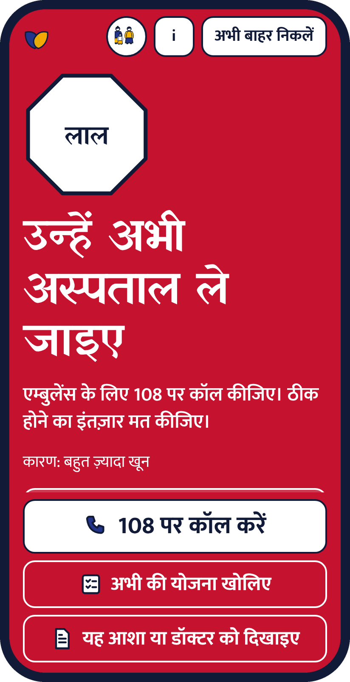
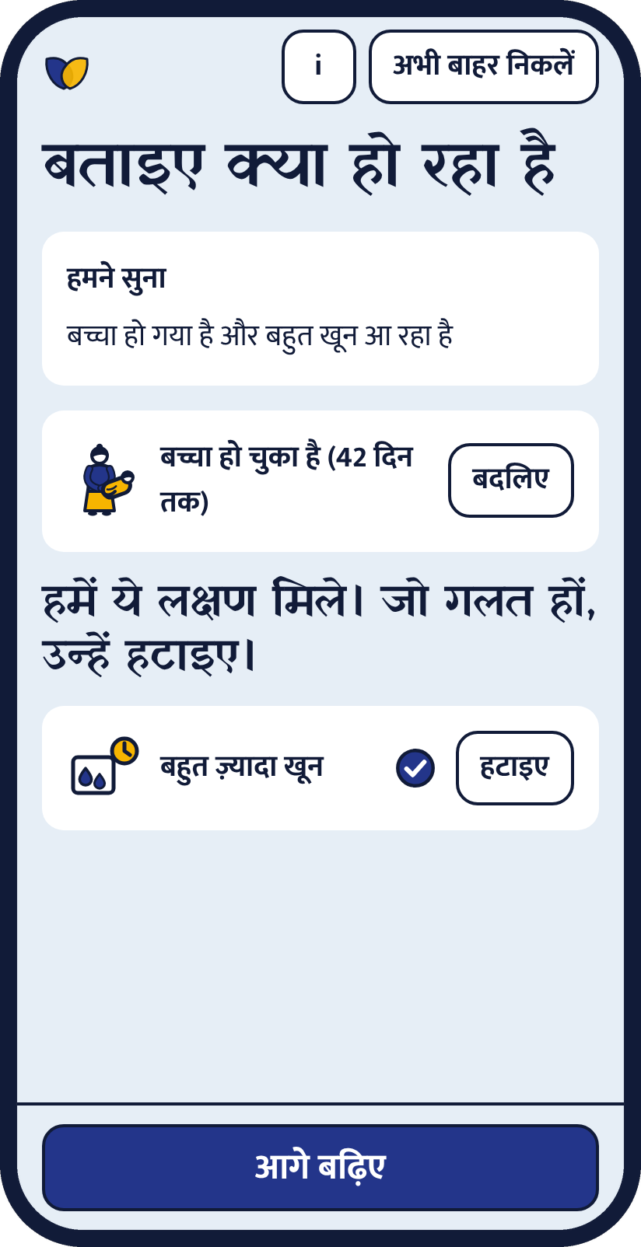
Maitri
A friend who tells the family what to do now
When the bleeding starts, a family has minutes. Maitri gives them the next step, and shows why.
Team Maitri | Aafreen Khan, Aastha Pandya
recHERsion 2026 | Problem Statement 1: Women's Healthcare
Notes:
Hook: when postpartum bleeding or fits start, the family has minutes and does not know what to do. Maitri is an offline, Hindi-first danger-sign checker that tells the family the next step and shows exactly why. Team names come from the repository history; change them if your registered team differs.

Slide 2

Contact is high. The decision is late.
25.2M
48.6%
1 in 3
births a year in India
of maternal deaths in one Indian hospital study involved a delay in deciding or seeking care
women still have fewer than four antenatal visits
Secondary source
Verified, single study
Secondary, derived
Why today's options fall short
A card has one level
Chatbots need typing and signal
Helplines need a phone and a clear head
No action plan, no voice
Hidden logic, may say "fine"
The decision is still the family's
Sources and confidence labels: docs/PITCH_FACTS.md
Notes:
Be exact about the figures. 25.2M registered births (secondary). 48.6% is from one West Bengal hospital study, not national. One in three is derived from NFHS-6 coverage (100 minus 65.2). We never present these as lives saved. The gap is not contact; it is recognising danger and deciding fast.

Slide 3


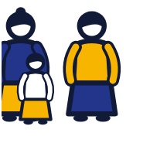
Who uses it first
Size of the opportunity
TAM
25.2M births a year in India
Secondary source
The woman
ASHA or ANM
The family
Pregnant or within 42 days of birth
Checks one woman after another
Decides if she goes now
SAM
Births in Hindi-first, ASHA-served states
To be sized from SRS data
About 36% of women do not own a phone (secondary), so ASHA and family modes come first.
SOM
One district pilot, ASHAs of one block
First users: ASHAs and families in a Hindi-speaking district with patchy signal. Only TAM is a sourced number. SAM and SOM are labelled "to be sized" on purpose.
To be sized with the health mission
Notes:
We only quote a number where we have a source. TAM uses registered births as a proxy. SAM and SOM are deliberately not invented: they need SRS state data and a conversation with a district health mission. Personas drive the three modes in the app.

Slide 4






Say it. See why. Know what to do.
An offline, Hindi-first checker that turns danger signs into one clear next step for the family.
Voice or tap
Shows its rule
One RED sign, one call
Speak it, or tap Yes, No, Not sure
Every verdict names its sign and source
The check stops and the call button shows
Slip for the ASHA
Works offline
Private by default
Share with consent. No name or number
After one visit, in airplane mode
No account needed. Exit now clears all
Notes:
Value proposition in one line: other tools tell a woman what her symptoms might mean; Maitri tells her family what to do in the next ten minutes and shows exactly why. Three levels: RED go to the hospital now, AMBER see the ANM, ASHA or doctor today, GREEN "No danger sign told". The three levels are our own design based on the MCP card and WHO guidance. Not sure always goes up.

Slide 5
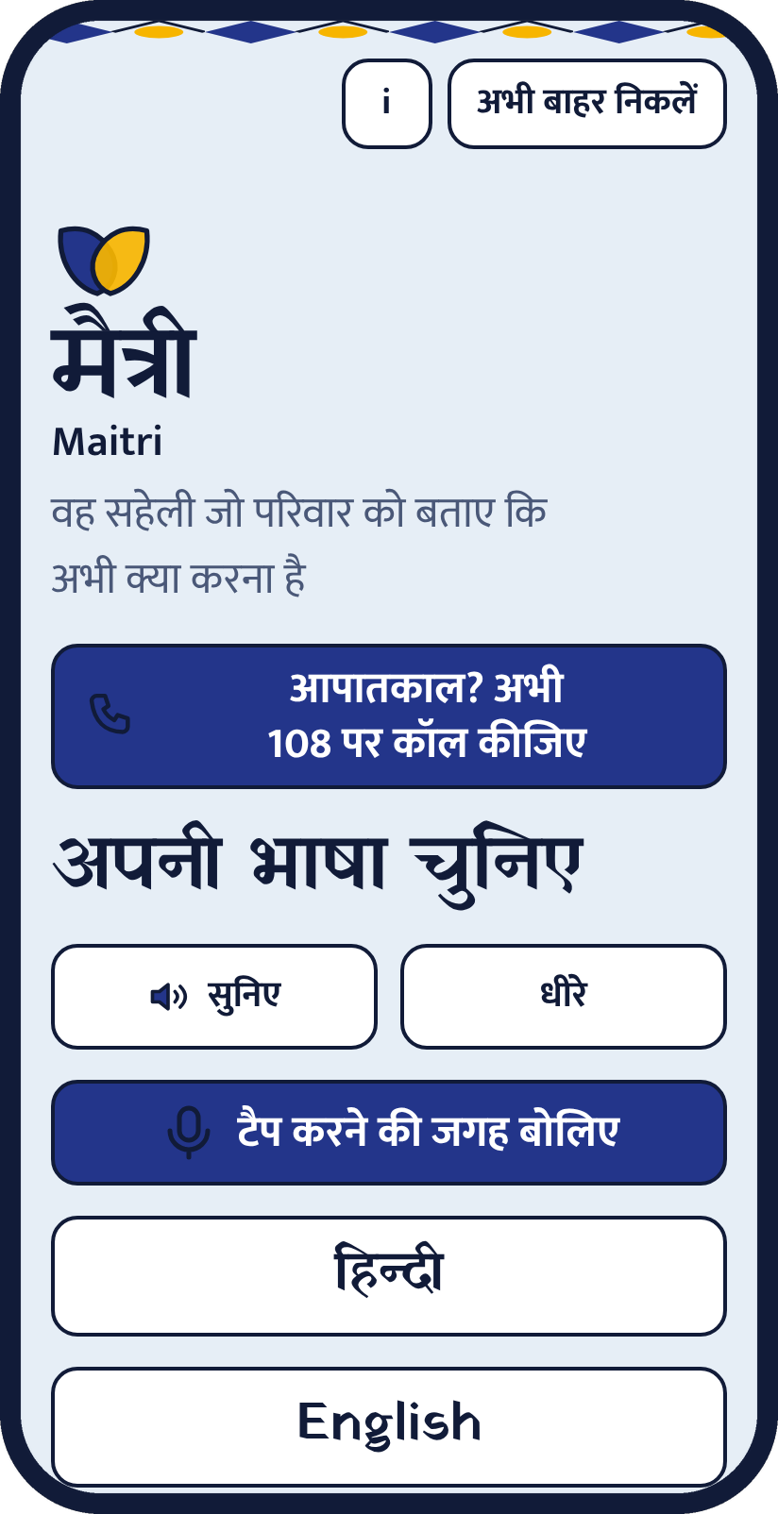
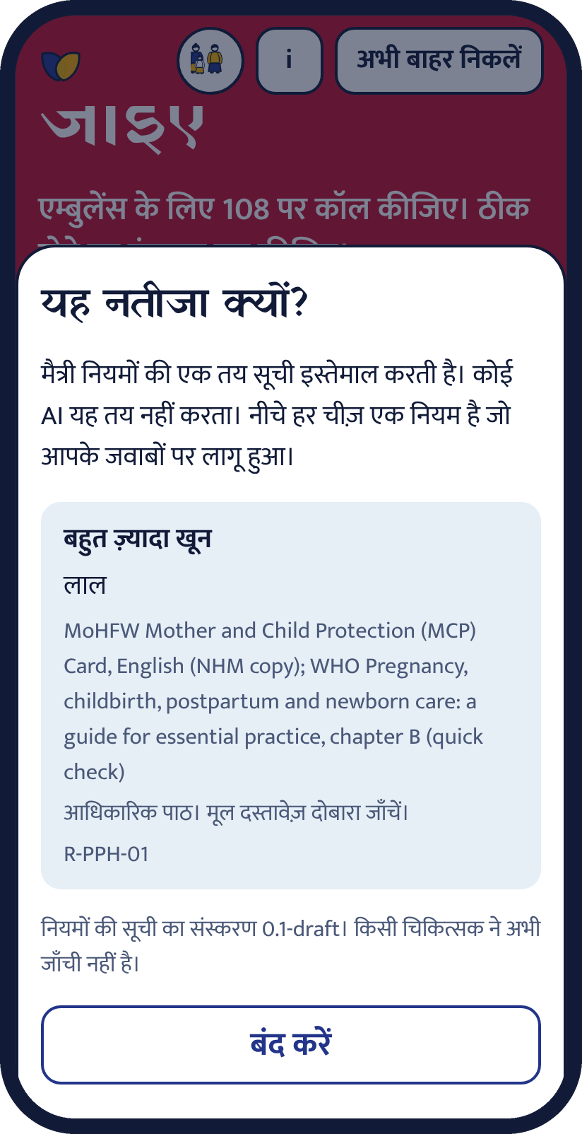

Prototype walkthrough
Scan for code, demo video and the live app link
github.com/aafreenzy/maitri
Demo video: docs/demo
Emergency call first
Say what is happening
One RED sign, one call
Why this result
Notes:
Walk the demo: emergency call button first; speak (a simulated recogniser in the video, real browser recognition on a phone); one RED sign ends the check; open Why this result. The QR opens the repository, whose README has the live link (GitHub Pages, once the owner enables it) and the demo video. Voice needs internet on most phones.

Slide 6
How it is built
Voice path: no model decides
Optional cloud (Supabase)
Browser speech
Transcript she can edit
Word lists (Hindi, English)
Same Yes / No / Not sure
Rule engine
Sign in with Google or phone code
checkins
user_id, entry_date, phase, answers (json), tier, rules_version
On the phone
Checks
profiles
user_id, stage, due_date, delivery_date, language
React 18 + TypeScript + Vite
Rules in one JSON file, 46 cases
Service worker: offline
Hindi and English strings
Browser speech recognition
205 automated tests
Python re-check, 12,420 cases
Database tests in real Postgres
axe audit, small-screen audit
CI on every pull request
Row level security: each woman reads only her own rows. Tested in Postgres.
Built, not connected yet
Notes:
No machine-learning model decides anything. Voice only turns spoken words into the same Yes, No, Not sure answers with fixed word lists, and she can edit them. The verdict is a deterministic rule engine, re-checked by an independent Python implementation on 12,420 generated cases. The optional cloud part (Google or phone sign-in, a daily log in Postgres with row level security) is built and tested in a local Postgres and against a simulated client; it is not connected to a real project. Static hosting on GitHub Pages or Vercel.

Slide 7


Feasible now. Clear next steps.
Static site
Offline
Low cost
Privacy first
No server for the check
Verified with the network cut
About INR 6 per language for voice clips
No account needed
Now
Next
Then
Later
Clinician review. ASHA field test. Real-phone voice test.
Odia, Assamese, Bengali. Connect sign-in and the daily log.
Visit and vaccine schedules. Scheme help.
Facility finder from a verified dataset.
Notes:
What blocks real use is people, not code: a named clinician must review the rules, native speakers must review each new language, and a district health mission must agree to a pilot. Every schedule and scheme page needs an official source and a clinician check. Language order follows the first pilot state.

Slide 8



Free for her. Funded by those who run care.
State missions and NGOs
CSR and grants
Open core
Licence, localisation, ASHA training and a district dashboard (with consent)
Fund new languages, voice clips and clinician review
Rules and app stay open and auditable. Services are paid.
We never sell data. No ads. Women and families pay nothing. This is a proposed model and has not been tested with a funder yet.
Notes:
Be honest: this is a proposal. The check is a public-health tool and stays free. Running costs are low (a static site; about INR 6 per language for generated voice clips at list price). Revenue would come from deployments (state missions, NGOs), grants and CSR for languages and clinical review, and paid services around the open core. No data is sold.

Slide 9


What broke. What we changed.
The build failed on main
Buttons clipped on short phones
A new screen changed the flow and a test was not updated. Tests now gate the build and CI runs on every pull request.
Items were squeezed in a scrolling column. One layout rule and a 15-screen audit fixed it.
A misheard "No" could hide a sign
Voice cannot be fully tested here
A spoken No is confirmed. A misheard Yes only over-escalates, so it goes straight through.
Tests use a simulated recogniser, and we say so. A real-phone test is the next step.
Trade-offs we chose
Rules, not AI
Over-escalate, never under
Offline over cloud
No numeric thresholds
Notes:
Be candid about what broke. The main-branch failure was real: the build runs the tests first, so the failure would have blocked a deploy; it was caught and fixed, and a CI workflow now guards it. The misheard-No risk led to the confirmation step. Trade-offs: deterministic rules over AI (auditable), over-escalation over under-triage, offline over cloud speech, and no numeric clinical thresholds in the app.

Slide 10
Sources and credits
MoHFW Mother and Child Protection card | HBNC leaflet | WHO essential practice guide, chapters B and D
JSSK guidelines (NHM) | PIB note on Tele-MANAS 14416
NFHS-6 findings and SRS maternal mortality bulletin 2021-23 (secondary coverage, labelled in the repository)
BMC Pregnancy and Childbirth 2019 delay study | Cochrane 2020 mobile messaging review | Kenya PROMPTS trial
Built with React, TypeScript, Vite, Vitest, PGlite (tests), Supabase client. Fonts: Yatra One and Mukta (SIL OFL). Pictograms drawn for this project.
AI assistance: built with Claude Code. The team is responsible for all content.
github.com/aafreenzy/maitri
Education tool. Does not diagnose. Rules are a draft, not reviewed by a doctor.
Notes:
Full source links and confidence labels are in docs/PITCH_FACTS.md.

