Slide 1
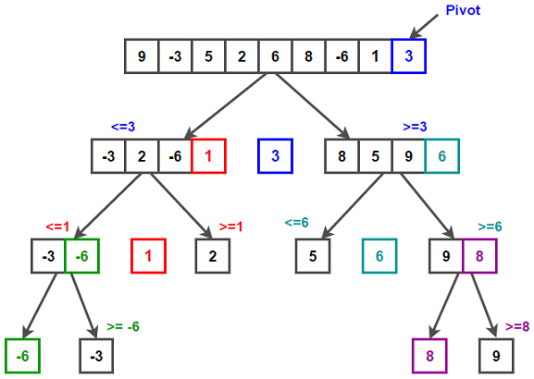
A variable that contains the address of a variable
A pointer is a group of cells(often two or four) that can hold an address
& can be applied to variables and array elements | not to expressions, constants, register variables
*indirection or dereferencing operator.
Int *ip means the pointer is referencing an int
a pointer is constrained to point to a particular kind of object: every pointer points to a specific data type.
There is one exception: a ``pointer to void'' is used to hold any type of pointer but cannot be dereferenced itself.
& * have higher precedence than arithmetic operators
*ip += 1 and ++*ip are the same
(*ip)++ increments what ip points to-here brackets are necessary-else the pointer is incremented by 1
Pointer arguments enable a function to access and change objects in the function that called it.
“adding 1 to a pointer,'' and by extension, all pointer arithmetic, is that pa+1 points to the next object, and pa+i points to the i-th object beyond pa.
a[i] = *(a+i)
A pointer(pa) is a variable. so pa=a , pa++ are legal. a=pa, a++ are illegal
/* strlen: return length of string s */ int strlen(char *s) { int n; for (n = 0; *s != '\0', s++) n++; return n; } s is a pointer. s++ does not effect the character string in the function that called strlen, but increments the private copy of the pointer. char s[]; and char *s; are the same
a[-1] , a[-2] ← syntactically legal
C guarantees that 0(NULL) is never a valid address for data. Return 0 when pointer expected but cant be found
If p and q point to members of the same array, then relations like ==, !=, =, etc., work properly. behavior is undefined for arithmetic or comparisons with pointers that do not point to members of the same array. (There is one exception: the address of the first element past the end of an array can be used in pointer arithmetic.)
p+n←n is scaled according to the size of the objects p points to
(type-bytes-stores)1. (char-1-character)2. (int/long-4-integer)3. (float/double/long double-8-floating) || 1 byte→ 8 bits
size_t is the unsigned integer type returned by the sizeof operator. All the pointer manipulations automatically take into account the size of the objects pointed to.
It is not legal to add two pointers, or to multiply or divide or shift or mask them, or to add float or double to them, or even, except for void *, to assign a pointer of one type to a pointer of another type without a cast.
printf("hello, world\n");printf receives a pointer to the beginning of the character array. That is, a string constant is accessed by a pointer to its first element.
pmessage = "now is the time"; assigns to pmessage a pointer to the character array. This is not a string copy; the pointer may subsequently be modified to point elsewhere, but the result is undefined if you try to modify the string contents.
int main() { int x = 10; int* p = &x; // Pointer p holds the address of variable x int** pp = &p; // Pointer pp holds the address of pointer p
printf("Value of x: %d\n", **pp); // Output: 10 return 0;
}
Multidimensional array→md_array[i][j] /* [row][col] */
SORTING
void qsort(char *v[], int left, int right)
{
int i, last;
if (left >= right)
return;
swap(v, left, (left + right) / 2);
last = left;
for (i = left + 1; i <= right; i++) {
if (strcmp(v[i], v[left]) < 0)
swap(v, ++last, i);
}
swap(v, left, last);
qsort(v, left, last - 1);
qsort(v, last + 1, right);
}
POINTERS

