Slide 1
DATABASE MANAGEMENT SYSTEMS · MAJOR PROJECT
Warehouse Network
Optimization System
A relational data model and analytics layer that decides how many warehouses a network should have, where they belong, what each one stocks, and which lane every shipment moves on.
26
39
25
11.28%
Entities
Relationships
Analytical queries
Best cost saving
AUTHOR
Aayushman Ghatak
MySQL 8.0 | October 2026
Notes:
Introduce the project: this is a DBMS project whose deliverable is a complete, runnable relational model for optimising a multi-echelon warehouse network. Everything in this deck is backed by SQL that executes without error.

Slide 2
The Problem
Three cost blocks that move in opposite directions
1
Facility cost
2
Transportation cost
3
Inventory carrying cost
Fixed rent, staff and handling per warehouse.
Freight, tolls, fuel and congestion on every lane.
Capital locked in stock, at roughly 22% a year.
▼ Falls when you operate fewer, larger nodes.
▲ Rises with every node you open.
▼ Falls when nodes sit close to demand.
▲ Rises when you centralise.
▼ Falls when you centralise (risk pooling).
▲ Rises when stock is fragmented.
Add a warehouse and freight falls but fixed cost rises and safety stock fragments. Close one and the reverse happens. No single department can see the whole trade-off — which is exactly what a shared database is for.
Existing practice: warehouse siting decided once, by intuition, then left untouched for years — while demand, fuel prices and customer geography all move.
02
Notes:
The core tension: facility, freight and carrying costs pull in opposite directions. Optimising any one of them in isolation makes the total worse.

Slide 3
Objectives
What the proposed system must be able to do
1
Model the physical network
2
Hold a live, auditable stock position
Facilities, storage zones, SKUs, suppliers, customers, lanes, carriers and fleet in one normalised schema (3NF / BCNF).
One row per warehouse-SKU, plus an immutable signed transaction ledger so any historical position can be replayed.
3
Forecast demand and measure the forecast
4
Choose lanes and modes on cost
Store the projection and the realised actual, so MAPE is a queryable column and not a claim.
Road, rail, air and multimodal arcs for the same city pair, priced with tolls and a congestion index.
5
Make optimizer output first-class data
6
Expose total network cost as one query
Scenarios, runs, algorithms and per-node recommendations are stored — so results are reproducible and comparable.
The objective function evaluated directly from live tables (Q20), not from a spreadsheet.
03
Notes:
Six objectives. Note objective 5 — storing optimizer output as data is what separates this from a script that prints a number and forgets it.

Slide 4
Existing System vs Proposed System
Why a spreadsheet stops working at network scale
Dimension | Existing practice | Proposed system (WNOS)
Data storage | Spreadsheets per warehouse, emailed monthly | Single normalised MySQL schema, 26 related entities
Stock accuracy | Manually keyed; no audit trail | Generated columns + immutable transaction ledger
Order allocation | Nearest warehouse, by habit | Recorded method: NEAREST / LOWEST_COST / LOAD_BALANCED / OPTIMIZER
Transport choice | One incumbent road carrier | Multi-modal lanes ranked on effective cost and transit time
Demand planning | Last year plus a percentage | Six forecast models with stored MAPE per warehouse-SKU
Network design | Reviewed every few years, if at all | Scenario + run + recommendation tables; re-runnable any day
Integrity | Enforced by convention | 39 FK constraints, 32 CHECK constraints, 13 indexes
04
Notes:
Contrast slide. The right-hand column is not aspirational — every row maps to something physically present in the DDL.

Slide 5
System Architecture and Technology Stack
Four layers, with the database as the system of record
Presentation Layer
HTML / CSS / JavaScript
Data Layer at a glance
1
Planner dashboard, warehouse console, KPI reports
26
tables
Application Layer
Python (Flask) / Java
39
relationships
2
Order capture, allocation, stock transfer, role-based access
32
CHECK constraints
Optimization Layer
PuLP · SciPy · scikit-learn
3
13
secondary indexes
MILP, Genetic Algorithm, Simulated Annealing, PSO, K-Means siting
3
reporting views
Data Layer
MySQL 8.0 (InnoDB)
4
25
analytical queries
26 entities, 3 views, constraints and indexes — the system of record
05
Notes:
Layered architecture. Point out that the optimization layer reads and writes the same database — its recommendations land in optimization_result, not in a log file.

Slide 6
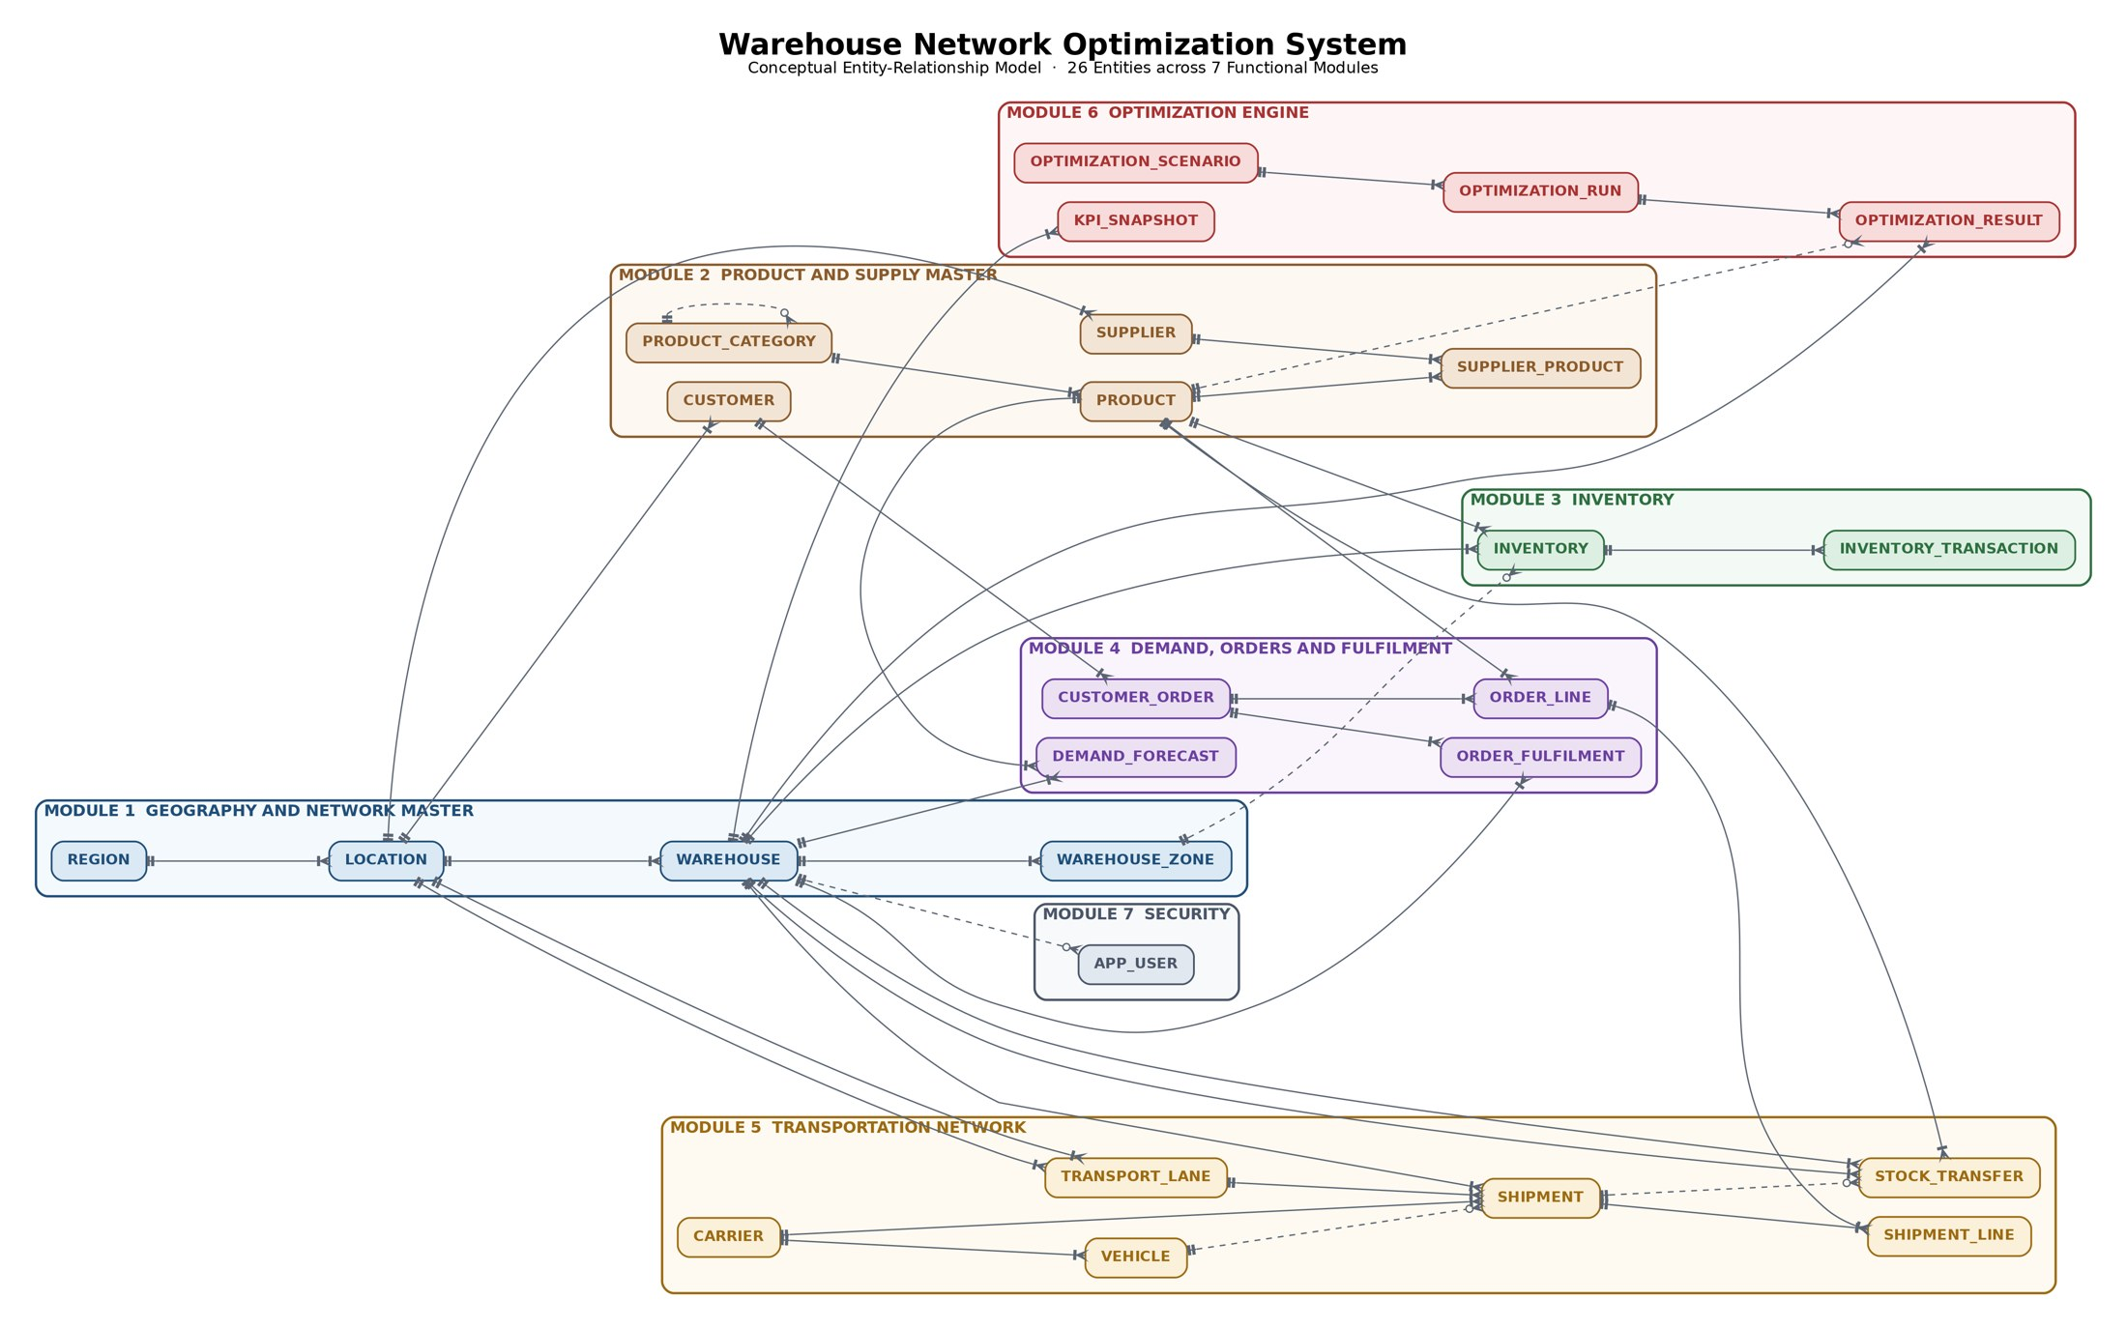
Conceptual ER Model
26 entities organised into 7 functional modules
Geography & Network
region · location · warehouse · warehouse_zone
Product & Supply
product_category · product · supplier · supplier_product · customer
Inventory
inventory · inventory_transaction
Demand & Orders
customer_order · order_line · order_fulfilment · demand_forecast
Transportation
carrier · vehicle · transport_lane · shipment · shipment_line · stock_transfer
Optimization
optimization_scenario · optimization_run · optimization_result · kpi_snapshot
Security
app_user
06
Notes:
Entity-level view. Warehouse, product and location are the three hub entities — almost every module reaches back to one of them.

Slide 7
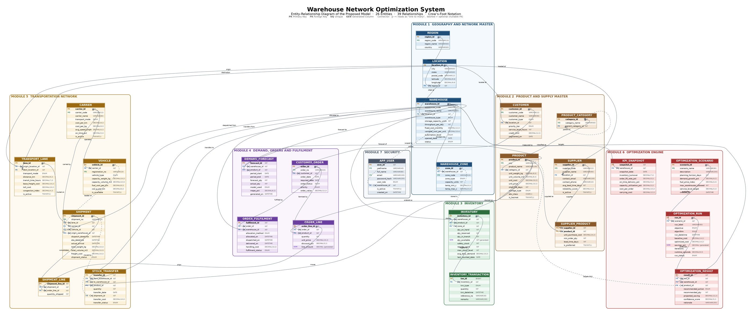
ER Diagram of the Proposed Model
Attribute level · crow's-foot notation · PK, FK, UQ and generated columns marked
Solid connector = mandatory foreign key. Dashed connector = optional (nullable) foreign key. Full-resolution PNG, PDF and SVG are supplied in the diagrams folder.
07
Notes:
Open the PDF version during the viva if the examiner wants to read attribute names — it is vector, so it zooms cleanly.

Slide 8
Schema Design and Normalisation
Every table in BCNF, with two deliberate exceptions
1NF
Every attribute atomic. Multiple zones, order lines or lanes become rows in child tables — never comma-separated columns.
Controlled redundancy — on purpose
order_line.unit_price
Duplicates product.unit_price at the moment of sale. Not a 3NF violation — it is a temporal attribute. Repricing a SKU must not rewrite history.
Generated columns
qty_available, line_amount and savings_pct are derived, but computed by the engine, so they cannot drift from their inputs.
customer_order.order_value
A materialised aggregate maintained by an explicit UPDATE … JOIN — read speed traded for one extra write.
2NF
In supplier_product (PK = supplier_id + product_id), unit_purchase_cost depends on both parts; supplier_name depends on supplier_id alone, so it stays in supplier.
3NF
warehouse stores location_id, not city / state / region_name — those depend on location_id, not on warehouse_id.
BCNF
Every determinant is a candidate key: warehouse_code, sku, order_no and shipment_no are all declared UNIQUE.
Referential integrity policy: RESTRICT on master data that transactions point at · CASCADE on true parent-child ownership (warehouse→zone, order→line, run→result) · SET NULL on optional associations (inventory→zone, shipment→vehicle).
08
Notes:
Expect a question on why unit_price is duplicated. The answer is temporal: an order is a historical fact and must not change when the price list does.

Slide 9
DDL — Data Definition Language
01_schema_ddl.sql · 26 CREATE TABLE statements, 3 views
CREATE TABLE inventory (
inventory_id INT NOT NULL AUTO_INCREMENT,
warehouse_id INT NOT NULL,
product_id INT NOT NULL,
zone_id INT NULL,
qty_on_hand INT NOT NULL DEFAULT 0,
qty_reserved INT NOT NULL DEFAULT 0,
qty_available INT AS (qty_on_hand - qty_reserved) STORED,
safety_stock INT NOT NULL DEFAULT 0,
reorder_point INT NOT NULL DEFAULT 0,
max_stock_level INT NOT NULL,
CONSTRAINT pk_inventory PRIMARY KEY (inventory_id),
CONSTRAINT uq_inventory_wh_product
UNIQUE (warehouse_id, product_id),
CONSTRAINT fk_inv_warehouse FOREIGN KEY (warehouse_id)
REFERENCES warehouse (warehouse_id)
ON UPDATE CASCADE ON DELETE CASCADE,
CONSTRAINT fk_inv_zone FOREIGN KEY (zone_id)
REFERENCES warehouse_zone (zone_id)
ON UPDATE CASCADE ON DELETE SET NULL,
CONSTRAINT ck_inv_max_level
CHECK (max_stock_level >= reorder_point)
) ENGINE = InnoDB;
Generated column
qty_available is stored and maintained by MySQL — application code can never let it disagree with its inputs.
Composite UNIQUE
(warehouse_id, product_id) makes the M:N resolution between warehouse and product structurally impossible to duplicate.
Three delete policies
CASCADE from warehouse (the row has no meaning without it), SET NULL from zone (an optional association).
CHECK constraints
32 across the schema — price ≥ cost, latitude in range, origin ≠ destination, eta > dispatch.
09
Notes:
Walk through the inventory table — it is the busiest table in the schema and shows every constraint type in one place.

Slide 10
DML — Sample Dataset Loaded
02_sample_data_dml.sql · 339 rows across all 26 tables, 0 foreign-key violations
A representative INSERT
INSERT INTO transport_lane
(lane_id, origin_location_id, dest_location_id,
transport_mode, distance_km, transit_time_hours,
base_freight_cost, toll_cost, congestion_index)
VALUES
( 3, 1, 4, 'ROAD', 1420.00, 34.00, 68500.00,
4200.00, 1.15),
(17, 1, 4, 'RAIL', 1385.00, 42.00, 38900.00,
0.00, 1.00);
Derived at load time
order_value is inserted as 0.00, then set by UPDATE … JOIN from SUM(line_amount) — the header can never disagree with its lines.
A decision in the data
Three converged runs recommend closing WH-NAG-01, so a post-load UPDATE flips its status to INACTIVE.
10
Notes:
The two Delhi-Mumbai lanes in the INSERT are the same city pair on different modes. That single pair of rows is what makes mode selection a real optimization decision.

Slide 11
Tables with Values — Network and Product Master
warehouse (8 rows) and product (15 rows), abridged
warehouse
warehouse_code | type | city | capacity | throughput/day | fixed cost/mo (₹) | status
WH-DEL-01 | CENTRAL_DC | Delhi | 95,000 | 12,000 | 4,500,000.00 | ACTIVE
WH-MUM-01 | REGIONAL_DC | Mumbai | 32,000 | 4,000 | 5,200,000.00 | ACTIVE
WH-BLR-01 | FULFILMENT_CENTRE | Bengaluru | 55,000 | 7,500 | 3,900,000.00 | ACTIVE
WH-KOL-01 | REGIONAL_DC | Kolkata | 45,000 | 5,500 | 2,750,000.00 | ACTIVE
WH-NAG-01 | CROSS_DOCK | Nagpur | 22,000 | 6,500 | 1,400,000.00 | INACTIVE
WH-HYD-01 | FULFILMENT_CENTRE | Hyderabad | 48,000 | 6,000 | 3,300,000.00 | ACTIVE
WH-GUW-01 | DARK_STORE | Guwahati | 12,000 | 1,500 | 620,000.00 | ACTIVE
WH-IDR-01 | REGIONAL_DC | Indore | 40,000 | 5,000 | 1,950,000.00 | PROPOSED
product
sku | product_name | weight kg | volume m³ | unit_cost | unit_price | storage_type | ABC
SKU-EL-1001 | 4K Smart LED TV 55 inch | 18.500 | 0.2200 | 32,000.00 | 41,999.00 | AMBIENT | A
SKU-MB-1002 | Smartphone 5G 128GB | 0.220 | 0.0015 | 14,500.00 | 19,999.00 | HIGH_VALUE | A
SKU-FM-1006 | Sunflower Refined Oil 5L | 4.800 | 0.0060 | 620.00 | 799.00 | AMBIENT | A
SKU-PH-1010 | Insulin Vial 10ml | 0.090 | 0.0003 | 380.00 | 620.00 | COLD_CHAIN | A
SKU-IS-1013 | Hydraulic Oil 20L Drum | 18.000 | 0.0250 | 2,400.00 | 3,200.00 | HAZMAT | B
Weight and volume per unit are what let a shipment be checked against a vehicle's weight AND cube capacity — the two-constraint loading problem. Mumbai carries the network's highest fixed cost at its lowest utilisation (43.66%).
11
Notes:
Real values, straight from 02_sample_data_dml.sql. WH-NAG-01 shows INACTIVE because the post-load UPDATE acted on the optimizer's recommendation.

Slide 12
Tables with Values — Inventory and the Reorder Alert
inventory (32 rows) driving query Q3
inventory · qty_available is a generated column: qty_on_hand − qty_reserved
warehouse | sku | on_hand | reserved | available | safety | reorder pt | max level | avg daily
WH-DEL-01 | SKU-EL-1001 | 380 | 120 | 260 | 150 | 300 | 1,200 | 42.50
WH-DEL-01 | SKU-FM-1006 | 17,000 | 1,500 | 15,500 | 2,500 | 5,000 | 18,000 | 720.00
WH-DEL-01 | SKU-PH-1009 | 36,000 | 2,000 | 34,000 | 5,000 | 9,000 | 40,000 | 1,250.00
WH-MUM-01 | SKU-PH-1010 | 1,600 | 500 | 1,100 | 900 | 1,800 | 6,500 | 210.00
WH-KOL-01 | SKU-PH-1010 | 550 | 220 | 330 | 400 | 850 | 3,000 | 96.00
WH-NAG-01 | SKU-FM-1006 | 1,600 | 800 | 800 | 600 | 1,400 | 5,000 | 410.00
WH-GUW-01 | SKU-PH-1009 | 1,800 | 400 | 1,400 | 1,000 | 1,900 | 7,500 | 240.00
Q3 — Reorder alert
Result — 5 rows
SELECT w.warehouse_code, p.sku, i.qty_available,
i.reorder_point,
i.reorder_point - i.qty_available AS shortfall_units,
CASE WHEN i.qty_available <= i.safety_stock
THEN 'CRITICAL' ELSE 'REORDER' END AS alert_level
FROM inventory i
JOIN warehouse w ON w.warehouse_id = i.warehouse_id
JOIN product p ON p.product_id = i.product_id
WHERE i.qty_available <= i.reorder_point;
WH-KOL-01 · SKU-PH-1010
520 short
CRITICAL
WH-GUW-01 · SKU-PH-1009
500 short
REORDER
WH-MUM-01 · SKU-PH-1010
700 short
REORDER
WH-NAG-01 · SKU-FM-1006
600 short
REORDER
WH-DEL-01 · SKU-EL-1001
40 short
REORDER
12
Notes:
Kolkata's insulin position is below safety stock, not just below the reorder point — that is the difference between CRITICAL and REORDER, and it comes straight out of the CASE expression.

Slide 13
The Optimization Engine
Scenarios, runs and recommendations stored as first-class data
Objective function
Seven runs · six algorithms · outcome stored per run
run_label | algo | baseline ₹ | optimized ₹ | save %
Fuel Shock MILP | MILP | 57,390,000 | 50,914,000 | 11.28
Peak Season MILP | MILP | 61,840,000 | 55,106,000 | 10.89
Baseline MILP Run | MILP | 48,250,000 | 44,180,000 | 8.44
Baseline GA Benchmark | GA | 48,250,000 | 44,962,000 | 6.81
Peak Season Service Max | SA | 61,840,000 | 58,472,000 | 5.45
Green Network CO₂ Min | PSO | 44,180,000 | 42,335,000 | 4.18
Green Network Trial * | MILP | 44,180,000 | 44,180,000 | 0.00
Minimise Z = Σ fixed facility cost
+ Σ variable handling cost × units
+ Σ freight cost per lane-mode
+ Σ inventory carrying cost
s.t. demand met · capacity · throughput ·
vehicle weight & cube · SLA hours ·
qty_on_hand ≥ safety_stock
Query Q20 evaluates Z directly from the live tables.
Four what-if scenarios
GA = Genetic Algorithm · SA = Simulated Annealing · PSO = Particle Swarm. savings_pct is a generated column, so a run can never be reported with a saving its own cost figures do not support. * Run 7 returned INFEASIBLE and is kept deliberately — an infeasible run is a result.
scenario_name | horizon | demand +% | fuel index | SLA target
Baseline FY2026 Network | 90 d | 0.00 | 1.000 | 95.00%
Peak Season Surge +25% | 60 d | 25.00 | 1.120 | 97.00%
Fuel Shock Stress Test | 90 d | 5.00 | 1.380 | 93.00%
Green Network 2027 | 180 d | 12.00 | 1.050 | 96.00%
Top recommendation
OPEN_NEW · WH-IDR-01 (Indore)
₹3,820,000 projected saving · 88.50% confidence
"Indore DC cuts central-region line-haul distance by 21 percent." MILP and the Genetic Algorithm reached this siting decision independently — MILP in less than half the wall-clock time.
13
Notes:
Emphasise that the schema stores the scenario, the algorithm, the runtime and the outcome — so two algorithms on the same scenario can be compared as data, not as anecdote.

Slide 14
Results and Key Findings
What the 25 analytical queries surfaced from the loaded dataset
11.28%
3.27%
5
₹44,705
Best network cost saving
(Fuel Shock MILP)
Lowest forecast MAPE
(LSTM, 3 forecasts)
SKU positions below
reorder point (1 critical)
Saved per Delhi–Mumbai
trunk by switching to rail
1
Mumbai is the network's clearest anomaly
Highest fixed cost in the network (₹5.2 M/month) at the lowest utilisation (43.66%).
2
MILP beats the metaheuristics here
1.63 points better than the GA on the identical scenario, in 186 s against 413 s.
3
Rail wins the Delhi–Mumbai trunk
₹83,605 by road in 34 h versus ₹38,900 by rail in 42 h — 8 extra hours buys a 53% freight cut.
4
Three runs agree on closing Nagpur
Independent agreement across MILP, GA and the fuel-shock run is what triggers the status change.
14
Notes:
These four findings all come out of queries, not out of assumptions. If asked, show Q13, Q7, Q10 and Q2 in the SQL file.

Slide 15
Conclusion and Future Scope
What was delivered, and where it goes next
Delivered
Future scope
A 26-entity relational model in BCNF covering the whole physical network, from region down to individual shipment line.
A sample dataset of 339 rows that loads with zero foreign-key violations and satisfies all 32 CHECK constraints.
25 analytical queries — window functions, recursive-style hierarchy, Haversine distance, centre of gravity, EOQ and ROP.
An optimization layer whose scenarios, algorithms and recommendations are stored, versioned and comparable.
A verified best-case network cost reduction of 11.28% under the fuel-shock scenario.
1
Live telematics
Stream GPS and temperature from vehicles into shipment, replacing planned ETAs with observed ones.
2
Real solver integration
Wire PuLP / CBC directly to the schema so optimization_run rows are written by the solver itself.
3
Stochastic demand
Replace point forecasts with distributions and size safety stock on service-level probability.
4
Carbon as a hard constraint
Promote co2_g_per_km from a reporting column to a binding constraint in the MILP.
5
Partitioning and archival
Range-partition inventory_transaction and shipment by date as the ledger grows past millions of rows.
Thank you Aayushman Ghatak
15
Notes:
Close on the verified figures rather than on ambition: the model runs, the data loads clean, and the 11.28% is reproducible from the files supplied.

