Slide 1

Ataraxia
Medium-Fi Prototype
Katherine E., Claire S., Ashwin A., Josh L.

Slide 2
Presentation Overview
ataraxia
Tasks
Interface
Prototyping

Slide 3
ataraxia

Slide 4
Problem
Solution
Value Proposition
People aren’t aware of what they can be doing to take care of themselves - what makes them happier and what doesn’t
Ataraxia will help people through the process of learning what works for them and what doesn’t when it comes to taking care of themselves by guiding users to curate their own self-care routine
Learn to be a happier you

Slide 5
Tasks
Simple
Medium
Complex

Slide 6
Simple
Medium
Complex
Discover new self care activity
Reflect on self care activity
Construct a self care routine

Slide 7
design changes

Slide 8
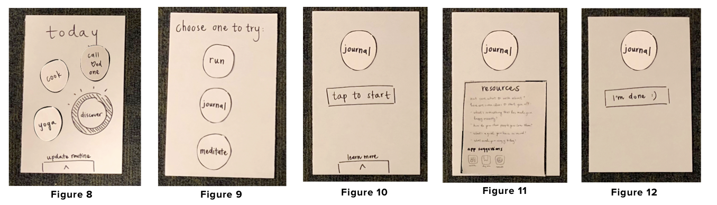
design change #1
(before)
Discover a new self care activity flow
Key issues were:
People didn’t know what to do after ‘tap to start’
People didn’t see resources tab but wanted resources

Slide 9
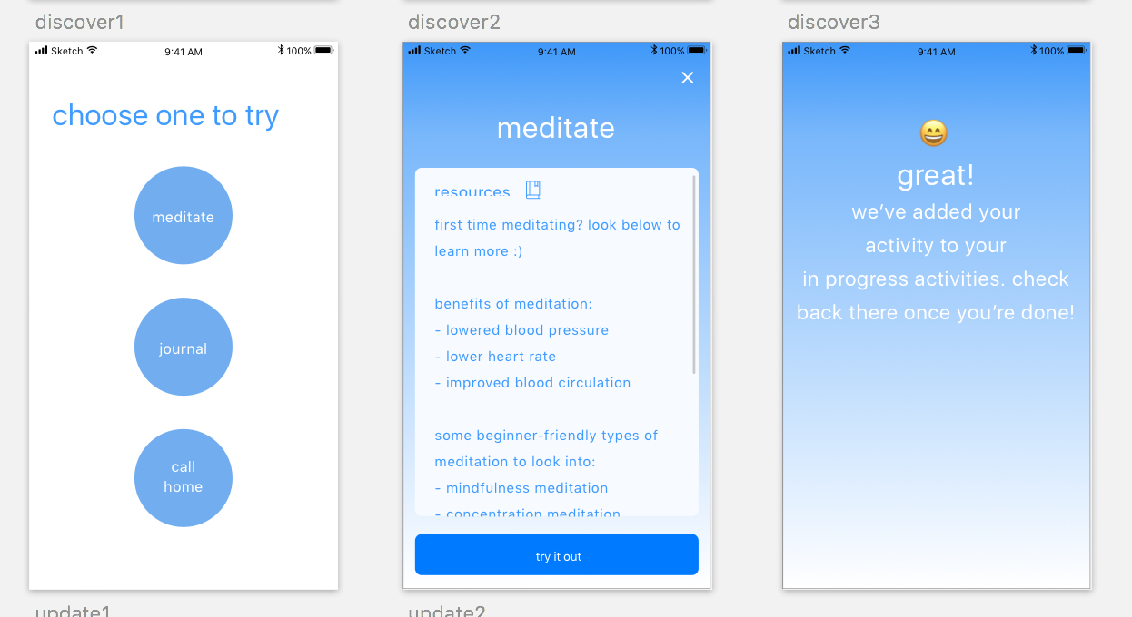
design change #1
(after)
Discover a new self care activity
How we addressed key issues:
Resources are always shown after choosing a new activity
Adds new activity to your ‘in progress’ activities

Slide 10
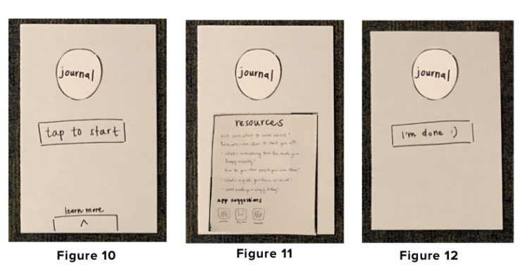
design change #2
(before)
In progress/Review an activity flow
Key issues were:
People could only try one activity at a time

Slide 11
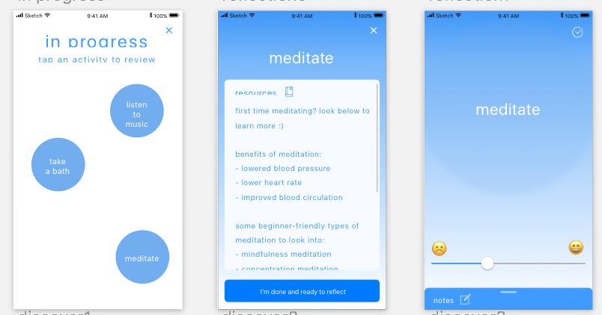
design change #2
(after)
In progress/Review an activity flow
How we addressed key issues:
Added ‘In progress’ screen
Reflection happens at the user’s convenience

Slide 12
design change #3
(before)
‘History’ screen for viewing notes and resources
Key issues were:
No way to access old notes/reflections

Slide 13
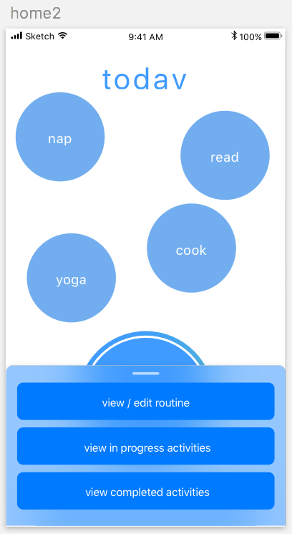
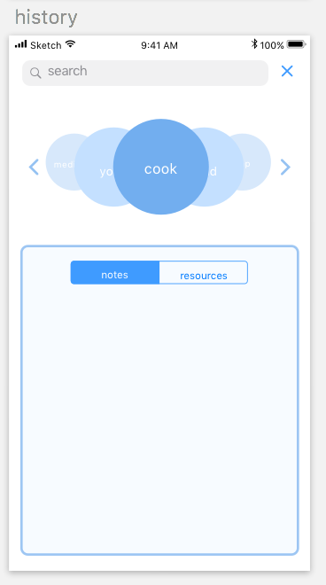
design change #3
(after)
‘History’ screen for viewing notes and resources
How we addressed key issues:
Added history screen accessible from home page

Slide 14
revised
taskflow
complex
medium
simple

Slide 15
Simple
Medium
Complex
Discover new self care activity
Reflect on self care activity
Construct a self care routine

Slide 16
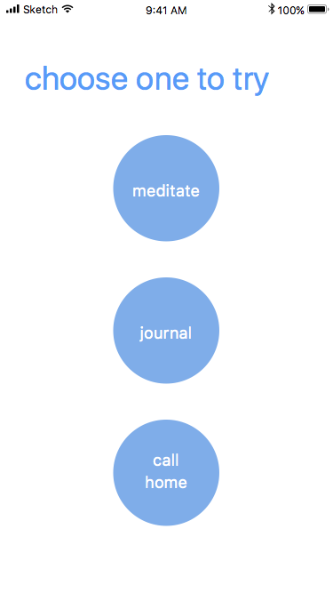
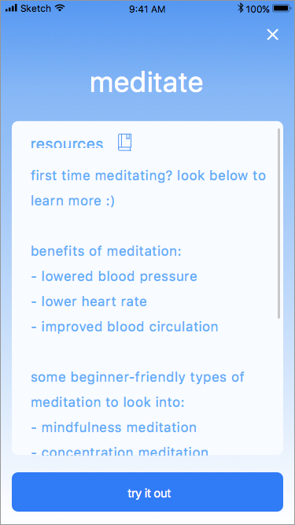
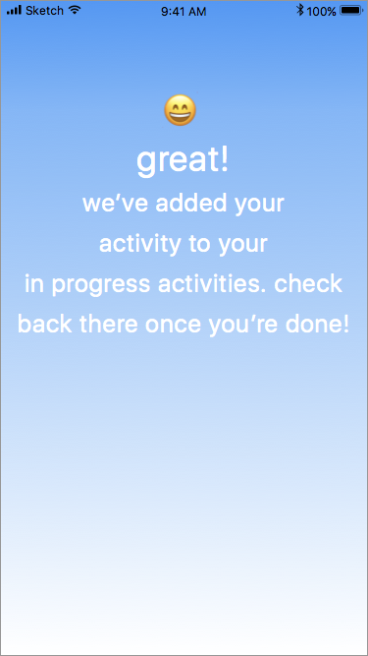
Task 1: Discover a new self care activity

Slide 17
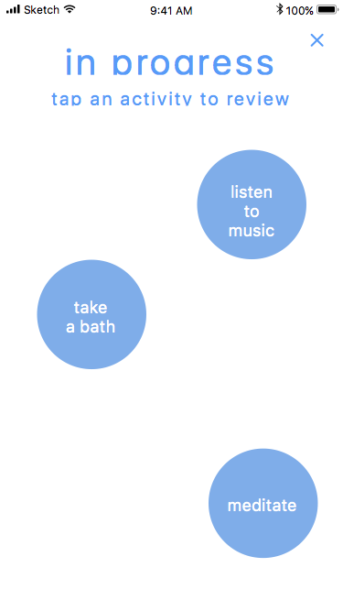
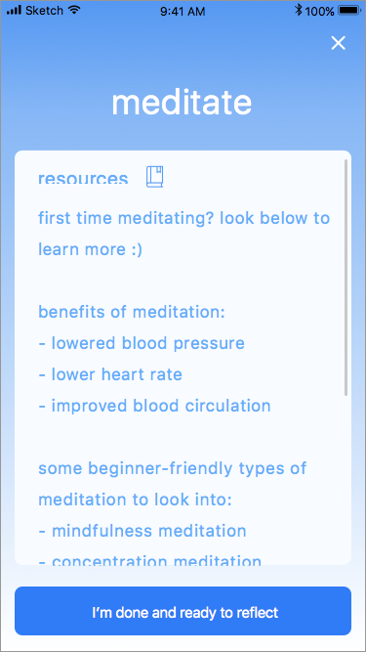
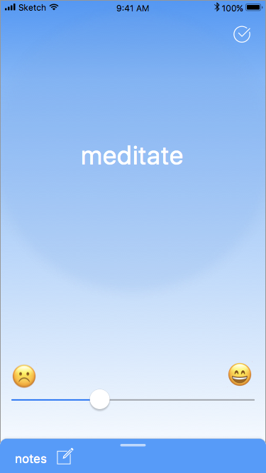
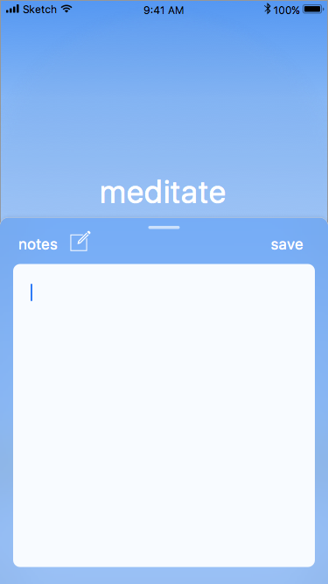
Task 2: Reflect on self-care activity

Slide 18
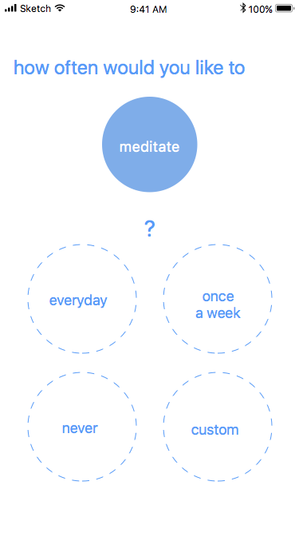
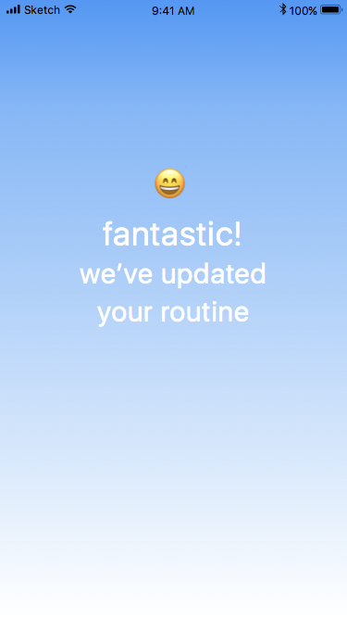
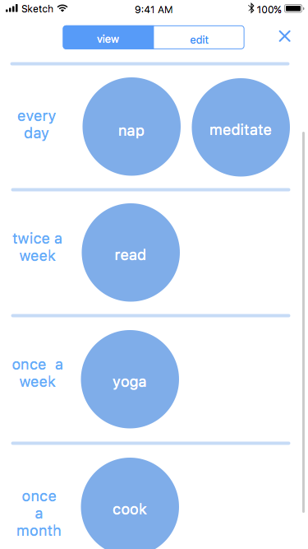
Task 3: Construct a self-care routine

Slide 19
prototyping

Slide 20
prototyping
tools
Sketch
Pros:
Made comprehensive designs
Had prior experience with it
Easily integrated into proto.io
Cons:
Using built-in proto.io tools would have provided additional functionality
Had to use two separate platforms
proto.io
Pros:
Good documentation
Easy to integrate with sketch
Cons:
Hard to do quality animation (e.g. drag and drop)

Slide 21
functionality limitations
- Home screen/In Progress: Icons don’t float around; No animations on tapping discover. Prototyping tool doesn’t have functionality to do floating animation.
- Discover: Hard-coded 3 activities, so activities are pre-set and not curated per user. Not feasible to actually generate activities without preserving state and user data. So far only meditate is active on the discover screen (only need to make one work to demonstrate the concept).
- Edit routine: Can only update routine by deleting meditation and selecting cooking afterwards to update frequency. Prototyping tool makes it difficult to drag and drop + lock into place, and users are already familiar with similar interface (updating apps on home screen in iOS).

Slide 22
functionality limitations
- Reflect: Only goes to everyday bucket; Can’t type notes. Prototyping tool has limitations for drag and drop and text input. Also not critical to implement text input, since users likely already know what to expect.
- History: Dummy screen, no scrolling. Prototyping tools has limitations on carousels and displaying notes/resources dynamically based on which activity is selected.
- General: State changes don’t persist for any of the states. No easy way to store data within prototyping tool.

Slide 23
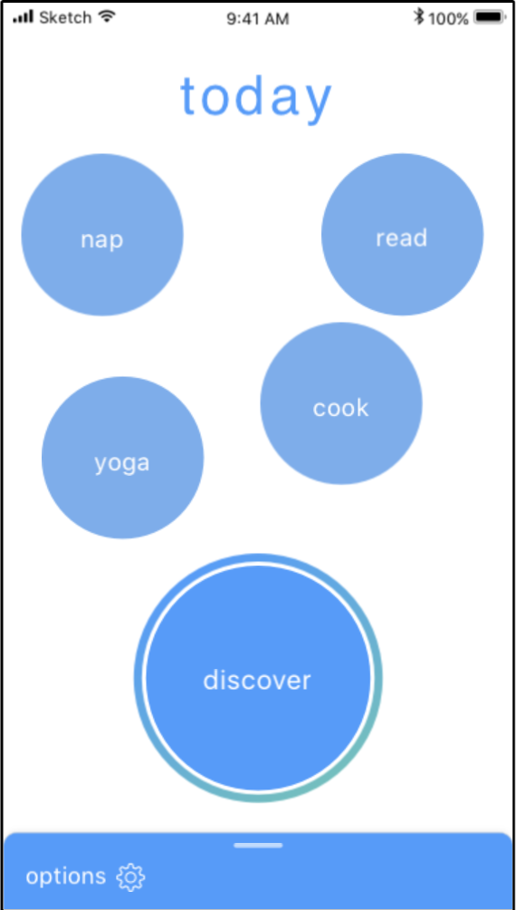
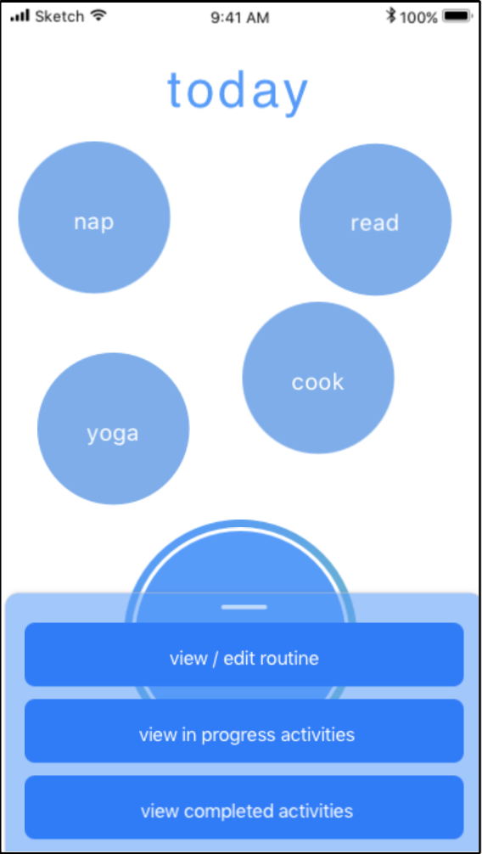
Home
Screen

Slide 24
Discover

Slide 25
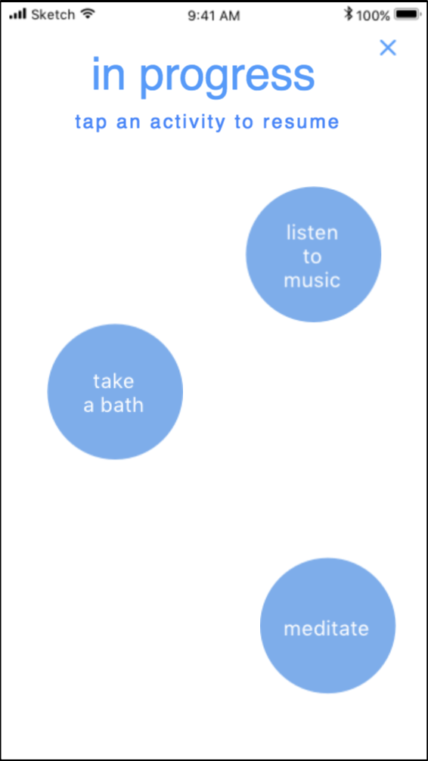
In progress

Slide 26
Reflect (from in progress)

Slide 27
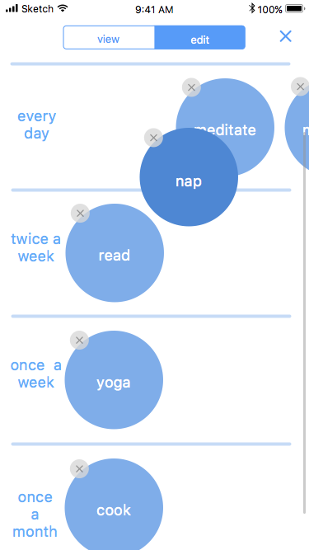

Slide 28
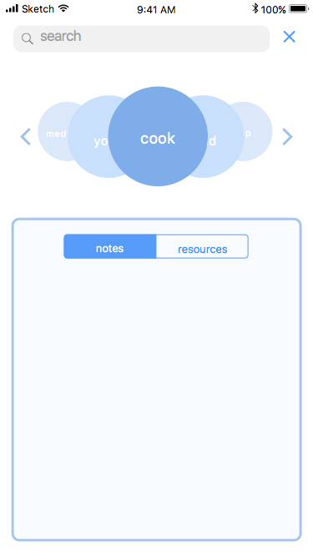

Slide 29
questions?

