Slide 1
SafeHome AI
START HERE
One room photo becomes a prioritized home-safety plan for older adults, families, and caregivers.
Take or upload
a room photo
Created by Aagam Jain
The app explains what it notices
1
Notes:
VIDEO TIMING
0:00-0:12 (12 seconds)
NARRATION
I am Aagam Jain, creator of SafeHome AI. Ordinary fall hazards are easy to miss, so one room photo becomes a prioritized safety plan for older adults and caregivers.
NEXT APP CLIP
0:12-0:32 - Clip A: Use two prepared shots. First show room selection. Cut to the uploaded photo and begin analysis.

Slide 2
A faster alternative to a long checklist
The app starts with visible evidence and asks only what the photo cannot answer.
FASTEST
FOR TRACKING
Quick Safety Check
Account Check
1
Choose room type
1
Sign in and select Room Name
▼
▼
2
Upload one photo
2
Run the same safety check
▼
▼
3
Get three priority actions
3
Track trends and share summaries
BOTH PATHS → photo review → validated hazards → follow-up questions → room score
2
Notes:
VIDEO TIMING
0:32-0:44 (12 seconds)
NARRATION
Long checklists can overwhelm users. SafeHome AI starts with the room. Quick Check needs no account, while signing in adds saved progress, comparisons, and sharing.
NEXT APP CLIP
0:44-1:14 - Clip B: Use three prepared shots: marked evidence, one follow-up question, and the completed score.

Slide 3
The system and the problem I solved
Python rules keep an AI-assisted score explainable and consistent.
STREAMLIT
QUALITY GATE
OPENAI VISION
PYTHON RULES
HUMAN CHECK
RESULT
receives photo
and Room Type
→
orientation • light
contrast • blur
→
hazards • evidence
confidence • x/y
→
schema • allowlist
1-15 clamp • fallback
→
simple questions
for uncertain facts
→
score • risk bar
three-step plan
My main challenge was variable AI scoring. The model identifies evidence; my Python layer controls every stored result.
▼
▼
▼
SUPABASE
BREVO EMAIL API
ACTIVE SESSION
account email + password hash
Room Names
structured check history
sends password reset codes
and text-only safety summaries
to as many as five recipients
current photo + analysis state
connect pages during the check
photo is not saved
Built with Python, Streamlit, CSS, OpenAI Vision, Supabase, and Brevo. Invalid AI values use tested defaults, and room photos are not stored.
3
Notes:
VIDEO TIMING
1:14-1:30 (16 seconds)
NARRATION
I built the app with Python, Streamlit, and CSS. Vision AI locates evidence; my validation layer checks categories, clamps points, and uses fallbacks. Supabase stores history, Brevo sends text-only summaries, and photos are not saved.
NEXT APP CLIP
1:30-1:50 - Clip C: Use two prepared shots: the safety plan and the completed before-and-after comparison.

Slide 4
How the score stays consistent
Three inputs contribute to one room score, capped at 100.
VISIBLE HAZARDS
FOLLOW-UP CONCERNS
SKIPPED QUESTIONS
1-15 points each
+
Weighted by answer
+
0-15 point buffer
0-29
30-59
60-100
Low
Moderate
High
WORKED EXAMPLE
Visible hazards 28 + Follow-up concerns 12 + Skip buffer 0 = Room score 40 Moderate
Fallback rule: if an AI point value is missing or invalid, the app uses the category's tested default. Final score = min(100, total).
4
Notes:
VIDEO TIMING
1:50-2:05 (15 seconds)
NARRATION
The hardest problem was inconsistent AI scoring. I solved it by limiting hazards to one through fifteen points, adding confirmed follow-up concerns, using category fallbacks, and capping the room at one hundred.

Slide 5
Testing & validation
Results from 10 room photographs I staged and reviewed
Test image | Reference hazards | AI reported | Correct | Missed
Bedroom 1 | 4 | 4 | 4 | 0
Kitchen 1 | 3 | 3 | 3 | 0
Living Room 1 | 5 | 5 | 5 | 0
Hallway 1 | 3 | 3 | 3 | 0
Bathroom 1 | 3 | 3 | 3 | 0
Bedroom 2 | 4 | 4 | 4 | 0
Entryway 1 | 2 | 2 | 2 | 0
Living Room 2 | 4 | 4 | 4 | 0
Kitchen 2 | 3 | 3 | 3 | 0
Bedroom 3 | 4 | 3 | 3 | 1
TOTAL | 35 | 34 | 34 | 1
34 of 35 reference hazards detected | 97.1% in this test set
5
Notes:
VIDEO TIMING
2:05-2:20 (15 seconds)
NARRATION
For validation, I labeled thirty-five hazards across ten staged photos before running the app. It found thirty-four. That small test revealed a miss and improved my rules; it does not prove real-world accuracy.
NEXT APP CLIP
2:20-2:45 - Clip D: Use three prepared shots: dashboard and trend, add a recipient field, and Accessibility.

Slide 6
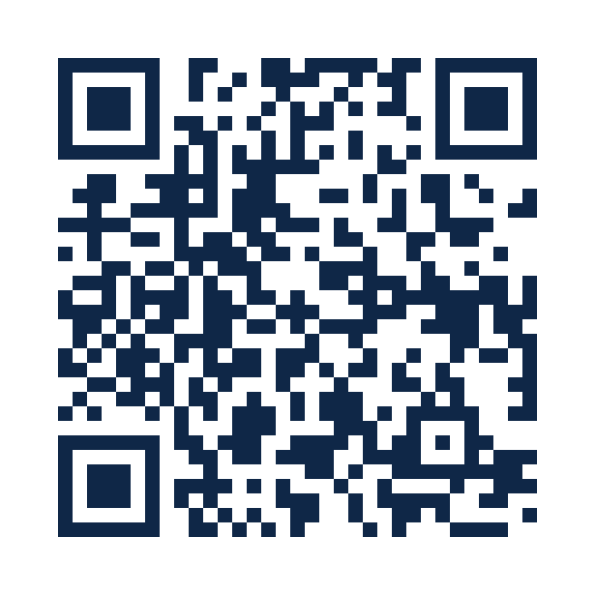
Designed for action and human review
The result stays useful, accessible, and honest about uncertainty.
CONSISTENCY
UNCERTAINTY
AI proposes 1-15 points.
Python clamps values, applies tested fallbacks, and caps the room at 100.
The model does not guess hidden facts.
It turns important unknowns into simple follow-up questions.
ACTION
ACCESS
Results become three prioritized fixes,
impact estimates, and before/after comparisons.
Large controls, four color modes, Read Aloud, reduced motion, and a mobile-first layout.
SafeHome AI supports a caregiver or safety professional. It does not diagnose a person or guarantee safety.
TRY THE APP
6
Notes:
VIDEO TIMING
2:45-3:00 (15 seconds)
NARRATION
SafeHome AI helps families notice risks sooner, choose the first fix, and verify improvement. It supports caregivers and safety professionals rather than replacing them. The QR code opens the working app.

