Slide 1
SafeHome AI
1 room photo
A fall can begin with one overlooked cord and lead to injury, lost confidence, and less independence.
↓
Identified fall risks
and ways to take action
Created by Aagam Jain
1
Notes:
VIDEO TIMING
0:00-0:12 (12 seconds)
NARRATION
A fall can begin with one overlooked cord. I am Aagam Jain, and I built SafeHome AI to help older adults and caregivers notice everyday risks sooner.
NEXT APP CLIP
0:12-0:32 - Clip A: Use two prepared shots. First show room selection. Cut to the uploaded photo and begin analysis.

Slide 2
Start with the room, not a long checklist
The photo handles visible evidence. The user answers only what the image cannot prove.
NO ACCOUNT REQUIRED
OPTIONAL ACCOUNT
Quick Safety Check
Keep the progress
1
Choose room type
1
Sign in and select Room Name
▼
▼
2
Upload one photo
2
Run the same safety check
▼
▼
3
Get three priority actions
3
Track trends and share summaries
AN ACCOUNT ADDS saved progress • comparisons • sharing
2
Notes:
VIDEO TIMING
0:32-0:44 (12 seconds)
NARRATION
Instead of a long checklist, SafeHome AI starts with the room and asks only what the image cannot answer. An account adds progress, comparisons, and sharing.
NEXT APP CLIP
0:44-1:14 - Clip B: Use three prepared shots: marked evidence, one follow-up question, and the completed score.

Slide 3
The system and the problem I solved
Python rules keep an AI-assisted score explainable and consistent.
STREAMLIT
QUALITY GATE
OPENAI VISION
PYTHON RULES
HUMAN CHECK
RESULT
receives photo
and Room Type
→
orientation • light
contrast • blur
→
hazards • evidence
confidence • x/y
→
schema • allowlist
1-15 clamp • fallback
→
simple questions
for uncertain facts
→
score • risk bar
three-step plan
My main challenge was variable AI scoring. The model identifies evidence; my Python layer controls every stored result.
▼
▼
▼
SUPABASE
BREVO EMAIL API
ACTIVE SESSION
account email + password hash
Room Names
structured check history
sends password reset codes
and text-only safety summaries
to as many as five recipients
current photo + analysis state
connect pages during the check
photo is not saved
Built with Python, Streamlit, CSS, OpenAI Vision, Supabase, and Brevo. Invalid AI values use tested defaults, and room photos are not stored.
3
Notes:
VIDEO TIMING
1:14-1:30 (16 seconds)
NARRATION
I built the app with Python, Streamlit, and CSS. Vision AI locates evidence, while my validation layer checks categories, clamps points, and uses fallbacks. Supabase stores history, Brevo sends text-only summaries, and photos are never saved.
NEXT APP CLIP
1:30-1:50 - Clip C: Use two prepared shots: the safety plan and the completed before-and-after comparison.

Slide 4
The hardest problem was inconsistent AI scoring
I kept the model's judgment inside four rules that my Python code enforces.
1
Limit each hazard to 1-15 points
THE PROBLEM
The same type of hazard could receive a different point value when the AI analyzed another photo.
2
Add only confirmed follow-up concerns
→
3
Use a tested category fallback
That variation made room scores harder to compare.
4
Cap the final room score at 100
The AI identifies evidence. The application controls the score.
4
Notes:
VIDEO TIMING
1:50-2:05 (15 seconds)
NARRATION
The hardest problem was inconsistent AI scoring. I solved it by limiting hazards to one through fifteen points, adding confirmed follow-up concerns, using category fallbacks, and capping the room at one hundred.

Slide 5
Testing & validation
Results from 10 room photographs I staged and reviewed
Test image | Reference hazards | AI reported | Correct | Missed
Bedroom 1 | 4 | 4 | 4 | 0
Kitchen 1 | 3 | 3 | 3 | 0
Living Room 1 | 5 | 5 | 5 | 0
Hallway 1 | 3 | 3 | 3 | 0
Bathroom 1 | 3 | 3 | 3 | 0
Bedroom 2 | 4 | 4 | 4 | 0
Entryway 1 | 2 | 2 | 2 | 0
Living Room 2 | 4 | 4 | 4 | 0
Kitchen 2 | 3 | 3 | 3 | 0
Bedroom 3 | 4 | 3 | 3 | 1
TOTAL | 35 | 34 | 34 | 1
34 of 35 reference hazards detected | AI can still miss small details, so human review remains necessary
5
Notes:
VIDEO TIMING
2:05-2:20 (15 seconds)
NARRATION
For validation, I labeled thirty-five hazards across ten staged photos before running the app. It found thirty-four. AI can still miss small details, so every result keeps human review explicit.
NEXT APP CLIP
2:20-2:45 - Clip D: Use three prepared shots: dashboard and trend, add a recipient field, and Accessibility.

Slide 6
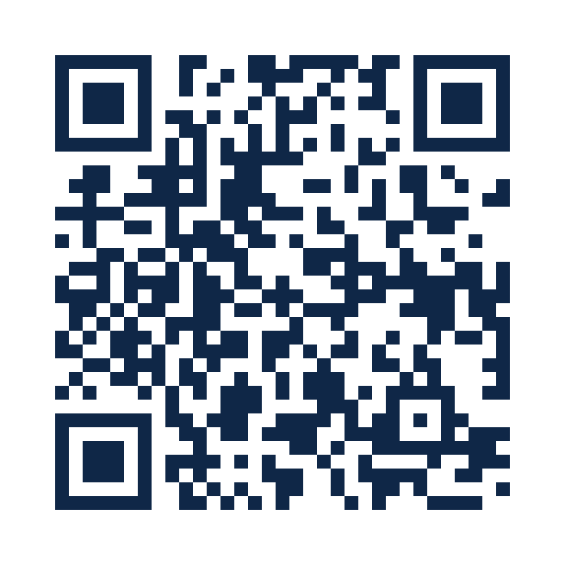
More than 200 rooms checked
Friends and family used the results to notice concerns and decide what to address first.
200+
What I heard
The interface felt friendly, and the results were useful and written in simple language.
rooms belonging to
friends and family
My goal
Help make falls less of a common fear for older adults and their families.
AI can still miss small details. SafeHome AI keeps human review part of every result.
TRY THE APP
6
Notes:
VIDEO TIMING
2:45-3:00 (15 seconds)
NARRATION
I have also used SafeHome AI in more than two hundred rooms belonging to friends and family, and they found the results extremely useful. My goal is to help more families catch risks sooner.

