Slide 1
Review 2 Presentation on
"AI-Based ICU Patient (Sepsis) Deterioration &
Early Warning System with SHAP Explainability"
Submitted in partial fulfillment for the award of degree of
Bachelor of Technology in Department of Computer Engineering
By
Aagam Katariya (123B1E127) | Bhargavram Pedgaonkar (123B1E131)
Ayush Bankar (123B1E134)
Under the supervision of
Mrs. Akanksha Magare, Assistant Professor
Pimpri Chinchwad College of Engineering, Pune

Slide 2
Agenda
1. Problem Statement & Motivation
2. Traditional vs. Modified Approach
3. Objectives & Scope
4. Bibliography Analysis
5. Literature Review Summary (10 Papers)
6. Research Gaps / Limitations
7. Dataset Description & Sources
8. EDA Analysis
9. Proposed Approach & Architecture
10. Mathematical Model
11. GroupKFold Cross-Validation Methodology
12. Baseline Model Results
13. Advanced XGBoost Results
14. Deep Learning Exploration (Future Work)
15. Threshold & PR Curves
16. SHAP Explainability Results
17. SHAP Force Plots
18. Dashboard Screenshots
19. Research Ethics
20. Acknowledgement & Conclusion
21. References
Sepsis Early Warning System — Review 2
2 / 28

Slide 3
Problem Statement & Motivation
Real-World Problem & Limitations
Proposed Solution
• Sepsis causes ~11 million deaths globally per year
• Every 1-hour delay raises mortality by 7–8%
• ICU staff cannot monitor 50+ patients continuously
• Traditional tools (SIRS, qSOFA) ~50% sensitive
• Existing ML models predict CURRENT sepsis only
• Low precision (7–15%) → alert fatigue
• Black-box models lack clinical trust
Impact:
Late or missed detection → preventable deaths
• 6h & 12h FUTURE sepsis prediction with XGBoost
• 84 engineered features:
– 21 Lag features (1h, 3h, 6h)
– 21 Change features (Δ1h, Δ3h, Δ6h)
– 28 Rolling stats (mean/std/min/max)
• scale_pos_weight for class imbalance
• SHAP-based per-patient explanations
• Interactive HTML / Streamlit dashboard
• GroupKFold — no patient-level leakage
Sepsis Early Warning System — Review 2
3 / 28

Slide 4
Traditional vs. Modified Approach
Traditional Approach
Our Modified Approach
Raw ICU Data (14 features)
Raw ICU Data (546K × 44)
▼
▼
Single Classifier
Temporal Feature Engineering (84)
▼
▼
Binary Output
Dual XGBoost + SHAP
▼
▼
Limitations
Improvements
• Only CURRENT detection
• No temporal context
• Poor recall (2–50%)
• No interpretability
• Not deployable
• FUTURE 6h / 12h prediction
• 84 engineered temporal features
• AUROC improved to 0.80
• SHAP per-patient explanations
• Deployed HTML + Streamlit dashboard
Sepsis Early Warning System — Review 2
4 / 28

Slide 5
Research Objectives
1. To develop a temporal feature engineering pipeline that captures physiological deterioration patterns from ICU time-series data (lags, changes, rolling statistics).
2. To design a regularized XGBoost classifier for predicting sepsis onset 6 and 12 hours in advance, handling severe class imbalance (2.17% positive rate).
3. To analyze feature contributions using SHAP explainability to identify whether the model relies on dynamic vitals or static context features.
4. To implement a patient-level decision-support dashboard providing per-patient risk scores, top contributing factors, and rule-based clinical recommendations.
5. To evaluate model performance using imbalance-robust metrics (AUPRC, Recall, F1) against 3 classical baselines under 5-fold GroupKFold cross-validation.
Sepsis Early Warning System — Review 2
5 / 28

Slide 6
Scope of Research
In Scope
Out of Scope / Deliverables
• Sepsis prediction for ICU patients
• PhysioNet 2019 dataset (546K × 44)
• 6-hour & 12-hour prediction horizons
• Temporal feature engineering (84 features)
• Classical ML baselines (LR, RF, HGB)
• Advanced XGBoost (6h + 12h)
• SHAP-based interpretability
• Patient-aware 5-fold GroupKFold
• SMOTE on training folds only
• HTML + Streamlit dashboard
OUT OF SCOPE:
• Real-time EHR integration
• Multi-hospital prospective trial
• Transformer architectures
• Drug recommendation
• Pediatric / neonatal ICU
DELIVERABLES:
• 6h + 12h XGBoost models (.pkl)
• SHAP artifacts (.pkl)
• Patient predictions CSV
• HTML + Streamlit dashboards
• LSTM/GRU exploration (future_work/)
Sepsis Early Warning System — Review 2
6 / 28

Slide 7
Bibliography Analysis
Bibliography Analysis (45)
▼
International
Conference (18)
Books / Thesis (05)
International
Journal (22)
IEEE
(12)
Springer
(04)
Scopus
(08)
SCI
(06)
Others
(08)
Observation
• 60%+ of literature is from 2019 onwards (post-PhysioNet Challenge era)
• Strong recent growth in explainable AI for clinical decision support
• PhysioNet 2019 dataset dominates the benchmark
• SHAP-based interpretability remains underexplored in sepsis ML
• Few papers compare engineered features vs. deep learning under identical CV
Sepsis Early Warning System — Review 2
7 / 28

Slide 8
Year-wise Publication Analysis
Publication Year | IEEE Conf. | Springer/IEEE Jrnl | Other Journals
2025–2026 | 2 | 2 | 3
2023–2024 | 3 | 3 | 2
2021–2022 | 4 | 3 | 2
2020 | 5 | 3 | 1
2019 | 1 | 1 | 1
2018 | 2 | 1 | 1
2017 | 2 | 1 | —
2016 | 1 | — | —
2015 | 1 | — | —
2000–2014 | 3 | 3 | 2
Total | 24 | 17 | 12
Sepsis Early Warning System — Review 2
8 / 28

Slide 9
Literature Review Summary (Part 1)
# | Paper | Year | Method | Limitation | Our Improvement
1 | Oxford PhysioNet Winners | 2019 | Rough path signatures | Complex, not interpretable | XGBoost + SHAP
2 | Automated Prediction (2nd) | 2020 | XGBoost + missingness | Utility-focused only | + SHAP + dashboard
3 | PhysioNet Challenge Report | 2020 | 104 teams | Failed on hidden hospital | Diagnoses static reliance
4 | Informative Missingness | 2019 | XGBoost + masking | Non-generalizable | Median imputation
5 | Novel Classical ML | 2024 | Stacking + COPULA | Synthetic artifacts | Cost-sensitive learning
Key Insight
• PhysioNet 2019 challenge winners and follow-ups lack per-patient explainability.
Sepsis Early Warning System — Review 2
9 / 28

Slide 10
Literature Review Summary (Part 2)
# | Paper | Year | Method | Limitation | Our Improvement
6 | Decision-aware Two-stage | 2025 | XGBoost + refinement | No interpretability | SHAP + dashboard
7 | Clinically Optimized ML | 2026 | Calibrated XGBoost | No explainability | SHAP + recommendations
8 | Hybrid LSTM-GAT | 2026 | Deep learning | High compute cost | Gradient boosting
9 | Sepsis-3 Consensus | 2016 | SOFA criteria | Definition only | ML implementation
10 | Global Burden of Sepsis | 2020 | GBD Study | Epidemiology only | Actionable prediction
Key Insight
• Recent 2024–2026 papers focus on deep learning / calibration, but NONE combine explainability + deployment.
Sepsis Early Warning System — Review 2
10 / 28

Slide 11
Research Gaps / Limitations
1. Future Prediction vs. Detection — Most models detect current sepsis. Our work: 6h & 12h future prediction.
2. Interpretability Gap — Only 1–2 papers use SHAP/LIME. Our work: per-patient SHAP + dashboard.
3. Static Feature Dominance — ICULOS, HospAdmTime dominate many models. Our work: quantify static vs. dynamic SHAP.
4. Class Imbalance Handling — Synthetic oversampling introduces artifacts. Our work: cost-sensitive learning.
5. Deployment Gap — Most models remain in research papers. Our work: deployable HTML + Streamlit dashboards.
6. Patient-Level Evaluation Missing — Most papers report row-level metrics. Our work: 5-fold GroupKFold, patient-level split.
7. Threshold Optimization Ignored — Most papers use default 0.5. Our work: threshold locked from validation set.
8. DL vs. Classical Comparison — Rarely done under identical CV. Our work: 5 model families compared fairly.
Sepsis Early Warning System — Review 2
11 / 28

Slide 12
Dataset Description
Property | Value
Dataset Name | PhysioNet 2019 Sepsis Challenge
Total Records | 546,122 hourly ICU records
Total Columns | 44 (original) → 39 used for modeling
Total Patients | 14,057
Sepsis Rate (row) | ~2.17%
Sepsis Rate (patient) | 8.81%
Class Imbalance | ~45 : 1
Target Variables | Target_6h, Target_12h
Evaluation | 5-fold GroupKFold (by Patient_ID)
Feature Group | Count | Examples
Vitals | 7 | HR, O2Sat, Temp, SBP
Static | 5 | Age, Gender, Units
Time | 2 | Hour, ICULOS
Engineered | 70 | Lags, changes, rolling
Total | 84
Note
• All preprocessing (winsorization, imputation, scaling, SMOTE)
is applied inside CV folds — no test-set leakage.
Sepsis Early Warning System — Review 2
12 / 28

Slide 13
Data Sources
Primary Sources
1. PhysioNet 2019 Challenge — https://physionet.org/content/challenge-2019/1.0.0/
2. MIMIC-III Clinical Database — https://physionet.org/content/mimiciii/1.4/
3. eICU Collaborative Research DB — https://physionet.org/content/eicu-crd/2.0/
Secondary Sources
1. Sepsis-3 Consensus Definition — Singer et al., JAMA 2016
2. Global Burden of Disease Study — Rudd et al., Lancet 2020
3. Surviving Sepsis Campaign Guidelines — Evans et al., 2021
4. Fleischmann et al., Am. J. Respir. Crit. Care Med., 2016
Sepsis Early Warning System — Review 2
13 / 28

Slide 14
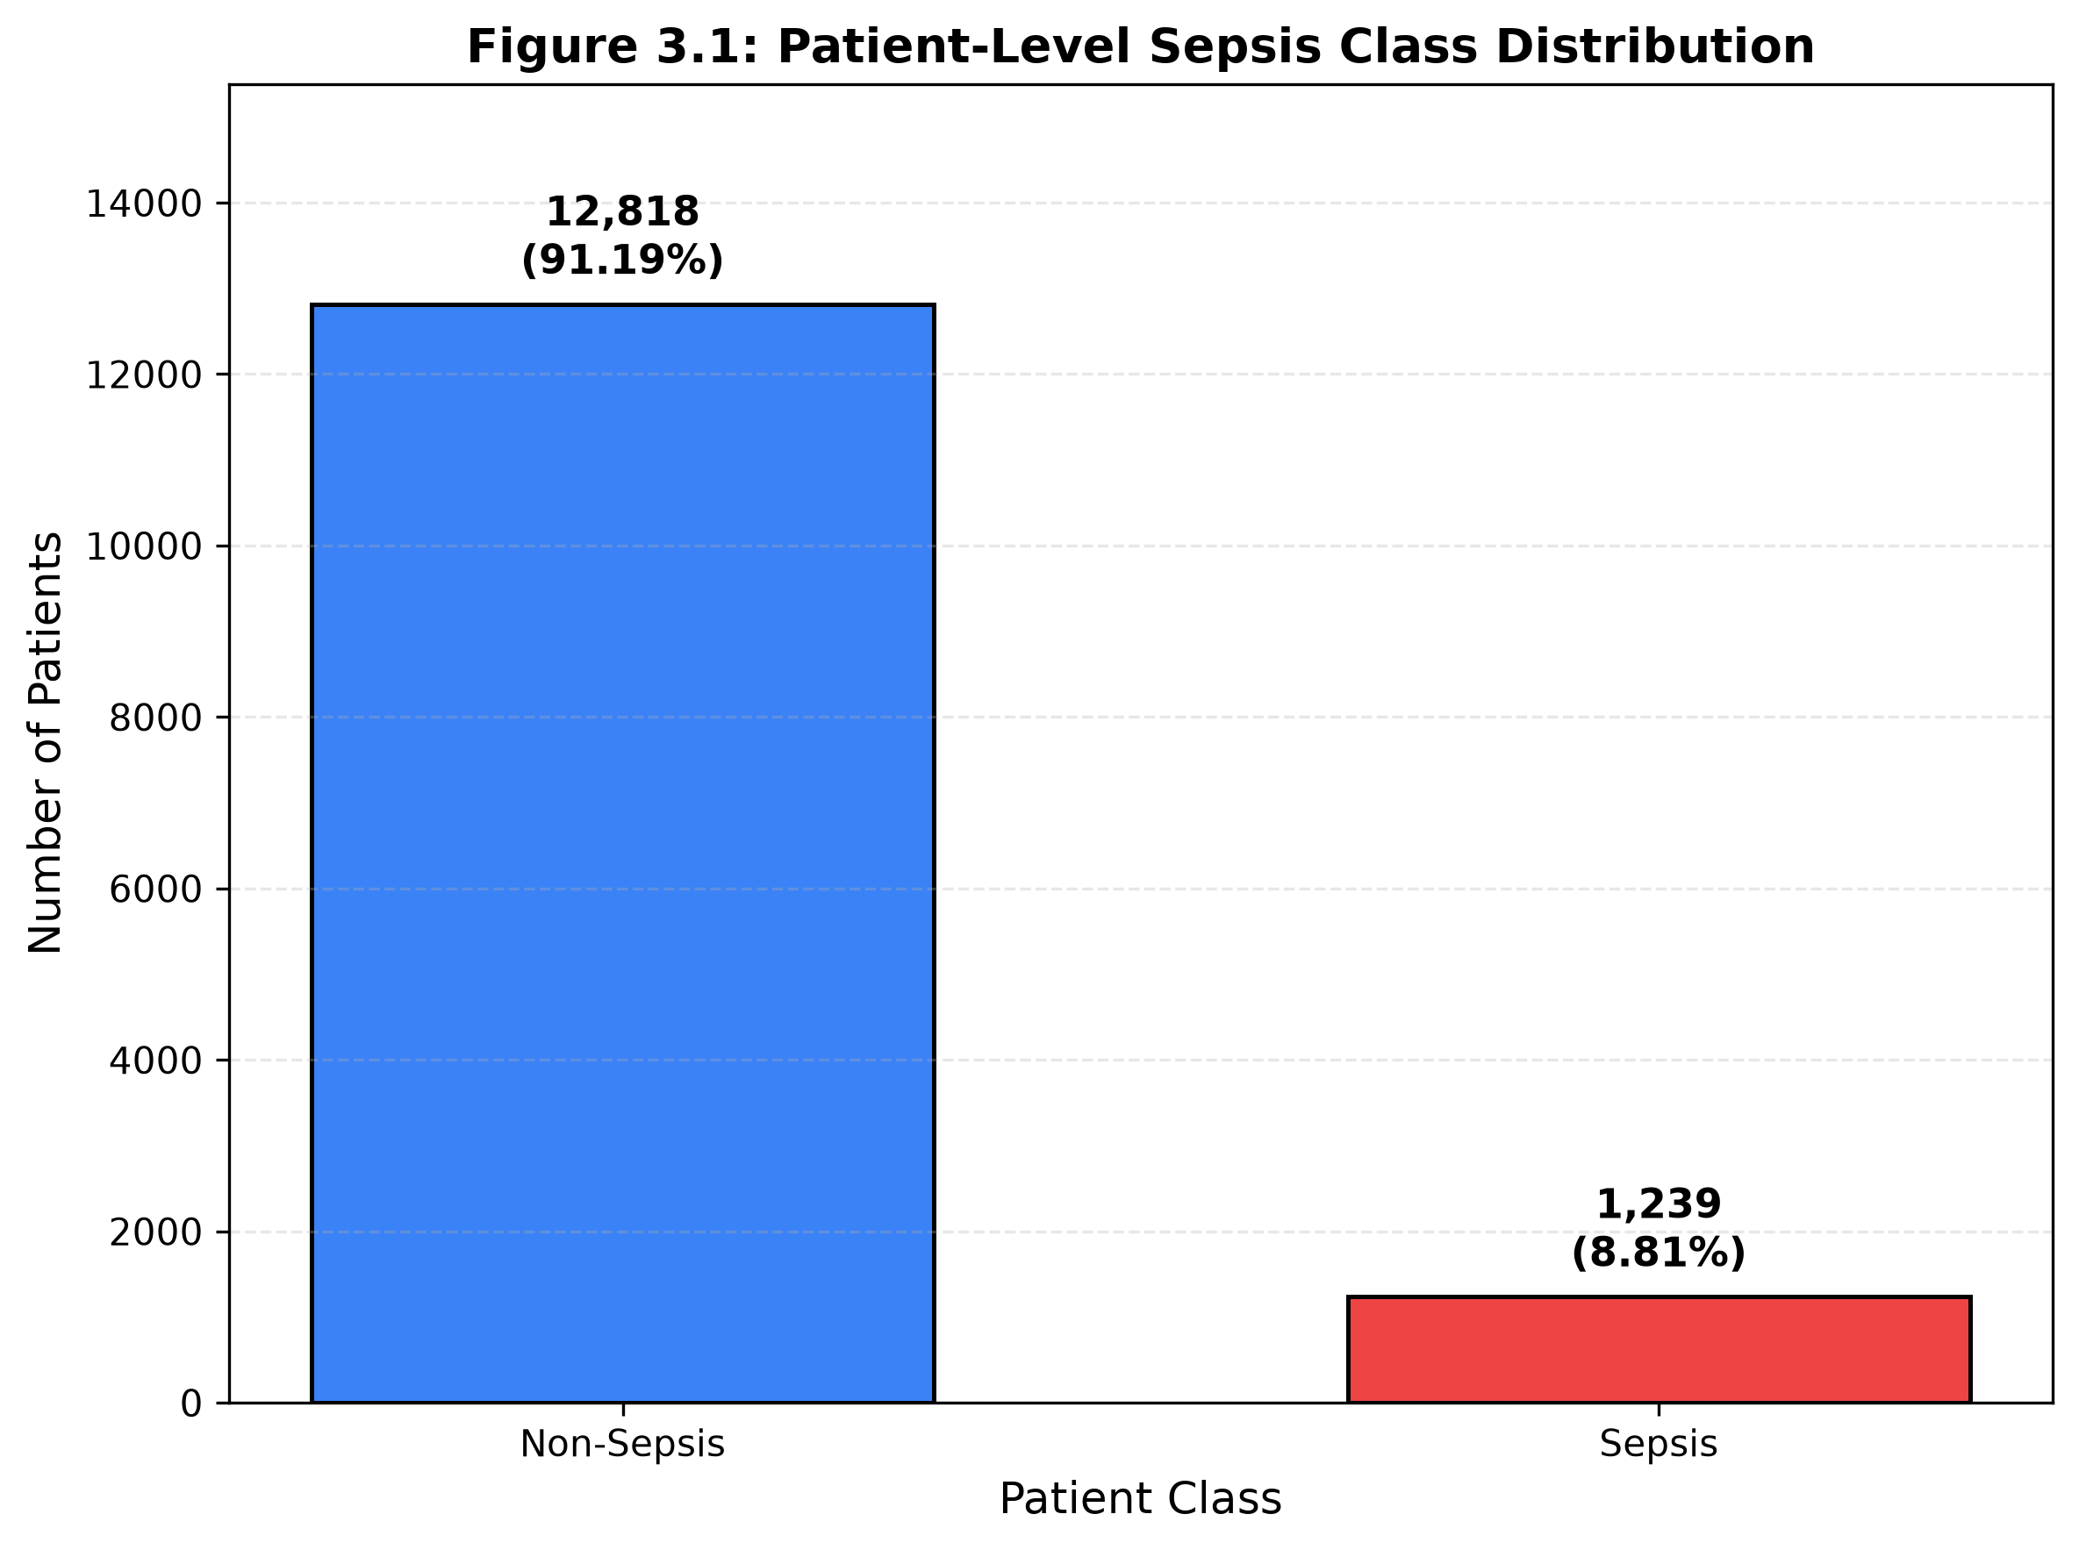
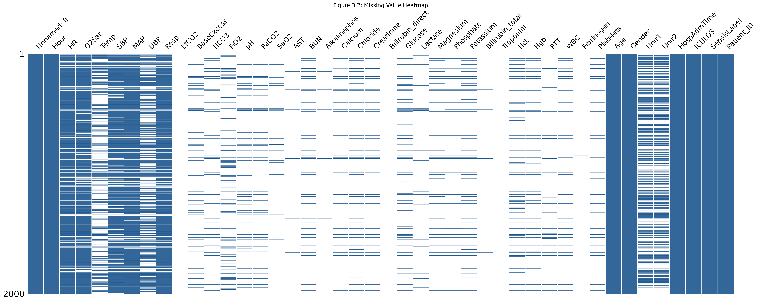
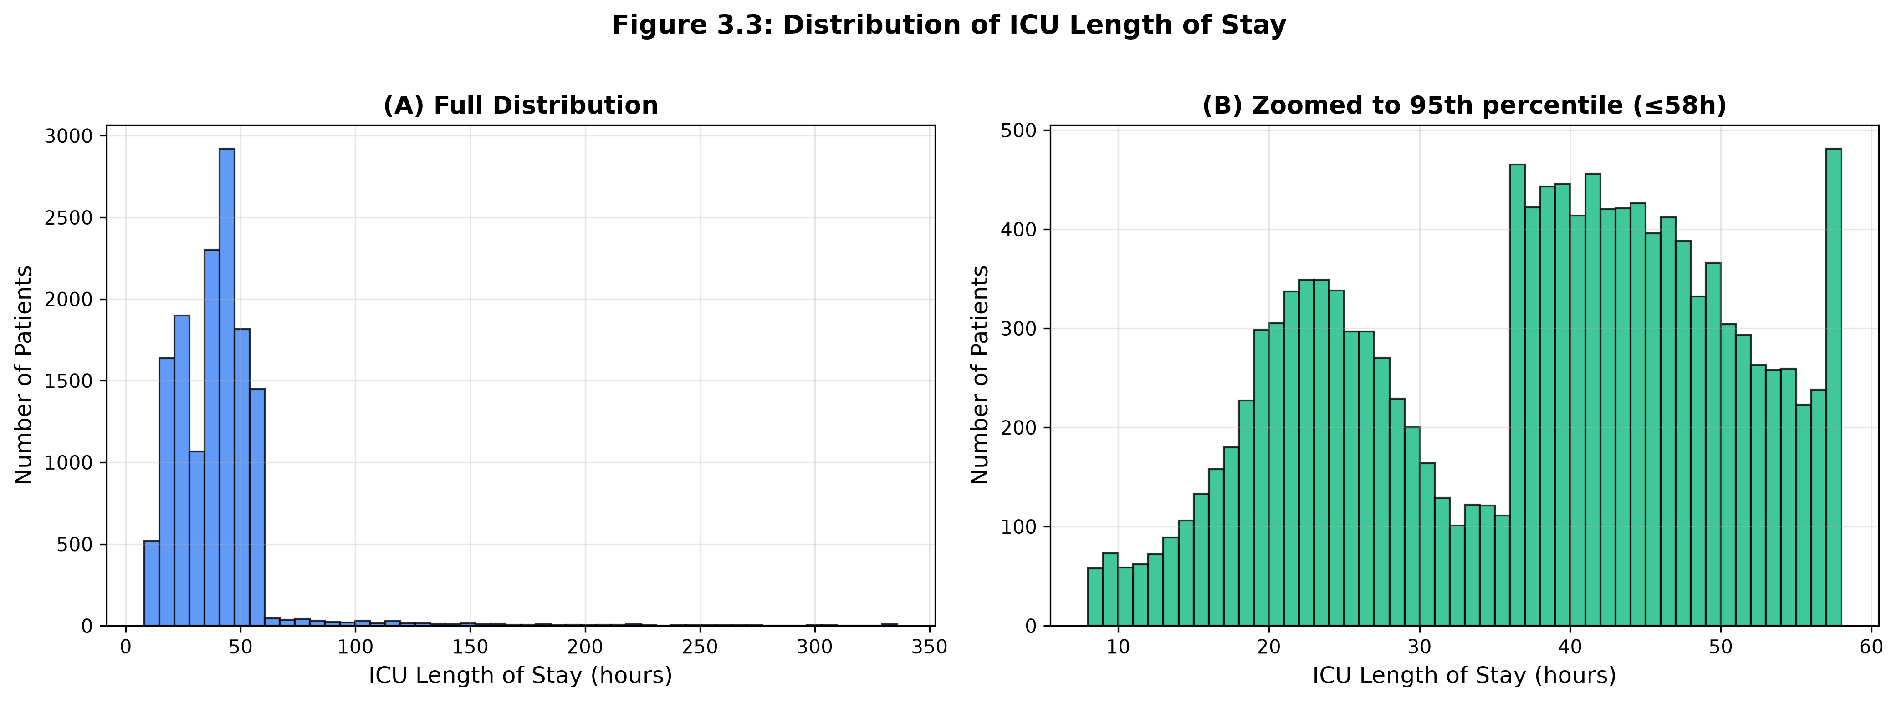
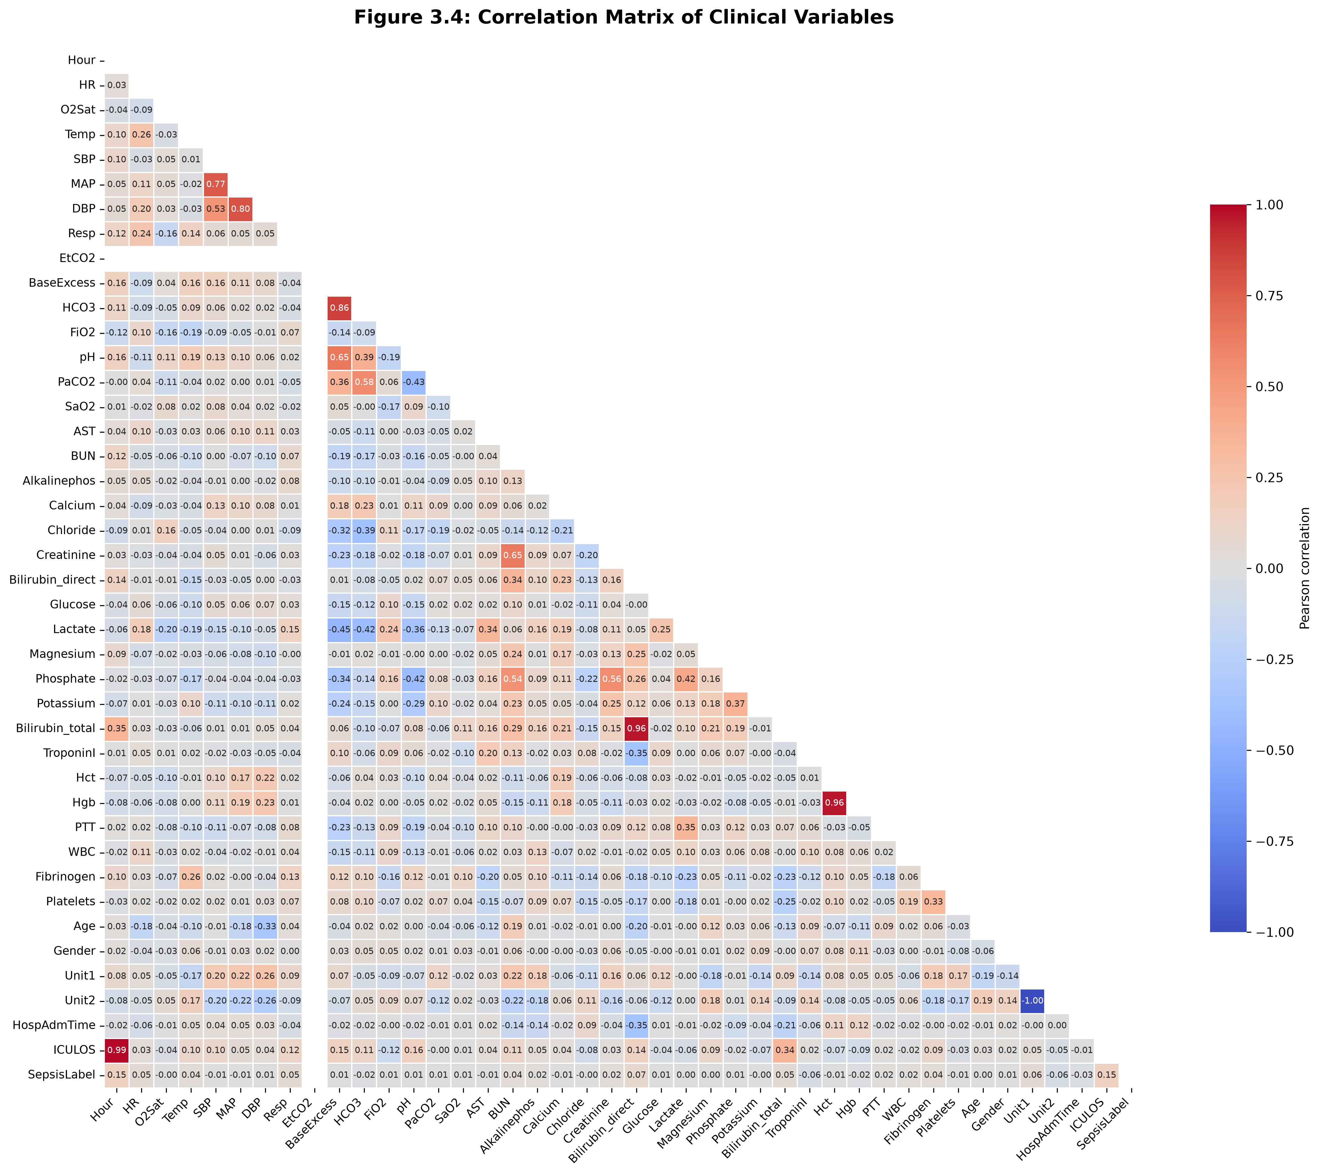
Exploratory Data Analysis — Key Findings
Class Distribution
Missing Value Heatmap
ICU Length of Stay
Correlation Matrix
Sepsis Early Warning System — Review 2
14 / 28

Slide 15
Proposed Approach — Block Diagram
Step 1: Data Collection
PhysioNet 2019 Dataset (546K × 44)
Step 2: Data Cleaning
Drop unnamed, drop >80% missing (43→16), sort
Step 3: Target Construction
Target_6h & Target_12h; filter SepsisLabel==0
Step 4: Feature Engineering
21 Lag + 21 Change + 28 Rolling → 84 features
Step 5: Cross-Validation
5-fold GroupKFold grouped by Patient_ID
Step 6: Model Training
3 baselines + XGBoost 6h/12h; SMOTE on train folds
Step 7: Threshold Locking
Best F1 from validation; applied to test set
Step 8: SHAP + Dashboard
TreeExplainer; per-patient factors; HTML + Streamlit
Sepsis Early Warning System — Review 2
15 / 28

Slide 16
System Architecture
Raw ICU Dataset
546,122 × 44, 14,057 patients
▼
Preprocessing Layer
Column dropping | Median imputation | Feature engineering
▼
Feature Store (84)
14 base + 70 engineered
▼
Model Layer
XGBoost 6h | XGBoost 12h (scale_pos_weight≈85)
▼
Explainability Layer
TreeExplainer | Per-patient SHAP factors
▼
Prediction Output
Patient predictions CSV
▼
Dashboard
HTML + Streamlit | Search | Filter | SHAP cards
Sepsis Early Warning System — Review 2
16 / 28

Slide 17
Mathematical Model — Algorithm
Feature Engineering Equations
XGBoost Objective & SHAP
Lag: X_lag_k(t) = X(t − k), k ∈ {1,3,6}
Change: ΔX_k(t) = X(t) − X(t − k)
Rolling Mean (3h):
X̄_3h(t) = (1/3) Σ X(t−i)
Rolling Std:
σ_3h(t) = sqrt( (1/3) Σ (X − X̄)² )
Class Weight:
scale_pos_weight = N₋ / N₊ ≈ 85.66
Objective:
Obj = Σ L(y, ŷ) + Σ Ω(f_k)
L = binary cross-entropy
Ω(f) = γT + ½λ‖w‖²
Prediction:
P(sepsis|X) = σ( Σ f_k(X) )
Threshold:
t* = argmax_t F1(y_val, 𝟙[P ≥ t])
SHAP:
φ_i = Σ_S [ |S|!(|F|−|S|−1)!/|F|! ]
× [ f(S ∪ {i}) − f(S) ]
Sepsis Early Warning System — Review 2
17 / 28

Slide 18
Patient-Aware Cross-Validation — GroupKFold
The Leakage Problem
GroupKFold Solution
• ICU data has multiple hourly rows per patient
• Random k-fold: same patient in train AND test
• Model 'remembers' patient baseline → inflated scores
• Result: unrealistically high AUROC that fails in hospital
• All rows for one patient go to EITHER train OR test
• Guarantees evaluation on unseen patients
• 5-fold CV grouped by Patient_ID
• Mirrors real clinical deployment exactly
Preprocessing Discipline (No Leakage)
• Winsorization bounds fit on TRAIN fold only → applied to VAL
• Median imputation values computed on TRAIN fold only
• StandardScaler fit on TRAIN fold only
• SMOTE applied ONLY to training fold — validation stays untouched
Why This Matters
• Published AUROC values are often inflated by row-level splits
• Our GroupKFold results represent realistic generalization performance
Sepsis Early Warning System — Review 2
18 / 28

Slide 19
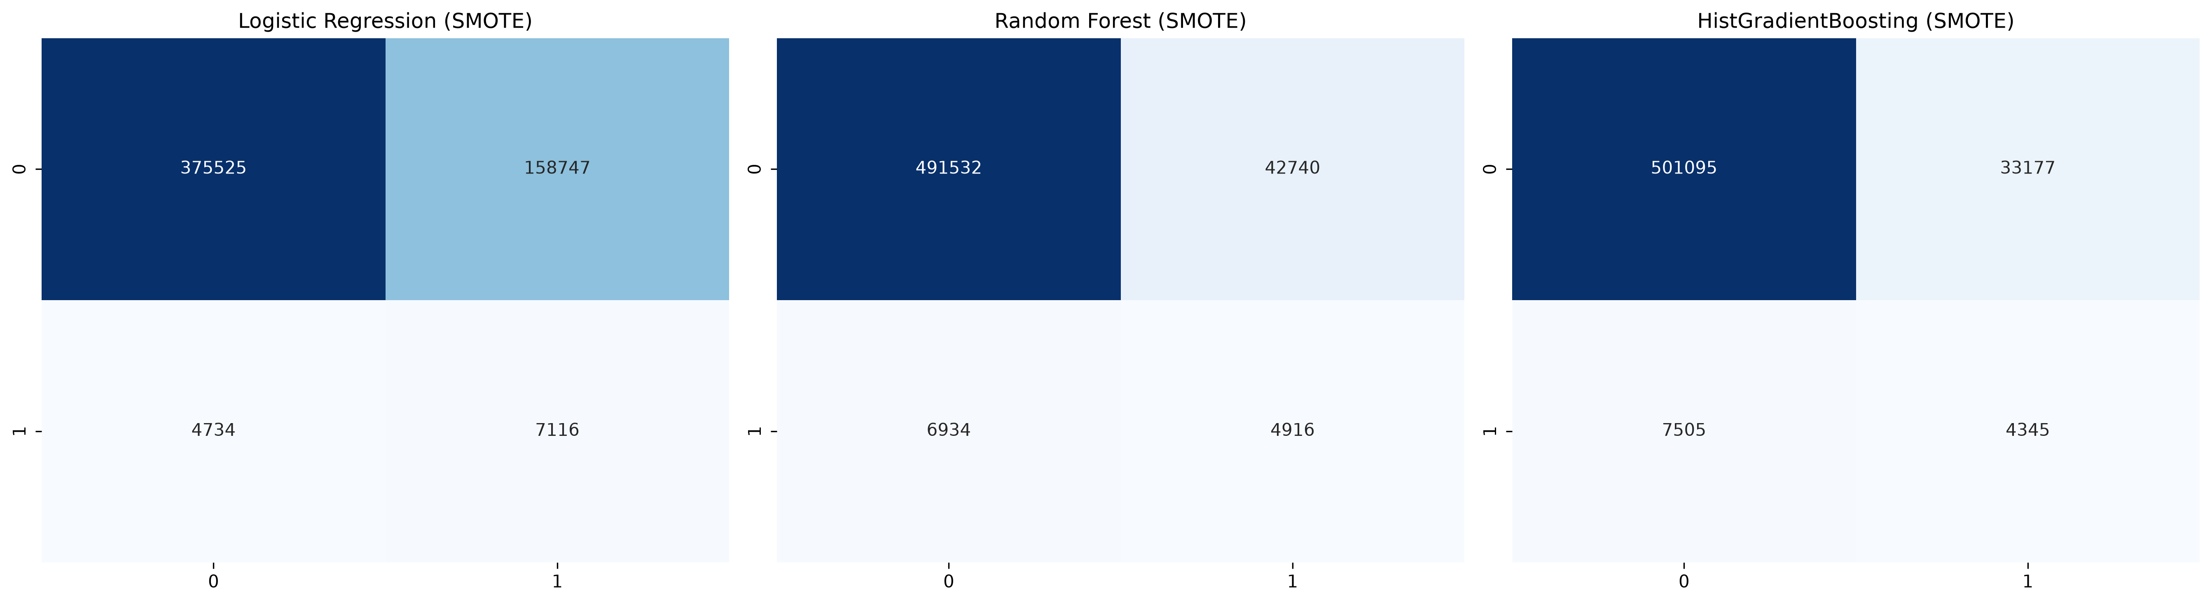
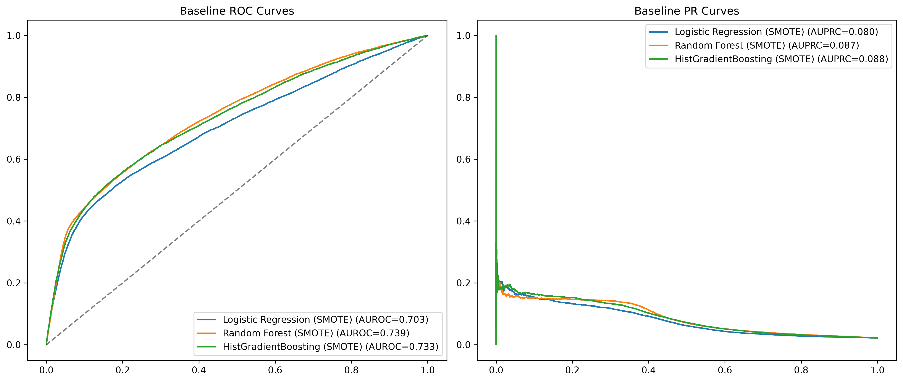
Results — Baseline Models (5-Fold GroupKFold + SMOTE)
Model | AUROC | AUPRC | Recall | Precision
Logistic Regression + SMOTE | 0.703 ± 0.013 | 0.079 | 0.601 | ~0.08
Random Forest + SMOTE | 0.739 ± 0.010 | 0.088 | 0.416 | ~0.09
HistGradientBoosting + SMOTE | 0.733 ± 0.012 | 0.088 | 0.367 | ~0.09
Confusion Matrices — Baselines
ROC & PR Curves — Baselines
Sepsis Early Warning System — Review 2
19 / 28

Slide 20
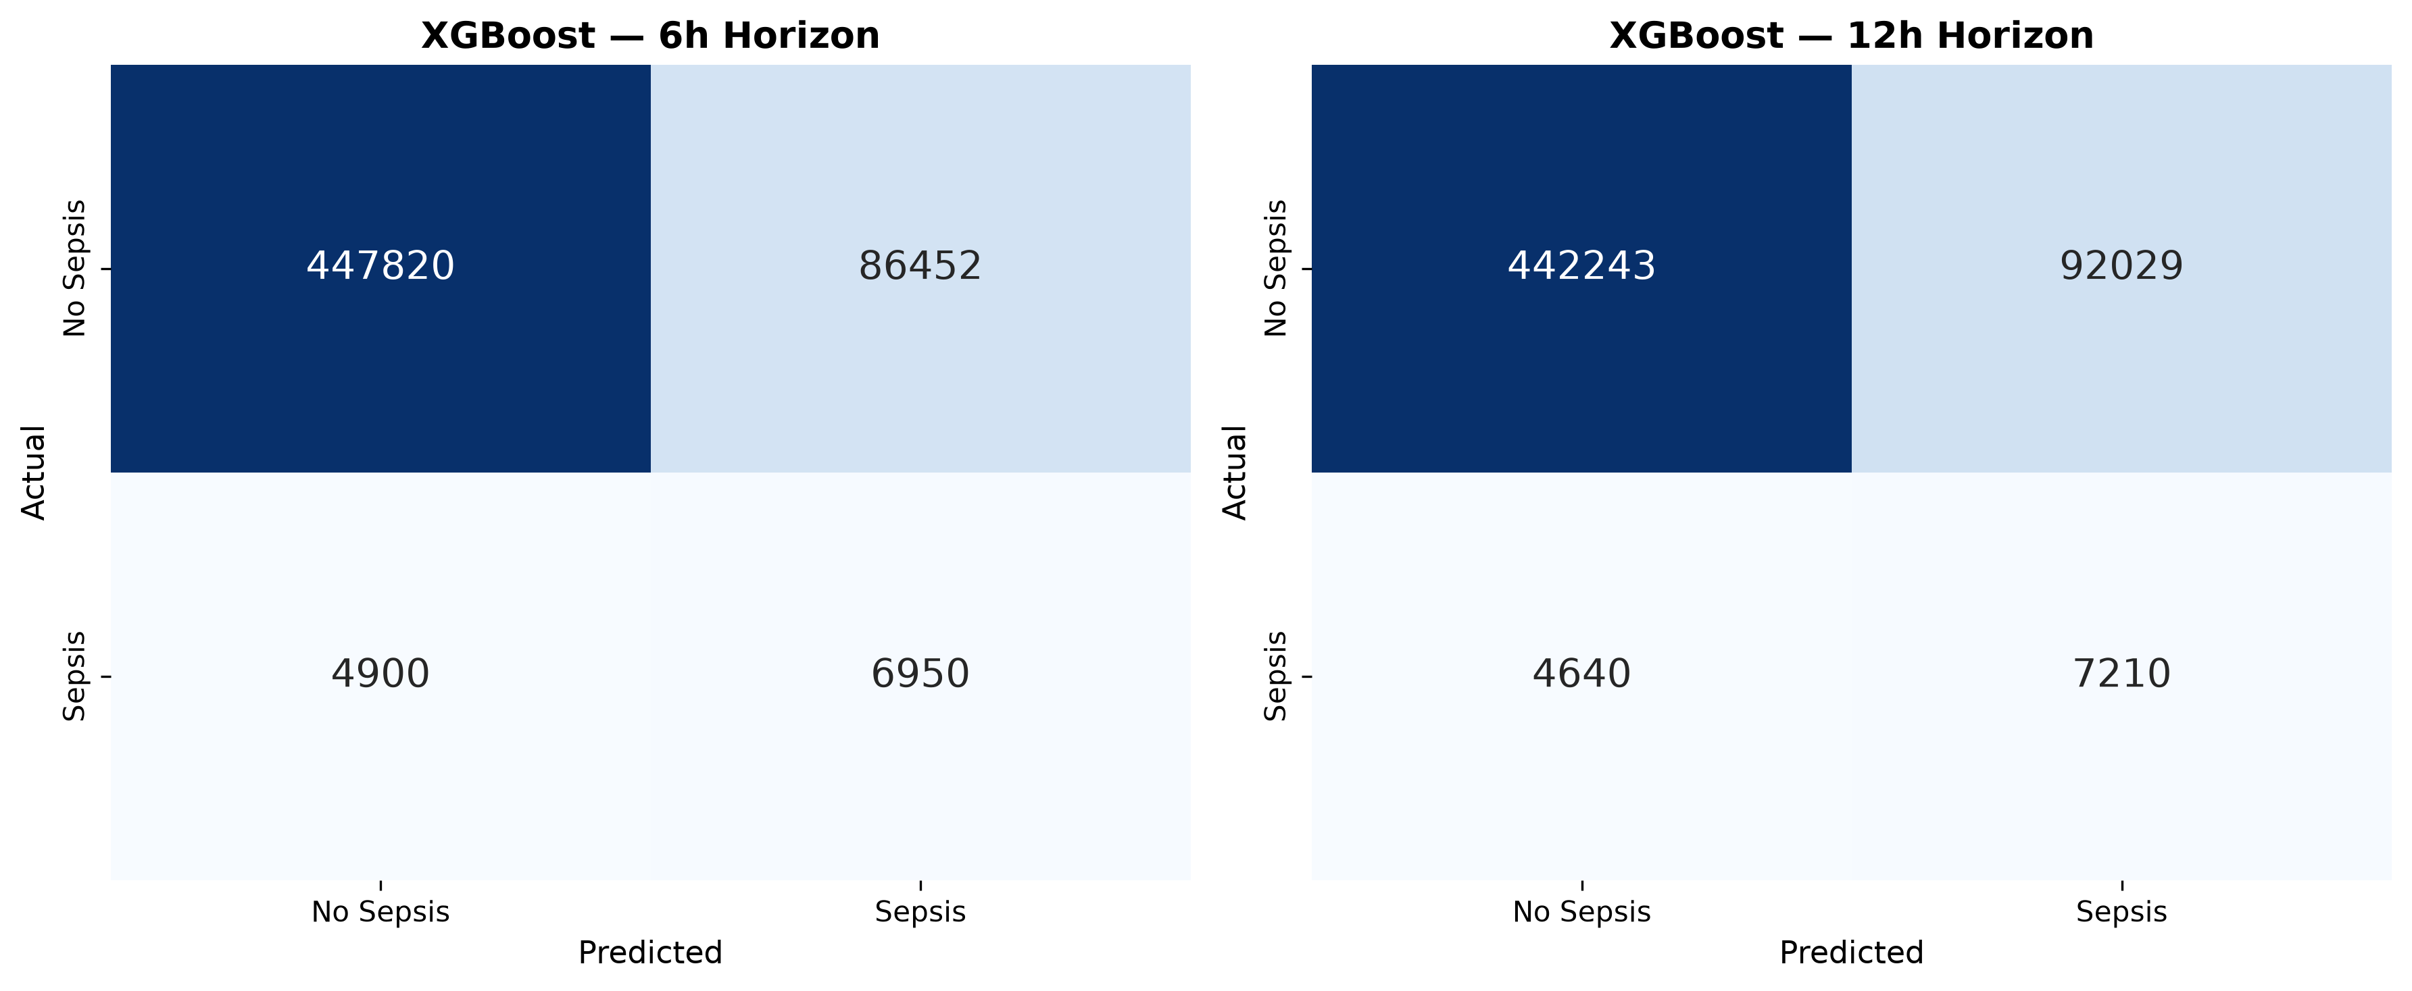
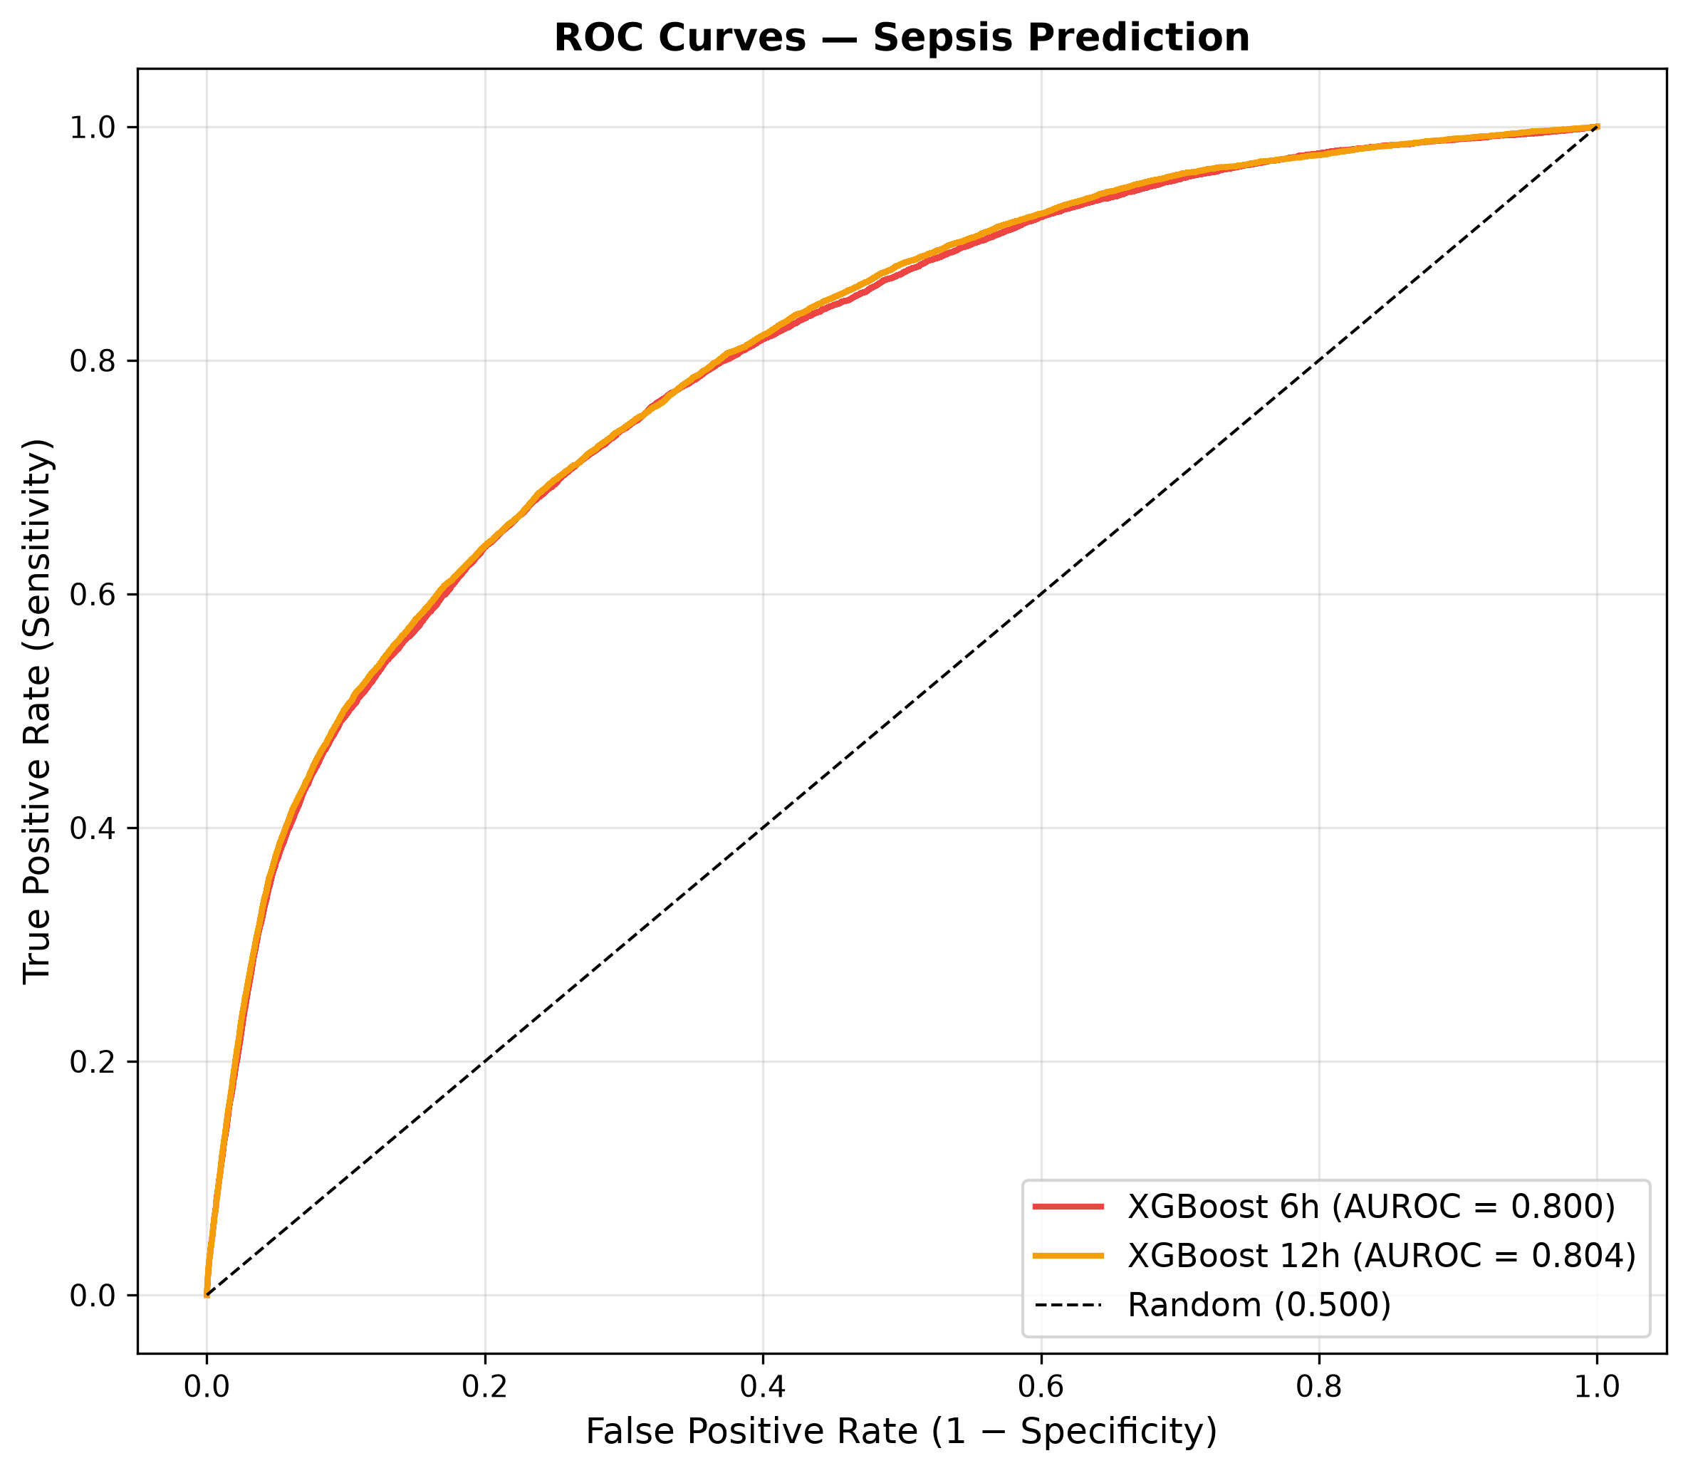
Results — Advanced Temporal XGBoost
6h Model (Threshold = 0.80)
12h Model (Threshold = 0.65)
Key Takeaways
AUROC = 0.800
AUPRC = 0.112
Recall = 0.312
Precision = 0.104
F1 = 0.156
AUROC = 0.804
AUPRC = 0.115
Recall = 0.409
Precision = 0.181
F1 = 0.251
• +0.06 AUROC over best baseline
• 12h catches 41% of sepsis
• Precision improved 2.5×
• AUPRC 5× better than random
• Threshold locked from validation
Final Confusion Matrices
ROC Curves — 6h vs 12h
Sepsis Early Warning System — Review 2
20 / 28

Slide 21
Deep Learning Exploration (Future Work)
LSTM / GRU — Detection (Naive Labeling)
LSTM / GRU — Prediction (Proper Framing)
• Input window INCLUDES septic period
• LSTM: AUROC 0.934 ± 0.004
• GRU: AUROC 0.934 ± 0.009
• Warning: inflated by TARGET LEAKAGE
• Model reads the answer from input
• Input strictly precedes prediction time
• LSTM: AUROC 0.571 ± 0.014
• GRU: AUROC 0.563 ± 0.013
• Underperforms even Logistic Regression
• XGBoost wins at AUROC 0.80
Key Finding — Methodological Contribution
• 0.37 AUROC gap between detection and prediction quantifies target leakage
• Aligns with Grinsztajn et al. (2022): tree models beat DL on tabular data
• Result: XGBoost remains the deployed production model
• Full DL experiments preserved in future_work/ for reproducibility
LSTM/GRU — Detection vs Prediction ROC & PR Curves (optional)
[INSERT IMAGE]
dl_lstm_gru_curves.png
Sepsis Early Warning System — Review 2
21 / 28

Slide 22
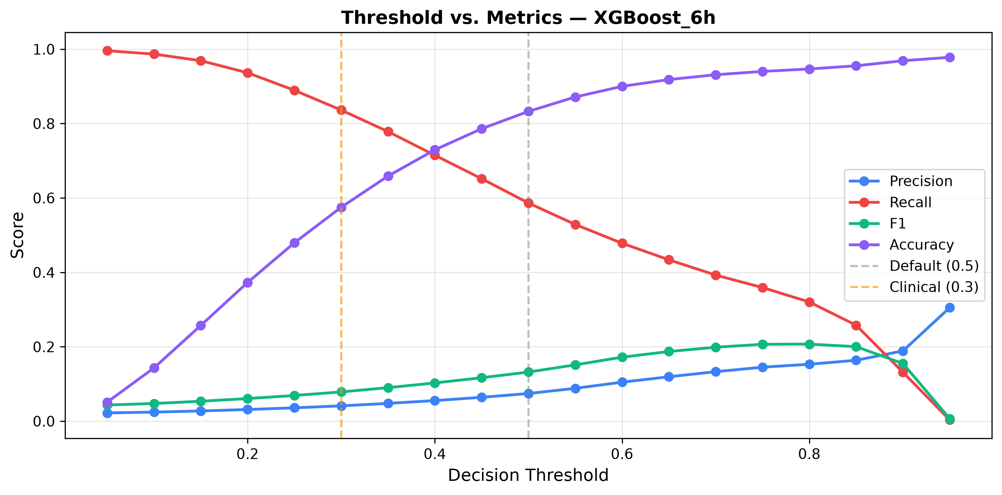
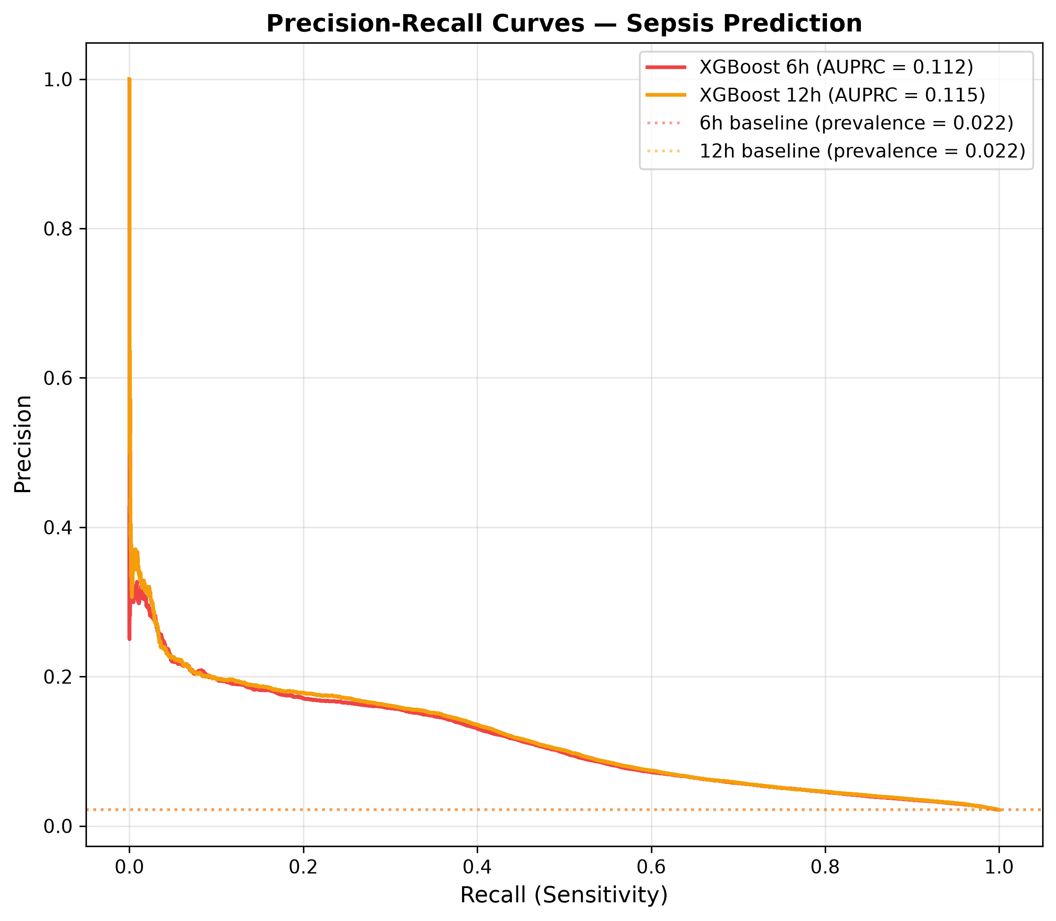
Threshold Sensitivity & PR Curves
Threshold Analysis — 6h Model
Precision-Recall Curves (6h vs 12h)
Sepsis Early Warning System — Review 2
22 / 28

Slide 23
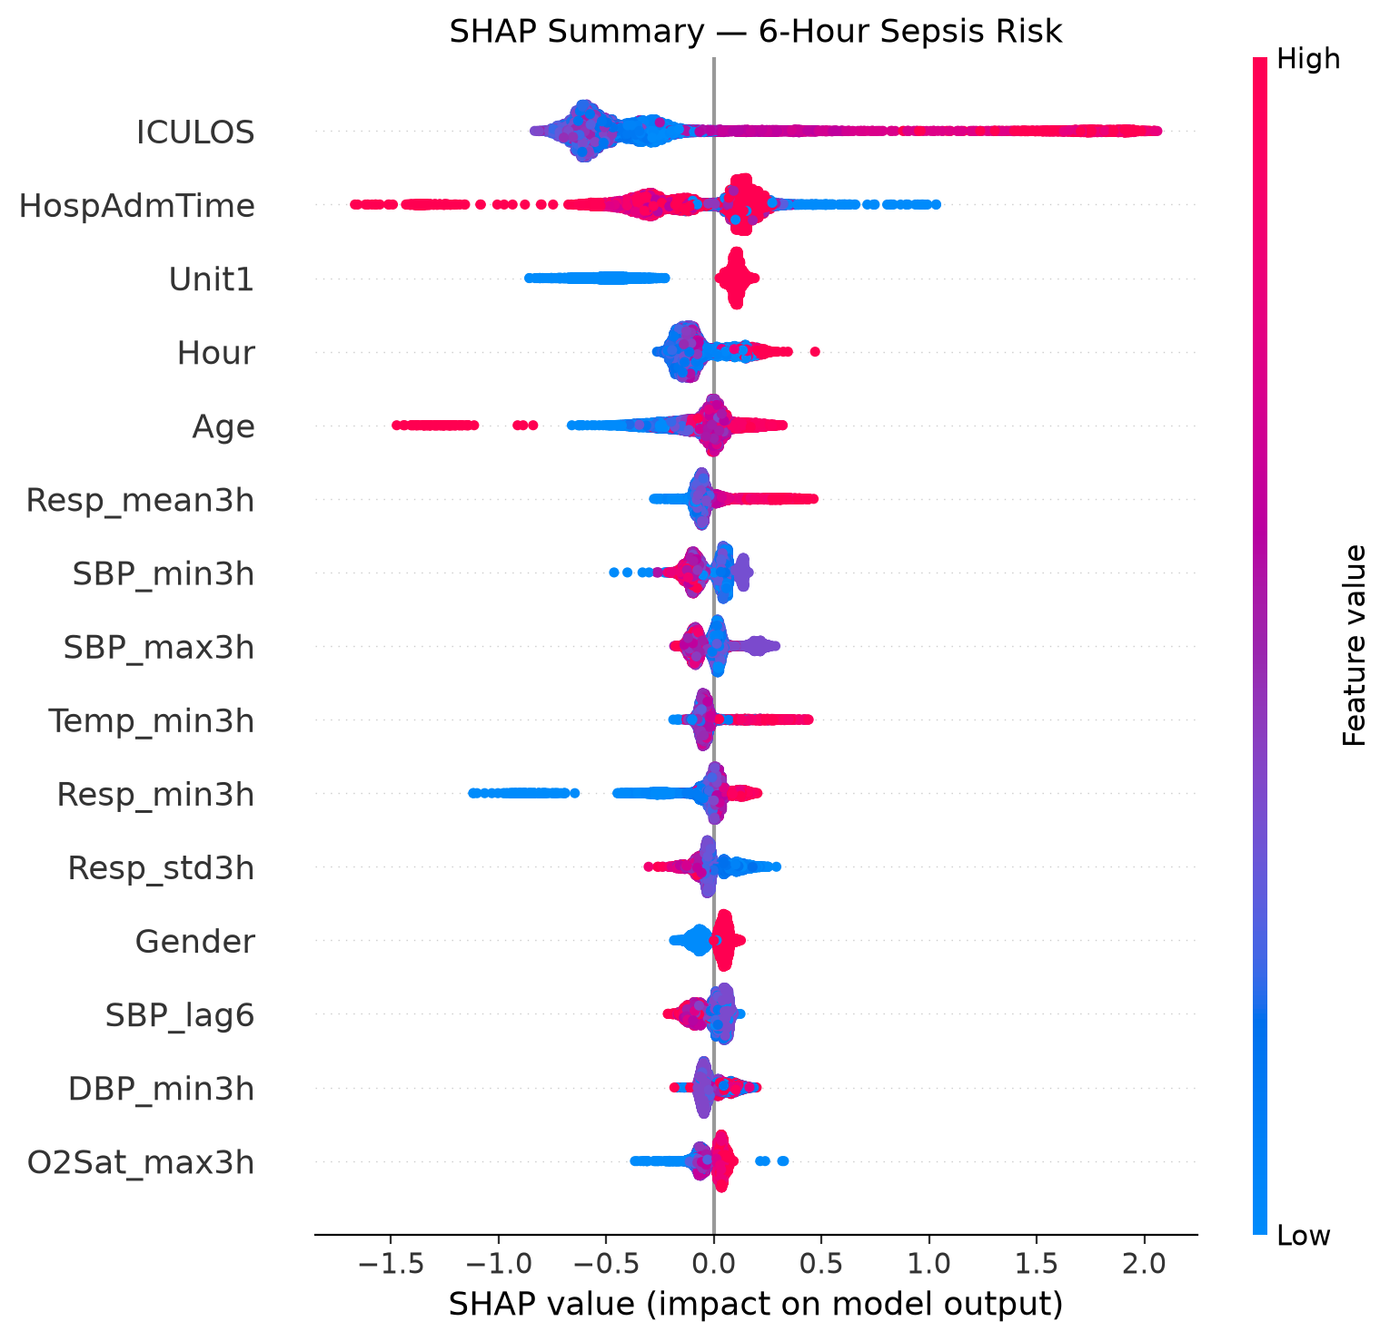
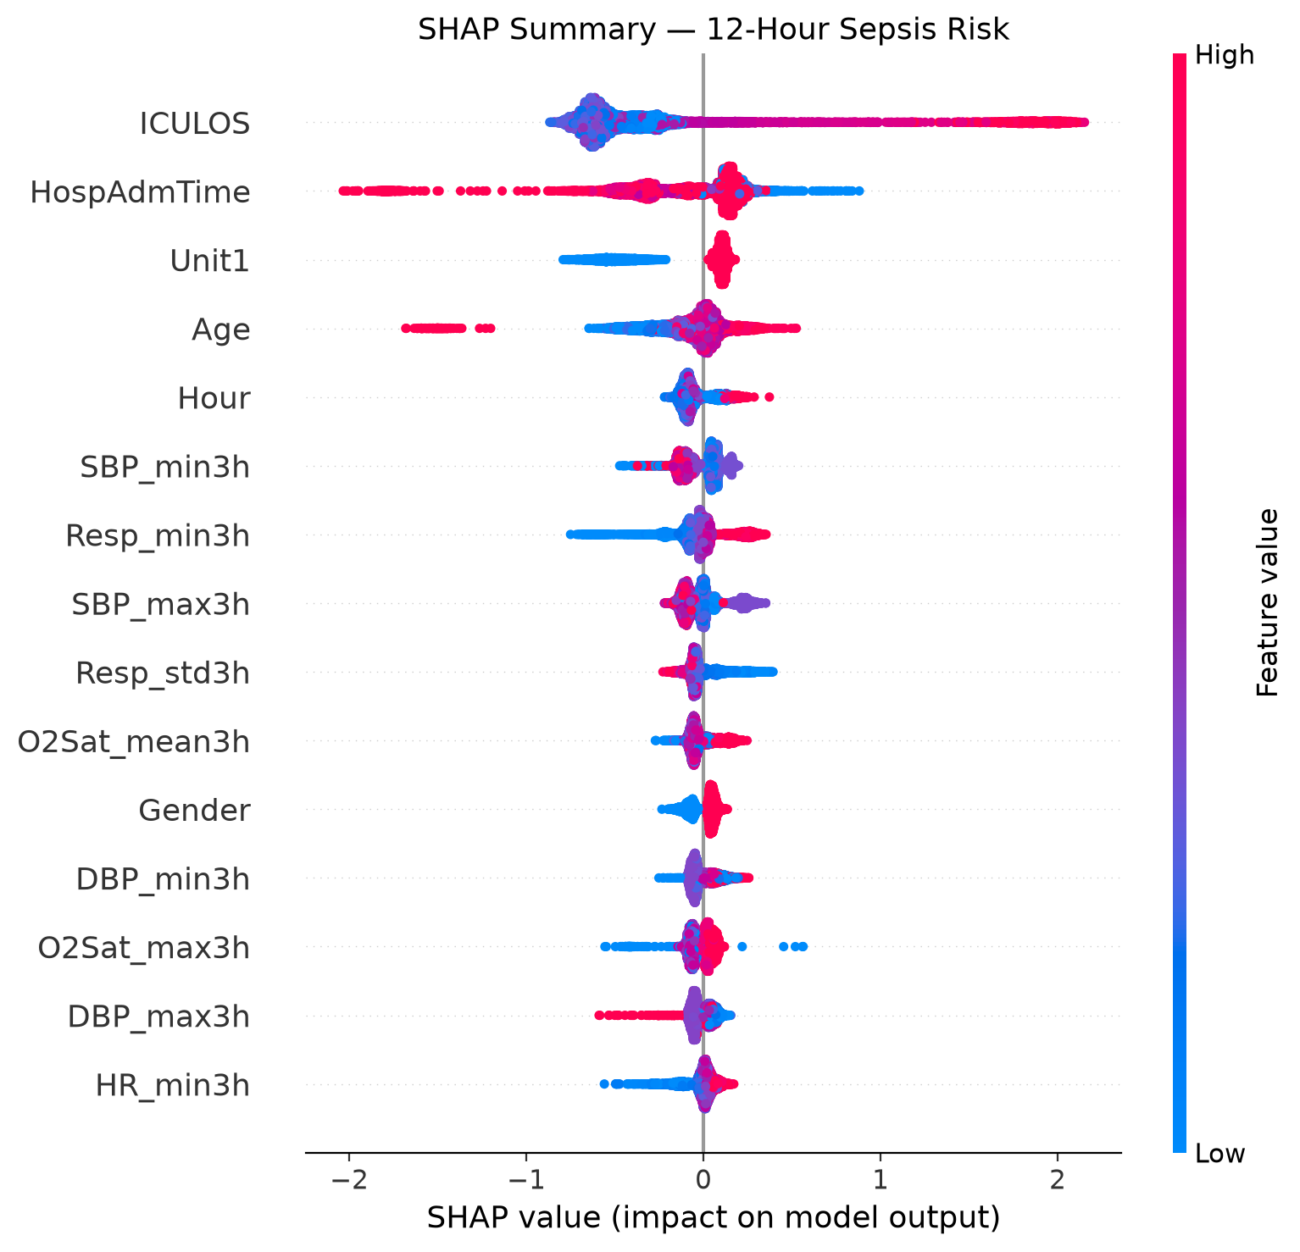
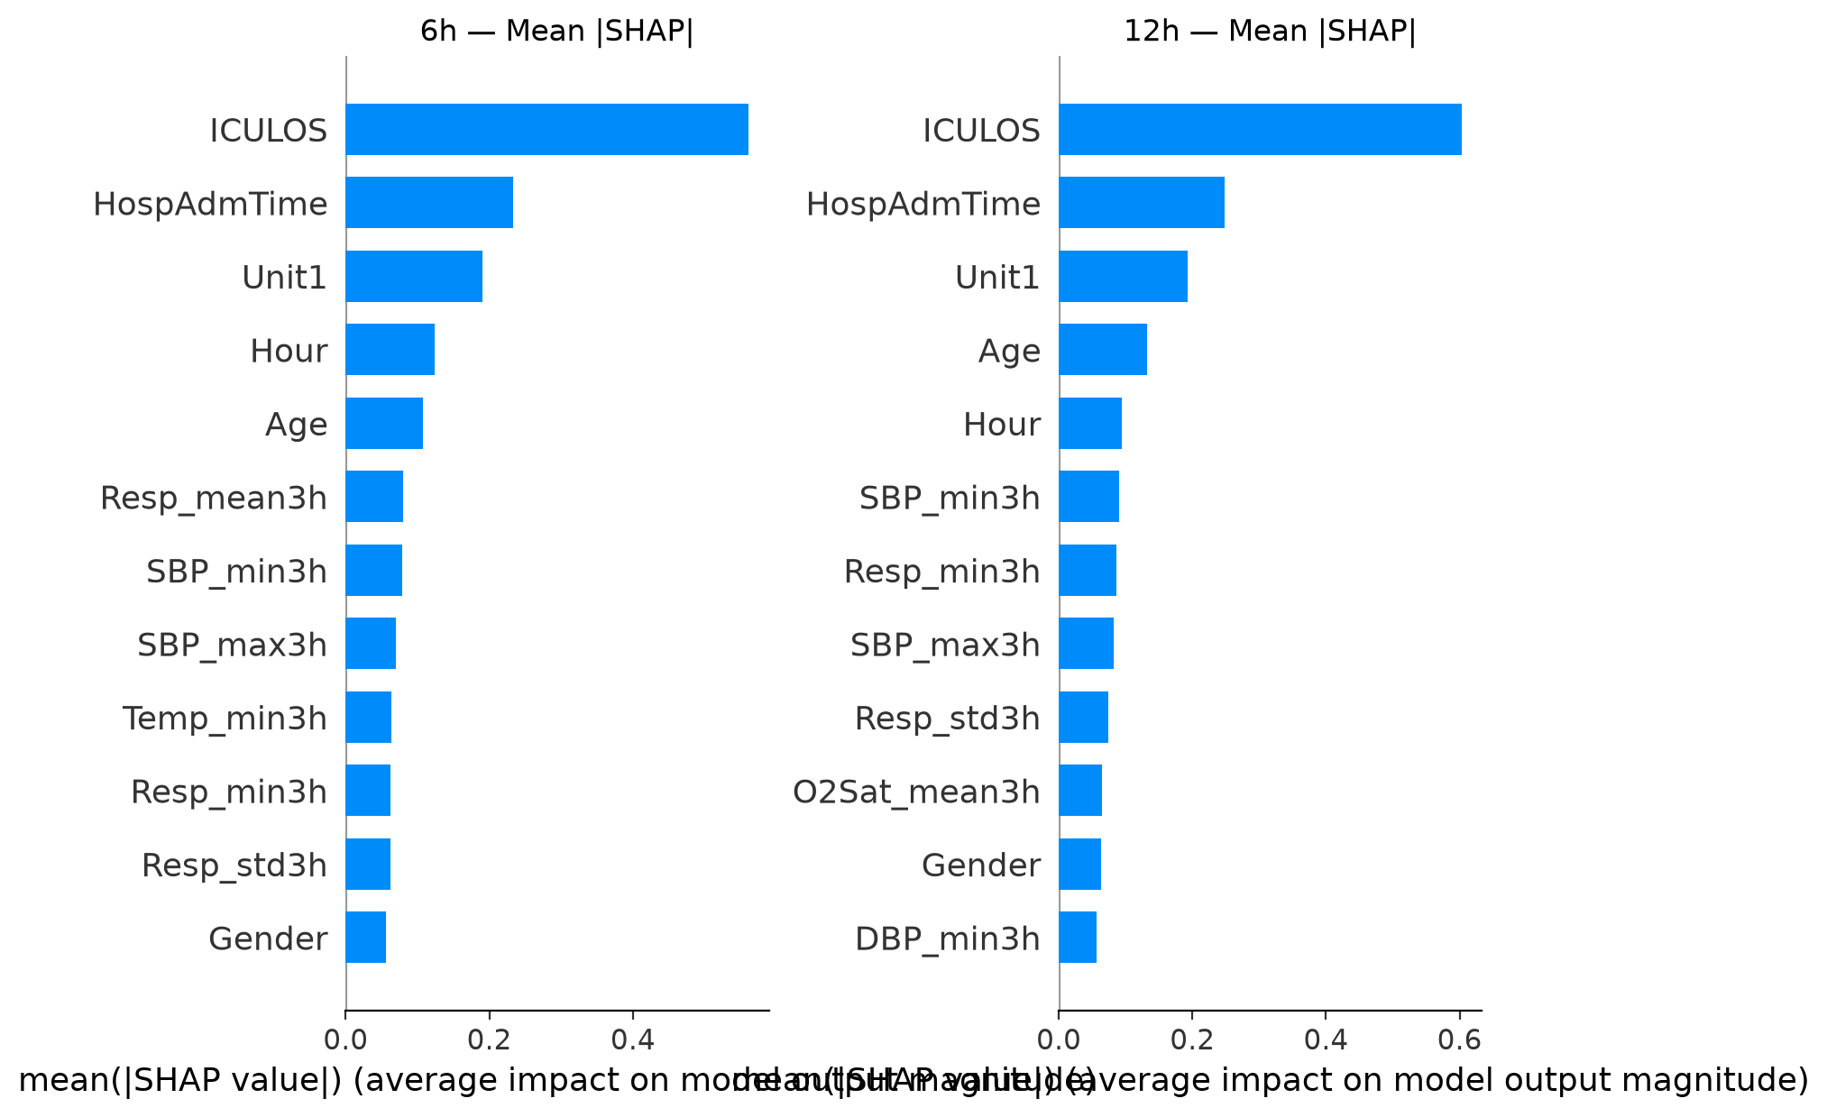
SHAP Explainability Results
SHAP Summary — 6h Model
SHAP Summary — 12h Model
SHAP Bar Comparison
Key SHAP Finding
• Top 5: ICULOS, HospAdmTime, Unit1, Hour, Age
• Static/time features → 42% of attention
• Dynamic vitals (lags, rolling) → 57.5% aggregate
• Action item: ablation removing static features
Sepsis Early Warning System — Review 2
23 / 28

Slide 24
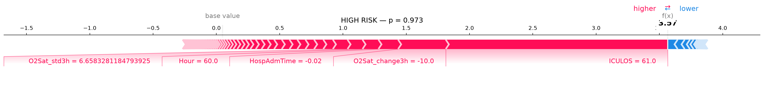
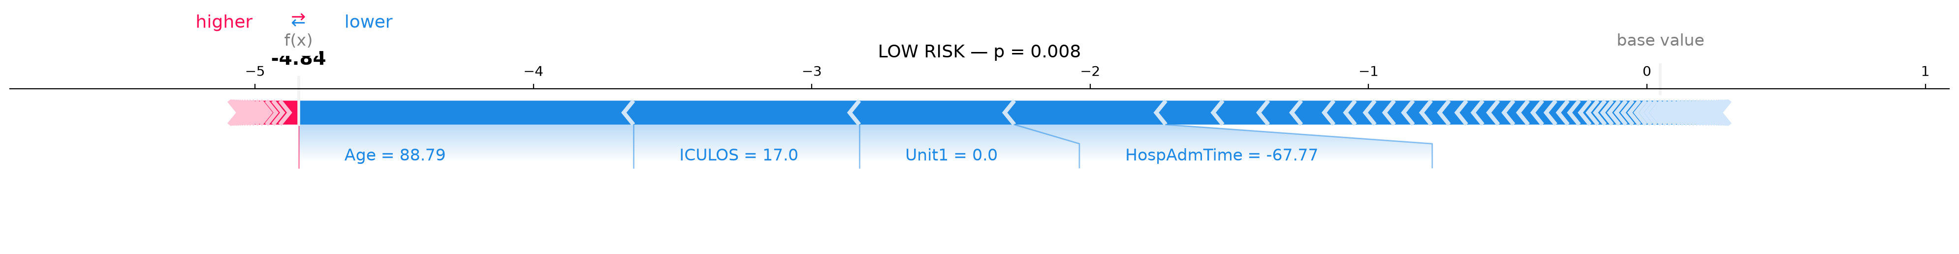
SHAP Force Plots — Patient-Level Explanations
High-Risk Patient (p ≈ 0.978)
Low-Risk Patient (p ≈ 0.004)
Sepsis Early Warning System — Review 2
24 / 28

Slide 25
Dashboard Deployment — Screenshots
Main Dashboard — Patient Search & Filters
Patient Detail — Vitals, Risk & SHAP
[INSERT IMAGE]
dashboard_main_view.png
[INSERT IMAGE]
dashboard_patient_detail.png
High-Risk Cohort Filter
Features
[INSERT IMAGE]
dashboard_high_risk_filter.png
• Searchable patient dropdown
• Risk filters with live counts
• SHAP top-3 factors per patient
• Rule-based clinical recommendations
• 14,057 patients loaded
Sepsis Early Warning System — Review 2
25 / 28

Slide 26
Research Ethics Principles
Ethical Principle | How It Applies to Our Project
Honesty & Integrity | Report actual experimental results from PhysioNet dataset
No Fabrication | No synthetic sepsis labels; real ICU data only
No Falsification | Test metrics at thresholds locked from validation
No Plagiarism | All PhysioNet papers cited; XGBoost/SHAP attributed
Data Privacy | Public de-identified dataset; no patient identifiers
Informed Consent | Not applicable — public research dataset
Fairness | Patient-level GroupKFold split prevents leakage
Intellectual Property | Open-source libraries used per license
Transparency | Full pipeline shared; SHAP reveals model reasoning
Responsible AI | Dashboard states 'not a clinical diagnosis'
Sepsis Early Warning System — Review 2
26 / 28

Slide 27
Acknowledgement & Conclusion
Acknowledgement
Conclusion
We sincerely thank:
• Mrs. Akanksha Magare, for continuous guidance
• PCCOE Dept. of Computer Engineering
• PhysioNet 2019 organizers for public dataset
• Open-source: scikit-learn, XGBoost, SHAP
AI Tools Used:
• GitHub Copilot — code completion
• ChatGPT / Claude — documentation
• draw.io — architecture diagrams
• matplotlib + seaborn — figures
Achievements:
✓ Built 84-feature temporal pipeline
✓ Trained 6h & 12h XGBoost (AUROC 0.80)
✓ +0.06 AUROC over best baseline
✓ 5× AUPRC improvement over random
✓ SHAP per-patient explanations
✓ HTML + Streamlit dashboards deployed
✓ Quantified target-leakage in DL framing
Future Work:
• Ablation removing ICULOS/HospAdmTime
• Transformer architectures
• Multi-hospital generalization
• EHR integration (HL7 FHIR)
Sepsis Early Warning System — Review 2
27 / 28

Slide 28
References (Selected)
[1] M. Singer et al., "Sepsis-3 Consensus Definitions," JAMA, 315(8), 2016.
[2] K. E. Rudd et al., "Global sepsis incidence and mortality 1990–2017," Lancet, 395, 2020.
[3] C. Fleischmann et al., "Global Incidence and Mortality of Hospital-treated Sepsis," AJRCCM, 2016.
[4] M. A. Reyna et al., "Early Prediction of Sepsis: PhysioNet Challenge 2019," CCM, 48(2), 2020.
[5] T. Chen and C. Guestrin, "XGBoost: A Scalable Tree Boosting System," KDD, 2016.
[6] S. M. Lundberg and S.-I. Lee, "A Unified Approach to Interpreting Model Predictions," NeurIPS, 2017.
[7] A. E. Johnson et al., "MIMIC-III: a freely accessible critical care database," Sci Data, 2016.
[8] E. P. Raith et al., "Prognostic Accuracy of SOFA, SIRS, qSOFA," JAMA, 317(3), 2017.
[9] L. Grinsztajn et al., "Why tree-based models still outperform deep learning on tabular data," NeurIPS, 2022.
[10] N. V. Chawla et al., "SMOTE: Synthetic Minority Over-sampling Technique," JAIR, 16, 2002.
Sepsis Early Warning System — Review 2
28 / 28

