Slide 1
R Programming Basics Workshop
with Abhinav Agrawal
aagarw30@gmail.com

Slide 2
Workshop topics
8:30 – 11:00 AM
Introduction
Getting Started with R
R as a simple calculator
In-built functions and Data Structure in R
Looping and Conditional Statements
Input and Output Data
Sub setting
Summary Statistics
Basic plots
11:00 – 11:15 AM
Short Break
11:15 AM – 12:30 PM
Introduction to external packages,
Installing and Loading external packages,
Ggplot2 package
Demonstration of graphics with GGplot2
12:30 – 01:30 PM
Lunch Break
01:30 – 03:30 PM
Exploratory Data Analysis (using the concepts learnt so far..)
Quick demo of regression, text analytics, classification
R learning resources
aagarw30@gmail.com

Slide 3
Learning Objectives
Familiarity with R console and R Studio
Use R data structure and in built functions to perform basic operations
Perform basic data analysis
Data Visualization
Draw basic inference from the data
Exposure to external packages in R
aagarw30@gmail.com

Slide 4

Need for data analysis ?
“ Gives valuable information from raw data that could be used for answering questions, making business decisions, optimizations, research and academia “
aagarw30@gmail.com

Slide 5
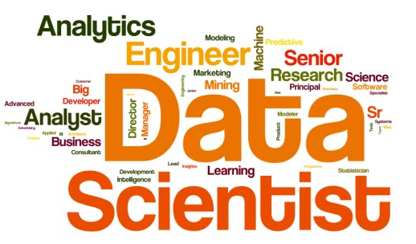
Sexiest job in the market
aagarw30@gmail.com

Slide 6








Data Analysis Tools
aagarw30@gmail.com

Slide 7
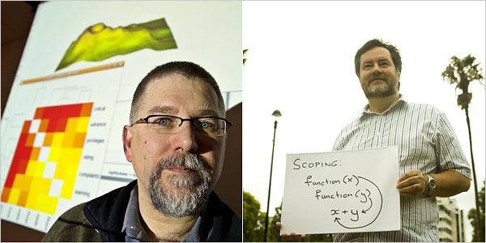
R Statistical Programming Language
R is a programming language for statistical computing, data analysis and graphical display
Written by Ross Ihaka and Robert Gentleman, at the University of Auckland
It is originated from the S language, which was principally developed by John Chambers at Bell Labs
aagarw30@gmail.com

Slide 8
Why R?
R is free, open source
Rich collection of user contributed packages (libraries) used for data analysis and manipulations
Supported by open source community – more than 2M R users/developers around the world
Great graphics and data visualization
Can be integrated with other languages like C, C++, Java
Frequent releases (annual+bug fixes)/active development
aagarw30@gmail.com

Slide 9
R Capabilities
Mathematical Computations
Exploratory Data Analysis and Visualizations
Statistical modeling and tests
Probability distributions
Data Mining
Social Network Analysis
Machine Learning and Algorithms
aagarw30@gmail.com

Slide 10
Lets get started …..
aagarw30@gmail.com

Slide 11
R learning resources
Download and Install R : http://cran.r-project.org
http://cran.r-project.org/doc/manuals/r-release/R-admin.html
Books: Use R! by Springer, R IN ACTION by Robert I. Kabacoff
Online websites:
http://www.r-bloggers.com
http://www.r-tutor.com
MOOCs:
https://www.coursera.org
https://www.edx.org
https://www.udacity.com
aagarw30@gmail.com

