Slide 1

Exploration and Analysis of Gene-Disease Associations
ARUN AGARWAL
Temple university
Data science
Notes:
Name
School
Major and Minor
ICER ACRES REU Student
8 Weeks done, 2 more to go
Working under Arjun and Anna, both who have been incredibly helpful
About questions: feel free to ask me while I am presenting or at the end

Slide 2
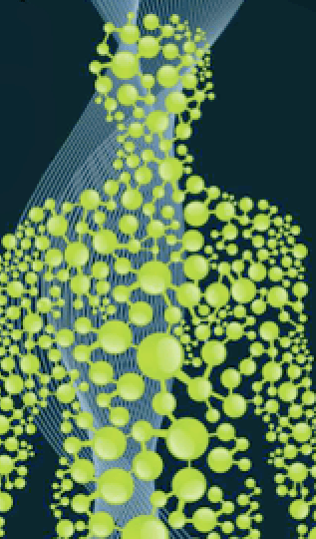
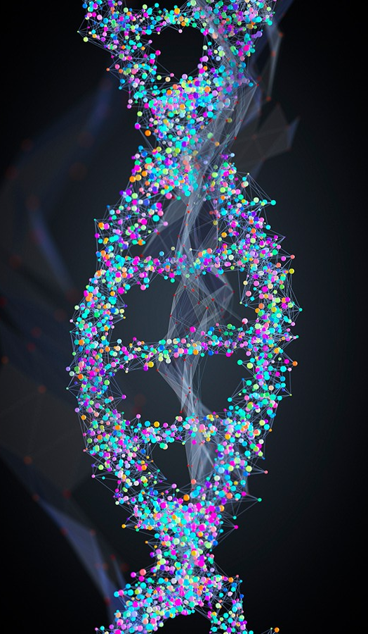
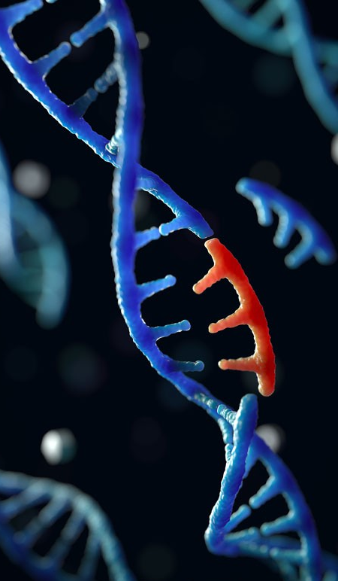
INTRODUCTION/MOTIVATION
X
= Gene
= Disease
= Gene
= Disease
= Gene
= Disease
Notes:
CLICK
The many trillions of cells within the human body are each sustained by the activities of thousands of genes in the genome. Here, I have drawn out some diseases, represented by circles, and their associated genes, represented by triangle, connected by a line.
CLICK
Genetic mutations prevent one or more of these genes from working properly; when such a mutation alters a gene that plays a critical role in the body, it can disrupt normal development and cause a medical condition.
CLICK
Many diseases do in fact arise due to the contribution of disruptions in multiple genes, so multiple triangles are connected to a single disease, and one or multiple can create trouble
To work towards cures for such complex diseases, the human genome has been studied through various experimental methods, each of which has provided a different and sometimes unique understanding of the disease’s underlying genetic cause.

Slide 3
GOALS
Hypothesis: The genomic basis of complex diseases can be understood on a holistic level through the exploration and combination of genetic data from many sources, experiments, and association types
Develop supervised machine learning approaches
Ensemble Model
Why Care:
Better understanding of complex diseases
Development of drugs to combat disease-related signals
X
= Gene
= Disease
Notes:
We hypothesize that the genomic basis of complex diseases can be understood on a holistic level through the exploration and combination of genetic data from many distinct sources, experimental methods, and association types.
This gene-disease exploration can lead to the discovery of new gene-disease associations, of old gene-disease associations being debunked, and of genes being correlated to multiple diseases, creating a network.
Furthermore, as shown on the right with the squares (representing association types), genes for a disease can be labeled under one association type but not another, yet they all are mapped to the same disease. Thus, different experimental methods are providing different (and sometimes unique) views of the underlying genome, and we want to explore these comparisons. We want to see if we can develop supervised machine learning approaches to determine if, for a given disease, genes from an association type can be used to accurately predict genes from another type based on their patterns of interaction in a gene network. From there, it is hoped we can combine the machine learning models from the different association types into an ensemble model that discovers novel genes across the human genome associated with that disease.
Such results can lead to a better understanding of the genomic basis of complex diseases and in the design of drugs that target and reverse the disease-related signals.

Slide 4

The dataset
NID | diseaseNID | geneNID | source | association | associationType | sentence | pmid | score | EL | EI | year
1130681 | 2107 | 793 | BEFREE | NaN | Biomarker | No correlation could be found between Broder's... | 1000501.0 | 0.10 | NaN | 0.956175 | 1976.0
261998 | 431 | 775 | BEFREE | NaN | GeneticVariation | However, there are few reports describing soma... | 10021299.0 | 0.40 | NaN | 0.987013 | 1999.0
369637 | 450 | 775 | BEFREE | NaN | GeneticVariation | WAF1 genotype and endometrial cancer susceptib... | 10021299.0 | 0.02 | NaN | 1.000000 | 1999.0
2128526 | 10033 | 775 | BEFREE | NaN | GeneticVariation | WAF1 genotype and endometrial cancer susceptib... | 10021299.0 | 0.07 | NaN | 1.000000 | 1999.0
262799 | 431 | 7385 | BEFREE | NaN | Biomarker | APC and APC2 may therefore have comparable fun... | 10021369.0 | 0.01 | NaN | 1.000000 | 1999.0
⋮ | ⋮ | ⋮ | ⋮ | ⋮ | ⋮ | ⋮ | ⋮ | ⋮ | ⋮ | ⋮ | ⋮
3,261,324 Rows, 12 Columns
Notes:
For this project, a source we found to be great for exploring these gene-disease associations was the DisGeNET database, a discovery platform that has one of the largest publicly available collection of genes and variants associated to human diseases
Version 7 of this database contains:
1,134,942 gene disease associations (which is what I am working with) between 21,671 genes and 30,170 diseases
369, 554 variant disease associations, between 194,515 variants and 14,155 diseases
It has multiple files with useful data, but one I specifically make use of in the beginning is the geneDiseaseAttributes csv file, with over 3 million listed gene-disease associations, and also some related files to acquire universally used IDs for both the genes and diseases. I later make use of a subset of the geneDiseaseAttributes file that only contains curated data.
Looking at the columns here:
NID: the Network Identification Number assigned to the gene-disease association by DisGeNet
diseaseNID: the Identification Numbers used for diseases in DisGeNET. They are the Concept Unique Identifiers from the Unified Medical Language System. I later transform these into the universally used disease ID and a DOID format using separate files.
geneNID: the Identification Numbers used for genes in DisGeNET. They are the NCBI Entrez gene identifiers. And, similar to diseases, this can be easily transformed to display the universally used gene ID using another provided csv file
source: name of source of the data
association: NOT HELPFUL AND NOT USED
associationType: an ontology developed by DisGeNET that structures the gene-disease relationship in a sort of hierarchy; I was told to think of each of the fifteen association types as a different experiment type; these association types can be mapped according to the original source label if desired. I will be showing a hierarchy of these association types later on.
sentence: this is a sentence describing the gene-disease association (either from the publication or the title of the publication itself)
pmid: Pubmed Identifier, the publication(s) that report the gene-disease association
score: score to rank the disease-gene association according to level of evidence, taking into account number of sources, type of sources, and number of publications supporting the association
EL (Evidence Level): measures strength of evidence of gene-disease relationship that correlates to a qualitative classification (Definitive, Strong, Moderate, Limited, Disputed); This data is only available for a few of the sources
EI: (Evidence Index): indicates the existence of contradictory results in publications supporting the gene-disease associations. This only exists for those entries that have source of BeFree or PsyGeNET
Year: the date of report of the association
Generally speaking, the columns we are focusing our attention on are the disease NID, the gene NID, and the association type

Slide 5
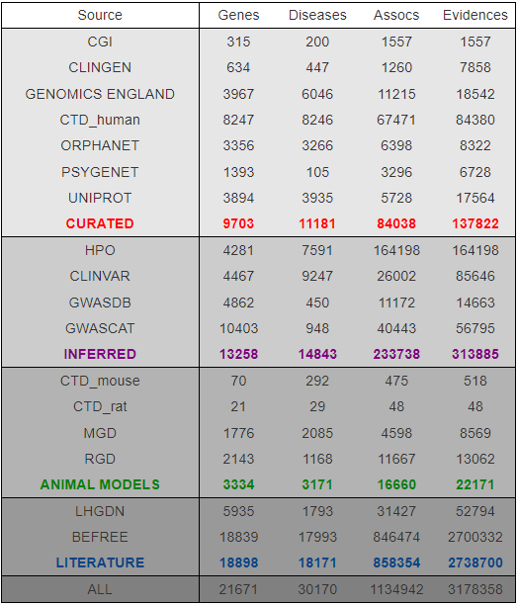
DATA SOURCES
Expert-curated Repositories
GWAS Catalogs
Animal Models
Rat and Mouse Data
Scientific Literature
Notes:
This database integrates data from expert-curated repositories (which is what is substantially used at the end of my project), GWAS catalogs, animal models (rat and mouse data that can be correlated to human gene-disease associations), and scientific literature. The dataset I worked with at the start included data from all of these sources. I will talk about in more detail the curated sources listed here later on today.
GWAS Catalogs – You all are probably aware of what GWAS is, but at least I wasn’t at the start, so just in case, The GWAS catalog is a free online database that compiles data of genome-wide association studies (GWAS), summarizing unstructured data from different literature sources into accessible high- quality data.

Slide 6

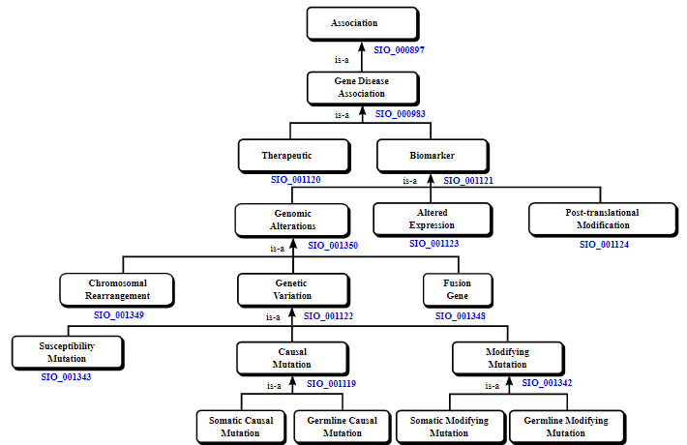
ASSOCIATION TYPES HIERARCHY
Ontology developed by DisGeNET
Structures gene-disease relationships in a hierarchy
15 association types
Notes:
This is the ontology developed by DisGeNET that structures the gene-disease relationship in a sort of hierarchy; I was told to think of each of the fifteen association types as a different experiment type; these association types can be mapped according to the original source label if desired.
While the current dataset currently maps information from all of these association types, we later take subsets that only fall under certain associations for more succinct and meaningful plots.

Slide 7
The association types
ASSOCIATION TYPE | DESCRIPTION
Therapeutic | Gene/protein has a therapeutic role in curing the disease
Biomarker | Gene/protein plays a role it the etiology of the disease or is a biomarker for a disease
Genomic Alterations | Gene/protein has a genomic alteration associated to it
Genetic Variation | A sequence variation (a mutation, a SNP) is associated with the disease phenotype
Causal Mutation | There are allelic variants or mutations known to cause the disease
Germline Causal Mutation | There are germline allelic variants or mutations known to cause the disease and may be passed to offspring
Somatic Causal Mutation | There are somatic allelic variants or mutations known to cause the disease and may not be passed to offspring
Chromosomal Rearrangement | A gene is included in a chromosomal rearrangement associated with a manifestation of the disease
Fusion Gene | The fusion between two different genes (between promoter and/or other coding DNA regions) is associated with the disease
Susceptibility Mutation | A gene mutation in a germ cell that predisposes to the development of a disorder, and that is necessary but not sufficient for the appearance of the disease
Modifying Mutation | A gene mutation is known to modify the clinical presentation of the disease
Germline Modifying Mutation | A germline gene mutation modifies the clinical presentation of the disease, and it may be passed to offspring
Somatic Modifying Mutation | A somatic gene mutation modifies the clinical presentation of the disease, but it may not be passed to offspring
Altered Expression | An altered expression of the gene is associated with the disease phenotype
Posttranslational Modification | Alterations in the function of the protein through post-translational modifications (methylation or phosphorylation of the protein) are associated with the disease phenotype
Notes:
Therapeutic: This relationship indicates that the gene/protein has a therapeutic role in the curing of the disease.
Biomarker: This relationship indicates that the gene/protein either plays a role in the etiology of the disease (e.g. participates in the molecular mechanism that leads to disease) or is a biomarker for a disease.
Genomic Alterations: This relationship indicates that a genomic alteration is linked to the gene associated with the disease phenotype.
AlteredExpression: This relationship indicates that an altered expression of the gene is associated with the disease phenotype.
Post-translational Modification: This relationship indicates that alterations in the function of the protein by means of post-translational modifications (methylation or phosphorylation of the protein) are associated with the disease phenotype.
GeneticVariation: This relationship indicates that a sequence variation (a mutation, a SNP) is associated with the disease phenotype, but there is still no evidence to say that the variation causes the disease.
Causal Mutation: This relationship indicates that there are allelic variants or mutations known to cause the disease.
Germline Causal Mutation: This relationship indicates that there are germline allelic variants or mutations known to cause the disease, and they may be passed on to offspring.
Somatic Causal Mutation: This relationship indicates that there are somatic allelic variants or mutations known to cause the disease, but they may not be passed on to offspring.
Chromosomal Rearrangement: This relationship indicates that a gene is included in a chromosomal rearrangement associated with a particular manifestation of the disease.
Fusion Gene: This relationship indicates that the fusion between two different genes (between promoter and/or other coding DNA regions) is associated with the disease.
Susceptibility Mutation: This relationship indicates that a gene mutation in a germ cell that predisposes to the development of a disorder, and that is necessary but not sufficient for the manifestation of the disease.
Modifying Mutation: This relationship indicates that a gene mutation is known to modify the clinical presentation of the disease.
Germline Modifying Mutation: This relationship indicates that a germline gene mutation modifies the clinical presentation of the disease, and it may be passed on to offspring.
Somatic Modifying Mutation: This relationship indicates that a somatic gene mutation modifies the clinical presentation of the disease, but it may not be passed on to offspring.

Slide 8
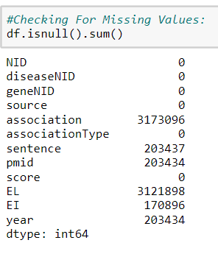
MISSING VALUES
Notes:
For some preliminary data exploration, I checked to see how many missing values the dataset contained and for which columns. Fortunately, association, sentence, pmid, evidence level, evidence index, and year are all columns we don’t make use of in this project.

Slide 9
QUESTION RAISED
What are the distributions of the number of genes per disease for each of these association types?
Notes:
We needed to better understand the association types in this dataset (their sizes, their variance, their correlation). So, we decided to make one boxplot per association type that is showing the distribution of the number of genes per disease from that type. I would have one plot with the absolute numbers and another with the fraction of genes for a disease from that association type

Slide 10
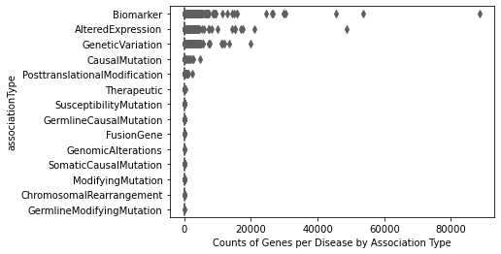
BOXPLOT OF THE COUNT OF GENES PER DISEASE FOR EACH ASSOCIATION TYPE
Notes:
This plot is showing the absolute numbers, with association type along the y-axis and counts of genes per disease on the x-axis, but it is a bit hard to read due to the large variation in counts, especially with Biomarker, a very general category. Thus, I plotted the log of the count of genes per disease for each association type.

Slide 11
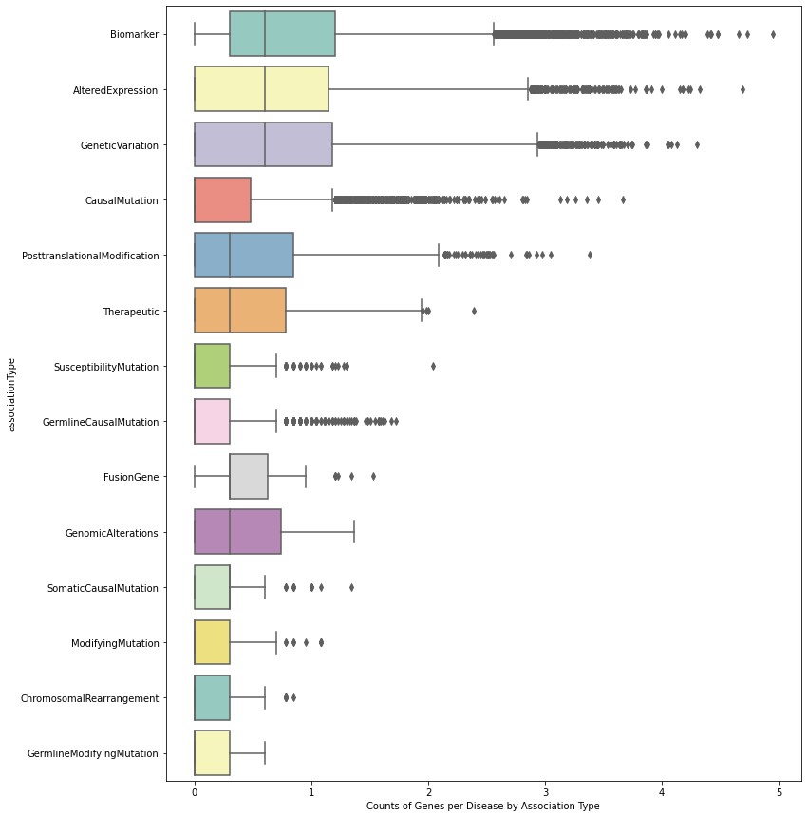
BOXPLOT OF THE LOG OF COUNT OF GENES PER DISEASE FOR EACH ASSOCIATION TYPE
Notes:
So here is the boxplot for the log of the count of genes per disease for each association type. The axes are the same except the x-axis is now the log of the count.
Those association types with a greater median have more genes associated to the specific diseases then some other association types.
One can notice that the association types that are more general and more encompassing have the larger medians, which I have circled. By more general, I mean they are higher up in the association type hierarchy.
They also have the larger number of outliers, suggesting they have encompassed a larger number of diseases that have unusually large genes associated to certain diseases.
We can see that Somatic Causal Mutation, Germline Causal Mutation, Germline Modifying Mutation, Modifying Mutation, and Susceptibility Mutation also have very similar boxplots (minimum, maximum, median, shape of box), which makes a bit of sense when we notice that they are all children or descendants of Genetic Variation.
From this, we began to think that it would be better to re-categorize the data so that we have five to six main association types rather than fifteen. Especially when you realize that one of the association types, Somatic Modifying Mutation, did not even have any data to be plotted.

Slide 12
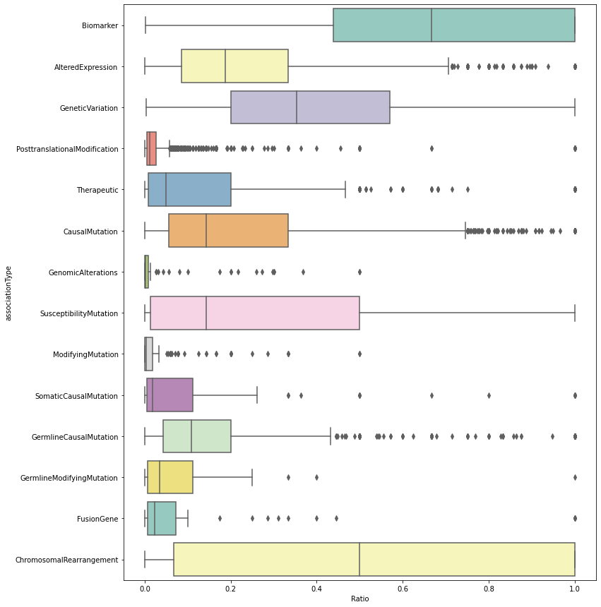
BOXPLOT OF THE FRACTION OF GENES FOR A DISEASE FROM THAT ASSOCIATION TYPE
Notes:
Then, for each association type, the fraction of genes for a disease divided by all genes for an association type is displayed in a box plot format.
One could see for the Biomarker association type, for example, that there is a much larger percentage of genes associated to each disease than compared to some smaller categories. One can also see that almost every association type contains at least one disease that has the entire gene set associated to it. For many of the boxplots, these diseases are considered outliers. The Chromosomal Rearrangement boxplot is also intriguing due to the broadness of its graph. This suggests that the size of the gene sets for diseases contain much variance. Also, for most association types that were lower down, or more specific, on the hierarchy, their median ratios are much closer to 0 than the broader association types. Thus, the more specific association types have smaller percentages of genes associated to each disease. Understanding the reasoning behind this relationship (as well as the relations for the other association types) is important preliminary work to determine the direction to take with this research project.

Slide 13
QUESTION RAISED
Do different experimental methods provide the same view of the underlying biology (lots of gene overlap between association types), or do they present different aspects of it (very separate gene sets)?
Notes:
I next tried to answer if different experimental methods provide the same view of the underlying biology (lots of gene overlap between association types), or if they present different aspects of it (very separate gene sets).
We went about this through comparison of gene sets between association types for every disease in a boxplot and heatmap format.

Slide 14
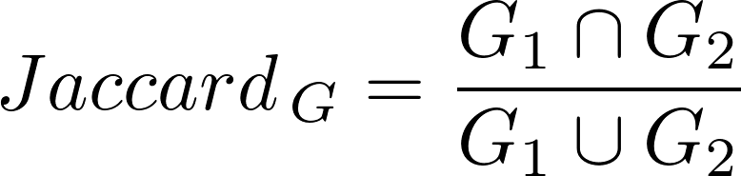
GENE SETS DATA TABLE
diseaseNID | associationType1 | associationType2 | geneNID1 | geneNID2 | JaccardIndex
3 | CausalMutation | GeneticVariation | {5458, 1813, 3065} | {6417, 4711, 17182} | 0.000000
3 | CausalMutation | Biomarker | {5458, 1813, 3065} | {2818, 7694, 2648, 7005, 4959, 4711, 2270, 127... | 0.000000
3 | GeneticVariation | Biomarker | {6417, 4711, 17182} | {2818, 7694, 2648, 7005, 4959, 4711, 2270, 127... | 0.010000
5 | AlteredExpression | GeneticVariation | {3288, 1924} | {8699, 2126, 5304, 5241} | 0.000000
5 | AlteredExpression | Biomarker | {3288, 1924} | {4577, 3288, 1567, 1489, 129, 11754, 3799, 3559} | 0.111111
... | ... | ... | ... | ... | ...
67,659 Rows, 6 Columns
Notes:
To do this, I first worked on defining sets of genes associated with each disease based on a particular association type. Then, we compared gene sets from the same disease--yet separate association types–using the Jaccard Correlation Coefficient, to quantify the overlap in the genes contributed by the different association types. So, looking at the first few rows in this table, disease 3 has association types of Causal Mutation, Genetic Variation, and Biomarker. Combination pairs were made between these and their correlated gene sets, shown in the two gene set columns. The correlation coefficient is shown in the final column
CLICK TO SEE FORMULA FOR JACCARD INDEX
Also, here is the formula for the Jaccard Index, it is just the intersection of the two gene sets divided by their union.
With this table, we can make plots of the correlation scores in the form of boxplots and a heatmap to determine if different experimental methods have some sort of correlation between the gene sets

Slide 15
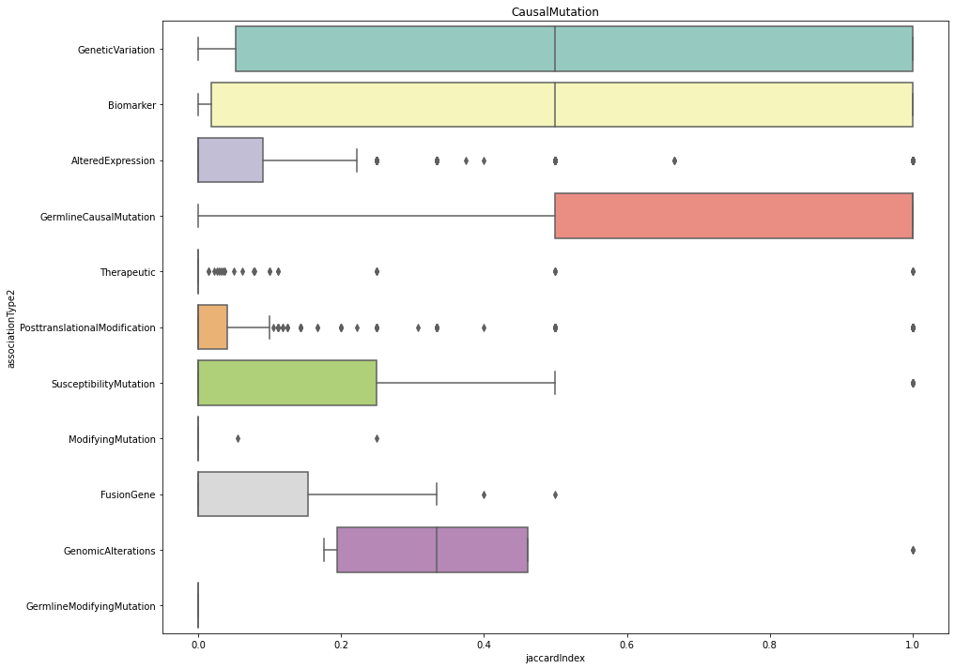
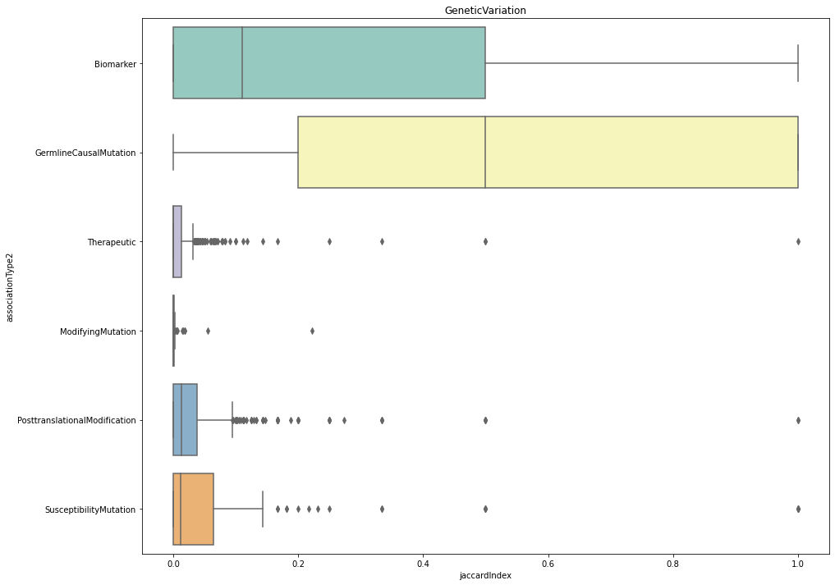
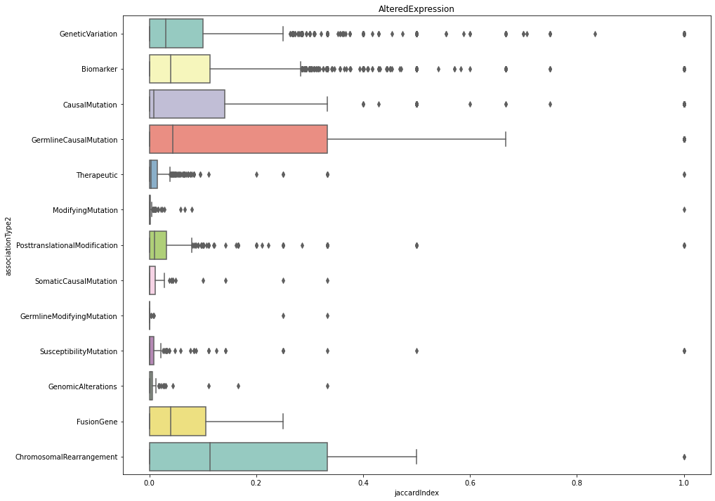
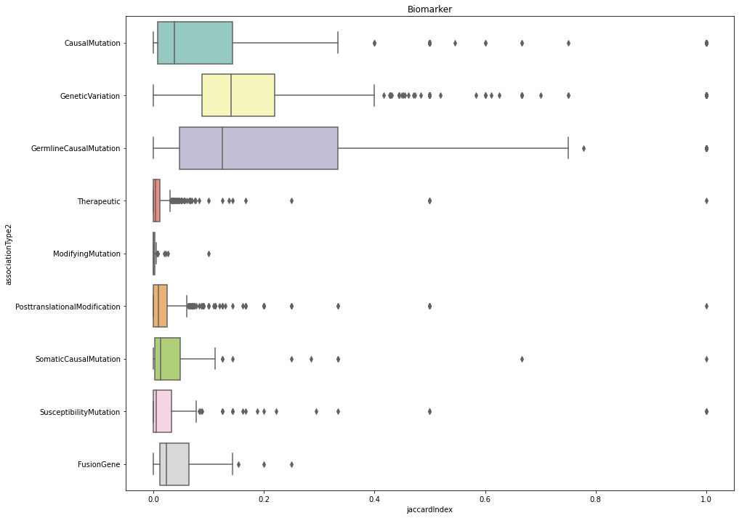
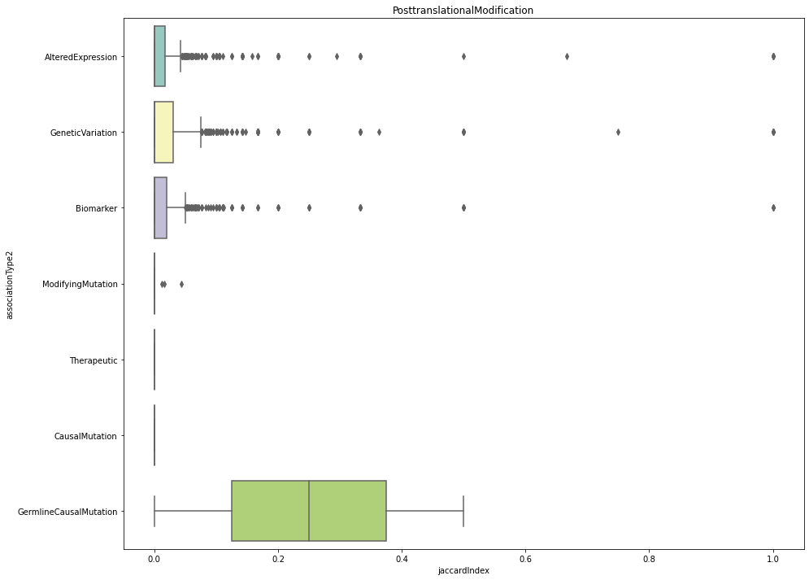
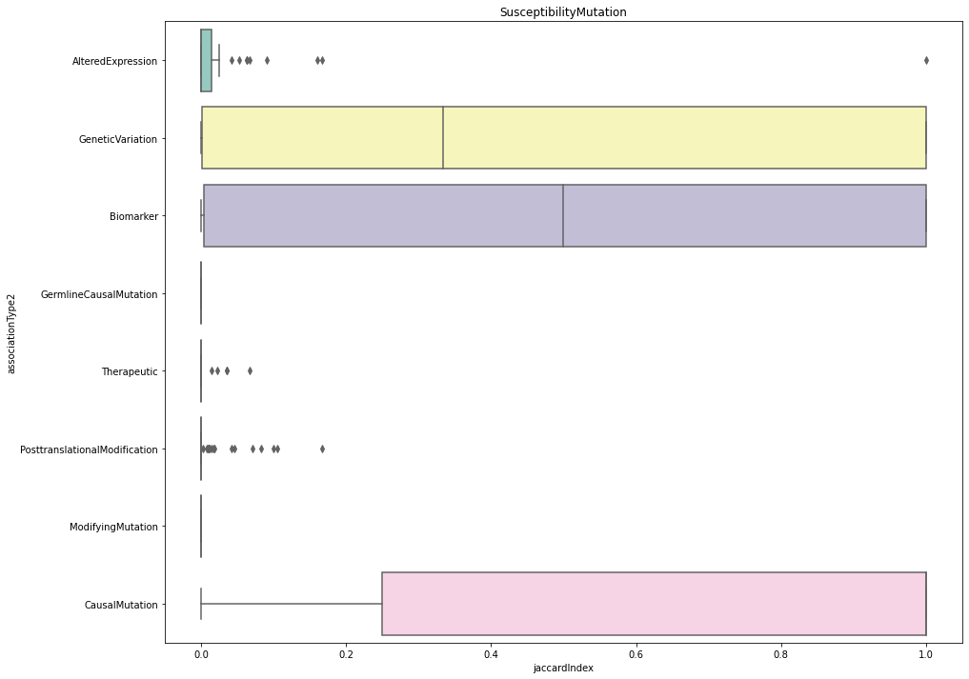
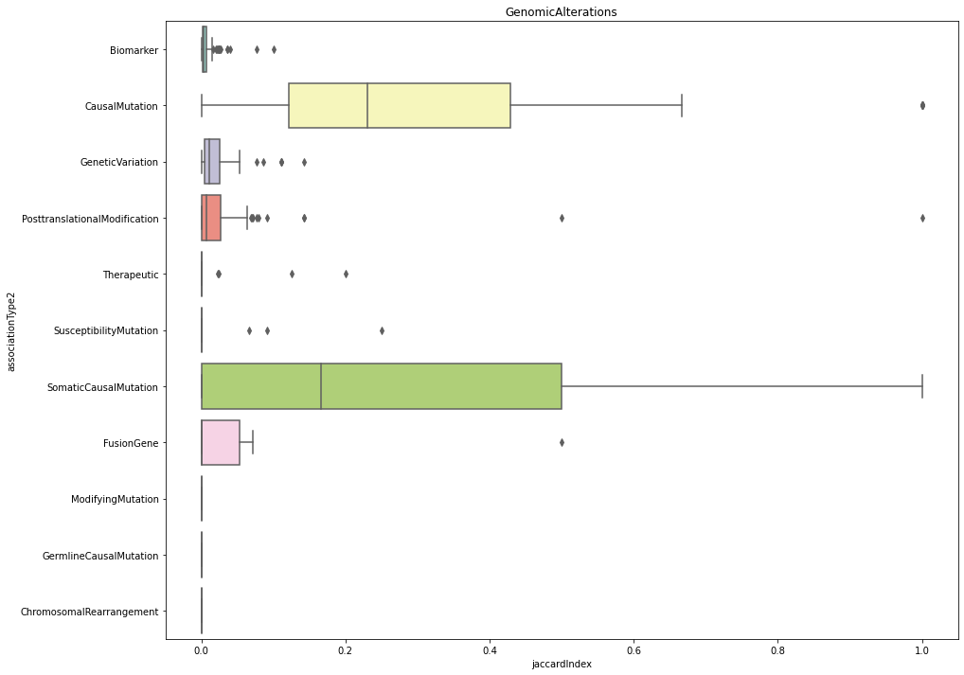
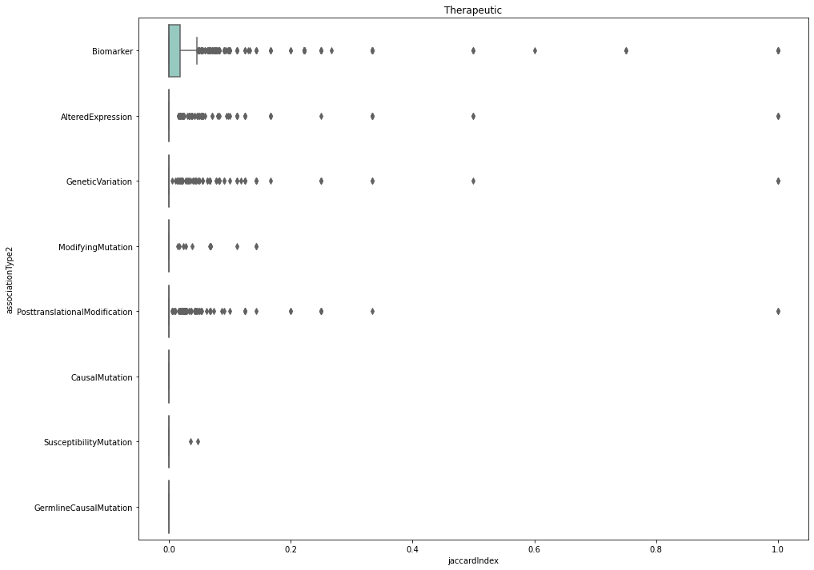
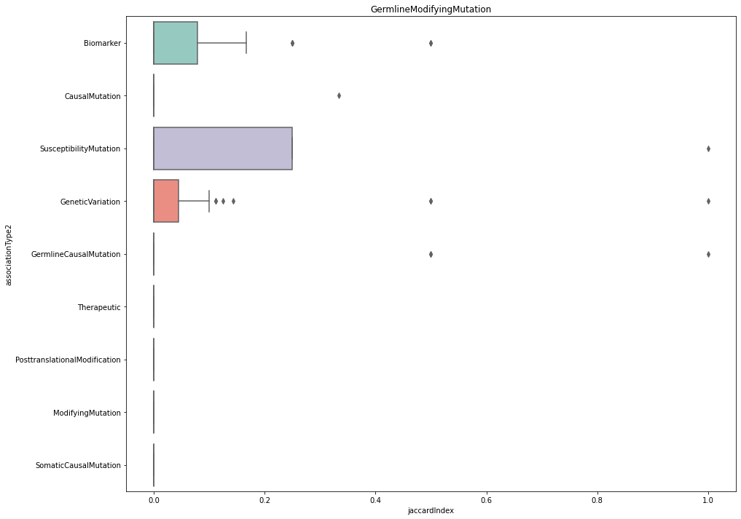
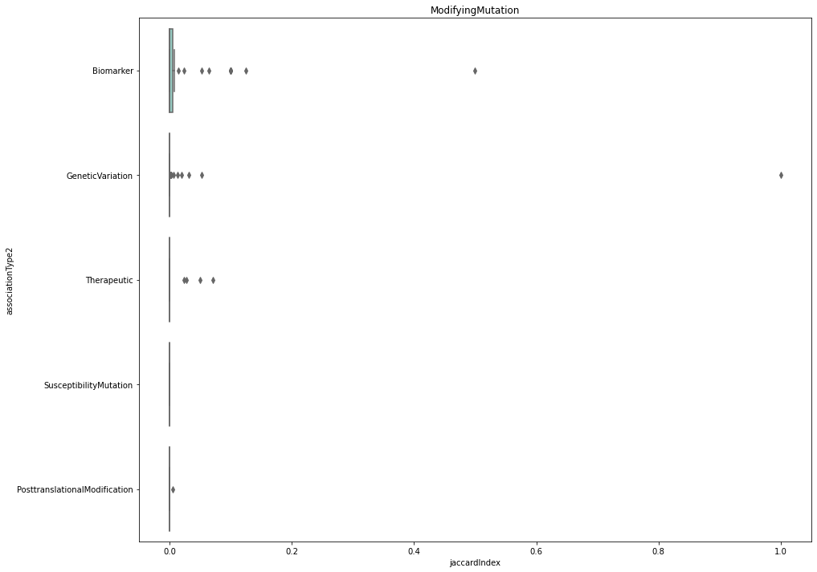
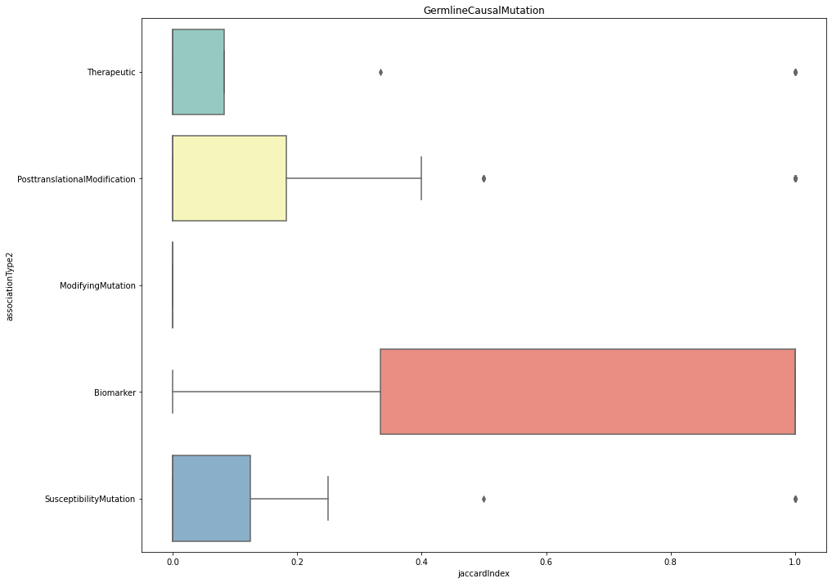
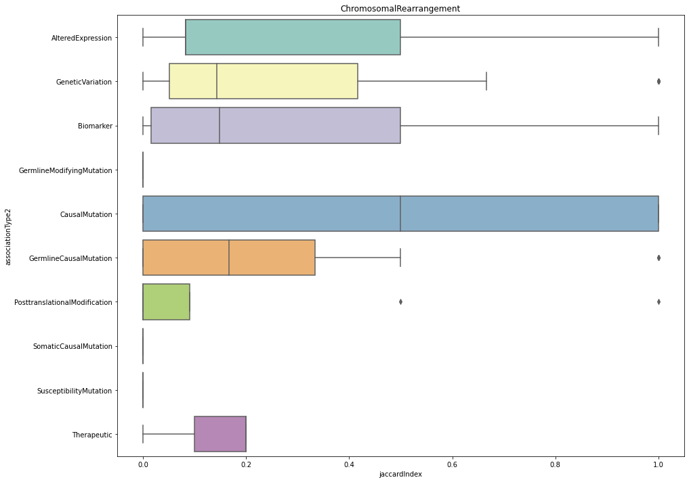
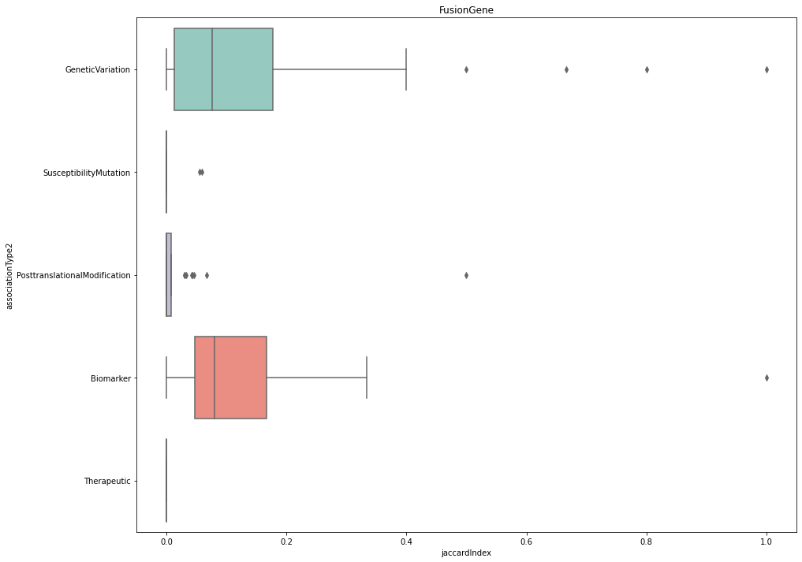
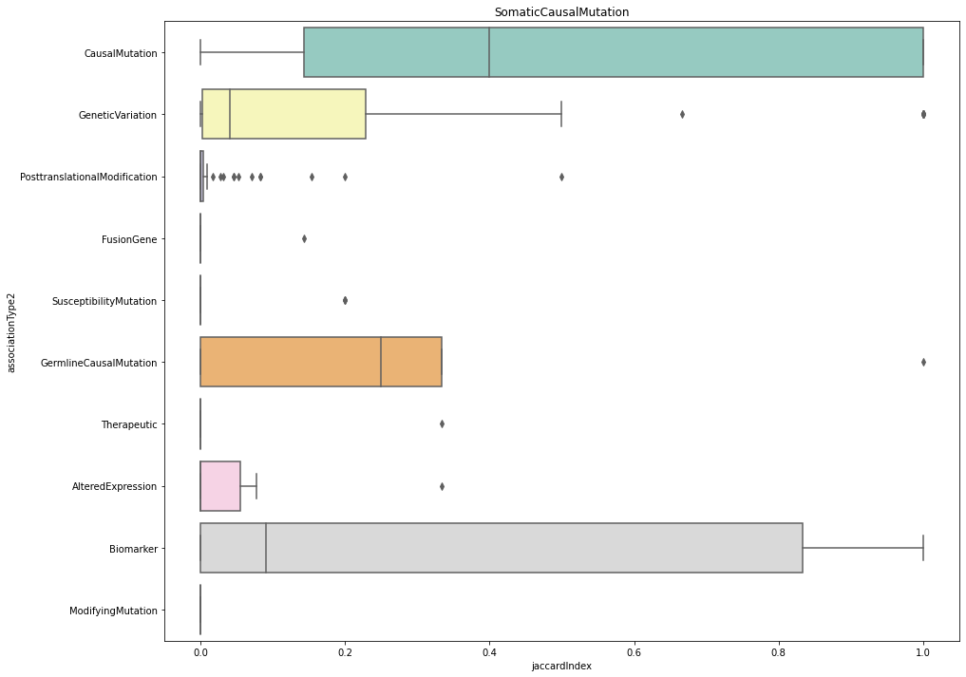
Notes:
So, fourteen boxplots were created, one plot for each association type, of course missing that one that had no data.
I am not expecting you to read these here, but let’s zoom in on one to see what they are showing.

Slide 16
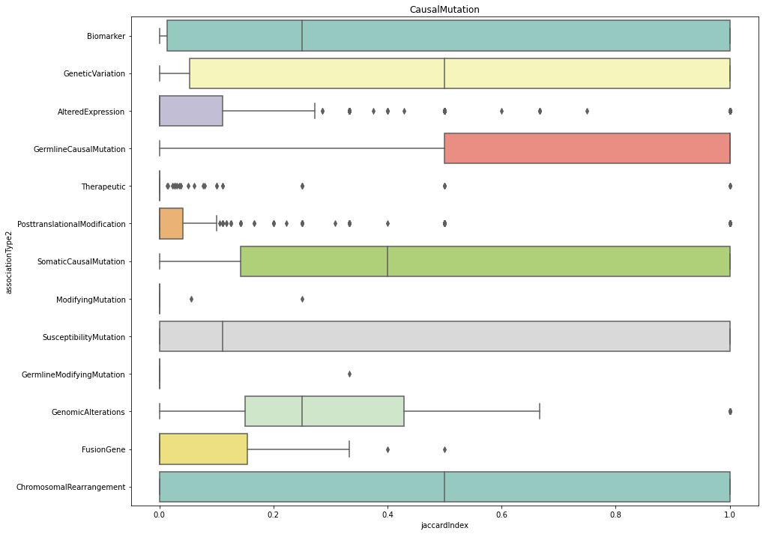
CAUSAL MUTATION GENE SET COMPARISON BOXPLOT
Notes:
So here is the causal mutation boxplot, with the Jaccard index along the x-axis and the association types being compared to causal mutation on the y-axis.
Each Association type from the pair is plotted against its paired association type to demonstrate the correlation between gene sets from the same disease. So here, we can see that the correlation between genetic variation and causal mutation as well as biomarker, genetic variation, somatic causal mutation, susceptibility mutation, and chromosomal rearrangement have a lot of variance. Chromosomal rearrangement and Genetic variation also interestingly have a median correlation coefficient of .5, meaning the sets have 50% correlation on average. In contrast, Therapeutic, Posttranslational modification, altered expression, modifying mutation, fusion gene, and germline modifying mutation all have median correlation coefficients of 0, meaning not correlated. This makes sense based on the hierarchy, as all these association types do not have a direct family relationship to causal mutation (parent, grandparent, child, grandchild, etc.), but have relationships such as nephew, aunt, or uncle.

Slide 17
HEATMAP DATASET
associationType1 | associationType2 | jaccardIndex | Median
AlteredExpression | Biomarker | [0.1111111111111111, 0.0245614035087719, 0.061... | 0.039286
AlteredExpression | CausalMutation | [0.0769230769230769, 0.1111111111111111, 0.0, ... | 0.007875
AlteredExpression | ChromosomalRearrangement | [0.2, 0.0, 0.0, 0.1153846153846153, 0.5, 0.166... | 0.113248
AlteredExpression | FusionGene | [0.0183150183150183, 0.0094339622641509, 0.0, ... | 0.039855
AlteredExpression | GeneticVariation | [0.0, 0.027027027027027, 0.0857142857142857, 0... | 0.030928
... | ... | ... | ...
117 Rows, 4 Columns
Notes:
To create the heatmap, the dataset was reorganized to obtain the median values for each association type combination. Thus, the new dataset has one row for each association type combination, a set of the Jaccard indices for that association type combination, and a median of the value for each of those sets; this median is what gets added to the heatmap.
We use the median (rather than the average/mean) to deal with outliers effectively.
Something one can see is that this dataset is said to have 117 rows, but if it were to really map each association type to every other association type, that would be 14 x 14 = 196 rows, so a lot of combos are missing, which is because I originally had used combination pairings instead of permutations. Once I had changed this to permutations, there were a much more acceptable number of rows.

Slide 18
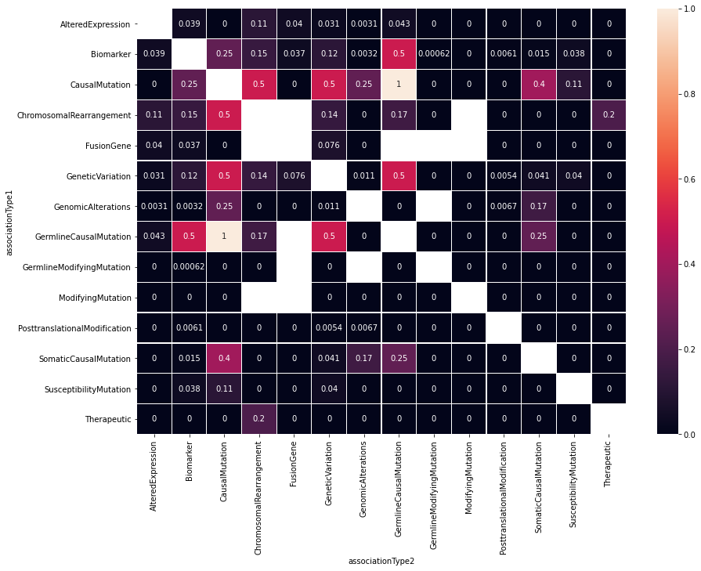
GENE EXPLORATION HEATMAP
Notes:
Along both axes are all of the association types. We are trying to see which association types have the highest correlation between gene sets.
One can see that the diagonal of the heatmap is empty, which makes sense because we purposely did not make association type combinations of the same association type (as the values would all be 1). If I wanted to, I could just change my code to run on permutations with replacements instead of just permutations to fill this diagonal.
The heatmap does help to show a few clear highlights/high correlations between association types. CausalMutation/GermlineCausalMutation has a heatmap/median value of 1, suggesting they correlate perfectly. I think it makes sense that they correlate so strongly since Causal Mutation is an ancestor or parent of Germline Causal Mutation.
Other high correlations can be seen in the red filled squares between CausalMutation/GeneticVariation, ChromosomalRearrangement/CausalMutation, GeneticVariation/GermlineCausalMutation, and Biomarker/GermlineCausalMutation. All of these are direct family relationships (parent, grandparent, child, grandchild), so I would say it makes sense that their correlations are higher than others.
One more thing is that there are empty squares in the permutations heatmap that are not a part of the diagonal. These are for association type pairs that do not have any data to map or compare. For example, Modifying Mutation and Chromosomal Rearrangement, two pretty unrelated association types based on the hierarchy, do not both have data for a certain disease that would allow their gene sets to be compared in this map.
Although this heatmap can provide a lot of useful information, we don’t plan to use it in further analysis due to its cumbersomeness to read. Focusing our attention on five or six associations will make more succinct data and plots.

Slide 19
Notes:
Also, similar to the heatmaps getting changed to reflect permutations, the boxplots needed to be changed as well, which can be seen to have made some dramatic differences in all the boxplots.
And I just picked Causal Mutation again for consistency.
Like we can see the median correlation coefficient for Biomarker decreased significantly when using permutations over combinations, but the median stayed the same for Genetic Variation. We can also see all association types being compared to Causal Mutation now like we should, while with the combination's boxplot, only 11 association types were being compared to Causal Mutation.

Slide 20
RECATEGORIZED DATASET method 1
Notes:
So we mentioned that we wanted to recategorize the dataset into five or six associations instead of fifteen, but at the time, we were unsure of how best to tackle it. So, we decided to go ahead with two different categorizations.
CLICK TO SHOW INITIAL SELECTION
Recategorization initially included Therapeutic, Genomic Alterations, Altered Expression, Post-translational Modification, and Genetic Variation. We did not want to include Biomarker because it mapped over half of all gene-disease pairs in the dataset.
CLICK TO SHOW UNIQUE BIOMARKER ASSOCATIONS:
But we decided to first try a recategorization involving no Genetic Variation and using only unique biomarker associations. And I will explain what we mean by unique biomarker in a second.

Slide 21
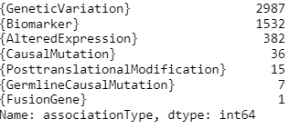
Unique genes in each association type
Notes:
We partly decided to do it this way by examining the number of unique genes for each association type. For example, there are 2987 genes that are associated under the genetic variation association type and no other type. This allows us to determine how many unique genes would be lost in the recategorization. If we had removed Biomarker in totality, like we initially were considering because of its generality, we would be losing analysis for 1532 unique genes. With our categorization choice, we would be losing the unique genes under Genetic Variation, Causal Mutation, Germline Causal Mutation, and Fusion Gene, totaling around 3000 genes of the 30,000+ genes in this database. However, these genes will actually be shown in our dataset in a different way through propagation, by which we mean:
TALK ABOUT PROPAGATION USING HIERARCHY
So, those unique genes under Genetic Variation are actually going to appear in our recategorized dataset under labels of Genetic Variations ancestors (Genomic Alteration and Biomarker, but also not really biomarker, which I will explain why next).

Slide 22
PROPAGATED DATASET
diseaseNID | geneNID | associationType | propagatedAssociationTypes
1 | 1088 | {Biomarker} | {Biomarker}
448 | 1088 | {Biomarker} | {Biomarker}
589 | 1088 | {Biomarker} | {Biomarker}
827 | 1088 | {Biomarker} | {Biomarker}
1102 | 1088 | {Biomarker} | {Biomarker}
... | ... | ... | ...
29239 | 20075 | {Biomarker} | {Biomarker}
29280 | 20163 | {Biomarker} | {Biomarker}
29341 | 20169 | {Biomarker} | {Biomarker}
29763 | 9527 | {Biomarker} | {Biomarker}
29932 | 21333 | {Biomarker} | {Biomarker}
BIOMARKER
diseaseNID | geneNID | associationType | propagatedAssociationTypes
1 | 1088 | {Biomarker} | {Biomarker}
1 | 3070 | {Biomarker} | {Biomarker}
2 | 10721 | {Biomarker} | {Biomarker}
3 | 54 | {Biomarker} | {Biomarker}
3 | 170 | {Biomarker} | {Biomarker}
... | ... | ... | ...
30292 | 11963 | {AlteredExpression} | {Biomarker, AlteredExpression}
30292 | 18471 | {Biomarker} | {Biomarker}
30292 | 19792 | {Biomarker} | {Biomarker}
30293 | 6353 | {Biomarker} | {Biomarker}
30293 | 8057 | {Biomarker} | {Biomarker}
557317 rows × 4 columns
diseaseNID | geneNID | associationType | propagatedAssociationTypes
1317 | 1088 | {AlteredExpression} | {Biomarker, AlteredExpression}
1338 | 1088 | {AlteredExpression} | {Biomarker, AlteredExpression}
1741 | 1088 | {AlteredExpression} | {Biomarker, AlteredExpression}
2107 | 1088 | {PosttranslationalModification} | {Biomarker, PosttranslationalModification}
2592 | 1088 | {AlteredExpression} | {Biomarker, AlteredExpression}
... | ... | ... | ...
29802 | 18834 | {AlteredExpression} | {Biomarker, AlteredExpression}
29802 | 18837 | {AlteredExpression} | {Biomarker, AlteredExpression}
30104 | 25482 | {CausalMutation} | {CausalMutation, GeneticVariation, Biomarker, ...
30147 | 21709 | {CausalMutation} | {CausalMutation, GeneticVariation, Biomarker, ...
30157 | 10975 | {CausalMutation} | {CausalMutation, GeneticVariation, Biomarker, ...
NON-BIOMARKER
Filter: ONLY ‘AlteredExpression', 'PosttranslationalModification', ‘GenomicAlterations', or 'Therapeutic'
1135045 rows × 4 columns
577728 rows × 4 columns
Notes:
Here we see the propagated dataset:
To do this propagation, I basically coded that association type hierarchy into a network x digraph and used the ancestor function to grab the ancestors for an association type.
After propagating the dataset,
CLICK TO SHOW TWO TABLES
I split the table based on whether the ORIGINAL association type (before propagation) was plain biomarker or not. So let’s say a gene-disease association originally has Altered Expression, Causal Mutation, and Biomarker as its labels. After propagation, the propagated association type set will include these three associations as well as Genetic Variation and Genomic Alterations. Even though the set before propagation had Biomarker in it, we put it in the Non-Biomarker dataset because of the other labels it contains. This is an important distinction for when we look at the second way we recategorized the dataset.
Also, it should be noted that at this point, the propagated association types have not been split into separate rows but are still listed in sets next to their original association type.
CLICK TO SHOW FILTER
So after splitting the propagated association type sets into separate rows, one propagated association per row, the non-biomarker dataset was filtered to only include AlteredExpression', 'PosttranslationalModification', ‘GenomicAlterations', or 'Therapeutic' to adhere to our chosen categorization.
Between the two datasets, we currently only have unique gene-disease associations since the biomarker association rows that are non-unique could have only been created from propagation which was grouped with the non-biomarker dataset. These biomarker rows that would have been produced from propagation did not make it through our filter, so that leaves us with the biomarker rows from the top table.

Slide 23
RECATEGORIZED DATASET
diseaseNID | geneNID | associationType | propagatedAssociationTypes
1 | 1088 | {Biomarker} | {Biomarker}
448 | 1088 | {Biomarker} | {Biomarker}
589 | 1088 | {Biomarker} | {Biomarker}
827 | 1088 | {Biomarker} | {Biomarker}
1102 | 1088 | {Biomarker} | {Biomarker}
... | ... | ... | ...
29239 | 20075 | {Biomarker} | {Biomarker}
29280 | 20163 | {Biomarker} | {Biomarker}
29341 | 20169 | {Biomarker} | {Biomarker}
29763 | 9527 | {Biomarker} | {Biomarker}
29932 | 21333 | {Biomarker} | {Biomarker}
BIOMARKER
diseaseNID | geneNID | propagatedAssociationType | ogAssociationTypes
1317 | 1088 | AlteredExpression | {'AlteredExpression'}
1338 | 1088 | AlteredExpression | {'AlteredExpression'}
1741 | 1088 | AlteredExpression | {'AlteredExpression'}
2107 | 1088 | PosttranslationalModification | {'PosttranslationalModification'}
2592 | 1088 | AlteredExpression | {'AlteredExpression'}
... | ... | ... | ...
29239 | 20075 | Biomarker | {'Biomarker'}
29280 | 20163 | Biomarker | {'Biomarker'}
29341 | 20169 | Biomarker | {'Biomarker'}
29763 | 9527 | Biomarker | {'Biomarker'}
29932 | 21333 | Biomarker | {'Biomarker'}
557317 rows × 4 columns
diseaseNID | geneNID | associationType | propagatedAssociationTypes
1317 | 1088 | {AlteredExpression} | {Biomarker, AlteredExpression}
1338 | 1088 | {AlteredExpression} | {Biomarker, AlteredExpression}
1741 | 1088 | {AlteredExpression} | {Biomarker, AlteredExpression}
2107 | 1088 | {PosttranslationalModification} | {Biomarker, PosttranslationalModification}
2592 | 1088 | {AlteredExpression} | {Biomarker, AlteredExpression}
... | ... | ... | ...
29802 | 18834 | {AlteredExpression} | {Biomarker, AlteredExpression}
29802 | 18837 | {AlteredExpression} | {Biomarker, AlteredExpression}
30104 | 25482 | {CausalMutation} | {CausalMutation, GeneticVariation, Biomarker, ...
30147 | 21709 | {CausalMutation} | {CausalMutation, GeneticVariation, Biomarker, ...
30157 | 10975 | {CausalMutation} | {CausalMutation, GeneticVariation, Biomarker, ...
NON-BIOMARKER
Filter: ONLY ‘AlteredExpression', 'PosttranslationalModification', ‘GenomicAlterations', or 'Therapeutic'
1202264 rows × 4 columns
577728 rows × 4 columns → 644947 rows × 4 columns
Notes:
Then, the two tables could be appended to make our propagated, relabeled dataset.
This table has the disease and gene IDs, the propagated association type, and the originally labeled association type from before propagation.
Note that this new dataset is larger than the dataset at the start because we have separate rows for each propagated association type. And then we also removed rows that didn’t pass our filter.

Slide 24
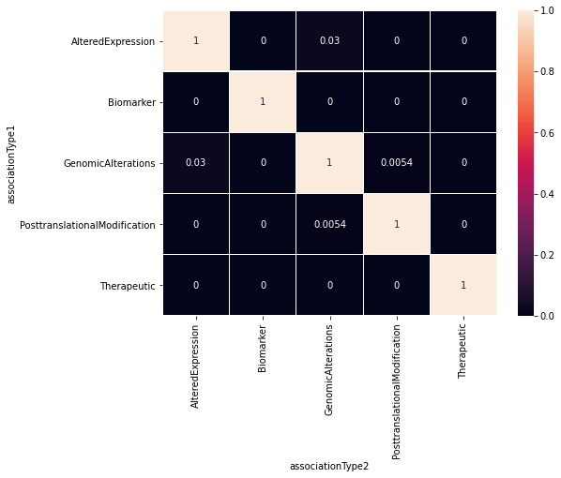
heatmaps
Same Procedure as Prior:
How much gene overlap is there between association types for a disease?
Building gene sets for each disease
Compare Gene Sets from same disease but different association type
Jaccard Correlation Coefficient
Plot the scores in a boxplot and plot the median/mean values of each association type combination in a heatmap
Notes:
Now, doing the same gene exploration procedure as we did with the whole dataset prior, we can get boxplots and heatmaps for the propagated and relabeled dataset.
So, the heatmap is again mapping each of the association types to every other association type in the dataset. Overall, there are not high correlations whatsoever between association types, as can be seen by all the black squares in the heatmap, but the highest correlations are seen between Altered Expression and Genomic Alterations, squared in red, which are siblings in our association type hierarchy.
I believe we were expecting these correlations to be low anyways because they are all pretty different from each other. While Genomic Alterations, Altered Expression, and Posttranslational Modification are children of Biomarker, anything that would show that they are correlated has been removed with our recategorization (we took only the unique biomarker rows). We can visually see that they have no correlation by looking at the Biomarker row in both heatmaps. All the way across are 0’s, suggesting that we correctly kept only unique Biomarker associations.

Slide 25
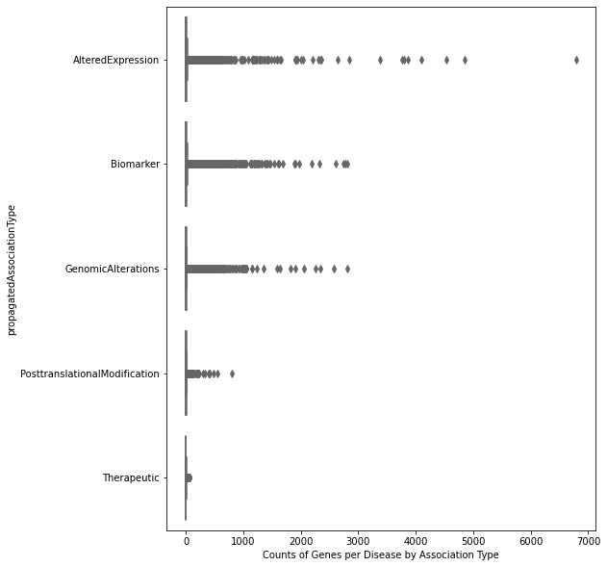
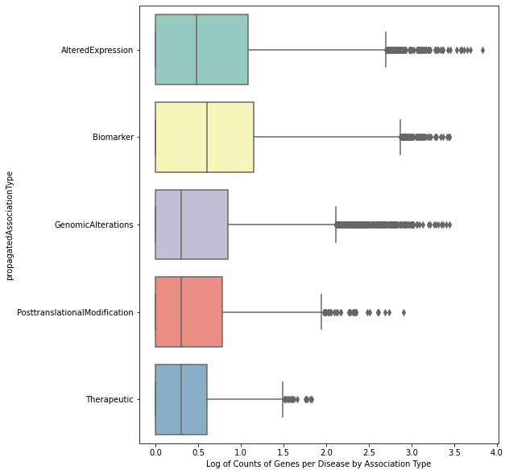
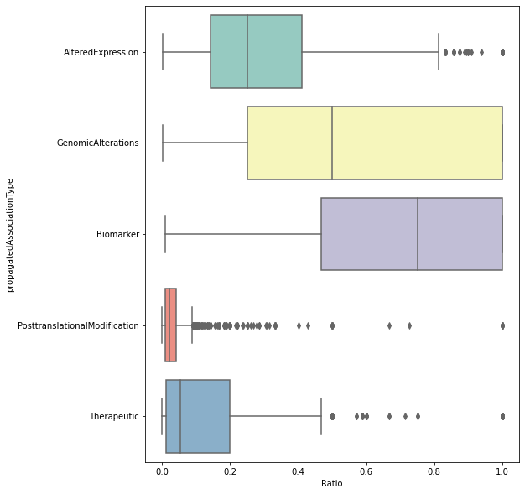
BOXPLOTS FOR RECATEGORIZED DATA
Boxplot of Counts of Genes per Disease for each Association Type:
Boxplot of Log of Counts of Genes per Disease for each Association Type:
Boxplot of Fraction of Genes for a Disease per Association Type:
Notes:
Similar to what I did what the whole dataset, I created boxplots of the counts of genes per disease for each association type, with and without taking the log. The non-log version, with the association type on the y-axis and the count of genes per disease on the x-axis, helps to demonstrate the large variation in gene set sizes, especially for Altered Expression, Biomarker, and Genomic Alterations. The log version helps us to better see the data, and that the median log size of gene sets for a disease are around 0 to 0.5 for all association types. Even though all association types have diseases with abnormally large gene sets (outliers), generally they are all pretty small. The fractional box plot on the right demonstrates that Biomarker has a much larger percentage of genes associated to each disease for all genes associated to Biomarker than compared to the other four. In contrast, Posttranslational modification has diseases that have a very small fraction of the total genes listed for that association type.

Slide 26
RECATEGORIZED DATASET method 2
Notes:
Next, we wanted to verify that if we included all data for Biomarker, that we would see increases in the median correlation coefficients between Biomarker and every other chosen association type. We also wanted to see if this categorization would end up being more useful for the next steps based on the results found. We did this by using the same dataset except instead of unique biomarker data, we used the original biomarker rows before propagation and recategorization.

Slide 27
diseaseNID | geneNID | ogAssociationTypes | propagatedAssociationType
1 | 1088 | {Biomarker} | Biomarker
1 | 3070 | {Biomarker} | Biomarker
2 | 10721 | {Biomarker} | Biomarker
3 | 54 | {Biomarker} | Biomarker
3 | 170 | {Biomarker} | Biomarker
... | ... | ... | ...
30292 | 9805 | {Biomarker} | Biomarker
30292 | 18471 | {Biomarker} | Biomarker
30292 | 19792 | {Biomarker} | Biomarker
30293 | 6353 | {Biomarker} | Biomarker
30293 | 8057 | {Biomarker} | Biomarker
RECATEGORIZED DATASET
#2
ALL BIOMARKER
diseaseNID | geneNID | propagatedAssociationType | ogAssociationTypes
1317 | 1088 | AlteredExpression | {AlteredExpression}
1338 | 1088 | AlteredExpression | {AlteredExpression}
1741 | 1088 | AlteredExpression | {AlteredExpression}
2107 | 1088 | PosttranslationalModification | {PosttranslationalModification}
2592 | 1088 | AlteredExpression | {AlteredExpression}
... | ... | ... | ...
30292 | 9805 | Biomarker | {Biomarker}
30292 | 18471 | Biomarker | {Biomarker}
30292 | 19792 | Biomarker | {Biomarker}
30293 | 6353 | Biomarker | {Biomarker}
30293 | 8057 | Biomarker | {Biomarker}
766865 rows × 4 columns
diseaseNID | geneNID | associationType | propagatedAssociationTypes
1317 | 1088 | {AlteredExpression} | {Biomarker, AlteredExpression}
1338 | 1088 | {AlteredExpression} | {Biomarker, AlteredExpression}
1741 | 1088 | {AlteredExpression} | {Biomarker, AlteredExpression}
2107 | 1088 | {PosttranslationalModification} | {Biomarker, PosttranslationalModification}
2592 | 1088 | {AlteredExpression} | {Biomarker, AlteredExpression}
... | ... | ... | ...
29802 | 18834 | {AlteredExpression} | {Biomarker, AlteredExpression}
29802 | 18837 | {AlteredExpression} | {Biomarker, AlteredExpression}
30104 | 25482 | {CausalMutation} | {CausalMutation, GeneticVariation, Biomarker, ...
30147 | 21709 | {CausalMutation} | {CausalMutation, GeneticVariation, Biomarker, ...
30157 | 10975 | {CausalMutation} | {CausalMutation, GeneticVariation, Biomarker, ...
NON-BIOMARKER
Filter: ONLY ‘AlteredExpression', 'PosttranslationalModification', ‘GenomicAlterations', or 'Therapeutic'
1411812 rows × 4 columns
644947 rows × 4 columns
Notes:
So we take that same non-biomarker dataset from the previous categorization, with the filter and the propagated association types separated into their own rows and append it with a dataset of all biomarker rows from the original dataset.
Note that this biomarker dataset has more than 200,000 more rows than the biomarker dataset from the first recategorization.
This is because we are now including gene-disease rows that had {Biomarker, Altered Expression} as its association type set before propagation. These added Biomarker rows are then of course much more correlated to other association types than our prior Biomarker rows.
When appended, we get a data table with the same few column types, which we can use to make heatmaps again.

Slide 28
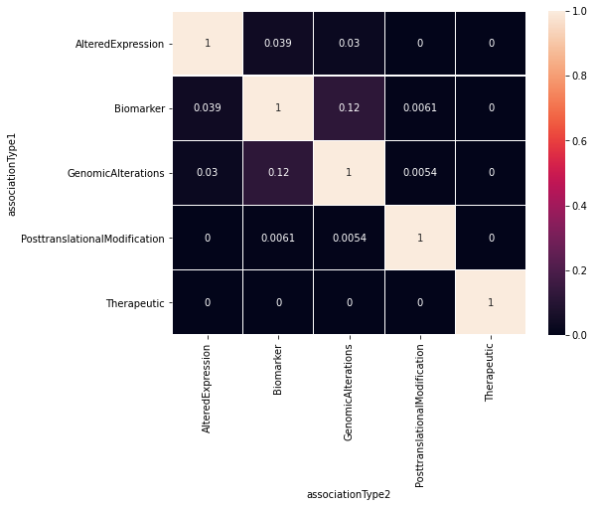
Heatmap OF MEDIAN JACCARD SCORE FOR ASSOCIATION PAIRS
Notes:
So the heatmap comparing median correlation scores for association pairs was created to understand this dataset, and overall, there are higher correlations between association types with this recategorization than with the unique biomarker categorization, but all these values are still very low.
The highest correlations are squared in red and can be seen between Biomarker/Altered Expression and Biomarker/Genomic Alterations, which we would hope to see. All we changed really was adding back in biomarker rows that were removed because that gene-disease pair was labeled under another association type as well. Thus, we have verified that these added rows are what increased the correlation scores.

Slide 29
QUESTION Raised:
Based on the exploratory data analysis performed on the ‘DiseseGeneAttributes’ dataset, have we learned enough about the gene-disease associations to be able to use them in the next steps of the project?
Notes:
So, as we mentioned prior, we realized that more than half of associations are marked as Biomarker. So we thought if we just removed Biomarker completely to focus on Therapeutic and Biomarker’s three children, we may not have diseases for which we have enough genes for each of the remaining association types. Thus, we needed to work with this dataset some more before continuing forward with it in the machine learning process. Since that would take some time, we thought we would set up the rest of the workflow by using a different type of dataset to get a different sense of genes for a particular disease. This led us to continuing our work with the curated dataset.

Slide 30
Curated dataset
geneId | geneSymbol | diseaseId | diseaseName | source
1 | A1BG | C0019209 | Hepatomegaly | CTD_human
1 | A1BG | C0036341 | Schizophrenia | CTD_human
2 | A2M | C0002395 | Alzheimer's Disease | CTD_human
2 | A2M | C0007102 | Malignant tumor of colon | CTD_human
2 | A2M | C0009375 | Colonic Neoplasms | CTD_human
... | ... | ... | ... | ...
109580095 | HBB-LCR | C0002875 | Cooley's anemia | CTD_human
109580095 | HBB-LCR | C0005283 | beta Thalassemia | CTD_human
109580095 | HBB-LCR | C0019025 | Hemoglobin F Disease | CTD_human
109580095 | HBB-LCR | C0085578 | Thalassemia Minor | CTD_human
109580095 | HBB-LCR | C0271979 | Thalassemia Intermedia | CTD_human
84038 rows × 5 columns
Sources: CGI (Cancer Genome Interpreter), CTD_human (Comparative Toxicogenomic Database), CLINGEN (Clinical Genome Resource), GENOMICS_ENGLAND, ORPHANET, PSYGENET (Psychiatric Disorders Gene Association Network), and UNIPROT.
Notes:
This curated data was a provided sub-dataset in the DisGeNet database.
Curated data as in a collection of datasets from various sources that is organized and managed to meet some usage.
Something to note is that instead of association types being compared we have sources, including CGI (Cancer Genome Interpreter), CTD_human (Comparative Toxicogenomic Database), CLINGEN (Clinical Genome Resource), GENOMICS_ENGLAND, ORPHANET, PSYGENET (Psychiatric Disorders Gene Association Network), and UNIPROT, and I can talk about what these are.

Slide 31
SOURCES OF CURATED DATA
SOURCE | DISEASE COUNT | DESCRIPTION
UNIPROT | 3935 | Protein sequence, structure, and function
CTD_HUMAN | 8246 | Focus on how environmental exposures affect human health
ORPHANET | 3266 | Rare diseases and orphan drugs
CLINGEN | 447 | Clinical relevance of genes and variants
GENOMICS_ENGLAND | 6046 | Virtual gene panels related to human disorders
CGI | 200 | Brain-tumor-causing alterations
PSYGENET | 105 | Psychiatric and associated diseases
Notes:
UNIPROT: database with curated info on protein sequence, structure and function. DisGeNET only included the human gene-disease associations marked as Disease from this database.
CTD/CTD_human (The Comparative Toxicogenomics Database): database with manually curated info about gene-disease relationships with focus on understanding how environmental exposures affect human health. DisGENET only included the associations marked as marker/mechanism or therapeutic.
ORPHANET: reference portal for info on rare diseases and orphan drugs to help improve the diagnosis, care, and treatment of patients with rare diseases. All gene-disease associations were kept by DisGeNET.
CLINGEN (Clinical Genome Resource): resource that defines the clinical relevance of genes and variants for use in precision medicine and research. DisGeNET uses all gene-disease associations exceptthose labeled as 'refuted.'
GENOMICS ENGLAND (Genomics England PanelApp): knowledge base that allows virtual gene panels related to human disorders to be created, stored, and queried. DisGeNET kept all gene-disease associations.
CGI (Cancer Genome Interpreter): tool that identifies known brain-tumor-causing alterations, predicts potential drivers among those of unknown significance, and itdentifies alterations in the tumor known to affect the response to anti-cancer drugs. It also has the catalog of Cancer Driver Genes, which is a selection of genes driving tumorigenesis (the formation/production of tumors) in a certain tumor type(s) upon a certain alteration. DisGeNET only kept validated data and not computational predictions.
PSYGENET (Psychiatric Disorders Gene Association Network): resource for exploratory analysis of psychiatric diseases and their associated diseases. DisGeNet uses all gene-disease associations from here.
Things to note:
Psygenet database used by DisGeNet is very small (both in gene count and disease count)! This leads to certain results with our machine learning model later on
CGI, PSYGENET, ORPHANET, and CTD_HUMAN are all pretty specific and distinct, so we can expect these to not be as correlated as CLINGEN and GENOMICS_ENGLAND, for example.

Slide 32
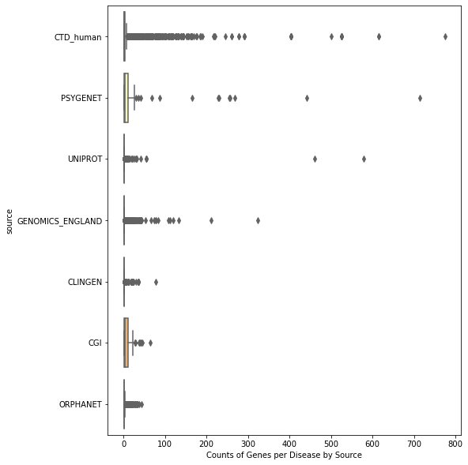
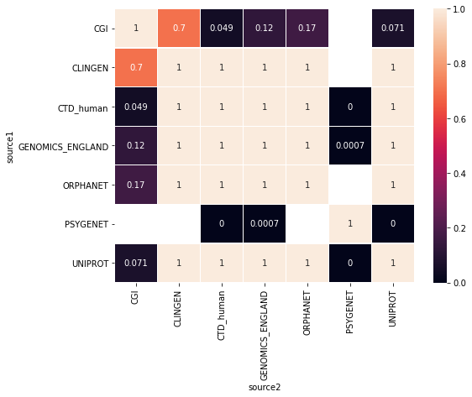
Boxplot of count of genes per disease for each source
HEATMAP OF MEDIAN JACCARD COEFFICIENT VALUES BETWEEN SOURCES
Notes:
Plotting the count of genes for each disease per source, we can see that there are extremely small gene sets, many containing only one gene per disease, in 5 of the 7 sources, which isn’t very useful for our machine learning model.
This idea is also shown through the heatmap, where most correlations are 1, suggesting that a lot of the gene sets for the source type pairs only have one gene in them, which makes it much more likely for the sets to be correlated perfectly. Thus, we need to filter the data to meet certain conditions, like a minimum gene set size, to obtain a curated dataset with more workable data.
We see some blanks in the heatmap between PSYGENET and CGI, CLINGEN, and ORPHANET, which we can expect. As we said, there is only a very small amount of data from PSYGENET in this dataset, so it is very likely for us to see no possible correlations between that source and others. Especially since CGI and CLINGEN are the next two smallest in size.

Slide 33
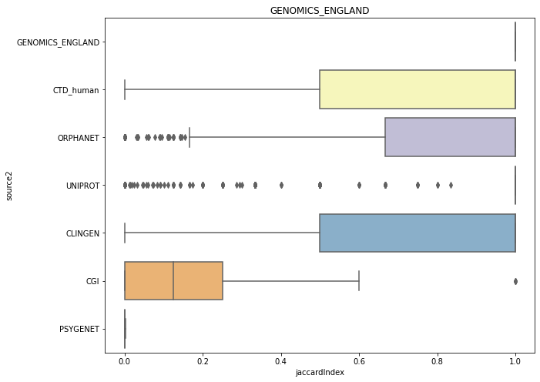
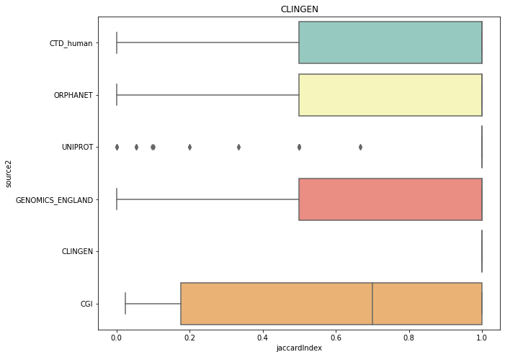
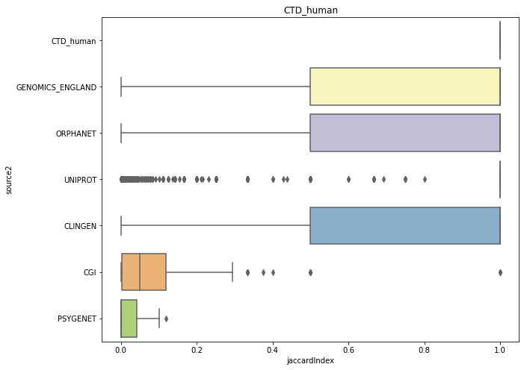
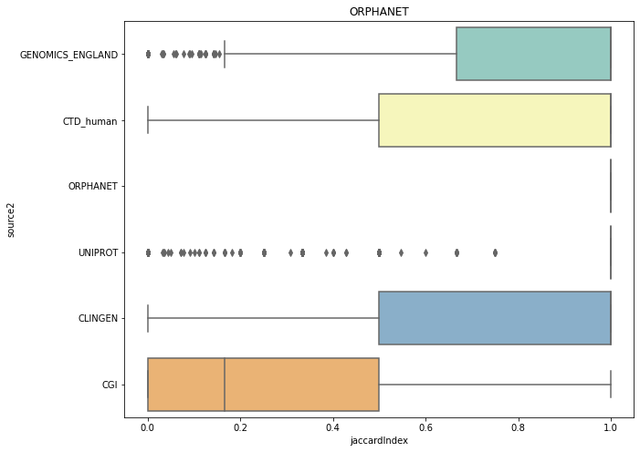
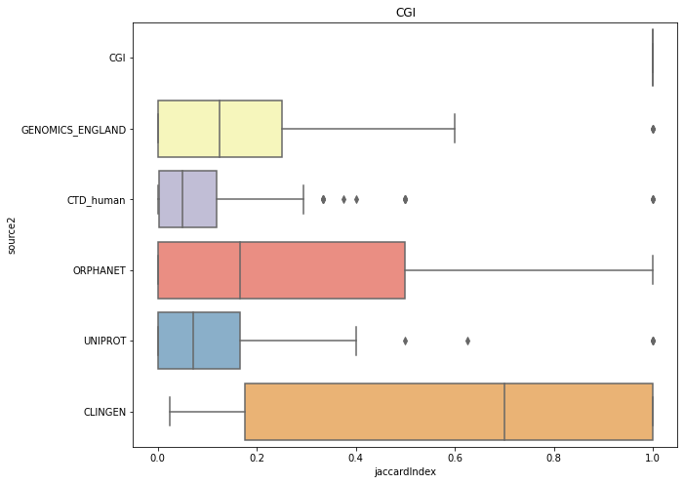
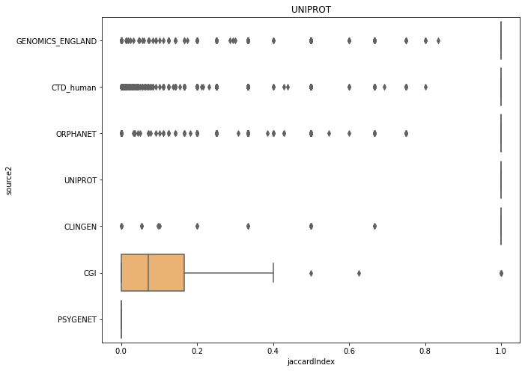
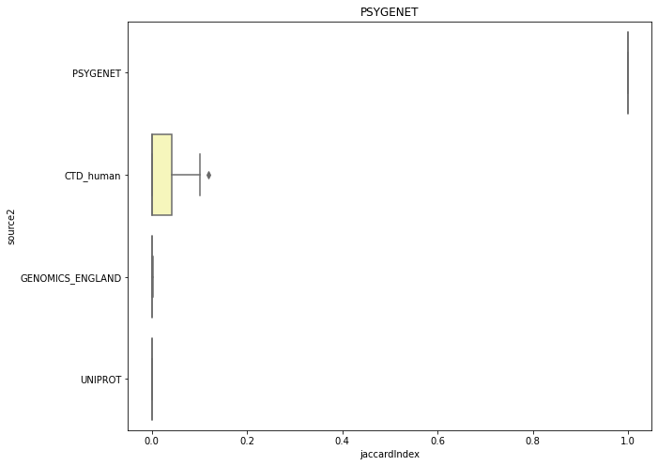
GENOMICS
ENGLAND
CLINGEN
ORPHANET
CGI
UNIPROT
PSYGENET
Notes:
This idea can also be seen through all the created boxplots for gene set exploration, since the median Jaccard coefficient for many of these source pairings is 1.
Thus, we need to filter the data to meet certain conditions, like a minimum gene set size, to obtain a curated dataset with more workable data.
Also, while not completely relevant, we can see that those sources in the CTD_human plot that do not have a median correlation of 1 are the two with the smallest disease and gene counts. The PSYGENET plot in the bottom right is so baren for this reason as well. It only has a median correlation of 1 with itself

Slide 34
SELECTED DOIDS:
Disease Name | Disease DOID
Cardiovascular System Disease | DOID:1287
Endocrine System Disease | DOID:28
Gastrointestinal System Disease | DOID:77
Hematopoietic System Disease | DOID:74
Immune System Disease | DOID:2914
Integumentary System Disease | DOID:16
Musculoskeletal System Disease | DOID:17
Nervous System Disease | DOID:863
Reproductive System Disease | DOID:229
Respiratory System Disease | DOID:1579
Thoracic System Disease | DOID:0060118
Urinary System Disease | DOID:18
Metabolism Diseases | DOID:0014667
Mental Health Diseases | DOID:150
Example: Disease ID: C0018923 → DOID: ‘DOID:0001816
Notes:
After changing the disease IDs into a DOID format, like shown in the example in the bottom left-hand corner, the first filter my mentor asked me to place was to only keep diseases that are descendants of one of the following 14 higher-level terms, and this was done by using a pre-existent disease ontology.

Slide 35
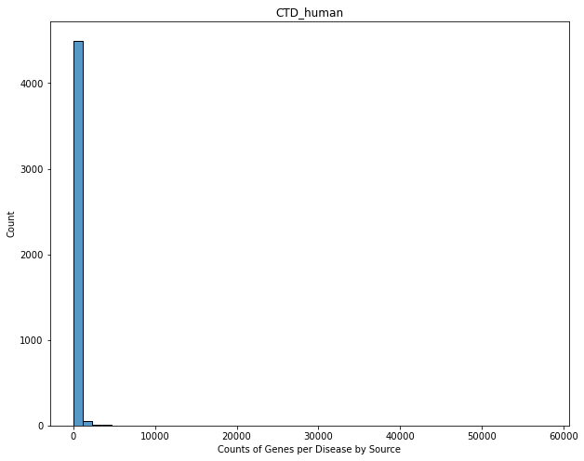
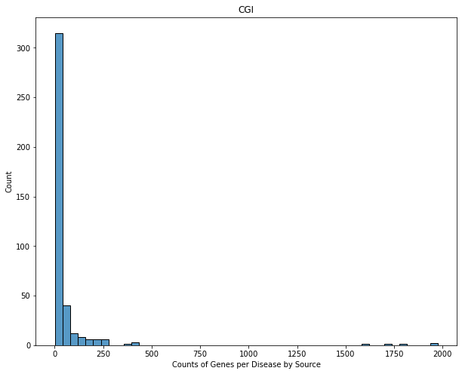
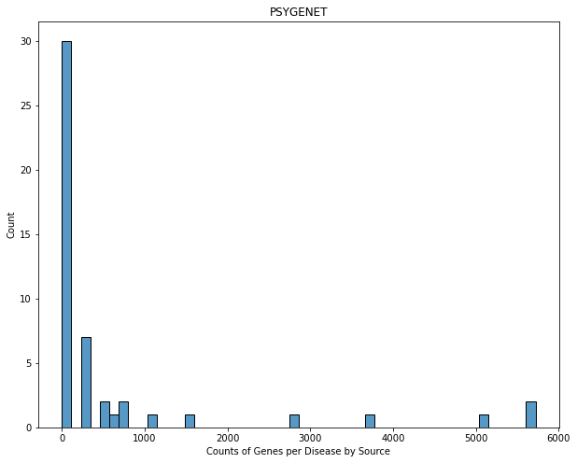
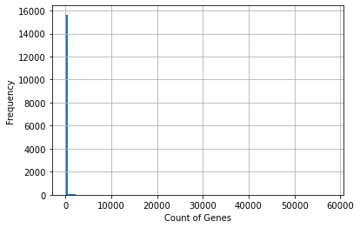
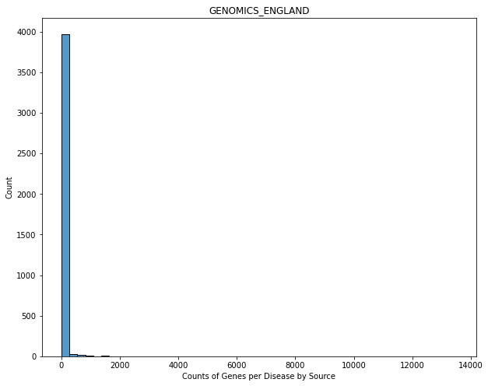
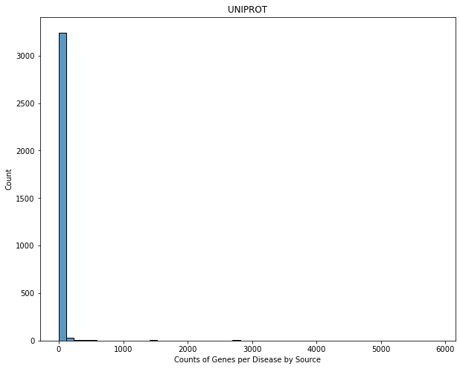
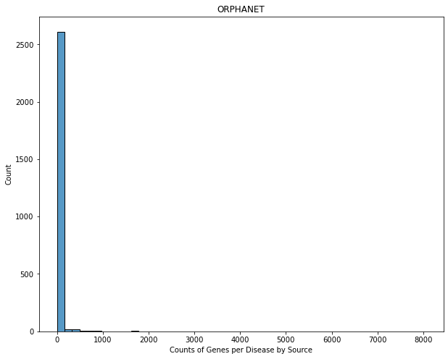
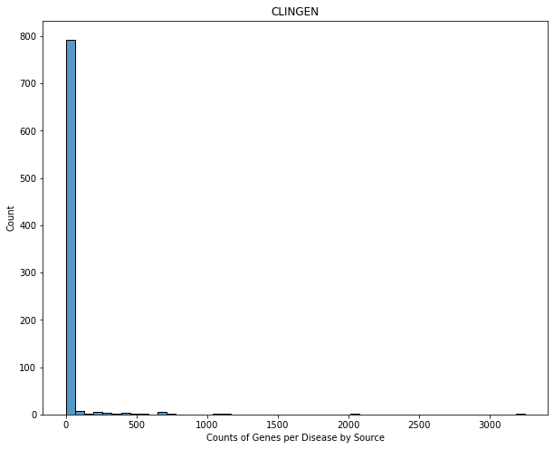
HISTOGRAMS
CTD
HUMAN
CGI
GENOMICS
ENGLAND
UNIPROT
ORPHANET
CLINGEN
Notes:
After using a disease ontology to propagate the diseases (so that the ancestors of a disease would also be paired to that gene-disease association), we created some histograms to select decent boundaries. The one on the left shows the counts of genes for all sources, and one can see there are an overwhelmingly large number of disease-source gene sets with small gene sets. The ones on the right are by source, with PSYGENET zoomed in as an example.
Overall, Arjun had used these plots and the filtered dataset I provided him to filter diseases that do not meet a minimum gene set size of 5 before propagation and 10 after.

Slide 36
FILTERED DATASET
dis_doid | dis_name | numgenes_CLINGEN | numgenes_CGI | numgenes_CTD_human | numgenes_GENOMICS_ENGLAND | numgenes_ORPHANET | numgenes_PSYGENET | numgenes_UNIPROT | numgenes_dir | numgenes_prop
DOID:863 | nervous system disease | 37 | 47 | 1657 | 974 | 601 | 0 | 553 | 53 | 2206
DOID:77 | gastrointestinal system disease | 5 | 71 | 1433 | 162 | 76 | 0 | 553 | 12 | 1987
DOID:1287 | cardiovascular system disease | 71 | 0 | 1087 | 227 | 163 | 0 | 96 | 36 | 1240
DOID:2914 | immune system disease | 4 | 120 | 907 | 209 | 163 | 0 | 81 | 49 | 1059
DOID:936 | brain disease | 15 | 32 | 747 | 320 | 156 | 0 | 118 | 27 | 1034
... | ... | ... | ... | ... | ... | ... | ... | ... | ... | ...
DOID:4254 | osteosclerosis | 0 | 0 | 15 | 14 | 10 | 0 | 9 | 7 | 18
DOID:4621 | holoprosencephaly | 0 | 0 | 11 | 14 | 14 | 0 | 7 | 17 | 18
DOID:0050534 | congenital stationary night blindness | 0 | 0 | 14 | 11 | 2 | 0 | 10 | 17 | 14
DOID:8499 | night blindness | 0 | 0 | 14 | 12 | 2 | 0 | 11 | 7 | 14
DOID:0060655 | autosomal recessive congenital ichthyosis | 0 | 0 | 10 | 12 | 12 | 0 | 10 | 11 | 12
129 rows × 11 columns
Notes:
So, with this propagated curated dataset, I first only kept rows that had ten or more genes from at least three sources. This was done to make sure that we have the desired number of genes for multiple sources to draw conclusions from multiple sources (for interesting data)
Then, reusing the dataset before propagation, I took a subset of the diseases that had 5 or more direct gene annotations to make sure we don’t end up with diseases that only exist in the dataset because of propagation (we want stuff from the actual ontology structure)
We then intersected this dataset with the filtered propagated one to get a dataset that meets all our filters, shown here.
The counts of genes for a source of that disease are listed in separate columns, and a sum before and after propagation of unique genes is listed at the very right.

Slide 37
SELECTED DOIDS
dis_doid | dis_name | numgenes_CLINGEN | numgenes_CGI | numgenes_CTD_human | numgenes_GENOMICS_ENGLAND | numgenes_ORPHANET | numgenes_PSYGENET | numgenes_UNIPROT | numgenes_dir | numgenes_prop
DOID:162 | cancer | 32 | 307 | 2963 | 168 | 247 | 0 | 740 | 128 | 3574
DOID:863 | nervous system disease | 37 | 47 | 1657 | 974 | 601 | 0 | 553 | 53 | 2206
DOID:77 | gastrointestinal system disease | 5 | 71 | 1433 | 162 | 76 | 0 | 553 | 12 | 1987
DOID:3119 | gastrointestinal system cancer | 3 | 76 | 993 | 29 | 17 | 0 | 528 | 6 | 1463
DOID:305 | carcinoma | 2 | 112 | 1087 | 36 | 36 | 0 | 211 | 166 | 1310
... | ... | ... | ... | ... | ... | ... | ... | ... | ... | ...
DOID:1342 | congenital hypoplastic anemia | 9 | 0 | 25 | 54 | 20 | 0 | 14 | 32 | 60
DOID:1793 | pancreatic cancer | 0 | 17 | 28 | 2 | 8 | 0 | 15 | 107 | 58
DOID:628 | combined T cell and B cell immunodeficiency | 1 | 0 | 24 | 28 | 26 | 0 | 16 | 42 | 38
DOID:0110274 | autosomal recessive limb-girdle muscular dystr... | 0 | 0 | 12 | 23 | 9 | 0 | 20 | 8 | 30
DOID:0050534 | congenital stationary night blindness | 0 | 0 | 14 | 11 | 2 | 0 | 10 | 17 | 14
77 rows × 12 columns
Notes:
I had also made a propagated curated dataset without any filters, but this was more for Arjun to help him select a subset of diseases to be used for the machine learning model.
Even with using diseases that are descendants of the shown fourteen higher level terms, we still had diseases that were very redundant, so Arjun had filtered out some of these redundancies.
Once Arjun had completed this manual curation (selected the diseases to use), I was able to move on to creating the labels using Anna’s code. Note that we are using 77 diseases in the machine learning model.

Slide 38
Question raised
Can models trained on one association type predict the genes associated to another association type?
Notes:
So, we wanted to see for any given disease, can models trained on one association type predict the genes associated to another category. I can determine this by using Anna’s code that she previously developed and applying it to our selected diseases.
We can then merge all these models together into an ensemble model for the disease to leverage the strength of all the association types and build a better model. And this is something I would like to work on in my remaining time.

Slide 39
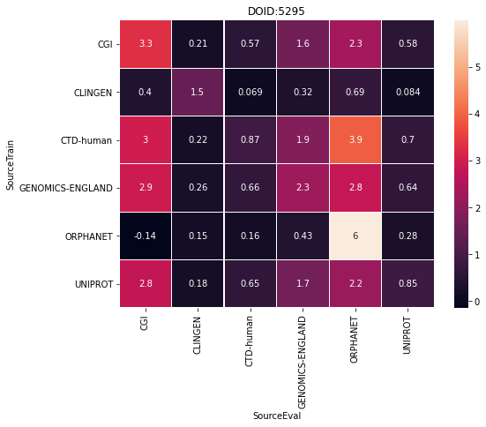

SUPERVISED MACHINE LEARNING MODEL AND RESULTS
DOID | SourceTrain | SourceEval | auROC | log2(auPRC/prior) | log2(P@r10/prior) | log2(P@r20/prior) | log2(P@r50/prior) | R@r10 | R@r20 | R@r50
DOID:936 | CGI | UNIPROT | 0.675605 | 0.832924 | 1.739775 | 1.632860 | 1.069923 | 0.059322 | 0.110169 | 0.186441
DOID:5295 | CLINGEN | CLINGEN | 0.821495 | 1.481127 | -inf | -inf | -inf | 0.000000 | 0.000000 | 0.000000
DOID:5295 | CLINGEN | UNIPROT | 0.642991 | 0.083763 | -inf | -inf | -inf | 0.000000 | 0.000000 | 0.000000
DOID:936 | ORPHANET | GENOMICS-ENGLAND | 0.677595 | 0.445159 | 0.750735 | 0.943380 | 0.665846 | 0.022082 | 0.050473 | 0.104101
DOID:936 | CLINGEN | UNIPROT | 0.559665 | 0.165131 | -1.067580 | -0.067580 | 0.195454 | 0.008475 | 0.033898 | 0.101695
... | ... | ... | ... | ... | ... | ... | ... | ... | ... | ...
DOID:5295 | CTD-human | CTD-human | 0.904299 | 0.873723 | 1.006789 | 1.006789 | 1.006789 | 0.018868 | 0.037736 | 0.094340
DOID:936 | CTD-human | CLINGEN | 0.722846 | 1.214725 | -inf | 0.616671 | 1.616671 | 0.000000 | 0.066667 | 0.333333
DOID:936 | CTD-human | CTD-human | 0.743564 | 0.387741 | 0.523646 | 0.601649 | 0.646503 | 0.012081 | 0.025503 | 0.065772
DOID:5295 | GENOMICS-ENGLAND | CLINGEN | 0.164486 | 0.258734 | -inf | -inf | -inf | 0.000000 | 0.000000 | 0.000000
DOID:5295 | CTD-human | ORPHANET | 0.900000 | 3.911620 | 4.172594 | 3.172594 | 2.850666 | 0.333333 | 0.333333 | 0.666667
72 rows × 11 columns
Notes:
All of the selected labels would be split into 3 folds and each of the 77 diseases would be trained on its sources it has labels for. We would then unsplit the folds and evaluate on another source that disease has information/label for.
After the evaluation process, files listing numerous model performance metrics are created and amended into a single dataset.
Results can then be analyzed through plots such as heatmaps. A sample dataset and heatmap from DOID:5295 and DOID:936 are shown here.
The 1st column in the dataset is the DOID for those values, the 2nd column is the source the model was trained on for that DOID, the 3rd column is the source the model was evaluated on for that DOID, and the last 8 columns are all performance values produced by the model. A value I was told to examine further was the log2(auPRC/prior), which basically states how much better the model did than random performance. If the value in this column is above 0, the model did better than random for that disease when trained on the listed source and evaluated on the other listed source. This value for each row is represented in these heatmaps for two DOIDS

Slide 40
SUPERVISED MACHINE LEARNING MODEL AND RESULTS
DOID | SourceTrain | SourceEval | auROC | log2(auPRC/prior) | log2(P@r10/prior) | log2(P@r20/prior) | log2(P@r50/prior) | R@r10 | R@r20 | R@r50
DOID:8692 | CTD-human | CGI | 0.873233 | 2.614241 | 3.147584 | 2.799661 | 2.662157 | 0.148936 | 0.234043 | 0.531915
DOID:936 | CGI | UNIPROT | 0.708895 | 0.977403 | 1.990186 | 1.797541 | 1.191820 | 0.067797 | 0.118644 | 0.194915
DOID:150 | CTD-human | UNIPROT | 0.751768 | 1.353335 | 1.634851 | 1.634851 | 1.705241 | 0.055556 | 0.111111 | 0.291667
DOID:263 | UNIPROT | ORPHANET | 0.645484 | 0.817277 | 1.232059 | 1.232059 | 1.232059 | 0.039216 | 0.078431 | 0.196078
DOID:2256 | GENOMICS-ENGLAND | ORPHANET | 0.813164 | 2.210550 | 3.086537 | 2.786976 | 2.349571 | 0.145455 | 0.236364 | 0.436364
... | ... | ... | ... | ... | ... | ... | ... | ... | ... | ...
DOID:74 | GENOMICS-ENGLAND | CTD-human | 0.773690 | 0.517985 | 0.348399 | 0.541044 | 0.645380 | 0.011532 | 0.026359 | 0.070840
DOID:1793 | GENOMICS-ENGLAND | UNIPROT | 0.672131 | 0.669673 | -inf | -inf | -inf | 0.000000 | 0.000000 | 0.000000
DOID:0080199 | CTD-human | CTD-human | 0.796087 | 1.007461 | 1.588456 | 1.353990 | 1.266528 | 0.036364 | 0.061818 | 0.145455
DOID:2914 | CTD-human | CTD-human | 0.834118 | 0.460756 | 0.612854 | 0.612854 | 0.612854 | 0.011050 | 0.022099 | 0.055249
DOID:178 | UNIPROT | UNIPROT | 0.863722 | 2.988346 | 3.754888 | 2.754888 | 2.017922 | 0.250000 | 0.250000 | 0.375000
2098 rows × 11 columns
Notes:
In terms of the process, all of the selected labels would be split into 3 folds and each of the 77 diseases would be trained on its sources it has labels for. We would then unsplit the folds and evaluate on another source that disease has information/label for.
After the evaluation process, files listing numerous model performance metrics are created and amended into a single dataset.
Results can then be analyzed through plots such as heatmaps, which I will show after this.
The 1st column in this dataset is the DOID, the 2nd column is the source the model was trained on for that DOID, the 3rd column is the source the model was evaluated on, and the last 8 columns are all performance values produced by the model. A value I was told to examine further was the log2(auPRC/prior), which basically states how much better the model did than random performance. If the value in this column is above 0, the model did better than random for that disease when trained on the listed source and evaluated on the other listed source. This value for each row is what is going to be represented in the heatmap for each DOID. Similarly, Arjun had asked that I plot the auROC value and the Jaccard Correlation Coefficient from earlier.

Slide 41

HEATMAPS OF JACCARD, LOG2(AUPRC/PRIOR), AND AUROC SCORES FOR A DOID:
x77
Notes:
So, here are the results for DOID 0050951, Hereditary Ataxia, plotted as an example. The first heatmap is for the Jaccard Correlation Score, so this just maps each association type to every other association type available for that DOID, contrary to what the axes say. Those axes were more for the following two heatmaps, where the sources on the y-axis are the ones trained on by the model, while the ones on the x-axis are the ones evalbuated on. The number next to each source on each heatmap represents the count of genes from that source for that disease. The total unique count of genes can be found in the title (here it is 98). I have not been able to take the time to examine these heatmaps yet because I had just finished them last night, and there are also a lot of them (3 heatmaps per disease for 77 diseases). Hopefully though, we can determine for which association-type models types trained on were able to proficiently predict genes from another association type based on these plots.
Something I would like to note is that some of these heatmaps were not square; however, we expect them to be square since each association type for a DOID is being trained and evaluated on. Anna had found that the 10 diseases with non-square heatmaps had lost a column of data on their heatmap due to their files being 0 bytes and removed. These 0-byte files had no positive genes in our network, so we couldn’t effectively train a model and subsequently collect any performance metrics to analyze. Even with being removed, they would not have provided any useful information anyways.

Slide 42

Heatmap of median jaccard, log2(auprc/prior), and auroc scores for source pairs
Notes:
I finally created summary heatmaps of the median jaccard correlation, log2(auPRC/prior), and auROC scores for source pairs. Similar to earlier, I grouped together all the values for each of these three scores into sets by source pairs and found their median value, which is plotted in their respective square. Therefore, the first plot of the jaccard score is the exact same type of heatmap I’ve been creating for the previous parts of this project, and the following two follow the same idea, just using a different score. I again have not gotten the chance to examine these heatmaps in detail yet because I just made them last night, but one thing to note is the few blank spots in the second and third heatmap. For both heamtaps, the square for when PSYGENET is trained on and CGI is evaluated on is blank because the model did not have the necessary data to do this comparison. This is not surprising when we remember that PSYGENET and CGI have the two smallest number of disease-gene pairs available. The other blank in the heatmap was caused by nAn value for one disease when trained and evaluated on those sources, while the rest of the values were fine. I am not sure if this nan value was by mistake or not, which is something I will probably look into. Overall, this is helping us to see which association-type models trained on generally do better to predict genes from another association type.

Slide 43

Next steps:
Analyze performance metric results for selected diseases further
Work on Posters and Presentations
Organize code for further use
Ensemble Model?
Notes:
After reviewing the metrics of the selected diseases further, I will mainly just be working on my final poster and presentation for MID-SURE. One thing we were considering was to combine the machine learning models built for each association type into an ensemble model to discover new gene-disease associations, but it does not look like I will be able to get to this before the end of this program.
My hope is that Anna will be able to use the code that I have developed to re-run everything I’ve done and continue building upon my work. She can incorporate this into her own project to study diseases further.

Slide 44
summary
Explored the initial dataset → decided it would be better to recategorize, filter, and propagate the dataset to determine if it could be used for next steps
Recategorized the dataset → realized we would need to take some time to explore this dataset more, so we moved forward with the curated dataset
Explored the curated dataset → after examining this data, we decided to propagate and filter it to be used in the machine learning model
Supervised machine learning model → can models trained on one association type predict the genes associated to another category?

Slide 45
acknowledgements
Anna Yannakopoulos
Dr. Arjun Krishnan
Jaewook Lee
General REU Staff (Laura Harris, Brian O’Shea)
Notes:
Anna Yannakopoulos:
Has helped me with every step of the process
Has been amazing in offering advice and answering my questions
Arjun:
Has been extremely helpful with overarching goals for the project and leading me in the best direction
Jaewook Lee:
Has been a great partner throughout the project
General REU Staff (Laura Harris, Brian O’Shea)

Slide 46
References
https://www.disgenet.org/home/
Pictures:
https://www.google.com/url?sa=i&url=https%3A%2F%2Fgeneticliteracyproject.org%2F2017%2F02%2F28%2Fcell-atlas-37-trillion-cells-in-the-human-body-will-be-catalogued-in-ambitious-effort%2F&psig=AOvVaw3apfkgoRHYM1CKVpu0_Mjz&ust=1624486232801000&source=images&cd=vfe&ved=0CAoQjRxqFwoTCLDTmO77rvECFQAAAAAdAAAAABAD
https://www.google.com/url?sa=i&url=https%3A%2F%2Fhub.jhu.edu%2F2017%2F07%2F05%2Flasso-probe-clones-thousands-genes-at-once%2F&psig=AOvVaw1tiKrxbRUWx-2R9St5k5Ka&ust=1624579437360000&source=images&cd=vfe&ved=0CAoQjRxqFwoTCICEh5r8rvECFQAAAAAdAAAAABAD
https://www.google.com/url?sa=i&url=https%3A%2F%2Fwww.nature.com%2Farticles%2Fd41586-019-03536-x&psig=AOvVaw0_kgJMWiXzUfn0ebt6G7Hg&ust=1624484880954000&source=images&cd=vfe&ved=0CAoQjRxqFwoTCLCsr_mbrPECFQAAAAAdAAAAABAQ
https://www.google.com/url?sa=i&url=https%3A%2F%2Fwww.aiche.org%2Fchenected%2F2020%2F05%2Fbioengineering-translational-medicine-addresses-formulation-and-delivery-strategies-covid-19-drugs&psig=AOvVaw1Lc853h-Fal62sLL2QDJxZ&ust=1624592303998000&source=images&cd=vfe&ved=0CAoQjRxqFwoTCLiZzIysr_ECFQAAAAAdAAAAABAD

Slide 47
Questions/contact info
Arun Agarwal, Temple University
Email: arunagarwal.aaa@gmail.com
Link to feedback form: https://docs.google.com/forms/d/e/1FAIpQLSesaAC9yIiXUKhlzCkKC4U0NU317dDyg89csivGPgeZoPyMEg/viewform?usp=sf_link
All code is currently on my local machine but will be placed in the lab GitHub (I think)

