Slide 1
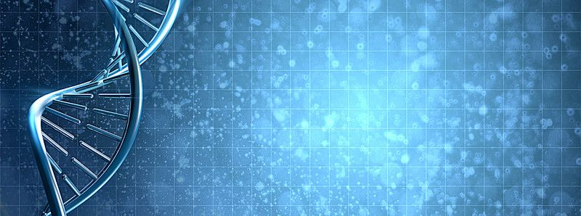
Exploration and Analysis of Gene-Disease Associations
RESEARCH UPDATE
ARUN AGARWAL

Slide 2
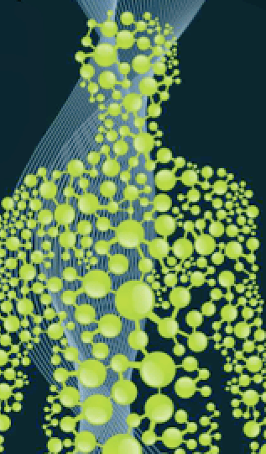
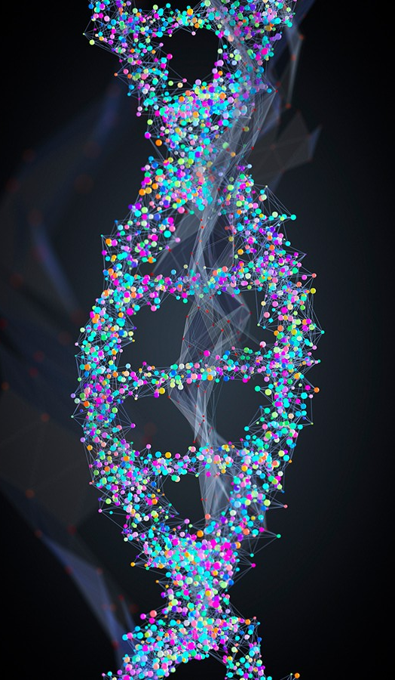
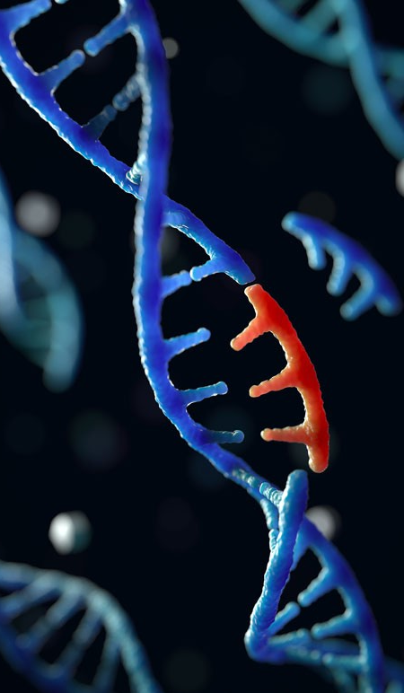
INTRODUCTION/BACKGROUND
X
= Gene
= Disease
= Gene
= Disease
= Gene
= Disease
Notes:
The trillions of cells within the human body are each sustained by the activities of thousands of genes in the genome.
CLICK
Genetic mutations prevent one or more of these genes from working properly; when such a mutation alters a gene that plays a critical role in the body, it can disrupt normal development and cause a medical condition.
CLICK
Many diseases do in fact arise due to the contribution of disruptions in multiple genes.
To work towards cures for such complex diseases, the human genome has been studied through various experimental methods, each of which has provided a different and sometimes unique understanding of the disease’s underlying genetic cause.
CLICK
We hypothesize that the genomic basis of complex diseases can be understood on a holistic level through the exploration and combination of genetic data from many distinct sources, experimental methods, and association types.

Slide 3

The dataset
NID | diseaseNID | geneNID | source | association | associationType | sentence | pmid | score | EL | EI | year
1130681 | 2107 | 793 | BEFREE | NaN | Biomarker | No correlation could be found between Broder's... | 1000501.0 | 0.10 | NaN | 0.956175 | 1976.0
261998 | 431 | 775 | BEFREE | NaN | GeneticVariation | However, there are few reports describing soma... | 10021299.0 | 0.40 | NaN | 0.987013 | 1999.0
369637 | 450 | 775 | BEFREE | NaN | GeneticVariation | WAF1 genotype and endometrial cancer susceptib... | 10021299.0 | 0.02 | NaN | 1.000000 | 1999.0
2128526 | 10033 | 775 | BEFREE | NaN | GeneticVariation | WAF1 genotype and endometrial cancer susceptib... | 10021299.0 | 0.07 | NaN | 1.000000 | 1999.0
262799 | 431 | 7385 | BEFREE | NaN | Biomarker | APC and APC2 may therefore have comparable fun... | 10021369.0 | 0.01 | NaN | 1.000000 | 1999.0
⋮ | ⋮ | ⋮ | ⋮ | ⋮ | ⋮ | ⋮ | ⋮ | ⋮ | ⋮ | ⋮ | ⋮
3,261,324 Rows, 12 Columns
Notes:
In this project, we obtained these data from the DisGeNET database, a discovery platform that has one of the largest publicly available collection of genes and variants associated to human diseases
Version 7 of this database contains:
1,134,942 gene disease associations (which is what I am working with) between 21,671 genes and 30,170 diseases
369, 554 variant disease associations, between 194,515 variants and 14,155 diseases
Contains multiple files with useful data, but I specifically make use of the geneDiseaseAttributes csv file and the associated files to acquire the ID’s universally used.
In the csv data table:
NID:
diseaseNID: the IDs/vocabulary used for diseases in DisGeNET are the Concept Unique Identifiers from the Unified Medical Language System; I later transform these into the universally used disease ID using a provided csv file
geneNID: the IDs/vocabulary used for genes in DisGeNET are the NCBI Entrez gene identifiers; similar to diseases, this can be easily transformed to display the universally used gene ID using another provided csv file
source: name of source of the data
association: NOT HELPFUL AND NOT USED
associationType: an ontology developed by DisGeNET that structures the gene-disease relationship in a sort of hierarchy; I was told to think of each of the fifteen association types as a different experiment type; these association types can be mapped according to the original source label if desired
sentence: sentence describing the gene-disease association (either from the publication or the title of the publication itself)
pmid: Pubmed Identifier, the publication(s) that report the gene-disease association
score: score to rank the disease-gene association according to level of evidence, taking into account number of sources, type of sources, and number of publications supporting the association
EL (Evidence Level): measures strength of evidence of gene-disease relationship that correlates to a qualitative classification (Definitive, Strong, Moderate, Limited, Disputed); This data is only available for a few of the sources
EI: (Evidence Index): indicates the existence of contradictory results in publications supporting the gene-disease associations. This only exists for those entries that have source of BeFree or PsyGeNET
Year: date of report of association
which integrates human gene-disease associations and variant-disease associations from expert-curated repositories, GWAS catalogs, animal models, and scientific literature to create one of the largest publicly available collections of genes and variants mapped to over 30,000 human diseases.

Slide 4


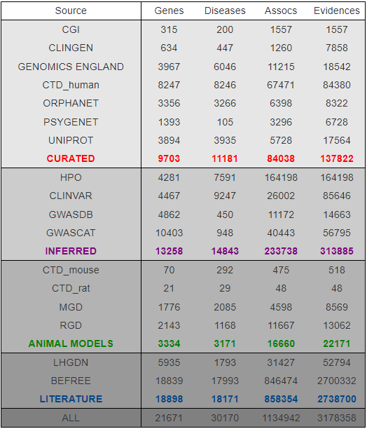
DATA SOURCES
Expert-curated Repositories
GWAS Catalogs
Animal Models
Rat and Mouse Data
Scientific Literature
Notes:
Integrates data from expert-curated repositories, GWAS catalogs, animal models (rat and mouse data), and scientific literature

Slide 5
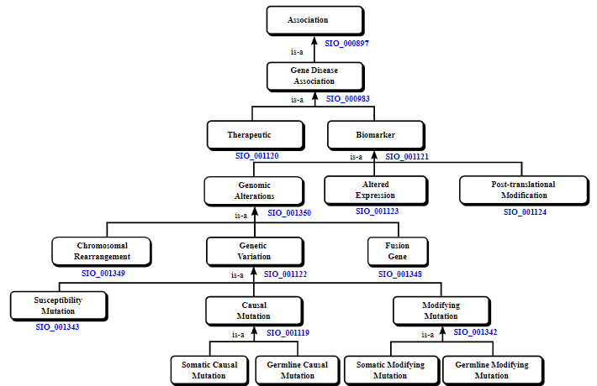
ASSOCIATION TYPES HIERARCHY
Ontology developed by DisGeNET
Structures gene-disease relationships in a hierarchy
15 association types
Notes:
An ontology developed by DisGeNET that structures the gene-disease relationship in a sort of hierarchy; I was told to think of each of the fifteen association types as a different experiment type; these association types can be mapped according to the original source label if desired

Slide 6
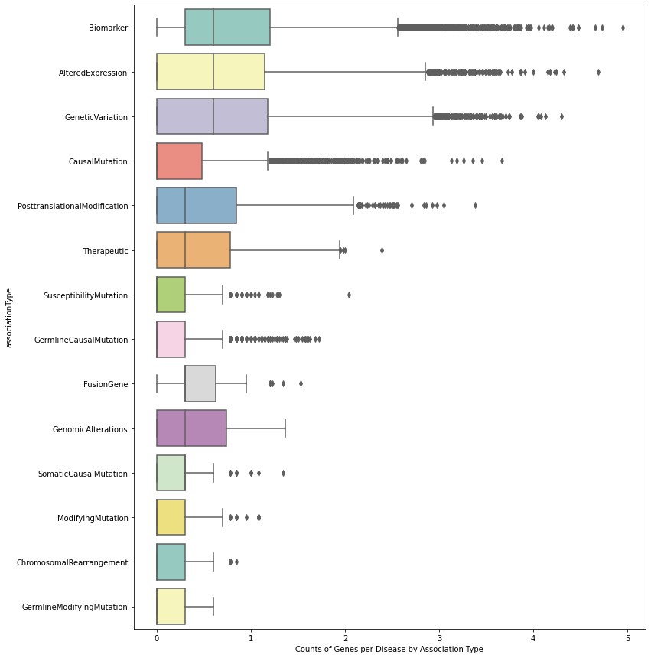
BOXPLOT OF THE COUNT OF GENES PER DISEASE FOR EACH ASSOCIATION TYPE
Notes:
Step 1: Preliminary Data Exploration: To better understand the dataset, I was first asked to make one boxplot per association type that is showing the distribution of the number of genes per disease from that type. I would have one plot with the absolute numbers and another with the fraction of genes for a disease from that association type
I needed to plot the log of the count of genes per disease for each association type due to the large variation in counts, which made many of the boxplots unreadable.
Those association types with a greater median have more genes associated to the specific diseases then some other association types.
One can notice that the association types that are more general and more encompassing have the larger medians (circled).
They also have the larger number of outliers, suggesting they have encompassed a larger number of diseases that have unusually large genes associated to certain diseases.
From this, we can determine that it would be better to re-categorize the data so that we have five to six main association Types rather than fourteen.
CLICK TO SLIDE SHOWING SELECTED ONES IN HIERARCHY

Slide 7
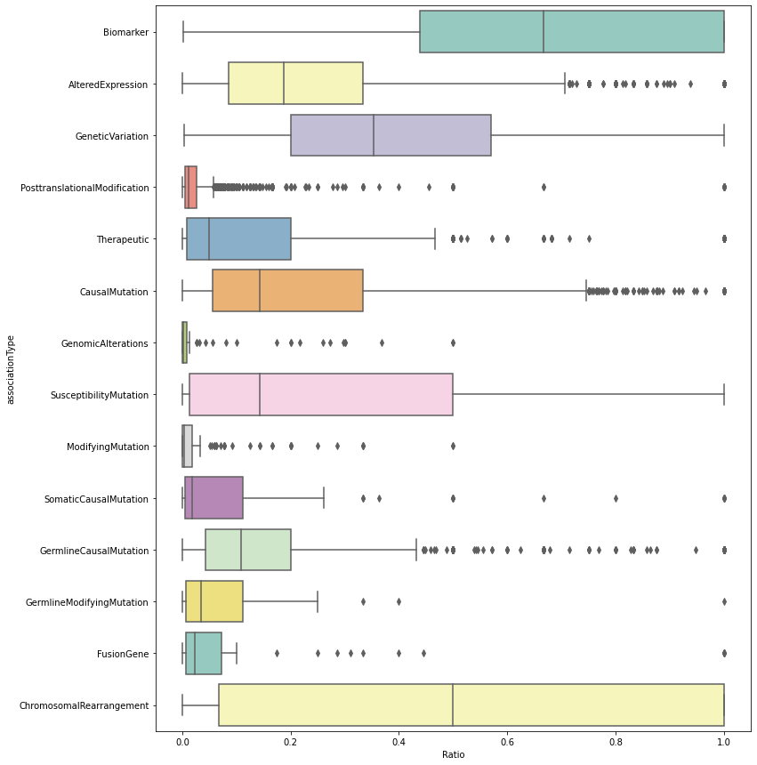
BOXPLOT OF THE FRACTION OF GENES FOR A DISEASE FROM THAT ASSOCIATION TYPE
Notes:
Step 1: Preliminary Data Exploration: To better understand the dataset, I was first asked to make one boxplot per association type that is showing the distribution of the number of genes per disease from that type. I would have one plot with the absolute numbers and another with the fraction of genes for a disease from that association type
For each association type, the fraction of genes for a disease divided by all genes for an association Type is displayed in a box plot format.
One could see for the Biomarker association type, for example, that there is a much larger percentage of genes associated to each disease than compared to some smaller categories. One can also see that almost every association type contains at least one disease that has the entire gene set associated to it. For many of the boxplots, these diseases are considered outliers. The Chromosomal Rearrangement boxplot is also intriguing due to the broadness of its graph. This suggests that the size of the gene sets for diseases contain much variance. Understanding the reasoning behind this relationship (as well as the relations for the other association types) is important for this research project.
I needed to plot the log of the count of genes per disease for each association type due to the large variation in counts, which made many of the boxplots unreadable.
Those association types with a greater median have more genes associated to the specific diseases then some other association types.
One can notice that the association types that are more general and more encompassing have the larger medians (circled).
They also have the larger number of outliers, suggesting they have encompassed a larger number of diseases that have unusually large genes associated to certain diseases.
From this, we can determine that it would be better to re-categorize the data so that we have five to six main association Types rather than fourteen.
CLICK TO SLIDE SHOWING SELECTED ONES IN HIERARCHY

Slide 8
RECATEGORIZED DATASET

Slide 9
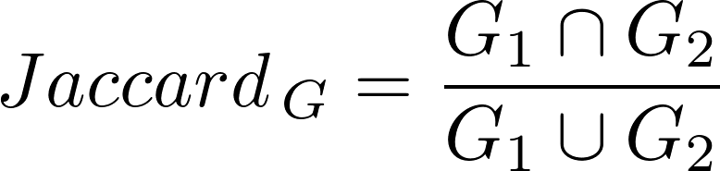
GENE SETS DATA TABLE
diseaseNID | associationType1 | associationType2 | geneNID1 | geneNID2 | JaccardIndex
3 | CausalMutation | GeneticVariation | {5458, 1813, 3065} | {6417, 4711, 17182} | 0.000000
3 | CausalMutation | Biomarker | {5458, 1813, 3065} | {2818, 7694, 2648, 7005, 4959, 4711, 2270, 127... | 0.000000
3 | GeneticVariation | Biomarker | {6417, 4711, 17182} | {2818, 7694, 2648, 7005, 4959, 4711, 2270, 127... | 0.010000
5 | AlteredExpression | GeneticVariation | {3288, 1924} | {8699, 2126, 5304, 5241} | 0.000000
5 | AlteredExpression | Biomarker | {3288, 1924} | {4577, 3288, 1567, 1489, 129, 11754, 3799, 3559} | 0.111111
... | ... | ... | ... | ... | ...
67,659 Rows, 6 Columns
Notes:
Step 2: I next tried to answer if different experimental methods provide the same view of the underlying biology (lots of gene overlap between association types), or do they present different aspects of it (very separate gene sets).
To do this, I first worked on defining sets of genes associated with each disease based on a particular association type. Then, we compared gene sets from the same disease--yet separate association types–using the Jaccard Correlation Coefficient, to quantify the overlap in the genes contributed by the different association types.
CLICK TO SEE FORMULA FOR JACCARD INDEX
We plot these correlation scores in the form of boxplots and a heatmap to determine if different experimental methods have some sort of correlation between the gene sets
To do this, I reorganized the dataset by creating gene sets for each association type based on the disease, creating sets of association types based on disease, creating different combinations of association types for each disease, removing the diseases the only held one association type, making a separate row for each combination, separating the created combinations into two columns, adding the associated gene sets back in with two separate columns, and calculating the Jaccard similarity coefficient/Jaccard index.

Slide 10
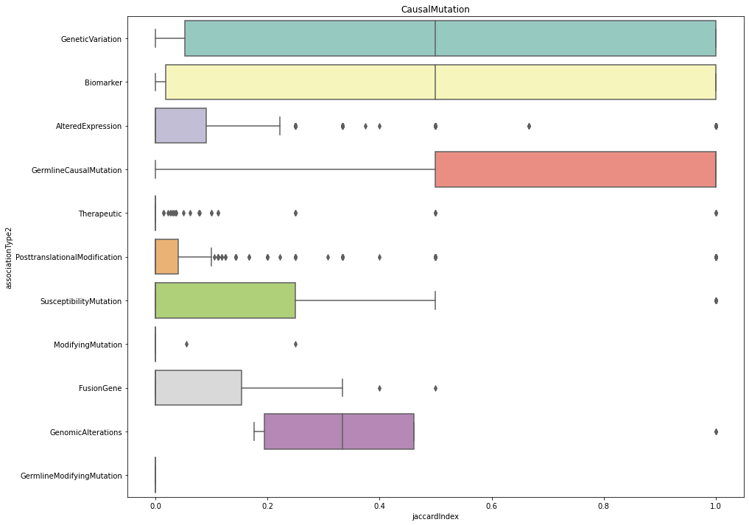
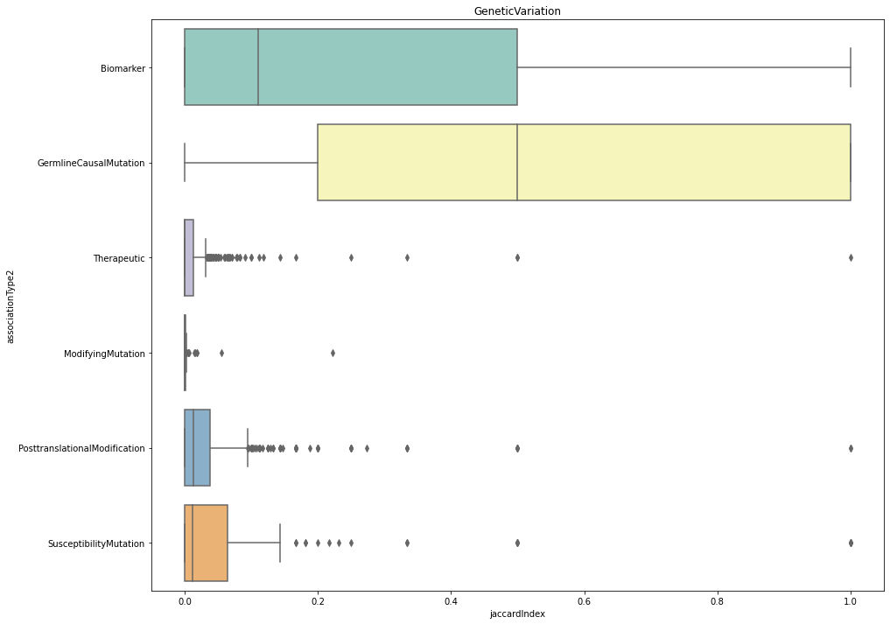
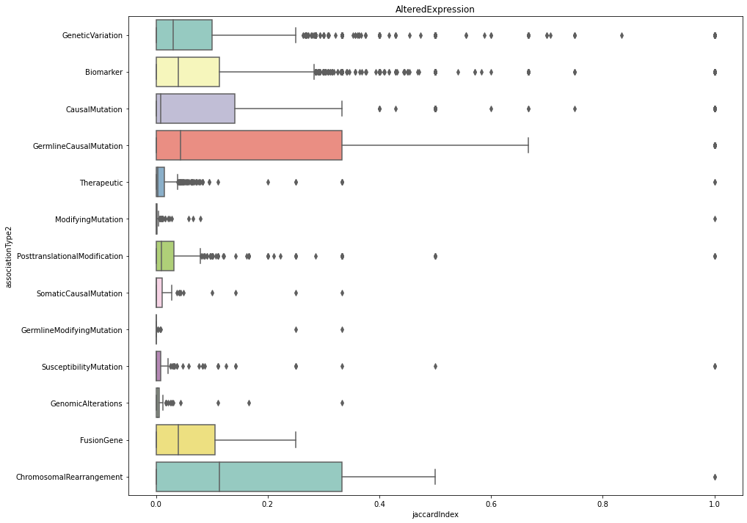
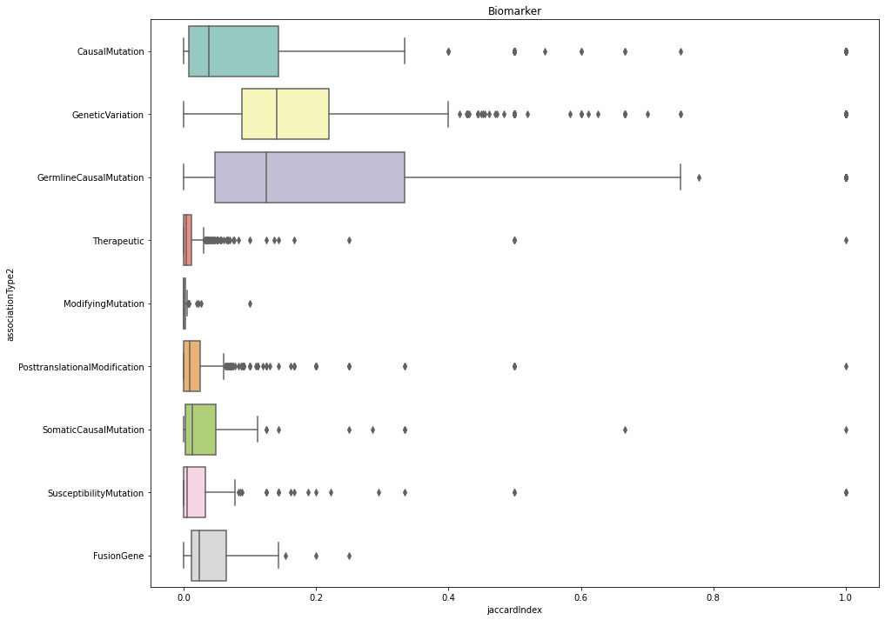
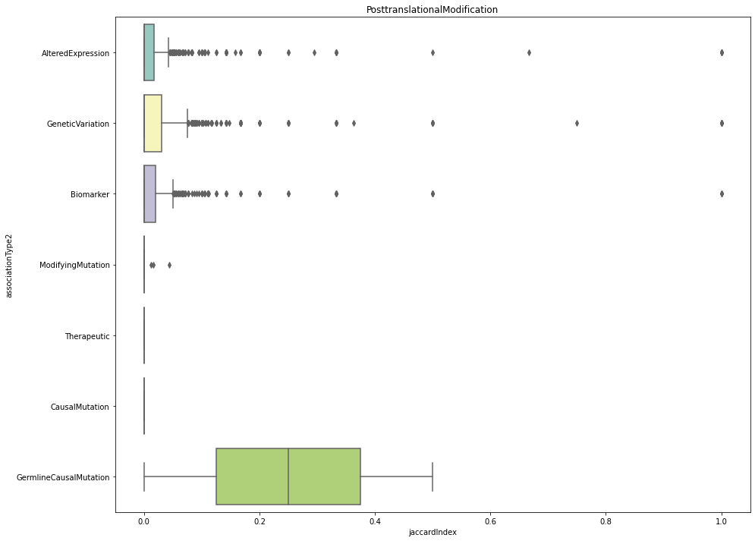
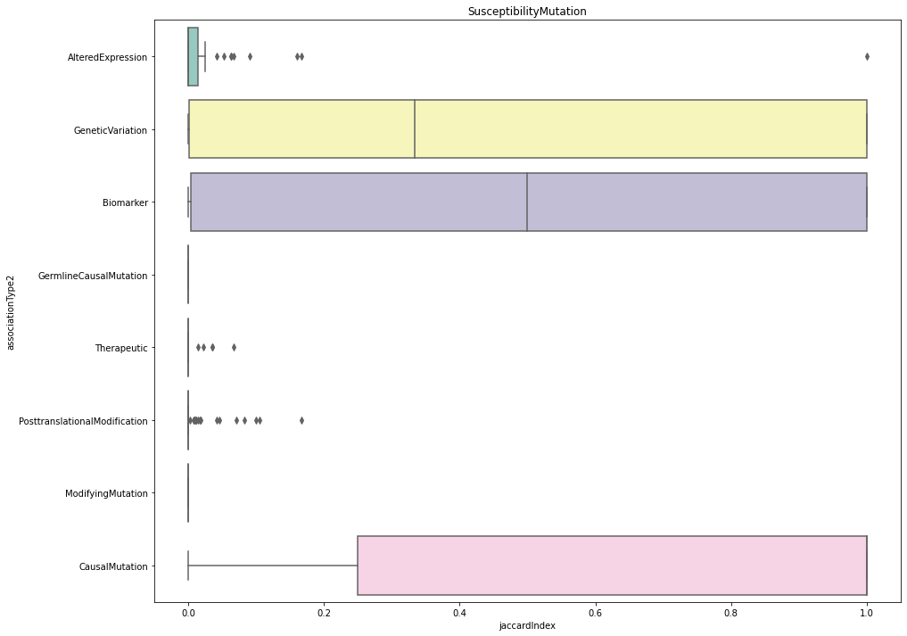
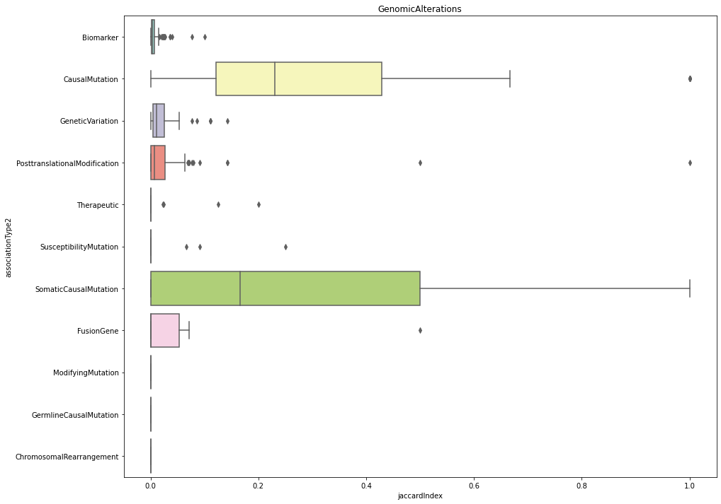
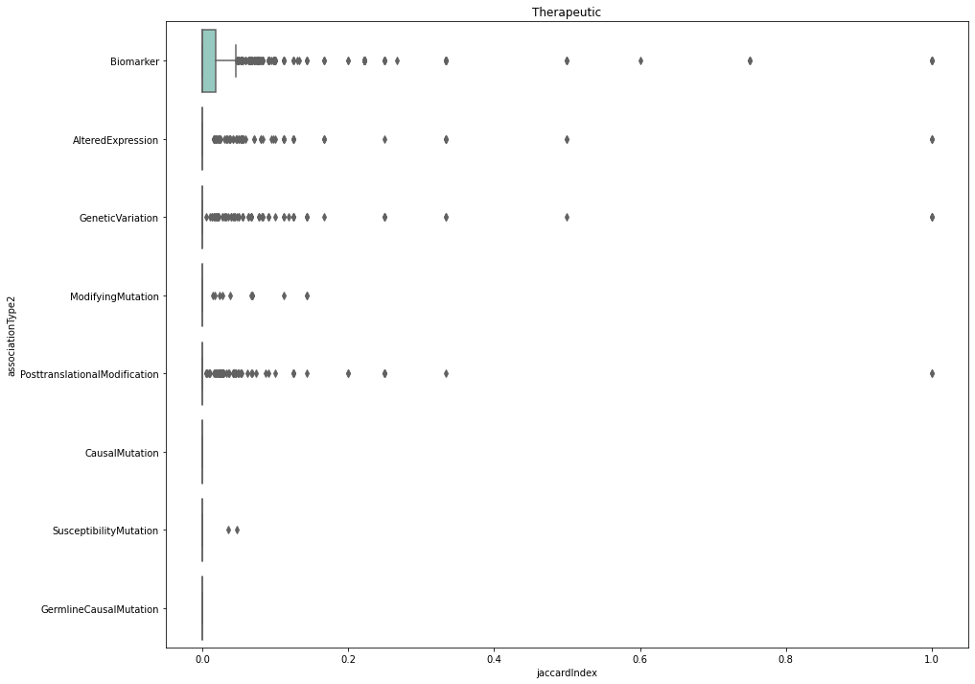
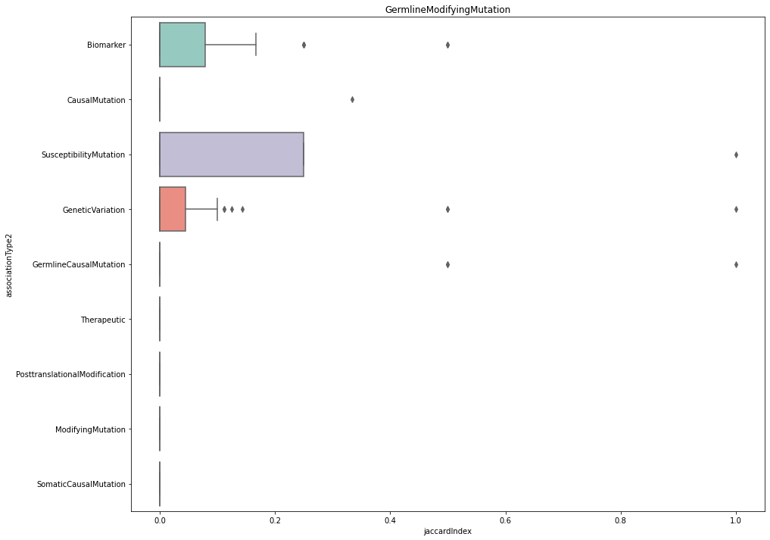
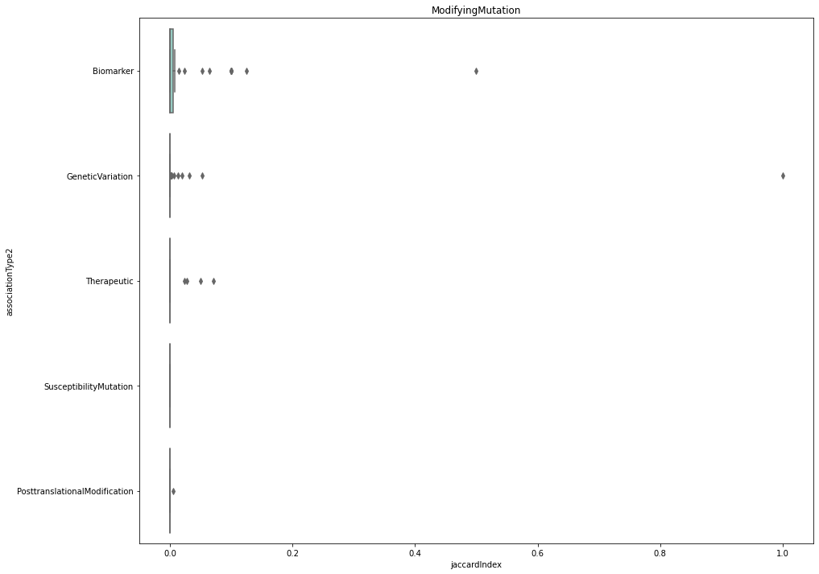
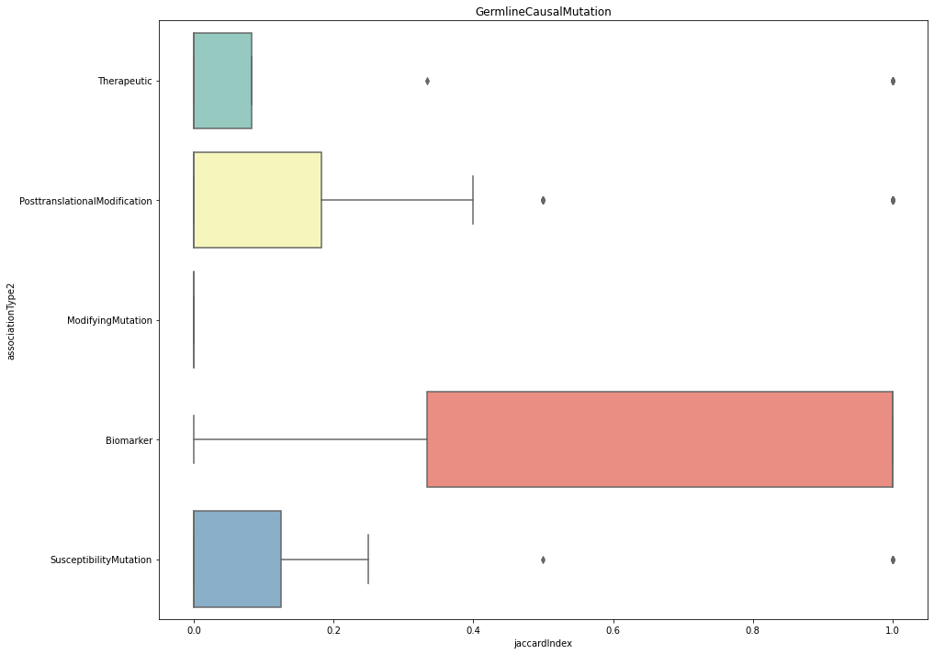
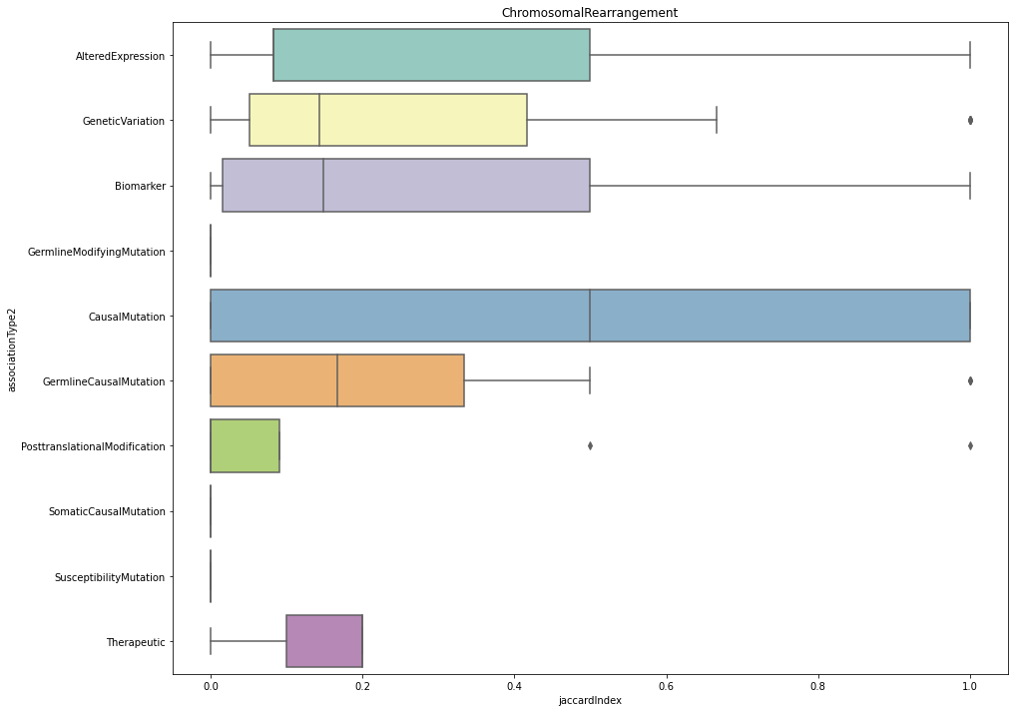
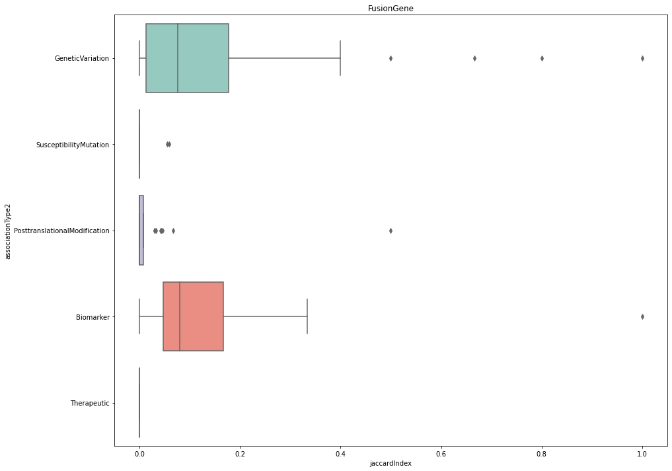
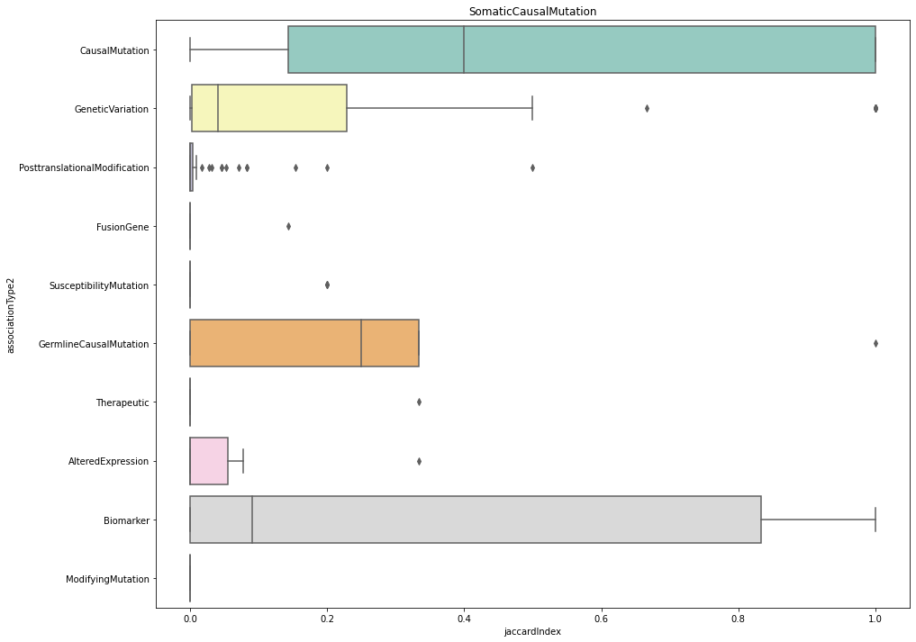
Notes:
Thus, fourteen boxplots were created, one plot for each association type (except one that had no data)
Not Expecting you to read them!

Slide 11
Notes:
Example:
Each Association type from the pair is plotted against its paired association type to demonstrate the correlation between gene sets from the same disease
These boxplots have a lot of information to unpack, which is something I will probably spend some time doing in the future.

Slide 12
HEATMAP DATASET
associationType1 | associationType2 | jaccardIndex | Median
AlteredExpression | Biomarker | [0.1111111111111111, 0.0245614035087719, 0.061... | 0.039286
AlteredExpression | CausalMutation | [0.0769230769230769, 0.1111111111111111, 0.0, ... | 0.007875
AlteredExpression | ChromosomalRearrangement | [0.2, 0.0, 0.0, 0.1153846153846153, 0.5, 0.166... | 0.113248
AlteredExpression | FusionGene | [0.0183150183150183, 0.0094339622641509, 0.0, ... | 0.039855
AlteredExpression | GeneticVariation | [0.0, 0.027027027027027, 0.0857142857142857, 0... | 0.030928
... | ... | ... | ...
117 Rows, 4 Columns
Notes:
To create the heatmap, the dataset was reorganized to obtain the median values for each association type combination. Thus, the new dataset has one row for each association type combination, a set of the jaccard indices for that association type combination, and a median of the value for each of those sets; this median is what gets added to the heatmap
We use the median (rather than the average/mean) to deal with outliers effectively

Slide 13
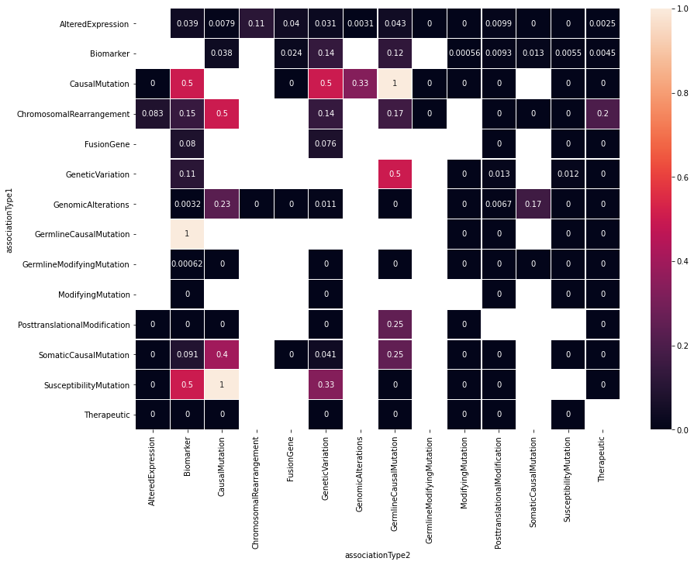
Notes:
While this heatmap can also provide a lot of useful information, this is actually not going to be utilized since we plan to recategorize the dataset into five association types rather than fifteen. One can clearly see a lot of blanks in the heatmap as it is, suggesting that not all association types even provide useful information for our purposes. It is also pretty cumbersome to read this and the numerous boxplots. Focusing our attention on five associations will make more succinct data and plots. I have just included this here to demonstrate what I plan to create with the recategorized dataset.
This heatmap provides a lot of useful information. The first thing one will probably notice the numerous blank spaces within the heatmap; this is due to the fact that not every association type could be mapped/compared to another association type. For example, a disease could have association types for Biomarker, Altered Expression, and Fusion Gene. This leads to three different combinations and six boxes filled in the heatmap above. However, for that disease, there are no combinations containing the other eleven association types. If there is not an association type combination made for any disease, there cannot be any data represented for that box in the heatmap. One can also see that the diagonal of the heatmap is completely empty, which makes sense because we purposely did not make association type combinations of the same association type (as the values would all be 1).
Moving on, the heatmap helps to show a few clear highlights/high correlations between association types. Germline Modifying Mutation/Biomarker, Susceptibility Mutation/Causal Mutation, and Causal Mutation/Germline Causal Mutation all interestingly have a heatmap/median value of 1, suggesting they correlate perfectly. It is especially interesting that Susceptibility Mutation and Causal Mutation have a correlation of 1 when they are two separate children of Genetic Variation. It may make sense that Germline Causal Mutation correlates strongly with Biomarker since Biomarker is an ancestor (more generalized) than Germline Causal Mutation. This similarly holds true for Causal Mutation (parent) and Germline Causal Mutation (child).
Other high correlations seen in the heatmap exist between Causal Mutation/Biomarker, Causal Mutation/Genetic Variation, Chromosomal Rearrangement/Causal Mutation, Genetic Variation/Germline Causal Mutation, and Susceptibility Mutation/Biomarker.

Slide 14
RECATEGORIZED DATASET

Slide 15
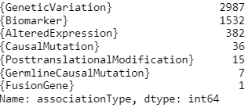
Unique genes in each association type
Notes:
This is around where I am at, but I am doing other stuff in relation to this like propagating the dataset for my lab partner, Jaewook, writing some of the organized data to gmt files, creating the hierarchy tree relationship in code using a digraph, and determining the number of unique genes for each association type (to determine how many unique genes would be lost in the recategorization)

Slide 16
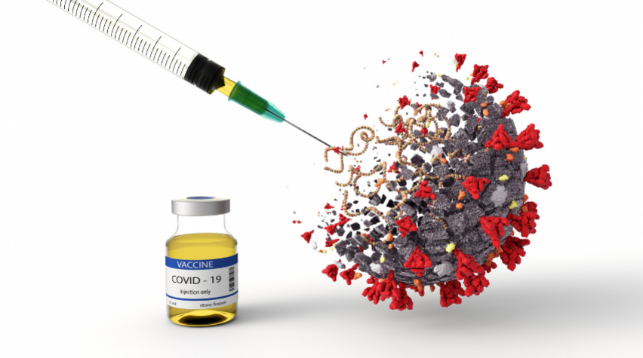
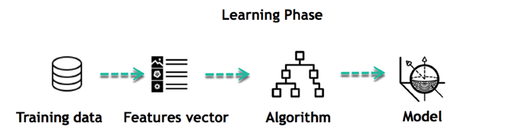
Next steps
Supervised Machine Learning Approaches
Logistic Regression
Combine Machine Learning Models into an Ensemble Model
Why Care:
Better understanding of complex diseases
Development of drugs to combat disease-related signals
Notes:
Since we expect these overlaps to be low, we will devise supervised machine learning approaches, including logistic regression, to determine if, for a given disease, genes from an association type can be used to accurately predict genes from another type based on their patterns of interaction in a gene network.
Finally, we will explore how to combine the machine learning models built for each association type into an ensemble model that discovers novel genes across the human genome associated with that disease.
Such results can lead to a general understanding of the genomic basis of complex diseases and in the design of drugs that target and reverse the disease-related signals.

Slide 17
References/acknowledgements
Mentors: Dr. Arjun Krishnan, Anna Yannakopoulos
https://www.disgenet.org/home/
Pictures:
https://www.google.com/url?sa=i&url=https%3A%2F%2Fgeneticliteracyproject.org%2F2017%2F02%2F28%2Fcell-atlas-37-trillion-cells-in-the-human-body-will-be-catalogued-in-ambitious-effort%2F&psig=AOvVaw3apfkgoRHYM1CKVpu0_Mjz&ust=1624486232801000&source=images&cd=vfe&ved=0CAoQjRxqFwoTCLDTmO77rvECFQAAAAAdAAAAABAD
https://www.google.com/url?sa=i&url=https%3A%2F%2Fhub.jhu.edu%2F2017%2F07%2F05%2Flasso-probe-clones-thousands-genes-at-once%2F&psig=AOvVaw1tiKrxbRUWx-2R9St5k5Ka&ust=1624579437360000&source=images&cd=vfe&ved=0CAoQjRxqFwoTCICEh5r8rvECFQAAAAAdAAAAABAD
https://www.google.com/url?sa=i&url=https%3A%2F%2Fwww.nature.com%2Farticles%2Fd41586-019-03536-x&psig=AOvVaw0_kgJMWiXzUfn0ebt6G7Hg&ust=1624484880954000&source=images&cd=vfe&ved=0CAoQjRxqFwoTCLCsr_mbrPECFQAAAAAdAAAAABAQ
https://www.google.com/url?sa=i&url=https%3A%2F%2Fwww.aiche.org%2Fchenected%2F2020%2F05%2Fbioengineering-translational-medicine-addresses-formulation-and-delivery-strategies-covid-19-drugs&psig=AOvVaw1Lc853h-Fal62sLL2QDJxZ&ust=1624592303998000&source=images&cd=vfe&ved=0CAoQjRxqFwoTCLiZzIysr_ECFQAAAAAdAAAAABAD

Slide 18
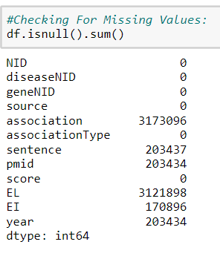
MISSING VALUES
Notes:
From this, it can be seen that I need to deal with the numerous missing values for association, sentence, pmid, EL, EI, and year

