Slide 1

Exploration and Analysis of Gene-Disease Associations
Week 8 research update
Arun agarwal

Slide 2
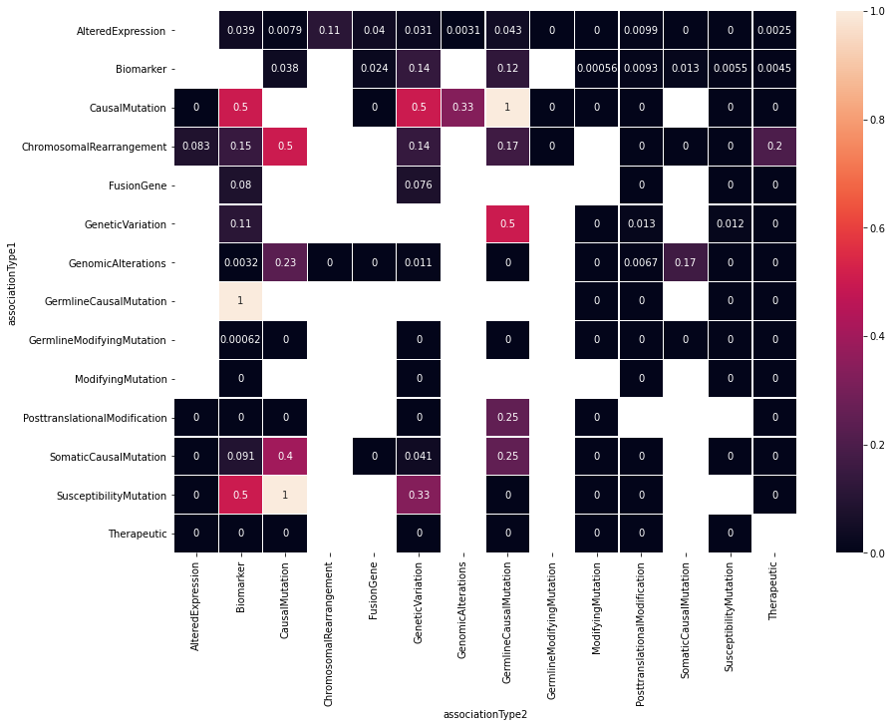
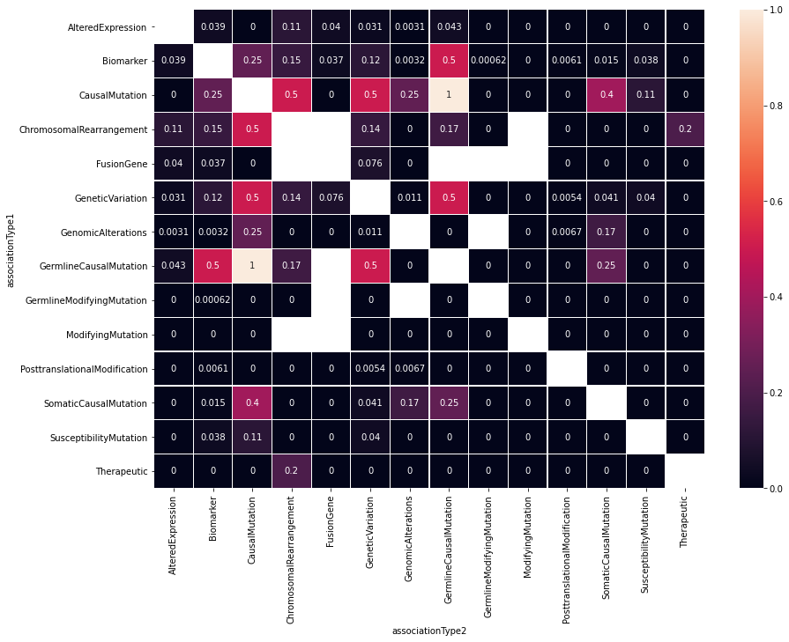
Notes:
Last time, I ended by trying to answer how much gene overlap is there between association types for a disease through plotting of Jaccard correlation coefficients in boxplots and heatmaps.
As we had mentioned, there were a lot of blanks in the heatmap, but many of these were due to me using combinations rather than permutations. Thus, after changing my code to reflect permutation comparisons, the heatmap came out as follows:
CLICK TO SHOW NEW HEATMAP
It looks a lot more filled and cleaner now. One can also see that the diagonal of the heatmap is still empty, which makes sense because we purposely did not make association type combinations of the same association type (as the values would all be 1).
And although this heatmap can provide a lot of useful information, we don’t plan to use it further due to its cumbersomeness to read. Focusing our attention on five associations will make more succinct data and plots.

Slide 3
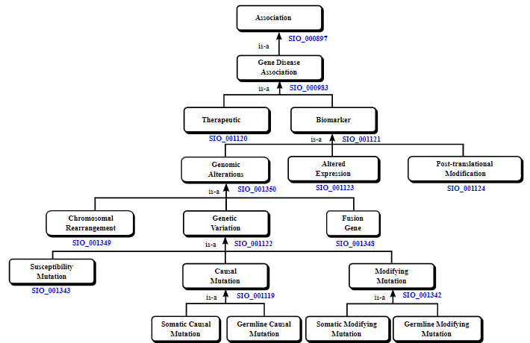
RECATEGORIZED DATASET method 1
Notes:
At the time, we were unsure of how best to tackle the recategorization. So, we decided to go ahead with two different categorizations.
CLICK TO SHOW INITIAL SELECTION
Recategorization initially included Therapeutic, Genomic Alterations, Altered Expression, Post-translational Modification, and Genetic Variation.
CLICK TO SHOW UNIQUE BIOMARKER ASSOCATIONS:
The first recategorization we did involved removing Genetic Variation and using only unique biomarker associations.

Slide 4
PROPAGATED DATASET
diseaseNID | geneNID | associationType | propagatedAssociationTypes
1 | 1088 | {Biomarker} | {Biomarker}
448 | 1088 | {Biomarker} | {Biomarker}
589 | 1088 | {Biomarker} | {Biomarker}
827 | 1088 | {Biomarker} | {Biomarker}
1102 | 1088 | {Biomarker} | {Biomarker}
... | ... | ... | ...
29239 | 20075 | {Biomarker} | {Biomarker}
29280 | 20163 | {Biomarker} | {Biomarker}
29341 | 20169 | {Biomarker} | {Biomarker}
29763 | 9527 | {Biomarker} | {Biomarker}
29932 | 21333 | {Biomarker} | {Biomarker}
BIOMARKER
diseaseNID | geneNID | associationType | propagatedAssociationTypes
1 | 1088 | {Biomarker} | {Biomarker}
1 | 3070 | {Biomarker} | {Biomarker}
2 | 10721 | {Biomarker} | {Biomarker}
3 | 54 | {Biomarker} | {Biomarker}
3 | 170 | {Biomarker} | {Biomarker}
... | ... | ... | ...
30292 | 11963 | {AlteredExpression} | {Biomarker, AlteredExpression}
30292 | 18471 | {Biomarker} | {Biomarker}
30292 | 19792 | {Biomarker} | {Biomarker}
30293 | 6353 | {Biomarker} | {Biomarker}
30293 | 8057 | {Biomarker} | {Biomarker}
557317 rows × 4 columns
diseaseNID | geneNID | associationType | propagatedAssociationTypes
1317 | 1088 | {AlteredExpression} | {Biomarker, AlteredExpression}
1338 | 1088 | {AlteredExpression} | {Biomarker, AlteredExpression}
1741 | 1088 | {AlteredExpression} | {Biomarker, AlteredExpression}
2107 | 1088 | {PosttranslationalModification} | {Biomarker, PosttranslationalModification}
2592 | 1088 | {AlteredExpression} | {Biomarker, AlteredExpression}
... | ... | ... | ...
29802 | 18834 | {AlteredExpression} | {Biomarker, AlteredExpression}
29802 | 18837 | {AlteredExpression} | {Biomarker, AlteredExpression}
30104 | 25482 | {CausalMutation} | {CausalMutation, GeneticVariation, Biomarker, ...
30147 | 21709 | {CausalMutation} | {CausalMutation, GeneticVariation, Biomarker, ...
30157 | 10975 | {CausalMutation} | {CausalMutation, GeneticVariation, Biomarker, ...
NON-BIOMARKER
Filter: ONLY ‘AlteredExpression', 'PosttranslationalModification', ‘GenomicAlterations', or 'Therapeutic'
1135045 rows × 4 columns
577728 rows × 4 columns
Notes:
Here we see the propagated dataset, and by propagated we mean:
SHOW HIERARCHY FROM PREVIOUS SLIDE
After propagating the dataset,
CLICK TO SHOW TWO TABLES
I split the table based on whether the ORIGINAL association type (before propagation) was biomarker or not.
CLICK TO SHOW FILTER
After splitting the propagated association type sets into separate rows, one propagated association per row, the non-biomarker dataset was filtered to only include AlteredExpression', 'PosttranslationalModification', ‘GenomicAlterations', or 'Therapeutic' to adhere to our chosen categorization.
The biomarker dataset is currently only containing unique gene-disease associations since the biomarker association rows that are non-unique could have only been created from propagation which was grouped with the non-biomarker dataset.

Slide 5
RECATEGORIZED DATASET
diseaseNID | geneNID | associationType | propagatedAssociationTypes
1 | 1088 | {Biomarker} | {Biomarker}
448 | 1088 | {Biomarker} | {Biomarker}
589 | 1088 | {Biomarker} | {Biomarker}
827 | 1088 | {Biomarker} | {Biomarker}
1102 | 1088 | {Biomarker} | {Biomarker}
... | ... | ... | ...
29239 | 20075 | {Biomarker} | {Biomarker}
29280 | 20163 | {Biomarker} | {Biomarker}
29341 | 20169 | {Biomarker} | {Biomarker}
29763 | 9527 | {Biomarker} | {Biomarker}
29932 | 21333 | {Biomarker} | {Biomarker}
BIOMARKER
diseaseNID | geneNID | propagatedAssociationType | ogAssociationTypes
1317 | 1088 | AlteredExpression | {'AlteredExpression'}
1338 | 1088 | AlteredExpression | {'AlteredExpression'}
1741 | 1088 | AlteredExpression | {'AlteredExpression'}
2107 | 1088 | PosttranslationalModification | {'PosttranslationalModification'}
2592 | 1088 | AlteredExpression | {'AlteredExpression'}
... | ... | ... | ...
29239 | 20075 | Biomarker | {'Biomarker'}
29280 | 20163 | Biomarker | {'Biomarker'}
29341 | 20169 | Biomarker | {'Biomarker'}
29763 | 9527 | Biomarker | {'Biomarker'}
29932 | 21333 | Biomarker | {'Biomarker'}
557317 rows × 4 columns
diseaseNID | geneNID | associationType | propagatedAssociationTypes
1317 | 1088 | {AlteredExpression} | {Biomarker, AlteredExpression}
1338 | 1088 | {AlteredExpression} | {Biomarker, AlteredExpression}
1741 | 1088 | {AlteredExpression} | {Biomarker, AlteredExpression}
2107 | 1088 | {PosttranslationalModification} | {Biomarker, PosttranslationalModification}
2592 | 1088 | {AlteredExpression} | {Biomarker, AlteredExpression}
... | ... | ... | ...
29802 | 18834 | {AlteredExpression} | {Biomarker, AlteredExpression}
29802 | 18837 | {AlteredExpression} | {Biomarker, AlteredExpression}
30104 | 25482 | {CausalMutation} | {CausalMutation, GeneticVariation, Biomarker, ...
30147 | 21709 | {CausalMutation} | {CausalMutation, GeneticVariation, Biomarker, ...
30157 | 10975 | {CausalMutation} | {CausalMutation, GeneticVariation, Biomarker, ...
NON-BIOMARKER
Filter: ONLY ‘AlteredExpression', 'PosttranslationalModification', ‘GenomicAlterations', or 'Therapeutic'
1202264 rows × 4 columns
577728 rows × 4 columns
Notes:
The two tables could then be appended to make our relabeled dataset.

Slide 6
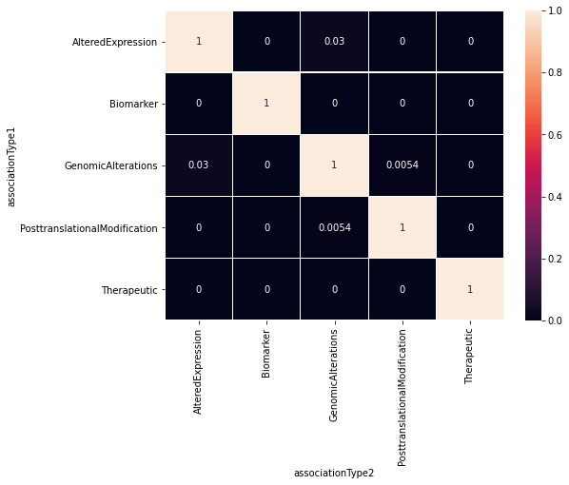
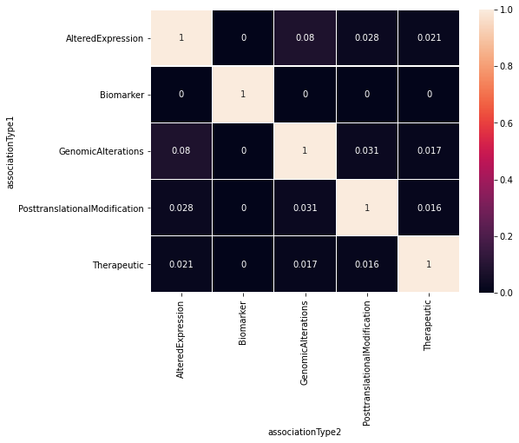
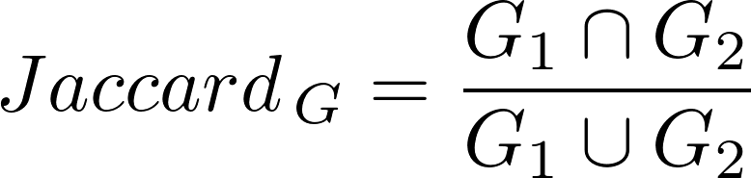
heatmaps
Median
Same Procedure as Prior:
How much gene overlap is there between association types for a disease?
Building gene sets for each disease
Compare Gene Sets from same disease but different association type
Jaccard Correlation Coefficient
Plot the scores in a boxplot and plot the median/mean values of each association type combination in a heatmap
Mean
Notes:
Now, doing the same gene exploration procedure as we did with the whole dataset prior, we can get boxplots and heatmaps for the propagated and relabeled dataset.
Displayed is both heatmaps for the median and mean, where the mean will help to show the affect of outliers.
Overall, there are not high correlations whatsoever between association types, as can be seen by all the black squares in the heatmap, but the highest correlations are squared in red. We can also see that outliers did play a role due to the higher mean correlation than median.

Slide 7
RECATEGORIZED DATASET method 2
Notes:
The second categorization we did involved the same dataset except instead of unique biomarker data, the original biomarker rows (before propagation and recategorization) was used. This way, all Biomarker rows are represented in the plots, which should be represented by increases in median correlation coefficients

Slide 8
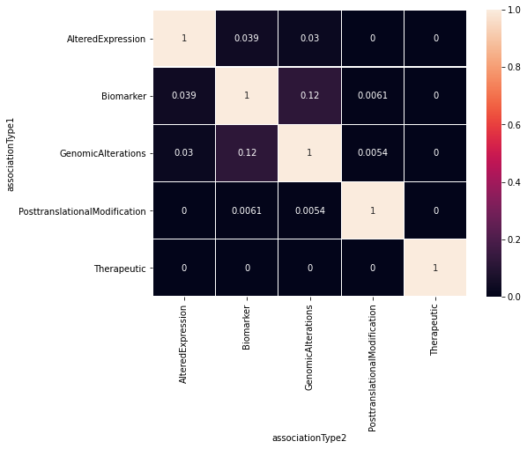
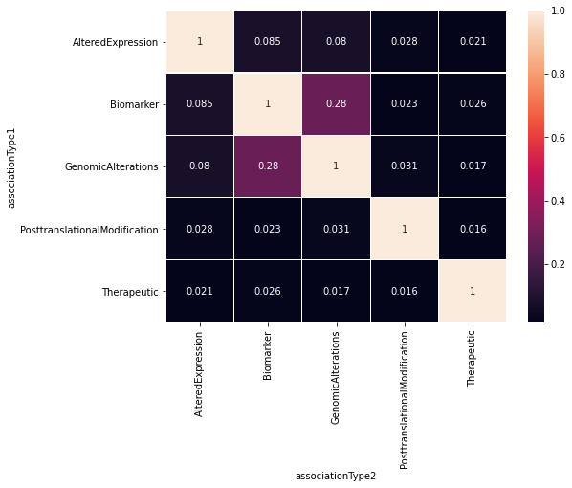
heatmaps
Median
Mean
Notes:
Again, the boxplots and heatmaps were created to understand the dataset, and overall, there are higher correlations between association types than with the unique biomarker rows (but still very low), and the highest correlations are seen between Biomarker/Altered Expression and Biomarker/Genomic Alterations, which we would hope to see. All we changed really was adding back in biomarker rows that were removed because that gene-disease pair was labeled under another association type as well.

Slide 9
Curated dataset
geneId | geneSymbol | diseaseId | diseaseName | source
1 | A1BG | C0019209 | Hepatomegaly | CTD_human
1 | A1BG | C0036341 | Schizophrenia | CTD_human
2 | A2M | C0002395 | Alzheimer's Disease | CTD_human
2 | A2M | C0007102 | Malignant tumor of colon | CTD_human
2 | A2M | C0009375 | Colonic Neoplasms | CTD_human
... | ... | ... | ... | ...
109580095 | HBB-LCR | C0002875 | Cooley's anemia | CTD_human
109580095 | HBB-LCR | C0005283 | beta Thalassemia | CTD_human
109580095 | HBB-LCR | C0019025 | Hemoglobin F Disease | CTD_human
109580095 | HBB-LCR | C0085578 | Thalassemia Minor | CTD_human
109580095 | HBB-LCR | C0271979 | Thalassemia Intermedia | CTD_human
84038 rows × 5 columns
Sources: CGI (Cancer Genome Interpreter), CTD_human (Comparative Toxicogenomic Database), CLINGEN (Clinical Genome Resource), GENOMICS_ENGLAND, ORPHANET, PSYGENET (Psychiatric Disorders Gene Association Network), and UNIPROT.
Notes:
However, we decided it would be better to make use of curated data, which was a provided sub-dataset in the DisGeNet database.
DON’T NEED TO SAY: Curated data- collection of datasets from various sources that is organized and managed to meet some usage
Something to note is that instead of association types being compared we have sources, including CGI, CTD_human, CLINGEN, GENOMICS_ENGLAND, ORPHANET, PSYGENET, and UNIPROT.

Slide 10


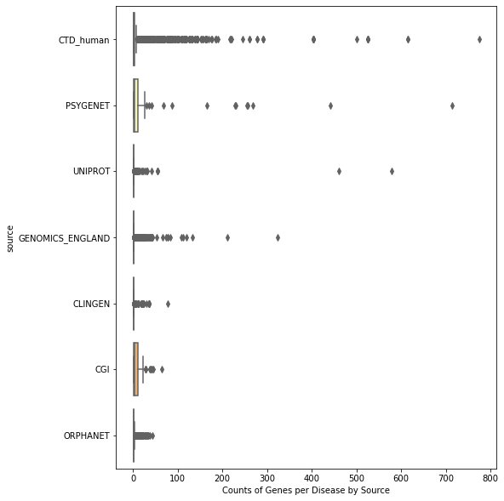
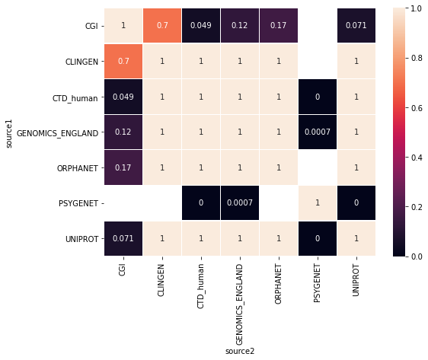
Boxplot of count of genes per disease for each source
HEATMAP OF MEDIAN JACCARD COEFFICIENT VALUES BETWEEN SOURCES
Notes:
Plotting the count of genes for each disease per source, we can see that there are extremely small gene sets, many containing only one gene per disease, which isn’t very useful for our machine learning model.
This idea is also shown through the heatmap, where most correlations are 1, suggesting that a lot of the gene sets for the source type pairs only have one gene in them, which makes it much more likely for the sets to be correlated perfectly.
Thus, we needed to filter the data to meet certain conditions, like a minimum gene set size, to obtain a more workable dataset

Slide 11
SELECTED DOIDS:
Disease Name | Disease DOID
Cardiovascular System Disease | DOID:1287
Endocrine System Disease | DOID:28
Gastrointestinal System Disease | DOID:77
Hematopoietic System Disease | DOID:74
Immune System Disease | DOID:2914
Integumentary System Disease | DOID:16
Musculoskeletal System Disease | DOID:17
Nervous System Disease | DOID:863
Reproductive System Disease | DOID:229
Respiratory System Disease | DOID:1579
Thoracic System Disease | DOID:0060118
Urinary System Disease | DOID:18
Metabolism Diseases | DOID:0014667
Mental Health Diseases | DOID:150
Notes:
After changing the disease IDs into a DOID format, the first filter my mentor asked me to place was to only keep diseases that are descendants of one of the following 14 higher-level terms, and this was done by using a pre-existent disease ontology.

Slide 12
FILTERED DATASET
dis_doid | dis_name | numgenes_CLINGEN | numgenes_CGI | numgenes_CTD_human | numgenes_GENOMICS_ENGLAND | numgenes_ORPHANET | numgenes_PSYGENET | numgenes_UNIPROT | numgenes_dir | numgenes_prop
DOID:863 | nervous system disease | 37 | 47 | 1657 | 974 | 601 | 0 | 553 | 53 | 2206
DOID:77 | gastrointestinal system disease | 5 | 71 | 1433 | 162 | 76 | 0 | 553 | 12 | 1987
DOID:1287 | cardiovascular system disease | 71 | 0 | 1087 | 227 | 163 | 0 | 96 | 36 | 1240
DOID:2914 | immune system disease | 4 | 120 | 907 | 209 | 163 | 0 | 81 | 49 | 1059
DOID:936 | brain disease | 15 | 32 | 747 | 320 | 156 | 0 | 118 | 27 | 1034
... | ... | ... | ... | ... | ... | ... | ... | ... | ... | ...
DOID:4254 | osteosclerosis | 0 | 0 | 15 | 14 | 10 | 0 | 9 | 7 | 18
DOID:4621 | holoprosencephaly | 0 | 0 | 11 | 14 | 14 | 0 | 7 | 17 | 18
DOID:0050534 | congenital stationary night blindness | 0 | 0 | 14 | 11 | 2 | 0 | 10 | 17 | 14
DOID:8499 | night blindness | 0 | 0 | 14 | 12 | 2 | 0 | 11 | 7 | 14
DOID:0060655 | autosomal recessive congenital ichthyosis | 0 | 0 | 10 | 12 | 12 | 0 | 10 | 11 | 12
129 rows × 11 columns
Notes:
So, I propagated this filtered dataset similar to earlier, and only kept rows that had ten or more genes from at least three sources.
Also, reusing the dataset before propagation, I took a subset of the diseases that had 5 or more direct gene annotations and intersected this dataset with the filtered propagated one to get a dataset that meets all our filters.
The counts of genes for a source of that disease are listed in separate columns, and a sum before and after propagation is listed at the very right.

Slide 13
SELECTED DOIDS
dis_doid | dis_name | numgenes_CLINGEN | numgenes_CGI | numgenes_CTD_human | numgenes_GENOMICS_ENGLAND | numgenes_ORPHANET | numgenes_PSYGENET | numgenes_UNIPROT | numgenes_dir | numgenes_prop
DOID:162 | cancer | 32 | 307 | 2963 | 168 | 247 | 0 | 740 | 128 | 3574
DOID:863 | nervous system disease | 37 | 47 | 1657 | 974 | 601 | 0 | 553 | 53 | 2206
DOID:77 | gastrointestinal system disease | 5 | 71 | 1433 | 162 | 76 | 0 | 553 | 12 | 1987
DOID:3119 | gastrointestinal system cancer | 3 | 76 | 993 | 29 | 17 | 0 | 528 | 6 | 1463
DOID:305 | carcinoma | 2 | 112 | 1087 | 36 | 36 | 0 | 211 | 166 | 1310
... | ... | ... | ... | ... | ... | ... | ... | ... | ... | ...
DOID:1342 | congenital hypoplastic anemia | 9 | 0 | 25 | 54 | 20 | 0 | 14 | 32 | 60
DOID:1793 | pancreatic cancer | 0 | 17 | 28 | 2 | 8 | 0 | 15 | 107 | 58
DOID:628 | combined T cell and B cell immunodeficiency | 1 | 0 | 24 | 28 | 26 | 0 | 16 | 42 | 38
DOID:0110274 | autosomal recessive limb-girdle muscular dystr... | 0 | 0 | 12 | 23 | 9 | 0 | 20 | 8 | 30
DOID:0050534 | congenital stationary night blindness | 0 | 0 | 14 | 11 | 2 | 0 | 10 | 17 | 14
77 rows × 12 columns
Notes:
After my mentor examined this much smaller dataset and selected the diseases to be used for the machine learning model, I was able to move on to creating the labels using my mentor’s code.

Slide 14
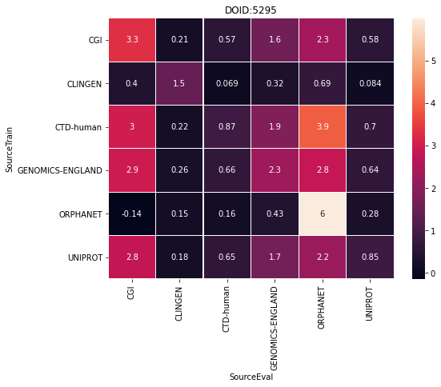
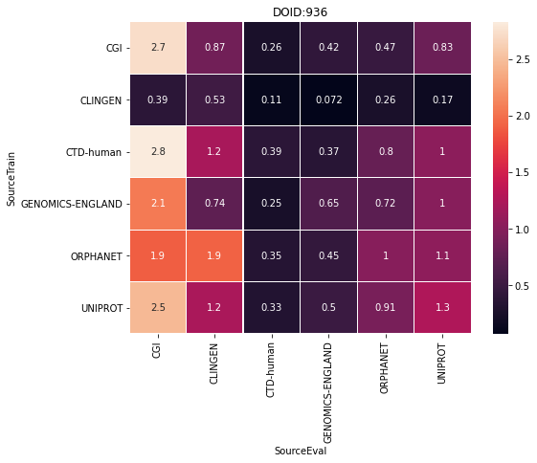
SUPERVISED MACHINE LEARNING MODEL AND RESULTS
DOID | SourceTrain | SourceEval | auROC | log2(auPRC/prior) | log2(P@r10/prior) | log2(P@r20/prior) | log2(P@r50/prior) | R@r10 | R@r20 | R@r50
DOID:936 | CGI | UNIPROT | 0.675605 | 0.832924 | 1.739775 | 1.632860 | 1.069923 | 0.059322 | 0.110169 | 0.186441
DOID:5295 | CLINGEN | CLINGEN | 0.821495 | 1.481127 | -inf | -inf | -inf | 0.000000 | 0.000000 | 0.000000
DOID:5295 | CLINGEN | UNIPROT | 0.642991 | 0.083763 | -inf | -inf | -inf | 0.000000 | 0.000000 | 0.000000
DOID:936 | ORPHANET | GENOMICS-ENGLAND | 0.677595 | 0.445159 | 0.750735 | 0.943380 | 0.665846 | 0.022082 | 0.050473 | 0.104101
DOID:936 | CLINGEN | UNIPROT | 0.559665 | 0.165131 | -1.067580 | -0.067580 | 0.195454 | 0.008475 | 0.033898 | 0.101695
... | ... | ... | ... | ... | ... | ... | ... | ... | ... | ...
DOID:5295 | CTD-human | CTD-human | 0.904299 | 0.873723 | 1.006789 | 1.006789 | 1.006789 | 0.018868 | 0.037736 | 0.094340
DOID:936 | CTD-human | CLINGEN | 0.722846 | 1.214725 | -inf | 0.616671 | 1.616671 | 0.000000 | 0.066667 | 0.333333
DOID:936 | CTD-human | CTD-human | 0.743564 | 0.387741 | 0.523646 | 0.601649 | 0.646503 | 0.012081 | 0.025503 | 0.065772
DOID:5295 | GENOMICS-ENGLAND | CLINGEN | 0.164486 | 0.258734 | -inf | -inf | -inf | 0.000000 | 0.000000 | 0.000000
DOID:5295 | CTD-human | ORPHANET | 0.900000 | 3.911620 | 4.172594 | 3.172594 | 2.850666 | 0.333333 | 0.333333 | 0.666667
72 rows × 11 columns
Notes:
All of the selected labels would be split into 3 folds and each of the 77 diseases would be trained on its sources it has labels for. We would then unsplit the folds and evaluate on another source that disease has information for.
From the evaluating process, files listing numerous model performance metrics are created and amended into a single dataset.
Results can then be analyzed through plots such as heatmaps. A sample dataset and heatmap from DOID:5295 and DOID:936 are shown here.
The last 8 columns are all performance values produced by the model, the 1st column is the DOID for those values, the 2nd column is the source the model was trained on for that DOID, and the 3rd column is the source the model was evaluated on for that DOID. A value I was told to examine further was the log2(auPRC/prior), which basically states how much better the model did than random performance. If the value in this column is above 0, the model did better than random for that disease. This value for each row is represented in these heatmaps for two DOIDS

Slide 15
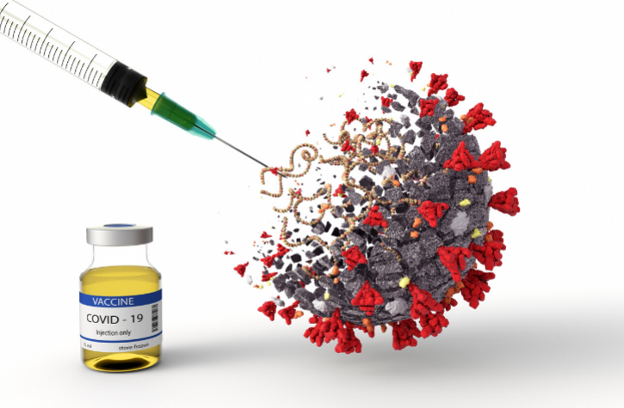
Next steps:
Analyze performance metric results for selected diseases further
Work on Posters and Presentations
Ensemble Model?
Why Care:
Better understanding of complex diseases
Development of drugs to combat disease-related signals
Notes:
After reviewing the metrics of the selected diseases further, I will continue working on my posters and presentations and potentially combine the machine learning models built for each association type into an ensemble model to discover new gene-disease associations

Slide 16
References/acknowledgements
Mentors: Dr. Arjun Krishnan, Anna Yannakopoulos
https://www.disgenet.org/home/
Pictures:
https://www.google.com/url?sa=i&url=https%3A%2F%2Fwww.linguamatics.com%2Fblog%2Fsystematic-approach-understanding-gene-disease-associations-rare-disease&psig=AOvVaw3PNfuazGB1nLAHE14eeT15&ust=1626413017529000&source=images&cd=vfe&ved=0CAoQjRxqFwoTCIDmxOaq5PECFQAAAAAdAAAAABAK
https://www.google.com/url?sa=i&url=https%3A%2F%2Fwww.aiche.org%2Fchenected%2F2020%2F05%2Fbioengineering-translational-medicine-addresses-formulation-and-delivery-strategies-covid-19-drugs&psig=AOvVaw1Lc853h-Fal62sLL2QDJxZ&ust=1624592303998000&source=images&cd=vfe&ved=0CAoQjRxqFwoTCLiZzIysr_ECFQAAAAAdAAAAABAD

