Slide 1
DIGITAL PORTFOLIO
Student name : t. Agasthiya
Register number and nmid : 24131060500122005 and C6F3A1947362125BDEC4FE032F0CB487
Department : bca-II year
College : shree Raghavendra Art’s and Science College , keezhmoongiladi , chidambaram .

Slide 2
PROJECT TITLE :
Digital portfolio using HTML ,CSS , And Javascript.

Slide 3
AGENDA :
Problem statement.
Project overview.
End users.
Tools and technologies.
Portfolio Design and layout.
Features and functionalities.
Result and screenshot.
GitHub link.

Slide 4
Problem statement :
Create a digital portfolio that effectively showcase an individual skills and experience , achieve in a visually appealing and interactive way , while also being easy to maintain and update.

Slide 5
Key challenges for portfolio :
Showcasing complex information.
Designing and engaging interface.
Maintaining and updating content.
Ensuring accessibility.

Slide 6
Project overview :
Project description.
Project Goals.
Target Audience.
Technical requirements of portfolio.
Deliverables of project.

Slide 7
Who are the end users ?
Potential end users.
Goals of end users.
Designing for end users.

Slide 8
Tools for portfolio :
HTML : Structuring content , creating pages , adding multimedia.
CSS : Styling and layout, creating responsive design .
Java Script : Adding interactively, create dynamic content.

Slide 9
Technologies For portfolio :
HTML : semantic HTML, accessible HTML.
CSS : Responsive design, Flex box and grid.
Java Script : Event handling, image galleries.
C6F3A1947362125BDEC4FE032F0CB487

Slide 10
Portfolio Design :
Simple and student friendly UI : clean layout with Bright, friendly color (eg : orange ).
Readable typography : use easy to read fonts like Arial for clarity.
Profile photo & icons : include a photo and icons for section like project or contact.

Slide 11
Layout For portfolio :
Header : student name, course and a short tagline.
About me : personal intro, academic background, and skills summary.
Contact section : Email, phone number, and optional form or LinkedIn/GitHub.

Slide 12
Features For portfolio :
Responding design : Accessible on various devices.
Project showcase : display project with images.
Interactive Element : Hover effects, and scrolling effects.
Navigation menu : Easy access to different section.

Slide 13
Functionalities For portfolio :
Smooth transition : smooth transition between pages or section.
Scrolling effects : scrolling effects to enhance user engagement.
Contact form : functional contact form for user enquiries.

Slide 14
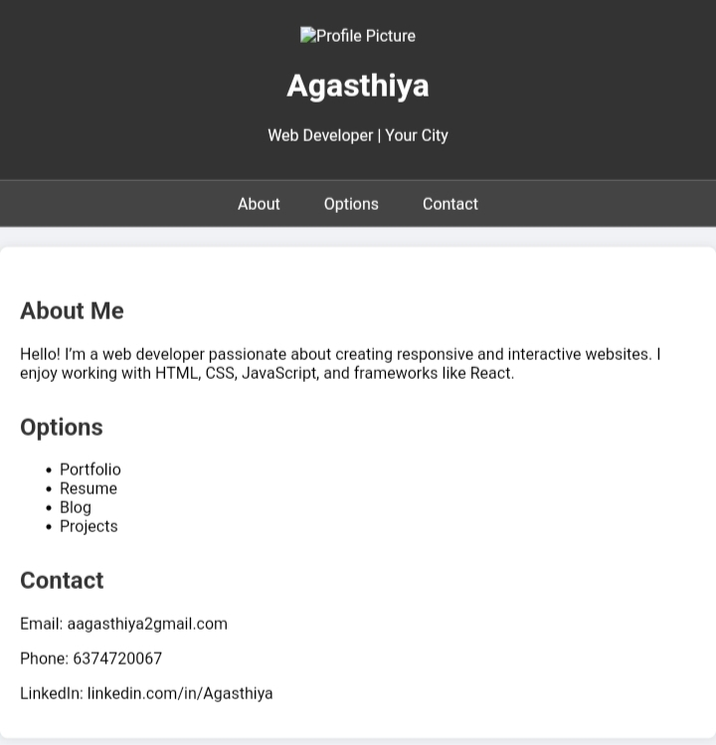
Screen shot And Results :

Slide 15
Conclusion :
A strong conclusion for a digital portfolio effectively summarizes skills, experience,and achievements while reiterating my goals and leaving a lasting impression on the viewer.

