Slide 1

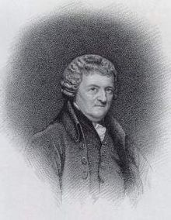
Inventor* of the flushing toilet
Alexander Cumming
Notes:
*Inventor, no. Technically the inventor of the modern flushing toilet was Kit Harington from off of Game of Thrones’ great great great great great great Grandad. Arguably the inventor of the flushing toilet was a nameless Minoan in 2nd millenium Crete, but for now, we’re looking at Alexander Cumming.
Cumming patented an improved flushing toilet, but his main innovation was the S-trap or ‘U-bend’, which keeps water in the waste pipe and prevents gases from the sewers entering buildings. Previous flushing toilets had a significant problem with the resulting odour.

Slide 2
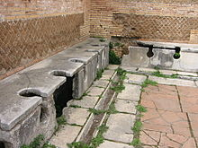
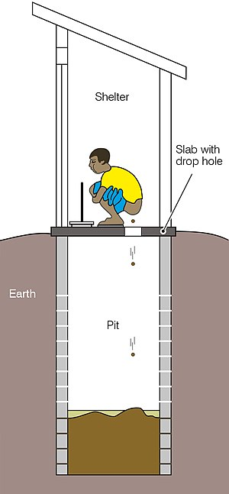
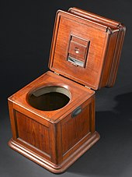
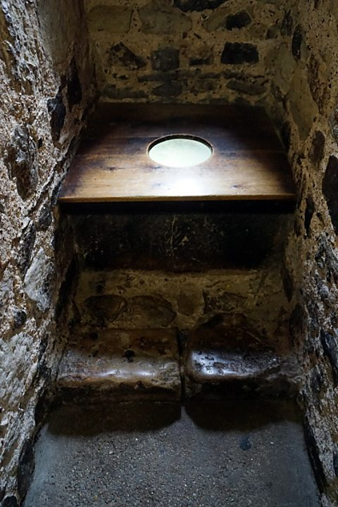
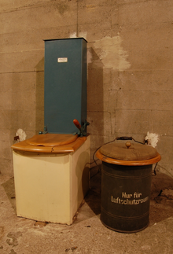


Previously on ‘Going to the Toilet’
Notes:
SLIDE 1 *Inventor, no. Technically the inventor of the modern flushing toilet was Kit Harington from off of Game of Thrones’ great great great great great great Grandad. Arguably the inventor of the flushing toilet was a nameless Minoan in 2nd millenium Crete, but for now, we’re looking at Alexander Cumming.
Cumming patented an improved flushing toilet, but his main innovation was the S-trap or ‘U-bend’, which keeps water in the waste pipe and prevents gases from the sewers entering buildings. Previous flushing toilets had a significant problem with the resulting odour.
SLIDE 2
Top Left: Roman public toilets
Bottom left: Pit Latrine diagram
Centre left: a medieval garderobe
Centre: a medieval garderobe from the outside
Centre Top Right: a commode, made of heavy wood and containing…
Centre Bottom Right: a chamber pot
Right: A dry toilet, used when water is scarce or unavailable, in this case releasing peat to cover the excreta.

