Slide 1
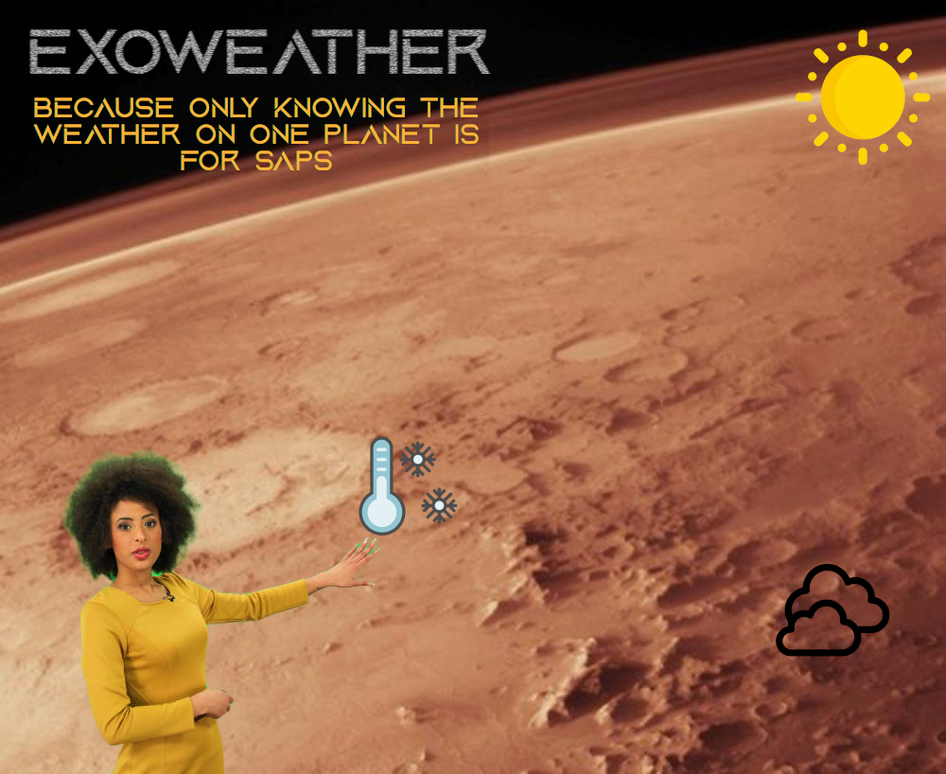

Slide 2
exoWeather app
Concept
We wanted to use NASA’s API to get weather data from Mars and then compare it with locations here on Earth using a secondary Weather API.

Slide 3
exoWeather app
Key Learning Objectives
it was important to us that we pushed ourselves and learned new things.
As such, we set the following learning objectives...

Slide 4
exoWeather app
Key Learning Objectives
Git/GitHub
React (all of it!) but specifically; API calls, Styled Components and the React Router DOM.
Express...

Slide 5
exoWeather app
Key Learning Objectives
MongoDB
Javascript
Trello
Teamwork and communication

Slide 6
exoWeather app
so Who wants to see the app?
I can’t hear you
okay

Slide 7
exoWeather app
OBSTACLES AND BLOCKERS
Nasa
The NASA API was essentially dead as the Insight Lander and the Curiosity Rover had gone in to power-saving mode and were Just sending back the date and location.

Slide 8
exoWeather app
OBSTACLES AND BLOCKERS
Nasa

Slide 9
exoWeather app
OBSTACLES AND BLOCKERS
Nasa
Api conflicts
Both APIs brought back different data, meaning we have to transform and combine into a new database.

Slide 10
exoWeather app
OBSTACLES AND BLOCKERS
Nasa
Api conflicts
Time
Due to various commitments over the weekend, this was essentially a 3 day project

Slide 11
exoWeather app
OBSTACLES AND BLOCKERS
Nasa
Api conflicts
Time
Trello
We weren’t diligent with keeping Trello tidy, resulting in duplications of work.

Slide 12
exoWeather app
OBSTACLES AND BLOCKERS
Nasa
Api conflicts
Time
Trello
File management
We didn’t stick to/or update our plan when files/folders changed within the project, meaning it was easy to get lost.

Slide 13
exoWeather app
POSITIVES
MOB RULE
MOB CODING HELPED EKE PROGRESS OUT ON A FEW OCCASIONS, ESPECIALLY WHEN BLOCKED. We were able to come together and solve issues.

Slide 14
exoWeather app
POSITIVES
MOB RULE
Team work MAKES THE DREAM WORK
We learned from each other throughout the project. We’re proud of what we’ve made and its complexity within such a short time period. we all put in a decent shift, meaning we could rely on each other.

Slide 15
exoWeather app
POSITIVES
MOB RULE
Team work
HEALTHY USE OF CHAT GPT, ANALOGIES AND ACTUALLY TURNING UP.

Slide 16
exoWeather app
OF COURSE THE REAL PROJECT WAS THE FRIENDS WE MADE ALONG THE WAY
...QUESTIONS?

