Slide 1
Protecting Michigan’s Water Resources
James Clift, Michigan Environmental Council
October 23, 2008
Notes:
Michigan Environmental Council – who we are – 25th anniversary
Who I am – my background – what I do for the organization
Why Michigan Needs to Better Regulate Water Use
When I’m talking to members of the public about water – they are most concerned about four things:
The first three all concern their direct day-to-day contact with water
Can I drink it?
Can I swim in it?
Can I feed the fish I caught to my family?
It’s a natural response – it’s how water impacts our lives directly

Slide 2
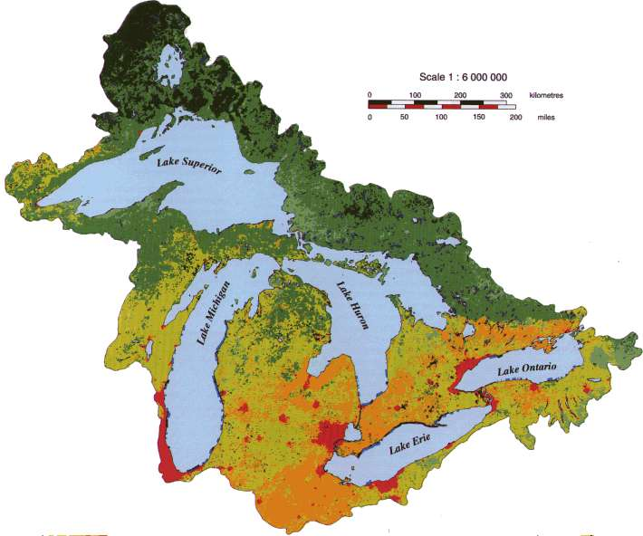
Notes:
First, my apologies to Quebec and the St. Lawerence Seaway (without you Michigan would still be bottomlands or something. When I first started looking at the compact and current implementation strategies I thought you would find one set of best practices that would work around the basin. After researching the topic for a while I think the answer may be sometimes yes – sometimes no. In Michigan, what the scientist tell us is that aquatic health is all about healthy flows. The rain falls, it flows through our rivers, streams and groundwater and into the lakes.

Slide 3
Great Lakes Compact
  Implementation Issues
    Preventing impacts
    Encouraging conservation
    Promoting public participation
Notes:
33 million within the basin – 25 million in US, 8 million in Canada
Major threats – Combined sewer overflows, invasive species

Slide 4
Michigan approach to defining impacts focuses on flow
"Adverse resource impact" means:
  1st round - Decreasing the “index” flow such that the stream's ability to support characteristic fish populations is functionally impaired (Feb/2006)
  2nd round – Specific flow reduction restrictions depending on stream class (July/2008)

Slide 5
Water Withdrawal Assessment Tool
GIS – Internet based system
Provides a screening function to determine which impacts warrant more detailed review and online registration
Provides easy access to information regarding water use, cumulative impacts, and planning information
Now available at: www.miwwat.org

Slide 6
Impact Assessment Tool - basics
Identifies which streams or rivers are potentially impacted – and estimates the flows during the sensitive low-flow summer months
Estimates how much a well will reduce the flow of the river or stream
Predicts how reduction in flow will diminish fish habitat (as indicator of aquatic health)

Slide 7
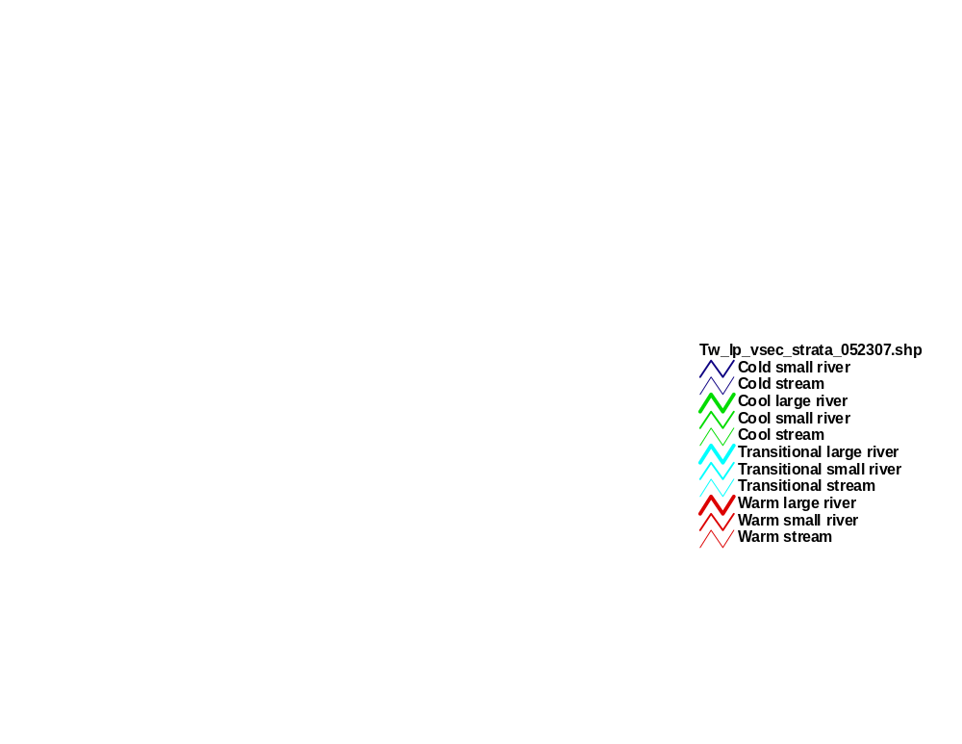
All river types
Notes:
My apologies to the UP

Slide 8
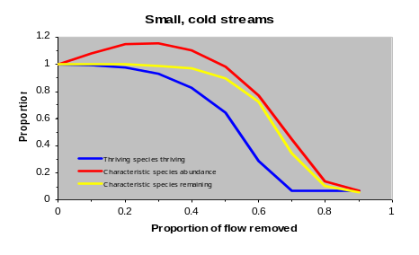
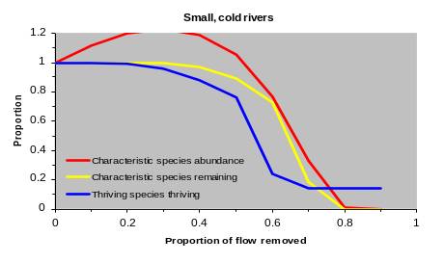
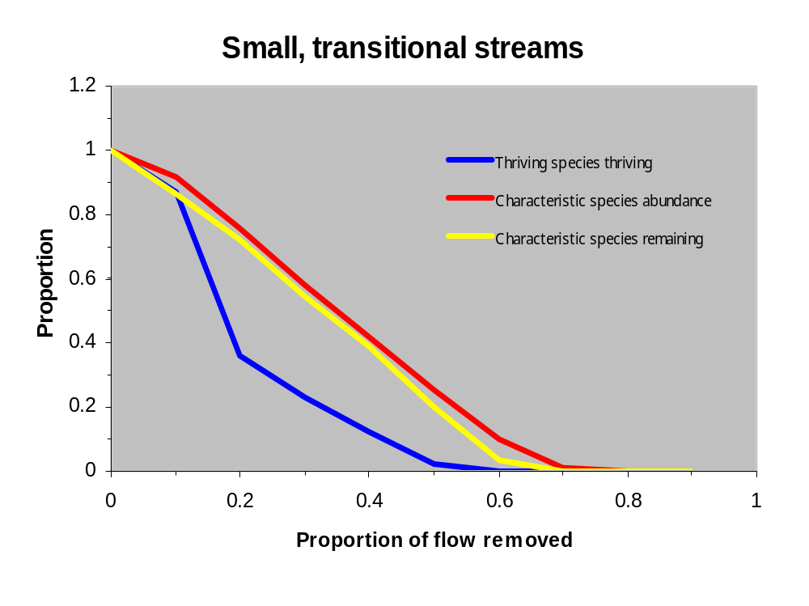
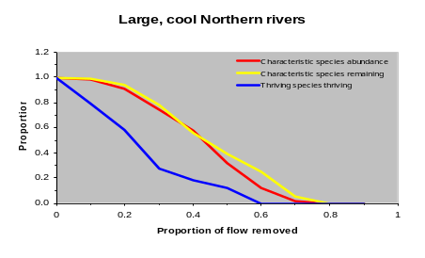
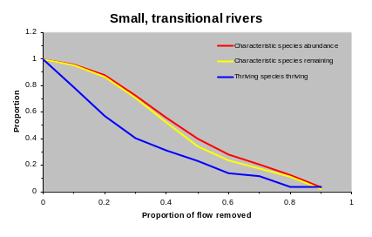
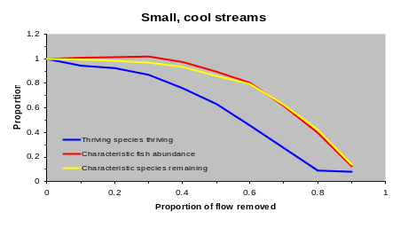
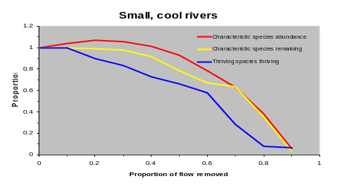
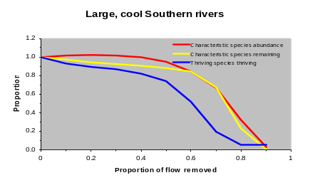
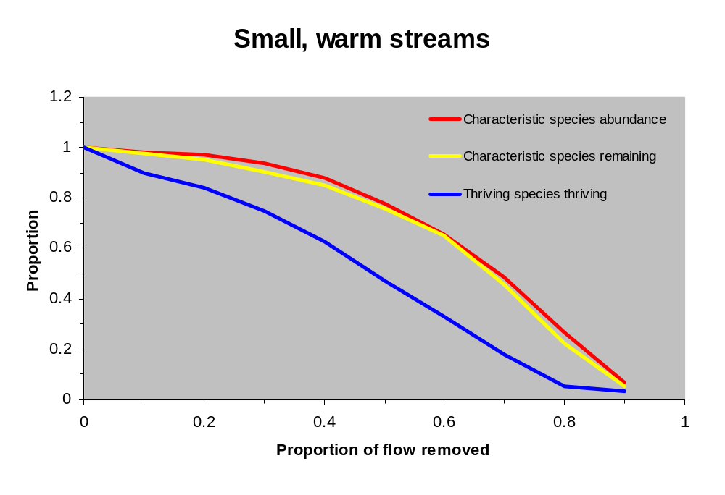
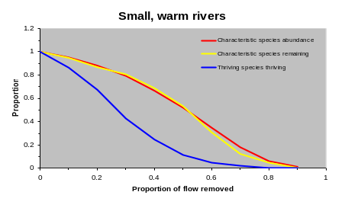
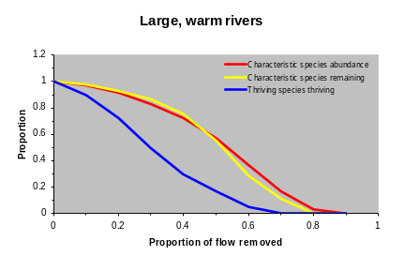
Cold
Trans
Cool
Warm
Streams
Small Rivers
Large Rivers

Slide 9
Silty

Slide 10
Silty
Notes:
N is low

Slide 11
Challenges in moving forward
Challenges scientific community to test current assumptions and explore other possible indicator species
Need better data on flow to improve modeling
Warming trend and potential increase in draught conditions due to climate change may warrant greater safety factors

Slide 12
Water conservation
  Focus on maintenance of flow and individual behavior
  Each sector develops best practices
  Each user certifies they have reviewed those in the context of their operation
  Implementation of best practices required in areas where impacts are being identified

Slide 13
Public participation
Encourages formation of water user committees – focus on large quantity user discussions
New Water Resources Assessment and Education Committees encouraged where some impacts are predicted – broader membership and focused on long-term planning and education

Slide 14
Water resources assessment and education committee
Notice to:
  Conservation districts
  Regional planning agencies
  Watershed management planning committees
  Stormwater committees under part 31
  Chief elected officials
  Community water supplies

Slide 15
Charge to committee
Education materials and recommendations:
  Long-term water resources planning
  Use of conservation measures
  Drought management activities
  Other topics related to water use identified by the committee

Slide 16
Public participation (cont.)
Citizens can become trained on measurement of summer low-flow
Can use assessment tool to compare land use plan with water use availability
Will be able to comment on any withdrawal subject to permitting – must both avoid impacts are be “reasonable” under common law principles

Slide 17
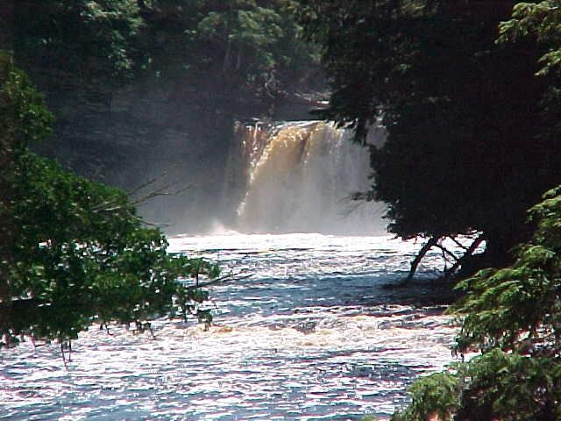
Notes:
The demand for water is only going grow – we need to put in place a system now that provides certainty to water users that water is going to be there for them for them in the future.
The greatest threat to the Great Lakes maybe the increasingly hectic nature of people’s lives today. Between jobs, family, home improvement and the latest reality TV show most people do not engage in the political process (not elections) – local land use decisions, state laws etc
The theme of Dave Dempsey’s books are that citizen involvement is the only thing that has resulted in true protections of our natural resources and that we are coming to a point that if we do not see a re-engagement of the public in the process the long-term health of the Great Lakes could be threatened.
I will use two examples
General Fund support for the Michigan Department of Environmental Quality has dropped from $101 million in 2001 to $28 million in this fiscal year.
Not addressing any new sites of environmental contamination
Inspecting polluting facilities less and less – major facilities may only be inspected every 2-3 years, smaller ones get inspected an average of every 5 to 6 years.
Less technical assistance to help with pollution prevention efforts
2nd example:
Toxic Free Shores - $5 million cleanup – wasted

Slide 18
For more information:
James Clift
Michigan Environmental Council
james@environmentalcouncil.org
517-487-9539
Notes:
Refined Petroleum
Septics

