Slide 1
ASSIGNMENT 2
Chaitanya Maheshwari
Amit Agrawal
Shrey Shah

Slide 2
👦
👧
ETHNICITY/NATIONALITY IDENTIFICATION
USING DEEP LEARNING TECHNIQUES

Slide 3
1
INTRODUCTION

Slide 4
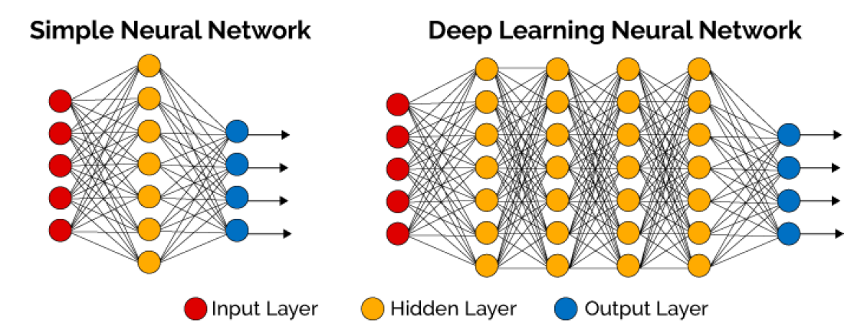
Deep learning can be thought of as a neural network with
more than one hidden layers

Slide 5
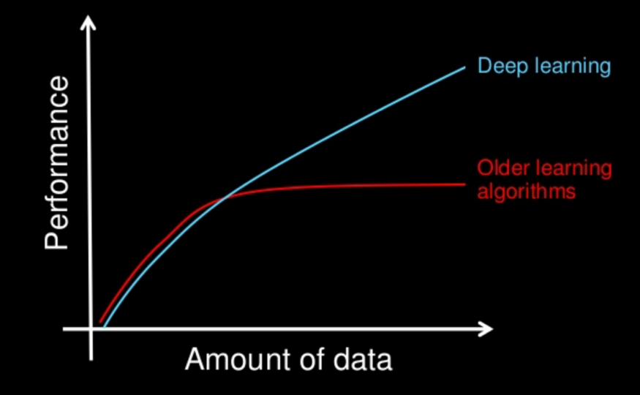
One striking features of deep learning is its increasing performance with the amount of data

Slide 6
METRIC LEARNING
Task: To learn the distance function over objects.
Heavily relies on the distances or similarity metric
The four axioms or conditions
non-negativity,
identity,
symmetry and
triangle inequality.

Slide 7
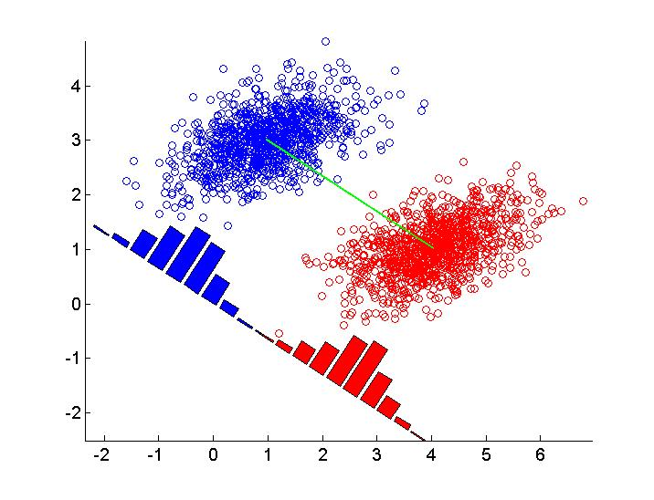
LINEAR
DISCRIMINANT
ANALYSIS
Based on preserving as much class discriminatory information as possible.

Slide 8
2
MODEL

Slide 9
PROBLEM STATEMENT
To identify the ethnicity or nationality of a person from his/her photograph.
To compare the performance of a conventional neural network built from the basic perceptron model to that of a deep learning network

Slide 10
DATASET
UTKFace (20,000 face images)
age: an integer from 0 to 116
gender: 0 (male) or 1 (female)
race: an integer from 0 to 4, 0=White, 1=Black, 2=Asian, 3=Indian, and 4=Others
date&time: yyyymmddHHMMSSFFF

Slide 11
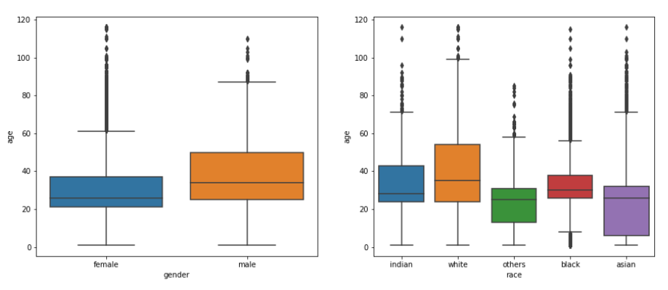

Slide 12
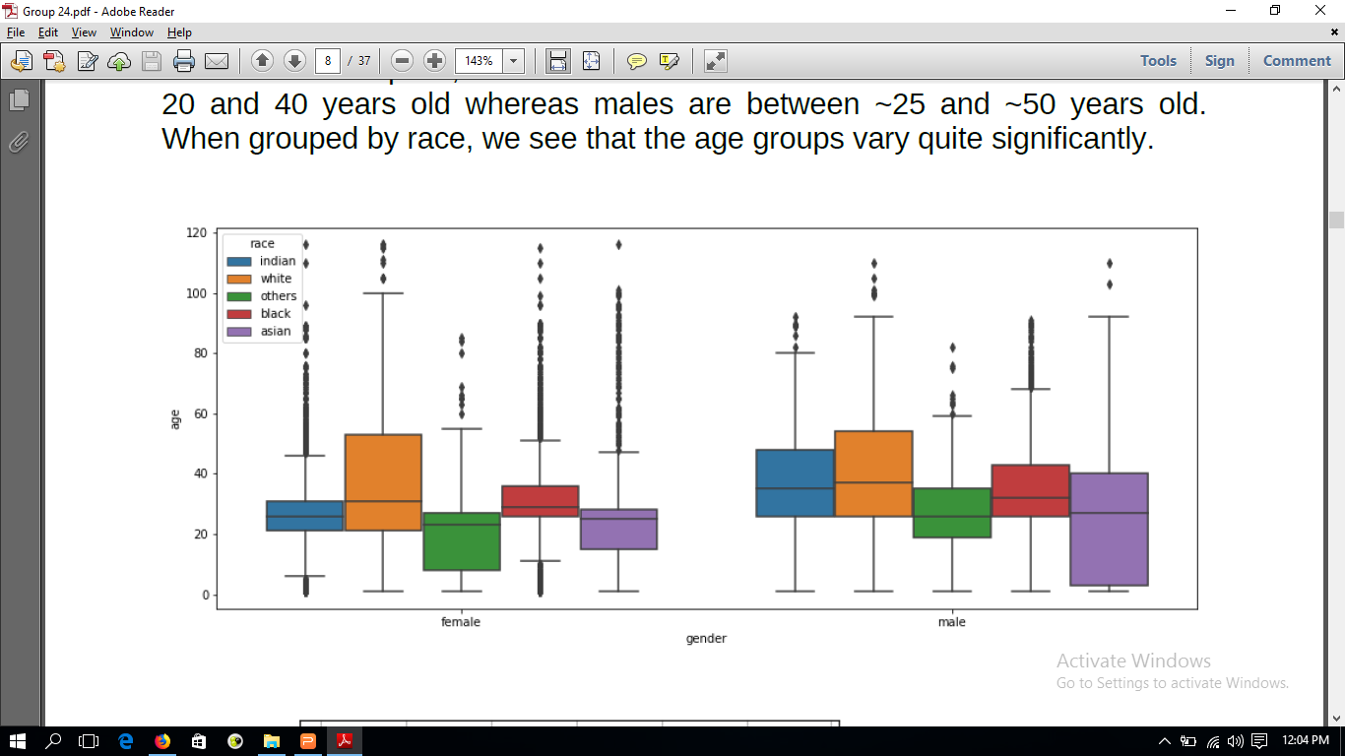

Slide 13
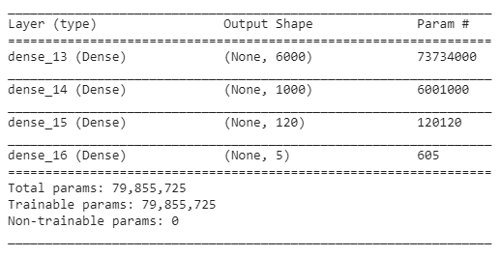
MODEL SUMMARY
Conventional Neural Network

Slide 14
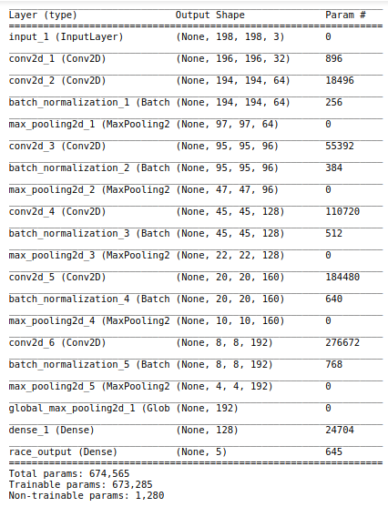
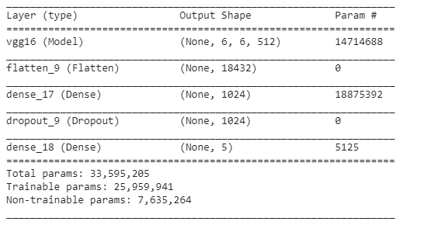
Transfer Learning Model
Deep Learning Model from Scratch

Slide 15
MODEL SELECTION
The results from various models are:
MODEL | ACCURACY
Convolutional Neural Network | 43.0%
Deep Learning Network (Fine Tuned) | 79.29%
Deep Learning Network (Built from scratch) | 74.00%

Slide 16
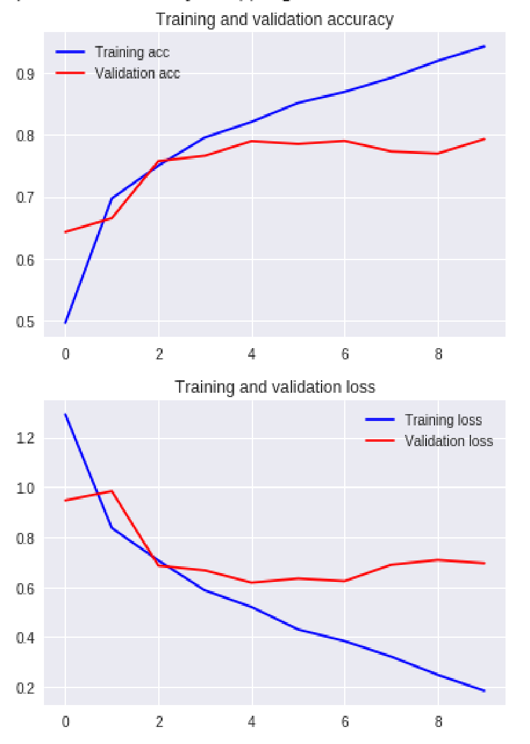
Training and validation accuracy and loss of the fine tuned network while it was learning.
It stopped early automatically as the model was over-fitting.
The validation accuracy was not increasing but the training accuracy was continuously increasing.

Slide 17
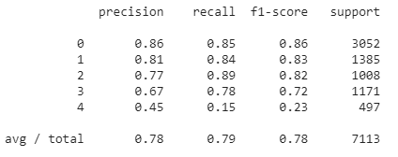
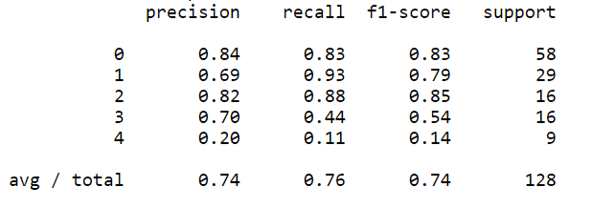
Fine Tuned Model
Classification Report
Model trained from Scratch

Slide 18
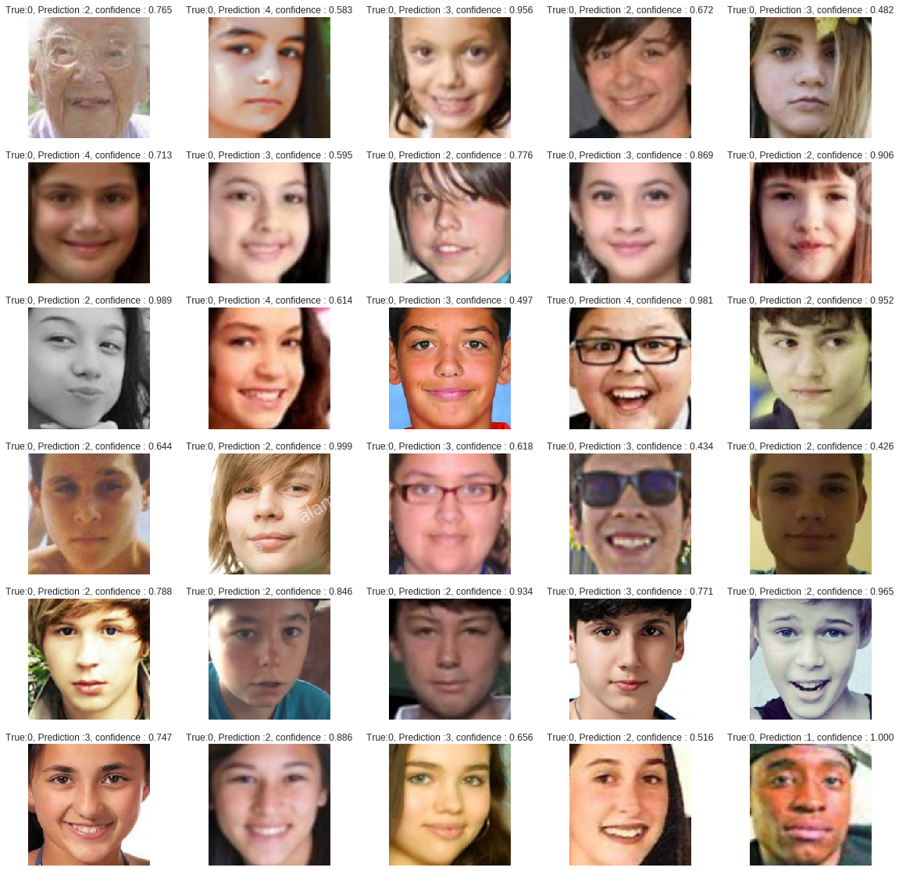
Some Misclassified Images

