Slide 1
Software products

Slide 2
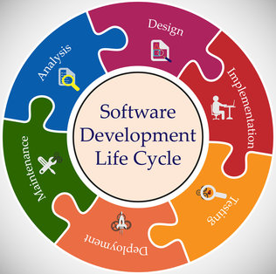
Software development lifecycle (SDLC): tasks to build an application

Slide 3
Software products: definition
Software products are generic software systems that provide functionality that is useful to a range of customers.
Ex: large-scale business systems (e.g. MS Excel); through personal products (e.g. OneNote) to simple mobile phone apps and games (e.g. Calculator, Minesweeper).
Software product engineering methods and techniques have evolved from software engineering techniques
Custom software systems are dedicated projects still used for large businesses, and government

Slide 4
"Product" software engineering

Slide 5
Product software engineering
Starting point for product development is a business opportunity identified by individuals or a company.
The goal is to develop a product for this opportunity and selling it
The company designs and implements a set of software features that realize the opportunity and benefits the customers.
The company decides on the development timescale, features to include, free and paid features, and change timeline.
Rapid delivery of the products is essential to capture the product market.

Slide 6
Software product lines vs platforms
Software product line
A set of software products that share a common core.
Each member of the product line includes customer-specific adaptations and additions.
Software product lines may be used to implement a custom system for a customer with specific needs
Examples:
Microsoft office
Windows 7, 8, 10, 11
Google doc, presentation, spreadsheet, …
Automotive software, a.k.a. in-car infotainment systems
different versions of the car use the same basic software while there are variations based on the car specs
Others: Game engines, content management systems, industrial automation, etc...

Slide 7
Software product lines vs platforms (Cont.)
Software platform A software (or software+hardware) product that includes functionality so that new applications can be built on it.
Examples:
Facebook provides a set of product functionality, but also supports creating ‘Facebook apps’
These add new features that may be used by a business or a Facebook interest group.
Apple iOS, Android,…
MATLAB

Slide 8
Software execution models
Stand-alone
The software executes entirely on the customer’s computers.
Hybrid
Part of the software’s functionality is implemented on the customer’s computer but some features are on the product developer’s servers.
Software (as a) service
All of the product’s features are implemented on the developer’s servers and the customer accesses these through a browser or a mobile app.

Slide 9
Software execution models (cont.)

Slide 10
The product vision
The starting point for software product development is a ‘product vision’.
Product visions are simple statements that define the essence of the product to be developed.
The product vision should answer three fundamental questions:
What is the product to be developed?
Who are the target customers and users?
Why should customers buy this product?

Slide 11
Moore’s vision template
FOR (target customer)
WHO (statement of the need or opportunity)
The (PRODUCT NAME) is a (product category)
THAT (key benefit, compelling reason to buy)
UNLIKE (primary competitive alternative)
OUR PRODUCT (statement of primary differentiation)

Slide 12
Vision template: example of SmartSight project
“FOR blind and visually impaired people WHO need ambient perception, THE SmartSight project is a hybrid app operating across a smartglass, a companion device (e.g., smartphone), and cloud THAT provides obstacle detection, motion detection, text detection, and face detection. UNLIKE other services or package software products (such as Gabriel), OUR product combines all the smart features in one system and is flexible to work with different types of companion devices (smartphone, laptop, etc.).”

Slide 13
Vision template example
“FOR a mid-sized company's marketing and sales departments WHO need basic CRM functionality, THE CRM-Innovator is a Web-based service THAT provides sales tracking, lead generation, and sales representative support features that improve customer relationships at critical touch points. UNLIKE other services or package software products (like Monday and Hubstop), OUR product provides very capable services at a moderate cost.”

Slide 14
How to develop a product vision
Domain experience The product developers may work in a particular area (say marketing and sales) and understand the software support that they need. They may be frustrated by the deficiencies in the software they use and see opportunities for an improved system.
Product experience Users of existing software (such as word processing software) may see simpler and better ways of providing comparable functionality and propose a new system that implements this. New products can take advantage of recent technological developments such as speech interfaces.
Customer experience The software developers may have extensive discussions with prospective customers of the product to understand the problems that they face, constraints, such as interoperability, that limit their flexibility to buy new software, and the critical attributes of the software that they need.
Prototyping and playing around Developers may have an idea for software but need to develop a better understanding of that idea and what might be involved in developing it into a product. They may develop a prototype system as an experiment and ‘play around’ with ideas and variations using that prototype system as a platform.

Slide 15
Example vision statement for the iLearn system
FOR teachers and educators WHO need a way to help students use web-based learning resources and applications, THE iLearn system is an open learning environment THAT allows the set of resources used by classes and students to be easily configured for these students and classes by teachers themselves. UNLIKE Virtual Learning Environments, such as Moodle, the focus of iLearn is the learning process rather than the administration and management of materials, assessments and coursework. OUR product enables teachers to create subject and age-specific environments for their students using any web-based resources, such as videos, simulations and written materials that are appropriate.
Schools and universities are the target customers for the iLearn system as it will significantly improve the learning experience of students at relatively low cost. It will collect and process learner analytics that will reduce the costs of progress tracking and reporting.

Slide 16
Practice 1: Develop a software vision for this client requirement Announcement Selection System
The announcements that department officials make may not be the same as the announcements that students want to hear. Design and implement an application/system that can efficiently deliver announcements. For example, the CSE department at UNT wants to identify what announcements students are most interested in and upload them to the department's main homepage.
Students can choose their interests (e.g., internships, student clubs, lecture, graduation criteria, etc.).
Students can select grade (e.g., freshman, sophomore, junior, senior, graduate students, etc.).
The above information will be forwarded to CSE officials so they can determine what kind of announcements students would like to know.
CSE officials can save effort, time, and money on uploading announcements by using this application/system.
* This topic was suggested by Minseo Kim

Slide 17
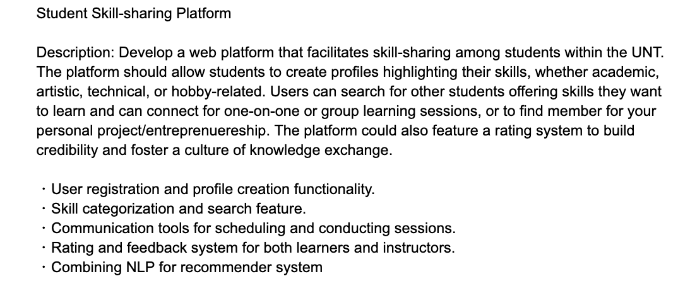
Practice 2:Develop a Software Vision for the Following Customer Requirement
This topic was suggested by Akiharu Esashi

Slide 18
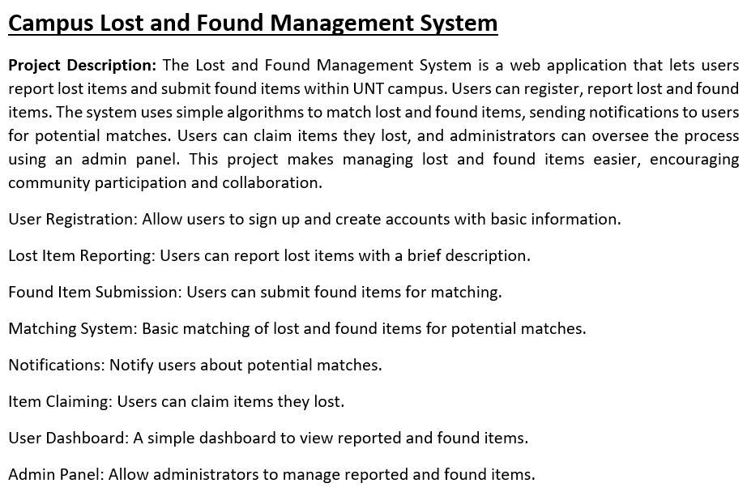
Practice 3:Develop a Software Vision for the Following Customer Requirement
Suggested by Amina Firdouse

Slide 19
Practice 4:Develop a Software Vision for the Following Customer Requirement
A semantic search system that for a given dataset of documents, extracts important keywords and enables users to search for documents that are semantically close to their queries. Accordingly, a web-based system is needed that gets a query from the user and searches through the dataset and retrieves documents based on their semantic similarity to the query. The retrieved documents must be ranked based on their relevance.
The user can introduce a dataset, add individual documents to the dataset, and remove from the dataset.
The search capabilities must be flexible, covering keyword search,and semantic search

Slide 20
Sample Project Topic
A web-based system based on Google map that shows the location of oil fields on the country map. The user can zoom in and click on the oil fields to see their detailed information (such as current state, start date, type of well, capacity, etc.).

Slide 21
Software product management
Software product management is a business activity that focuses on the software products developed and sold by the business.
Product managers (PMs) take overall responsibility for the product and are involved in planning, development and product marketing.
Product managers are the interface between the organization, its customers and the software development team.
They are involved at all stages of a product’s lifetime from initial conception through to withdrawal of the product from the market.
Product managers must look outward to customers and potential customers rather than focus on the software being developed.

Slide 22
Product management concerns

Slide 23
Product management (PM) concerns
Business match PMs have to ensure that the software being developed meets the business goals of the software development company.
Technology constraints PMs must make developers aware of technology issues that are important to customers.
Customer experience PMs should be in regular contact with customers and potential customers to understand what they are looking for in a product, the types of users and their backgrounds and the ways that the product may be used.

Slide 24
Technical interactions of product managers

Slide 25
Technical interactions of product managers
Product vision management (avoiding vision drift!)
The product manager helps with developing product vision. They are responsible for managing the vision, including assessing and evaluating proposed changes against the product vision.
Product roadmap development
A product roadmap is a plan for the development, release and marketing of the software. The PM should lead roadmap development and should be the ultimate authority in deciding if changes to the roadmap should be made.
User story and scenario development
User stories and scenarios are used to refine a product vision and identify product features. Based on his or her knowledge of customers, the PM should lead the development of stories and scenarios.

Slide 26
Technical interactions of product managers
Product backlog creation and management
The product backlog is a prioritized ‘to-do’ list of what has to be developed. PMs should be involved in creating and refining the backlog and deciding on the priority of product features to be developed.
Acceptance testing
Acceptance testing is the process of verifying that a software release meets the goals set out in the product roadmap and that the product is efficient and reliable. The PM should be involved in developing tests of the product features that reflect how customers use the product.
Customer testing
Customer testing involves taking a release of a product to customers and getting feedback on the product’s features, usability and business. PMs are involved in selecting customers to be involved in the customer testing process and working with them during that process.
User interface design
Product managers should understand user limitations and act as surrogate users in their interactions with the development team. They should evaluate user interface features as they are developed to check that these features are not unnecessarily complex or force users to work in an unnatural way.

Slide 27
Product prototyping
Product prototyping is to develop an early version of a product
This is to test ideas, convince funders that product has market potential.
Even if you have a great vision, users can only relate to your product when they see a working version of it. They can point out pros and cons and suggest new features.
A prototype help identifying fundamental software components or services and to test technology.
Building a prototype is the 1st development step.
The aim is to have a working version of the software to demonstrate its key features
You often throw-away the prototype after and re-implement the software--taking account of issues such as security and reliability.

Slide 28
Two-stage prototyping
Feasibility demonstration
An executable system to demonstrate the new ideas in the product.
The aims are to see if the ideas work and to show funders or company management the product features that are better than competitors.
Customer demonstration
You take an existing prototype created to demonstrate feasibility and extend this with your ideas for specific customer features.
Before developing this prototype, we need to do some user studies and have a clearer idea of your potential users and usage scenarios

Slide 29
Key points 1
Software products are software systems that include general functionality that is likely to be useful to a wide range of customers.
In product software engineering, the same company is responsible for deciding on the features that should be part of the product and the implementation of these features.
Software products may be delivered as stand-alone systems running on the customer’s computers, hybrid systems or service-based systems. In hybrid systems, some features are implemented locally and others are accessed over the Internet. All product features are remotely accessed in service-based products.
A product vision should succinctly describe what is to be developed, who are the target customers for the product and why they should buy the product that you are developing.
Domain experience, product experience, customer experience and an experimental software prototype may all contribute to the development of the product vision.

Slide 30
Key points 2
Key responsibilities of product managers are product vision ownership, product roadmap development, creating user stories and the product backlog, customer and acceptance testing and user interface design.
Product managers work at the interface between the business, the software development team and the product customers. They facilitate communications between these groups.
You should always develop a product prototype to refine your own ideas and to demonstrate the planned product features to potential customers

