Slide 1
Module 4– System Modeling using UML (Unified Modeling Language)

Slide 2
Topics covered
Context models
Interaction models
Structural models
Behavioral models
Model-driven engineering
Tool to use:
Astah: http://astah.net/ (Download the community version)
Draw.io (online tool)

Slide 3
System modeling
The process of developing abstract models of a system
each model presents a different perspective of the system.
are used to communicate with customers.
helps analysts to understand the functionality of the system
It represents a system using graphical notation
usually based on the Unified Modeling Language (UML) notation

Slide 4
System perspectives
External perspective
modeling the context (environment) of the system.
Interaction perspective
interactions between a system and its environment
interactions between the components of a system.
Structural perspective
modeling the organization of a system
modeling the structure of the data processed by the system.
Behavioral perspective
modeling the dynamic behavior of the system (how it responds to events).

Slide 5
Case Study: Perspectives for MHC-PMS
External perspective:
What other systems exist in the environments that MHC-PMS will operate
Interaction perspective:
What are the users' interactions with the system?
What are the other systems/devices interactions with the system
Structural perspective:
What are the classes/objects required in coding
How is the DB structure and its relationship to classes/objects
Behavioral perspective:
How the system behaves for a given interaction (e.g. adding a new patient)?

Slide 6
UML diagram types
Use case diagrams
interactions between a system and its environment.
Sequence diagrams
interactions between actors and the system
interactions between system components.
Class diagrams
classes and the associations between them in the system
Activity diagrams
activities involved in a process or in data processing .
State diagrams
how the system reacts to internal and external events.

Slide 7
UML diagram types
Views (perspectives)
UML Tools
Use case diagrams
Interaction perspective
Sequence diagrams
Structural perspective
Class diagrams
Behavioral perspective
State diagrams
Activity diagrams

Slide 8
Use of graphical models
Facilitates discussion about an existing or proposed system
Incomplete and incorrect models are OK as their role is to support discussion.
As a way of documenting an existing system
Models should be an accurate representation of the system but need not be complete.
As a detailed system description
can be used to generate a system implementation
Models have to be both correct and complete.

Slide 9
External Perspective (Context models)
Used to illustrate the operational context of a system
shows what lies outside the system boundaries.
It is a static view
Shows the system and its relationship with other systems.
Social and organisational concerns affect where to position system boundaries.

Slide 10
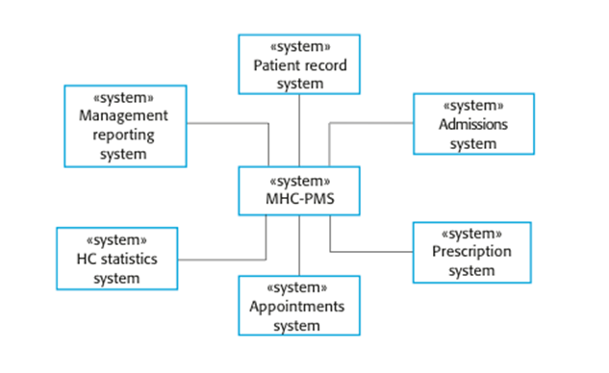
The context of the MHC-PMS

Slide 11
Interaction Perspective (Interaction model)
Modeling user interaction with the system
Modeling system-to-system interactions
Modeling component interaction
helps to understand if a proposed system structure will deliver the required system performance.
Use case diagrams and sequence diagrams used for interaction modelling.

Slide 12
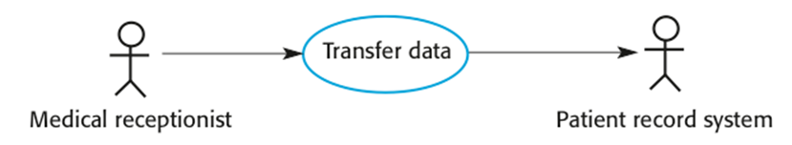
Use case modeling
Each use case represents a discrete feature that involves external interaction with a system.
Actors in a use case may be roles or other systems.
more details are mentioned in textual form.
Transfer-data use case in MHC-PMS:

Slide 13
Tabular description of the ‘Transfer data’ use-case
MHC-PMS: Transfer data
Actors | Medical receptionist, patient records system (PRS)
Description | A receptionist transfers data from the MHC-PMS to a general patient record database that is maintained by a health authority. The information transferred may either be updated personal information (address, phone number, etc.) or a summary of the patient’s diagnosis and treatment.
Data | Patient’s personal information, treatment summary
Stimulus | User command issued by medical receptionist
Response | Confirmation that PRS has been updated
Comments | The receptionist must have appropriate security permissions to access the patient information and the PRS.

Slide 14
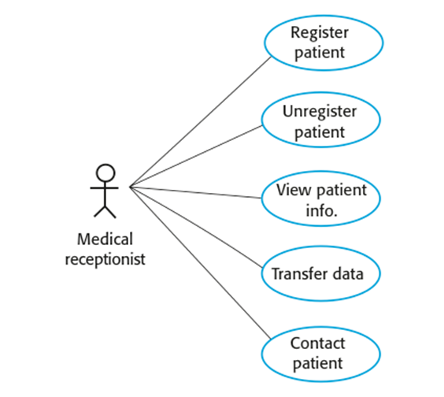
Use cases in the MHC-PMS involving the role ‘Medical Receptionist’

Slide 15
Sequence diagrams
Are used to model the interactions between the actors and the objects within a system
The sequence of interactions happen during a use case
The objects and actors involved are listed at the top of the diagram, with a dotted line drawn vertically from these.
Interactions between objects are indicated by annotated arrows.

Slide 16
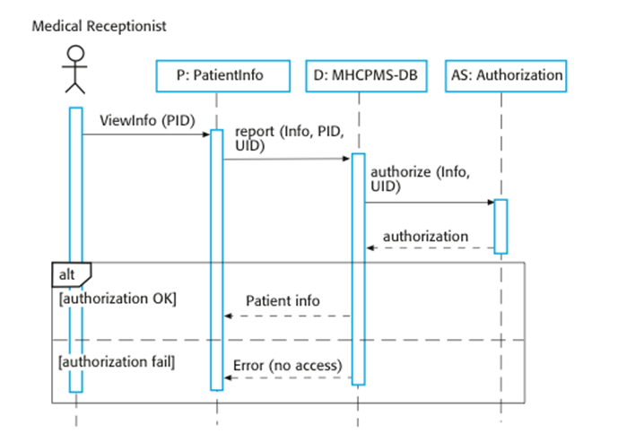
Example 1: Sequence diagram for View patient information

Slide 17
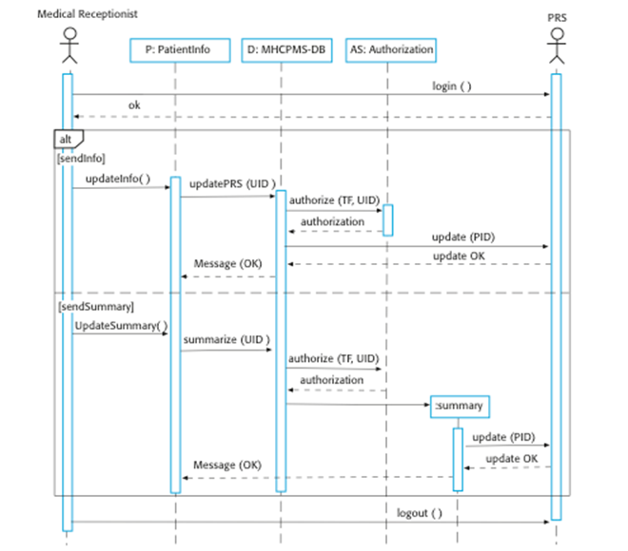
Example 2: Sequence diagram for Transfer Data

Slide 18
Structural Perspective (Structural models)
Used to design & discuss the system architecture.
Describes the organization of a system in terms of
the components (classes) of the system
the relationships between them
For developing an object-oriented structural model
show the classes in a system
shows associations between the classes

Slide 19
Class diagrams
An association is a link between classes that indicates that there is some relationship between these classes.
When developing models in the software engineering process
objects usually represent something in the real world
e.g., patient, prescription, doctor, etc.
rule of thumb: nouns in a sentence are objects/classes

Slide 20
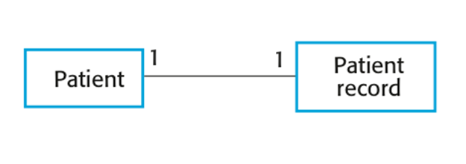
UML classes and association

Slide 21
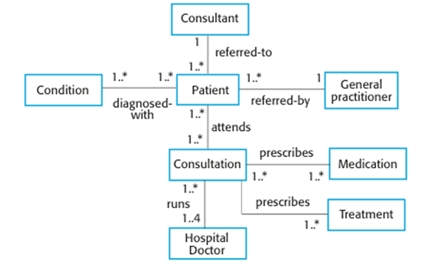
Classes and associations in the MHC-PMS

Slide 22
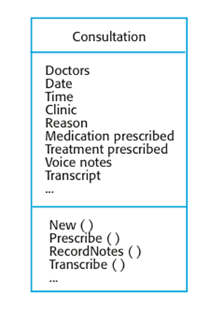
The Consultation class

Slide 23
Generalization
Generalization is an everyday technique that we use to manage complexity
We organize objects in more general classes
e.g., animals, vehicle, houses
learn the characteristics of these classes.
Members of these classes have some common characteristics
e.g. all vehicles have power, fuel, max speed, etc.

Slide 24
Generalization
In structural modeling from system requirement
Always examine the classes to see if there is scope for generalization
Usually identified through “is a” phrases in system requirements
Is implemented using the class inheritance mechanisms
A built-in feature in the object-oriented languages (e.g. java).
Attributes and operations of higher-level classes are also associated with the lower-level classes.
Lower-level classes inherit the attributes and operations from their superclasses.
Lower-level classes add more specific attributes and operations.
e.g., load capacity is a property of truck vehicles.

Slide 25
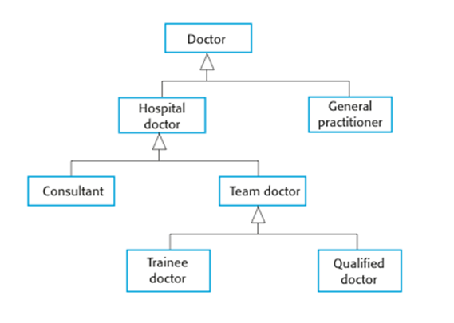
A generalization hierarchy

Slide 26
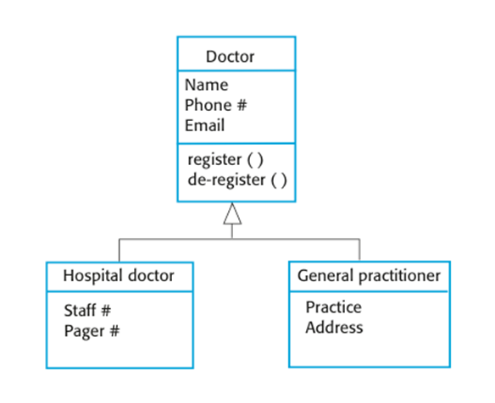
A generalization hierarchy with added detail

Slide 27
Aggregation
Shows how classes that are collections are composed of other classes/objects
Is like the “part-of relationship” in data modelling
Usually identified through “has a” relationship in system requirements

Slide 28
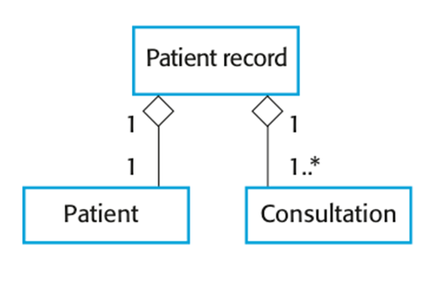
The aggregation association
Diamond at the “whole” object side
A patient record has one or more consultations
A patient record is composed of a patient

Slide 29
Behavioral perspective (behavioral model)
Describes the dynamic behavior of a system as it is executing.
They show what happens when a system responds to a stimulus (inputs) from the environment.
Stimuli can be of two types:
Input data
data that has to be processed by the system.
Events
that triggers system processing.

Slide 30
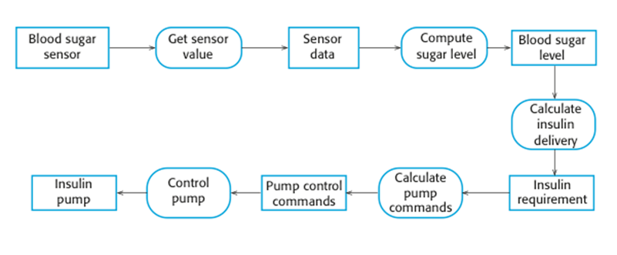
An activity model of the insulin pump’s operation

Slide 31
State machine models
These model the behaviour of the system in response to external and internal events.
They show the system’s responses to stimuli so are often used for modelling real-time systems.
State machine models show system states as nodes and events as arcs between these nodes. When an event occurs, the system moves from one state to another.

Slide 32
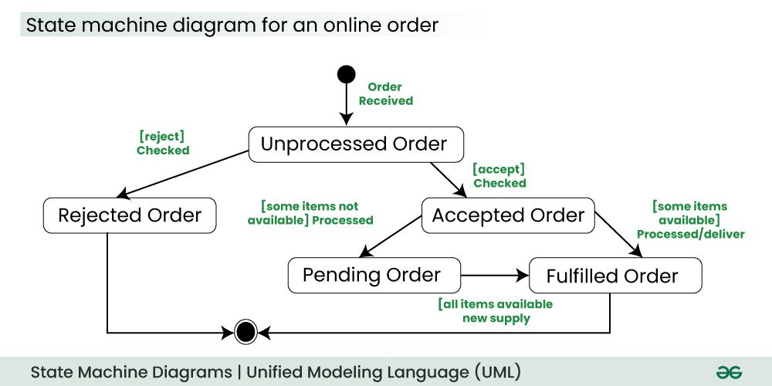
Example 1 of State Diagram
Source: https://www.geeksforgeeks.org/unified-modeling-language-uml-state-diagrams/

Slide 33
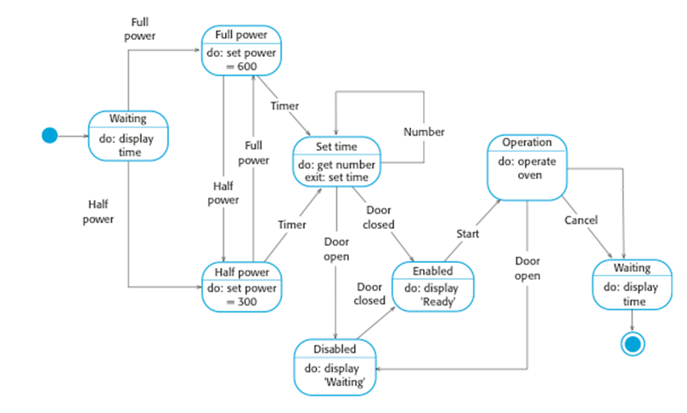
Example 2: State diagram of a microwave oven

Slide 34
States and stimuli for the microwave oven (a)
State | Description
Waiting | The oven is waiting for input. The display shows the current time.
Half power | The oven power is set to 300 watts. The display shows ‘Half power’.
Full power | The oven power is set to 600 watts. The display shows ‘Full power’.
Set time | The cooking time is set to the user’s input value. The display shows the cooking time selected and is updated as the time is set.
Disabled | Oven operation is disabled for safety. Interior oven light is on. Display shows ‘Not ready’.
Enabled | Oven operation is enabled. Interior oven light is off. Display shows ‘Ready to cook’.
Operation | Oven in operation. Interior oven light is on. Display shows the timer countdown. On completion of cooking, the buzzer is sounded for five seconds. Oven light is on. Display shows ‘Cooking complete’ while buzzer is sounding.

Slide 35
States and stimuli for the microwave oven (b)
Stimulus | Description
Half power | The user has pressed the half-power button.
Full power | The user has pressed the full-power button.
Timer | The user has pressed one of the timer buttons.
Number | The user has pressed a numeric key.
Door open | The oven door switch is not closed.
Door closed | The oven door switch is closed.
Start | The user has pressed the Start button.
Cancel | The user has pressed the Cancel button.

Slide 36
Key points
A model is an abstract view of a system that ignores system details. Complementary system models can be developed to show the system’s context, interactions, structure and behavior.
Context models show how a system that is being modeled is positioned in an environment with other systems and processes.
Use case diagrams and sequence diagrams are used to describe the interactions between users and systems in the system being designed. Use cases describe interactions between a system and external actors; sequence diagrams add more information to these by showing interactions between system objects.
Structural models show the organization and architecture of a system. Class diagrams are used to define the static structure of classes in a system and their associations.

Slide 37
Key points
Behavioral models are used to describe the dynamic behavior of an executing system. This behavior can be modeled from the perspective of the data processed by the system, or by the events that stimulate responses from a system.
Activity diagrams may be used to model the processing of data, where each activity represents one process step.
State diagrams are used to model a system’s behavior in response to internal or external events.
Model-driven engineering is an approach to software development in which a system is represented as a set of models that can be automatically transformed to executable code.

