Slide 1

DevOps CI/CD
Praveen Kumar Suggula
praveenkumarsuggula@my.unt.edu

Slide 2
Agenda
Git and GitHub Actions Overview
DevOps CI/CD Example with NodeJS (Angular/React/ExpressJS/NodeJS)
Sprint 3 DevOps Expected Deliverables.

Slide 3

Git Flow
Local (In our laptop)
Server (Remote origin)
To Create
New Repository
Git revert
Git init
Git add
Git stage
Git commit
Git push
Git clone <url>
Git reset
To Copy Existing Repository

Slide 4

Git Hub & its Actions
It makes it easy for developers to share code files and collaborate with fellow developers on open-source projects. GitHub also serves as a social networking site where developers can openly network, collaborate, and pitch their work.
Open source code repository
Code browsing
Issue tracking
Wiki pages
Working Offline
Ignoring some files

Slide 5
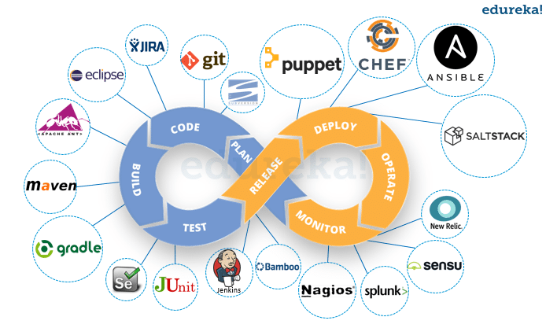
Devops Cycle

Slide 6
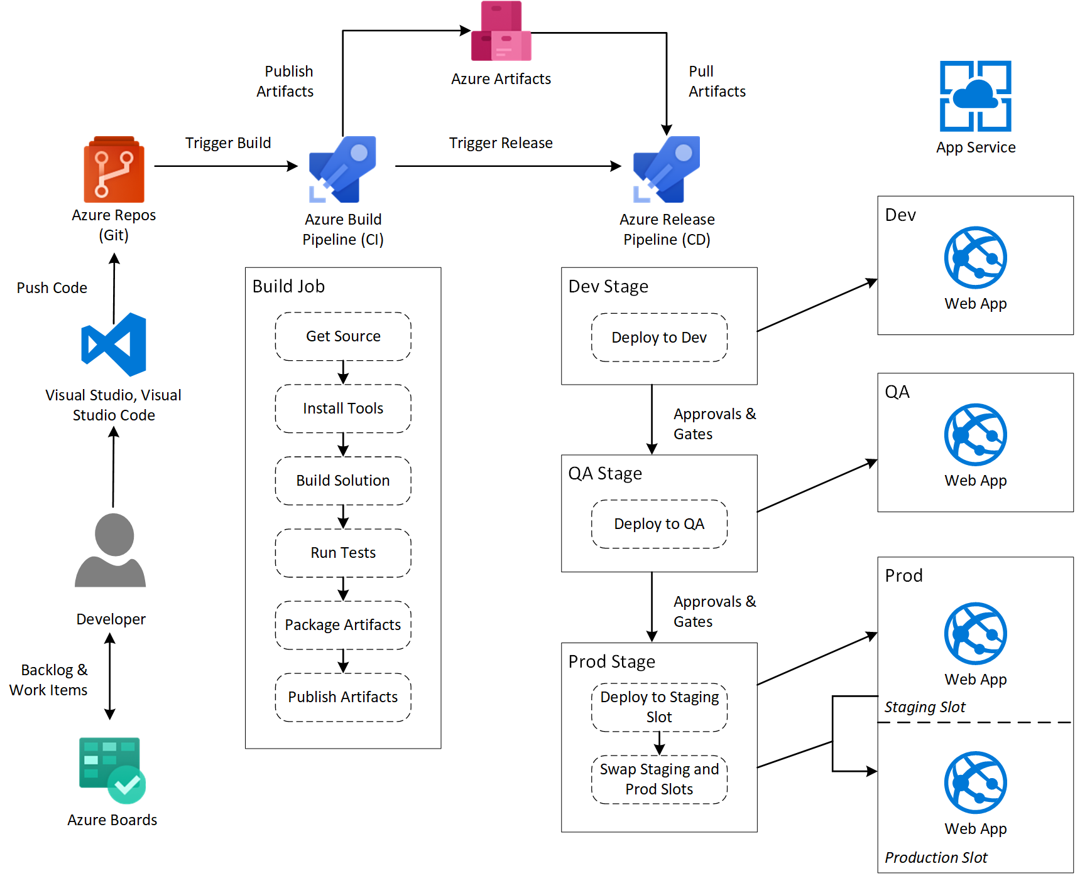
Azure DevOps CI/CD

Slide 7
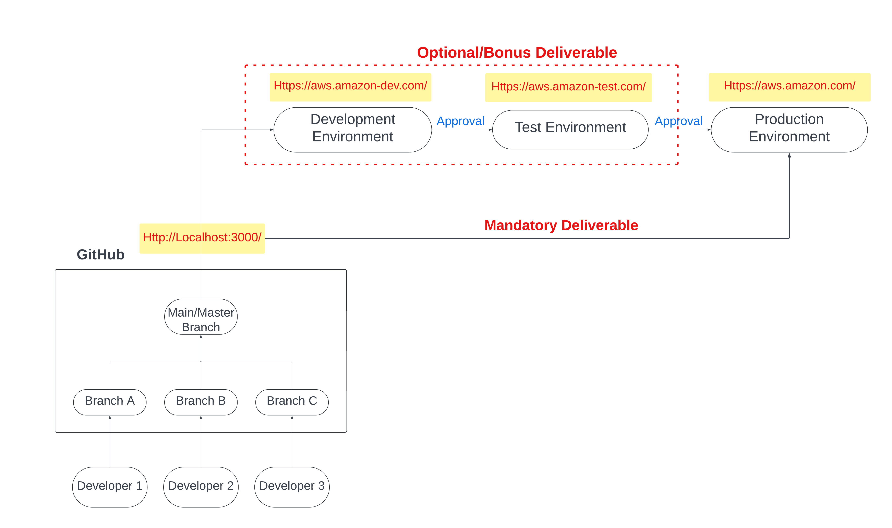
Sprint 3 DevOps Deliverables

Slide 8
Student Free Trial Azure
Please use this link to create student free trial account in azure cloud for your application deployment in production.
Benefits:
Easy to deploy
No need credit card
1 year free trail
New user can get $100 free credits with student email (i.e, my.unt.edu)

Slide 9
CI/CD Our Approach
For Sprint 3:
To create workflow for,
Continuous Integration
Continuous Deployment
Continuous Delivery
We considered node Js application (Node Js/Angular/React/Express Js) as an example.
Used GitHub actions to create workflow (CI/CD) using yml scripting.
Deployed application in azure cloud app services (Webapps)
Page URL Redirection when deploy code in Web Servers (Web.config).

Slide 10
Conclusion
In this lecture, we learned about Git, GitHub, DevOps(CI/CD).
Please note that the overall process is almost identical for every application approach, but more emphasis should be placed on the Continuous Integration aspect, which varies depending on the technologies employed.

Slide 11
Any Queries?

Slide 12
Thank You.

