Slide 1
AudioReminder
Group 9

Slide 2
Group Members
Justin Zeller
ScrumMaster
Backend
Database
Grace Wilson
Frontend
HTML Elements
Riley Keene
Backend
UI/UX
Frontend
Architecture
Macie Maranto
Frontend
CSS/Stylizing
Cristian Hernandez
Frontend
TTS/STT
Voice Command UX
Mario Onofrio
CI/CD
Database

Slide 3
Project Vision
FOR blind and visually impaired students, WHO need an accessible tool to manage their schedules, THE AudioReminder IS AN audio activated tool THAT helps visually impaired students organize tasks, set reminders, and receive voice notifications for upcoming deadlines using voice commands. UNLIKE digital calendars and tools that are not designed for the visually impaired, OUR PRODUCT provides a voice-friendly system that integrates with popular calendar platforms, helping students stay organized.

Slide 4
Personas
Persona #1 – Sara:
20 years old, full-time undergraduate student, legally blind since birth, tech-savvy
Goals:
- Manage multiple class schedules and assignment deadlines efficiently
- Coordinate study group meetings and social activities
- Set reminders for medication and daily routines
Challenges:
- Struggles with existing calendar apps that aren't fully screen reader compatible
- Struggles with websites and apps that do not have high enough color contrast
- Gets overwhelmed when managing multiple deadlines across different classes
- Needs a way to set reminders without having to type on a keyboard
- Finds it difficult to quickly check her schedule for upcoming events or deadlines

Slide 5
Personas
Persona #2 – Marcus:
28 years old, part-time graduate student, full-time office worker, gradual visual impairment, somewhat comfortable with technology but prefers simplicity
Goals:
- Balance work meetings with evening classes
- Track long-term project deadlines and milestones
- Have a calendar that shows days that are busy
Challenges:
- Has difficulty updating schedules quickly during work meetings
- Requires a system that works seamlessly with workplace tools, like Google Calendar
- Struggles to find and set prioritized events or deadlines on existing calendars
- Needs a way to use a calendar with either voice or text to use it quietly while in meetings or lectures

Slide 6
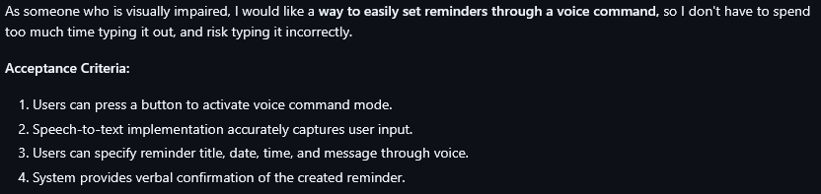
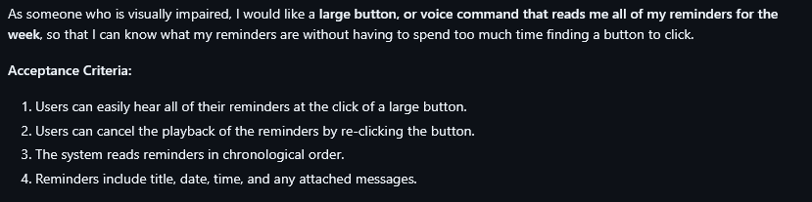
Sprint 1 User Stories

Slide 7
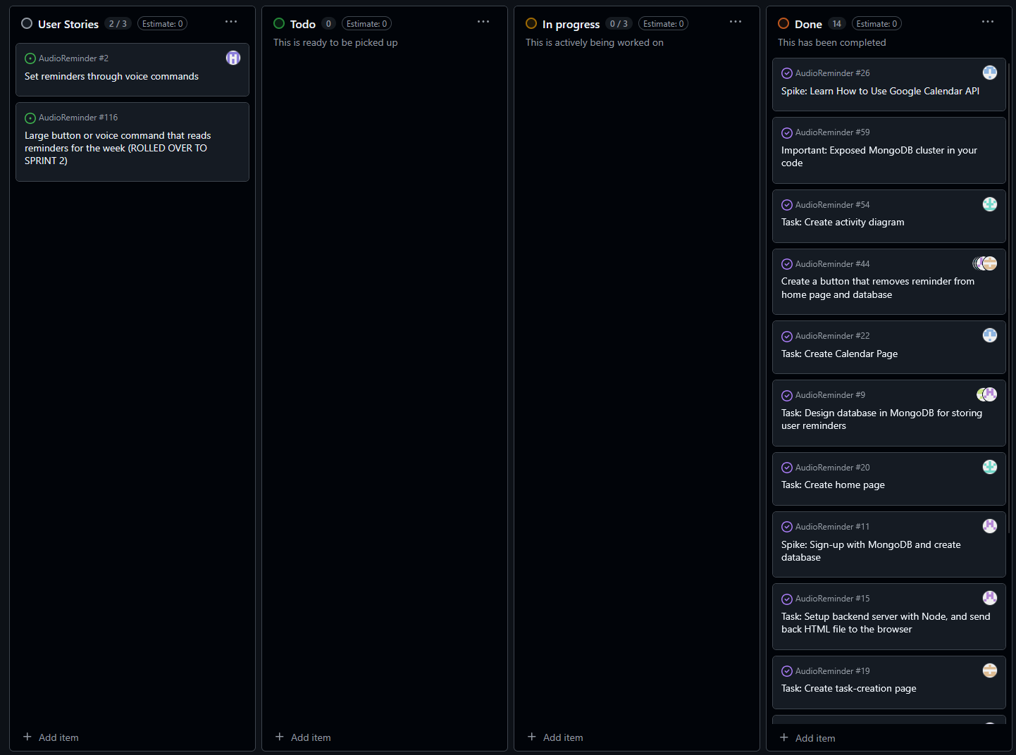
Sprint 1 Project Board

Slide 8
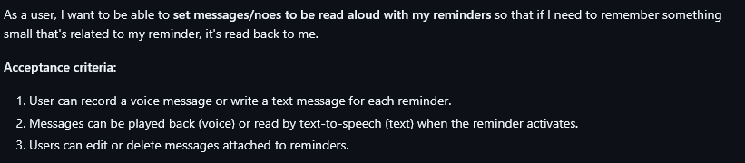
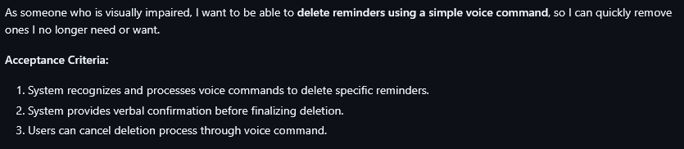
Sprint 2 User Stories

Slide 9
Rolled Over User Stories

Slide 10
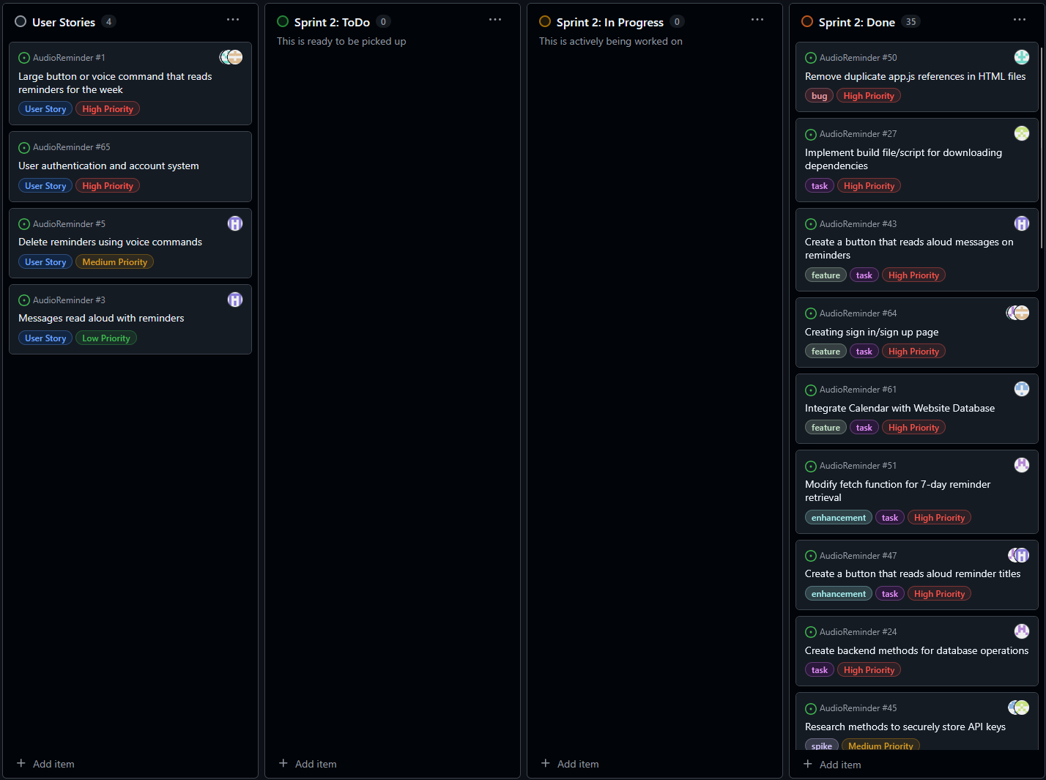
Sprint 2 Project Board

Slide 11
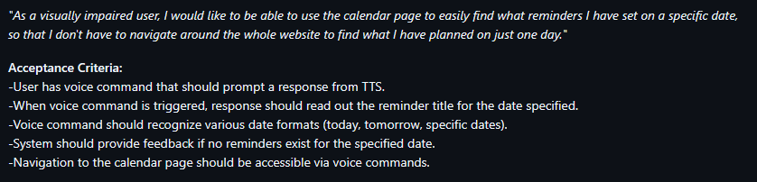
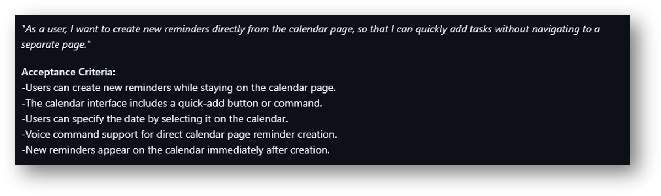
Sprint 3 User Stories

Slide 12
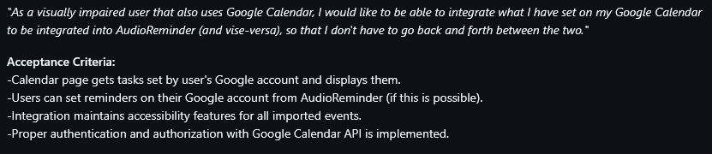
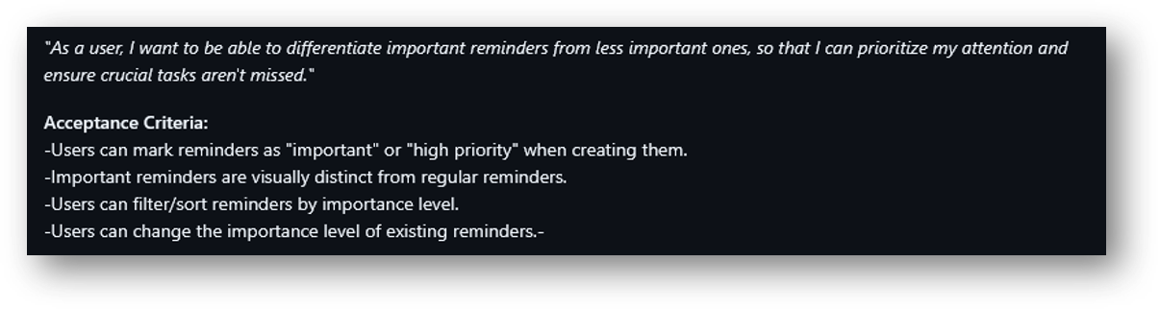
Lower Priority Sprint 3 User Stories

Slide 13
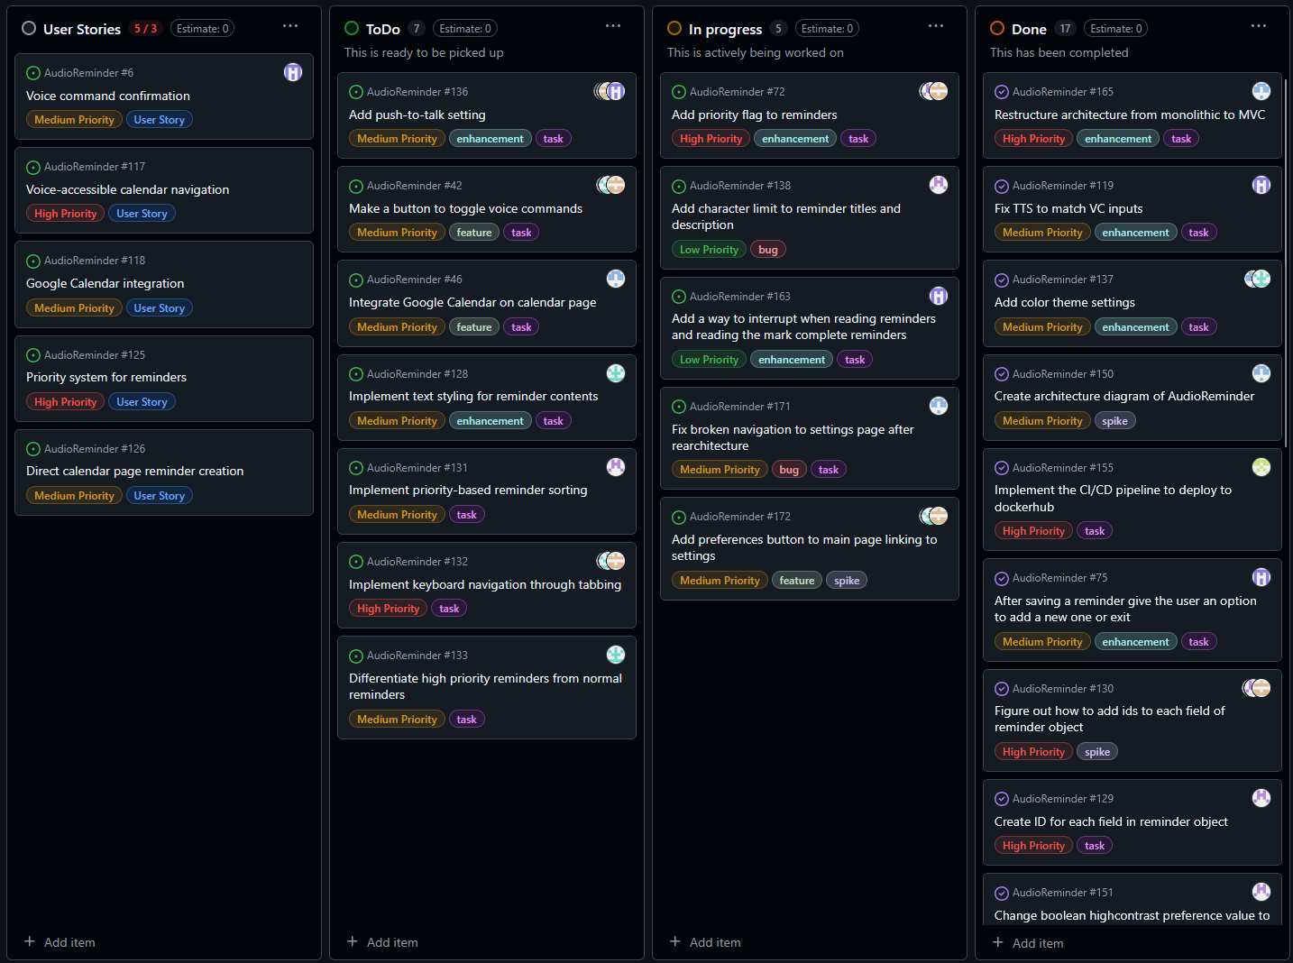
Sprint 3 Project Board

Slide 14
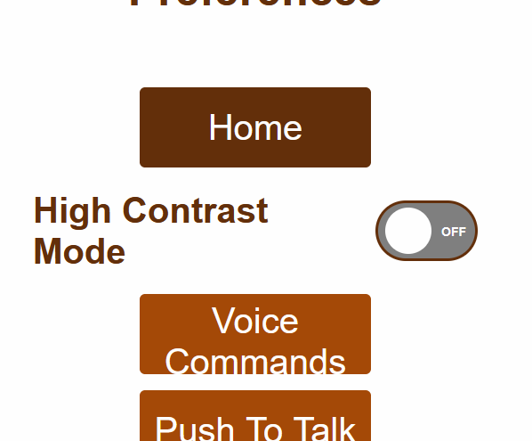
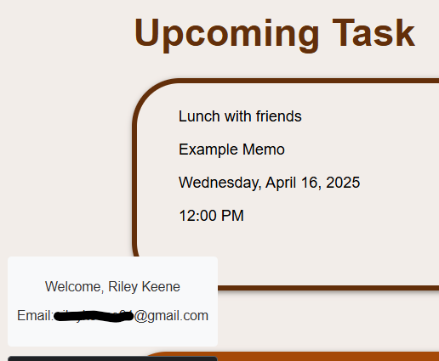
Features being worked on...
.
1.
1. Users can change their preferences...
✅ - High Contrast Mode: Working. (Sprint 3)
❌ - Voice Commands: Not working. (Sprint 3)
⚠️- Push-to-Talk: Works on main page but needs to be integrated to other pages. (Sprint 3)
❌ - Volume Control: Not working. (Sprint 3)
(NOTE: All settings above are defined in the application's Model layer and can be saved by the server. The Controller layer successfully processes changes and updates. Additional work needs to be done on the client-side (View layer) to make them work.)
2. Google API integration...
✅ - Google Authentication: Working. (Sprint 1)
❌ - Google Calendar: Not working. Needed to work on calendar first. (Sprint 3)
2.

Slide 15
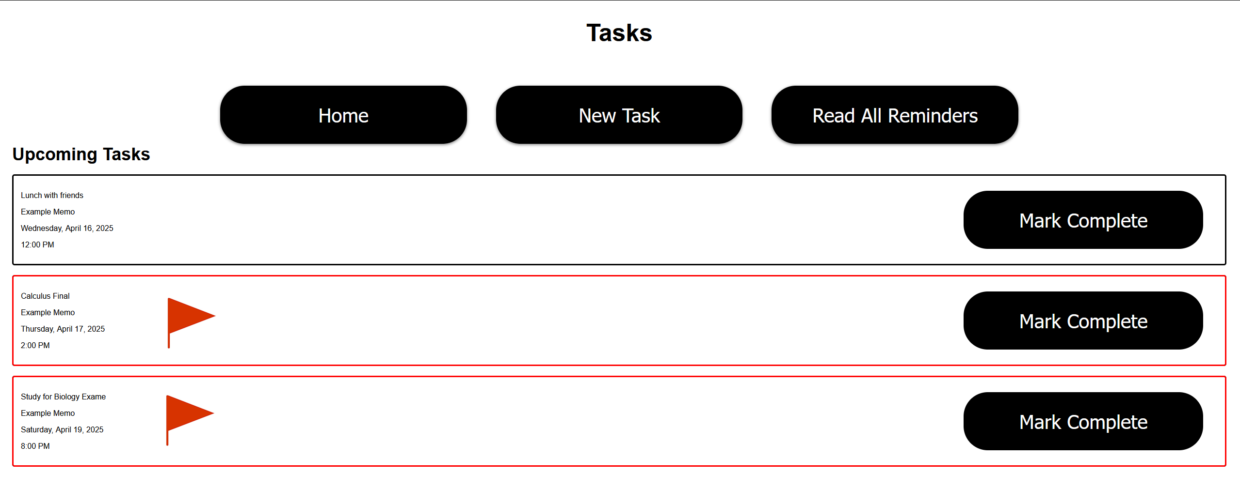
Features being worked on...
Users should be able to set/mark reminders as important, so that they will be read first, and be shown at the top
This is a prototype.

Slide 16
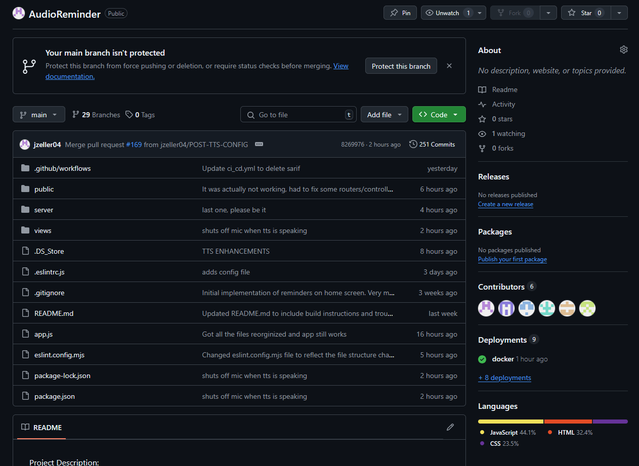
Our GitHub

Slide 17
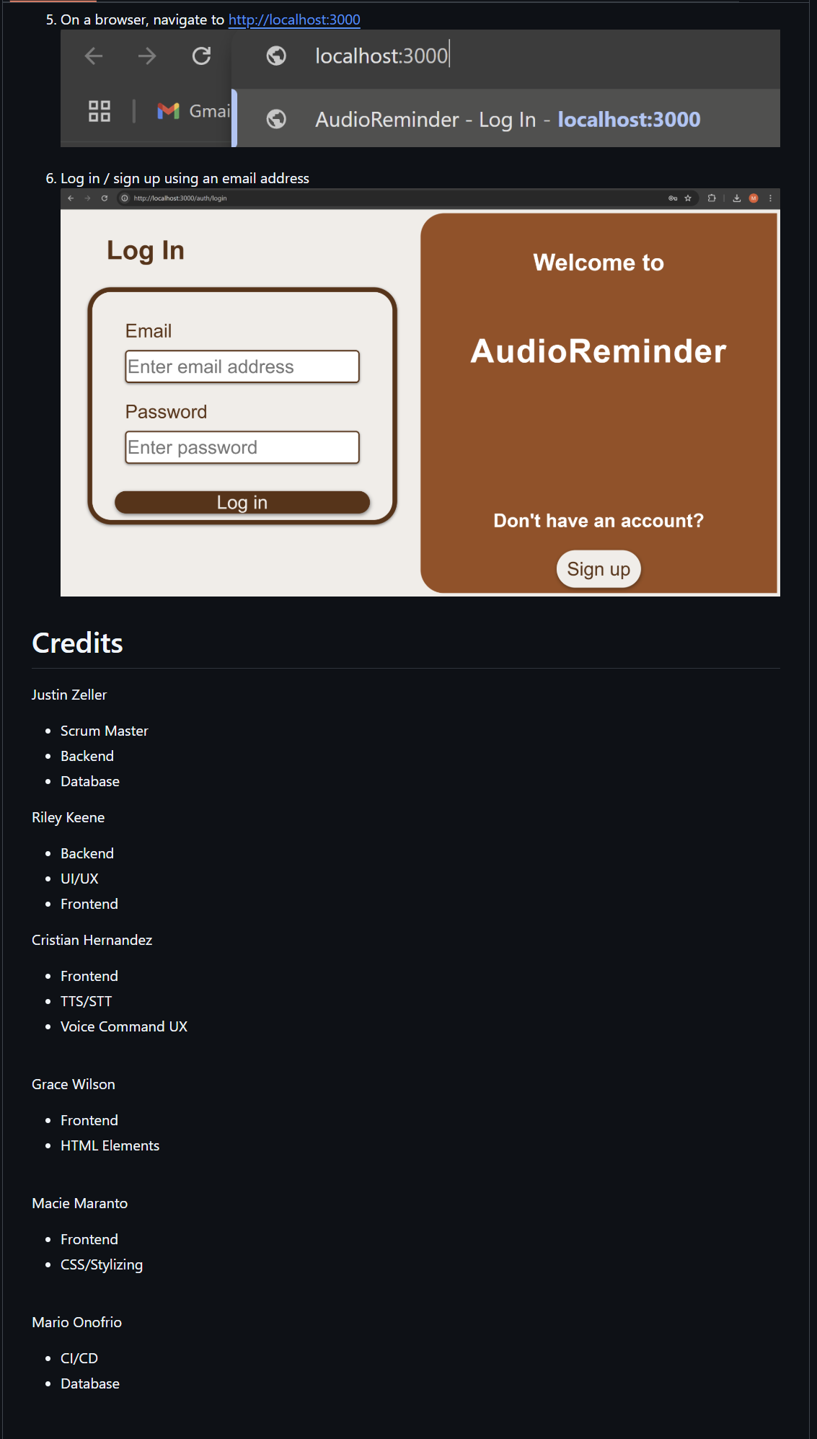
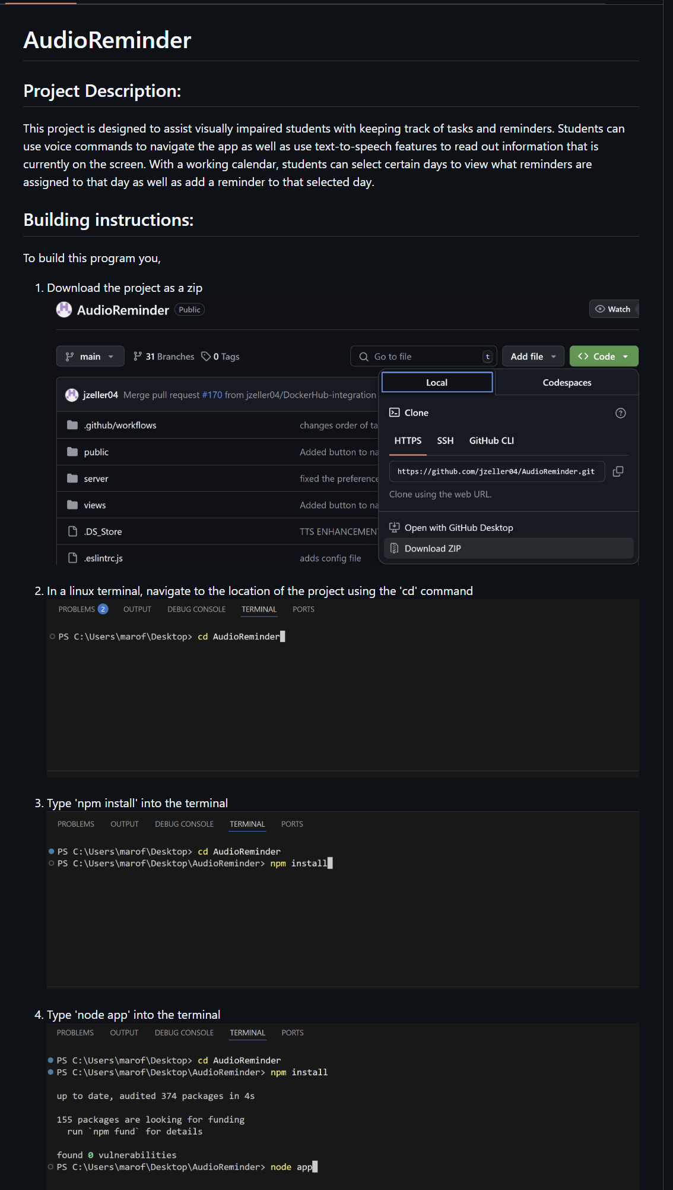
README

Slide 18
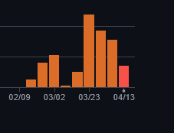
Measurement of GitHub commits
After sprint one, our commits almost doubled.

Slide 19
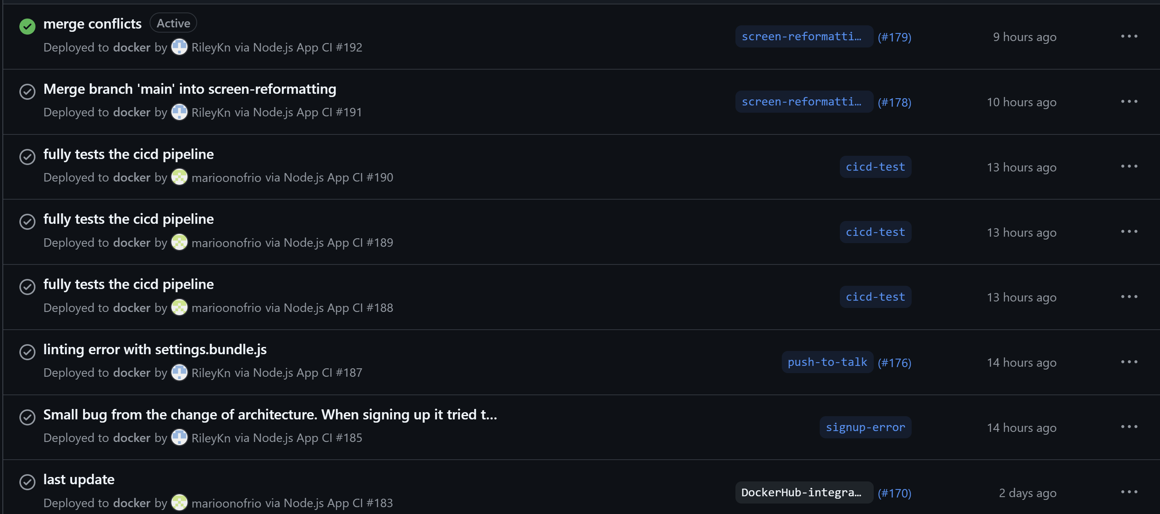
Deployment Measurements

Slide 20
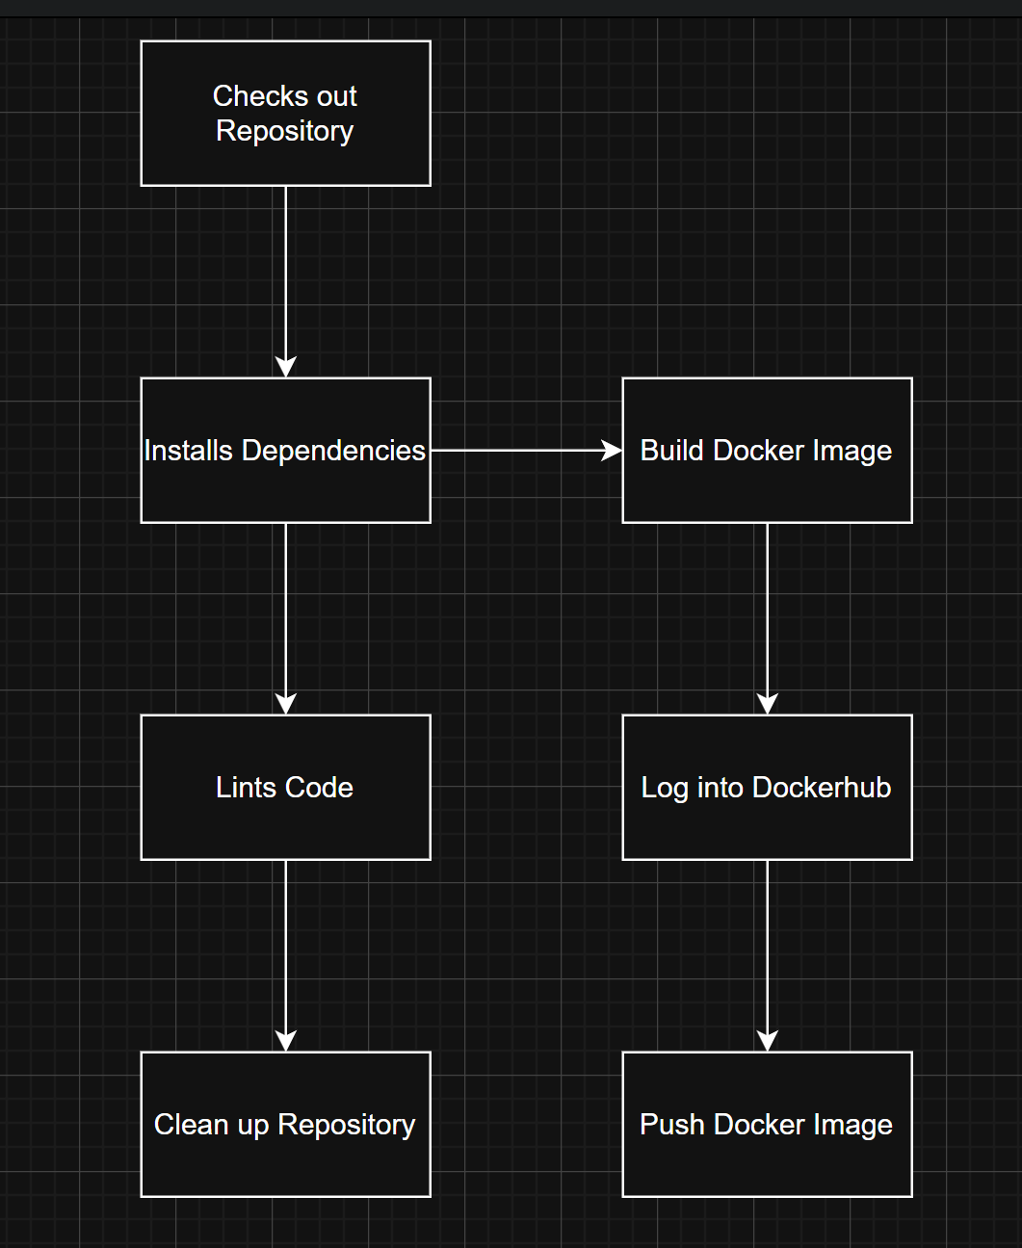
CI/CD Pipeline

Slide 21
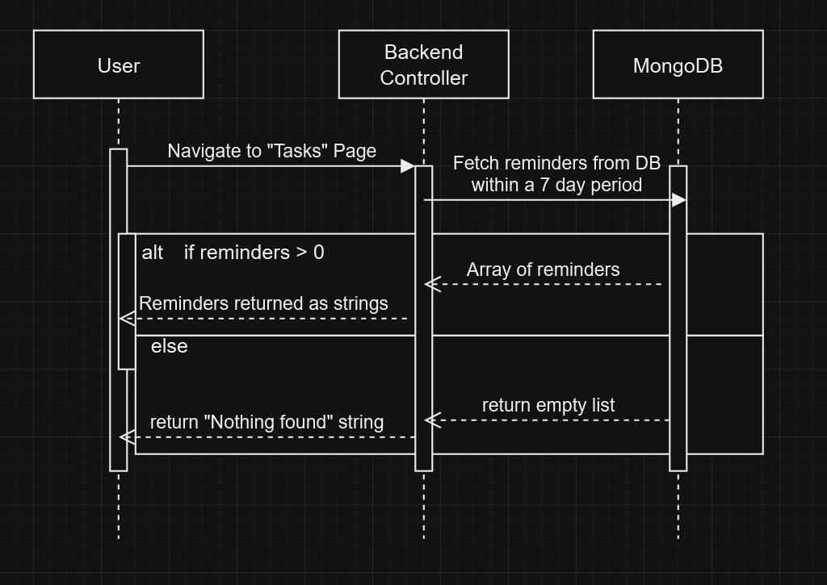
UML Sequence Diagram
Fetching reminders from the tasks page

Slide 22
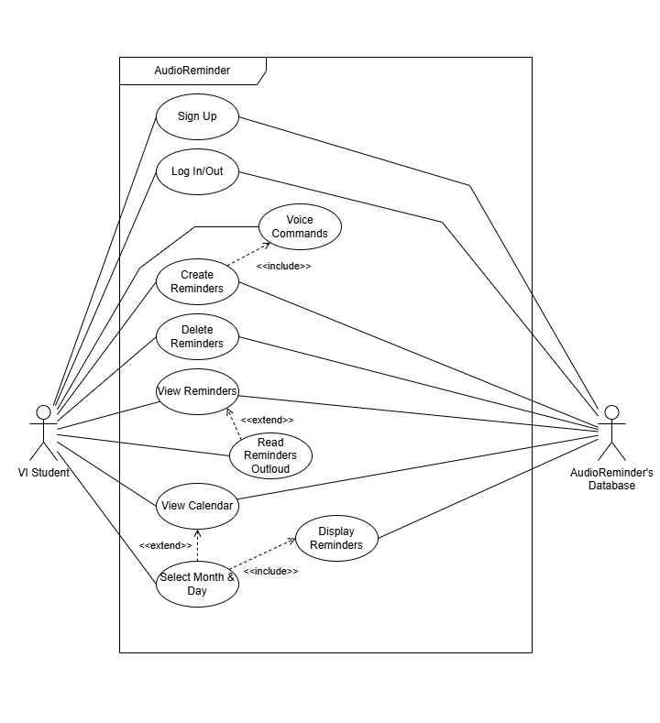
UML Use-Case Diagram
Two Primary User:
VI Student.
Database.
Core Account Functions:
Sign Up.
Sign In/Out.
Primary Reminder Operations:
Create Reminder.
Delete Reminder.
View Reminder.
Read Reminders Outloud.
Database Persistence:
Database actor connects all data-related operations.

Slide 23
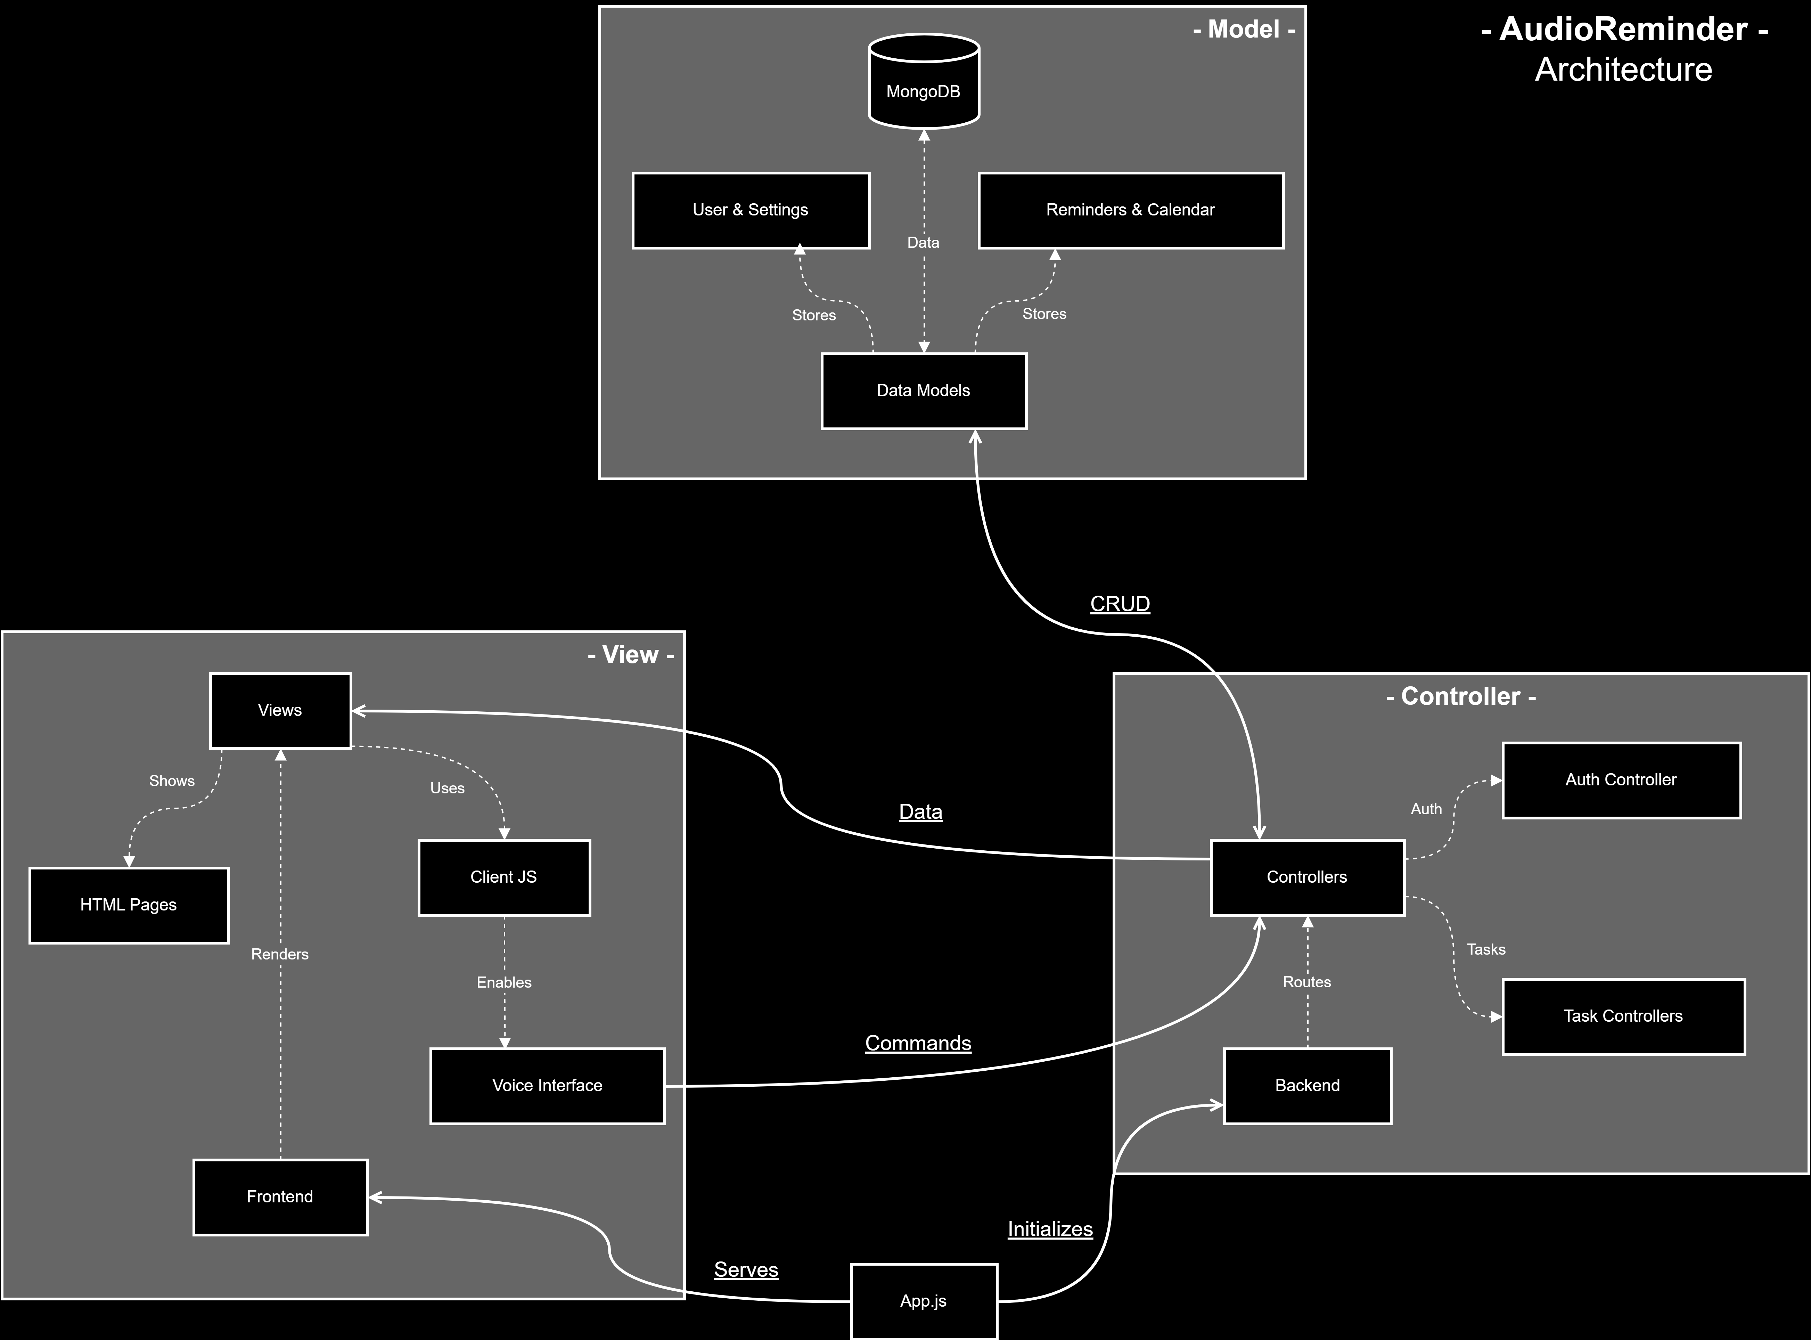
Architecture
Core Architecture
Mongoose models for User, Reminders, and Settings.
Controller Layer
Express routes direct traffic to appropriate controllers.
Controllers handle request processes and database operations.
Vanilla Javascript enhances user experience.
Voice interface provides accessibility through text-to-speech output and speech recognition navigation.
Technology Stack
MEVN stack (MongoDB, Express, Vanilla JS, and Node.js
Web-Speech API for voice recognition and synthesis.
Web MVC pattern. (MVC2)
Full-stack application.
Node.js backend with Express.js for routing and middleware.
Model Layer
MongoDB database for data storage.
Data validation and logic contained in model.
Authentication middleware ensures protected access to protected resources.
View Layer
HTML for rendering user interface.
Session-based authentication.

Slide 24
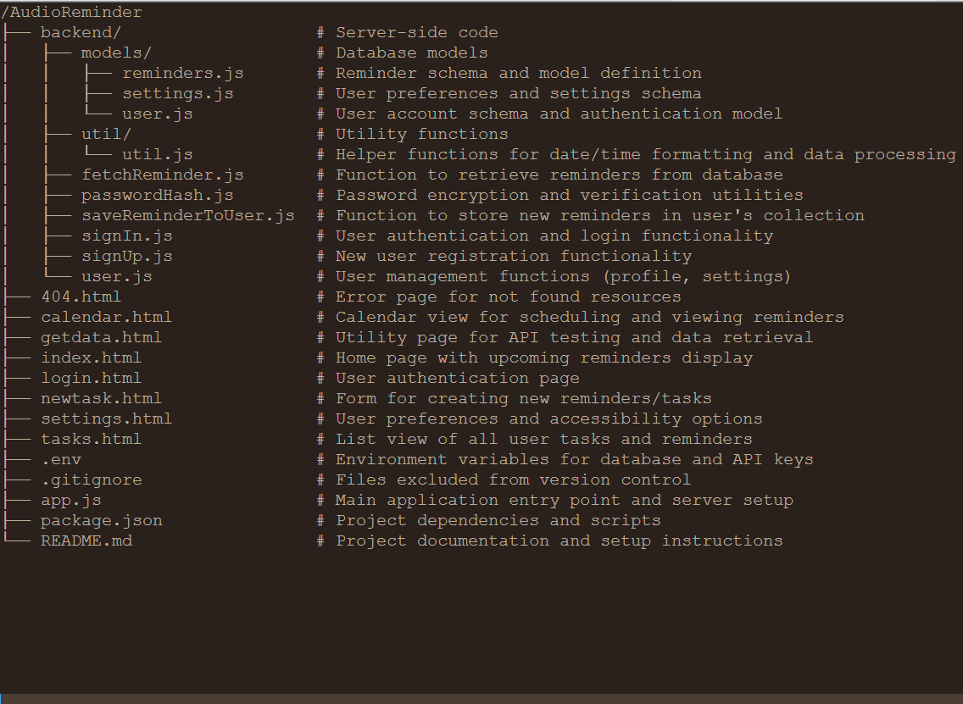
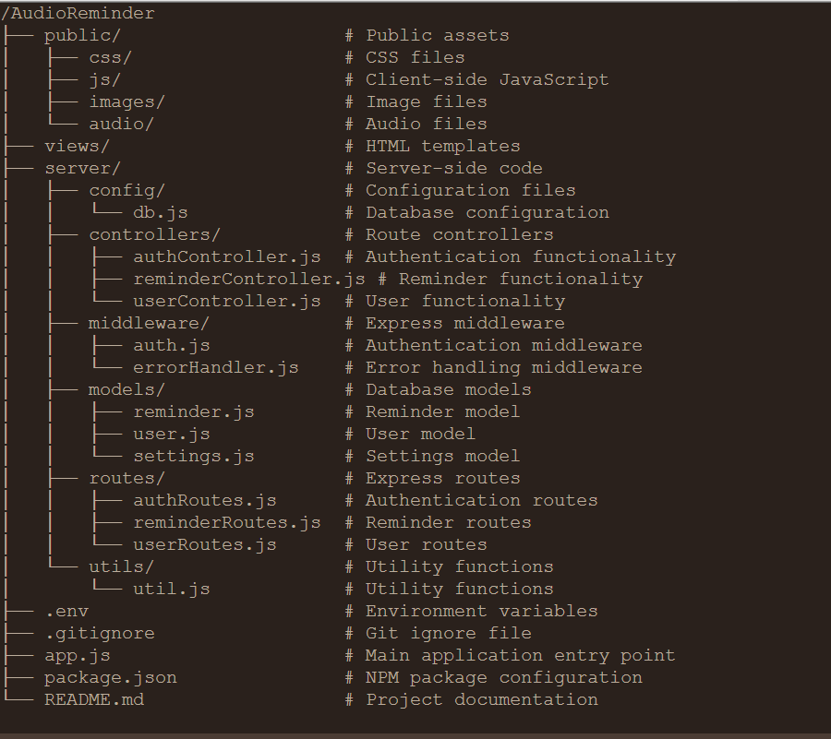
After
Restructure
Before Restructure

Slide 25
Demo

