Slide 1
An Overview to the Algorithm Design Course

Slide 2
Course Goals: Why do we study Algorithm course?
Understanding Fundamental Concepts of algorithms
Algorithm Efficiency
Evaluate and compare algorithms (space, time complexity)
Problem Classification
Algorithm Design Techniques
Like recursion, greedy, dynamic programming, …
Critical Thinking
Propose improvements for existing algorithms

Slide 3
Course Chapters
Time and space complexity of Algorithms
Divide and Conquer Design Pattern
Greedy Design Pattern
Dynamic Programming Design Pattern
Graph Algorithms
Single-Source Shortest Paths, …
Interactable Problems

Slide 4
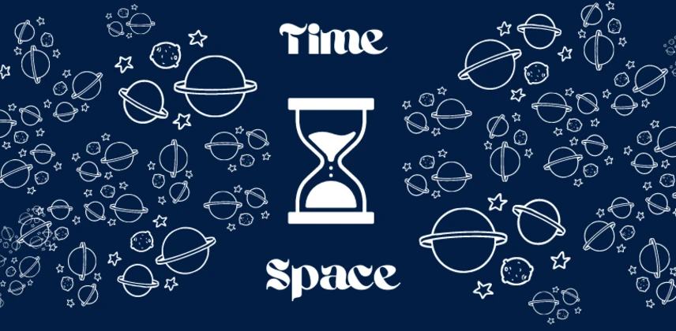
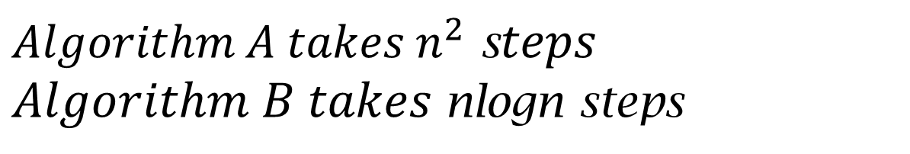
Time complexity
${Algorithm A takes n}^{2}$ s$teps$ $Algorithm B takes$nlogn steps
A: for n=1000, takes 1000,000 time units
B: for n=1000, takes 3000 time units

Slide 5
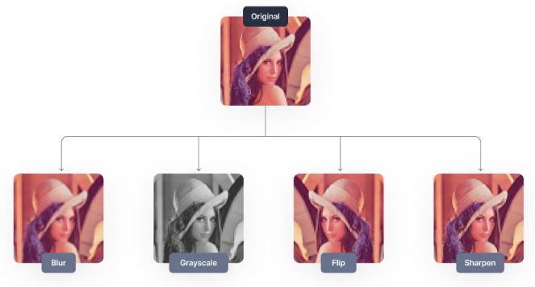
Space complexity
Efficient use of memory is crucial.
Example:
Applying filters in image processing: The space complexity of an algorithm can be O(m*n), where m and n are the dimensions of the image (height and width).
Optimizing space complexity helps minimize memory requirements and allows the algorithm to handle larger images without consuming excessive resources.

Slide 6
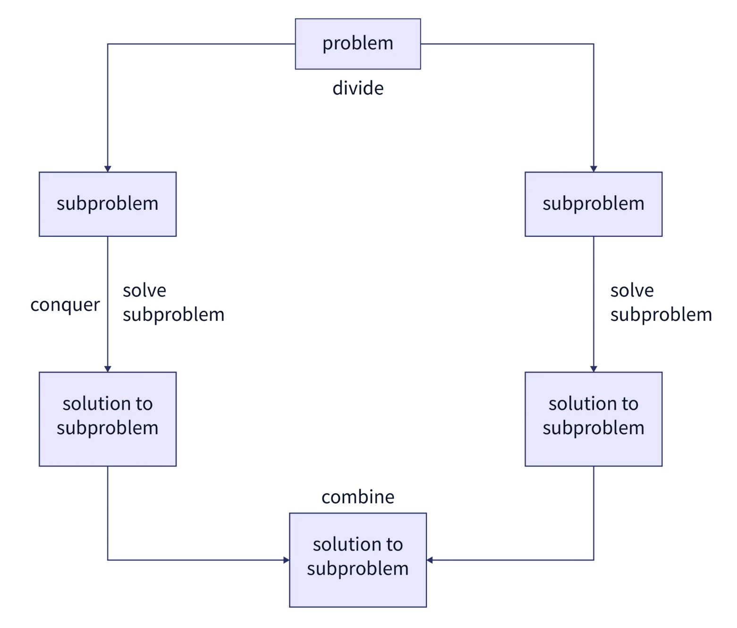
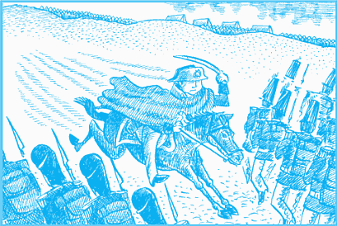
Divide and Conquer Design Pattern
Inspired from human life.
Tactic in wars. The attacker divide the enemy soldiers to two parts. Defeat each part more easily.

Slide 7
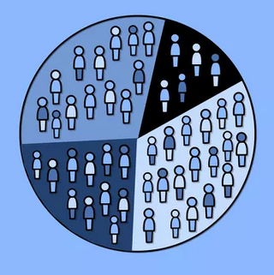
Another example of applying Divide and Conquer
In business, companies instead of targeting an entire market at once, they may focus on specific segments or demographics.

Slide 8

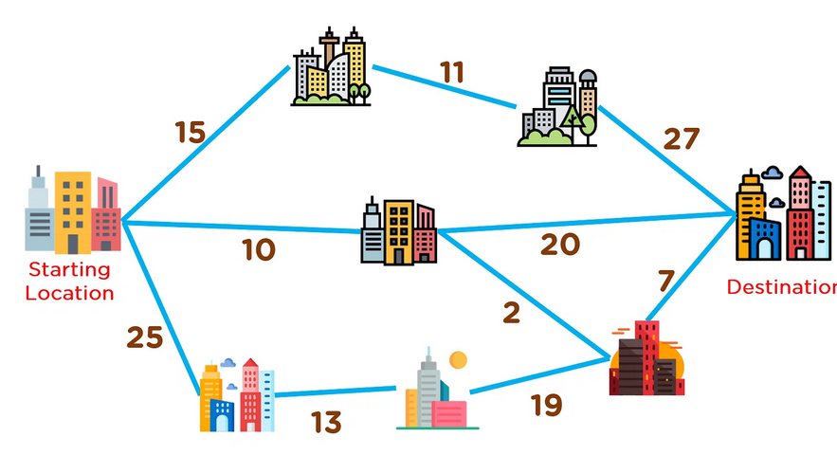

Greedy Algorithms
Solving a problem by selecting the best option available at the moment.

Slide 9
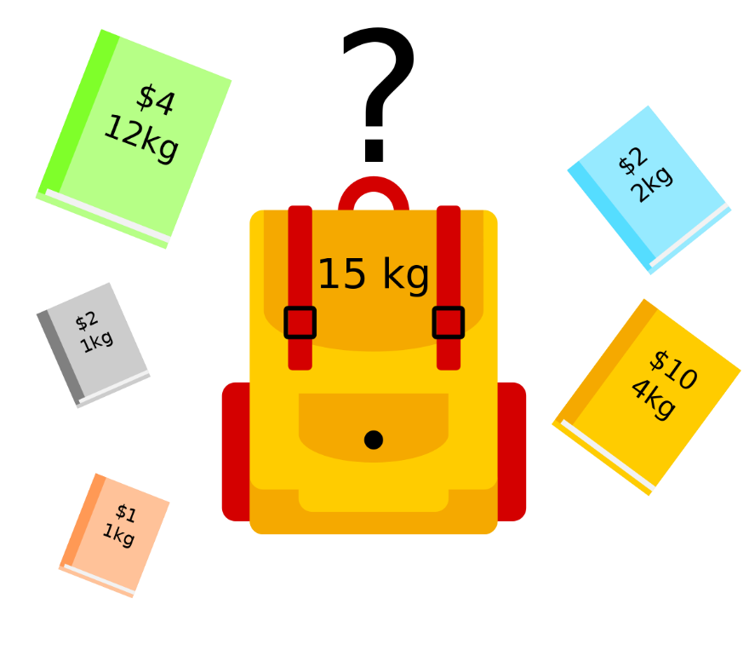

Dynamic Programming Design Pattern
Avoid recomputing the same sub-problems over and over again, by storing and reusing their solutions.
Example Problem: Knapsack Algorithm
A night before exams? Get more marks by less study in the remaining hours.

Slide 10
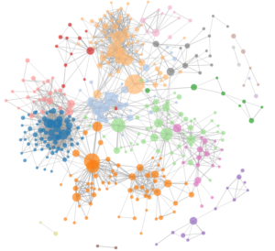

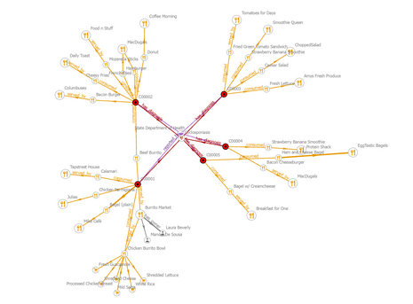
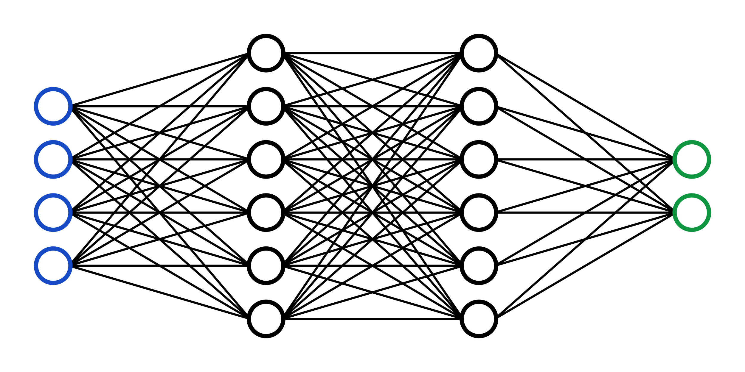
Graph Algorithms

Slide 11
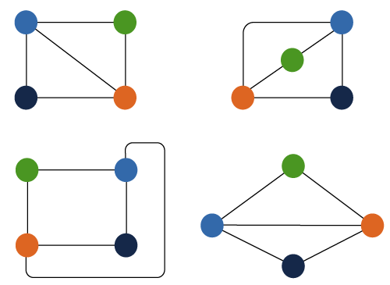
Intractable Problems
We want some way to classify problems that are hard to solve
Example: Graph Isomorphism
In chemistry and biology, determining whether two molecules have the same structure

