Slide 1
Floyd-Warshall Algorithm

Slide 2
Review Different Shortest Path Algorithms
Dijkstra: Find the shortest path from one node to all nodes (Greedy Alg)
Bellman-Ford: Find the shortest path from one node to all nodes, negative edges allowed (Dynamic Programming Alg)
Floyd-Warshall: Find the shortest path between all nodes, negative edges allowed (Dynamic Programming Alg)

Slide 3
Floyd-Warshall Algorithm All pairs shortest path
The problem: find the shortest path between every pair of vertices of a graph
The graph: may contain negative edges but no negative cycles
A representation: a weight matrix where: W(i,j)= weight of the edge between node i and j W(i,j)= 0 if i=j W(i,j)= ∞ if there is no edge between i and j
Note: This is a Dynamic Programming algorithm (not greedy)

Slide 4
The Weight Matrix and the Graph
1
3
v₁
v₂
9
5
1
2
3
v₅
3
v₄
2
v₃
4

Slide 5
The subproblems
How can we define the shortest distance d_{i,j} in terms of “smaller” problems?
The algorithm is looking for the shortest path between every pair of vertices by considering whether a path through another vertex could provide a shorter route.
Store weight of a shortest path from v_{i} to v_{j} in table D^{(k)}[i,j], while checking if a path through an intermediate vertex v_{k} provides a shorter path than the current known path.
How do we compute D^{(k)} from D^{(k-1)} ?
V_{k}
d_{k,j}
d_{i,k}
V_{j}
V_{i}
d_{i,j}
5

Slide 6
The Recursive Definition:
Case 1: A shortest path from v_{i} to v_{j} restricted to using only vertices from {v₁,v₂,…,v_{k}} as intermediate vertices, does not use v_{k}
Case 2: A shortest path from v_{i} to v_{j} restricted to using only vertices from {v₁,v₂,…,v_{k}} as intermediate vertices, use v_{k}
D^{(k)}[i,j]= D^{(k-1)}[i,j]
D^{(k)}[i,j]= D^{(k-1)}[i,k]+ D^{(k-1)}[k,j]
V_{k}
Shortest path using intermediate vertices {V₁, . . . ,V_{k} }
V_{j}
V_{i}
Shortest Path using intermediate vertices { V_{1, . . . ,}V_{k -1} }

Slide 7
The Recursive Definition
D⁽⁰⁾=W
D^{(n)}=D which is the goal matrix
D^{(k)}[i,j]= Min{ D^{(k-1)}[i,j] , D^{(k-1)}[i,k]+ D^{(k-1)}[k,j] }
#Direct edge between all vertices
V_{k}
Shortest path using intermediate vertices {V₁, . . . ,V_{k} }
V_{i}
V_{j}
Shortest Path using intermediate vertices { V_{1, . . . ,}V_{k -1} }

Slide 8
The pointer array P
Used to enable finding a shortest path
Initially the array contains 0
Each time that a shorter path from i to j is found the k that provided the minimum is saved (highest index node on the path from i to j)
To print the intermediate nodes on the shortest path a recursive procedure that print the shortest paths from i and k, and from k to j can be used
8
8

Slide 9
Example
1
2
3
1
1
0
4
5
5
W = D⁰ =
2
2
0
∞
4
2
3
3
∞
-3
0
2
-3
1
2
3
1
0
0
0
P =
2
0
0
0
3
0
0
0
9

Slide 10
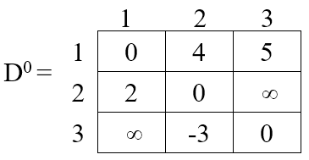
k = 1 Vertex 1 can be intermediate node
1
2
3
1
0
4
5
D¹[2,3] = min( D⁰[2,3], D⁰[2,1]+D⁰[1,3] )
= min (∝, 7)
= 7
D¹ =
2
2
0
7
3
∞
-3
0
1
5
4
3
1
2
3
2
D¹[3,2] = min( D⁰[3,2], D⁰[3,1]+D⁰[1,2] )
= min (-3,∝)
= -3
-3
1
0
0
0
2
P =
2
0
0
1
3
0
0
0
10

Slide 11
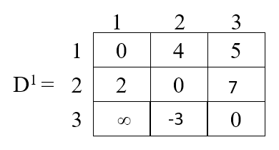
k = 2 Vertices 1, 2 can be intermediate
1
2
3
1
0
4
5
D²[1,3] = min( D¹[1,3], D¹[1,2]+D¹[2,3] )
= min (5, 4+7)
= 5
D² =
2
2
0
7
1
5
3
-1
-3
0
4
2
3
1
2
3
2
-3
1
0
0
D²[3,1] = min( D¹[3,1], D¹[3,2]+D¹[2,1] )
= min (∝, -3+2)
= -1
0
P =
2
0
0
1
3
2
0
0
11

Slide 12
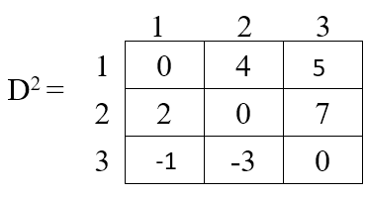
k = 3 Vertices 1, 2, 3 can be intermediate
1
2
3
1
0
2
5
D³ =
D³[1,2] = min(D²[1,2], D²[1,3]+D²[3,2] )
= min (4, 5+(-3))
= 2
2
2
0
7
3
-1
-3
0
1
5
1
2
3
D³[2,1] = min(D²[2,1], D²[2,3]+D²[3,1] )
= min (2, 7+ (-1))
= 2
4
2
3
1
0
3
0
2
-3
P =
2
0
1
0
3
2
0
0
12

Slide 13
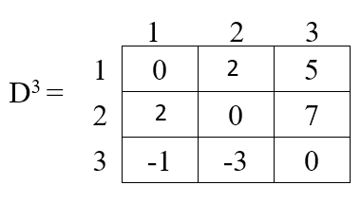
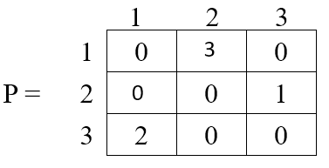
Shortest path between every pairs of vertices
1
5
1
5
4
2
3
3
2
2
-3
-3
2
13

Slide 14
Floyd Warshall’s Algorithm
D = W; // initialize D array to W[ ] P = 0 ; // initialize P array to [0] for (k = 1 ; k ≤ n ; k++) for (i = 1 ; i ≤ n ; i++) for (j = 1 ; j ≤ n; j++) if (D[ i, j ] > D[ i, k ] + D[ k, j ] ) then { D[ i, j ] = D[ i, k ] + D[ k, j ]; P[ i, j ] = k; }
Time Complexity: O(n³)
Space Complexity: O(n²)
Use adjacency matrix to store distances
14

