Slide 1
Computational Complexity and Intractability

Slide 2
Problems with different time complexity
Polynomial time: Linear Search, Binary Search, Insertion Sort, Merge Sort, Matrix Multiplication
Exponential time: Traveling Salesperson, Graph Coloring
Researcher looks for new solutions (with polynomial time) for problems with exponential time complexity.

Slide 3
Decidability
Problems that have algorithms to find a solution are called decidable.
Problems for which no algorithm can determine a solution are called undecidable (e.g., the Halting Problem).

Slide 4
Tractable
Decidable problems that can be solved in polynomial time; T(n)= O(n^{k}) are tractable for some constant k
Polynomial time : O(n²), O(n³), O(1), O(nlogn), …
Others that take more than polynomial time are intractable, “difficult to treat or work”.
Not in polynomial time: O(2^{n}), O(n^{n}), O(n!), …
Example: if T(n)=n³ and n=1000 then T(n)= 1 billion while for T(n)=2^{n} and n=1000, T(n) is a number much larger than the number of atoms in the universe!

Slide 5
Optimization/Decision Problems
Optimization Problems
An optimization problem is one which asks, “What is the optimal solution to problem X?”
Examples: 0/1 Knapsack, Minimum Spanning Tree
Decision Problems
A decision problem is one with yes/no answer
Example: Does a graph G have an MST of cost ≤ w?
Many problems will have decision and optimization versions
Example: Knapsack Problem
Optimization: What is the maximum value of a knapsack with a total weight=W?
Decision: Is there a subset of items that fits within the knapsack with a total weight=W?

Slide 6
Classes of Problems
Classes of decision problems:
The class P
The class NP
The class of NP-Hard
The class of NP-Complete

Slide 7
Class P (Polynomial-time)
Class P is set of all decision problems that can be solved by polynomial-time deterministic algorithms.
A deterministic algorithm is one that always computes the correct answer.
Example of problems in class P: MST, Sorting

Slide 8
Class P
Do problems such as 0-1 Knapsack (not polynomial-time algorithms) belong to class P?
No one knows
To know a decision problem is not in class P, it must be proven it is not possible to develop a polynomial-time algorithm to solve it!

Slide 9
Class NP (Non-deterministic Polynomial-time)
A problem is in class NP, if it can be verified in polynomial-time.
Like, checking if a Sudoku is solved correctly.
For NP, there exists a polynomial-time verification algorithm that, given a solution, can determine its correctness in polynomial-time.
There is a non-deterministic polynomial-time algorithm that can “guess” the solution, and the verification algorithm can then confirm its correctness in polynomial-time.
Example of NP: 0/1 knapsack problem , Subset Sum Problem, Graph Coloring

Slide 10
Analyze 0/1 Knapsack Problem
Time complexity of 0/1 Knapsack problem using dynamic programming: O(n.W)
In time complexity, we care about the input size.
W is part of the input, and its size could be an exponential number:
So, if W=2^{k} then O(n. 2^{k}) → So the runtime is exponential in k
0/1 Knapsack problem is NP problem, because:
It is easy to verify a solution in polynomial time
It is hard to find a solution (takes exponential time)

Slide 11
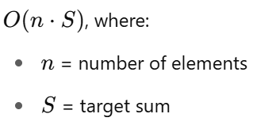
Another Example of NP problem: Subset Sum Problem
Given a set of integers and a target sum S, determine if there's a subset of the numbers that adds up exactly to S.
Example:
[5, 6, 10, 11, 16], S=21
Answers: [5, 6, 10], [5,16], [10, 11]
Time complexity:
As the target (S) might be exponentially large compared to its binary representation, therefore time complexity could be exponential

Slide 12
NP Example
If we write an algorithm for Subset Sum Problem with polynomial time complexity, some of the statements in the algorithm may not be figuring out how to make them polynomial. Those statements are non-deterministic.

Slide 13
Example of NP algorithm
The Subset Sum Problem is an NP problem.
def non_deterministic_subset_sum(S, target):
guessed_subset = guess_subset(S)
subset_sum = sum(guessed_subset)
if subset_sum == target:
return True
else:
return False
Non-deterministic statement

Slide 14
P vs NP
P are the problems that easy to solve and NP are those that hard to solve.
P= set of problems that can be solved in polynomial-time
NP= set of problems for which a solution can be verified in polynomial-time
If we can solve a problem quickly (in polynomial time), then of course we can also verify a solution quickly.
P ⊆ NP
Today’s P problems were NP problems before. When deterministic algorithms found, NP changed into P problems.
NP
P
Complexity

Slide 15
Reduction
Often, we can solve a problem by reducing it to a different problem.
Reducing problem A to problem B (A ≤_{p}​B) means convert A to B in polynomial-time.
In this case, if problem B can be solved in polynomial-time, then problem A is also can be solved in polynomial-time.

Slide 16
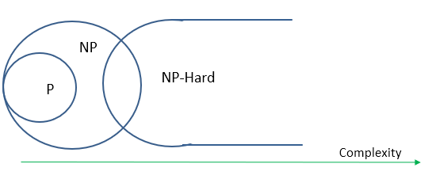
NP-Hard
NP-Hard: The problem is at least as hard as NP
Every problem in NP can be reduced to a problem in NP-Hard set
The reduction algorithm is in polynomial-time.
So, if one day we can solve only one NP-Hard problem, by using the reduction, we can solve all NP problem as well.

Slide 17




NP-Complete
A problem is NP-complete if it is in NP, and every problem in NP can be reduced to it in polynomial time.
Or, we can say:
An NP-Complete problem is an NP-Hard problem that is also in NP.
NP-Complete

Slide 18
Relation between problems
A is reducible to B, implies that B is at least as hard as A.
If A ≤_{p}​B (A reducible to B) and A is NP-Hard, then B is also NP-Hard.
If B is NP and A ≤_{p}​B (A reducible to B) and A is NP-Complete, then B is also NP-Complete.

Slide 19
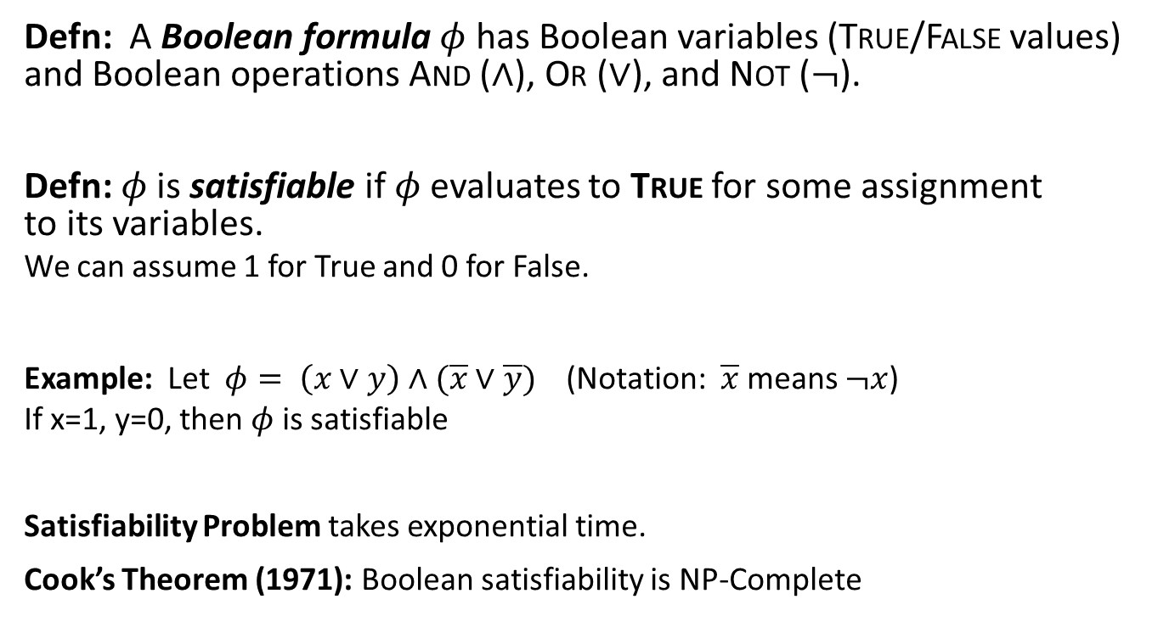
Boolean Satisfiability
Defn: A Boolean formula $φ$ has Boolean variables (True/False values) and Boolean operations And ($∧$), Or ($∨$), and Not ($¬$).
Defn: $φ$ is satisfiable if $φ$evaluates to True for some assignment to its variables.
We can assume 1 for True and 0 for False.
Example: Let $φ= \left(x∨y\right)∧(\overline{x}∨\overline{y})$ (Notation: $\overline{x}$ means $¬x$)
If x=1, y=0, then $φ$ is satisfiable
Satisfiability Problem takes exponential time.
Cook’s Theorem (1971): Boolean satisfiability is NP-Complete

Slide 20
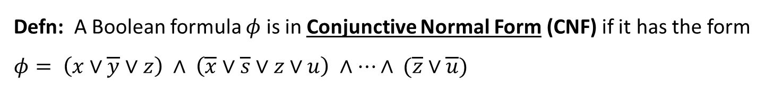

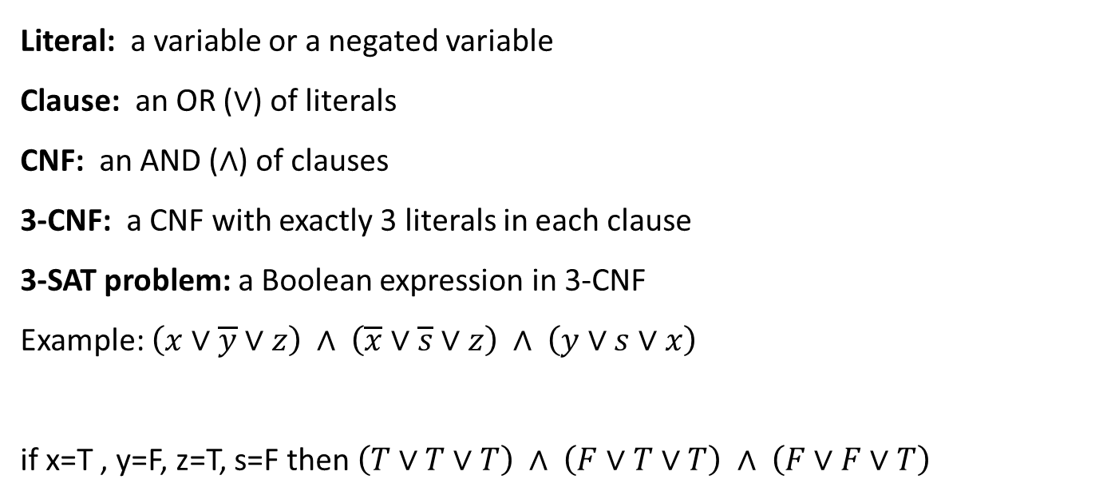
3-SAT problem
Defn: A Boolean formula $φ$ is in Conjunctive Normal Form (CNF) if it has the form $φ= \left(x∨\overline{y}∨z\right) ∧ \left(\overline{x}∨\overline{s}∨z∨u\right) ∧⋯∧ (\overline{z}∨\overline{u})$
clause
clause
literals
Literal: a variable or a negated variable
Clause: an OR ($∨$) of literals
CNF: an AND ($∧$) of clauses
3-CNF: a CNF with exactly 3 literals in each clause
3-SAT problem: a Boolean expression in 3-CNF
Example: $\left(x∨\overline{y}∨z\right) ∧ \left(\overline{x}∨\overline{s}∨z\right) ∧ \left(y∨s∨x\right)$
if x=T , y=F, z=T, s=F then $\left(T∨T∨T\right) ∧ \left(F∨T∨T\right) ∧ \left(F∨F∨T\right)$
T
T
T
$$=T$$

Slide 21
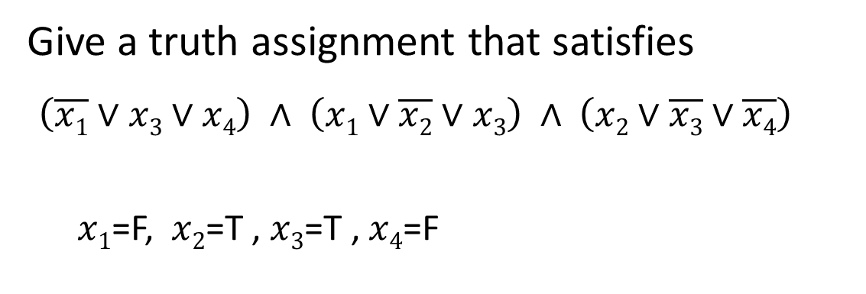
Example
Give a truth assignment that satisfies
$\left(\overline{x1}∨x3∨x4\right) ∧ \left(x1∨\overline{x2}∨x3\right) ∧ \left(x2∨\overline{x3}∨\overline{x4}\right)$
$x1$=F, $x2$=T , $x3$=T , $x4$=F

Slide 22
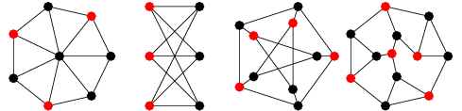
Independent Set (IS) Problem
An independent set in a graph is a set of vertices such that no two vertices in the set are adjacent.
In the example below the red vertices are in the independent set.
Problem is: Does a given graph have an independent set of size>= K?

Slide 23
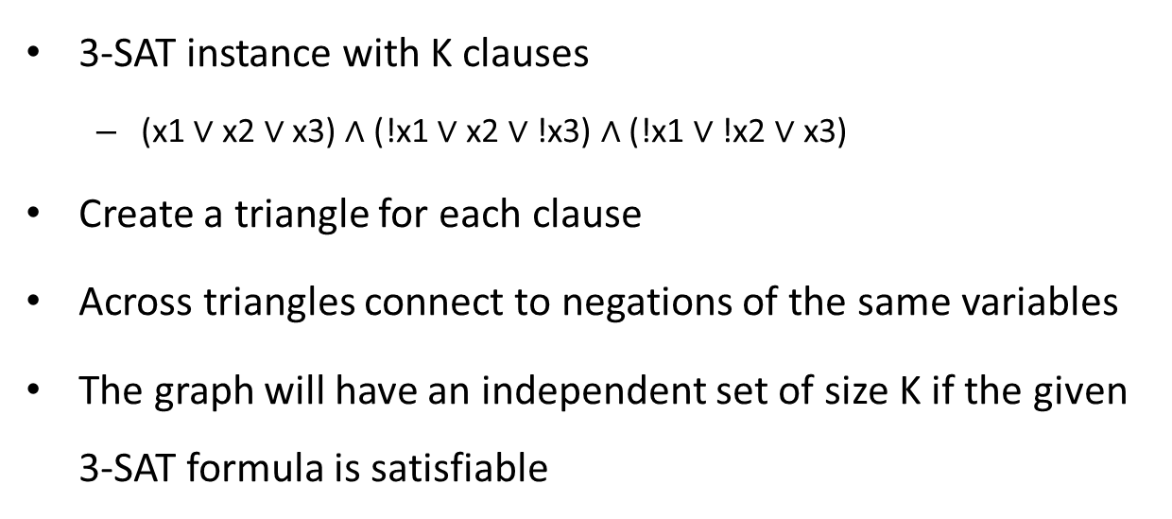
Reduce 3-SAT to IS (3-SAT ≤_{p} IS)
3-SAT instance with K clauses
(x1 $∨$ x2 $∨$ x3) $∧$ (!x1 $∨$ x2 $∨$ !x3) $∧$ (!x1 $∨$ !x2 $∨$ x3)
Create a triangle for each clause
Across triangles connect to negations of the same variables
The graph will have an independent set of size K if the given 3-SAT formula is satisfiable
!x1
!x1
x1
!x2
x3
x3
x2
!x3
x2

Slide 24
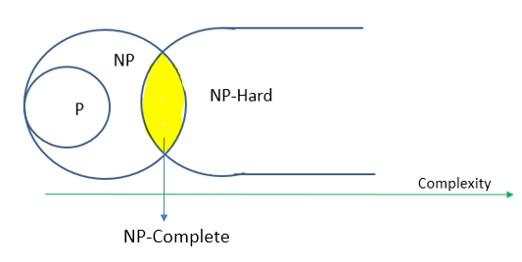
Why Independent Set (IS) is NP-Complete?
IS problem is in NP_Complete if:
IS is in NP and
IS is in NP-Hard
IS is in NP: Given a subset 𝑆⊆𝑉, we can verify in polynomial time that no two vertices in 𝑆 are adjacent and ∣𝑆∣=𝑘
We know that if L₁ ≤_{p} L₂ then L₂ is at least as hard as L₁
We showed that 3-SAT ≤_{p} IS
Cook’s Theorem: 3-SAT is in NP-Complete
So, IS is also NP-Complete
IS is at least as hard as 3-SAT

Slide 25
Cook’s Theorem
Every problem in NP can be reduced to the Boolean Satisfiability problem (SAT) in polynomial time.
Satisfiability is in NP-Complete but if we can find a deterministic solution for that then it will be in P Then P=NP
P=NP if and only if Satisfiability is in P

Slide 26
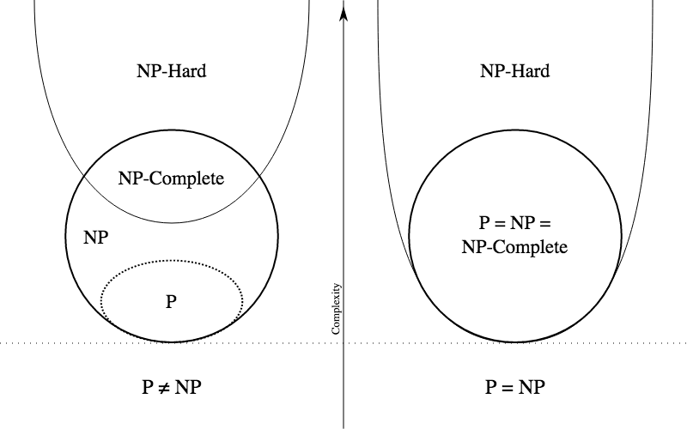
Is P=NP?
Nobody knows!
If we can solve one problem in the NP-complete set in polynomial time, we can solve all problems in the NP-complete set in polynomial time

