Slide 1
Starting up a Restaurant - Mumbai
Varun Mahesh
Coursera Applied Data Science Capstone Project

Slide 2
Introduction
Objective
Identify suitable region to setup a restaurant in Mumbai, India.
Process
Acquiring Geographical Data for Mumbai
Analyzing Venues through Foursquare API
Clustering Data Using K-Means
Identifying potential sites for setting up the restaurant
Audience
Prospective entrepreneurs exploring the restaurant space in Mumbai.

Slide 3
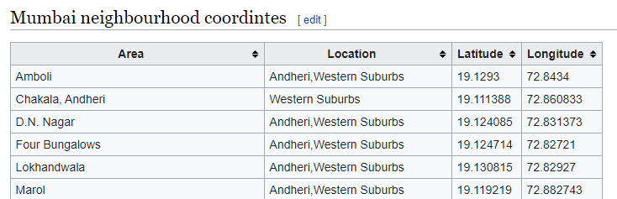
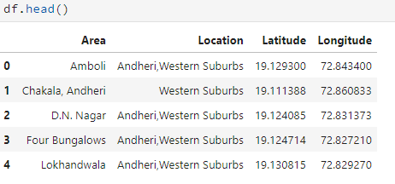
Data Acquisition and Wrangling
Preliminary Geographical Data on Mumbai Neighborhoods
https://en.wikipedia.org/wiki/List_of_neighbourhoods_in_Mumbai

Slide 4
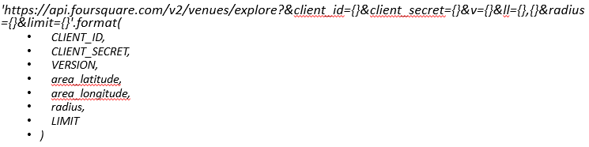
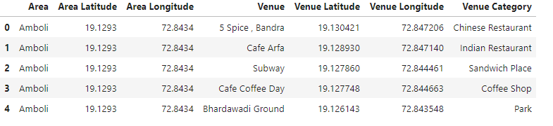
Data Acquisition and Wrangling
Foursquare API
Called to obtain Venue Data for each Neighborhood
Interested in Venue Name and Venue Category
Constraints:
Limit of 100 venues per call
Radius of 1000m from center of each Neighborhood
URL for Foursquare API Call
Dataframe obtained after Foursquare API Call

Slide 5
Methodology
Create primary dataframe from Wikipedia Data
Call Foursquare API for venues around each neighborhood
Filter Venues by Restaurants
Cluster Restaurants using k-Means Clustering (10 Clusters)
Visualize distribution through Folium
Identify potential spaces for setting up restaurant

Slide 6
Assumptions & Limitations
Property rents assumed to be uniform
Purchasing power assumed to be uniform
Procurement channels not considered
Scope for further filtering through:
Restaurant Type
Accessibility to public transport
Proximity to Residential centres

Slide 7
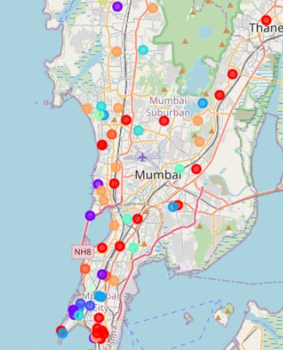
Results and Discussion
High Density of Restaurants in South and West Mumbai
Regions highlighted in the figure have sparsely distributed restaurants
Agreement with conventional wisdom that North and East Mumbai are developing regions
Conclusion
High potential to set up restaurants in North and East Mumbai
Provided assumptions & limitations are considered
N
Distribution obtained after performing K-Means Clustering

