Slide 1
Towards Network-Aware Resource Provisioning in Kubernetes for Fog Computing Applications
Abdul Ahad Ayaz

Slide 2
Outline
What is IoT and Fog Computing?
Why using Kubernetes for Fog Computing Applications?
What are the main components of Kubernetes?
How Kubernetes schedule resources and its drawbacks?
New scheduling technique
Comparison of new scheduling technique with other solutions
Conclusion

Slide 3
What is IoT and Fog Computing?

Slide 4
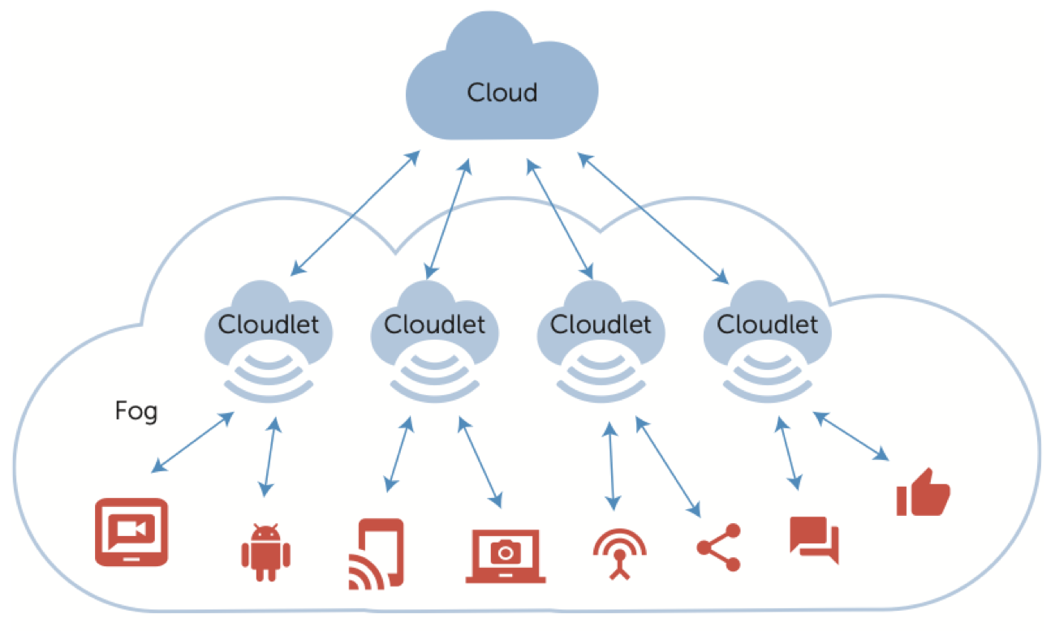
Fog Computing
Concept of Fog Compuing
IoT based Applications
IoT Application Resource:
VM
Containers
Fog Computing vs Cloud Computing
Cloud: OpenStack, AWS
Containers: Kubernetes, Docker Swarn

Slide 5
Why using Kubernetes for Fog Computing Applications?

Slide 6
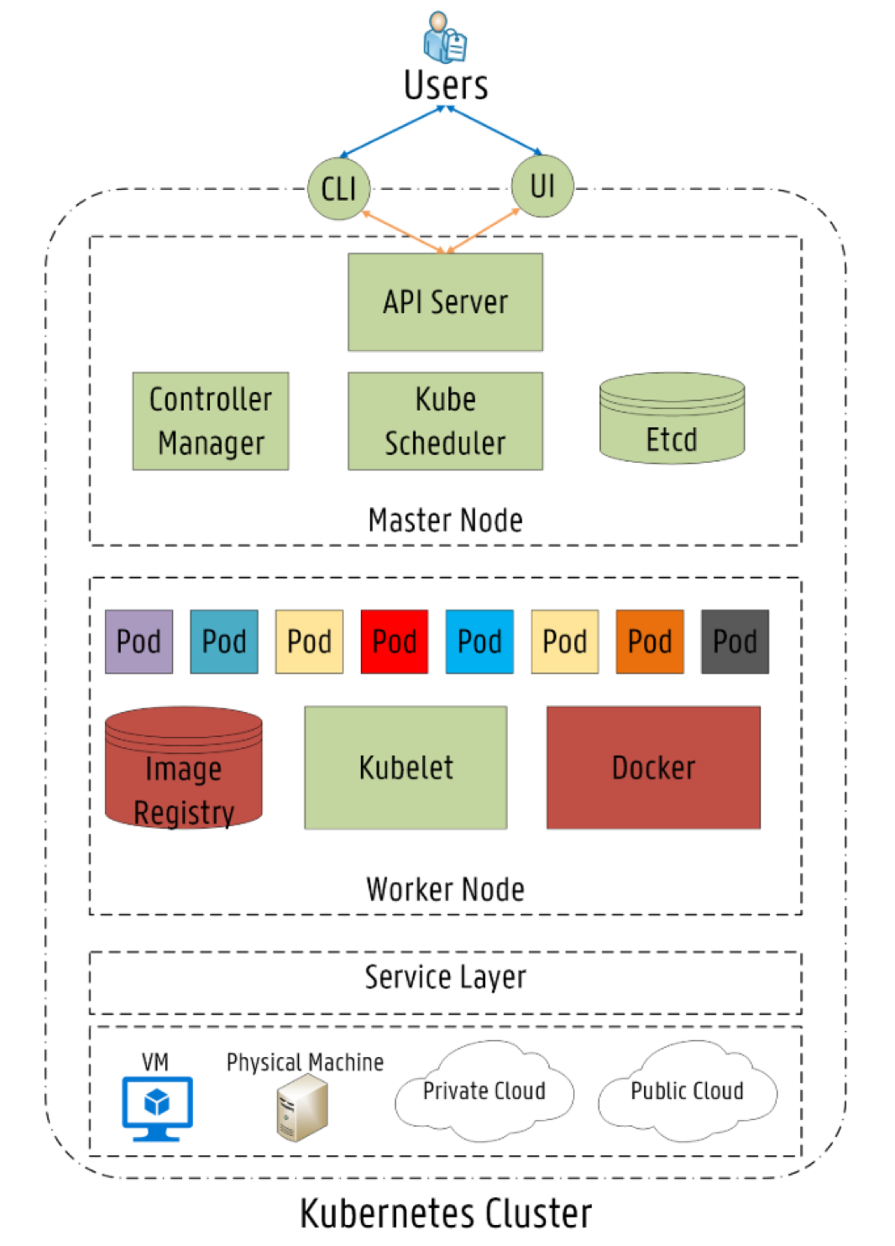
Kubernetes
Architecture
Master Node
Worker Node
Main Components
Controller Manager
Kube Scheduler
Kubelets
Image Registry
Orchestration
Starting/stoping of applications
Scalabilty of applications
Load management
Health monitoring

Slide 7
How Kubernetes schedule resources and its drawbacks?

Slide 8
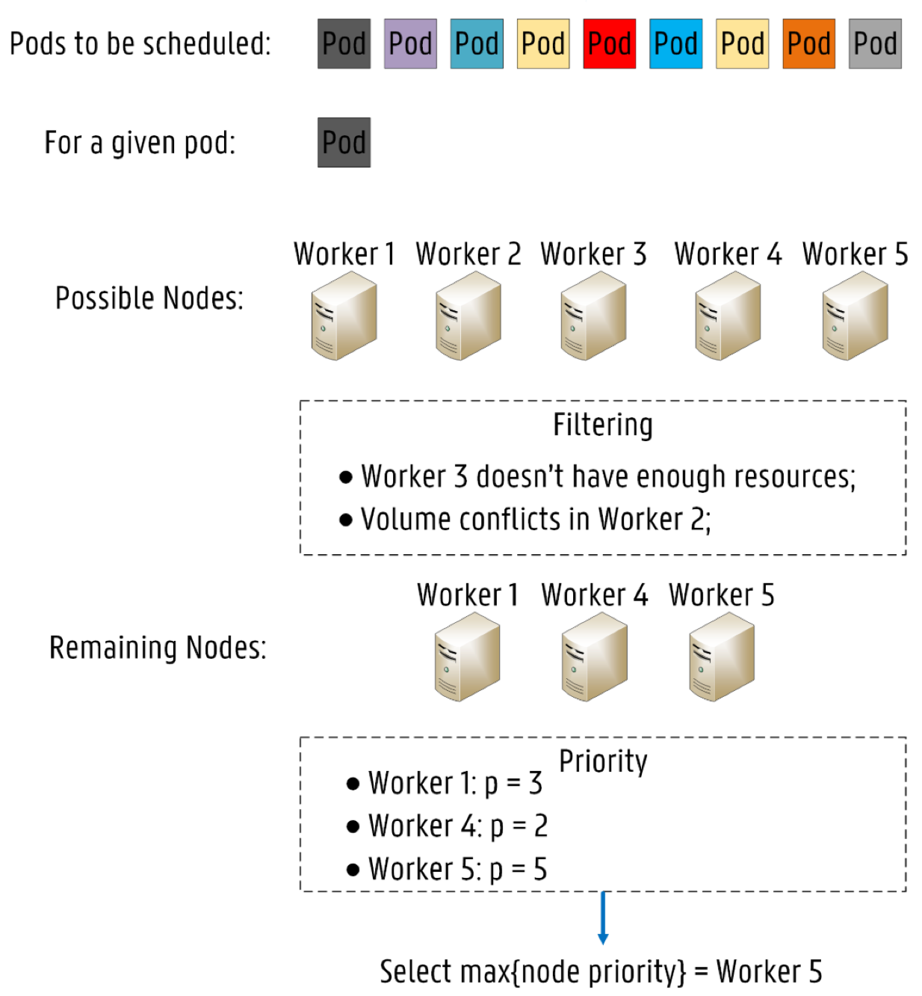
Kubernetes Resource Provisioning
Default Scheduler: “Kube Scheduler”
Used for Pod deployment across Worker Nodes
Node selection criteria:
Node Filtering
Pod Fits Host Ports
Pod Fits Resources
Node Priority/Scoring
Least Request Priority
Image Locality Priority
Drawbacks
No network resources consideration

Slide 9
Need for New Scheduling Technique

Slide 10
How to Add New Scheduling Technique?
Building new scheduler from scratch
Extending Kube Scheduler
Adding new filters or priorities
Calling external scheduling process by Kube Scheduler

Slide 11
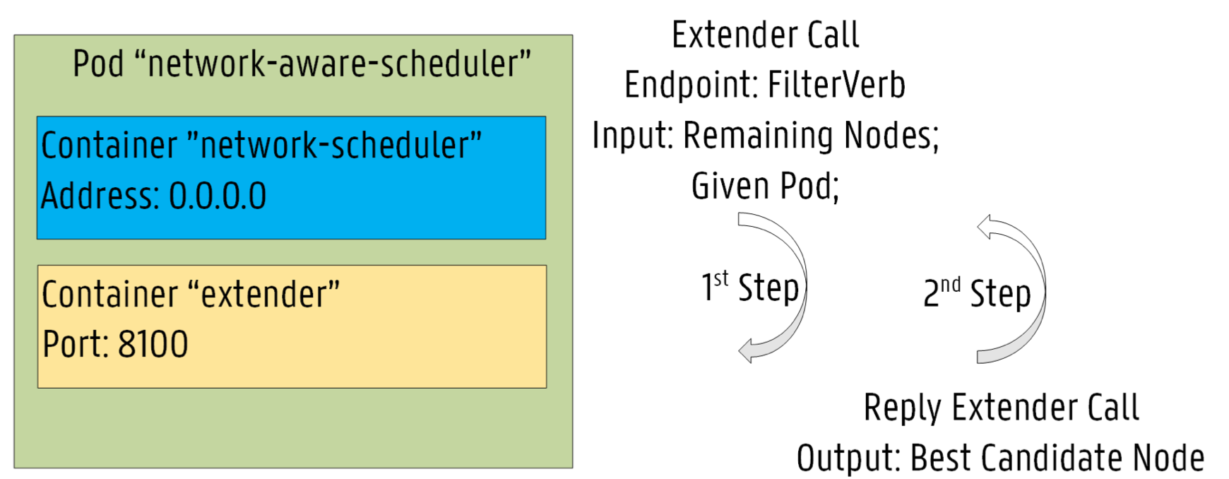
Network-Based Scheduler
Implemented using Go Language
Deployed as Pod with two container
Extender
Network-scheduler
Node Selection Criteria
Minimum Round Trip Time (RTT)
Enough Bandwidth support

Slide 12
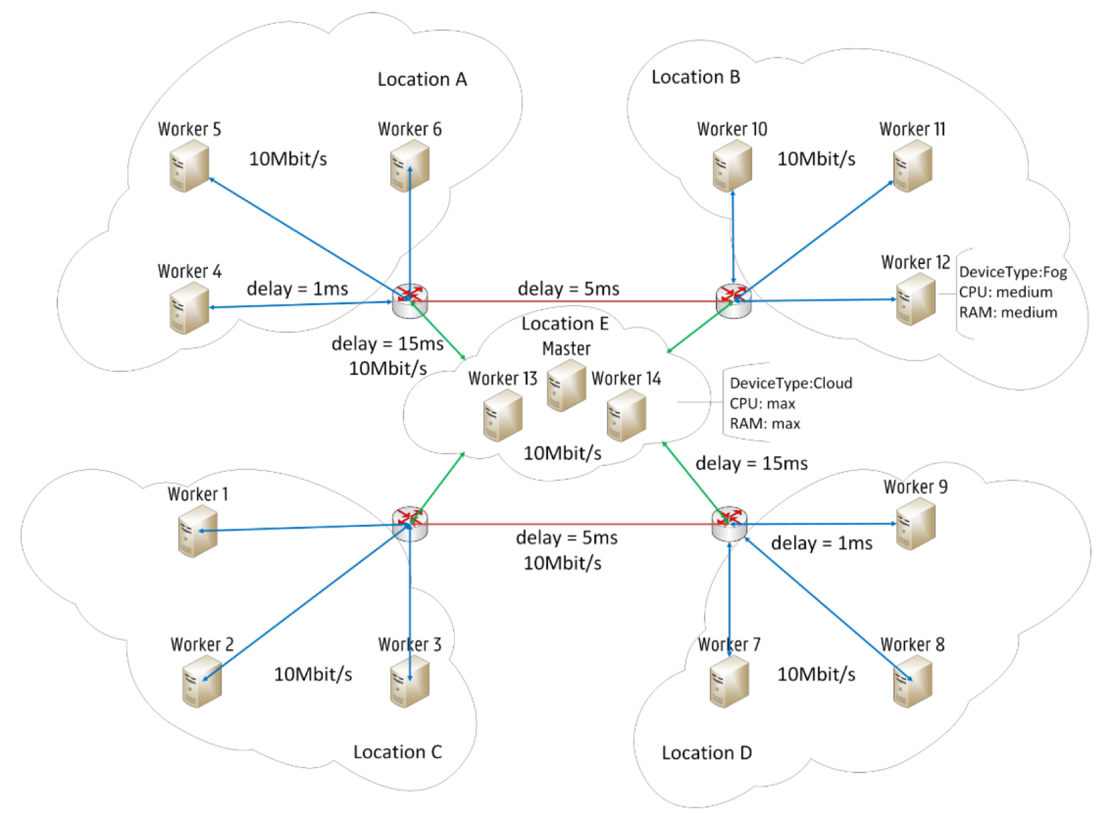
Fog Computing Infrastructure
Labeling of Infrastructure using Affinity/Anti-Affinity rule
Node labeling for resources
Resource: CPU, Memory -> {Min, High, Medium}
Device Type: {Fog, Cloud}
Network delay: RTT tags

Slide 13
Comparison of new scheduling technique with other solutions

Slide 14
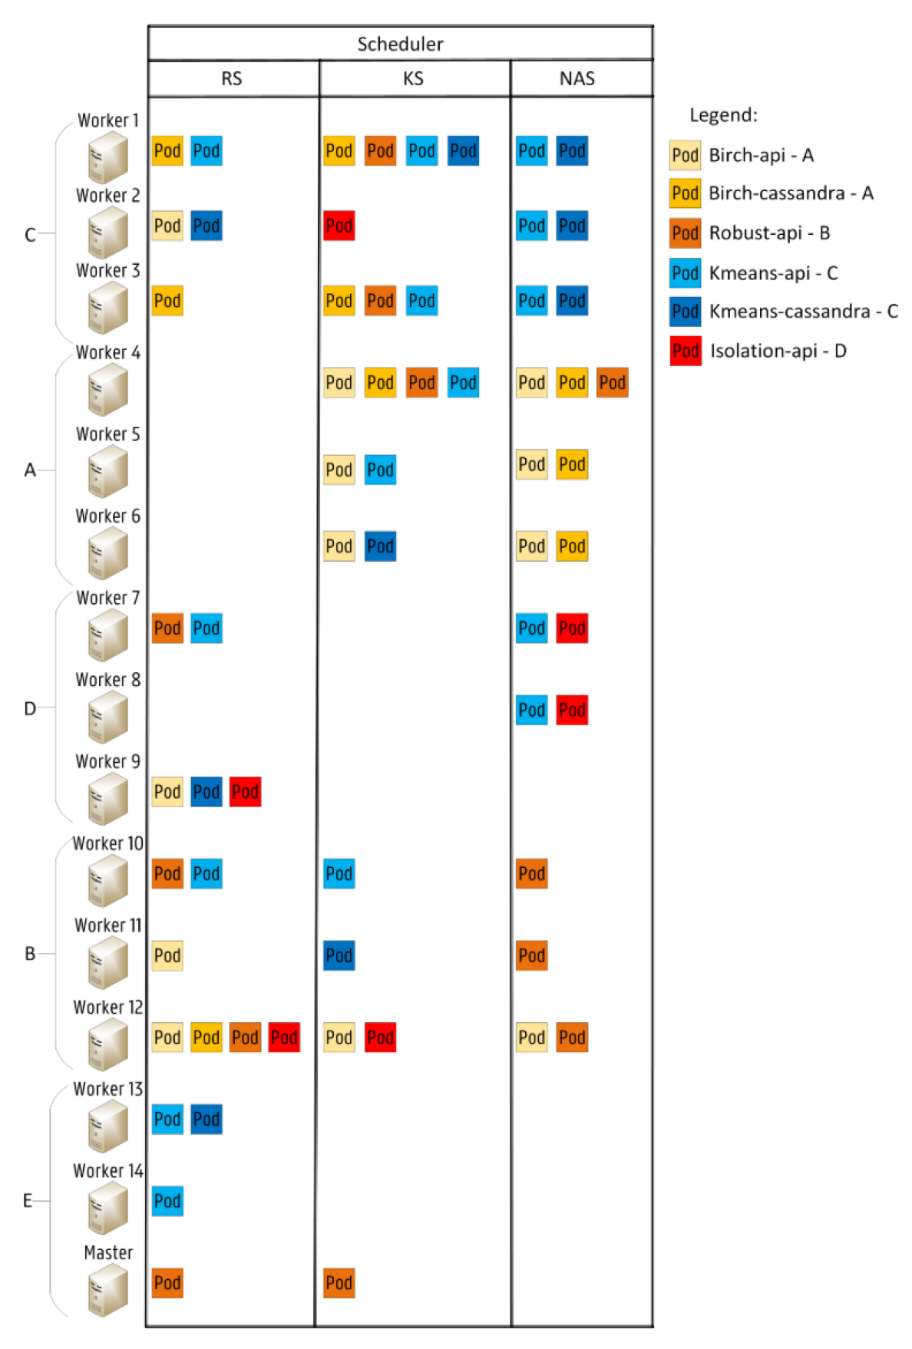
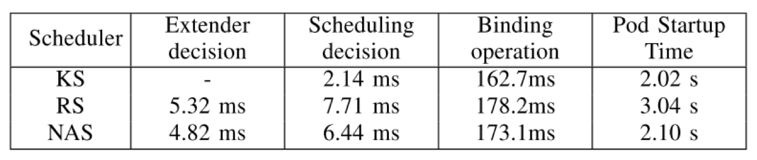
Evaluation of Network-based Scheduler
Smart City Scenario
Collection of air quality data
Comparison of Three Schedulers
Kube Scheduler
Network-based Scheduler
Random Scheduler

Slide 15
Comparsion
Based on Orchestrator
Fogernetes
Docker Swarm
Based on Scheduling Techniques
Scheduler [5]
DYSCO [6]

Slide 16
Conclusion
Network-based Scheduler adds extra execution time
Optimized technique considering default scheduler
Works along side the default scheduler

Slide 17
References
[1] J. Santos, T. Wauters, B. Volckaert, and F. De Turck. “Towards network-Aware resource provisioning in kubernetes for fog comput- ing applications”. In: http : / / physics . nist.gov/Document/sp811.pdf. IEEE Conference on Network Softwarization Un- leashing the Power of Network Softwariza- tion, NetSoft 2019, 2019.
[2] L. F. Bittencourt, J. Diaz-Montes, R. Buyya, O. F. Rana, and M. Parashar. “Mobility- Aware Application Scheduling in Fog Com- puting”. In: (2017). https://ieeexplore. ieee.org/document/7912261
[3] C. Wöbker, A. Seitz, H. Mueller, and B. Bruegge. “Fogernetes: Deployment and man- agement of fog computing applications”. In: https : / / ieeexplore . ieee . org / document / 8406321. IEEE/IFIP Network Operations and Management Symposium: Cognitive Management in a Cyber World, NOMS 2018, 2018.
[4] A. Reale, P. Kiss, M. Tóth, and Z. Horváth. Designing a decentralized container based Fog computing framework for task distribu- tion and management. Tech. rep. http:// www.naun.org/main/UPress/cc/2019/ a022012-044.pdf. 2019.
[5] D. Haja, M. Szalay, B. Sonkoly, G. Pongracz, and L. Toka. “Sharpening Kubernetes for the Edge”. In: https://dl.acm.org/doi/ 10.1145/3342280.3342335. SIGCOMM 2019 - Proceedings of the 2019 ACM SIG- COMM Conference Posters and Demos, Part of SIGCOMM 2019, 2019
[6] L. Mittermeier, F. Katenbrink, A. Seitz, H. Muller, and B. Bruegge. “Dynamic schedul- ing for seamless computing”. In: https : / / ieeexplore . ieee . org / stamp / stamp . jsp ? tp = &arnumber = 8567371. Proceedings-8th IEEE International Sympo- sium on Cloud and Services Computing, SC2 2018, 2018.

