Slide 1
Towards Network-Aware Resource Provisioning in Kubernetes for Fog Computing Applications
Abdul Ahad Ayaz

Slide 2
Outline
What is IoT and Fog Computing?
Why using Kubernetes for Fog Computing Applications?
What are the main components of Kubernetes?
How Kubernetes schedule resources and its darwbacks?
New scheduling technique.
Comparison of new scheduling technique with default scheduler.
Conclusion and Future work.

Slide 3
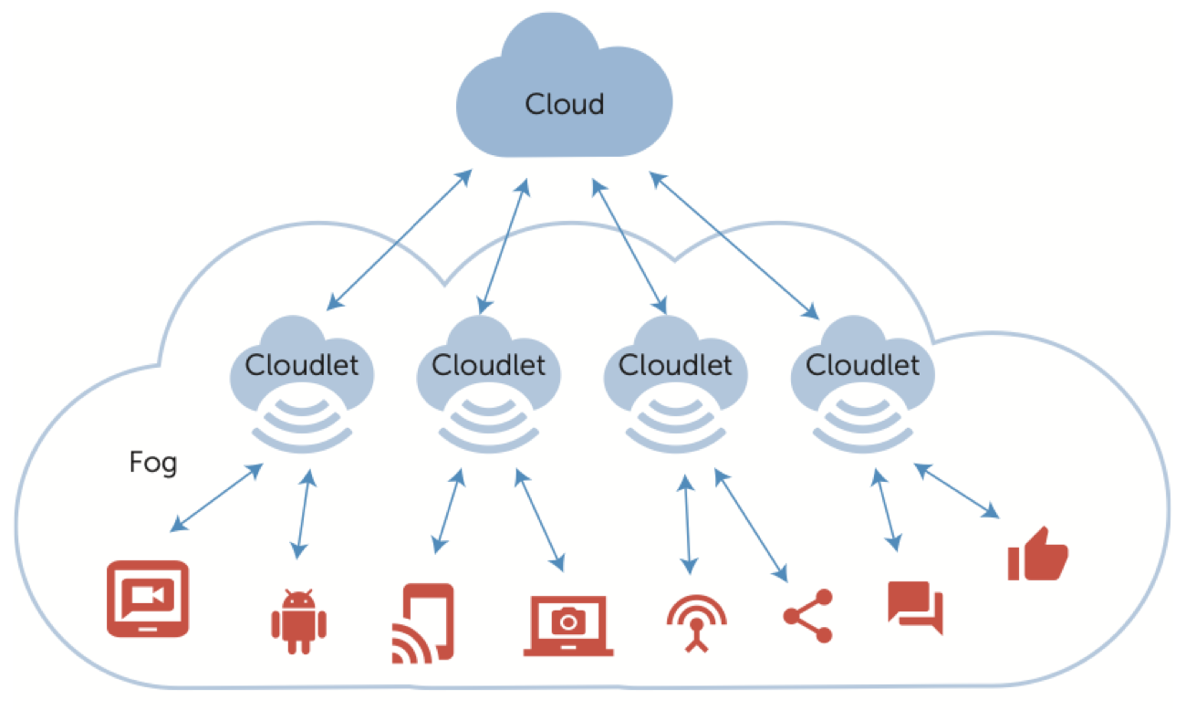
Fog Computing
Idea
IoT based Applications
IoT Application Resource:
VM
Containers
Fog Computing vs Cloud Computing
Cloud Infrastructure: OpenStack, AWS

Slide 4
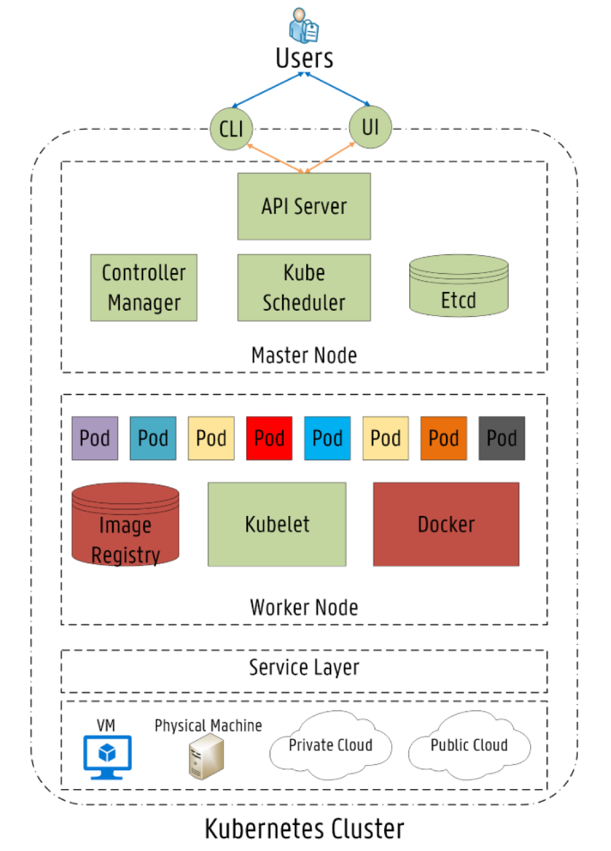
Kubernetes
Architecture
Master Node
Worker Node
Main Components
Orchestration

Slide 5
Kubernetes Resource Provisioning
Default Scheduler: “Kube Scheduler”
Used for Pod deployment across Worker Nodes
Node selection criteria:
Node Filtering
PodFitsHostPorts
PodFitsResources
Etc.
Node Priority/Scoring
LeastRequestPriority
ImageLocalityPriority
Etc.
Drawbacks
No network resources consideration

Slide 6
Network-Based Scheduler
Extending Kube Scheduler
Adding new filters or priorities
Building new scheduler from scratch
Calling external scheduling process by Kube Scheduler
Uses “Affinity/Anti-Affinity rule” and Node labeling

