Slide 1
Towards Network-Aware Resource Provisioning in Kubernetes for Fog Computing Applications
Abdul Ahad Ayaz

Slide 2
Outline
What is IoT and Fog Computing?
Why using Kubernetes for Fog Computing Applications?
What are the main components of Kubernetes?
How Kubernetes schedule resources and its darwbacks?
New scheduling technique.
Comparison of new scheduling technique with other solutions.
Conclusion.

Slide 3
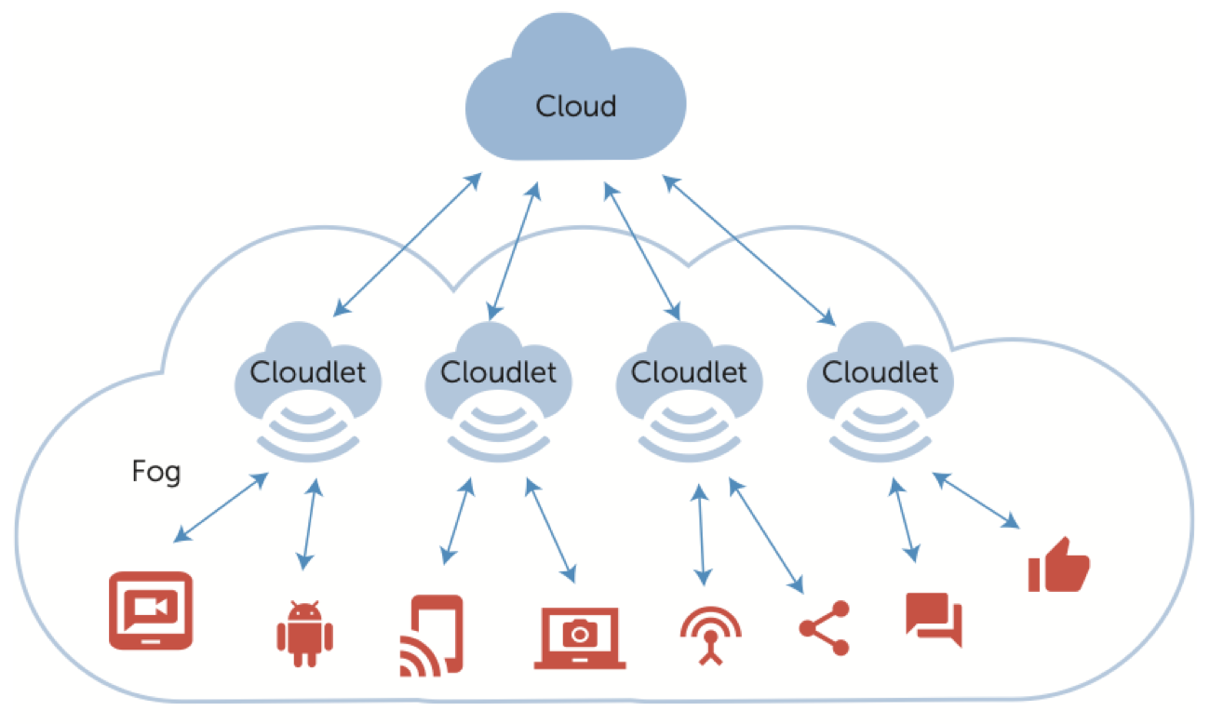
Fog Computing
Concept of Fog Compuing
IoT based Applications
IoT Application Resource:
VM
Containers
Fog Computing vs Cloud Computing
Cloud: OpenStack, AWS
Containers: Kubernetes, Docker Swarn

Slide 4
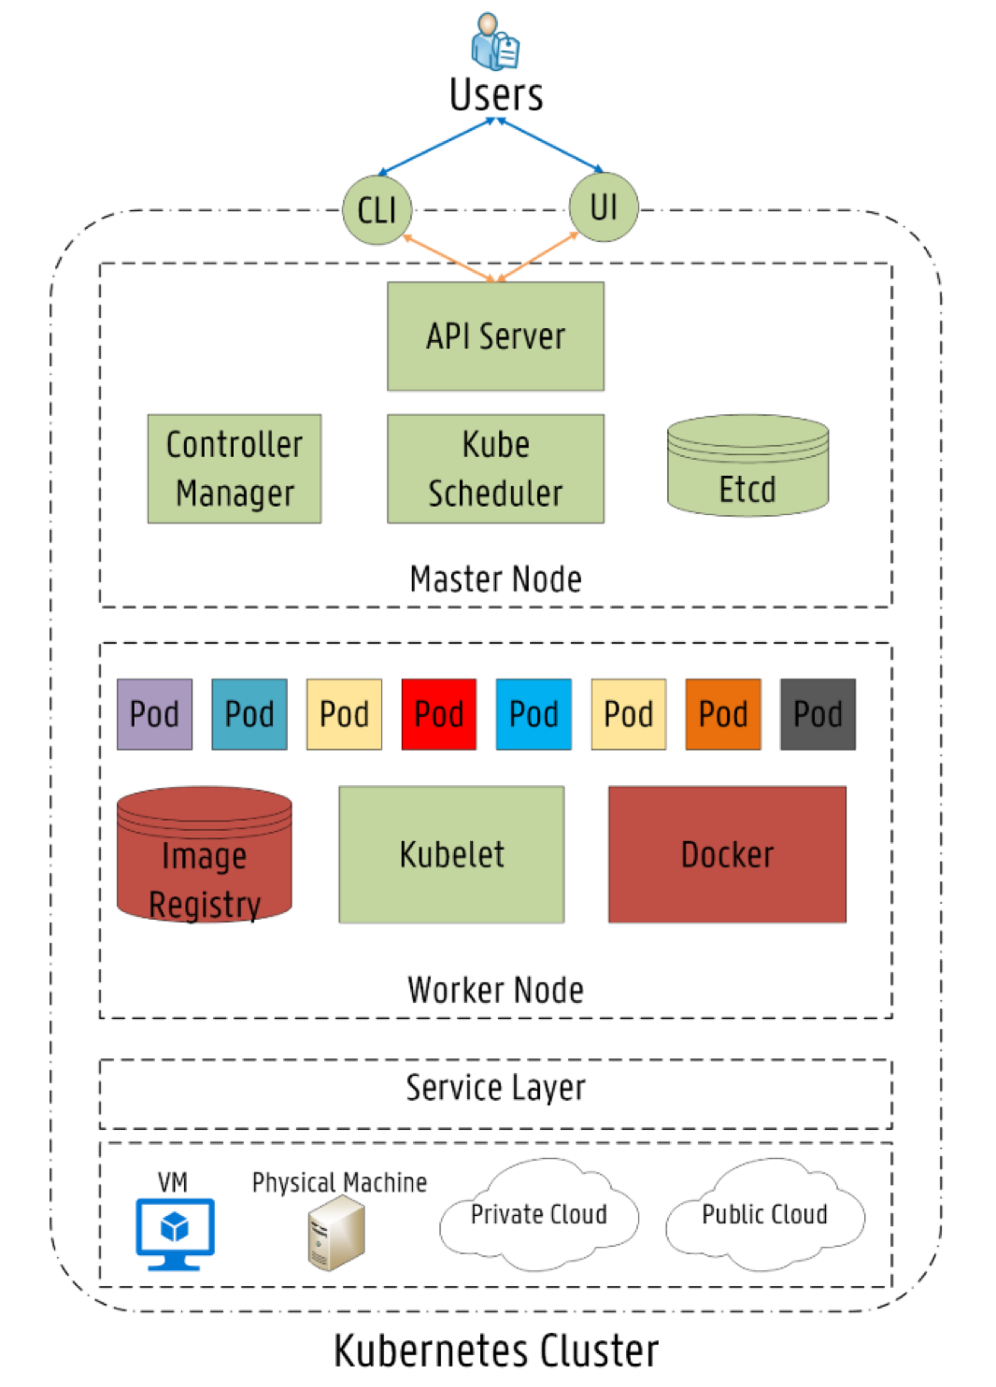
Kubernetes
Architecture
Master Node
Worker Node
Main Components
Controller Manager
Kube Scheduler
Kubelets
Image Registry
Orchestration
Starting/stoping of applications
Scalabilty of applications
Load management
Health monitoring

Slide 5
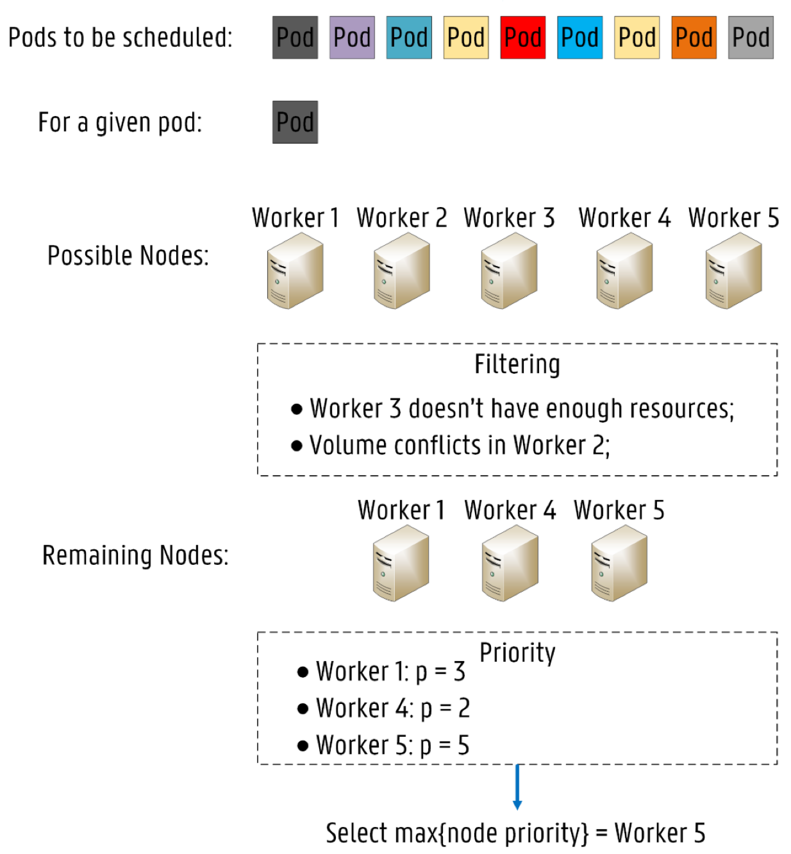
Kubernetes Resource Provisioning
Default Scheduler: “Kube Scheduler”
Used for Pod deployment across Worker Nodes
Node selection criteria:
Node Filtering
PodFitsHostPorts
PodFitsResources
Etc.
Node Priority/Scoring
LeastRequestPriority
ImageLocalityPriority
Etc.
Drawbacks
No network resources consideration

Slide 6
Network-Based Scheduler
Extending Kube Scheduler
Adding new filters or priorities
Building new scheduler from scratch
Calling external scheduling process by Kube Scheduler
Uses “Affinity/Anti-Affinity rule”
Uses Node labeling for resources
Resource: CPU, Memory -> {Min, High, Medium}
Device Type: {Fog, Cloud}
Network delay: RTT tags

Slide 7
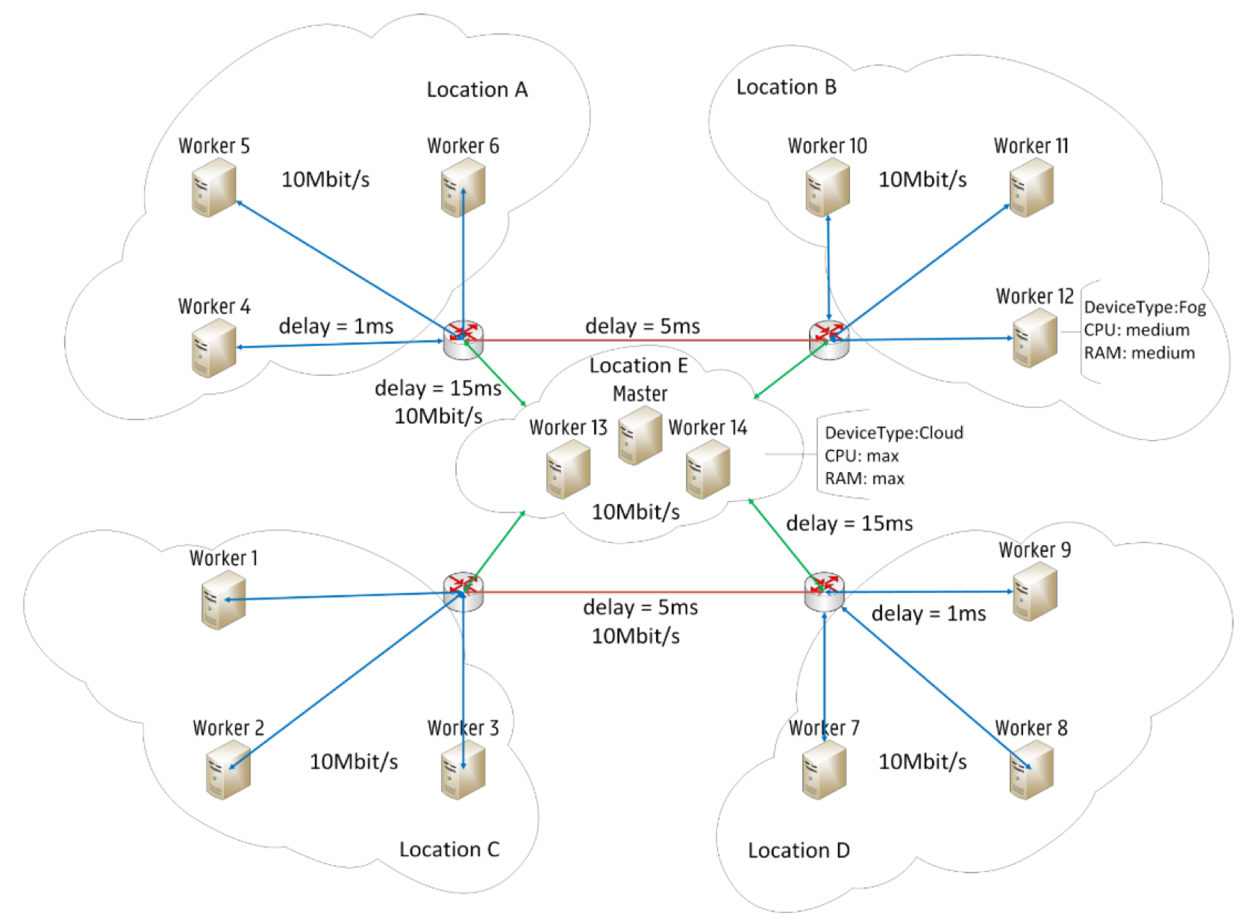
Fog Computing Infrastructure

Slide 8
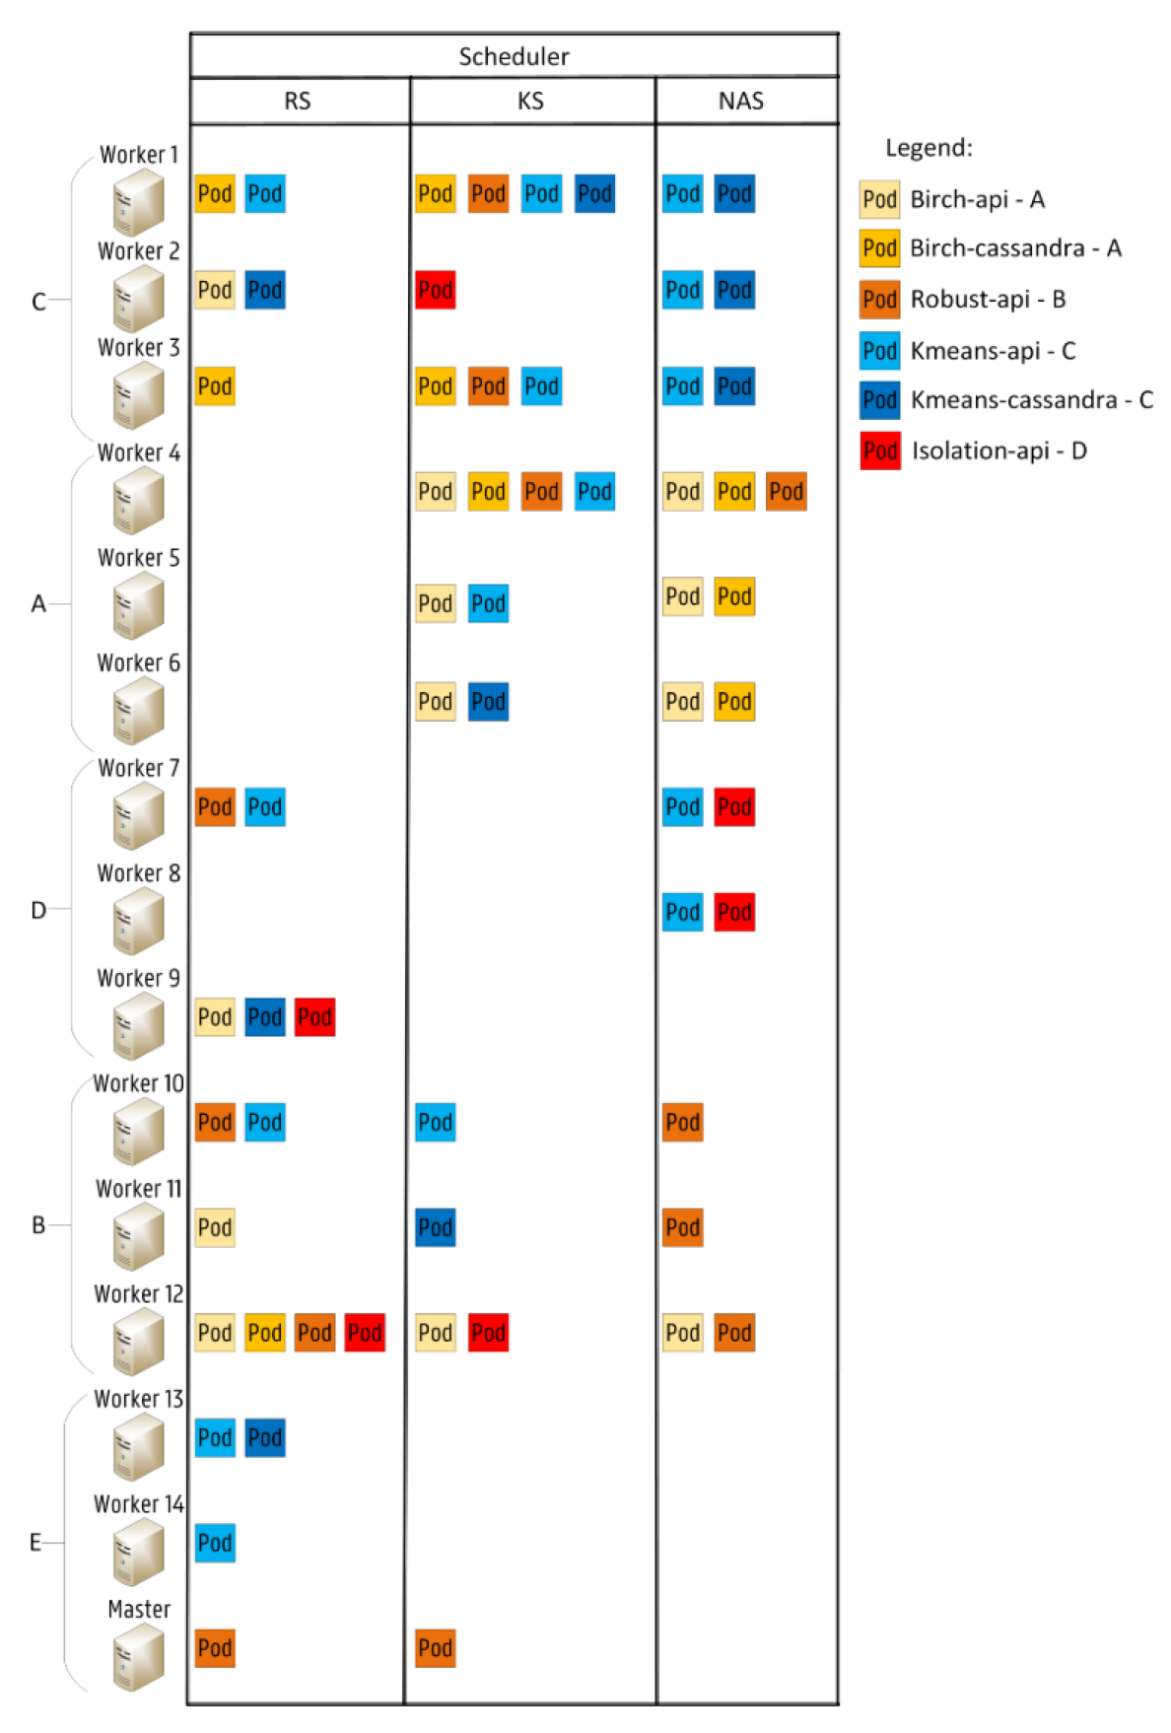
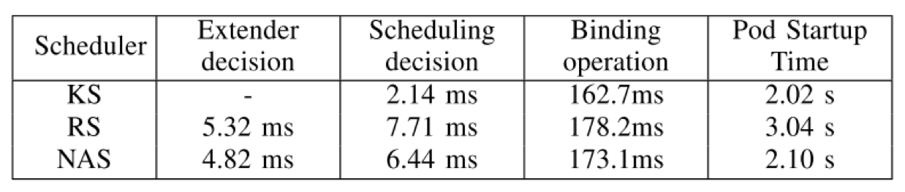
Evaluation of Network-based Scheduler
Smart City Scenario
Comparison of Three Schedulers
Kube Scheduler
Network-based Scheduler
Random Scheduler

Slide 9
Comparsion
Based on Orchestrator
Fogernetes
Docker Swarm
Based on Scheduling Techniques
Technique One [paper ref]
Techniques Two [paper ref]

Slide 10
Conclusion
Conclusion
Network-based Scheduler adds extra execution time
Optimized technique considering default scheduler
Works along side the default scheduler

Slide 11
References
Added after advisor reviews

