Slide 1
AINFV: Analysis of Isolation (memory/packet) in Network Function Virtualization
Abdul Ahad Ayaz
Notes:
Everyone introduce themselves?
<number>

Slide 2
Network Function Virtualization (NFV)
What is NFV?
Why we use NFV?
What are the requirement of NFV?
Issues of Using NFV
Executing NFs
Developing NFs

Slide 3
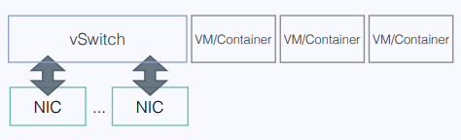
Executing NFs
Isolation vs Performance
Types of Isolation
Memory Isolation
Packet Isolation
Current Approach
Using VMs or Containers
[10]

Slide 4
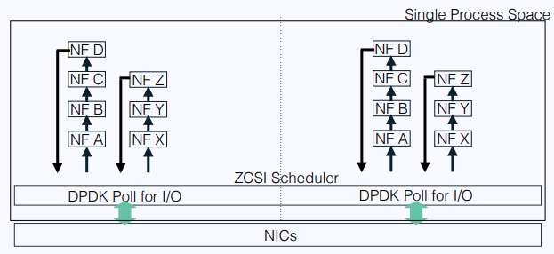
Executing NFs
NetBricks[1]
Execution Environment
Single Process Space
Isolation using Zero Copy Soft Isolation (ZCSI)[1]
Packet Isolation : Unique Types
Memory Isolation : Type checks and array bounds checks
NetBricks Architecture[10]

Slide 5
Developing NFs
High-Level Programming Language vs Performance
Current Approach
More focused on Low-level code
Spending a lot of time on optimization
NetBricks
Modular code
Separate common functionality and User-defined functionality

Slide 6
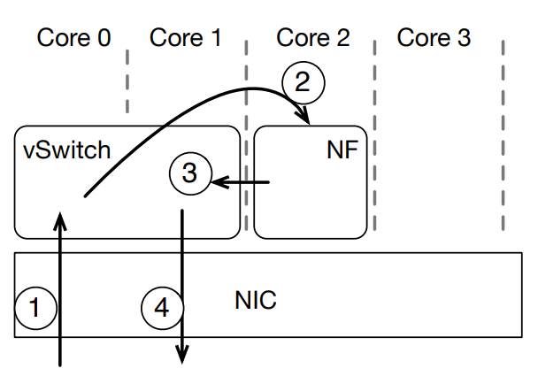
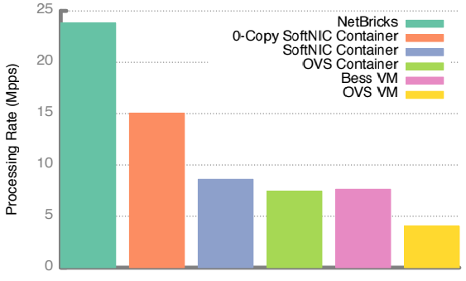
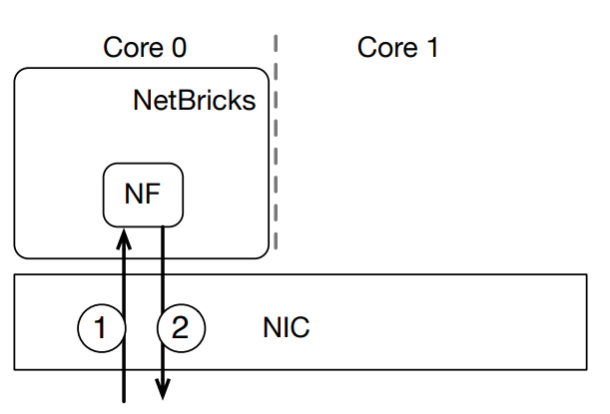
Isolation Analysis
Simple NF vs NF chains vs Complex NF
Simple NF
Swaps source and destination address of receiving packets.
For VM/Container[1]
For NetBricks[1] Throughput achieved using different Isolation techniques [1]

Slide 7
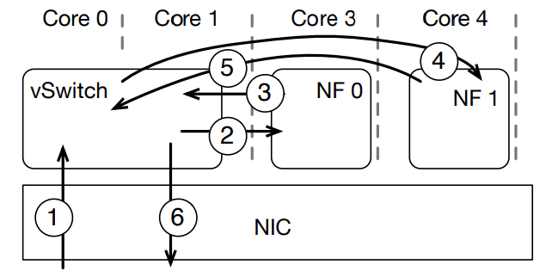
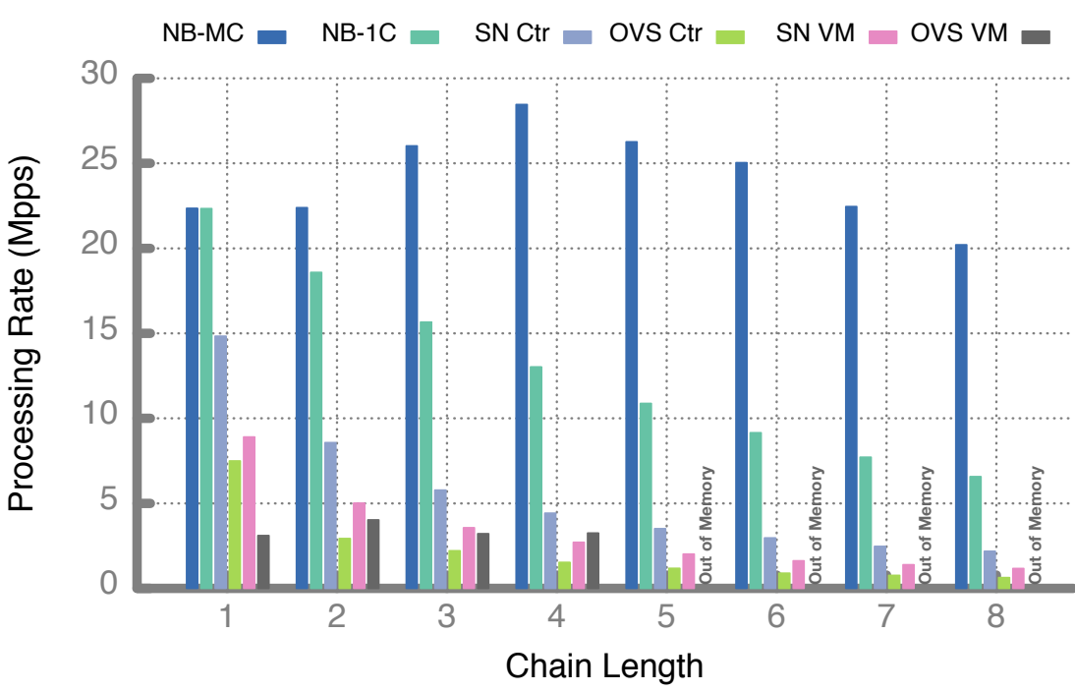
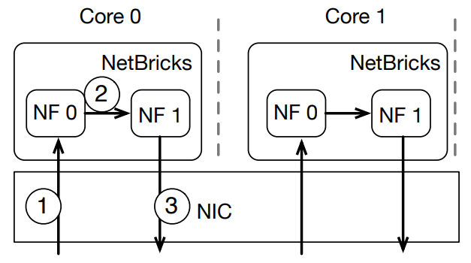
Isolation Analysis
Simple NF vs NF chains vs Complex NF
NF chains
Multiple instances of Packet TTL (time to live) = 0 NFs.
Two cases:
Single-core
Multi-core
For VM/Container[1]
Throughput analysis [1] For NetBricks[1]

Slide 8
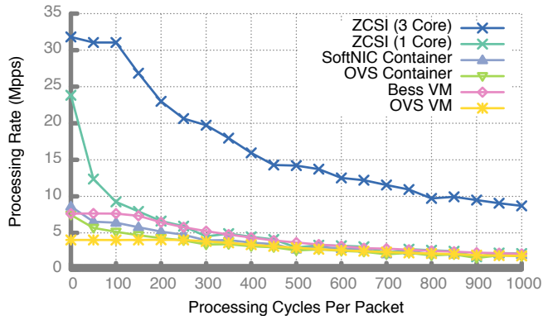
Isolation Analysis
Simple NF vs NF chains vs Complex NF
Complex NF
Simple NF used with increased computation time per packet.
Two cases:
Single-core
Three-cores
Throughput of complex NF using different technologies[1]

Slide 9
Related Frameworks
Developing NF
YANFF[2]
libVNF[3]
FLICK[4]
Executing NF
NetVm[5] / OpenNetVM[6]
HyperNF[7]
G-NET[8]
Isolation
SafeBricks[9]

Slide 10
Conclusion & Further Research
Conclusion
Isolation is necessary for NFV
VM/Container ensures isolation but at the cost of Performance degradation
NetBricks runs NF as a single process
Ensures both memory and packet isolation
Further Research
Add control plane functionality to NetBricks
NetBricks integration with MANO systems

Slide 11
References
[1] A. Panda, S. Han, K. Jang, M. Walls, S. Ratnasamy, and S. Shenker,“NetBricks: Taking the V out of NFV.” in OSDI’16, 2016, pp. 203–216. [Online]. Available: https://www.usenix.org/conference/osdi16/technical-sessions/presentation/panda
[2] I. Philippov and A. Melik-Adamyan, “Novel approach to network function development,” in Proceedings of the 13th Central & Eastern European Software Engineering Conference in Russia on -CEE-SECR ’17. ACM Press, 2017, pp. 1–6. [Online]. Available: http://dl.acm.org/citation.cfm?doid=3166094.3166111
[3] P. Naik, A. Kanase, T. Patel, and M. Vutukuru, “libVNF: A Framework for Building Scalable High Performance Virtual Network Functions,” in Proceedings of the 8th Asia-Pacific Workshop on Systems - APSys ’17. ACM Press, 2017, pp. 212–224. [Online]. Available: http://dl.acm.org/citation.cfm?doid=3124680.3124728
[4] A. Alim, R. G. Clegg, L. Mai, L. Rupprecht, E. Seckler, P. Costa, P. Pietzuch, A. L. Wolf, N. Sultana, J. Crowcroft, A. Madhavapeddy, A. W. Moore, R. Mortier, M. Koleni, L. Oviedo, M. Migliavacca, and D. McAuley, “FLICK: Developing and running application-specific network services,” in 2016 USENIX Annual Technical Conference (USENIX ATC 16). Denver, CO: USENIX Association, 2016, pp. 1–14. [Online]. Available: https://www.usenix.org/conference/atc16/technical-sessions/presentation/alim

Slide 12
References
[5] J. Hwang, K. K. Ramakrishnan, and T. Wood, “NetVM: High performance and flexible networking using virtualization on commodity platforms,” IEEE Transactions on Network and Service Management, vol. 12, no. 1, pp. 34–47, mar 2015. [Online]. Available: http://ieeexplore.ieee.org/document/7036139/
[6] M. Yurchenko, P. Cody, A. Coplan, R. Kennedy, T. Wood, and K. K. Ramakrishnan, “OpenNetVM: A Platform for High Performance Network Service Chains,” in Proceedings of the 2016 workshop on Hot topics in Middleboxes and Network Function Virtualization. ACM, 2018, pp. 1–2. [Online]. Available: https://dl.acm.org/citation.cfm?id=2940155
[7] K. Yasukata, F. Huici, V. Maffione, G. Lettieri, and M. Honda,“HyperNF: building a high performance, high utilization and fair NFV platform,” pp. 157–169, 2017. [Online]. Available: http://dl.acm.org/citation.cfm?doid=3127479.3127489
[8] “G-NET : Effective GPU Sharing in NFV Systems,”2018. [Online]. Available: https://www.usenix.org/conference/nsdi18/presentation/zhang-kai
[9] R. Poddar, C. Lan, R. A. Popa, and S. Ratnasamy, “SafeBricks: Shielding Network Functions in the Cloud,” pp. 201–216, 2018. [Online]. Available: https://www.usenix.org/conference/nsdi18/presentation/poddar
[10] A. Panda, S. Han, K. Jang, M. Walls, S. Ratnasamy, and S. Shenker,“NetBricks: Taking the V out of NFV.” in OSDI’16, 2016,(Presentation). [Online]. Available: https://www.usenix.org/sites/default/files/conference/protected-files/osdi16_slides_panda.pdf

