Slide 1
AINFV: Analysis of Isolation (memory/packet) in Network Function Virtualization
Abdul Ahad Ayaz
Notes:
Everyone introduce themselves?
<number>

Slide 2
Network Function Virtualization (NFV)
What is NFV?
Why we use NFV?
What are the requirement of NFV?
Issues of Using NFV
Executing NFs
Developing NFs

Slide 3
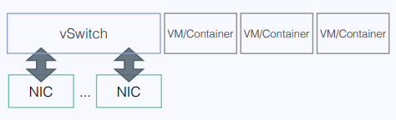
Executing NFs
Isolation vs Performance
Types of Isolation
Memory Isolation
Packet Isolation
Current Approach
Using VMs or Containers
Using vSwitch
[10]

Slide 4
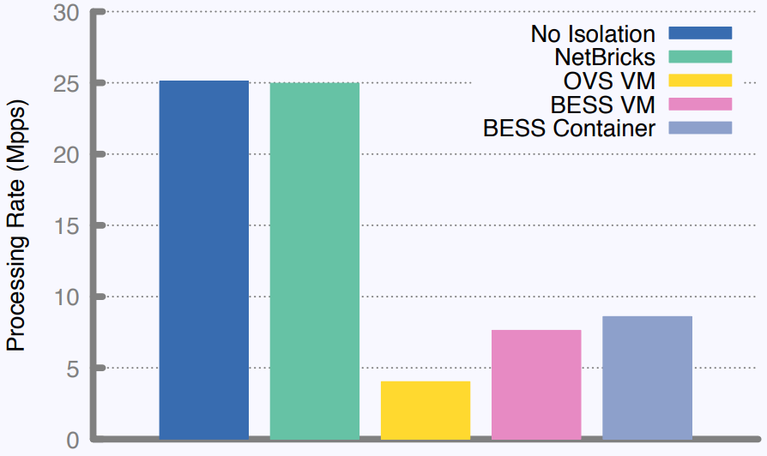
Executing NFs
Isolation vs Performance
Current Approach
Isolation costs Performance [10]

Slide 5
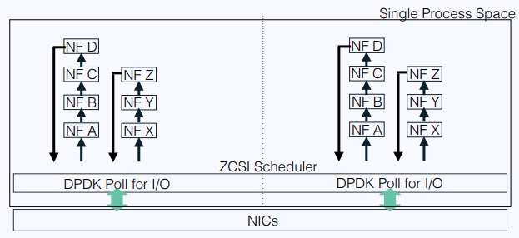
Executing NFs
NetBricks[1]
Execution Environment
Single Process Space
Isolation using software Isolation
Packet Isolation : Unique Types
Memory Isolation : Type checks and array bounds checks
NetBricks Architecture[10]

Slide 6
Executing NFs
NetBricks
Memory Isolation
Type checking at compile time
Bound checking at runtime to avoid memory overflow and underflow
Disallowing pointer arithmetic in NF code
Packet Isolation
Using Unique types to prevent data race at compile time
One NF has access to a packet at a time ensuring zero copy I/O

Slide 7
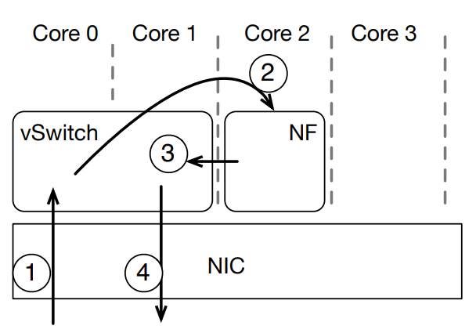
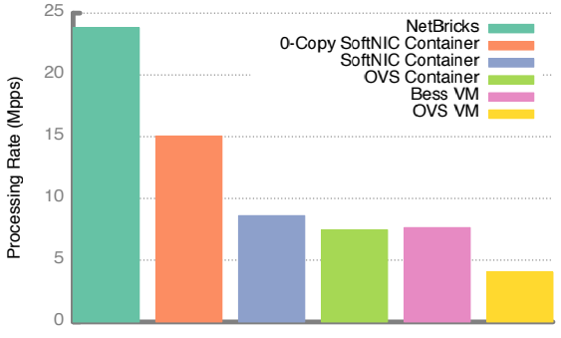
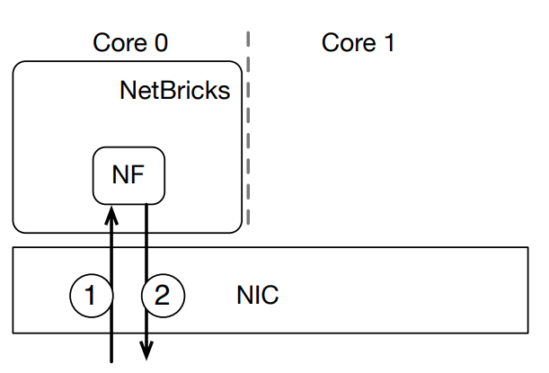
Isolation Analysis
Simple NF vs NF chains vs Complex NF
Simple NF
Swaps source and destination address of receiving packets
For VM/Container[1]
For NetBricks[1] Throughput achieved using different Isolation techniques [1]

Slide 8
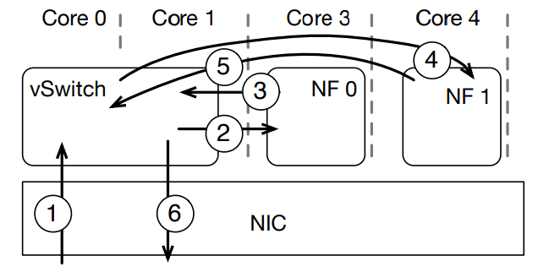
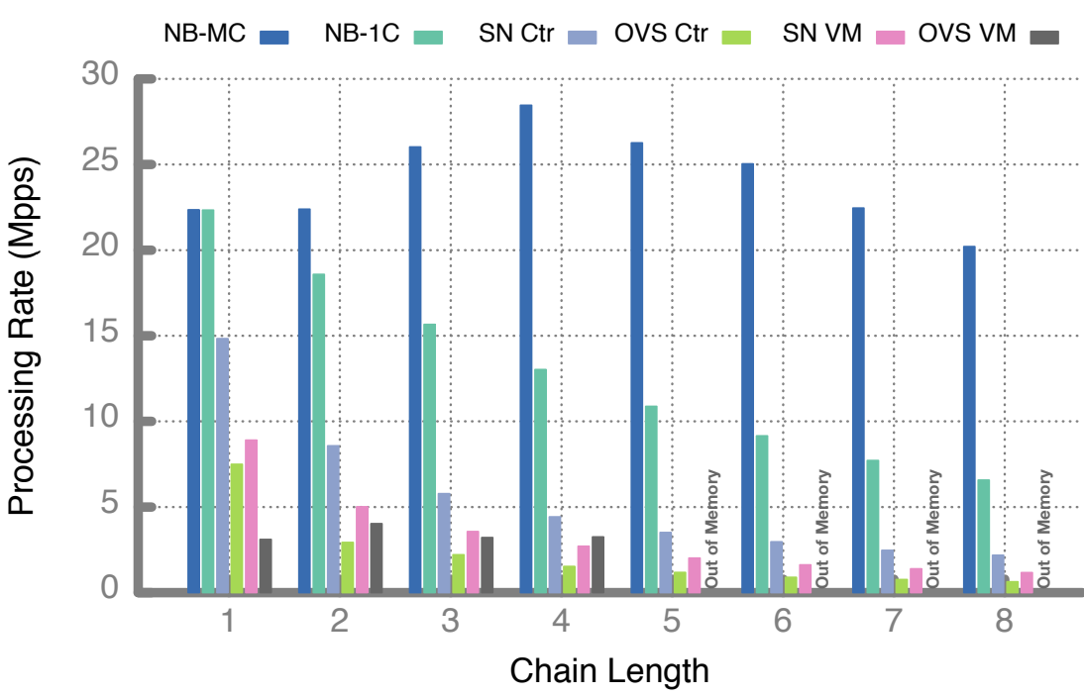
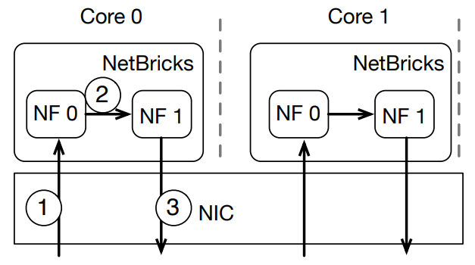
Isolation Analysis
Simple NF vs NF chains vs Complex NF
NF chains
Multiple instances of Packet TTL (time to live) = 0 NFs
Two cases:
Single-core
Multi-core
For VM/Container[1]
Throughput analysis [1] For NetBricks[1]

Slide 9
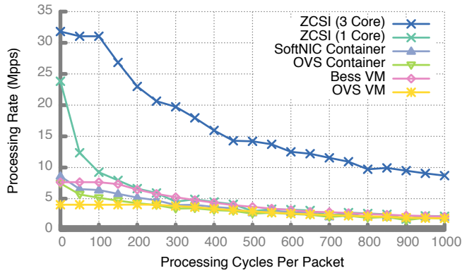
Isolation Analysis
Simple NF vs NF chains vs Complex NF
Complex NF
Simple NF used with increased computation time per packet
Two cases:
Single-core
Three-cores
Throughput of complex NF using different technologies[1]

Slide 10
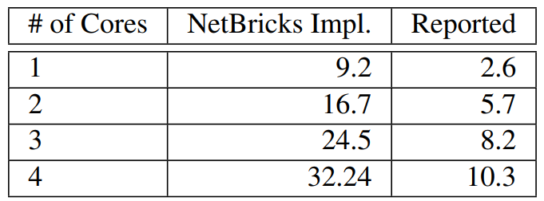
Developing NFs
High-Level Programming Language vs Performance
Current Approach
More focused on Low-level code
Spending a lot of time on optimization
NetBricks
Separate common functionality and User-defined functionality
Example NF : Maglev Load Balancer
3.2x to 2.9x better performance
Throughput in MPPS [1]

Slide 11
Related Frameworks
Developing NF
YANFF[2]
libVNF[3]
FLICK[4]
Executing NF
NetVm[5] / OpenNetVM[6]
HyperNF[7]
G-NET[8]
Isolation
SafeBricks[9]

Slide 12
Conclusion & Further Research
Conclusion
Isolation is necessary for performance of NFV
VM/Container ensures isolation but at the cost of Performance degradation
NetBricks runs NF as a single process
Ensures both memory and packet isolation
Further Research
Add control plane functionality to NetBricks
NetBricks integration with MANO systems

Slide 13
References
[1] A. Panda, S. Han, K. Jang, M. Walls, S. Ratnasamy, and S. Shenker,“NetBricks: Taking the V out of NFV.” in OSDI’16, 2016, pp. 203–216. [Online]. Available: https://www.usenix.org/conference/osdi16/technical-sessions/presentation/panda
[2] I. Philippov and A. Melik-Adamyan, “Novel approach to network function development,” in Proceedings of the 13th Central & Eastern European Software Engineering Conference in Russia on -CEE-SECR ’17. ACM Press, 2017, pp. 1–6. [Online]. Available: http://dl.acm.org/citation.cfm?doid=3166094.3166111
[3] P. Naik, A. Kanase, T. Patel, and M. Vutukuru, “libVNF: A Framework for Building Scalable High Performance Virtual Network Functions,” in Proceedings of the 8th Asia-Pacific Workshop on Systems - APSys ’17. ACM Press, 2017, pp. 212–224. [Online]. Available: http://dl.acm.org/citation.cfm?doid=3124680.3124728
[4] A. Alim, R. G. Clegg, L. Mai, L. Rupprecht, E. Seckler, P. Costa, P. Pietzuch, A. L. Wolf, N. Sultana, J. Crowcroft, A. Madhavapeddy, A. W. Moore, R. Mortier, M. Koleni, L. Oviedo, M. Migliavacca, and D. McAuley, “FLICK: Developing and running application-specific network services,” in 2016 USENIX Annual Technical Conference (USENIX ATC 16). Denver, CO: USENIX Association, 2016, pp. 1–14. [Online]. Available: https://www.usenix.org/conference/atc16/technical-sessions/presentation/alim

Slide 14
References
[5] J. Hwang, K. K. Ramakrishnan, and T. Wood, “NetVM: High performance and flexible networking using virtualization on commodity platforms,” IEEE Transactions on Network and Service Management, vol. 12, no. 1, pp. 34–47, mar 2015. [Online]. Available: http://ieeexplore.ieee.org/document/7036139/
[6] M. Yurchenko, P. Cody, A. Coplan, R. Kennedy, T. Wood, and K. K. Ramakrishnan, “OpenNetVM: A Platform for High Performance Network Service Chains,” in Proceedings of the 2016 workshop on Hot topics in Middleboxes and Network Function Virtualization. ACM, 2018, pp. 1–2. [Online]. Available: https://dl.acm.org/citation.cfm?id=2940155
[7] K. Yasukata, F. Huici, V. Maffione, G. Lettieri, and M. Honda,“HyperNF: building a high performance, high utilization and fair NFV platform,” pp. 157–169, 2017. [Online]. Available: http://dl.acm.org/citation.cfm?doid=3127479.3127489
[8] “G-NET : Effective GPU Sharing in NFV Systems,”2018. [Online]. Available: https://www.usenix.org/conference/nsdi18/presentation/zhang-kai
[9] R. Poddar, C. Lan, R. A. Popa, and S. Ratnasamy, “SafeBricks: Shielding Network Functions in the Cloud,” pp. 201–216, 2018. [Online]. Available: https://www.usenix.org/conference/nsdi18/presentation/poddar
[10] A. Panda, S. Han, K. Jang, M. Walls, S. Ratnasamy, and S. Shenker,“NetBricks: Taking the V out of NFV.” in OSDI’16, 2016,(Presentation). [Online]. Available: https://www.usenix.org/sites/default/files/conference/protected-files/osdi16_slides_panda.pdf

