Slide 1
Computer Graphics
Lecture 1-A
Course Overview
Modeling Animation Rendering
OpenGL Programming [Angel Ch. 1]
Jernej Barbic and Ahmed Kataby
University of Southern California

Slide 2
Prerequisites
Data Structures and Object-Oriented Design
Linear Algebra
Familiarity with calculus
C/C++ programming skills
2

Slide 3
Textbooks
Interactive Computer Graphics A Top-Down Approach with Shader-Based OpenGL, 6th Edition by Edward Angel, Dave Shreiner.
OpenGL Programming Guide (“Red Book”) Basic version also available online

Slide 4

What is Computer Graphics?
Computer graphics deals with all aspects of creating images with a computer:
Hardware
Software
Applications
Source: freepik.
4

Slide 5
Computer Graphics
One of the “core” computer science disciplines:
Algorithms and Theory
Artificial Intelligence
Computer Architecture
Computer Graphics and Visualization
Computer Vision
Computer Security
Computer Systems
Databases Networks
Programming Languages
Software Engineering
5

Slide 6
Course Overview
Theory: Computer graphics disciplines:
Modeling: how to represent objects
Texturing: how to give object colors
Animation: how to control and represent motion
Rendering: how to create images of objects
Image Processing: how to edit images
Practice: OpenGL graphics library
Not in this course:
Human-computer interaction
Graphic design
User interface libraries
6

Slide 7
OpenGL Graphics Library
Main focus:
Core OpenGL Profile (“Modern OpenGL”)
OpenGL 3.2 and higher
Shaders
We will also study:
Compatibility Profile (“Classic OpenGL”)
7

Slide 8
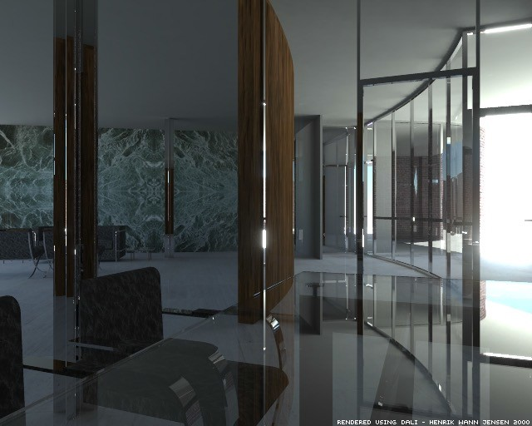
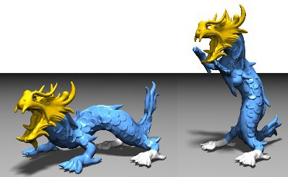
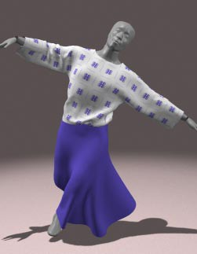
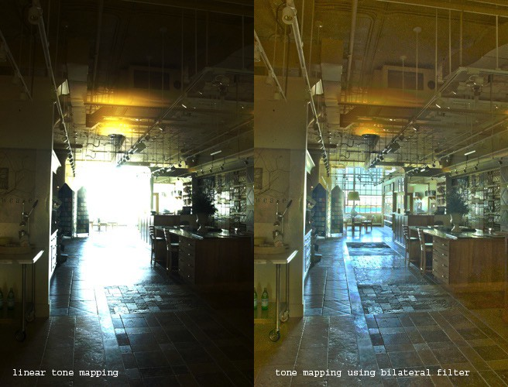
Computer Graphics Disciplines
Source: Botsch et al.
Source: Jensen
Rendering
Geometry(Modeling)
Source: Baraff and Witkin
Source: Durand
Image Processing
8
Animation

Slide 9
Computer Graphics Goals I
Synthetic images indistinguishable from reality
Practical, scientifically sound, in real time
9

Slide 10
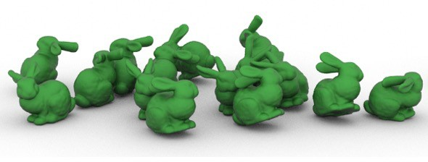

Example: Ray Tracing
Barbic, James, SIGGRAPH 2010
Thurey, Wojtan, Gross, Turk, SIGGRAPH 2010
10

Slide 11
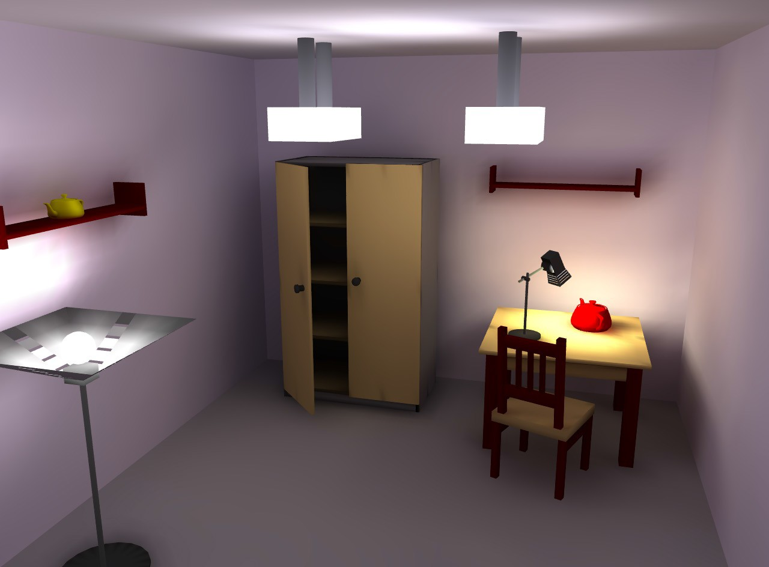
Example: Radiosity
11
Source: Wikipedia

Slide 12
Computer Graphics Goals II
Creating a new reality (not necessarily scientific)
Practical, aesthetically pleasing, in real time

Slide 13
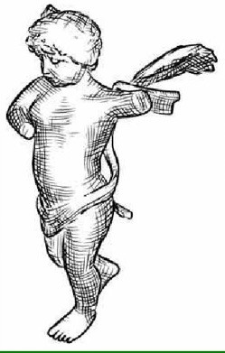
Example: Illustrating Smooth Surfaces
A. Hertzmann, D. Zorin, SIGGRAPH 2000
Non-photorealistic rendering (NPR)

Slide 14
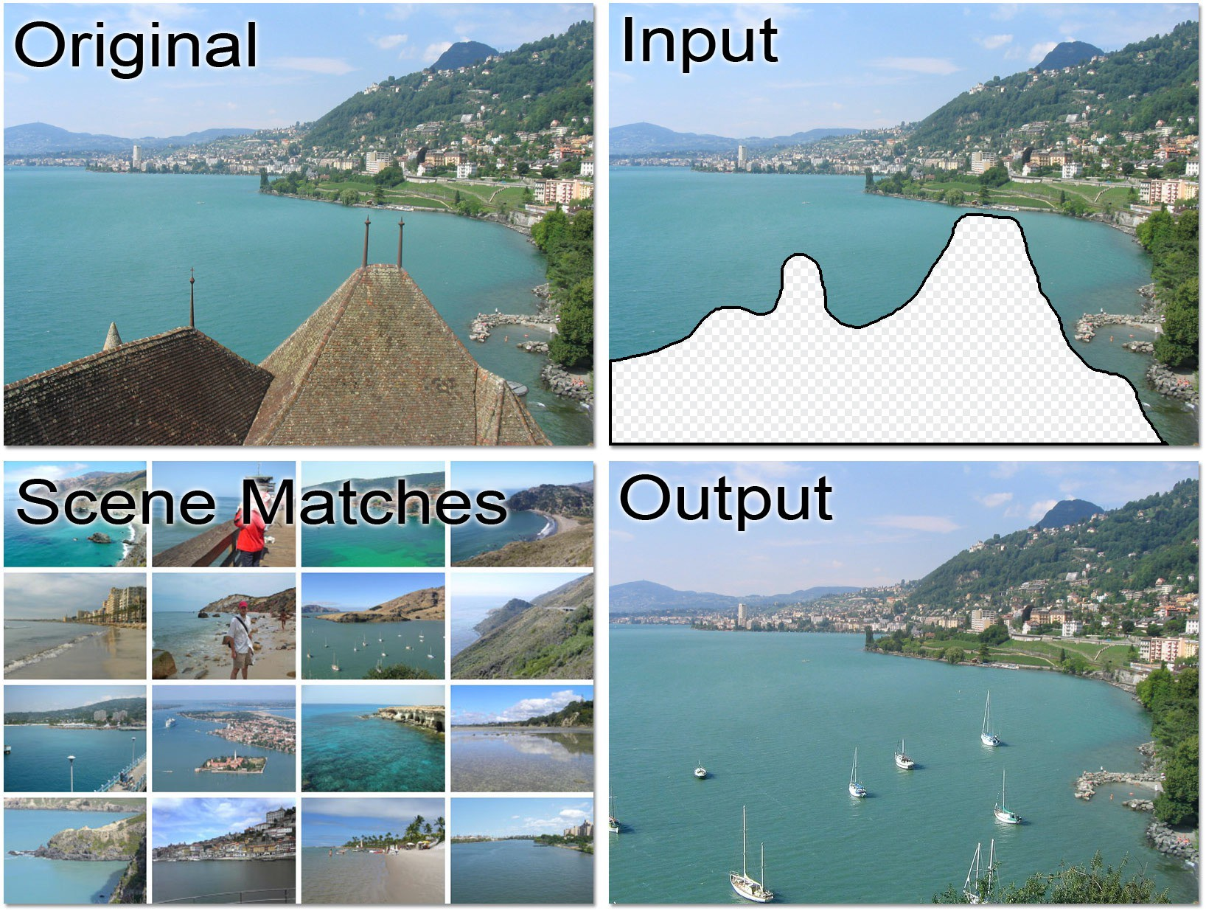
Example: Scene Completion
J. Hays, A. Efros, SIGGRAPH 2007

Slide 15
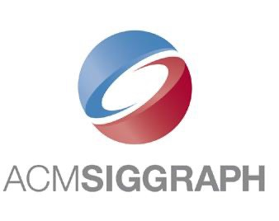
SIGGRAPH
Main computer graphics event in the world
Once per year
30,000 attendees
Academia, industry

Slide 16
Course Overview
OpenGL Basics
Input and Interaction
GPU Shader
Objects & Transformations
Viewing and Projection
Hierarchical Models
Light and Shading
Curves and Surfaces
16

Slide 17
Course Overview
Rendering
Textures and Pixels
Ray Tracing
Radiosity
Physically Based Models
17

Slide 18
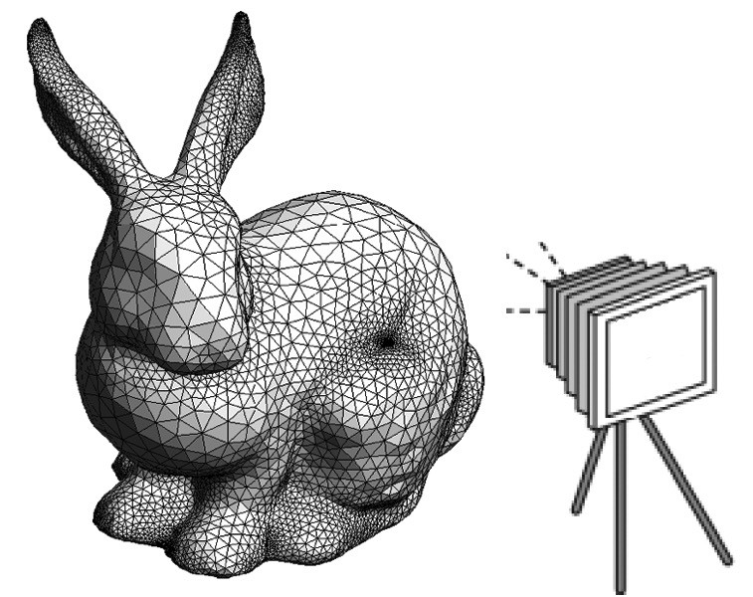
1. OpenGL Basics
Graphics pipeline
Primitives and attributes
Color
OpenGL core and compatibility profiles
[Angel, Ch. 1, 2]

Slide 19
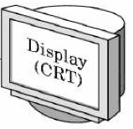
2. Input and Interaction
Clients and servers
Event driven programming
Hidden-surface removal
[Angel, Ch. 2]
“Client”
“Server”
CPU
GPU

Slide 20
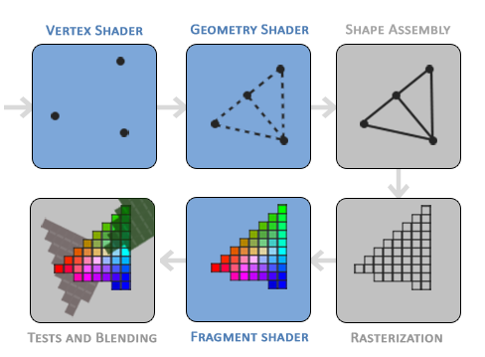
3. GPU Shaders
Vertex program
Fragment program
Pipeline program
Shading languages
GLSL shading language
Interaction with OpenGL
Source: LearnOpenGL
20

Slide 21
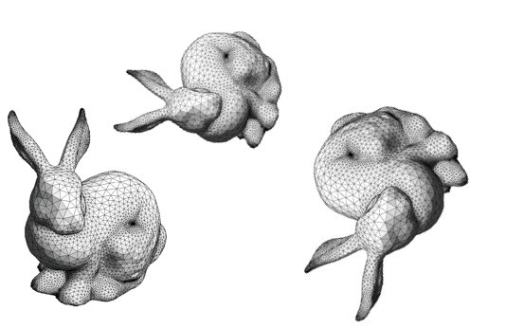
4. Objects & Transformations
Linear algebra review
Coordinate systems and frames
Rotation, translation, scaling
Homogeneous coordinates
OpenGL transformation matrices
[Angel, Ch. 3]
21

Slide 22
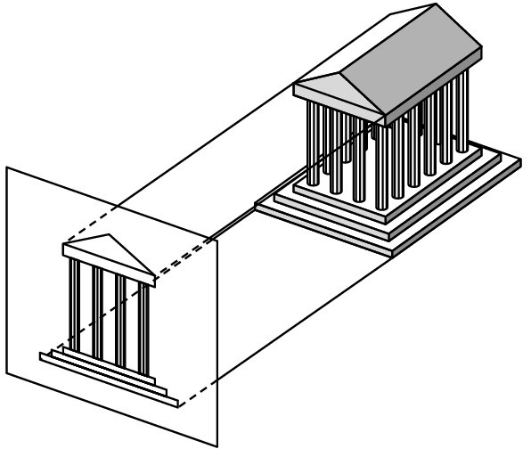
5. Viewing and Projection
Orthographic projection
Perspective projection
Camera positioning
Projections in OpenGL
[Angel, Ch. 4]

Slide 23
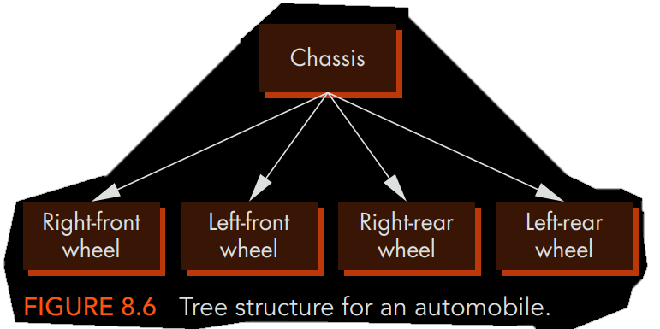
6. Hierarchical Models
Re-using objects
Animations
OpenGL routines
Parameters and transformations
[Angel, Ch. 8]

Slide 24
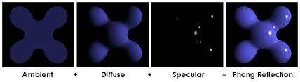
7. Light and Shading
Light sources
Ambient, diffuse, and specular reflection

Slide 25
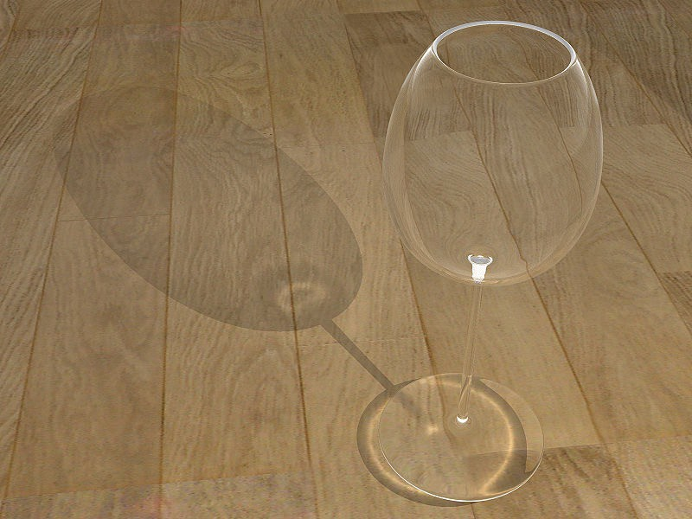
7. Light and Shading
Light sources
Ambient, diffuse, and specular reflection
Normal vectors
Material properties in OpenGL
Radiosity
[Angel, Ch. 5]
Tobias R. Metoc

Slide 26
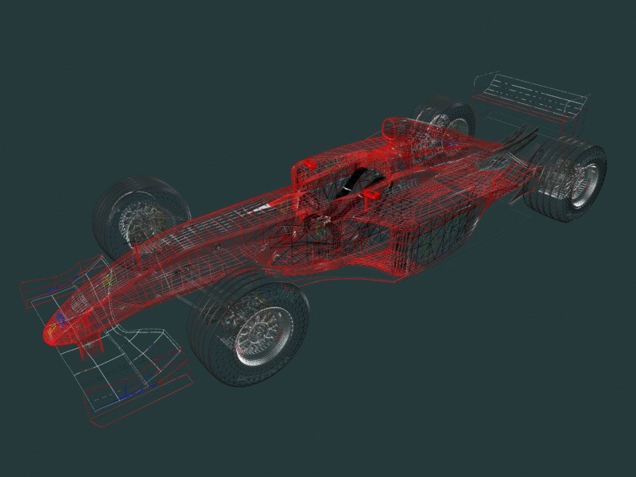
8. Curves and Surfaces
Review of 3D-calculus
Explicit representations
Implicit representations
Parametric curves and surfaces
Hermite curves and surfaces
Bezier curves and surfaces
Splines
Curves and surfaces in OpenGL
[Angel, Ch. 10]
26

Slide 27
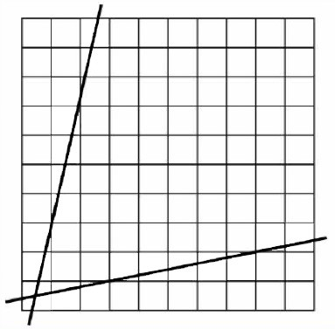
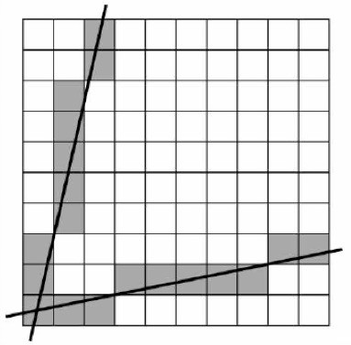
9. Rendering
Clipping
Bounding boxes
Hidden-surface removal
Line drawing
Scan conversion
Antialiasing
[Angel, Ch. 6]

Slide 28
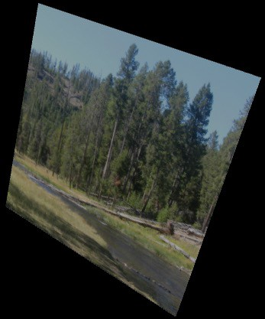
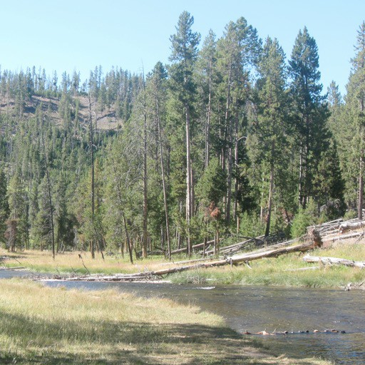
10. Textures and Pixels
Texture mapping
OpenGL texture primitives
Bump maps
Environment maps
texture map

Slide 29
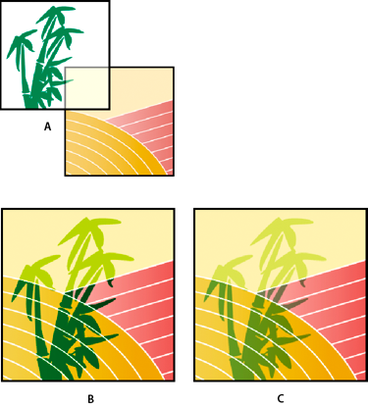
10. Textures and Pixels
Texture mapping
OpenGL texture primitives
Bump maps
Environment maps
Opacity and blending
Image filtering
[Angel, Ch. 7]

Slide 30

11. Ray Tracing
Basic ray tracing [Angel, Ch. 11]
Spatial data structures [Angel, Ch. 8]
Motion Blur
Soft Shadows
www.yafaray.org

Slide 31
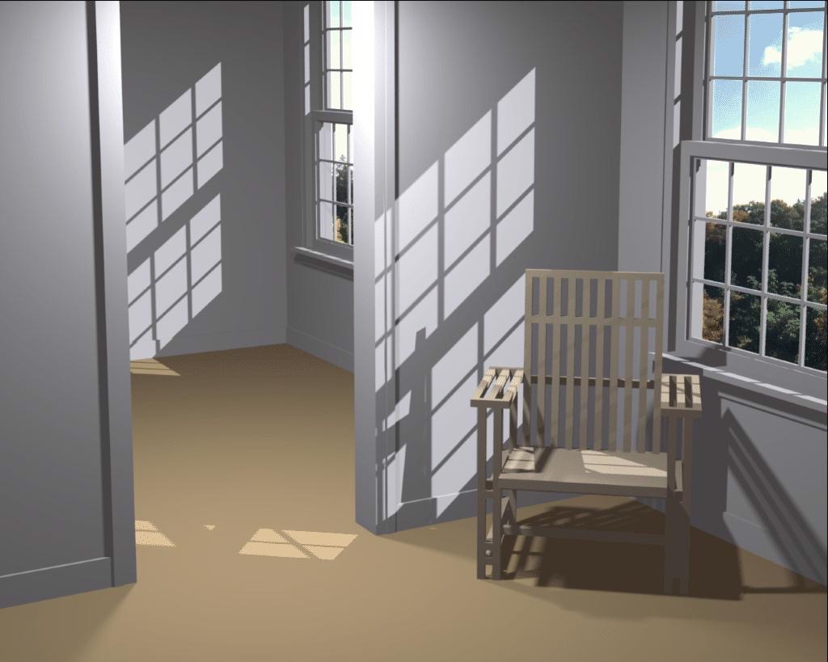
12. Radiosity
Local vs global illumination model
Interreflection between surfaces
Radiosity equation
[Angel Ch. 11]
Cornell University
31

Slide 32
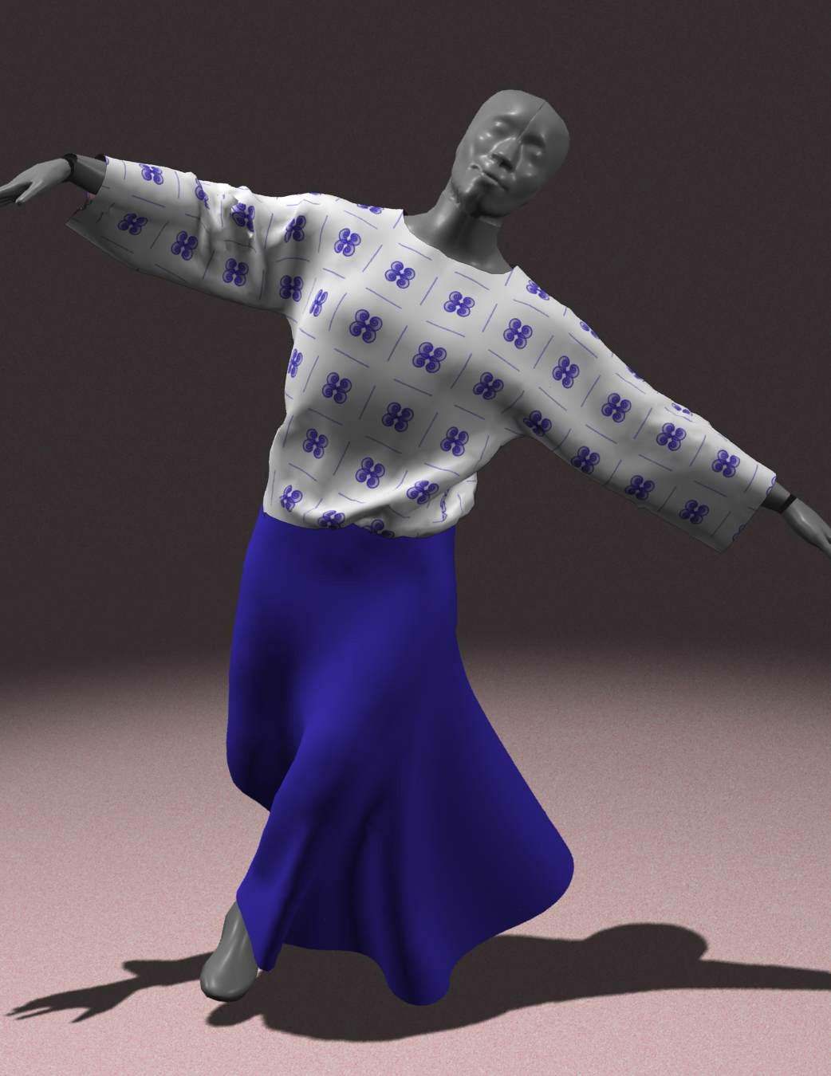
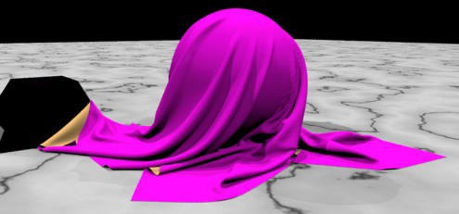
13. Physically Based Models
Particle systems
Spring forces
Cloth
Collisions
[Angel, Ch. 9]

Slide 33
Hot Application Areas
Film visual effects
Virtual reality
PC graphics boards
Video games
Visualization (science, architecture, space)

Slide 34
Hot Research Topics
Modeling
getting models from the real world
multi-resolution
Animation
physically based simulation
motion capture
Rendering:
more realistic: image-based modeling
less realistic: impressionist, pen & ink

Slide 35
Computer Graphics
Lecture 1-B
Introduction to OpenGL
OpenGL API
Core and Compatibility Profiles
Colors
[Angel Ch. 2]
Jernej Barbic and Ahmed Kataby
University of Southern California

Slide 36

What is OpenGL?
A low-level graphics library (API) for 2D and 3D interactive graphics.
Descendent of GL (from SGI)
First version in 1992; now: 4.6 (released July 2017)
Managed by Khronos Group (non-profit consortium)
API is governed by Architecture Review Board (part of Khronos)

Slide 37
Where is OpenGL used?
CAD
Virtual reality
Scientific visualization
Flight simulation
Video games

Slide 38
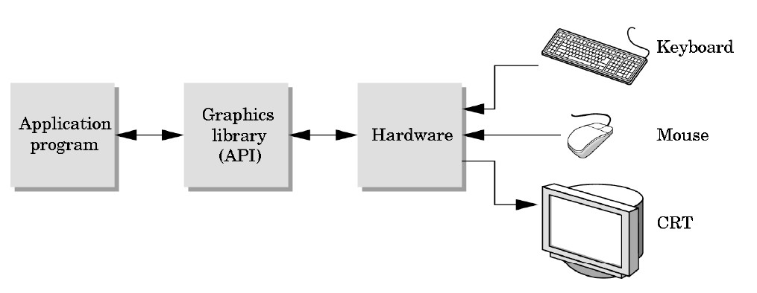
Graphics library (API)
Intermediary between applications and graphics hardware
Other popular APIs: Direct3D (Microsoft)
OpenGL ES (embedded devices) X3D (successor of VRML)
Vulkan (more low-level than OpenGL)
38

Slide 39
OpenGL is cross-platform
Same code works with little/no modifications
Windows: default implementation ships with OS Improved OpenGL: Nvidia or AMD drivers
Linux: Mesa, a freeware implementation Improved OpenGL: Nvidia or AMD drivers
Mac: ships with the OS. Apple announced deprecation in 2018, but OpenGL continues to work.
39

Slide 40
Choice of Programming Language
OpenGL lives close to the hardware
OpenGL is not object-oriented
OpenGL is not a functional language (as in, ML)
Use C to expose and exploit low-level details
Use C++, Java, ... for toolkits
40

Slide 41
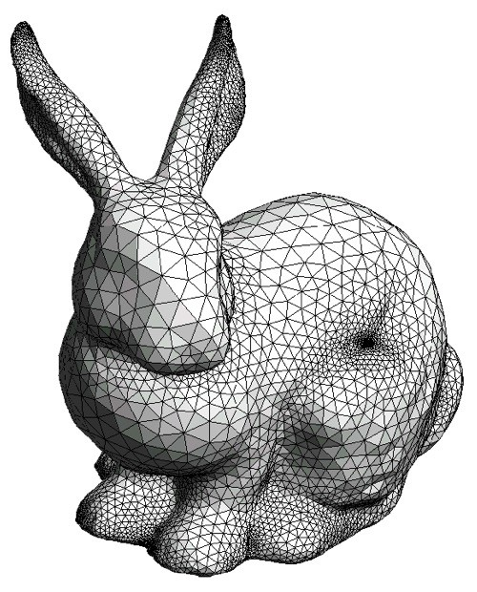
How does OpenGL work?
From the programmer’s point of view:
Specify geometric objects
Describe object properties
Color
How objects reflect light
41

Slide 42
How does OpenGL work?
Define how objects should be viewed
where is the camera
what type of camera
Specify light sources
where, what kind
Move camera or objects around for animation
42

Slide 43
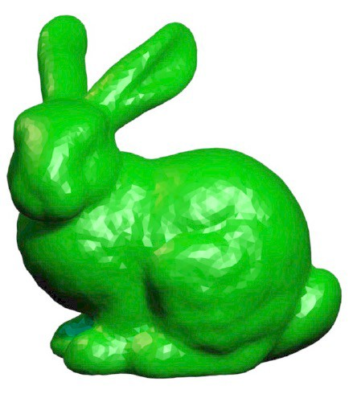
The result
Result
43

Slide 44
OpenGL is a state machine
State variables: vertex buffers, camera settings, textures, background color, hidden surface removal settings, the current shader program...
These variables (the state) then apply to every subsequent drawing command.
They persist until set to new values by the programmer.
44

Slide 45
Attributes:
color, shading and reflection properties
Set before primitives are drawn
Remain in effect until changed !
45

Slide 46
Core vs Compatibility Profile
Core Profile:
“Modern” OpenGL
Introduced in OpenGL 3.2 (August 2009)
Optimized in modern graphics drivers
Shader-based pipeline
Compatibility Profile:
“Classic” OpenGL
Supports the “old” (pre-3.2) OpenGL API
Not as optimized as Core Profile
Fixed-function (non-shader) pipeline
46

Slide 47
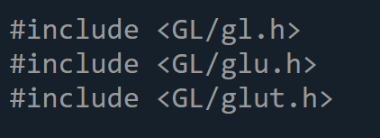
Compatibility vs Core
Include file (OpenGL Compatibility Profile) :
“gl.h” provides the core OpenGL functionality, including function prototypes, constants, and data types.
47

Slide 48
Compatibility vs Core
Include file (OpenGL Compatibility Profile) :
“glu.h” provides utility functions for OpenGL, such as routines for setting up perspective projection matrices or performing transformations.
48

Slide 49
Compatibility vs Core
Include file (OpenGL Compatibility Profile) :
“glut.h” is specific to the GLUT (OpenGL Utility Toolkit) library, which provides a platform-independent way to create windows, handle input events, and manage the main event loop for OpenGL applications.
49

Slide 50
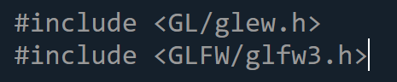
Compatibility vs Core
Include file (OpenGL Core Profile) :
“glew.h” is part of the GLEW (OpenGL Extension Wrangler) library, which helps manage OpenGL extensions and provides access to core OpenGL functions. GLEW is commonly used to query and load OpenGL functions dynamically.
50

Slide 51
Compatibility vs Core
Include file (OpenGL Core Profile) :
“glfw3.h” is specific to the GLFW library, which is a lightweight framework for creating windows, handling input events, and managing the main event loop for OpenGL applications.
51

Slide 52




OpenGL Library Organization
GL (Graphics Library): core graphics capabilities
GLUT (OpenGL Utility Toolkit): input and windowing
GLU (OpenGL Utility Library; compatibility profile only): utilities on top of GL
GLEW (Extension Wrangler): removes OS dependencies
GLEW
OpenGL application program
Graphics driver
Graphics card
Computer monitor
GL
GLUT
52

Slide 53
Mixing core and compatibility profiles
Windows, Linux:
Can mix core and compatibility profile OpenGL commands
can lead to confusion (is the specific OpenGL command optimized?)
advantage: more flexible (can re-use old code)
Mac:
Can only choose one profile (in each application)
53

Slide 54
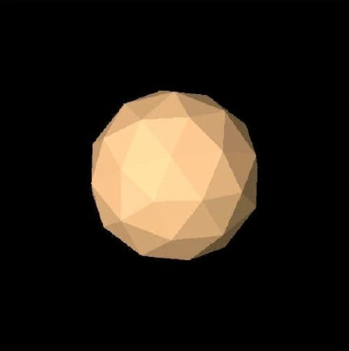
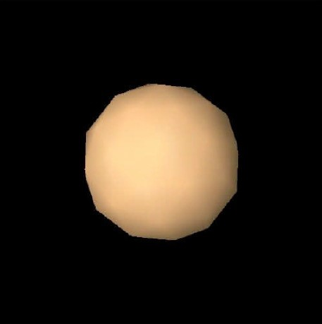
Flat vs Smooth Shading
Flat Shading
Smooth Shading
54

Slide 55
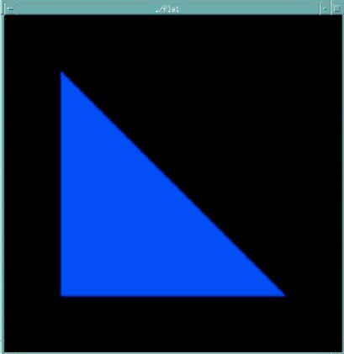
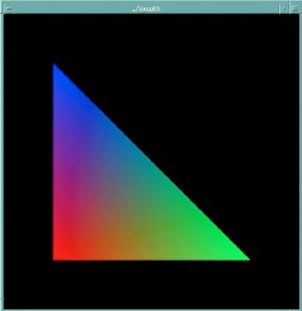
Flat vs Smooth Shading
color of last vertex
each vertex separate color smoothly interpolated
Compatibility profile: glShadeModel(GL_FLAT)
Compatibility profile: glShadeModel(GL_SMOOTH)
Core profile: use interpolation qualifiers in the fragment shader
55

Slide 56
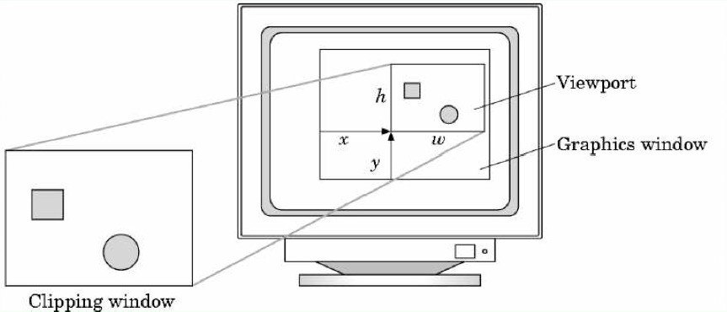
Viewport
Determines clipping in window coordinates
glViewport(x, y, w, h) (usually in reshape function)
56

Slide 57
Summary for 1-B
OpenGL API
Core vs compatibility profiles
Colors
Flat and smooth shading
Viewport
57

