Slide 1
Importance of N2Hx Reaction Pathways in Modelling of NH3/H2/Air Flame Chemistry
Department of Mechanical Engineering, Reactive Gas Dynamics
UROTHIYIL Aahil Ashraf
2026年11月8日

Slide 3
Develop a reduced kinetic mechanism optimized for NH3, NH3/CH4 and NH3 H2
  Prioritizing unstretched laminar burning velocity predictions
  Viable for cases with varying pressure and equivalence ratio
Validate the Present Mechanism with experimental flame speed measurements from literature

Slide 5
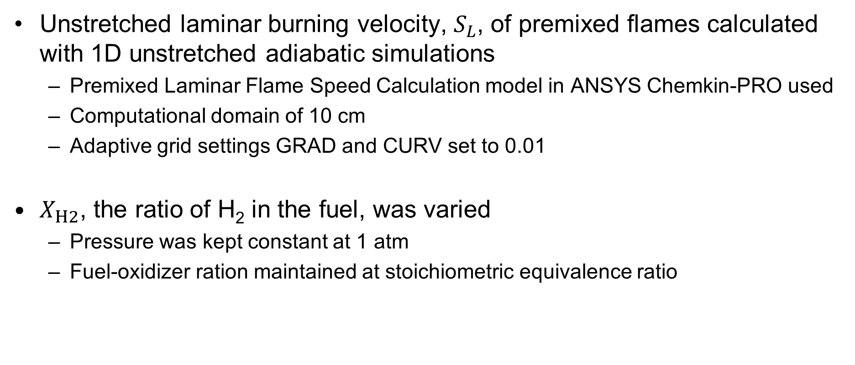
Unstretched laminar burning velocity, $S_{L}$, of premixed flames calculated with 1D unstretched adiabatic simulations
  Premixed Laminar Flame Speed Calculation model in ANSYS Chemkin-PRO used
  Computational domain of 10 cm
  Adaptive grid settings GRAD and CURV set to 0.01
$X_{H2}$, the ratio of H₂ in the fuel, was varied
  Pressure was kept constant at 1 atm
  Fuel-oxidizer ration maintained at stoichiometric equivalence ratio

Slide 6
