Slide 1
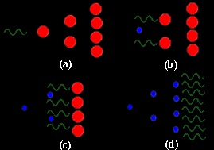
Masers
Donna Kubik
Why were masers developed before lasers?
How did the first maser work?
Applications?
What was really the first maser?

Slide 2
Masers
Maser
  microwave amplification by stimulated emission of radiation
A man-made maser is a device that sets up a series of atoms or molecules and excites them to generate the chain reaction, or amplification, of photons
Metastable emission states make masers possible

Slide 3
Masers
It is no coincidence that “laser action” was first produced in the microwave region
  There is no need for pumping
Pumping

Slide 4
Population ratio
  The Boltzman distribution may be used
    The first maser operated with a gaseous system
    The neither molecular state influences the other state
    The system is in thermal equilibrium
  
(eV)
masers
lasers

Slide 5
Population ratio
  The population ratio of the higher energy state to the lower energy state is about 1:1 in the energy range that corresponds to microwaves
  
   ΔE for maser is ~10⁻⁵ eV ΔΕ for a laser is a few eV
(eV)
masers
lasers

Slide 6
Population ratio
  So thermal energy (kT_{room} = 0.0258eV) is enough to generate a large population of atoms in the higher energy state
  
   ΔE for maser is ~10⁻⁵ eV ΔΕ for a laser is a few eV
(eV)
masers
lasers

Slide 7
Masers
Another reason it is no coincidence that “laser action” was first produced in the microwave region
  There is no need use 3 or 4 level schemes to populate a metastable state
3-level
4-level

Slide 8
Masers
The ratio of the spontaneous emission coefficient to the stimulated emission coefficient varies with frequency as ν³
This ratio is much smaller in the microwave part of the spectrum than in the optical
Spontaneous emission can therefore be neglected compared to other important processes such as stimulated emission and absorption.

Slide 9
Masers
  There is no need take advantage of an intermediate metastable state
  The states are inherently long-lived
  So all you have to do is physically separate the high energy state from the low energy state to achieve a metastable population inversion

Slide 10

First maser
The first maser was an ammonia- beam maser (1954)
The two energy levels used in the ammonia maser are vibrational states of the ammonia molecule
The hydrogen atoms can be considered to rotate
The nitrogen atom oscillates between two positions, above and below the plane of the hydrogen atoms
N
H
H
H
H
H
H
N

Slide 11
First maser
These two arrangements do not represent exactly the same energy
The wave functions of the hydrogen and nitrogen atoms are not quite symmetrical
Therefore the molecule exists in two energy states
The difference in energy between the states corresponds to a frequency difference of 23.87 GHz , or ~24 GHz
λ=1.25cm
N
H
H
H
H
H
H
N

Slide 12
First maser
H
H
H
N

Slide 13
First maser
N
24 GHz
H
H
H

Slide 14
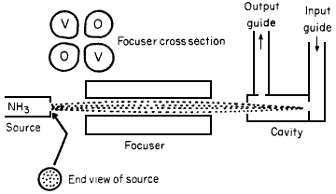
Ammonia-beam maser
1. A heater gives energy to molecules of ammonia (NH₃) in the source
At this point about half of the molecules are in an excited state, the other half are not.
2. The ammonia molecules stream into the focuser (also called a separator), which is evacuated.
6
5
1
2
3
4

Slide 15
Ammonia-beam maser
3. The focuser removes molecules in the lower quantum state from those in the upper quantum state (for these would absorb rather than emit photons at the desired frequency) while focusing those in the upper state
The energy states can be separated by a system of focusing electrodes.
6
5
1
2
3
4

Slide 16
Ammonia-beam maser
The electric dipole moments induced in the NH₃ molecules interact with the electric field produced by the electrodes
The internal energy of an upper state molecule is increased and that of a lower state molecule is decreased so that, in the non-uniform electric field, the lower state molecules move towards the higher field region and the upper state molecules move to the lower field region
6
5
1
2
3
4

Slide 17
Ammonia-beam maser
4. The ammonia molecules that pass into the resonant cavity (tuned to 24GHz) are almost all excited
They constitute an inverted population.
The cavity has a very high Q, so there is sufficient noise power to initiate transitions from the upper state the lower state
Photons from these transitions can then stimulate emission from other molecules.
6
5
1
2
3
4

Slide 18
Ammonia-beam maser
5. When it is used as an amplifier, the signal to be amplified is injected into the cavity that enter the cavity via an input waveguide
This radiation leads to even more rapid stimulated emission by the excited molecules
6
5
1
2
3
4

Slide 19
Ammonia-beam maser
6. The resultant coherent radiation detected at the output waveguide is an amplified version of the input signal
Masers are low-noise amplifiers
Since molecules are uncharged, the usual shot noise in electronic amplifiers is missing, and essentially no noise in addition to thermal noise is present in maser amplifiers
6
5
1
2
3
4

Slide 20
Ammonia-beam maser
This radiation reflects back and forth inside the cavity, whose size is specially chosen and regulated to reinforce waves of just this frequency
The maser is functioning as a self-oscillator
6
5
1
2
3
4

Slide 21
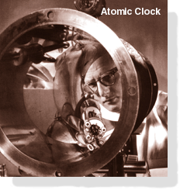
Ammonia-beam maser
Such masers are extremely selective as amplifiers
They will not amplify signals that are as little a 5000 Hz away from 24 GHz.
They do not shift by more than one part on a billion or more over long periods, so the early masers were used as atomic clocks
An NH₃-beam maser served as the first atomic clock standard by NIST (National Institute of Standards and Technology)

Slide 22
Solid state masers
Gas molecules are not closely crowded together as they are the molecules of a solid, thus the power output of gas-beam masers remains low
This inspired the development of solid state masers
Pulsed solid state masers may be 2-state masers
CW masers are generally 3-level systems

Slide 23
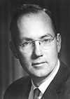
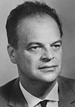
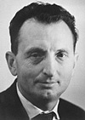
Nobel prize in 1964
"for fundamental work in the field of quantum electronics, which has led to the construction of oscillators and amplifiers based on the maser-laser principle"
Charles Hard Townes | Nicolay Gennadiyevich Basov | Aleksandr Mikhailovich Prokhorov
1/2 of the prize | 1/4 of the prize | 1/4 of the prize
USA | USSR | USSR
Massachusetts Institute of Technology (MIT) Cambridge, MA, USA | Lebedev Institute for Physics, Akademija Nauk Moscow, USSR | Lebedev Institute for Physics, Akademija Nauk Moscow, USSR
b. 1915 | b. 1922 d. 2001 | b. 1916 d. 2002

Slide 24
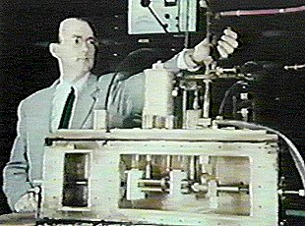
First maser?
But was this really the first maser?
Charles Townes and the first manmade NH₃-beam maser

Slide 25
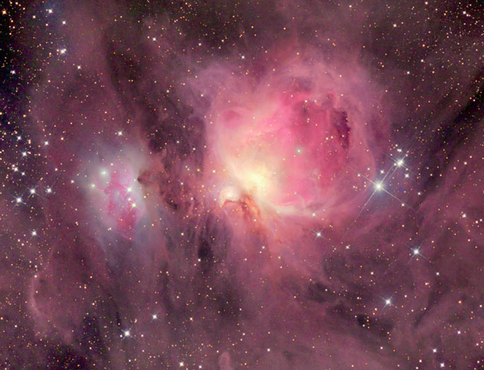
Astrophysical masers
Naturally occurring molecular masers and lasers have been oscillating for eons in interstellar space, on comets, and in planetary atmospheres
Orion Nebula

Slide 26
Astrophysical masers
In 1962, molecular lines detected in radio emission from interstellar clouds had huge intensities (equivalent to blackbody temperature of 10¹²-10¹⁵ K) but at the same time had very narrow doppler linewidths (corresponding to kinetic temperatures below 100 K)
An explanation is that these emissions represent naturally occurring masers
Many types of astrophysical masers have been detected as OH, SiO, and H₂O
Orion Nebula

Slide 27
Astrophysical masers
In colliding galaxies and near black holes, astronomical masers can be a million times stronger than regular masers
These megamasers were discovered in 1982.
Orion Nebula

Slide 28
Conclusions
Why were masers developed before lasers?
  Because of the low energy of the microwave transitions
How did the first maser work?
  Physically separating a 2-state system of NH₃ molecule
Applications?
  Low noise amplifiers, oscillators, accurate clocks
What were really the first masers?
  Astrophysical masers!

Slide 29
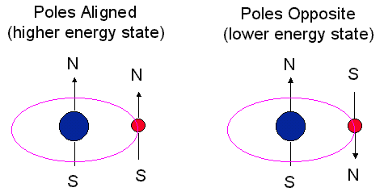
Hydrogen maser
Another type of gas maser, using hydrogen rather than provides for an even more accurate clock
The hydrogen maser uses another two-state system
A 21-cm photon is emitted when poles go from being aligned to opposite (a spin flip).
This event only happens rarely for each H atom.
1.42 GHz

Slide 30
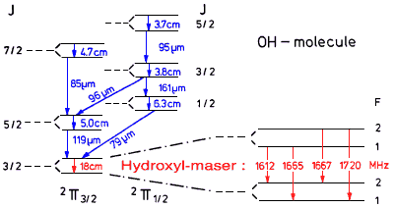
Interstellar OH
OH was the the first radioastronomical observation of an interstellar molecule (1963)
The identification was secure, because the 4 hyperfine splittings of 18-cm transition were detected at the relative strengths according to theory with the line ratios of 1612, 1665, 1667 and 1720 MHz being 1:5:9:1
Energy level diagram depicting the
18 cm microwave transition and
its hyperfine structure

Slide 31
Astrophysical masers
Two years after he discovery of OH in radio absorption lines, OH was observed in emission
The emission was of very high intensity, peculiar line-ratio strengths, very small line widths, and very high degrees of polarization, and varied on a timescale of days.
The intensity was so high that if it arose from thermal processes, the temperature would have to be on the order of 10¹² K!
Energy level diagram depicting the
18 cm microwave transition and
its hyperfine structure

Slide 32
Astrophysical masers
It is now believed that maser action causes the intense emission of OH.
Since the discovery of OH masers, astronomers have discovered SiO masers,
Energy level diagram depicting the
18 cm microwave transition and
its hyperfine structure

Slide 33
Astrophysical masers
Masers whose detailed modeling has been most successful are the OH masers in late-type stars that are pumped by infrared radiation resulting from the reemission of the stellar radiation by the dust particles that permeate the stellar wind.
Detailed models of the H₂O masers in these sources show that pumping is controlled by collisions.
Energy level diagram depicting the
18 cm microwave transition and
its hyperfine structure

