Slide 1
Introduction to R for Psychoacoustics
Axel Ahrens
My procedure to analyse perceptual data

Slide 2
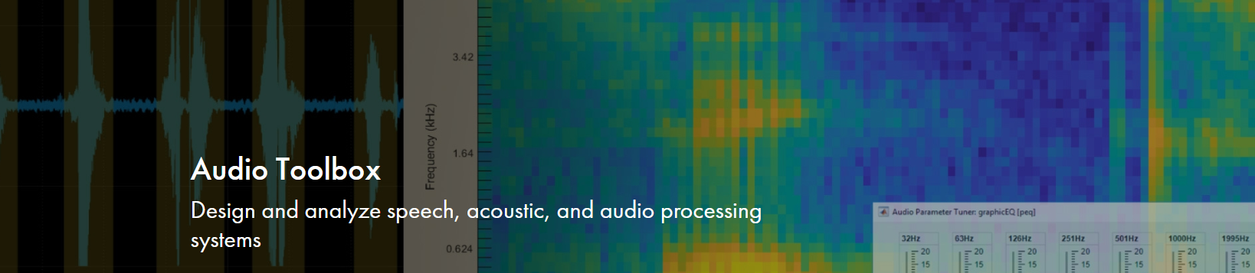

Motivation
MATLAB is great for psychoacoustics research! At least for data collection.
Not ideal for data visualization
Not ideal for statistical analysis

Slide 3


Agenda
Prepare data in MATLAB
Export data from MATLAB
Import data in R using the Tidyverse
Data visualization using ggplot2
Statistical analysis with mixed linear models using lmerTest
Disclaimer: This is only my workflow. There are likely more efficient ways.

Slide 4
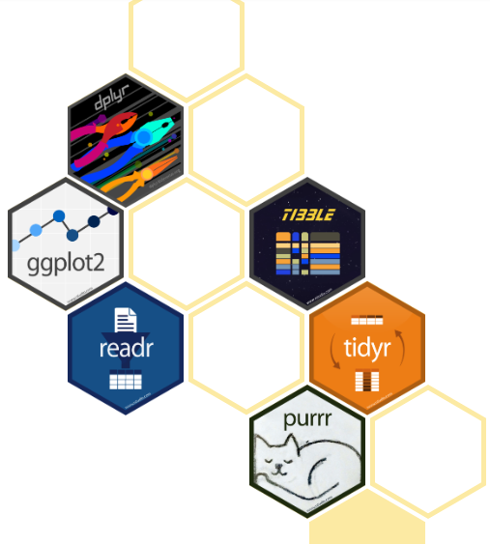
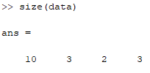
Tidy data
My MATLAB data looks generally like this:
Subjects, Factor 1, Factor 2, Factor 3
Each dimension is a factor
For R, the better way is to have it “tidy”
www.tidyverse.org

Slide 5

Get the resources
https://github.com/aahr/Intro-R-Psychoacoustics

Slide 6
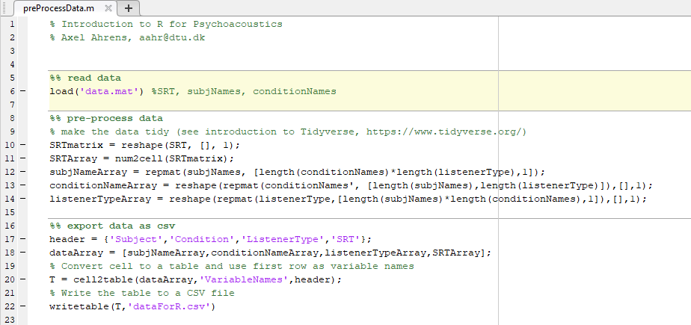
Data preparation in MATLAB
Take the data from the perceptual experiment

Slide 7
Data export in MATLAB
Write data to csv or xlsx file

Slide 8
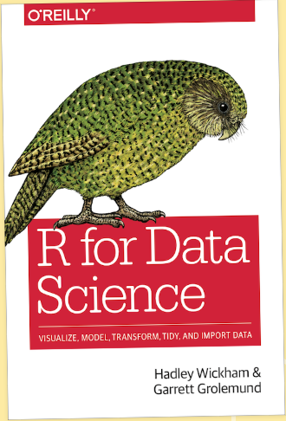
Base-R vs Tidyverse
The Tidyverse introduces packages and data handling in a slightly different way
Learn more here:
R for Data Science (Garrett Grolemund, Hadley Wickham) - https://r4ds.had.co.nz/
There is a discussion if Base-R or Tidyverse is the way to go in R
http://varianceexplained.org/r/teach-tidyverse/

Slide 9
More on R / Tidyverse
Data import
readr – https://readr.tidyverse.org/
readxl – https://readxl.tidyverse.org/
Data manipulation
tidyr – https://tidyr.tidyverse.org/
dplyr – https://dplyr.tidyverse.org/
data.table – https://rdatatable.gitlab.io/data.table/
Data visualization
ggplot2 – https://ggplot2.tidyverse.org/
Data analysis (see Vignettes)
lmerTest – https://cran.r-project.org/web/packages/lmerTest/
emmeans – https://cran.r-project.org/web/packages/emmeans/

Slide 10

Install and load packages in R

Slide 11
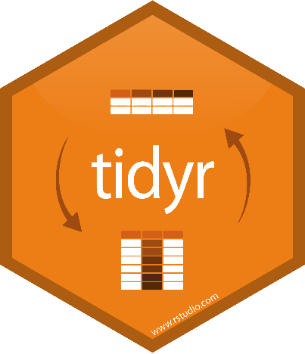
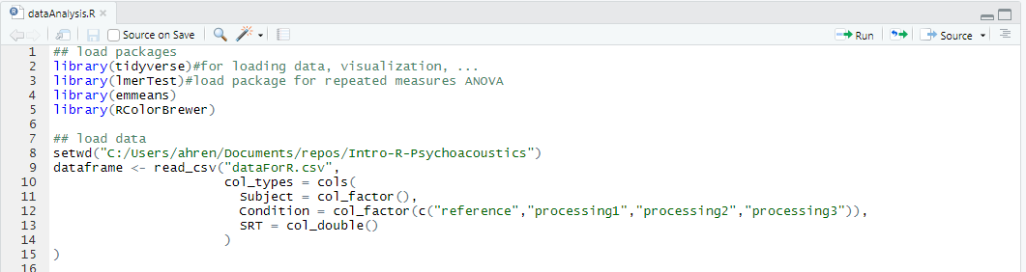
Data import in R

Slide 12

Data visualization
https://www.youtube.com/watch?v=h29g21z0a68 for a great workshop on ggplot2
https://github.com/rstudio/cheatsheets/blob/master/data-visualization-2.1.pdf

Slide 13
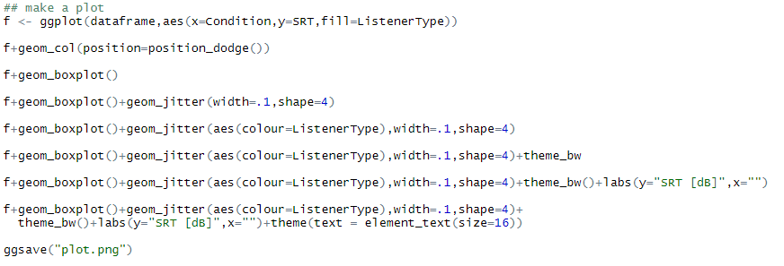
Data visualization

Slide 14

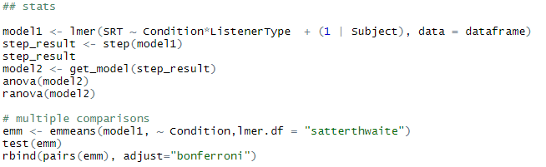
Statistical Analysis
Fitting a linear mixed model to the data
Removing factors/interactions from the model
Post-hoc analysis

