Slide 1
Introduction to R for Psychoacoustics
Axel Ahrens
My procedure to analyse perceptual data

Slide 2
Agenda
Prepare data in MATLAB
Export data from MATLAB
Import data in R using the Tidyverse
Data visualization using ggplot2
Statistical analysis with mixed linear models using lmerTest
Disclaimer: This is only my workflow. There are likely more efficient ways.

Slide 3
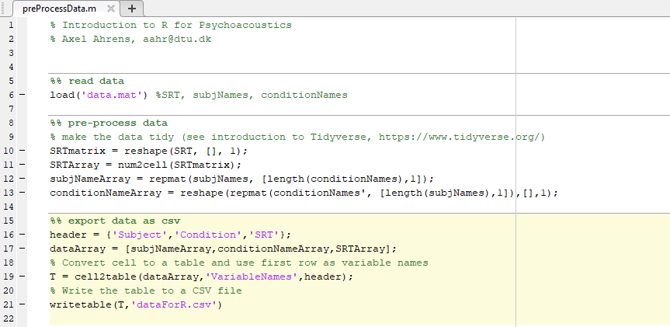
Data preparation
Take the data from the perceptual experiment

Slide 4
Data export in MATLAB

Slide 5
Base R vs Tidyverse

Slide 6
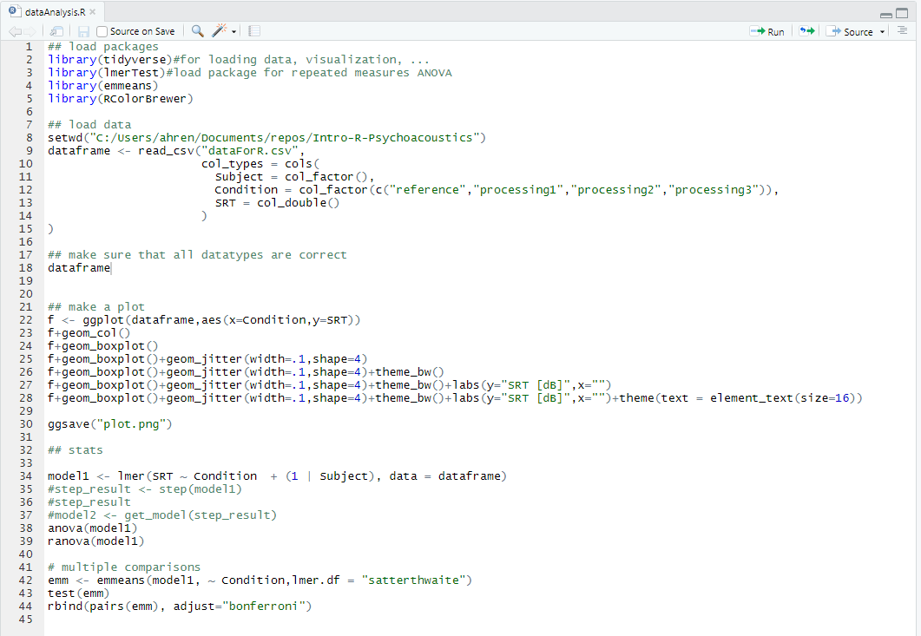
Data import in R

Slide 7
Data visualization
ggplot2
https://github.com/rstudio/cheatsheets/blob/master/data-visualization-2.1.pdf

Slide 8
Statistical Analysis

Slide 9
Summary

