Slide 1

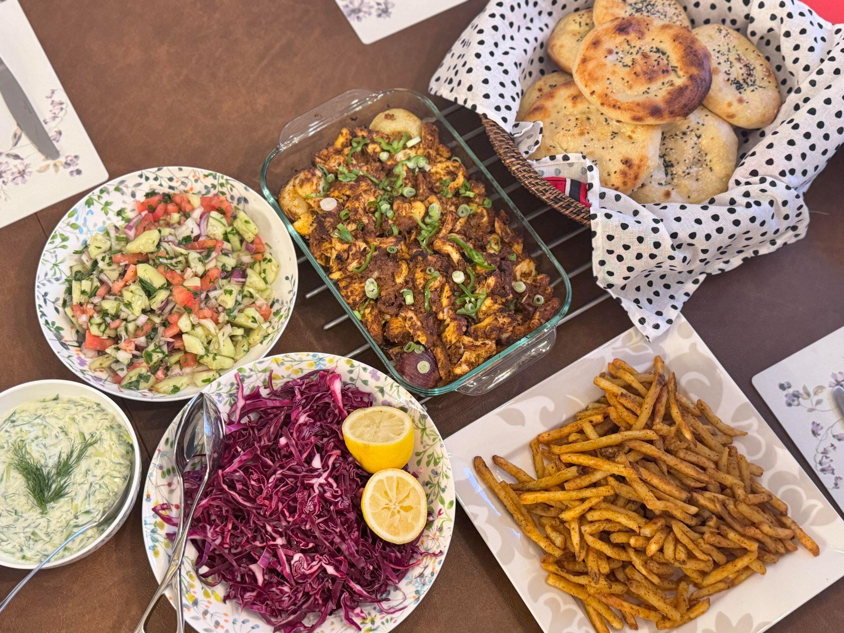
Recipe Recommendation System
-Aamna Ahsan

Slide 2
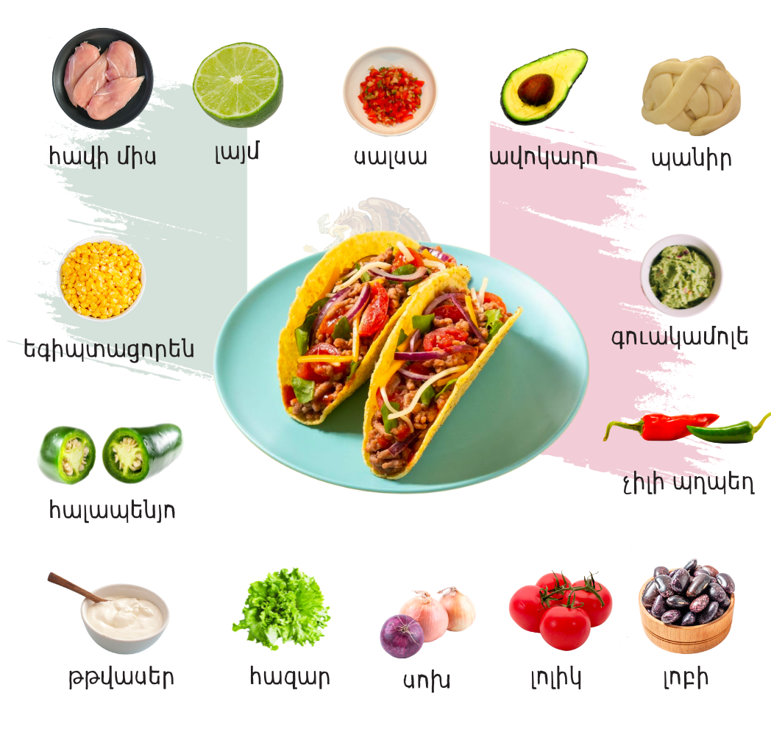
Purpose
Having difficulty deciding what to cook?
OR
Are you looking to expand your cuisine based on special diet, ingredients or culture?
A recipe recommendation system can personalize your needs based on popularity, exploring new recipes based on your favorite ingredients, cuisines, and dietary preferences.

Slide 3


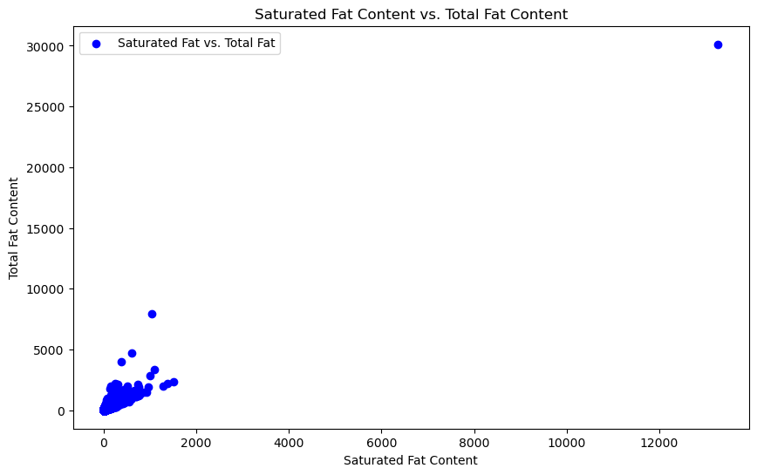
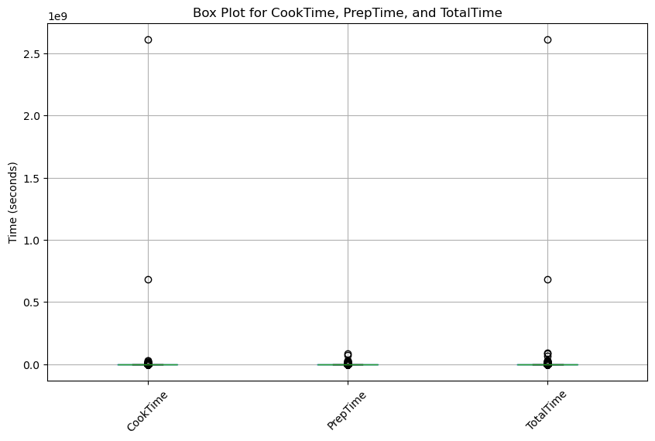
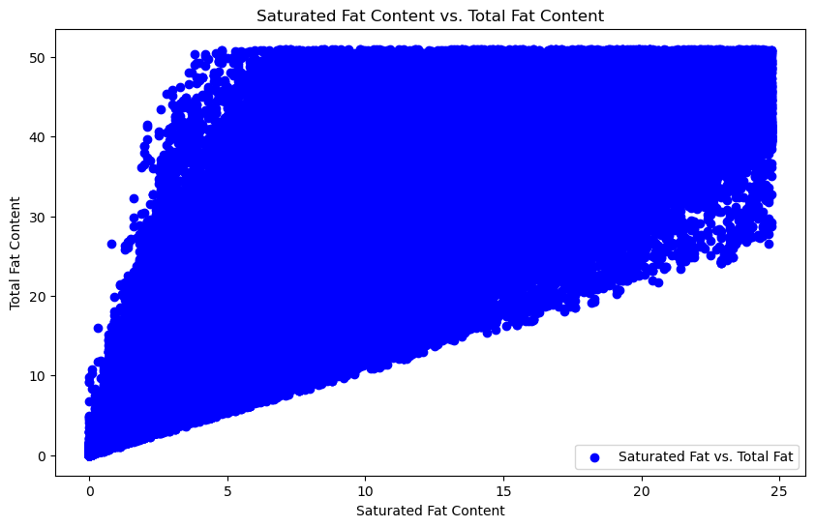
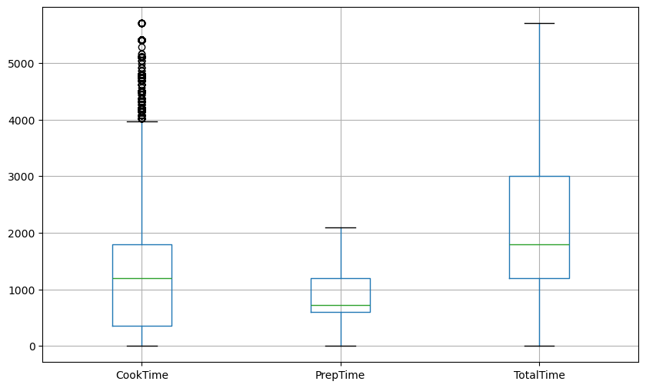
Example1: Fat Content vs Saturated Fat:
Example 2: Box plot of CookTime, PrepTime, and TotalTime.
1. Data:
Recipe.csv file was extracted from kaggle.
Clean-up -remove NaN values, duplicates and outliers in the data.

Slide 4
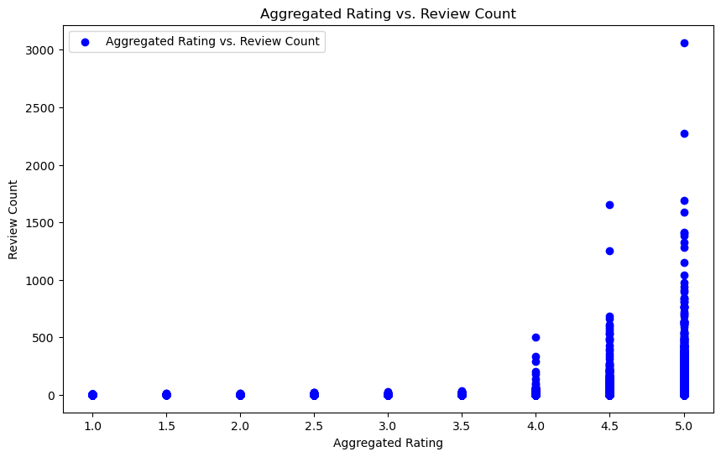
This chart shows how the recipes were rated in the data:
Looks like there were a lot of recipes that people loved.
Most ratings were 5.0/5.0

Slide 5
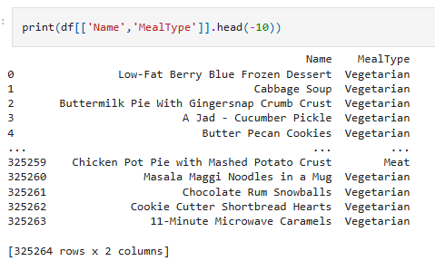
Specialized Features:
Dietary preference: Gluten-Free, Dairy-Free, Low-carb.
Categories: Meat, seafood, Vegetarian :

Slide 6
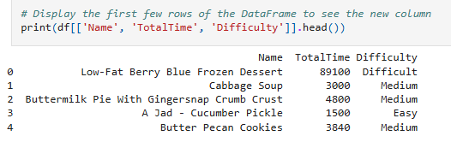
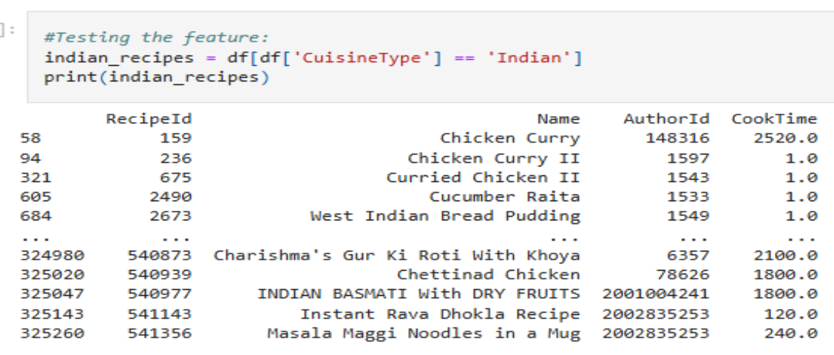
Specialized Features
Continued:
3. Categorizing based on level of difficulty: Easy= 30min,
Medium= 30min-1hr,
Hard=2hr +
4. Categorizing the cuisines: Italian, Mexican, Chinese, Indian, Japanese, Thai, Asian, Persian, American, Middle East.
(Results are shown on the left)

Slide 7
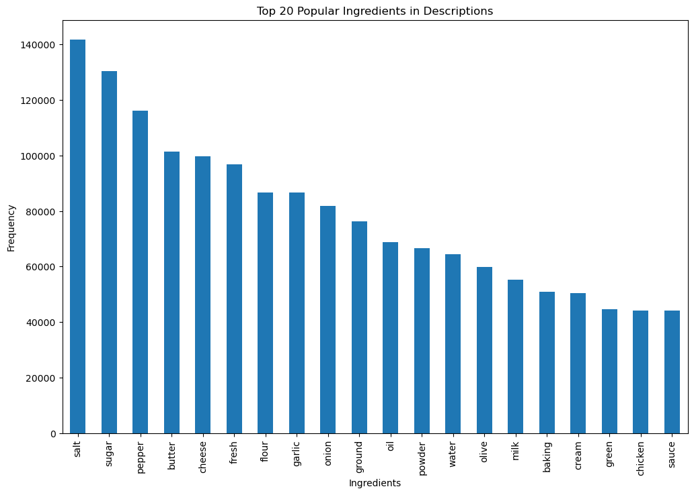
Top 20 Ingredients
This Graph shows another feature which can be used for recommending recipes based on popular ingredients. For now, this feature was added to the data.

Slide 8
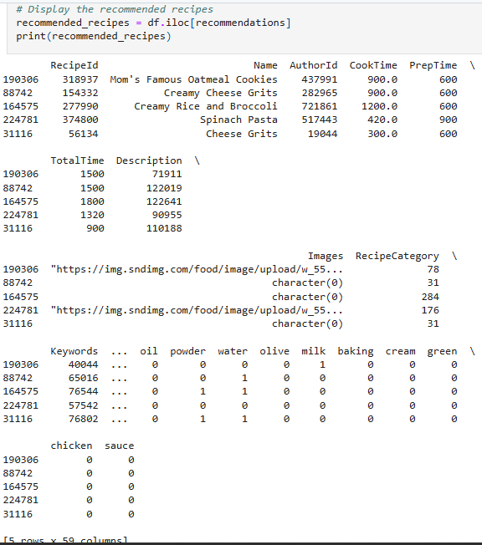
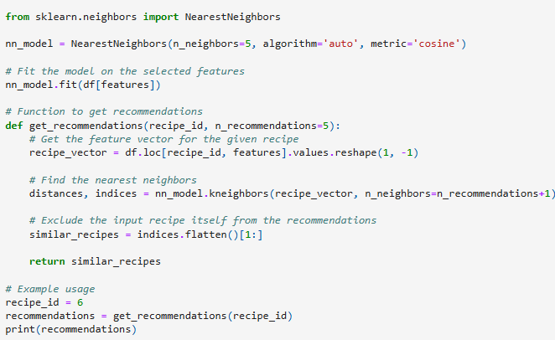
Model 1:
Recommendation based on K-nearest Neighbor (Instance-based Learning)
This output is based on recipes most similar to recipe_id =6.

Slide 9
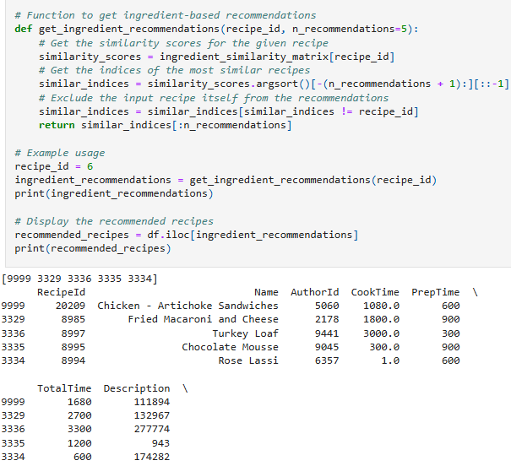
Model 2:
Recommendation based Ingredients (content-based filtering):
This model is targeted to taste:
based on similarity between the ingredients used in the recipes. In this case, this example shows recipes that are similar to recipe_id= 6.

Slide 10
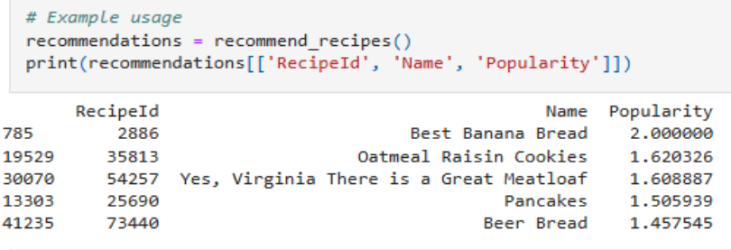
Model 3:
Recommendation based on Reviews (collaborative filtering):
These recipes have similarly reviews to: recipe_id = 6

Slide 11
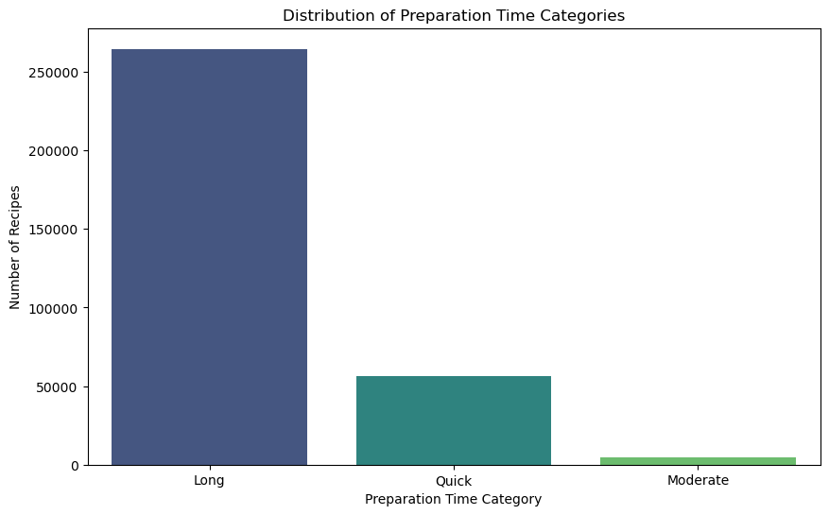
Future Improvements:
There were a lot of time consuming recipes in this data.
As the goal of this system is to provide ease especially for those who have a busy schedule, There should be more available short recipes.
Scrape and Add new data
Perhaps create a feedback with user recommendation.

Slide 12
Further Improvements:
Adding a “like” or thumbs up feature, to create a user based recommender
The recommendation system can be categorized as “easy”, “moderate”, and difficult. Adding more data is essential, and having shorter recipes as mentioned in previous slide is also very important.
Adding new cuisines.
Seasonal Recommendations
More cuisine categories.

