Slide 1
ANVIL v0.1.2
The four v0.1.2 features, shown through real runs:
intake Q&A · standing instructions · OKF artifacts · build-from-file
companion to Anvil_v0.1.2_overview.pptx · branch v0.1.2_jc · 2026-07-03

Slide 2
THE INTAKE PROCESS
Two files in, one recorded out
anvil-instructions.md
HOW Anvil behaves — standing defaults, conventions, fallbacks. Workspace-level, living; injected into every phase prompt.
Complete
builds straight through — zero pauses, same fire-and-forget as before.
INTAKE
new phase — runs first, before proposal, at every complexity tier (cheap planning-tier model)
assesses whether the request is complete enough to build
Gaps · interactive
asks up to 5 questions in chat, one bounded round; answers are appended to the file under ## Clarifications.
background-information.md
WHAT this run builds — your request, verbatim. Per-run, in the run's domain-knowledge/.
Gaps · yolo
never pauses — fills gaps from instructions defaults, recorded under ## Assumptions.
Every answer and every assumption lands in background-information.md — the file is the single source of truth; chat history is never load-bearing.

Slide 3
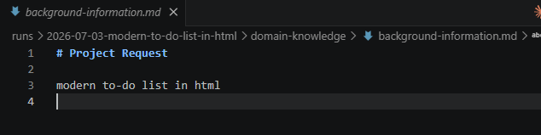
THEN · v0.1.1
Fire-and-forget: built from your words alone
@anvil build a modern to-do list in html
The gap
Stack, features, styling, persistence — all assumed silently.
It worked, but you only discovered the assumptions in the finished product.
v0.1.2 closes exactly this loop.
v0.1.1 wrote the request verbatim into background-information.md and built from there — no questions asked.
The run's entire intent: one line in domain-knowledge/background-information.md — “build it from here.”

Slide 4
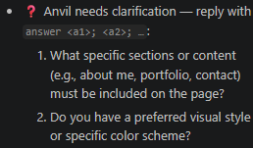
NOW · v0.1.2
@anvil build opens a conversation — once
@anvil build a personal webpage for me
Bounded by design
One clarification round per run — like bounded self-heal retries, a run can never stall on questions.
Gated, then unattended
build now starts runs in gated mode so intake can ask from chat; after that, the run builds itself. A complete request still means zero pauses.
yolo unchanged
REST callers keep mode: yolo for the hard never-pause guarantee.
run pauses: awaiting_clarification
Intake asks only what neither file already answers
stack, persistence & platform were covered by anvil-instructions.md — so just 2 questions.
@anvil answer for my portfolio; dark mode
✓ completed intake → … → implementation · simple tier

Slide 5
SINGLE SOURCE OF TRUTH
The file remembers the conversation
# Project Request
a personal webpage for me
## Clarifications
Q: What sections/content must be included?
A: for my portfolio
Q: Preferred visual style or color scheme?
A: dark mode
## Assumptions
- single-file HTML/CSS/JS
- placeholder portfolio sections
- no persistence · single-page layout
Request, verbatim — what you typed is never rewritten — only appended to.
Q&A appended — answers land under ## Clarifications the moment you reply.
Defaults recorded — anything intake assumed is written under ## Assumptions — nothing is silent.
Fully auditable — ClarificationRequired / ClarificationReceived / IntakeAssessed events in logs/events.jsonl.
Downstream reads the file — proposal, spec and every later phase see the enriched file — never the chat.
runs/2026-07-03-a-personal-webpage-for-me/domain-knowledge/background-information.md

Slide 6
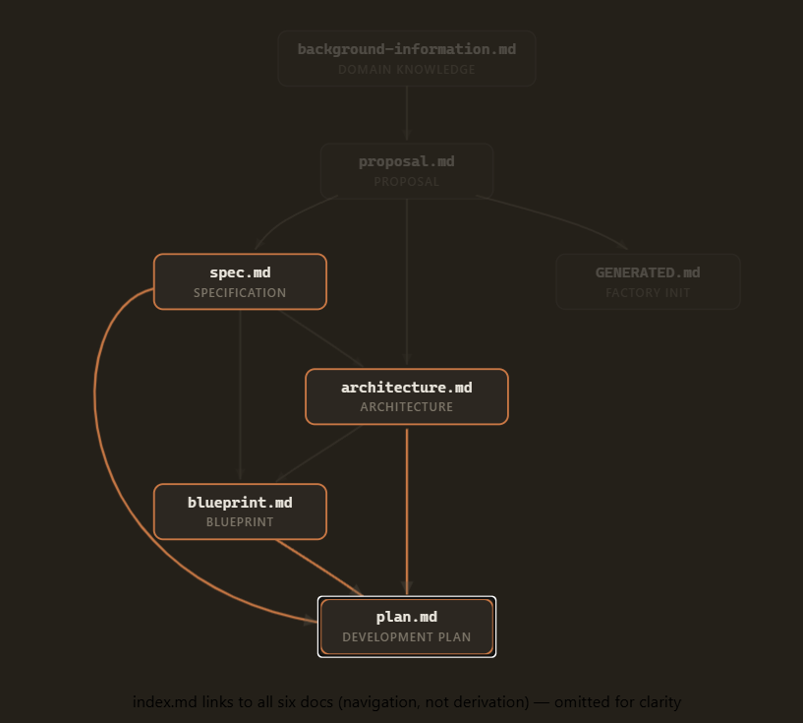
OKF ARTIFACTS
Docs that machines can read — and graph
---
type: Architecture
title: "Architecture — …"
description: …
tags: [anvil, architecture]
timestamp: 2026-07-03T23:56:00Z
artifactId: architecture-v1 # Anvil
phase: architecture # lineage
derivedFrom: # fields
- docs/spec.md
---
derivedFrom makes every run's docs/ a derivation graph you can visualize or feed to other agents.
Plus a deterministic docs/index.md per run — no LLM call.
Google's Open Knowledge Format (v0.1, June 2026): only type is mandated — Anvil's lineage fields ride along as producer extensions.
The docs graph of the personal-webpage demo run, straight from its frontmatter.

Slide 7
BUILD FROM A FILE
Bring your own background-information.md
your-folder/
domain-knowledge/
background-information.md
runs/<date>-<slug>/
fresh, isolated run workspace — slug from the file's first heading
normal run: intake → … → implementation
copied
Bare @anvil build resolves the open folder's domain-knowledge/background-information.md and builds from it.
REST: source_path on POST /v1/runs (mutually exclusive with task; clean 400 on a missing file).
Isolation preserved: runs never build inside your repo — the v0.1.1 FR-001 guarantee applies unchanged.

Slide 8
RECAP
Three commands, one contract
@anvil build <text> isolated run · asks once if something is missing · then fully autonomous
@anvil build same, but the intent comes from the open folder's background-information.md
@anvil answer <a1>; <a2> answers intake's questions — the run resumes and finishes unattended
@anvil start [mode] advanced path: in-place, unisolated run from an existing file
Ask when interactive · assume from documented defaults when autonomous · record everything in the file.

